Slide 1


感恩遇见，相互成就，本课件资料仅供您个人参考、教学使用，严禁自行在网络传播，违者依知识产权法追究法律责任。
更多教学资源请关注
公众号：溯恩高中英语
知识产权声明

Slide 2

活用教材词汇，靶向高考写作
B4U5单词拓展
武汉开发区汉阳三中：廖英

Slide 3


devote/dɪˈvəʊt/ vt.把…献(给);把…专用
1.如果我被选中，我将致力于成为一名合格的志愿者。_{2019全国卷I应用文“美术馆志愿者申请信”}
If I am chosen, I would devote myself to being a qualified volunteer.
2.邻居们利用业余时间帮助他人重建房屋。
Neighbors devoted their spare time to helping others
rebuild their houses.
3.王先生致力于培养学生对科学的兴趣。
Mr. Wang is devoted to developing students’ interest in
science.

Slide 4
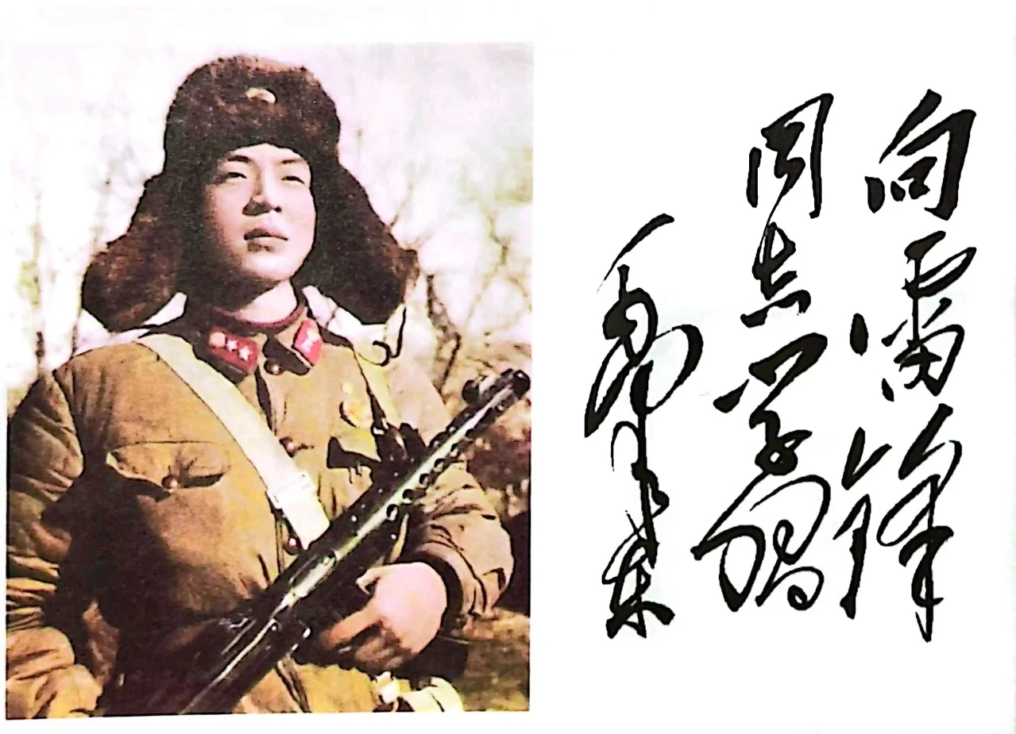
devote/dɪˈvəʊt/ vt.把…献(给);把…专用
4.雷锋精神，以中国人民解放军一名忠诚的战士雷锋的名字命名，代表着奉献、无私和善良。_{沈阳三模应用文“介绍雷锋精神”}
5.我们之所以授予Mike这个称号，是希望更多的
老师和员工能够学习Mike的专业精神和奉献精神，
并进一步追随他的脚步。_{南京三模应用文“最受欢迎教师颁奖词”}
LeiFeng Spirit, named after Lei Feng, a devoted soldier of PLA, stands for commitment, selflessness and kindness.
The reason why we award this title to Mike is that
we want more teachers and staff to learn from
Mike’s professionalism, devotion and further
follow his footstep.

Slide 5

“专心于…、致力于…”表达归类：
1.他不分日夜地努力工作。他的敬业为他赢得了很高的声誉。
2.钟扬常年在偏远原始地区寻找和采集种子，一生致力于种子研究。
3.她做任何事都力求卓越。
4.家长和学校应该努力鼓励学生更频繁地参加户外活动。
He committed himself to working day and night. His commitment won him a great reputation.
Zhong Yang, who spent years in remote and primitive areas searching for and collecting seed, dedicated his life to research on seeds.
She strives for excellence in everything she does.
Parents and schools should make an effort to encourage
students to engage in outdoor activities more frequently.

Slide 6

“专心于…、致力于…”表达归类：
5.我们应该不遗余力地构建和谐社会。
6.随着就业前景的黯淡，成千上万的毕业生想尽办法找到一份好工作。
7.这个可爱的女孩正竭尽全力帮她妈妈做家务。
8.如果我之前全力以赴，我就能通过考试了。
9.他们在今天下午的比赛中全力以赴争取胜利。
We should spare no efforts to construct a harmonious society.
With job prospects dimming, hundreds of thousands of graduates go to great lengths to get a decent job.
The sweet girl is bending over backwards to help her mother with the housework.
I would have passes the exams if I had applied myself.
They are going all out for victory in this afternoon’s game.

Slide 7

tackle/ˈtækl/ vt.解决(难题);应付(局面)
1.我认为要解决污染问题，需要开发更清洁的燃料。
2.我陷入了两难的境地，心中充满了悲伤，仍然不明白为什么事情会变得那么复杂，不知道如何解决这个问题。_{长沙一模读后续写“三人友情”}
I think to tackle the problem of pollution, cleaner fuels need to be developed.
Trapped in a dilemma, I was seized by a sense of sorrow, still confused why things turned out to be that complicated, not knowing how to tackle the problem.

Slide 8

“解决…”表达归纳：
1.一切都解决了，父亲离开了厨房，答应保守秘密。^{2021全国卷I读后续写”母亲节惊喜”}
2.他已经准备好处理今天要面对的一切。
3.我需要解决一个关于在网站帐户登录错误的问题。
4.如果您能帮助我尽快解决这个问题，我将不胜感激。
Everything settled, father left the kitchen, promising to keep their secret.
He is ready to handle whatever is ahead of him for the day.
I need to address a problem concerning an error in website account logging.
I would greatly appreciate it if you could assist me in
resolving this issue as soon as possible.

Slide 9

“解决…”表达归纳：
5.必须采取措施来处理这些问题。
Measures must be taken to deal with these problems.
6.地方政府被要求进一步改善服务，以迅速有效地应对突发事件。
7.他请了短假去处理私人事务。
Local governments have been asked to further improve services to cope with emergencies swiftly and effectively.
He took a short leave of absence to
attend to personal business.

Slide 10


crisis/ˈkraɪsɪs/ n.危机;危急关头
1.今天的污染危机是真实存在的，但它解决起来不容易。
2.她眼里含着感激的泪水，紧紧地拥抱着他，感谢他在危急时分的指导。_{南京202309高三学情调考读后续写“紧急迫降”}
Today’s pollution crisis is real, but it won’t be cured by easy solutions.
With tears of gratitude in her eyes, she hugged him tightly and thanked him for his guidance during the crisis.

Slide 11

boost/bu:st/ vt.使增长;使兴旺 n.增长
1.经过反复尝试，我终于把自己做的香喷喷的菜摆上了餐桌，父母的赞美声沁人心魄，也让我信心大增。_{2023全国II卷应用文“学习一门新技能”}
2.尽管队员们疲惫不堪，但他们都认为这项比赛是提高身体素质的好方法。_{2020新高考全国I卷应用文“五公里越野跑活动报告”}
After going trials and errors, I finally put the tasty dish I made on the table, praiseful words from my parents pleased my ears and boosted my confidence.
Though tired and exhausted, the players all regarded this competition as a good way of boosting physical quality.

Slide 12

“促进…、提升…”表达归类
1.这个节日产生了积极的影响，极大地增强了我们的信心，增强了我们的求知欲，培养了学生们对阅读的热爱。
2.感谢您远道而来参加首届茶文化交流节，这必将促进我们两校之间的关系。
3.它提高了我的生活质量，改善了我的健康，增加了我的快乐。
4.这次活动锻炼了我的力量，大大增强了我的意志力，
使我们充分体会到体育的独特魅力。
The festival has produced a positive influence, greatly boosting our confidence, enhancing our appetite for knowledge and fostering a love of reading among students.
Thank you for traveling a long way to attend the first Tea Culture Exchange Festival, which will definitely promote the relations between our two schools.
It has enhanced the quality of my life, improved my health
and increased my happiness.
The activity build up my strength and greatly
strengthened my willpower, enabling us to fully
appreciate the unique charm of sports.

Slide 13

“促进…、提升…”表达归类
5.他粗鲁的话加剧了我们的愤怒。
6.为了促进学生们对中华文明的了解，我们邀请大家参加这次活动，也可以帮助我们更好地向全世界弘扬中华文化。^{202304杭州二模应用文“让文物活起来活动开幕词”}
7.通过激励人们学习救生技能，你将有助于建立一个更好的社区，在那里人们可以在关键时刻正确而自信地进行急救护理。
His rude remarks heightened our anger.
Aiming at facilitating students’ understanding of Chinese civilization, we invite all of you to attend the event, which can also help us better carry forward Chinese culture to the whole world.
By motivating people to learn life-saving skills, you will contribute to building a better community where people may perform emergency care correctly and confidently at critical moments.

Slide 14

convince/kənˈvɪns/ vt.使相信;使确信;说服
1.我已经说服大卫接受挑战，并决定加入越野车队。_{2022全国卷I读后续写“脑瘫男孩参加跑步比赛”}
2.我完全相信，这次活动将有助于您欣赏历史文化遗迹和令人惊叹的作品收藏。_{202304杭州二模应用文“让文物活起来活动开幕词”}
I have convinced David to take up the challenge and decide to join in the
cross-country team.
I’m fully convinced that the activity will help you admire historic and cultural relics with amazing collection of works.
3.然而，当谈到克隆可能给我们带来的道德风险时，我发现很难使我的观点足够令人信服，因为我缺乏确凿的证据和相关知识。所以我想知道你是否可以推荐一些关于这个话题的分享专家观点的书。
However, when it comes to the moral risks cloning may
bring us, I find it quite hard to make my viewpoint
convincing enough, as I lack solid evidence and relevant
knowledge. So, I wonder if you could recommend some
books sharing experts’ arguments on this topic.

Slide 15
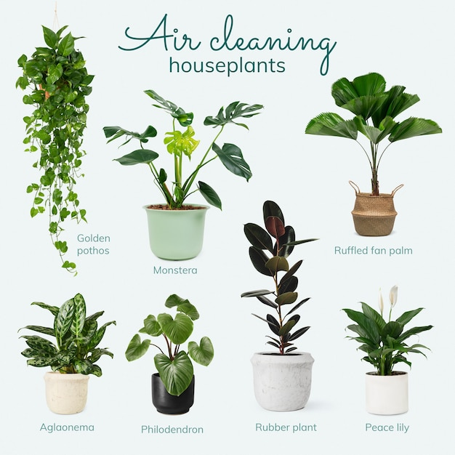
characteristic/ˌkærəktəˈrɪstɪk/ n.特征;特点;品质 a.典型的
1.我们邀请所有学生提交原创照片和文字，展示他们家乡独特的文化、风景和特色。_{盐城三模应用文“最美家乡征稿启事”}
2.按照计划，我们首先听取了一位知识渊博的教授的
报告，内容是如何根据植物的特征来识别不同的植物。
_{“认识我们身边的植物”活动报道应用文}
We invite all students to submit original photos and text showcasing the unique cultures, scenic beauty and distinctive characteristics of their hometown.
As scheduled, we were given a presentation first by
a knowledgeable professor about how to identify
various plants depending on their characteristics.

Slide 16


“特点、特征”表达归类
1.在这堂课中，你将了解到中国传统绘画的特征。
2.勇气和决心这两种品质使她成为一名杰出的领导者。
3.她善良的品质吸引了每个人。
You will get to know the identifying features of traditional Chinese painting in this lecture.
The two traits, courage and resolution, have made her an outstanding leader.
Her quality of kindness appeals to everyone.

Slide 17
“特点、特征”表达归类
characteristic是一事物区别于其他事物的独有特征，用于具体的人或事也用于抽象的东西。
quality指人的基本素质或事物质的优劣。
characteristic
quality
内容结构
feature
trait
feature多指事物显而易见的特点或特色，指人时常指人的外貌。
trait特指人的品德、性格、心情或常有的行为模式，强调一种恒定的而非孤立一时的行为特征。

Slide 18

attain/əˈteɪn/ vt.(经过努力)获得;得到
1.在我们达到目标之前，我们需要付出巨大的努力。
2.自互联网出现以来，许多机构都慷慨地在网上免费提供
相关课程和学术成果，这有助于实现教育资源的公平分配。
Great efforts are needed before we can attain our goal.
Since the advent of the internet, many institutions have
been generously offering relevant courses and academic
achievements online for free, which can work to attain
the equal distribution of educational resources.

Slide 19

“获得;得到”表达归类
1.许多年轻的学生在音乐厅外等候，希望得到这位流行歌手的签名。
2.这位年轻教师在过去两年中获得了一些宝贵的教学经验。
3.父母应该帮助孩子养成良好的习惯。
4.没有什么能阻止我实现我的抱负。
5.他们之间没有达成任何协议。
6.只有建立信心，我们才能实现目标。
Many young students waited outside the concert hall, wishing to obtain an autograph of the popular singer.
The young teacher has gained some valuable teaching experience in the past two years.
Parents should help their children acquire and develop good habits.
Nothing could stop me from achieving my ambition.
No agreement had been reached between them.
Only by establishing confidence can we accomplish our goals.

Slide 20

“获得;得到”表达归类
reach较普通，可以指达到任何目标，包括目的地、奋斗目标或某种显赫地位。强调“到达”，不涉及目标是否事先择定，付出多大努力。
attain是比较郑重的说法，有较强的抱负和渴望的意味，常用于一般人不易达到的目标。
achieve强调为达到某一既定目标需要技能、耐性和努力。但一般指按常规步骤去达到这一目的。
gain指通过竞争或经过一段时间的努力得到。
obtain比较正式，指付出一定努力后才能得到渴望的事物。
acquire强调经过点滴艰苦努力而获得知识、技能等。

Slide 21
assumption/əˈsʌmpʃn/ n.假定;设定;(责任的)承担
1.不出所料，克里斯托以为儿子是在开玩笑，所以她没有把他的话当真，只是一笑置之。
2.作为学生，我们应该承担起我们的责任，比如保持环境清洁，有礼貌，以及为来自各个国家的运动员加油。_{应用文“亚运会小主人倡议信}
3.人们普遍认为锻炼不仅能使人精神焕发，而且还能增强记忆力。
4.假设我当选为主席，我将组织更加丰富多彩的课外活动来丰富我们的学校生活。_{应用文之申请信}
As expected, Krystal assumed her son was playing a practical joke, so she didn’t take any of his words seriously and laughed off.
As students, we should assume our responsibility such as keeping the surroundings clean, being polite, as well as cheering for athletes from all Asis.
It is generally assumed that not only can taking exercise refresh people, but it can also strengthen our memory.
On the assumption that/Assuming that I am elected chairman, I will organize more colorful after-class activities to enrich our school lives.

Slide 22
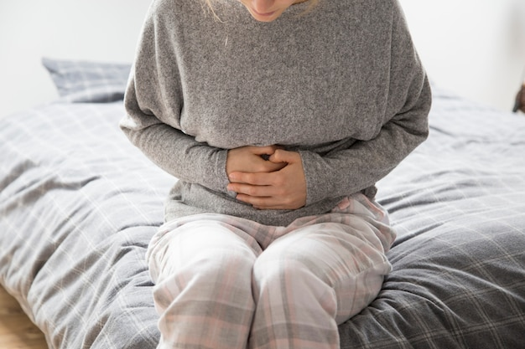
intense/ɪnˈtens/ a.热切的;十分强烈的;激烈的
1.读完之后，她开心极了，眼睛也有神了。
2.他突然觉得背部一阵剧痛。
3.经过艰苦的努力，袁隆平克服了巨大的技术困难，于1974年研制出了第一种可用于农业的杂交水稻。_{2020全国高考I卷应用文“身边值得尊敬和爱戴的人”}
4.两队之间的冲突加剧了。
After he read it, an expression of intense joy illuminated his eyes.
He suddenly felt an intense pain in his back.
Through intense effort, Yuan Longping overcame
enormous technical difficulties to develop the first
hybrid rice that could be used for farming in 1974.
The conflict between the two teams has intensified.

Slide 23

overcome/ˌəʊvəˈkʌm/ vt.克服;解决;战胜
1.他无法克服自己的羞怯，一言不发地站在那里。
2.良好的英语能力使我能够克服语言障碍，与英国的绘画爱好者进行顺畅的交流。 _{2019全国卷I应用文“美术馆志愿者申请信”}
3.考试的前一天晚上，我充满了恐惧和绝望。
Unable to overcome his shyness, he stood there without saying anything.
With a good command of English, I can overcome
the language barriers, which allows me to
communicate smoothly with British painting lovers.
The night before the test, I was overcome by/with
fear and despair.

Slide 24

expand/ɪkˈspænd/ v.扩大;增加 vt.扩展;发展
1.袁隆平博士发明了超级杂交水稻，在不扩大田地面积的情况下能够增加水稻收成。_{2020全国高考I卷应用文“身边值得尊敬和爱戴的人”}
2.奶奶咯咯地笑着说:“好吧，看来我得扩充我们的菜单，增加一些适合猫吃的点心。”
3.它不仅为我提供了一个拓展视野的平台，而且它丰富的
内容也能点燃我对英语的热情。_{2021新高考I卷应用文“Youth英语报创刊}
_{十周年投稿信”}
Dr. Yuan invents super hybrid rice, making it possible to increase rice harvest without expanding the area of the fields.
Gramma chuckled, “Well, it looks like I’ll need to expand
our menu to include some cat-friendly dim sum option.
Not only does it supply me with a platform to expand
my horizon, but its rich content can also spark my burning
passion for English.

Slide 25

consumption/kənˈsʌmpʃn/ n.消耗;消耗量;消费
1.消费而不是储蓄已成为当代社会的主要特征。
2.人类消耗了大量的水资源，使美丽的地球遭到破坏而没有得到保护。
3.我们应该多吃蔬菜和水果，因为它们对我们的身体有益。
4.他深感内疚。
5.注重健康的消费者希望了解他们所购买食品的相关信息。
Consumption rather than saving has become the central feature of contemporary societies.
Humans consume enormous amounts of water resources, having a beautiful earth destroyed not protected.
We should consume more vegetables and fruits as they
are beneficial for our bodies.
He was consumed/overcome/overwhelmed with guilt.
Health-conscious consumers want for information
about the food they buy.

Slide 26
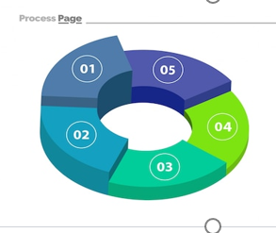
comprise/kəmˈpraɪz/ vt.包括;包含;由…组成
be comprised of/bi kəmˈpraɪzd əv/ 包括;包含;由…组成(或构成)
1.这次活动有数百名学生参加，活动内容多样，包括自我保健讲习班、冥想课程和心理健康专家的启发性演讲。_{“心理健康日活动报道”应用文}
2.贾思勰写了一本叫《齐民要术》的书，里面对务农者有很好的建议和做法。
3.鼓起勇气，因为生活是由欢乐和悲伤组成。
4.这个游乐园由七个主题区组成。
With hundreds of students involved, the event featured a diverse range of activities, comprising workshops on self-care, meditation sessions, and enlightening talks by mental health professionals.
Jia Si xie wrote a book named Qi Min Yao Shu, which is comprised of sound advice and practices for people doing agricultural work.
Keep up your courage, since life is composed of joy
and sadness.
The amusement park is made up of seven themed zones.

Slide 27

表“包含、包括”的其他近义词
1.中华民族除汉族外，还包括50多个少数民族。
2.我们大学由25个系组成。
3.这是一个难度很大的实验。
4.海水含盐。
The Chinese nation included more than 50 national minorities besides the Hans.
Our university consists of twenty-five departments.
This is an experiment which involves a lot of difficulty.
Sea water contains salt.

Slide 28

表“包含、包括”的其他近义词
comprise较为正式，指包含的人或者事构成整体的全部。
include一般用语，所包含的人或事是整体的组成部分。
consist of指由几个部分构成一个整体，不能用被动语句。
involve指根据整体的性质决定应包含有哪些成分或结果。
contain一般用语，指所容纳的东西是其组成
的一部分，有时指一大物体容纳许多小物体。

Slide 29

strain/streɪn/ n.(动、植物)系;品种;拉伤
1.不及时进餐，血糖水平下降，会使你的大脑紧张。
2.工作情况很糟糕，在压力下人们越来越吃不消了。
3.这件事让我意识到，我不应该让情绪紧张和焦虑阻止我公开愉快地与人交流。
4.他没完没了的抱怨让我们忍无可忍。
5.我们竭尽全力划船，终于看到了我祖母的房子。
Missed meals put a strain on your brain as your blood sugar level drops.
Things are getting terrible at work and people are cracking under the strain.
The incident helped me realized that I should not let emotional strain and anxiety prevent me from communicating with people openly and pleasantly.
His constant complaint were straining our patience.
Straining every nerve to row, we eventually saw
my grandmother’s house.

Slide 30

leisure/ˈleʒə(r)/ n.闲暇;休闲;空闲
1.闲暇时间对身体和心理都有好处，可以减少压力、焦虑和抑郁，改善情绪，提高积极情绪。
2.晚饭后，他们悠闲地散步，感受微风拂过脸颊。
There are both physical and psychological benefits of leisure time, with reduced levels of stress, anxiety and depression, improved mood and higher levels of positive emotion.
After dinner, they went for a leisurely walk, feeling the gentle breeze brush against their cheek.

Slide 31


deep down/di:p daʊn/ 在内心深处;本质上;实际上
1.我有很多朋友，但在内心深处，我害怕孤独。
2.在内心深处，我知道打篮球的渴望之火从未熄灭。
_{2023年南京三模读后续写“轮椅上的篮球梦”}
3.在我的内心深处，我被铭文深深地打动了，
感受到了就好像我是他的家人一样。
Down at the bottom of my heart, I was deeply
touched by the inscription and felt as if I was
part of his family.
I have so many friends, but deep down I have
a fear of loneliness.
Deep down I know the flames of desiring playing
basketballs were never extinguished.

Slide 32
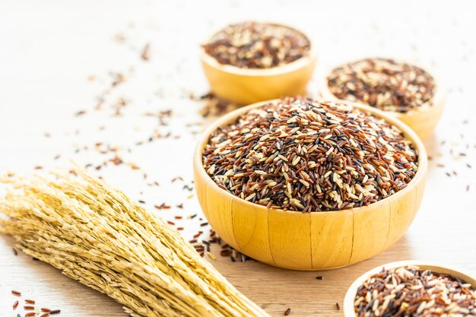

grain/greɪn/ n.谷物;谷粒;颗粒
1.李绅的《悯农》这首诗告诉我们要感恩农民，珍惜每一粒粮食。
2.谷雨源于古语“雨生百谷”，可见这一时期的降雨对农作物的生长极为重要。谷雨预示着寒冷天气的结束和气温的迅速上升。
The poem the peasants by Li Shen conveys the message that we should show gratitude to farmers and treasure every grain of rice.
Grain Rain originates from the old saying, “Rain
brings up the growth of hundreds of grains,” which
shows that this period of rainfall is extremely important
for the growth of crops. The Grain Rain signals the end
of cold weather and a rapid rise in temperature.

Slide 33
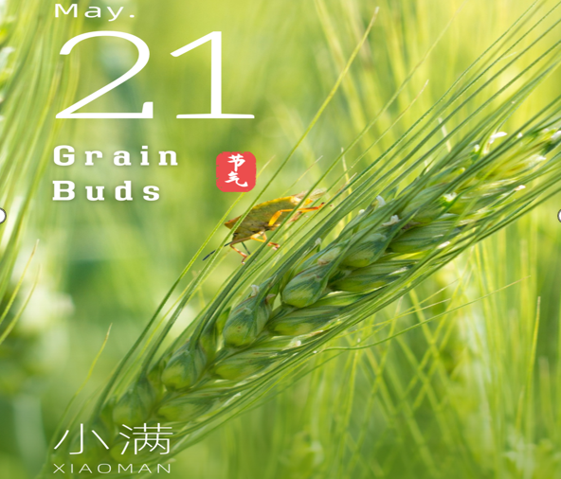
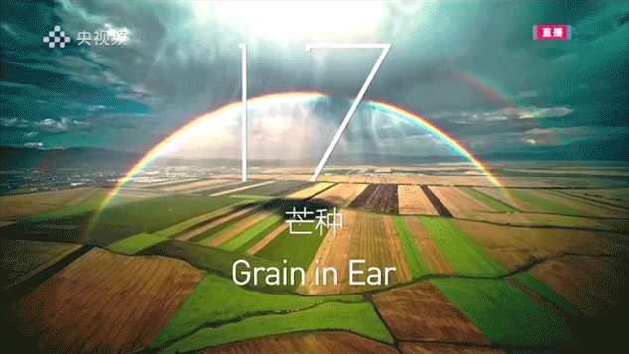
grain/greɪn/ n.谷物;谷粒;颗粒
3.小满是夏季的第二个节气，也是谷雨之后的第一个节气。在华北，“满”意味着谷物的饱满，而“小满”则表示谷物正处于成长期但还未饱满。在华南，这个节气则表示降雨量大。
4.芒种是一年中的第九个节气，意味着
谷物成熟了，可以收割了。它也标志着
种植水稻和其他作物的旺季。
Grain Buds, also named Xiao Man in Chinese, is the second solar term of summer. In North China, “Man” means the fullness of grain, and “Xiao Man” means that the grains are growing full but are not yet at their fullest. In South China, this solar term indicates an abundance of rain.
Grain in Ear, the ninth solar term
of a year, means the grains are mature
and ready to be harvested. It also marks
the busy season for planting rice and other
crops.

Slide 34

vision/ˈvɪʒn/ n.想象;视力;视野;影像
1.儿童的视力健康正面临越来越大的威胁。他们的习惯可能包括在昏暗的光线下阅读，过度接触手机和平板电脑等电子产品。
2.突然，一只小猫，它的毛被水和泥土弄皱弄脏了，进入了我的视野。
3.就在这时，我注意到他灰白的头发和僵硬的脖子，意识到他任劳任怨地辛苦工作，为这个家庭做出了多大的贡献。泪水模糊了我的双眼。_{202106浙江卷读后续写“第一份薪水”}
4. 我可以想象这样一个未来，机器人设备将成为我们日常生活中必不可少的一部分。
The health of children’s vision is facing a growing threat. Their
habits might range from reading in a dim light to overexposure to
electronic products like mobile phones and computer tablets.
Suddenly, a kitty, whose fur was crumpled and dirtied by water
and mud, entered my vision.
Just at that moment I noticed his grey hair and stiff neck, realizing how much he had contributed to the family through his tiring work. Tears began to blur my vision.
I can envision a future in which robotic devices will become a necessary part in our daily life.

Slide 35

reality/riˈæləti/ n.现实;实际情况;事实
1.我们渴望知道你为实现梦想所付出的努力。
2.我仿佛突然从可怕的噩梦中惊醒，简直不敢相信我所听到的。
_{202106浙江卷读后续写“第一份薪水”}
3.根据她的经验，贝尔斯知道她的徒步旅行是可行的，
尽管天气预报说条件不利。
We are eager to know the efforts you made to make your dream
a reality.
As if suddenly jerked to reality from a terrible nightmare,
I could hardly believe what I was hearing.
Based on her experience, Bales knew her hike was realistic
although the weather forecast described the conditions
as unfavorable.

Slide 36
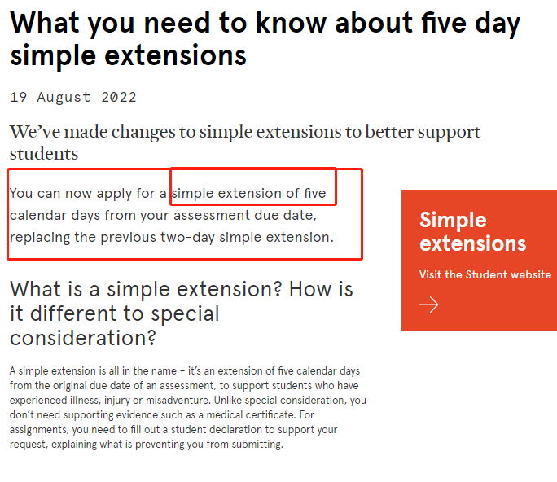
extension/ɪkˈstenʃn/ n.扩建部分;扩大;电话分机
1.创造力是我们热情的自然延伸。——厄尔南丁格尔
2.他上课总是认真听讲，空闲时间总是广泛阅读。
3.首先，我要衷心感谢您和您的团队组织了如此精彩的
英语周。_{202309浙江名校联合体应用文“英语周活动反馈信”}
Creativity is a natural extension of our enthusiasm.---Earl Nightingale
He was always listening to his teacher attentively in class and
reading extensively in his free time.
Firstly, I would like to extend my heartfelt gratitude to you
and your team for organizing such a remarkable English Week.
4.如果您认为最后期限不够，我们可以延长期限。
We will extend the deadline if you consider the deadline is not enough.
5.男孩伸手接球。
The boy extended his hand to catch the ball.

Slide 37

chemical/ˈkemɪkl/ a.与化学有关的 n.化学制品
1.整个食物链都受到农业中过度使用化学品的影响。
2.然而，尽管化学耕作具有产量高、作物病害少的明显优势，
但科学家已经证实了化学耕作造成的危害。这些化学物质倾向
于在土壤和水中积累，并被食物链吸收。因此，我们吃的植物、
奶制品、鸡蛋和肉类都含有高浓度的农药。
The whole food chain has been affected by the overuse of chemicals in agriculture.
However, despite its obvious advantages of high production and
less crop disease, scientists have confirmed the damage caused by
chemical farming. The chemicals tend to accumulate in the soil
and water, which are absorbed in the food chain. As a result, we
end up eating plants, dairy products, eggs and meats that have high
level of pesticides.

Slide 38
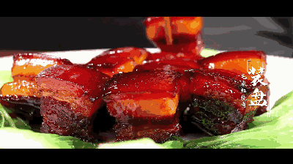

flavor/ˈfleɪvə(r)/ n.味道;特点;特色
1.我很荣幸和大家分享一道传统的中国菜，红烧肉。它具有色、
香、味的完美结合，受到越来越多的人的欢迎。_{2023温州一模应用文}
_{“介绍中国美食演讲稿”}
2.总之，宫保鸡丁是一道美味的标志性中国菜，应该出现
在每个美食爱好者的清单上。它浓郁的味道、通用性和健
康益处使它成为任何对探索传统中国美食感兴趣的人必尝
的一道菜。
I’m privileged to share a traditional Chinse cuisine, red braised pork.
Featuring in a perfect combination of color, flavor and taste,
it gains popularity among an increasing number of people.
In conclusion, Kung Pao Chicken is a delicious and iconic
Chinese dish that should be on every food lover’s list. Its
bold flavors, versality and health benefits make it a
must-try dish for anyone interested in exploring traditional Chinese cuisine.

Slide 39
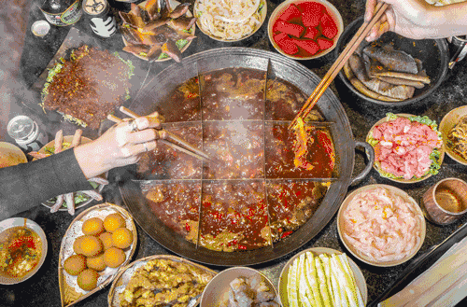

flavor/ˈfleɪvə(r)/ n.味道;特点;特色
3.浓汤口味各异，从辣牛肉汤到海鲜汤，
火锅一定能满足每个人的喜好。
4.从我的角度来看，与朋友和家人进行一些
户外娱乐可以为我们的日常生活增光添彩。
With differently flavored thick soup, from
spicy beef soup to seafood-based soup, Hotpot
is bound to meet everyone’s preference.
From my perspective, undergoing some outdoors
entertainment with our friends and family can add
much flavor/spice to our daily life.

Slide 40
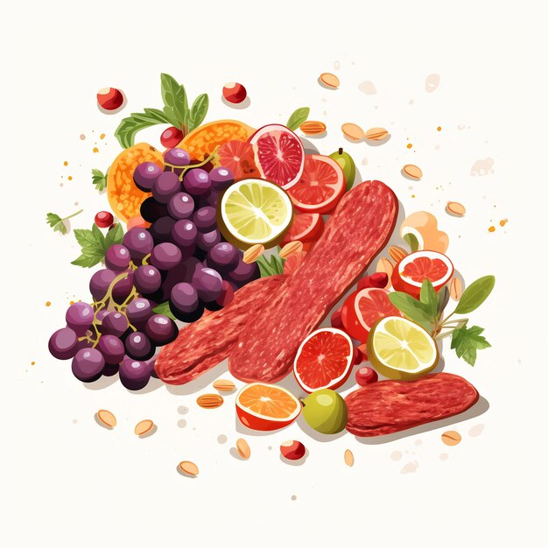
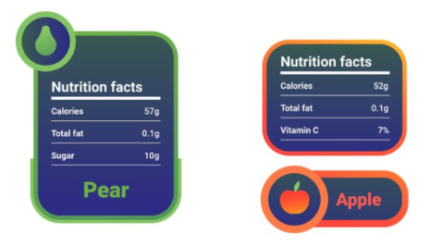
nutritious/njuˈtrɪʃəs/ a.有营养的;营养丰富的
nutrition/njuˈtrɪʃn/ n.营养;滋养
1.食用有营养的食物可以增强我们的体能和幸福感。
2.这是一个充满教育和实践机会的盛会。我们举办了营养和运动方面内容丰富的研讨会，烹饪方面的互动讲习班，体育比赛和健身课程。_{应用文“健康生活主题系列活动介绍”}
3.大多数即食食品都是用额外的盐和脂肪加工而成的，以增加风味，而且不像蔬菜或沙拉那样含有足够的营养物。
Consuming nutritious food can enhance our strength and happiness.
It was a great event filled with both education and hands-on opportunities. We had informative seminars on nutrition and exercise, interactive workshops on cooking, sports competitions and fitness sessions.
Most ready-made meals are processed with extra salt and fat to add flavor and do not contain enough nutrients in the form of vegetables or salad.

Slide 41

alleviate/əˈli:vieɪt/ vt.减轻;缓解
1.他们会让你头疼吗?如果是这样，吃一片阿司匹林来减轻疼痛。
Do they make your head ache? If so, take an aspirin to alleviate, or relieve, your pain.
2.适量的运动可以减轻压力或抑郁。
3.该组织呼吁人们捐款以缓解世界饥饿
和疾病。
A proper amount of exercise can alleviate stress or depression.
The organization is calling on people to donate funds to alleviate world hunger and disease.

Slide 42

“减轻;缓解”表达归纳：
1.为了减轻学习带来的巨大压力，鼓励学生尝试各种各样的休闲活动。
2.积极参加课外活动可以放松我们的思想，开阔我们的视野。
3.适当的社会活动不仅可以缓解压力，还可以培养学生的社区意识和归属感。
4.每一次拜访，我都能感觉到内心的痛苦减轻了。
看到他帮助我度过了深深的悲伤。
To reduce the intense stress from studying, students are encouraged to try a variety of leisure activities.
Taking an active part in extra-curriculum activities can ease our mind and broaden our horizons.
Proper social activities can not only relieve the pressure but also develop a sense of community and belonging among students.
With each visit, I could feel the ache in my heart lessen.
Seeing him was helping me work through my deep sorrow.

Slide 43
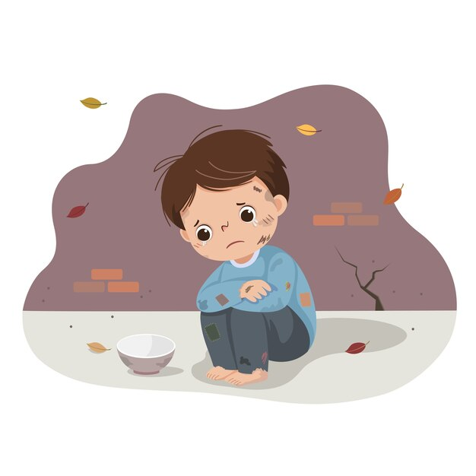
poverty/ˈpɒvəti/ n.贫穷;贫困
1.这个男孩穷困潦倒，连一双新鞋都买不起。
2.他们陷入赤贫。
3.我们主张你捐款帮助那些贫困户。
4.我们不是那么穷，但是我们负担不起一次那么奢侈的
旅行。
We aren’t too badly off but we can’t afford a luxury trip
like that.
5.他们勉强维持开支。
They are struggling to make both ends meet.
The boys is in such poverty that he can’t afford a new pair of shoes.
They were reduced to extreme poverty.
We advocate you to make a donation to help those poverty-stricken households.

Slide 44

organic/ɔ:ˈgænɪk/ a.有机的;不使用化肥的
1.首先，导游会带领我们参观农场，从中我们可以了解有机蔬菜
是如何种植的。然后我们将分成小组采摘各种有机蔬菜，这些蔬
菜将作为我们的午餐食材。_{应用文“有机蔬菜采摘活动邀请信”}
2.在我看来，为了可持续发展，有机农业比化学农业更好。有机农业就是不使用任何化学物质的农业。开展有机农作的农民专注于通过自然手段，如动物的自然废物作为肥料，保持土壤肥沃和无疾病。有机食品通常比用人造化学品种植的食品更有营养。虽然价格高一点，但是我们多付出的一点小代价，最终会给我们带来巨大的回报。
First of all, there will be a guided tour of the farm, through which we can know how organic vegetables are grown. Then we will be divided into groups to pick various organic vegetables, which will be used as our lunch ingredients.
In my opinion, organic farming is preferable to chemical farming for the sake of sustainable development. Organic farming is simply farming without using any chemicals. Organic farmers focus on keeping their soil rich and free of disease through natural means, such as natural waste from animals as fertilizer. Organic food is generally more nutritious than food grown with man-made chemicals. Although the price is a little higher, but the small price we pay extra will bring us huge rewards in the end.

Slide 45


widespread/ˈwaɪdspred/ a.分布广的;普遍的;广泛的
1.COVID-19是一种广泛传播的疾病，已经影响全球数百万人。
2.当旅程结束时，他的冒险经历得到了媒体的广泛报道。
3.这段视频几个小时就在网上传疯了。
Within hours the video had gone viral.
COVID-19 is a widespread disease that has affected millions of people worldwide.
When the journey ended, his adventure received widespread media coverage.

Slide 46
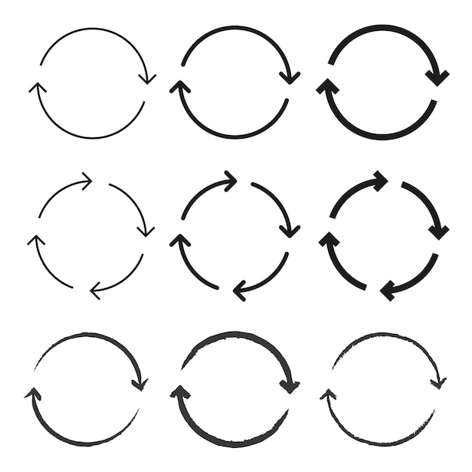
in turn/ɪn tɜ:n/ 相应地;转而;依次;轮流
1.孩子们逐一自报姓名。
2.看到他们的女儿如此快乐，相应的也让劳拉的父母更加放松。
Seeing their daughter so much happier has in turn made Lara’s parents more relaxed.
3.任何理论都来源于实践，反过来又为实践服务。
All theories originate from practice and in turn serve practice.
4.我们轮流当导游，向客人介绍景点。
We take turns to be a guide and introduce the scenic spots to
the guests.
The children called out their names in turn.

Slide 47

digest/daɪˈdʒest/ v.消化;领会;领悟 n.摘要
1.饭后你应该留点时间让食物消化。
You should allow a little time after a meal for the food to digest.
2.她什么都读，在充分领会新闻的每一个细节点。
3.有些书可浅尝，有些书可囫囵吞枣，少数书则需
细细咀嚼消化。
She read everything, digesting every fragment of news.
Some books are to be tasted, others to be swallowed,
and some few to be chewed and digested.

Slide 48

essential/ɪˈsenʃl/ a.完全必要的;极其重要的
1.作为评委，你应该根据演讲者的发音、流利程度和听众参与度对10篇演讲进行评分。这些都是评委的基本职责。
2.缝纫是我最喜欢的课程之一。我从中获得的一些
基本的生活技能，比如缝纽扣，织围巾。
3.她收拾了一些必需品，然后去了农村。
As a judge, you should rate each of the ten speeches in terms of the speakers’ pronunciation, fluency and audience engagement. These are the essential duties of a judge.
Sewing is one of my favorite courses, where I obtained
essential life skills such as sewing a button, knitting a scarf.
She packed a few essentials and headed for the countryside.

Slide 49

“重要的…”表达归类
1.众所周知，良好的第一印象在很多方面都至关重要。
2.积极的生活态度很重要，因为态度决定一切。
3.泰勒当时并没有意识到她刚刚失去了关键的着陆设备。
4.作为一名学生，这绝对是至关重要的。优先考虑你的学习。过度沉迷于深夜的比赛可能会分散你的学习注意力。
5.没有什么比健康更好，没有健康我们将一无所有!
It is well known that a good first impression is vital in many aspects.
A positive attitude towards life is significant because attitude is everything.
Taylor was unaware at that point that she had just lost crucial landing equipment.
As a student, it is definitely of critical importance to prioritize
your studies. Overindulging in late-night matches can potentially
distract you from your academic work.
Nothing can be better than health, without which we would
have nothing!

Slide 50

alternative/ɔ:lˈtɜ:nətɪv/ n.可选的事物 a.可供替代的
1.在大城市，自行车正在取代私家车，成为短途交通的另一种方式。
2.由于忙于准备期末考试，我不得不谢绝您的邀请。_{应用文之谢绝信}
3.您可以通过电子邮件或微信发送您的作品。
In big cities, bicycles are replacing private cars and becoming an alternative means of short-distance transport.
Occupied in preparing for my final exam, I have no alternative but to decline your invitation.
You can send your works by email or alternatively,
through WeChat.

Slide 51

instance/ˈɪnstəns/ n.例子；实例；事例
for instance/fə(r) ˈɪnstəns/ 例如;比如
1.当被要求举出一些有用昆虫的例子时，他想到了瓢虫。
2. 城市里有各种各样的交通方式可供选择。例如，你可以乘坐地铁，骑自行车或使用出租车。
3.在这种情况下，我建议采用不同的方法。
I would recommend using a different approach
in this instance/case.
When asked to cite some instances of useful insects, he came up with the ladybird.
There are various options for transportation in the city. For instance, you can take the subway, ride a bike or use a taxi.

Slide 52

“例如；比如“表达归类
1.许多水果富含维生素。例如，橙子是维生素C的极好来源。
2. 获得清洁水对社区至关重要。例如，一个村庄曾因缺乏干净的水，导致居民的健康问题增加。
3.气候变化对生态系统有各种影响。例如，气温上升会导致珊瑚礁生物多样性的丧失。
Many fruits are rich in vitamins. For example, oranges are an excellent source of vitamin C.
Access to clean water is crucial for communities. As a case in point, the lack of clean water in a village resulted in increased health issues among the residents.
Climate change has various impacts on ecosystems. As an illustration, rising temperatures can lead to the loss of biodiversity in coral reefs.
instance指很具体的例子，如人、物、行为等，用以解释、说明、证明等总结性描述。
case案例，事例。此种例子引起人们对某种待考虑、研究或处理的情况予以注意。
example例子，榜样。最常用的，可以指一种具体例子，但更多指引用的补充材料。

Slide 53

depth/depθ/ n.向下(或向里)距离;深(度)
1.没有人知道她对孩子的爱有多深。
2.在参观展览的过程中，我被中国戏曲所蕴含的巨大文化深度所震撼。
3.他陷入了绝望的深渊。
4.在开发海洋深处各种海洋资源的同时，我们也应该
让人们意识到保护海洋的重要性。
Nobody knew the depth of her love for the child.
As I explored the exhibition, I was struck by the
immense cultural depth that Chinese opera embodies.
He was in the depths of despair.
While exploiting various marine resources in the
depths of the sea, we should also make people aware
of the importance of protecting the ocean.

Slide 54
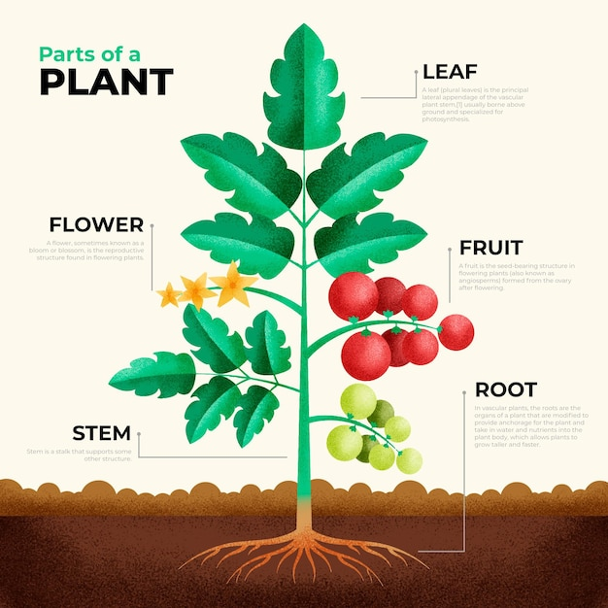
root/ru:t/ n.根;根茎;根部;根源
1.我申请的动机源于我对各种体育项目的热爱。
2.从那时起，对中餐的热爱就在他心中扎下了根。
3.听到这个坏消息，玛丽震惊得僵住了，仿佛在地上扎了根。
4.火锅在中国文化中根深蒂固，它不仅是一种历史悠久的
美食，也是一种象征着家人和朋友团聚的社交活动。
Motivation of my application lies/has its roots in my passion for various sports event.
Ever since then, a love for Chinese food has taken root
in his heart.
At the bad news, Mary froze with shock, as if rooted to
the ground.
Deeply rooted/ingrained in Chinese culture, Hotpot is not
only a time-honored meal but also a social gathering activity
symbolizing reunion of families and friends.

Slide 55
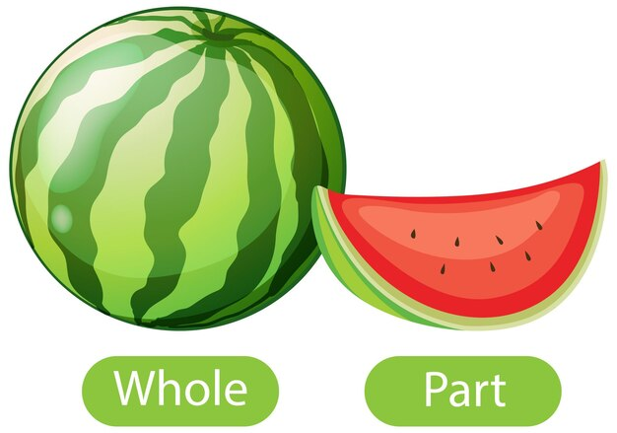
entirely/ɪnˈtaɪəli/ ad.全部地;完整地;完全地
1.对自己完全诚实是一种很好的锻炼。- - -西格蒙德•弗洛伊德
2.一阵恐惧攫住了我，我一动也不能动。
3.全班突然爆发出一阵笑声，老师严肃的表情
也变成了笑容。
Being entirely honest with oneself is a good exercise.---Sigmund Freud
A burst of horror held me entirely in its power,
and I was unable to move an inch.
The entire class suddenly exploded with laughter
and the teacher’s serious expression softened into a grin.

Slide 56

aspect/ˈæspekt/ n.方面;层面
1.就我个人而言，我认为风筝是我们文化遗产的象征，需要得到保护和推广，以确保后代子孙能继续欣赏中国传统文化美好的这一面。
2.事实上，劳动是生活中最重要的内容之一，它
教会了我们纪律、责任和努力工作的价值。通过
从事劳动，我们获得实用技能，塑造品格，并为
改善我们的社区做出贡献。_{202309Z20名校联盟应用文“劳动周倡议信”}
Personally, I see kites as a symbol of our culture heritages that need to be safeguarded and promoted, ensuring future generations continue to appreciate this beautiful aspect of traditional Chinese culture.
In fact, labor is one of the most important aspects of life,
which teaches us discipline, responsibility and the value of
hard work. By engaging in labor, we gain practical skills,
build character and contribute to the betterment of our
community.

Slide 57


http://www.sunedu.com
Thank You!

