Slide 1


感恩遇见，相互成就，本课件资料仅供您个人参考、教学使用，严禁自行在网络传播，违者依知识产权法追究法律责任。
更多教学资源请关注
公众号：溯恩高中英语
知识产权声明

Slide 2
Events/Activities in Practical Writing
活动类话题的应用文写作

Slide 3



Recently, I’m helping my best friend design her wedding ceremony…
?
Activities
1. take beautiful photos
2. make up（化妆） & get dressed
3. attend a lecture
4. wedding dinner
wrong order
improper activity

Slide 4
（2023 .01浙江高考）上周末你参加了学校学生会组织的“认识你身边的植物”活动，请你给校英文报写一篇报道。
（2022.01浙江高考）假定你是李华，在“中国-爱尔兰文化节”活动中结识了爱尔兰朋友Chris，现在他已回国。请你给他写一封邮件。
（2021.01浙江高考）假定你是李华，下周有新西兰学生访问你校，你将为学生代表致欢迎辞。请为此写一篇发言稿。1. 表示欢迎；2. 介绍活动安排；3. 表达祝愿。
（2021.06浙江高考）昨天你参观了学校举办的学生国画作品展。请给校英文报写一篇宣传稿。
（2020年新高考I ）假定你是李华，上周日你校举办了5公里越野赛跑活动。请你为校英语报写一篇报道。
（2020全国II）上周末，你和同学参加了一次采摘活动。请你为班级英语角写一篇短文，介绍这次活动。
（2019全国III）假定你是校排球队队长李华。请你写邮件告知你的队友Chris球队近期将参加比赛。

Slide 5
What to Write?
Work in groups of four: brainstorm more activities that are topic-centered!
What do you think of the activities?
（2023.01浙江高考）上周末你参加了学校学生会组织的“认识你身边的植物”活动（Getting to Know the Plants Around Us），请你给校英文报写一篇报道。内容包括：
1. 活动过程；2. …
On Saturday morning, all the participants first gathered in the school hall to attend a lecture brought by a famous professor. They asked a lot of questions after the speech and took a photo with the professor. In the afternoon, all students went to the school garden to look for plants around us. Everyone involved found these activities interesting and meaningful.
attend a lecture brought by a famous botanist(植物学家)

Slide 6
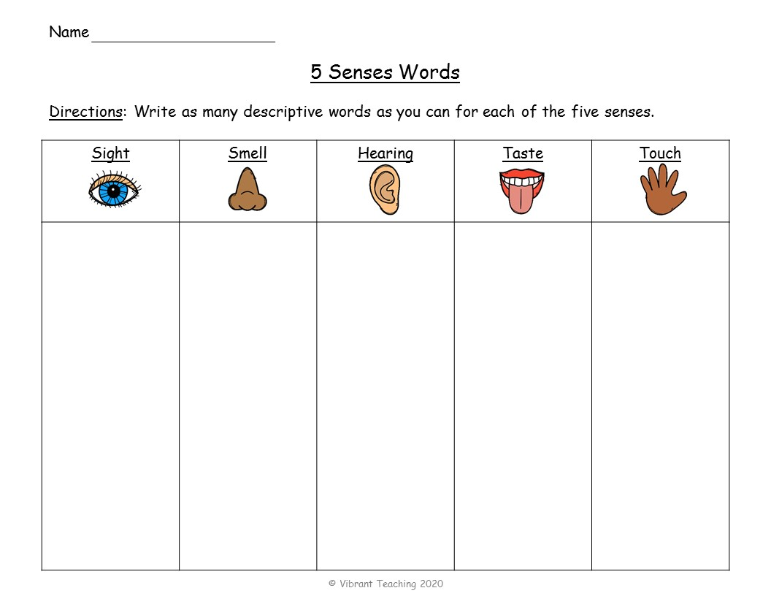
“认识你身边的植物”（Getting to Know the Plants Around Us）
活动过程
Step2: choose several activities and organize them logically.
Step1: brainstorm topic-centered activities related to five senses to enrich the content.
observe plants
watch a video about plants
take photos for plants
draw pictures to show plants’ features
collect seeds and leaves
make leaf bookmark
attend a lecture brought by a famous botanist (植物学家)
taste fruits of various plants
identify the fragrance(香味) of different flowers

Slide 7
Step2: choose several activities and organize them logically.
attend a lecture brought by a famous botanist;
explore the campus garden
observe plants;
take photos for plants;
collect seed and leaves
In what order would you organize activities?
time order
Example1: On Saturday morning, ... After doing sth, ... The next few hours witnessed them doing A, doing B and ....
from general to specific
Example2: experience the charm of plants by doing A, doing B and ....
Example1: On Saturday morning, all the participants attended a lecture brought by a famous botanist. After learning how to identify different plants, the students set out to explore the campus garden. The next few hours witnessed them observing plants, taking photos for them and collecting seeds and leaves that they are interested in.
Example2: The students set out to explore the campus garden and experience the charm of plants by observing plants, taking photos for them and collecting seeds and leaves that they are interested in.

Slide 8
“认识你身边的植物”（Getting to Know the Plants Around Us）
活动过程
Original:
On Saturday morning, all the participants first gathered in the school hall to attend a lecture brought by a famous professor. They even asked a lot of questions after the speech. In the afternoon, all students went to the school garden to look for plants around us. Everyone involved found these activities interesting and meaningful.
Revised：
On Saturday morning, all the participants attended a lecture brought by a famous botanist. After learning how to identify different plants, the students set out to explore the campus garden. The next few hours witnessed them observing plants, taking photos for them and collecting seeds and leaves that they are interested in. Everyone involved found these activities interesting and meaningful.
Topic-centered
Logical and rich content

Slide 9

Conclusion
topic
rich &
topic-related content
Events/
Activities
time order
from general to specific
…
logical order

Slide 10
Practice
（2021.01浙江高考）假定你是李华，下周有新西兰学生访问你校，你将为学生代表致欢迎辞。请为此写一篇发言稿。内容包括：
1. 表示欢迎；2. 介绍活动安排；3. 表达祝愿。
Brainstorm topic-centered activities related to five senses.
topic

Slide 11
新西兰学生访问你校
活动安排
Step2: choose several activities and organize them logically.
Step1: brainstorm topic-centered activities related to five senses to enrich the content.
visit a Chinese culture museum
watch Chinese dance performance
write calligraphy
make artworks like paper-cutting
learn to sing Chinese folk songs
attend a lecture about Chinese festivals
enjoy Chinese cuisine
On the first day, you will visit a Chinese culture museum, where you can make your own artworks like paper-cutting. In the following days, staying with one of our students, you can experience the charm of Chinese culture by learning to sing traditional song, enjoying Chinese cuisine and so on.

Slide 12
Homework
假定你是校学生会主席李华。下周你学生会举办将举办元宵节（the Lantern Festival）庆祝活动，师生共同参加。请你代表校学生会写一则书面通知，内容包括：
1. 时间和地点；
2. 活动安排。
topic

Slide 13
Sample writing
Notice
To mark the approaching Lantern Festival, a celebration will be scheduled at 13:00 next Saturday in our school auditorium.
Then event will start will a fascinating folk dance show, where all the dancers will be dressed in traditional Chinese costumes and bring you into a world of splendor. And the highlight will come at night, when you can be immersed in the charm of this Chinese festival by appreciating lanterns of various shapes and sizes, guessing lantern riddles, and tasting Yuanxiao, a traditional food for the Lantern Festival.
All teachers and students are welcome to enjoy the celebration. Your participation is bound to add color to this event!
Students’ Union

Slide 14

Thank You!

