Slide 1


感恩遇见，相互成就，本课件资料仅供您个人参考、教学使用，严禁自行在网络传播，违者依知识产权法追究法律责任。
更多教学资源请关注
公众号：溯恩高中英语
知识产权声明
试卷

Slide 2

The World
October 16th-31st, 2023

Slide 3
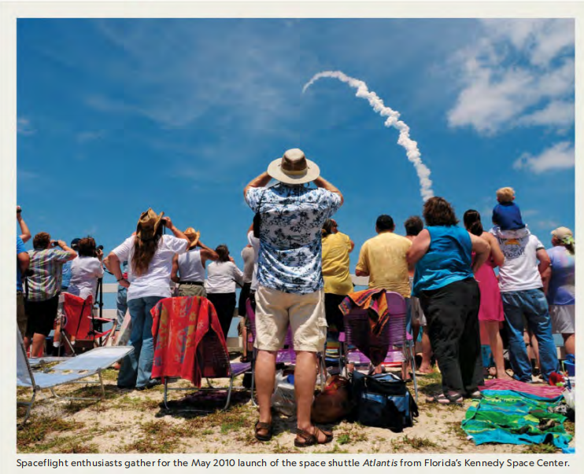
1. Rocket Launch Tourism 观看火箭发射

Slide 4

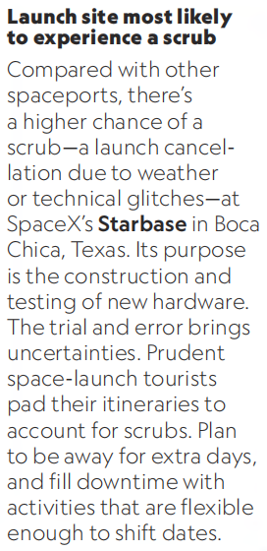
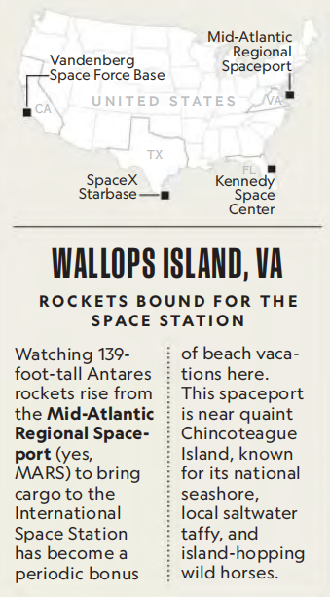
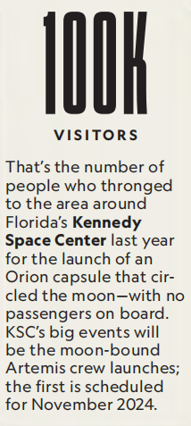
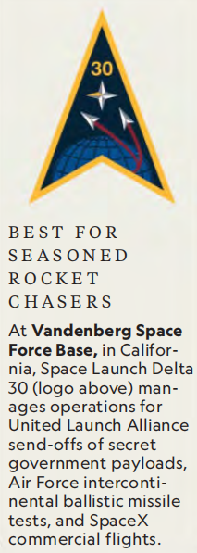
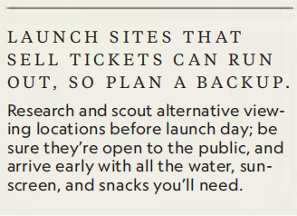

Slide 5

阅读理解
1. Which of the following statements is correct?
A. Manned spacecrafts will be lauched at MARS.
B. Kennedy Space Center had the most visitors last year.
C. Vandenberg is suitable for less experienced liftoff fans.
D. Other viewing sites may not be accessible to the general public.
细节理解
2. Tourists to which launch site had better have a backup plan?
A. Mid-Atlantic Regional Spaceport. B. Kennedy Space Center.
C. Vandenberg Space Force Base. D. SpaceX Starbase.
细节理解
3. Where is the text probably taken from?
A. An engineering book. B. An astronomy magazine.
C. A science paper. D. A physics textbook.
主旨大意

Slide 6
词汇讲解
1. throng: to go somewhere or be present somewhere in large numbers
群集；拥塞；拥向
The crowds thronged into the mall. 人群涌进大厅。
2. prudent: sensible and careful when you make judgements and decisions; avoiding unnecessary risks 谨慎的；慎重的；精明的
Being a prudent and cautious person, you realise that the problem must be resolved.
慎重小心的人都会意识到这个问题非解决不可。
翻译句子
人们成群结队地去看他的新戏。
People are thronging to see his new play.
翻译句子
刚开始一项锻炼计划时循序渐进总是明智的。
It is always prudent to start any exercise programme gradually at first.

Slide 7
句子翻译
That’s the number of people who thronged to the area around Florida’s Kennedy Space Center last year for the launch of an Orion capsule that circled the moon —with no passengers on board.
翻译
这是去年聚集在佛罗里达州肯尼迪航天中心附近观看绕月“猎户座”飞船升空的人数——飞船没有载人。
Its purpose is the construction and testing of new hardware. The trial and error brings uncertainties. Prudent space-launch tourists pad their itineraries to account for scrubs. Plan to be away for extra days, and fill downtime with activities that are flexible enough to shift dates.
翻译
其目的是构建和测试新硬件。试错带来了不确定性。谨慎的太空发射游客将他们的行程填满，以应对可能的发射推迟或取消。计划多离开几天，用足够灵活的活动来填补时间。

Slide 8
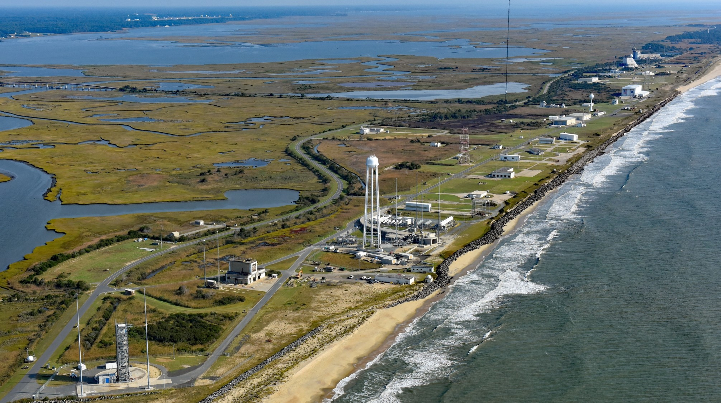
Mid-Atlantic Regional Spaceport

Slide 9
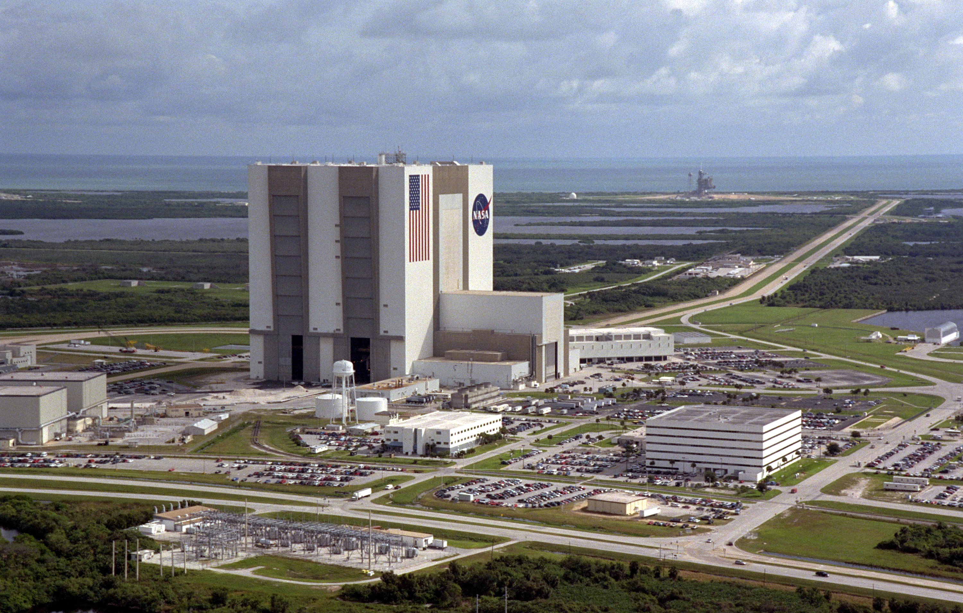
Kennedy Space Center

Slide 10
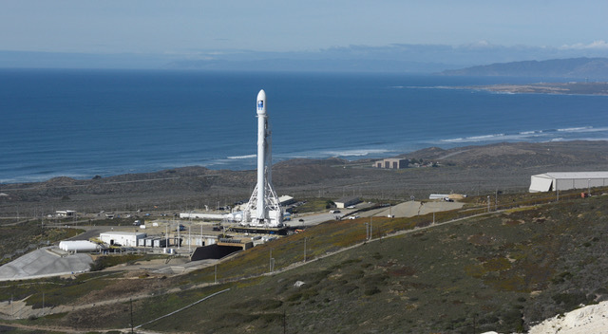
Vandenberg Space Force Base

Slide 11
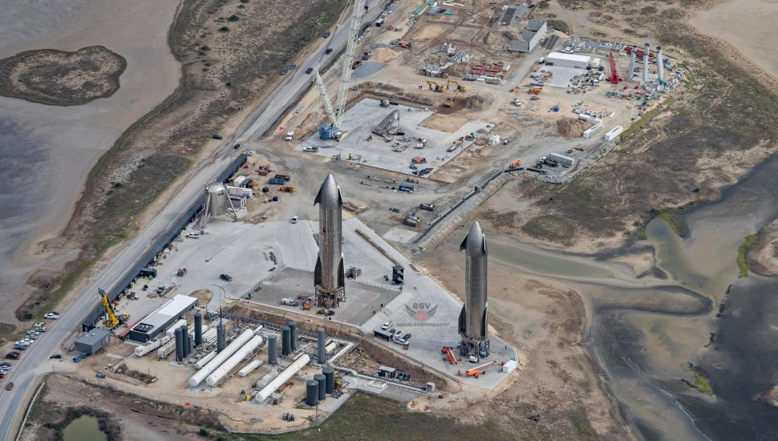
SpaceX Starbase

Slide 12
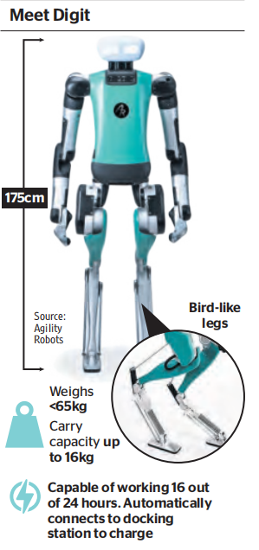
2. Digit adds pointer in the debate about AI 亚马逊人工智能新动向

Slide 13
语篇填空
（《泰晤士报》2023年10月21日 50页）
When Amazon introduced the outside world to its ______ (late) new recruit, the reac-tion was not entirely ______ it had hoped for. The new figure stacking boxes on shelves in its vast warehouse in Seattle was a robot, one, moreover,that _________ (resemble) a human and was doing a job that until now a human being would do.
Yet the robot, 175cm tall, able to carry up to 16kg and named “Digit”, is not alone. Amazon is intent on using automation to speed up its vast retail operation _____this, in turn, has posed questions about the future of its human employees and the advance of artificial intelligence more _________ (general).
Digit can walk forwards and backwards, can crouch and can sense, avoid and navigate around _________ (obstacle), including its human colleagues. It points to the fact _____ Digit’s human-like form is not entirely incidental. It was designed to work in environments suited to people. It has the ability ______ its arms and legs and to rebalance itself if _________ (knock), according to Agility’s website, which — conspicuously — also points out that the robot is able to run for 16 of 24 hours, double the average daily shift of ___ full-time human employee.
latest
what
resembled
and
generally
obstacles
that
to use
knocked
a

Slide 14
词汇讲解
1. stack: to arrange objects neatly in a pile; to be arranged in this way （使）放成整齐的一叠（或一摞、一堆）
Their regular and standardized shapes would have made them simple to stack and store. 它们形状规则且标准，极易堆放储藏。
2. navigate: to find your position or the position of your ship, plane, car etc. and the direction you need to go in 导航；确定（船、飞机、汽车等）的位置和方向
I'll drive, and you can navigate. 我开车，你引路。
翻译句子
他命令他们在他背后堆放一些枕头。
He ordered them to stack up pillows behind his back.
翻译句子
你怎么才能设法走出森林？
How do you navigate your way through a forest?

Slide 15
句子翻译
The new figure stacking boxes on shelves in its vast warehouse in Seattle was a robot, one, moreover,that resembled a human and was doing a job that until now a human being would do.
翻译
在其位于西雅图的巨大仓库里，在货架上堆放箱子的新身影是一个机器人，而且，它长得像一个人，正在做迄今为止人类才会做的工作。
It has the ability to use its arms and legs and to rebalance itself if knocked, according to Agility’s website, which — conspicuously — also points out that the robot is able to run for 16 of 24 hours, double the average daily shift of a full-time human employee.
翻译
据Agility的网站介绍，它有能力使用自己的手臂和腿，并且在被撞的情况下能够重新平衡自己。网站还特别指出，这款机器人可以在24小时内工作16小时，是全职人类员工平均每天工作时间的两倍。

Slide 16
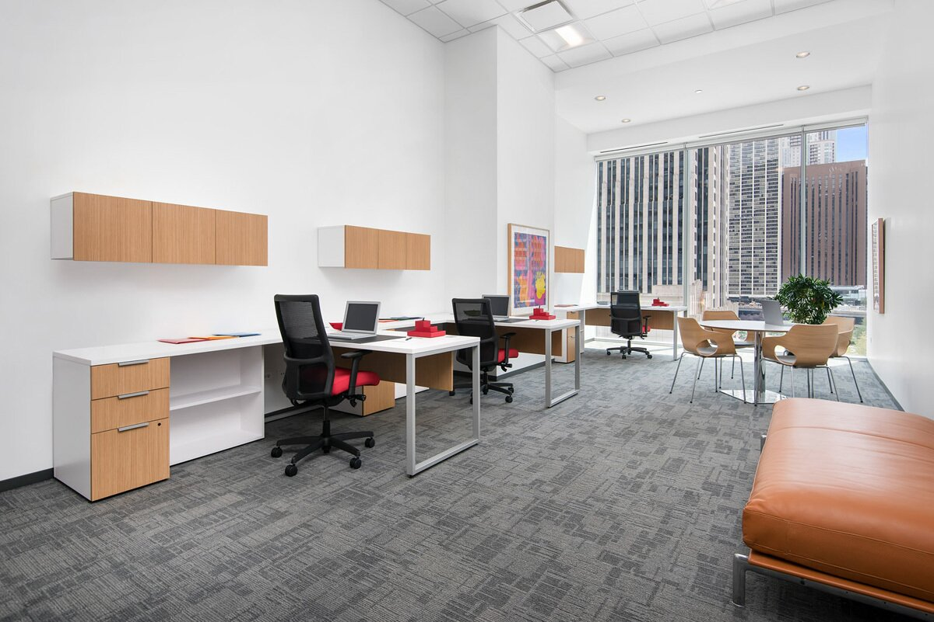
3. Empty offices may contain solution to housing crisis
空置的办公室可缓解住房问题

Slide 17
语篇填空
（《泰晤士报》2023年10月19日 36页）
Thousands of homes could __________ (create) in London if owners of empty office buildings converted them into flats, a report has claimed. The proportion of vacant office space in the capital has almost doubled since the onset of the pandemic __ about 8.5 percent, according to CBRE, the property agent behind the report. In all, there is an estimated 16 million sq ft of older, empty blocks that, ___ re-purposed, could create close to 28,000 new homes, the report said. London, like the rest of the country, is in the grip of a housing crisis: CBRE estimates that 90,000 fewer homes ______________ (build) over the past decade than were needed. The ________ (short) is likely to worsen over the coming years, with new home applications and planning permissions falling this year given the jump in financing costs and ___ onerous planning process, which CBRE’s report said “remains a key hindrance”. At the same time, there is an excess of office space. ________ (turn) empty offices into homes would help to solve both of those problems. Re-purposing is on the minds of some investors, _____ since last year have spent ￡l.3 billion buying offices in London for re-purposing, albeit most of those are for hotels or ___________ (laboratory). CBRE expects more and more office buildings will have to be retrofitted or repurposed. “The previous strategy of _______ (simple) demolishing an old office to replace it with a new building is becoming largely redundant,” the report said.
be created
to
if
have been built
shortage
an
Turning
who
laboratories
simply

Slide 18
词汇讲解
1. in the grip of: experiencing sth unpleasant that cannot be stopped 处于不快却无法制止的境遇；受制于某事
The country is in the grip of a teenage crime wave. 青少年犯罪的激增让该国陷入困境。
2. hindrance: a person or thing that makes it more difficult for sb to do sth or for sth to happen 造成妨碍的人（或事物）
To be honest, she was more of a hindrance than a help. 说实在的，她没帮上忙，反而成了累赘。
翻译句子
当时国家处于经济萧条期。
The country was in the grip of economic depression.
翻译句子
价格高是使潜在买主却步的主要阻碍。
The high price is a major hindrance to potential buyers.

Slide 19
句子翻译
The shortage is likely to worsen over the coming years, with new home applications and planning permissions falling this year given the jump in financing costs and an onerous planning process, which CBRE’s report said “remains a key hindrance”.
翻译
未来几年，这种短缺可能会加剧，由于融资成本飙升和繁琐的规划程序，今年的新房申请和规划许可将下降，CBRE的报告称，这“仍是一个关键障碍”。
CBRE expects more and more office buildings will have to be retrofitted or repurposed. “The previous strategy of simply demolishing an old office to replace it with a new building is becoming largely redundant,” the report said.
CBRE预计，将有越来越多的写字楼需要翻新或改作用途。报告称:“以前简单地拆除旧办公室，用新楼取而代之的策略在很大程度上变得多余了。”
翻译

Slide 20
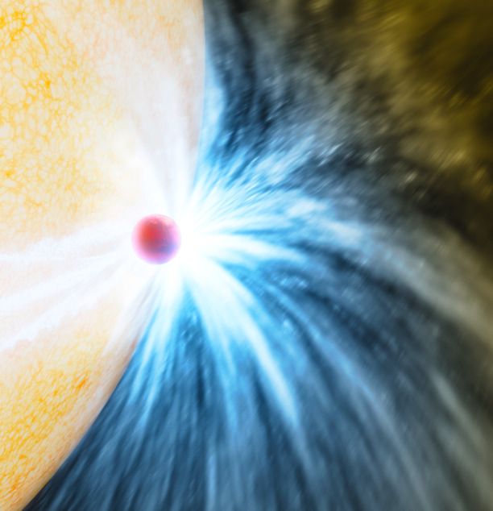
4. Telescopes caught a star gobbling up a planet
望远镜捕捉到一颗恒星正在吞噬一颗行星

Slide 21
语篇填空
（《科学新闻探索》2023年10月刊 4页）
eating
For the first time, scientists—have spotted a star _____ (eat) a planet. The planet was probably about 10 times the mass of Jupiter and orbited a star about 10,000 light-years away. The stellar meal gave off a burst of light ________ (capture) by telescopes on Earth and in space. Stars were long suspected to eat their own planets, says Kishalay De. ____ no one knew how often this happened.
He’s an astrophysicist at MIT _________ led the research. De was hunting for pairs of stars that orbit each other. One cosmic event from 2020 caught his eye. A spot of light in the sky quickly got about 100 times as bright as it was before —maybe two stars merging? But a ______ (close) look revealed one one-thousandth of the energy that would __________ (expect) from merging stars. Plus, the area lacked the hot plasma De expected _____ a star collision. Instead, it was full of chilly dust.
If the flash was from two objects smashing into each other, he determined, they weren’t both stars. One was probably __ giant planet. As the star chowed down on the planet, a stream of cold dust sailed away like cosmic breadcrumbs. His team shared the discovery in Nature. The planet-eating star in this study is turning into a red giant. But it’s still early in its _____________ (transform). This dramatic end may give a glimpse of Earth’s future. Our sun will _________ (eventual) evolve into a red giant, consuming Earth—in about 5 billion years.
captured
But
who / that
closer
be expected
from
a
transformation
eventually

Slide 22
词汇讲解
1. merge: to combine or make two or more things combine to form a single thing （使）合并，结合，并入
The banks are set to merge next year. 这几家银行准备明年合并。
2. collision: an accident in which two vehicles or people crash into each other 碰撞，互撞
There has been a collision on the southbound stretch of the motorway. 在高速公路南向路段上发生了一起撞车事故。
翻译句子
这些村庄扩大了并且结合成了一个大集镇。
The villages expanded and merged into one large town.
翻译句子
他的车和一辆摩托车撞上了。
His car was in collision with a motorbike.

Slide 23
句子翻译
But a closer look revealed one one-thousandth of the energy that would be expected from merging stars. Plus, the area lacked the hot plasma De expected from a star collision. Instead, it was full of chilly dust.
但仔细观察发现，它的能量只有预期恒星合并所产生能量的千分之一。此外，该区域缺乏恒星碰撞所产生的热等离子体De。相反，它充满了寒冷的灰尘。
翻译
The planet-eating star in this study is turning into a red giant. But it’s still early in its transformation. This dramatic end may give a glimpse of Earth’s future. Our sun will eventually evolve into a red giant, consuming Earth—in about 5 billion years.
在这项研究中，这颗吞噬行星的恒星正在变成一颗红巨星。但它仍处于转型的早期阶段。这个戏剧性的结局或许能让我们窥见地球的未来。我们的太阳最终会演化成一颗红巨星，在大约50亿年后吞噬地球。
翻译

Slide 24

5. BBC News 10/16/2023

Slide 25

听力填空
A prominent Italian journalist has been found guilty of ________ the prime minister Giorgia Meloni and handed a ________ fine. Roberto Saviano had called her a bastard because of her hardline views on immigration. His fine of 1,000 euros was much less than prosecutors wanted, and he’ll only have to pay it if he repeats the _______. Mr. Saviano is best known for his book about the mafia “Gomorrah”.
A judge in Brazil has overturned a ruling against the former Brazilian Formula One racing champion, Nelson Piquet for alleged racist and homophobia _________ he made about the British driver Lewis Hamilton. Piquet had been ordered to pay $1 million ________________ Hamilton. The Brazilian anti-racism groups that initiated the case are expected to ______.
India has rejected the latest global ___________ that ranks the country 111 out of 125 surveyed nations. India’s ranking has dropped by four places in this year’s report, ____________ most South Asian countries except Afghanistan. The report is compiled by the Irish aid agency Concern Worldwide and German organization Welthungerhilfe. The index looks at undernourishment, the number of children under the age of five with the low height and weight and child ________. India, the world’s 5th biggest economy has fallen into the “serious” category. But the Indian government says the __________ for the report was too small.
insulting
symbolic
offense
comments
in compensation to
appeal
hunger index
falling behind
mortality
sample size

Slide 26
词汇讲解
1. alleged: An alleged fact has been stated but has not been proved to be true. 声称的；被断言的；涉嫌的
They have begun a hunger strike in protest at the alleged beating.
他们开始绝食以抗议有人所宣称的殴打行为。
2. undernourishment: If someone is suffering from undernourishment, they have poor health because they are not eating enough food or are eating the wrong kind of food. 营养不足；营养不良
Many children in Africa are short for their age because of undernourishment.
非洲很多孩子因为营养不良而身高偏低。
翻译句子
嫌疑犯今天被逮捕了。
The alleged suspect was arrested today.
翻译句子
世界上营养不良的人数有所增加。
The number of people suffering from undernourishment in the world has increased.

Slide 27
句子翻译
A prominent Italian journalist has been found guilty of insulting the prime minister Giorgia Meloni and handed a symbolic fine. Roberto Saviano had called her a bastard because of her hardline views on immigration.
翻译
意大利一名著名记者因侮辱总理乔治娅·梅洛尼被判有罪，并被象征性地处以罚款。由于她在移民问题上的强硬立场，罗伯特·萨维亚诺称她为混蛋。
India has rejected the latest global hunger index that ranks the country 111 out of 125 surveyed nations. India’s ranking has dropped by four places in this year’s report, falling behind most South Asian countries except Afghanistan.
翻译
印度否认最新的全球饥饿指数，在接受调查的125个国家中，印度排在第111位。在今年的报告中，印度的排名下降了4位，落后于除阿富汗以外的大多数南亚国家。

