Slide 1

感恩遇见，相互成就，本课件资料仅供您个人参考、教学使用，严禁自行在网络传播，违者依知识产权法追究法律责任。
更多教学资源请关注
公众号：溯恩高中英语
知识产权声明

Slide 2
2023年11月
衢丽湖高三教学质量检测
英语试题讲评及二次开发
浙江省衢州第二中学
徐芳红

Slide 3


Part 1
阅读理解
A
Four Books about Curious Creatures
B
Pathways into the Library
C
Future Cities under the Ocean
D
Tap into Geothermal Energy

Slide 4

A篇: 应用文 主题语境：人与社会，人与自然
Tip 1:先梳理框架，再寻找细节。
Title
Intro
Book name
Author
Illustrator (插图画家)
Brief introduction to the book
Four Books about Curious Creatures
In these brilliant books…
Animal Sidekicks
by Macken Murphy.
Illustrated by Dragan Kordic
This illustrated book explores…
The Secret Life of Foxes
by Chole Petrylak
Have you ever spotted…

Slide 5
A篇: 应用文 主题语境：人与社会，人与自然
Tip 2:应用文解题，先看题目，再看文本。
21. In which book can you find the fish that help clean sharks’ teeth?
A. Animal Sidekicks. B. The Secret Life of Foxes.
C. Please Don’t Bite Me. D. Stone Age Beasts.
Animal Sidekicks
by Macken Murphy.
Illustrated by Dragan Kordic
This illustrated book explores the idea of symbiosis—animals that form amazing relationships to help each other. You’ll learn about clownfish living peacefully with poisonous sea anemone, the frog that lives with a tarantula, and lots more.

Slide 6
A篇: 应用文 主题语境：人与社会，人与自然
Tip 3:直接跳过不考的信息，提高阅读效率。
22. How is the book The Secret Life of Foxes different from others?
It deals with a curious creature.
B. It has no illustrations in the book.
C. It only attracts wildlife enthusiasts.
D. It doesn’t mention relationships of creatures.
Animal Sidekicks
by Macken Murphy.
Illustrated by Dragan Kordic
The Secret Life of Foxes
by Chloe Petrylak.
Please Don’t Bite Me
by Nazzy Pakpour.
Illustrated by Owen Davey
Stone Age Beasts
by BenLerwill.
Illustrated by Grahame Baker-Smith

Slide 7
A篇: 应用文 主题语境：人与社会，人与自然
23. What kind of creatures are mentioned in the book Stone Age Beasts?
A. Amazing and giant ocean life.
B. Mysterious and fascinating birds.
C. Interesting and surprising insects.
D. Unbelievable and ancient animals.
Travel back in time to meet incredible creatures in this beautiful book. It features many of the prehistoric animals that our human ancestors would have met face-to-face in the Stone Age. Learn about the woolly mammoth, the sabre-toothed cat, and the six-metre snake that once slithered along the forest floor.

Slide 8
表达积累
sidekick n. 助手，伙伴
track down(经过长时间艰难搜索后) 找到
She had spent years trying to track down her parents.
feature v. 以…为特色
prehistoric adj. 史前的，古老的
slither v. (蛇等) 蜿蜒地滑行
buzz v. 嗡嗡地响
sting v.刺; 叮
the prehistoric animals that our ancestors would have met face-to-face in the Stone Age. (我们的祖先在石器时代会面对面遇到的史前动物)
would have done本来会做某事，用于虚拟语气中，表示对过去所发生的事情的假设。

Slide 9
B篇: 人物介绍 主题语境：人与社会
Tip:人物介绍类文本的结构顺序一般为时间顺序（从出生开始）。
From the time he was a young boy, Jim Haskins always had a book in his hand. While other kids were outside playing ball, Jim was usually reading. He could be found in one of his favorite places: curled up underneath the kitchen table or up in the tree that grew in his front yard.
24. What can we learn from the description in paragraph 1?
Jim Haskins studied harder than other kids.
Jim Haskins had no interest in playing ball.
Jim Haskins was enthusiastic about reading.
Jim Haskins preferred to read under the table.

Slide 10
B篇: 人物介绍 主题语境：人与社会
When Jim was a teenager, Black Americans’ struggle for equal rights was becoming the civil rights movement. Many brave people were taking risks by refusing to follow unfair segregation laws. Jim went to Montgomery, Alabama, and joined a civil rights group. The group was headed by Dr. Martin Luther King, Jr. Jim believed in King’s nonviolent approach to change. Once, during a peaceful march, Jim was arrested. Because of that, his college expelled him.
He did graduate from another college…(从另一所大学毕业。)
25. What does the underlined word “expelled” in paragraph 3 mean?
Dismissed. B. Promoted. C. Praised. D. Monitored.
开除，解雇 晋升，升职 称赞，夸奖 监控，监听

Slide 11
B篇: 人物介绍 主题语境：人与社会
Para 4- He did graduate from another college. Afterward, he went on to teach school in Harlem, a part of New York City. As a teacher, he had trouble finding books that interested his Black students. So he decided to write his own books about successful Black Americans. Through his writing, he met and interviewed many of the people he admired, including Rosa Parks.
26. Why was Jim Haskins determined to write his own books?
To rise to be a famous writer.
B. To put an end to segregation.
C. To appeal to Black students.
D. To introduce the people he admired.

Slide 12
标题题的答案一般有两个特征：1.概括性（归纳文本内容）；2.文学性（吸引读者阅读）。
27. What can be a suitable title for the text?
A. Pathways into the Library B. Anxiety for Knowledge
C. Struggle for Equal Rights D. Protest against Segregation
From the time he was a young boy, Jim Haskins always had a book in his hand. While other kids were outside playing ball, Jim was usually reading. He could be found in one of his favorite places: curled up underneath the kitchen table or up in the tree that grew in his front yard.
Jim was born in Demopolis, Alabama, during the time of segregation (隔离). Because Jim was Black, he was not allowed to check out a single book at the public library. Libraries were for whites only. The laws of segregation separated Jim from all the books he longed to read. But Jim was determined. He convinced a teacher at school to lend him books of her own. He even managed to get some public library books through a white woman whom his mom worked for doing laundry.
When Jim was a teenager, Black Americans’ struggle for equal rights was becoming the civil rights movement. Many brave people were taking risks by refusing to follow unfair segregation laws. Jim went to Montgomery, Alabama, and joined a civil rights group. The group was headed by Dr. Martin Luther King, Jr. Jim believed in King’s nonviolent approach to change. Once, during a peaceful march, Jim was arrested. Because of that, his college expelled him.
He did graduate from another college. Afterward, he went on to teach school in Harlem, a part of New York City. As a teacher, he had trouble finding books that interested his Black students. So he decided to write his own books about successful Black Americans. Through his writing, he met and interviewed many of the people he admired, including Rosa Parks.
Today, libraries have more than one hundred books written by Jim Haskins, the boy who loved to read, and today, children of all races can walk through the doors of any public library and find interesting books that inform, entertain, and inspire them.

Slide 13
表达积累
curl up 蜷作一团
In colder weather, your cat will curl up into a tight, heat-conserving ball.
在更冷的天气里，你的猫会蜷缩成紧紧的一团来保暖。
check out 退房，借阅（图书）
separate A from B 使分离; 脱离
convince v. 说服
the civil right movement（美国）民权运动（20 世纪 50 年代和 60 年代非裔美国人争取平等权利的运动）segregation: (对不同种族、宗教或性别的人所采取的）隔离并区别对待，隔离政策
expel v. 开除，逐出
长难句：Today, libraries have more than one hundred books written by Jim Haskins, the boy who loved to read(同位语), and（连接两个并列句） today, children of all races can walk through the doors of any public library and find interesting books that inform, entertain, and inspire them（定语从句）.

Slide 14
c篇: 说明文 主题语境：人与社会，人与自然
P2- “Technologically speaking, it is absolutely possible to colonize the bottom of the sea,” says Fabien Cousteau, a well-known ocean explorer who once spent 3l days living in what is now the world’s only functioning undersea habitat, Aquarius. It’s about the size of a school bus and located 62 feet below the ocean surface off the Florida Keys.
28. What do we know about Aquarius?
It is still under construction.
It functions as an undersea school bus.
It is the only ocean habitat in operation.
It only allows a person to live there for 31 days.
Tips:关注选项中的文本表达近义词：
in operation=functioning
正在运作中的

Slide 15
c篇: 说明文 主题语境：人与社会，人与自然
Tips: 1.关注上下文中具有概括性质的名词。(reason, challenge)
2. 关注文本中用于类比的表达。（astronaut 宇航员 aquanauts海底实验室工作人员）
P3- Just as astronauts test what it would be like to live in space, aquanauts try out undersea living with an eye on the future. Escaping from disasters such as climate change, wars, or pandemics is one reason to live under the sea. Others(other reasons) include studying, exploring, or appreciating the ocean. It’s costly and expensive to constantly keep up an ocean habitat which must pump in or make its own air, electricity, and fresh water. Inhabitants have to deal with high pressure. And infections can develop rapidly due to high humidity.
P4 - Despite the challenges, several new ocean habitats and cities are under construction…
29. What is paragraph 3 mainly about?
The present and future of living under the sea.
The reasons and challenges of living under the sea.
The purpose and cost of building undersea settlements.
The problems and findings of building undersea settlements.

Slide 16
c篇: 说明文 主题语境：人与社会，人与自然
P5- Not everyone agrees that building homes in the ocean is a good idea. This type of development could place even more strain on ecosystems that are already struggling with pollution and climate change. It’s important to make sure that any construction is done carefully, says Susanne Menden-Deuer, an oceanographer at the University of Rhode Island. Wild undersea habitats should be treated as “the precious, irreplaceable resource that they are,” she says.
30. What would be the result of building homes in the ocean according to the text?
Rapid development of undersea habitats.
Protection of irreplaceable ocean resource.
Negative impacts on undersea ecosystems.
Struggles with pollution and climate change.

Slide 17
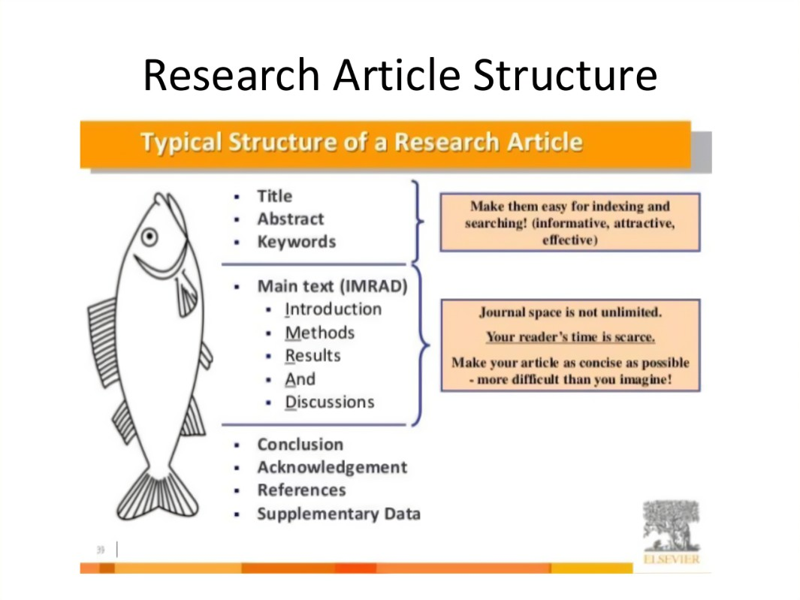
c篇: 说明文 主题语境：人与社会，人与自然
31. Where is the text most probably taken from?
A textbook.
B. An exam paper. （试卷）
An academic article. （学术论文）
A science magazine.
学术论文框架

Slide 18
表达积累
colonize: If people colonize a foreign country, they go to live there and take control of it. 把…变为殖民地
infection n. 传染病
humidity n. 湿度
hydrothermal vent 水热通道：位于海底裂隙中的热液喷口，特别是在中洋脊附近的喷口，从中喷出富含矿物质的超热水。
place(v.) strain on 带来压力
oceanographer n. 海洋学家；海洋研究者
句型转换：
Despite the challenges, several new ocean habitats and cities are under construction.
Despite the challenges, several new ocean habitats and cities are being constructed.

Slide 19
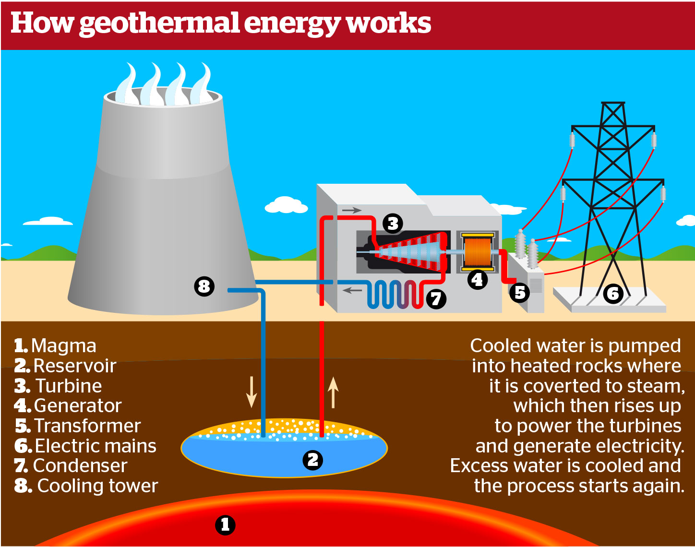
D篇: 说明文 主题语境：人与社会，人与自然
配图解释 段二How a geothermal power plant works:

Slide 20
D篇: 说明文 主题语境：人与社会，人与自然
P2- The Geysers is an area north of San Francisco in California where magma’s heat turns a reservoir of underground water into steam. This region is home to 18 geothermal power plants. The steam rises up through spaces between the rocks underground, a bit like how steam pours from a teakettle boiling on a stove. The power plant has pipelines that send the steam into the turbines (涡轮机) where electricity flow is generated. Once the steam leaves the turbine, it goes into a cooling tower where it turns back into liquid. Then it’s piped back into the reservoir to be reheated again. Other kinds of geothermal power plants pump hot groundwater into the power plant. Then the pressure is reduced, causing the liquid to flash into steam that turns the turbine and generates electricity flow. Once the steam cools and turns back into liquid, it’s pumped back down into the reservoir to begin the cycle again.
32. In which part of power plants is the electricity made?
The turbine.
The reservoir.
The pipeline.
The tower

Slide 21
D篇: 说明文 主题语境：人与社会，人与自然
P3- So why don’t we all heat our homes with free steam from the earth? First, the heat has to be close enough to the surface for us to reach it. Next, there has to be plenty of underground water to be heated. Finally, there has to be a layer of rock that water or steam can flow through. So in places where all three of those things come together, geothermal energy can be a powerful renewable energy source. Besides, when a geothermal plant returns water back into the hot rocks of a reservoir, it makes the rock crack a bit, which can cause small earthquakes. There’s another danger that comes with drilling near magma—pipes and other equipment might melt if they hit a pocket of magma or are caught in an eruption. One geothermal plant in Hawaii was partially buried by lava in 2018. But engineers are hopeful that the repaired plant will generate even more power. Geothermal energy isn’t the answer for everywhere, but it’s a piece of the puzzle to help slow climate change.
33. What prevents free steam from being widely developed according to paragraph 3?
Hard surface and possible earthquakes.
Changeable climate and unqualified equipment.
Limited underground water and thin layers of rock.
Unsuitable geological conditions and potential dangers.

Slide 22
D篇: 说明文 主题语境：人与社会，人与自然
P3- So why don’t we all heat our homes with free steam from the earth? First, the heat has to be close enough to the surface for us to reach it. Next, there has to be plenty of underground water to be heated. Finally, there has to be a layer of rock that water or steam can flow through. So in places where all three of those things come together, geothermal energy can be a powerful renewable energy source. Besides, when a geothermal plant returns water back into the hot rocks of a reservoir, it makes the rock crack a bit, which can cause small earthquakes. There’s another danger that comes with drilling near magma—pipes and other equipment might melt if they hit a pocket of magma or are caught in an eruption. One geothermal plant in Hawaii was partially buried by lava in 2018. But engineers are hopeful that the repaired plant will generate even more power. Geothermal energy isn’t the answer for everywhere, but it’s a piece of the puzzle to help slow climate change.
34. Why is the buried geothermal plant in Hawaii mentioned?
To demonstrate the great effort that engineers made.
To show the power that the repaired plant can generate.
To illustrate the danger caused by drilling near magma.
To praise the engineers who repaired the generate plant.

Slide 23
D篇: 说明文 主题语境：人与社会，人与自然
P1-Far, far below your feet lies a source of nearly endless energy. Earth’s core is about as hot as
the surface of the Sun, so hot that it melts the rocky layers above it into magma, or liquid rock. Wouldn’t it be great if we could tap into all that energy? In some places, we do!
如果我们能利用这些能量不是很好吗?在某些地方，我们是这样做的!（结合标点，作者超期待，超激动）
P3- So why don’t we all heat our homes with free steam from the earth? …..There’s another danger that comes with drilling near magma—pipes and other equipment might melt if they hit a pocket of magma or are caught in an eruption. One geothermal plant in Hawaii was partially buried by lava in 2018. But engineers are hopeful that the repaired plant will generate even more power. Geothermal energy isn’t the answer for everywhere, but it’s a piece of the puzzle to help slow climate change. （结尾肯定了Geothermal energy的积极意义。 ）
Tips:作者态度题的解题，可以从首尾段中寻找表达作者态度观点的句子。
35. What is the author’s attitude towards geothermal energy?
A. Unconcerned. B. Unclear. C. Doubtful. D. Approving
不感兴趣的 不清楚的 怀疑的 同意的

Slide 24
表达积累
tap into 挖掘，利用（已经存在的能源、知识等资源）
The company is trying to tap into the growing market for organic food.
公司正在试图利用有机食品不断增长的市场。
a reservoir of 大量储备
geothermal power 地热
magma n.岩浆
lava n. 熔岩

Slide 25
Part 2
七选五
Tips for
Foreign Students in China

Slide 26
Tips for Foreign Students in China
Tips:先看标题和首段，了解文章大概内容，再分析选项
China is a very popular destination for foreign students today. 36 At this point, the most popular choices for study are management and technical courses, though the interest in other disciplines is growing every minute. Here is a short list of some great tips for you if you want to study in China.
解释原因：中国成为留学热门选择是因为这里的高校教育质量高。
Get a Chinese phrasebook and learn the must-knows.
Then, make sure to keep track of it and follow your plan.
Once you choose the program, arrange the rest of the details.
If you’re moving to a place with a different culture, learn a bit before you go.
The colleges and universities are known for their excellence and high standards.
Studying abroad is a big step, but also one of the best experiences students get to live today.
G. However, students who have gone to China to study always regret not spending more time there.

Slide 27
Tips for Foreign Students in China
Learn the culture
China has a history of over five thousand years. Depending on where you come from, you might find it hard to fit in. This is the rule that applies to any transfer you make in the world. 37 The more you learn, the sooner you’ll make friends.
与小标题呼应，与前句有近义表达。
Get a Chinese phrasebook and learn the must-knows.
Then, make sure to keep track of it and follow your plan.
Once you choose the program, arrange the rest of the details.
If you’re moving to a place with a different culture, learn a bit before you go.
The colleges and universities are known for their excellence and high standards.
Studying abroad is a big step, but also one of the best experiences students get to live today.
G. However, students who have gone to China to study always regret not spending more time there.

Slide 28
Learn the language
Even when travelling for a short time, it’s always wise to learn the basic phrases of the language people speak in your target country. 38 This will help you connect better with the people and show that you’ve made an effort.
Know your budget
Wherever you go, you need to set your budget before you depart. This is extremely important if you plan to live on a budget for a certain period of time. Before you leave for China to study, check the costs in your selected city or area and plan your budget accordingly. 39 |
关键词重现，关注代词指代。
Get a Chinese phrasebook and learn the must-knows.
Then, make sure to keep track of it and follow your plan.
Once you choose the program, arrange the rest of the details.
If you’re moving to a place with a different culture, learn a bit before you go.
The colleges and universities are known for their excellence and high standards.
Studying abroad is a big step, but also one of the best experiences students get to live today.
G. However, students who have gone to China to study always regret not spending more time there.

Slide 29
Tips for Foreign Students in China
Don’t limit yourself
Moving across the world to study in a place you don’t know with people you have never seen can seem daunting(使人畏缩的) . 40 Don’t limit yourself. Go all in.
前句内容消极（negative）, 需要转折（however）成积极（positive）的内容。
Get a Chinese phrasebook and learn the must-knows.
Then, make sure to keep track of it and follow your plan.
Once you choose the program, arrange the rest of the details.
If you’re moving to a place with a different culture, learn a bit before you go.
The colleges and universities are known for their excellence and high standards.
Studying abroad is a big step, but also one of the best experiences students get to live today.
G. However, students who have gone to China to study always regret not spending more time there.

Slide 30
表达积累
daunting adj. 使人畏缩的
discipline n. (尤指大学里的) 学科
interdisciplinary course 跨学科课程
depart v. 离开，启程
departure n.
Flights should be confirmed 48 hours before departure.
航班应在起飞前48小时予以确认。
live on a budget
按预算生活：在有限的收入范围内进行生活和消费，以避免超支和债务。
We have to learn to live on a budget if we want to save money.
如果我们想要省钱，就必须学会按预算生活。

Slide 31
Part 3
完形填空
Hayley’s story

Slide 32
I’m Hayley. I graduated from YCIS Shanghai in 2021, and I’m now 41 computer engineering and economics at Johns Hopkins University in America. This autumn, I will 42 my third year. （21年高中毕业，马上大学三年级）
In the summer two years ago, I remember being extremely excited yet nervous, as I was about to begin my university 43 . I was also quite 44 |at the idea of being away from home for so long for the first time in my life. As I said goodbye to my parents at the airport, I felt a mix of 45 and upset. I was travelling to a different continent by myself, with two suitcases beside me, and the 46 to have an unforgettable college experience.
文本背景：上海国际学校毕业的Hayley，现在就读于美国的约翰霍普金斯大学，她以过来人的身份与即将要出国留学的学生们分享经验。
41. A. teaching B. studying C. explaining D. testing
42. A. plan B. miss C. avoid D. start
43. A. application B. tournament C. journey D. vacation
44. A. annoyed B. anxious C. disappointed D. shocked
45. A. anger B. hate C. respect D. fear
46. A. luck B. patience C. determination D. freedom

Slide 33
At school, there might be challenging times. What if I don’t make any friends? What if my classes get 47 ? How will I do my laundry? Yes, I’ve been there too, and 48 these questions. Don’t worry; you’ll make friends. Just learn to 49 the right people.
(我也经历过这些，想过这些问题：比如担心交不到朋友，担心课业压力大等等。)
Classes will, most 50 , become intense, especially towards midterms and exams. But it’s all right; we all can 51 . You will have a lot of people around you who can help.
(大概率你的课程强度会很大，但没关系，我们都会熬过去的。)
It’s 52 to worry about things like these. You’ll slowly 53 that you’ll take on these 54 as you go, and that they won’t be as terrifying as you had 55 .
(现在你有这些担心很正常，迎接这些挑战，你会渐渐发现其实并没有想象中的可怕。)
47. A. painful B. stressful C. meaningful D. peaceful
48. A. commented on B. escaped from C. thought about D. brought back
49. A. hire B. pick C. interview D. appoint
50. A. frequently B. encouragingly C. likely D. importantly
51. A. dream B. relax C. enjoy D. survive
52. A. difficult B. interesting C. normal D. unusual
53. A. forget B. realize C. promise D. regret
54. A. challenges B. activities C. responsibilities D. jobs
55. A. overcome B. advertised C. highlighted D. imagined

Slide 34
表达积累
at the idea of 一想到；听到某个想法时的反应或情感
She shuddered at the idea of living alone in the woods.
她一想到独自住在树林里就感到不寒而栗。
I have been there too. 我也去过那里（字面意思）；我也经历过这些（用来安慰人）
A: How come it can happen to me?
这怎么会发生在我身上？
B: Don't worry. I have been there too.
别担心，我也经历过。

Slide 35
Part 4
语法填空
“The British Museum please return Chinese antiquities”

Slide 36
主题语境：人与社会
主旨大意：Chinese social media users have backed calls from the country’s state media to have its artworks kept in the British Museum returned.
设空类型：有提示词7，无提示词3

Slide 37
social
Tens of thousands of Chinese 56 (society) media users have backed calls from the country’s state media to have its artworks 5 57 (current) kept in the British Museum returned. （动词变形容词；形容词变副词）
The topic “The British Museum please return Chinese antiquities (古董)”was in response 58 a piece（一篇报道）published by Chinese state media Global Times that called for all cultural relics in the British Museum 59 (return) “free of charge”. (介词短语 in response to；文化遗产要被免费归还）
The British Museum has been under pressure after around 2,000 items were reported “missing, 60 (steal) or damaged” two weeks ago, 61 (lead) to accusations that it was failing to fulfil its duty of care.（文物被盗，动词的过去分词；非谓语动词)
currently
to
to be returned
stolen
leading

Slide 38
that/which
The calls follow a piece published by the Global Times 62 argued, “The world-renowned British museum 63 (fail) to take good care of ‘cultural property belonging to other countries’ up to these years.” (考查定语从句，先行词是piece；up to these years 搭配现在完成时)
The British Museum looks after 23,000 Chinese objects, from the Neolithic (新石器) age to the present day. It is one of the largest 64 (collection) of Chinese antiquities in the West. The collection includes 65 large range of precious items such as paintings, prints, jade and bronzes.
(one of +名词复数；a range of 一系列)
has failed
collections
a

Slide 39
表达积累
back v. If you back a person or a course of action, you support them, for example, by voting for them or giving them money.
支持 （熟词生义）
His defense says it has found a new witness to back his claim that he is a victim of mistaken identity.
他的辩词称已经找到一位新的证人来证实他是弄错了的身份的受害者。
accusation n. 指责，指控 accuse-accusation
world-renowned adj. 世界闻名的
jade n. 玉

Slide 40
谢谢观看
“
”

