Slide 1


感恩遇见，相互成就，本课件资料仅供您个人参考、教学使用，严禁自行在网络传播，违者依知识产权法追究法律责任。
更多教学资源请关注
公众号：溯恩高中英语
知识产权声明

Slide 2

活用教材词汇，靶向高考写作
XB4U4单词拓展
浙江省义乌市青岩书院：普薇薇

Slide 3


parcel /pɑːʳsəl/ n.包裹 vt.裹好;打包
父亲左臂下夹着一个棕色的大包裹走进了房间。“惊喜！”他咧嘴笑着说。
Into the room came father with a large brown paper parcel under his left arm. “Surprise!” He grinned.
顾客们订购的商品将被打包好，与第二天发出。
The products the customers ordered would be parcelled up and delivered the next day.
Relevant Idioms
part and parcel of sth：an essential part of sth
服务的核心就是要让客户满意。
The customer satisfaction is part and parcel of the service.
作为可持续旅游业的重要部分，文化遗产复兴可能并非一项艰巨的任务。资源唾手可得 。
As part and parcel of sustainable tourism, cultural heritage revival may not be such a tall order. Resources are readily available.

Slide 4
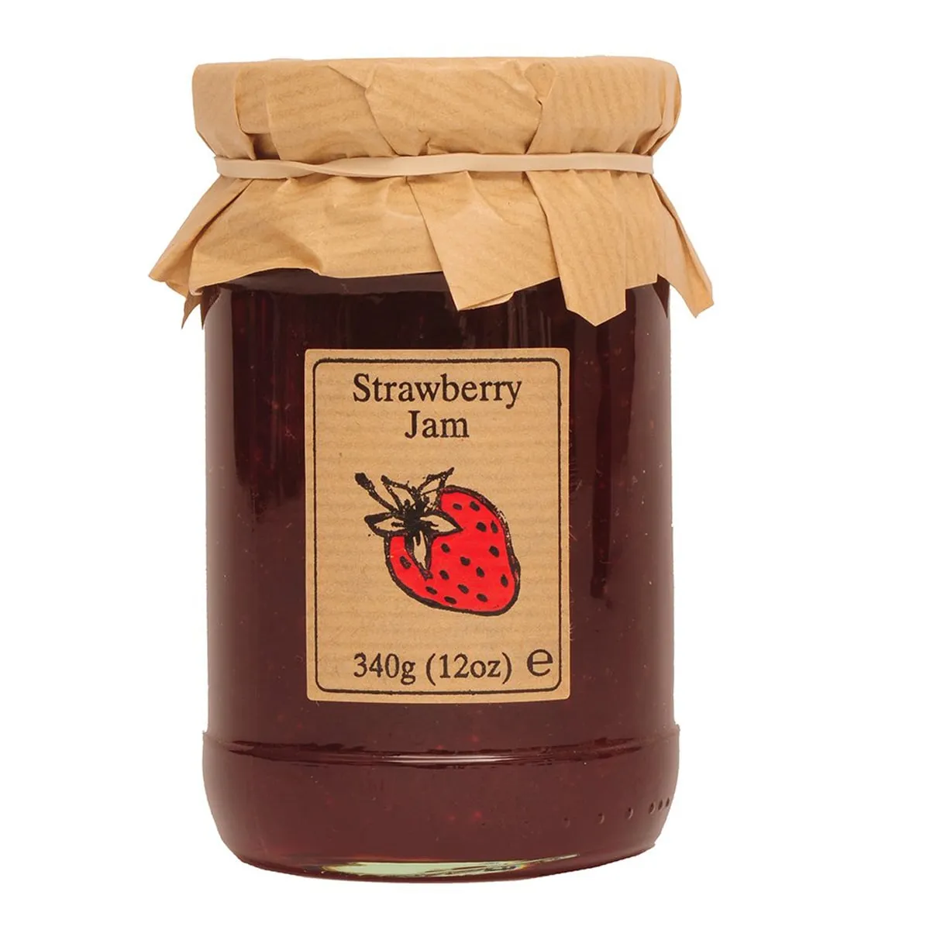

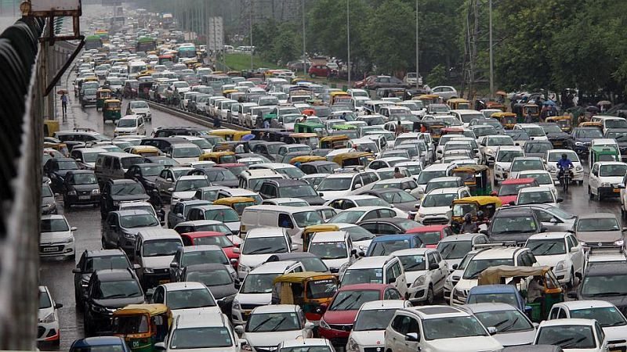
jam /dʒæm/ n.果酱;堵塞
小型摩托车通勤方便而且便于应对交通拥堵，因此越来越多的年轻人喜欢骑它们。
Scooters are very convenient for commuting and can help navigate traffic jams, so more and more young people enjoy riding them.
由于食堂东门在维修，最近其他出入口常常发生拥堵。因此我建议相应地调整不同年级的就餐时间。_{应用文-建议信}
Since the east doorway is under repair, jams usually occurs at other exits recently. Therefore, I suggest that the dinner time for different grades be adjusted accordingly.
春节时，城市里满是欢聚和团圆，而街道上则挤满了兴高采烈的人群。_{2017年11月浙江高考应用文“邀请老外过春节”}
The city explodes into parties and reunions during the Spring Festival, while the streets are jammed with delighted crowds.
the taffic jam

Slide 5
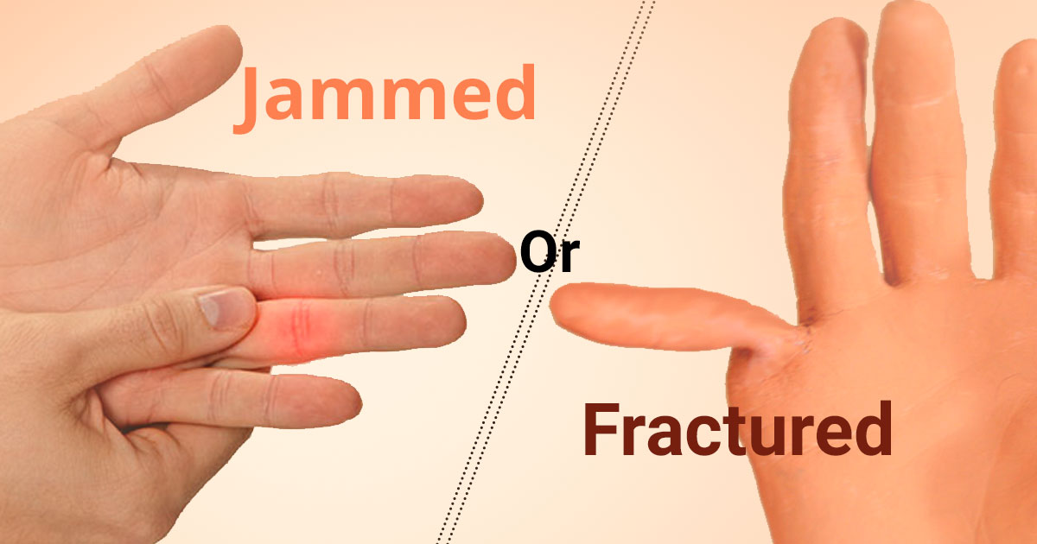
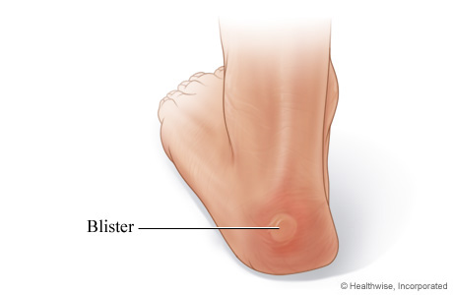
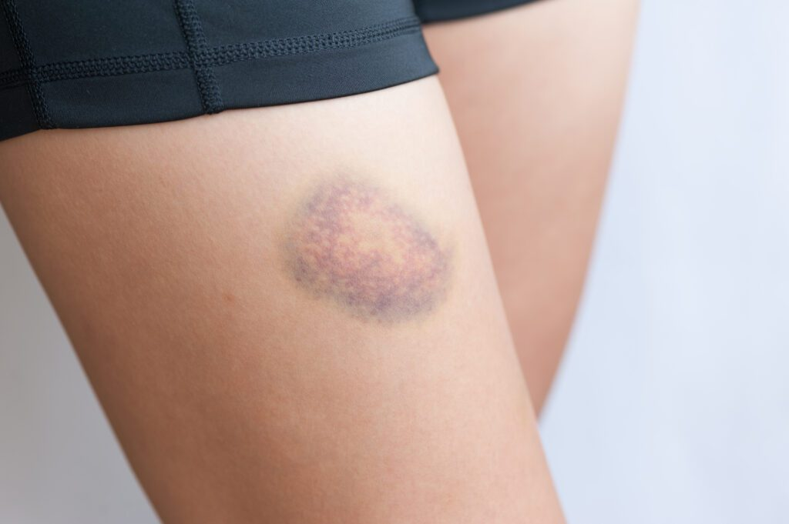
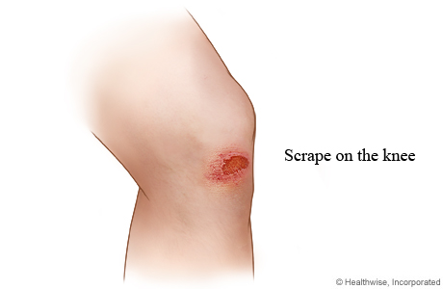
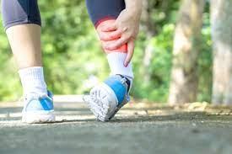
jam /dʒæm/ n.果酱;堵塞
bruise
sprain
他的手指被门夹了。
He jammed his finger in the door.
走了一整天，脚上起泡也就不稀奇了。
After a day’s walk, it’s not surprising to get blisters on feet.
她在浴室滑倒了以至于现在身上到处是淤青。
She slipped in the bathroom so that she got bruises here and there.
詹姆斯在足球赛中摔倒了，擦伤了膝盖。庆幸地是，他没有扭伤脚踝。
James fell down on the ground in the football match and got scrapes on his knees. Fortunately, he didn’t sprain his ankles

Slide 6
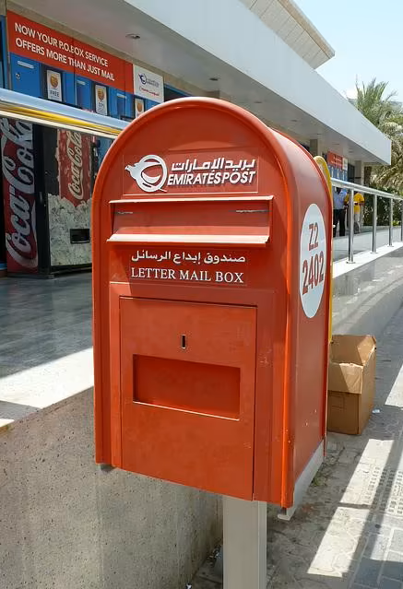





mail /meɪl/ n.邮件;信件;邮政 vt.邮寄
在邮递途中
in the mail/post
当今几乎所有的产品都可以邮购。
Currently, almost all the products are available by mail order.
作品须在周五之前电邮发给学生会。
The work must be electronically mailed （emailed）to the Students' Union before next Friday.
通过邮递的方式
by mail
寄信或包裹给/到
mail a letter/parcel to ...
Email
电子邮件
《星期日邮报》
垃圾邮件
平邮

Slide 7
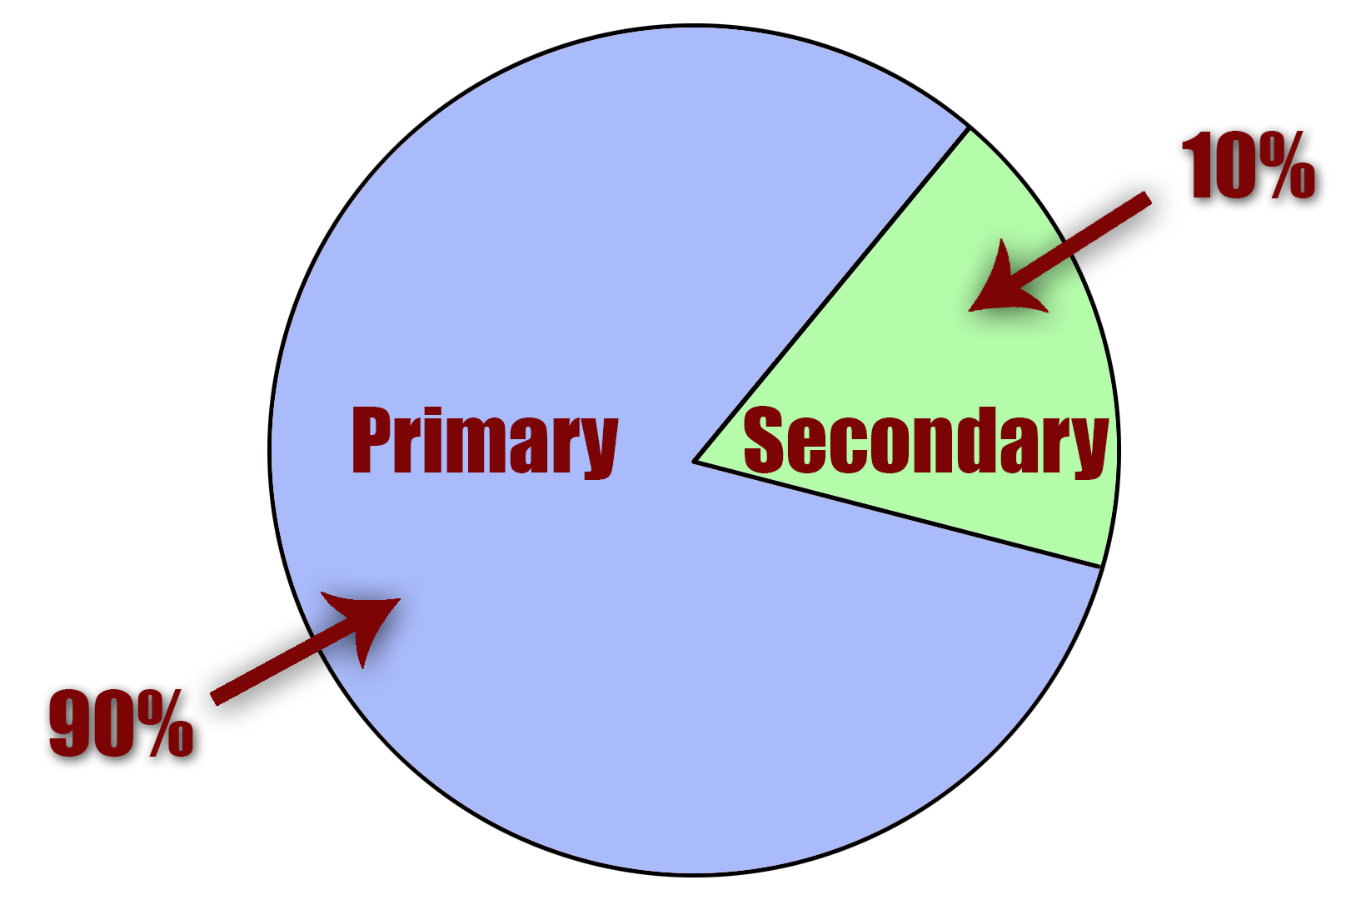
secondary /ˈsekəndri/ a.中学的;次要的
这两个项目都将有助于弥合中小学教育之间的差距，这对许多学生来说可能是一个挑战和压力。
Both projects will help to bridge the gap between primary and secondary education that can be challenging and stressful for many pupils.
和收获相比，困难只是次要因素。
Difficulties are just a secondary consideration, compared to the gains.
水灾发生后，当地政府正在努力调查河流的高风险部分，以防止次生灾害。
After the floods, local government’s efforts are being focused on investigating the high-risk sections of rivers to prevent secondary disasters.

Slide 8
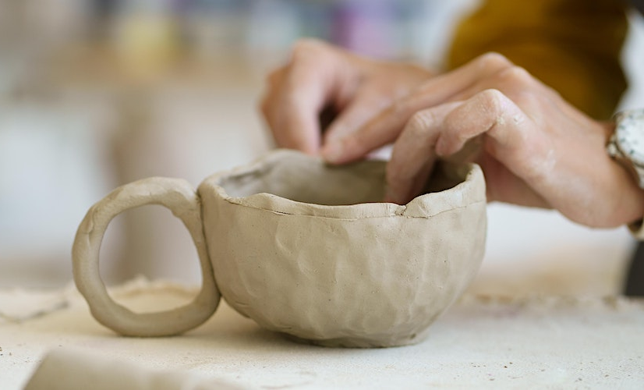
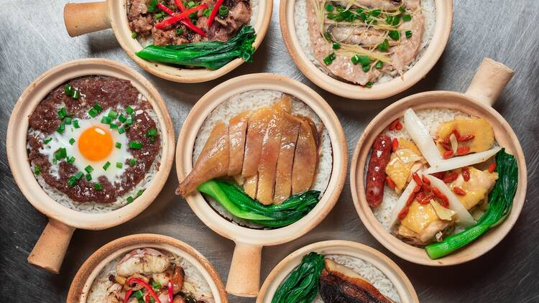
clay /kleɪ/ n.黏土;陶土
环境描写：Classrooms made of bamboo with clay floors and roofs of grass
我们新的黏土课程专注于创作过程，是为工艺爱好者设计的，这也有助于加强精细运动技能和自我表达能力。
Focusing on the process of creating, our new clay classes are designed for craft-lovers,which also help strengthen fine motor skills and self-expression.
欢迎来到兴记煲仔饭厨房。这家餐厅已经开业43年了。你之所以能在这里吃到独特的带有锅底脆米饭的煲仔饭，是因为你品尝的是技术和手艺。
Welcome to Xingji’s clay pot kitchen.This restaurant has been opened for 43 years. The reason why you can have the unique clay pot rice with the crispy rice bottom here is because what you're tasting is technique and craftsmanship.
Relevant Idioms
feet of clay/ have clay feet/ have feet of clay : A weakness or failing in someone. The phrase originated in the Bible.
- I know it's hard to believe, but anyone you admire surely has feet of clay.

Slide 9
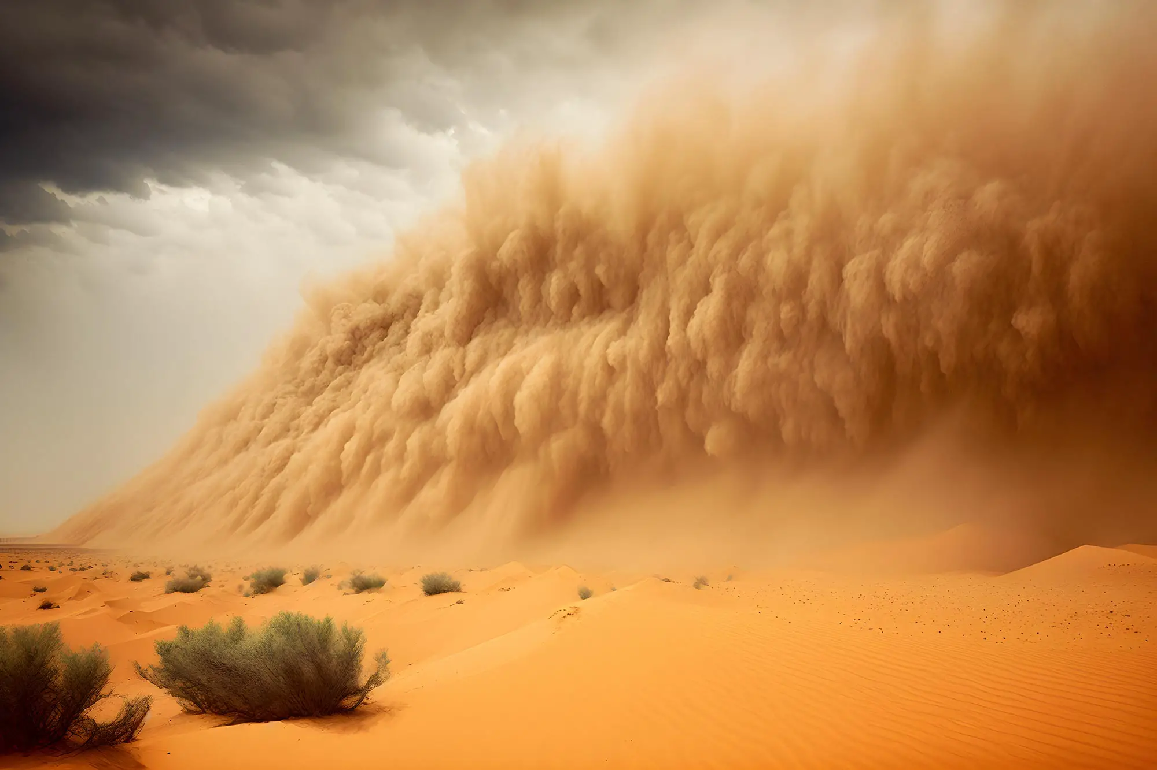
dust /dʌst/ n.沙土;灰尘 vi.&vt.擦灰
比喻 Metaphor - When/After the dust settles,....当尘埃落定，...
I know you don't understand my motivation for this decision, but after the dust settles you'll see that it all makes sense.
类比 Analogy - as dry as dust: 干的/枯燥乏味的
I followed the recipe exactly, and yet my cake is as dry as dust.
头韵 Alliteration - be done and dusted: 完成了的
I'm exhausted, but at least that workout is done and dusted.
沙尘暴像一条正在狩猎的响尾蛇一样在峡谷中盘旋。
The dust devil swirled across the canyon like a rattlesnake on the hunt. （明喻 Simile）

Slide 10
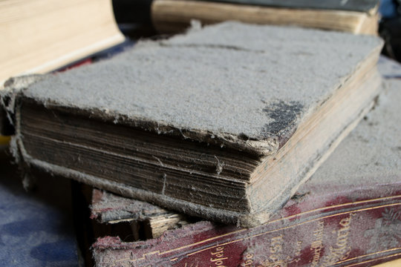
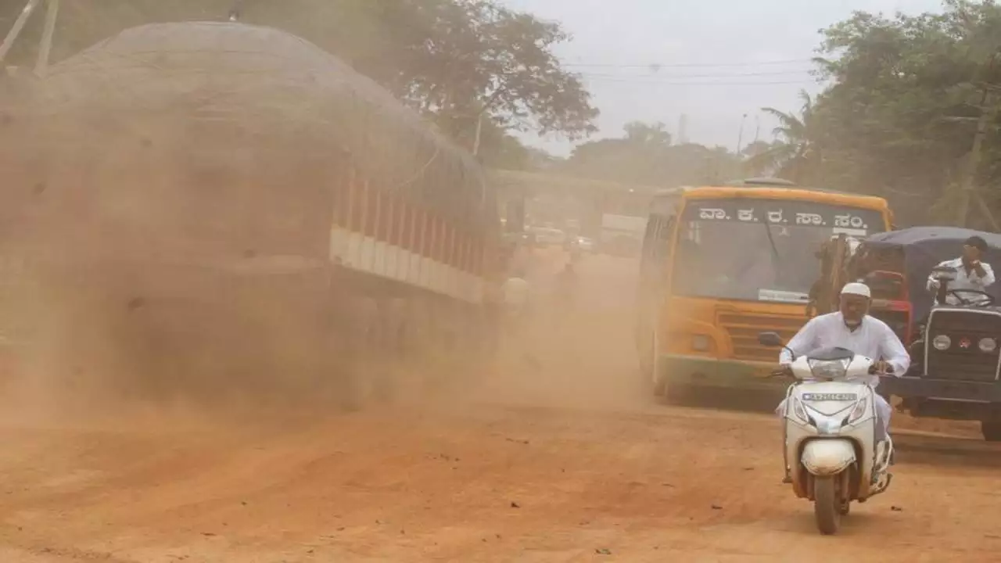
dusty /ˈdʌsti/ a.布满灰尘的
一堆满是灰尘的书
a pile of dusty books
历史不仅仅是研究尘土飞扬的老物件和过去的大事件。
_{2019年6月高考天津卷}
History is much more than the study of dusty old objects and events long past ．
城市里尘土飞扬、崎岖不平的道路使居民的生活变得悲惨。雨后，路上的稀泥浆干涸，变成了尘土。由于车辆的移动，灰尘越来越大。
Dusty and bumpy roads in the city are making the life of residents miserable. After the rain, slush(泥浆) on the roads has dried up and transformed into dust. The dust is raising up due to vehicular movement.

Slide 11
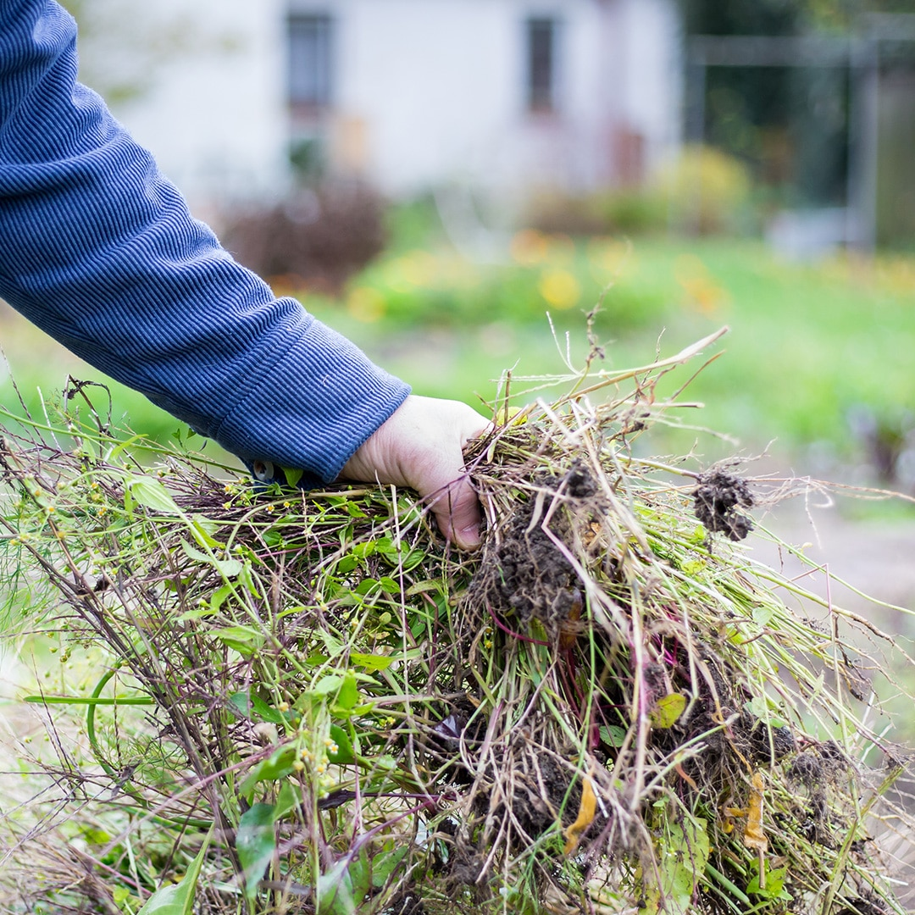
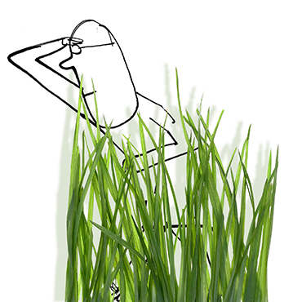
weed /wi:d/ n.杂草;野草 vt.&vi.除杂草
通常，太阳能开发商最终会用小石头填满这个区域，并使用化学物质来控制杂草。_{2023年1月高考英语浙江卷}
Often, Solar developers will end up filling the area with small stones and using chemicals to control weeds.
对中学生和高中生来说，翻土、拔草、收割卷心菜听起来都是一项艰巨的工作。_{2023年6月全国高考英语新课标II卷}
Turning soil, pulling weeds, and harvesting cabbage sound like tough work for middle and high school kids.
Related Idioms:
(deep) in the weeds
全神贯注于（某事）的细节或复杂性
totally immersed in the details or complexities (of something)
尽管我想和他充分分享我的想法，但他似乎一直在深入分析他自己设想的相关数据。_{2022年1月高考英语浙江卷 读后续写}
Though I wanted to share my ideas with him fully, it seemed that he had been deep in the weeds analyzing his own data about the hypothesis.

Slide 12
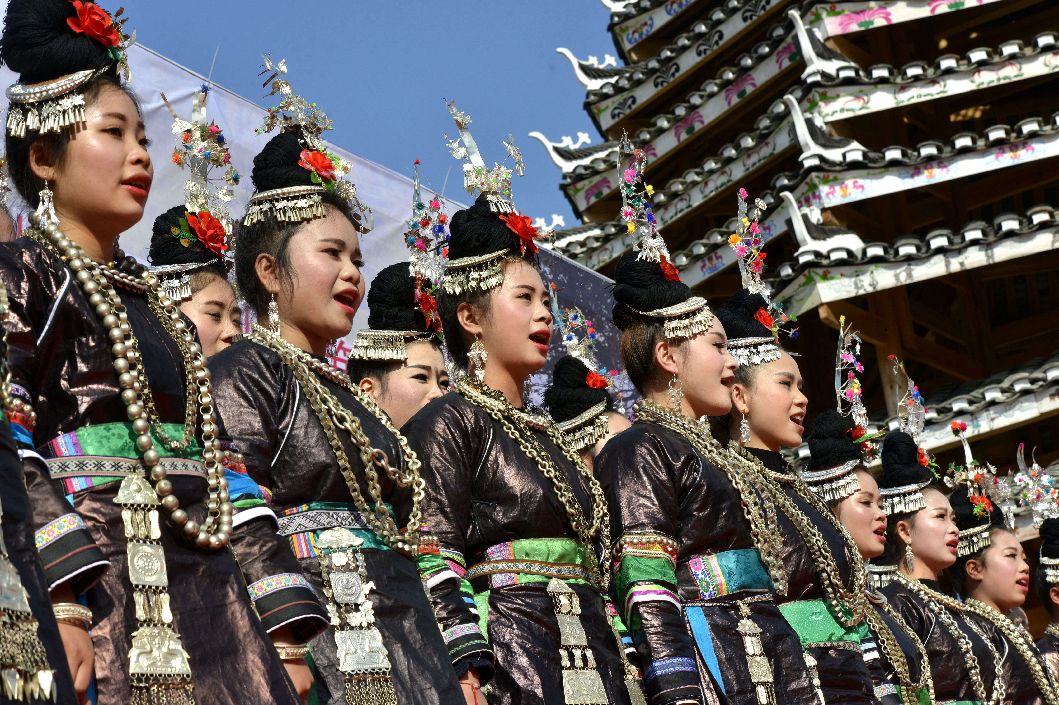
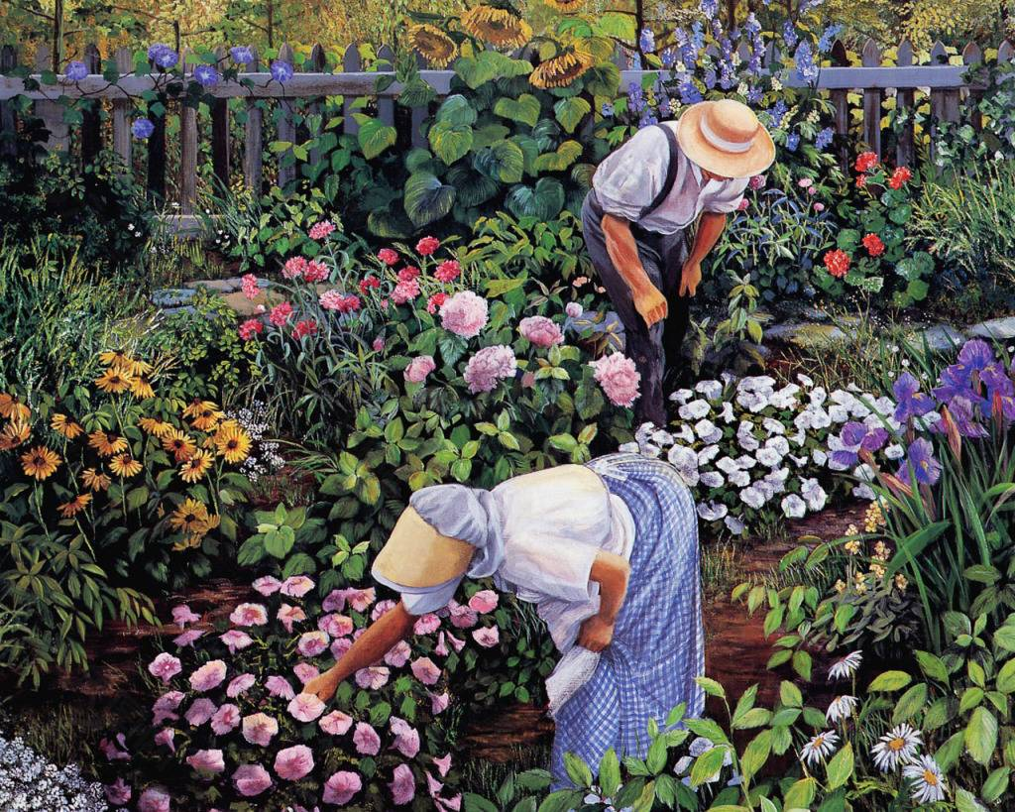
chorus /ˈkɔ:rəs/ n.合唱曲;合唱团 vt.合唱
a chorus of 齐声;异口同声
中场休息时，一支侗族合唱团以无伴奏合唱的民歌吸引了观众。一位来自陕西省西安的游客说: “我一句歌词都听不懂，但我被他们美丽的声音深深打动了，我能感受到他们对生活的热爱。”
At halftime, an ethnic Dong chorus captivated the audience with their a cappella rendition of folk songs. "I didn't understand any of the lyrics, but I was deeply moved by their beautiful voices, and I can feel their love for life," said a tourist hailing from Xi'an, in Shaanxi province.
问任何一组园丁他们最不喜欢的任务，你一定会听到他们异口同声地说 “除草!”。猖獗的杂草从有益植物可能接受的土壤中窃取水分和宝贵的营养物质，而它们不那么可爱的头会影响草坪和花园的设计。
Ask any group of gardeners about their least favorite task, and you’re bound to hear a chorus of “Weeding!” Rampant weeds steal water and valuable nutrients from the soil that beneficial plants could be receiving, and their less-than-lovely heads detract from lawn and garden design.

Slide 13


cotton /ˈkɒtn/ n.棉布;棉花
她戴着一顶粉红色的羊毛帽，穿着一件脏得看不出颜色的棉质夹克，通常推着一辆装着一口沸腾锅的手推车在车站卖煮玉米。
Wearing a pink woolen hat and dressed in a cotton jacket that was too dirty to tell the color, she usually pushed a cart bearing a bubbling pot to sell boiled corn at the station.
象征 Symbolism: pure, soft, fluffy,in a fog
It looks as soft as cotton.
Her head felt heavy and like it was stuffed with cotton, the way she felt when she came to after surgery.
cotton candy/candy floss 棉花糖
The cotton candy clouds had dissipated leaving us with a blank canvas.
Her voice was as sweet as cotton candy.
His monsters are tearing through our warriors like they're made of cotton candy.

Slide 14

uniform /ˈju:nɪfɔ:m/ n.校服;制服 a.—致的
词缀：uni- 一，单一的+ form 形式
经理厌恶地看着他的制服衬衫。
The chief looked at his uniform shirt in disgust.
居民楼看起来外表都一致。
The residential buildings were uniform in appearance.
由于统一和连续的书写系统， 在中国一种共同的身份得以幸存并蓬勃发展。
Thanks to the uniform and continuous writing system, a shared identity in China has survived and boomed.

Slide 15
not to mention /nɒt tə ˈmenʃn/ 更不用说;且不说
功能：表达递进关系
生活突然充满了可能性，更不用说一些意想不到的惊喜了。
Life was suddenly full of possibilities, not to mention a few unexpected surprises.
网上购物可以让你比较功能和特点，更不用说价格了。
Shopping online allows you to compare features and functionality, not to mention prices.
污染对城市里每个人的健康都有负面影响，更不用说对环境的破坏了。
Pollution has a negative effect on the health of everyone living in the city, not to mention the damage to the environment.

Slide 16

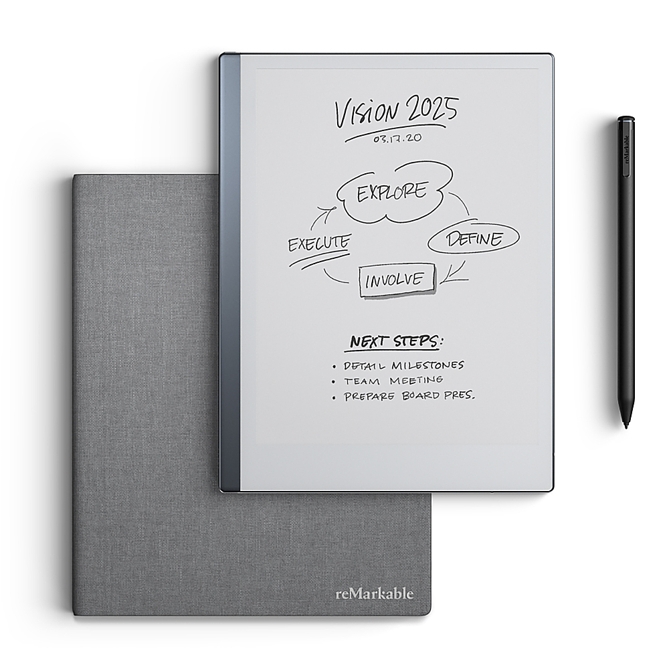

tablet /ˈtæblət/ n.平板电脑;便笺本;药片
由于经济和社会发展的影响，今天的儿童越来越依赖智能手机、平板电脑和电脑进行学习和娱乐。这不仅损害了他们的视力，还减少了他们与自然和社会生活联系的机会。
Due to the influence of economic and social development, children today have become increasingly dependent on smartphones, tablets and computers for both learning and entertainment. This not only harms their eyesight but also diminishes their opportunities to connect with nature and social life.
几个世纪以来，石碑上的铭文被无数游客的手擦掉了。
The inscription on the stone tablet has been rubbed away by the hands of countless tourists over the centuries.
当他把便签本递给她时，她看到了歪歪扭扭的字迹。
When he handed her the tablet, she read the shaky handwriting.
这种药物现在有片剂和胶囊两种形式。
The drug is now available in tablet and capsule form.

Slide 17
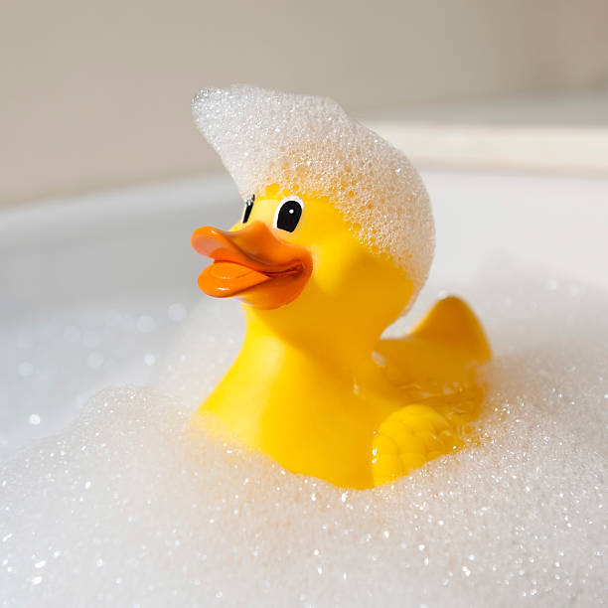
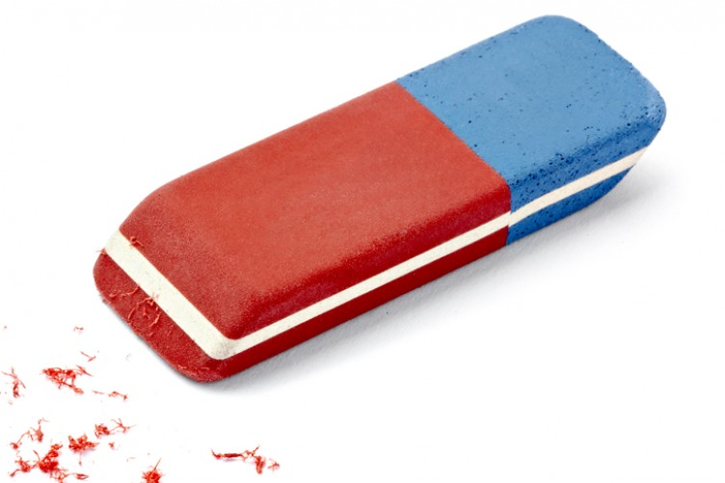
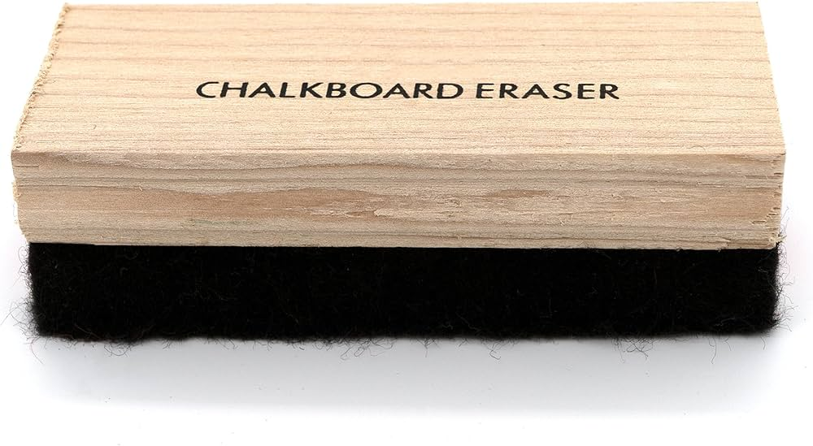
rubber /ˈrʌbə(r)/ n.橡皮;黑板擦;橡胶
浴缸里漂浮着一只橡皮鸭。
A rubber duck floated in the bath.
在邮局，几乎每一份通过柜台的文件都盖上了橡皮图章。
In Post Offices, virtually every document that's passed across the counter is stamped with a rubber stamp.
西非的大多数外贸公司经营橡胶、可可和植物油。
Most foreign trading companies in West Africa deals in rubber, cocoa and vegetable oil.
我总是在铅笔盒里放一块橡皮，用来修正我画的任何错误。
I always keep a rubber eraser handy in my pencil case to fix any errors in my drawings.

Slide 18
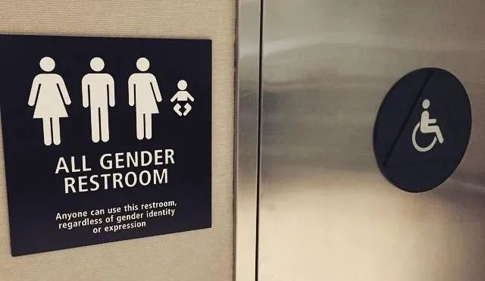
washroom /ˈwɒʃru:m/ n.洗手间;厕所
I need to use the washroom.
I want to go to the restroom.
Can I use the toilet(s)?
Where is the ladies’s room/men’s room?
Common
Expression:
I have to pee.
Take a piss/leak.
I need to go to the loo.
I need to relieve oneself.
Pay a visit to Mrs. John.
Sb. be in the John.
Visit the conveniences.
I need to powder my nose.
Gotta answer the call of nature.
Some
Slangs:
他以上厕所为借口逃避回答我的问题。
He grabbed at the excuse of using the washroom to avoid answering my question.

Slide 19
rigid /ˈrɪdʒɪd/ a.死板的;固执的
死板的教育方法 rigid methods of education
他的作品灵感不是来自突发奇想，而是来源于对传统物体的构建，并从功能和解构的角度汲取新思想，这不是对中国元素的刻板模仿。
His works are inspired not by ideas but by the construction of traditional objects — which is not a rigid imitation of Chinese elements — and by drawing new ideas from the perspective of functionality and deconstruction.
他的身体僵硬了，满脸困惑。
His body went rigid, and confusion crossed his features.
在回家的路上，亚历克斯异常安静，他的嘴唇抿成一条线，下巴僵硬。
On the way home Alex was unusually quiet, his lips a thin line and his jaw rigid.
由于在狮尾部分的舞狮演员需要托举头部的演员，所以他们需要强壮的体魄，不然的话，就会令得表演僵硬而迟缓。
The actors of dragon dance in the lion tail have to be strong, since they often have to lift people at the head which, if not done properly, can make the performance appear rigid and sluggish.

Slide 20

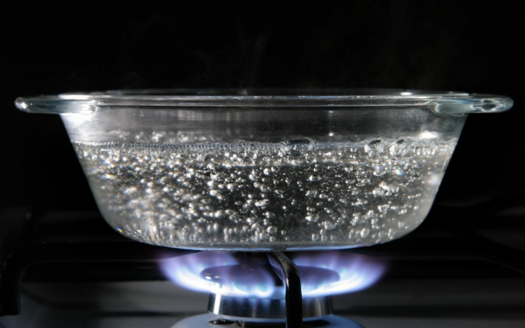
bubble /ˈbʌbl/ vi.起泡;沸腾
迪恩不想打破他的幻想，所以他保持沉默。
Dean didn't want to pop his bubble, so he remained quiet.
如果你想在美味的菜肴中搭配甜味，Tom’s餐厅供应草莓、蜜露和其他气泡茶口味。
Tom's serves strawberry, honey dew and other bubble tea flavors if you are looking for sweet flavors to go with savory dishes.
这个服饰品牌有泡泡裙、动物印花、亮片等等。
This outfit brand has bubble dresses, animal print, sequins, and more.
她感到一阵恐慌，泪水再次刺痛了她的眼睛。
She felt panic bubbling and tears stinging her eyes once again.
塔兰感到愤怒在他心中翻腾。
Taran felt anger bubbling within him.

Slide 21
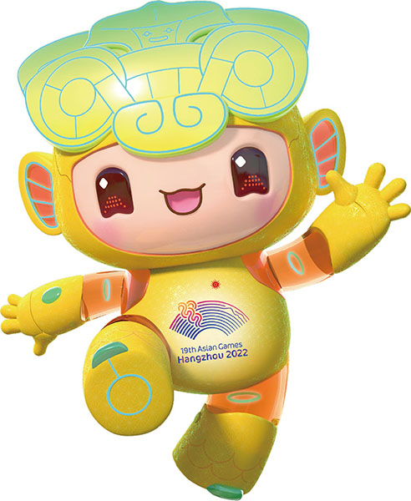
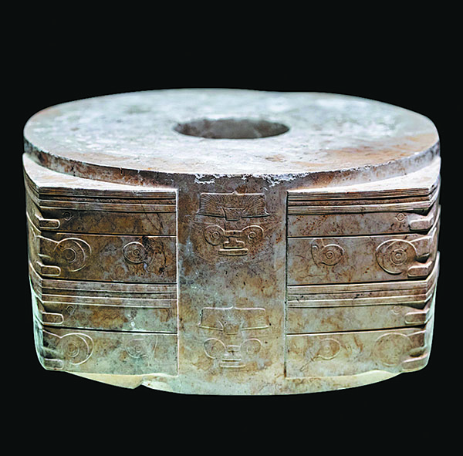
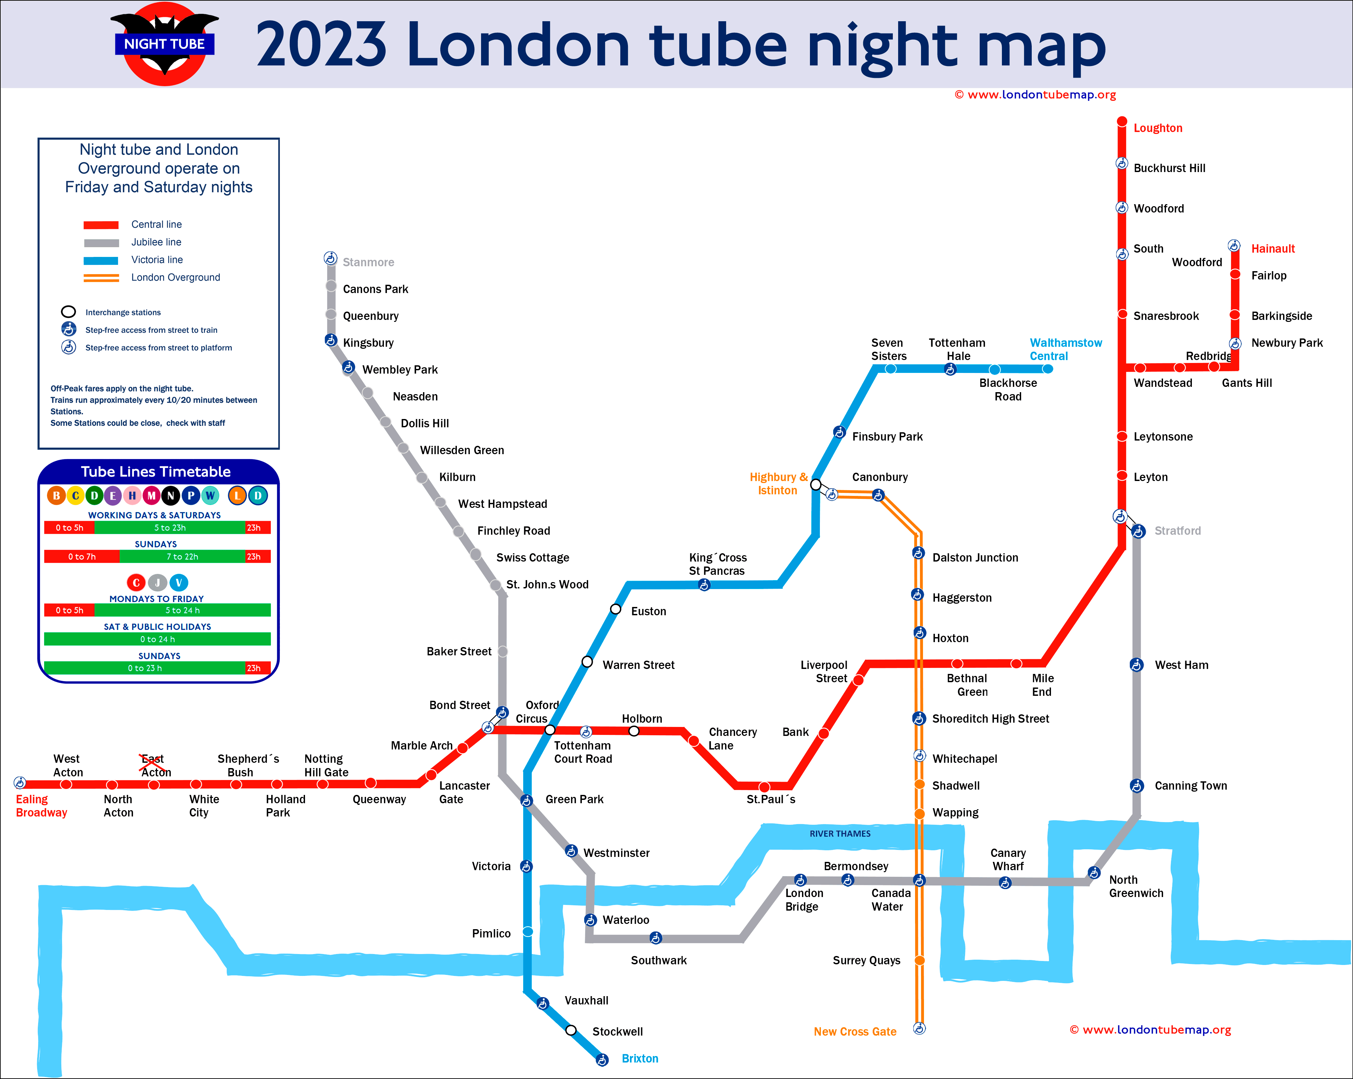
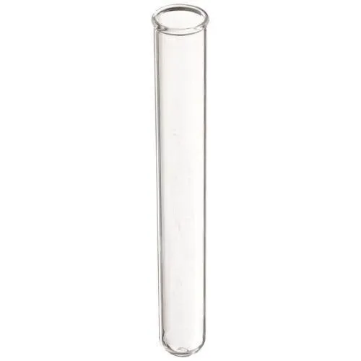
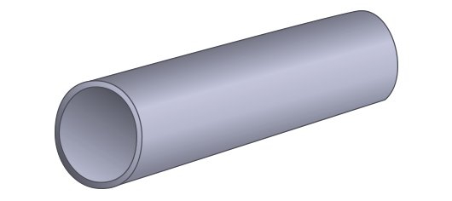
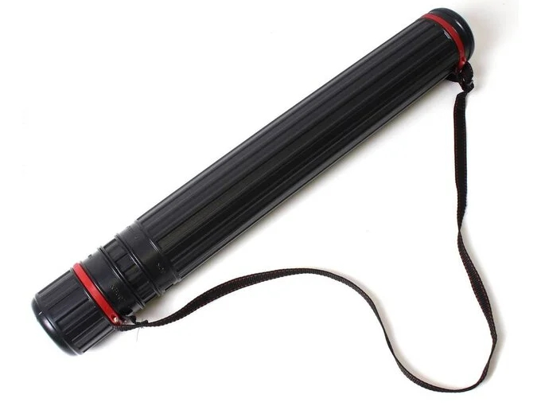
tube /tju:b/ n.管子;管状物
琮是公元前3300年至公元前2300年之间的长江三角洲地区良渚文明最具代表性的礼玉类型，其特征是一个圆柱形的管被包裹在一个方棱柱中。
Typically featuring a cylindrical tube encased in a square prism, cong is the type of ritual jade most representative of the Liangzhu civilization, which existed in the Yangtze River Delta region between 3300 BC and 2300 BC.
当食管被切换到另一侧时，他的注意力被分散了。
His attention was distracted momentarily as the feeding tube was switched to the other side.
underground train
round tube
test tube
expandable storage tube

Slide 22
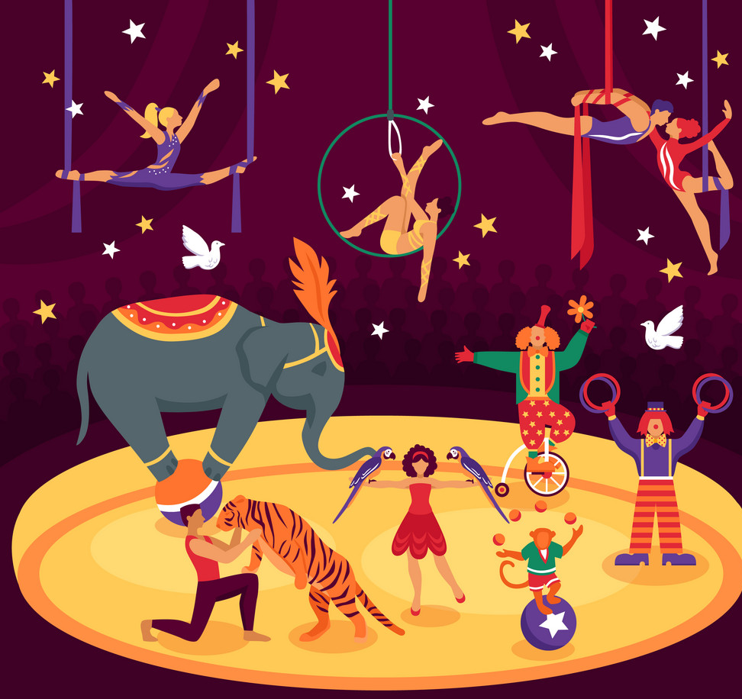
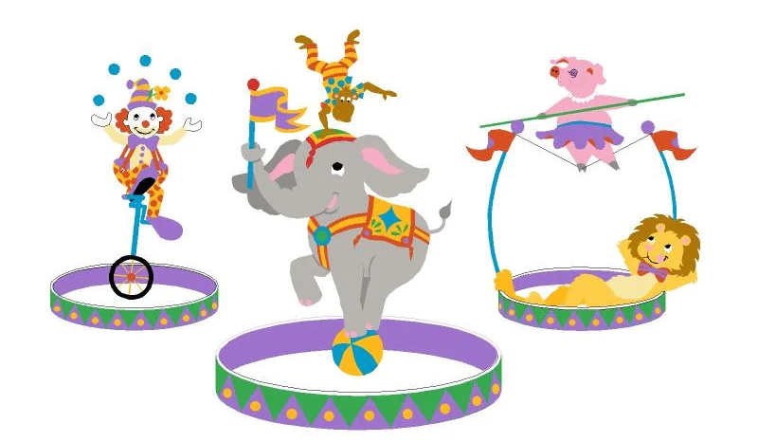
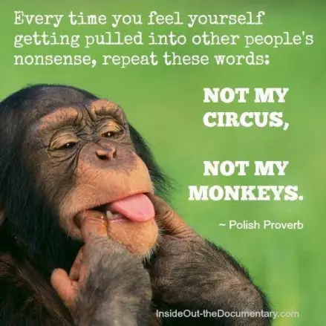
circus /ˈsɜ:kəs/ n.马戏团
我们带海伦去了马戏团，玩得很开心！
We took Helen to the circus, and had "the time of our lives"!
Relevant Idioms
be in/like a three-ring circus 乱成一团
Not my circus, not my monkeys. 和我无关
两辆车在高速公路上相撞后，整个情况乱成一团糟。
The whole situation was like a three-ring circus after the two vehicles crashed into each other on the highway.
当我照顾邻居的三个吵闹、顽皮的孩子时，我感觉自己就像在一个三环马戏团里，乱成一团。
I felt like I was in a three-ring circus when I babysat my neighbor's three noisy, mischievous children.
--你不认为我们应该设法帮他解决这个问题吗。
--是他造成了这一切。和我没关系
-- Don't you think we should try to help him fix the problem.
-- He's the one who caused it to begin with. Not my circus, not my monkeys.

Slide 23
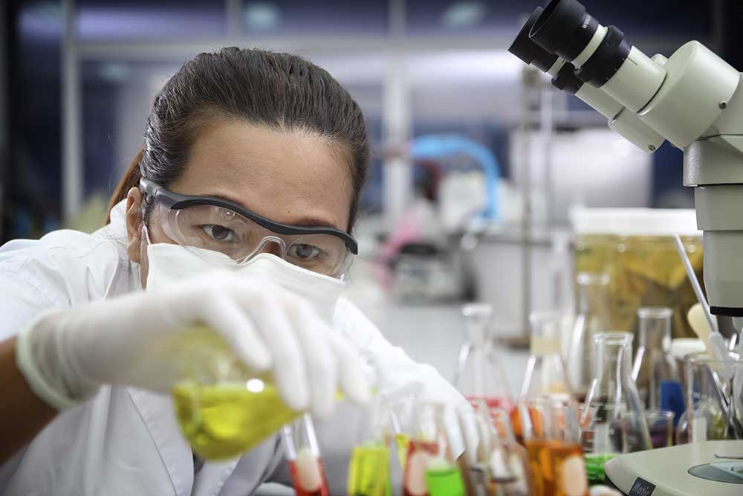
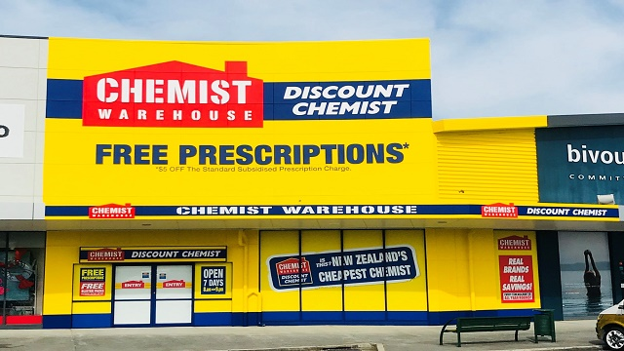
chemist /ˈkemɪst/ n.化学家;药剂师;药房
他在研究所实验室学习，并与这位瑞典药剂师建立了终身友谊。
He studied in the institute’s laboratory, and there began a lifelong friendship with the Swedish chemist.
他是一位著名的野外植物学家，但他的大部分学术生涯都是作为一名物理和工业化学家度过的。
He was well known as a field botanist but had spent most of his academic life as a physical and industrial chemist.
你可以从当地药店便宜地买到这种糖浆。
This is a syrupy liquid which you can buy cheaply from your local chemist.

Slide 24

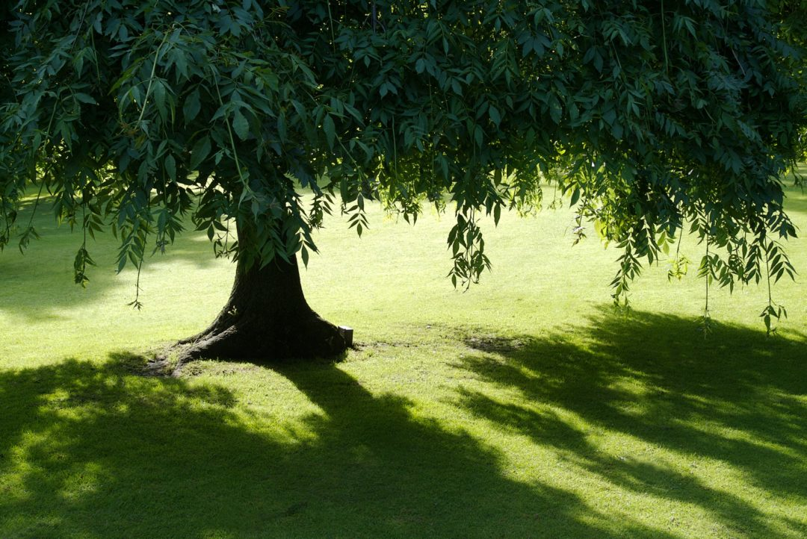
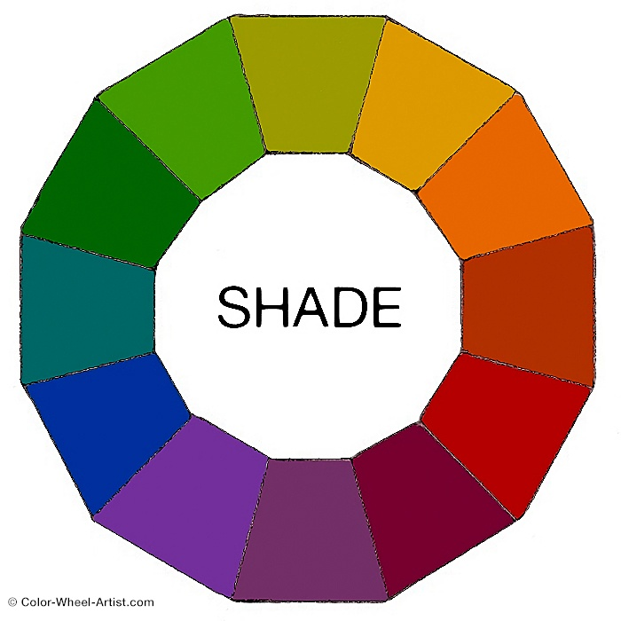
shade /ʃeɪd/ vt.给…遮挡光线 n.阴凉处
卡门转过身来，举起一只手遮挡阳光。
Carmen turned and lifted a hand to shade her eyes from the sun.
那棵老苹果树在池塘边的草地上披上了一层树荫。
The old Apple tree spread a blanket of shade in the grass beside the pond.
他停顿了一下，脸变成了更深的红色。
He paused, his face turning a darker shade of red.
她的眼睛和达金的一样黑，皮肤苍白。（色度）
Her eyes were the same shade as Darkyn's, her skin pale.

Slide 25


jaw /dʒɔ:/ n.额;下巴
令人瞠目结舌的是，有多少非常好的食物被扔掉了——从被杂货商拒绝的“丑陋”（但很容易吃）的蔬菜，到被扔进餐馆垃圾桶的大量未吃完的菜。22年新课标卷I
It’s jaw-dropping how much perfectly good food is thrown away - from “ugly” (but quite eatable) vegetables rejected by grocers to large amounts of uneaten dishes thrown into restaurant garbage cans.
后来，我们的颌骨变成了覆岩结构, 使得更容易产生这样的声音。22年新课标卷I
Later, our jaws changed to an overbite structure (结构), making it easier to produce such sounds.
他一听到这个问题就咬牙切齿。
His jaw clenched at the question.
他的歌声中充满了亲切和质朴，皮埃尔试图回答，但他的下巴颤抖着，眼泪夺眶而出。
There was so much kindliness and simplicity in his singsong voice that Pierre tried to reply, but his jaw trembled and he felt tears rising to his eyes.

Slide 26

wrinkle /ˈrɪŋkl/ v.(使脸上)起皱纹 n.皱纹
辩论者计划虽然很精彩，但也有一些不足。它从文档库和预先构建的参数中提取句子，并将它们串在一起。这可能会导致任何人都不会犯的错误。毫无疑问，这些小问题/瑕疵会被消除，但它们也指出了一个根本问题。 23年1月高考浙江卷
Brilliant though it is, Project Debater has some weaknesses. It takes sentences from its library of documents and prebuilt arguments and strings them together. This can lead to the kinds of errors no human would make. Such wrinkles will no doubt be ironed out, yet they also point to a fundamental problem.
腐烂的海藻散发出的味道使她的鼻子皱了起来。
The sweet scent of rotting seaweed made her nose wrinkle.
每当我把这件衬衫挂在外面晾干时，我真希望它不要皱得那么厉害。
I wish this shirt didn't wrinkle up so badly whenever I hang it out to dry.
Related Idioms:
(add) a new wrinkle 带来的新的，出乎意料的发展/维度
iron the wrinkles out (of/in something) 解决问题/麻烦
If proven to be true, the discovery could add a new wrinkle to the way we think about the evolutionary process.
Your friends and family are great means of support when you need to iron the wrinkles out in your life.

Slide 27
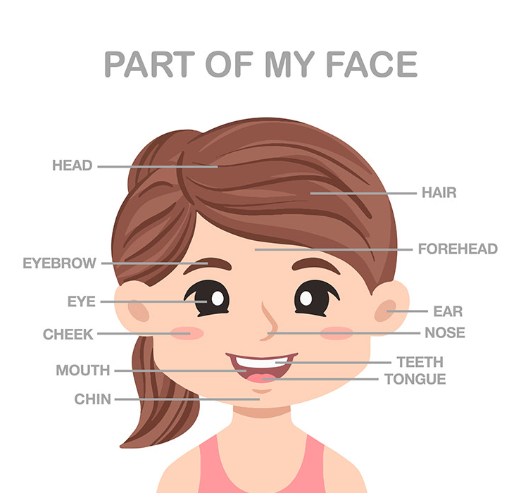
forehead /ˈfɔ:hed/ n.额;前额
他们的嗓音也很高，额头很高，皮肤也有皱纹。
They also have high-pitched voices, high foreheads, and wrinkled skin.
克里克先生很可怕，额头上有厚厚的青筋，刻薄，小眼睛和大下巴。
Mr Creakle was scary, with thick veins in his forehead, mean, small eyes and a large chin. （David Copperfield）

Slide 28
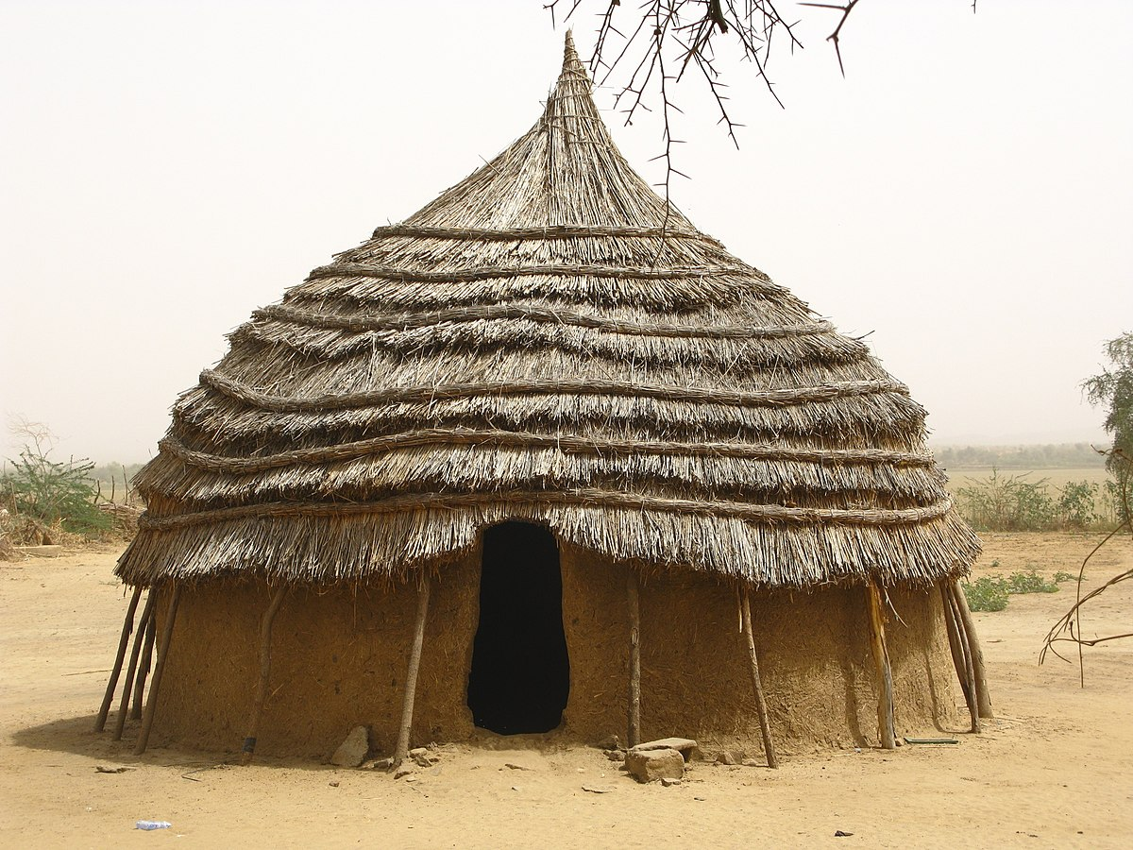
hut /hʌt/ n.简陋的小房子(棚/舍)
他给他盖了一间小茅屋，以便在夜间和暴风雨天气时有栖息之所。
He built him a little hut for shelter at night and in stormy weather.
他不愿在不了解他的情况下离开，于是就去了小屋。
Unwilling to leave without learning something of him, he went to the hut.
我们感谢汤姆多年来对小屋事务的奉献和贡献。
We thank Tom for many years of dedication and contributions to hut affairs.

Slide 29

housing /ˈhaʊzɪŋ/ n.住房;住宅
这种麻烦可以通过在初秋用蔗糖制成的优质食物喂养蜜蜂，并将它们安置在通风良好的蜂箱中，用合适的覆盖物保持温暖和干燥来解决。
This trouble may be guarded against by feeding the bees in the early autumn with good food made from cane sugar, and housing them in well-ventilated hives kept warm and dry by suitable coverings.
参观结束时，在小镇的一个有遮挡的住宅综合体吃了一顿自助午餐。
The tour finished with a buffet lunch in a sheltered housing complex in the county.
在公开市场上买不起房子的年轻家庭更迫切地需要住房协会的住房。
Young families who can no longer afford to buy homes on the open market more urgently need housing association accommodation.

Slide 30
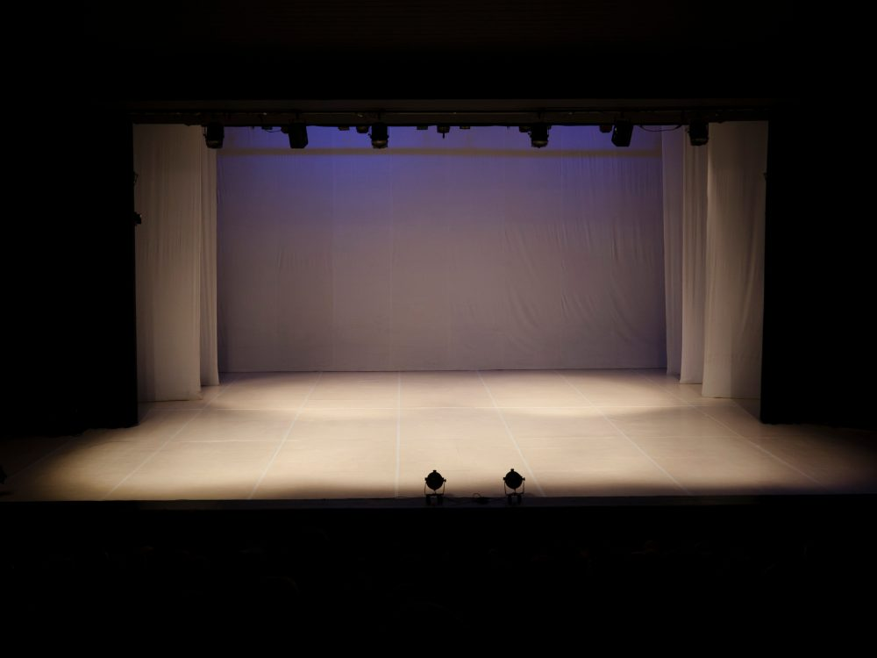
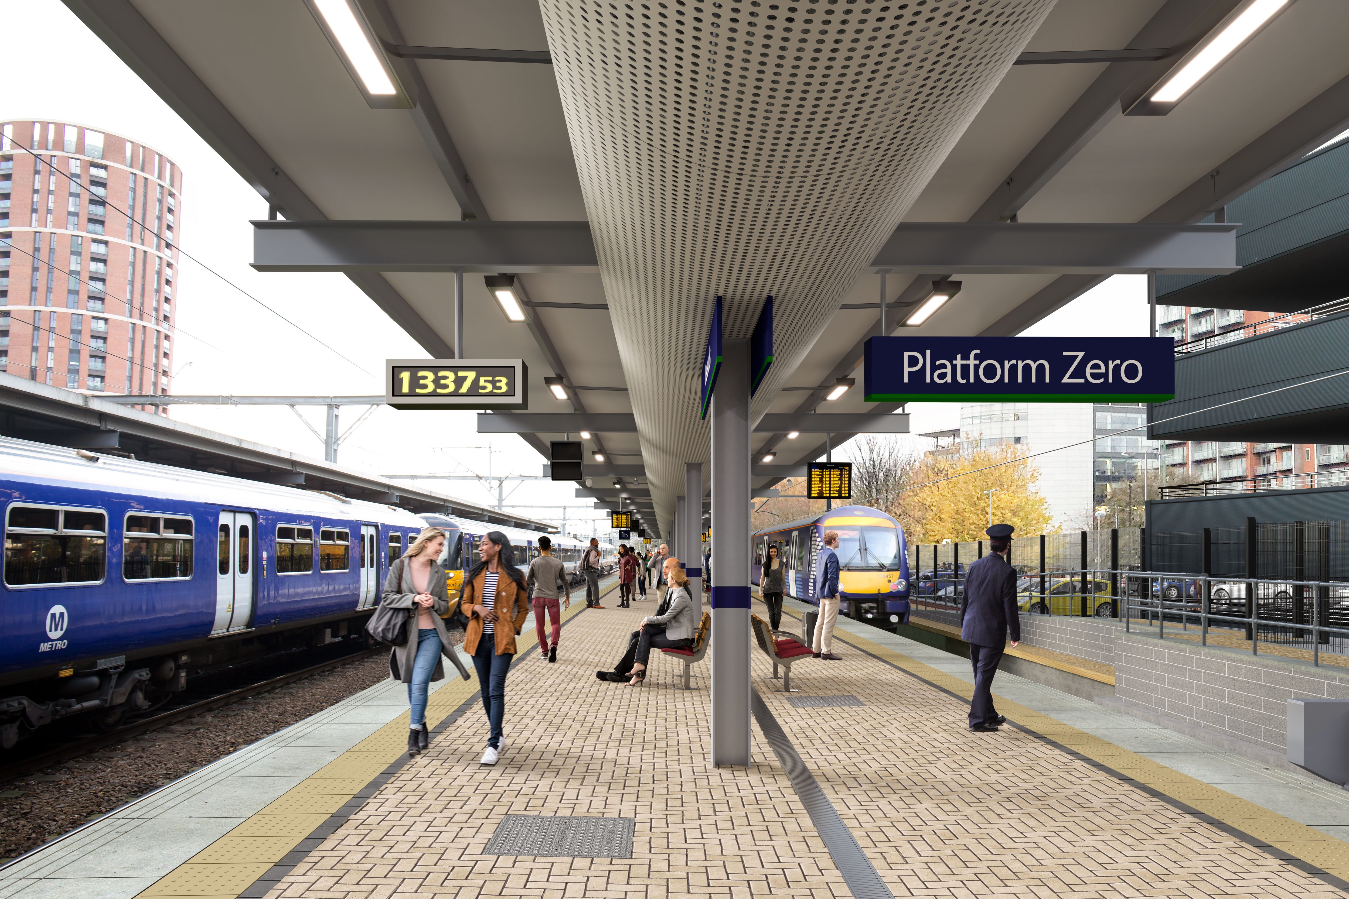
platform /ˈplætfɔ:m/ n.平台;站台;舞台
在South Rim路Artist Point较低的平台上会面，进行简短的交谈。23年新课标卷II
Meet on the lower platform at Artist Point on the South Rim Drive for this short talk.
我几乎还未察觉，火车便在车站停了下来，整家人都站在那儿。
Almost before I knew it, the train stopped at the station, and there on the platform stood the whole family.
下周首次亮相的灯会将为各界观众提供一个绝佳的平台展示中国丰富的传统文化。
The lantern show's debut next week will offer a good platform to showcase China's rich traditional culture to audience from all walks of life.

Slide 31
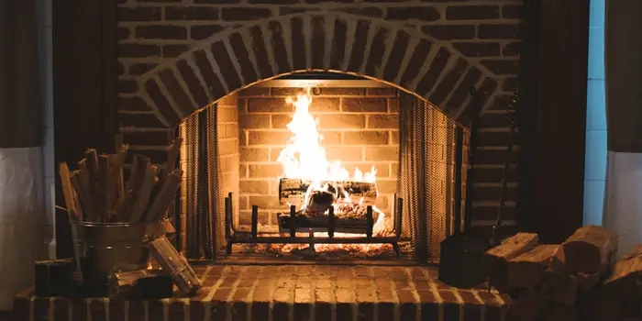
fireplace /ˈfaɪəpleɪs/ n.壁炉
客厅里有一个壁炉，旁边有一个舒适的摇椅。
There is a fireplace in the living room, with a cozy rocker next to it.
当大厅的钟敲了十一下时，他站起身来，走向壁炉，开始封炉火。
He rose and crossed to the fireplace and began to bank the fire as the hall clock struck eleven times.
她在书房里等着他，坐在一个燃烧着黑色火焰的壁炉旁。
She was waiting for him in his study, sitting beside a fireplace that burned with black flames.

Slide 32
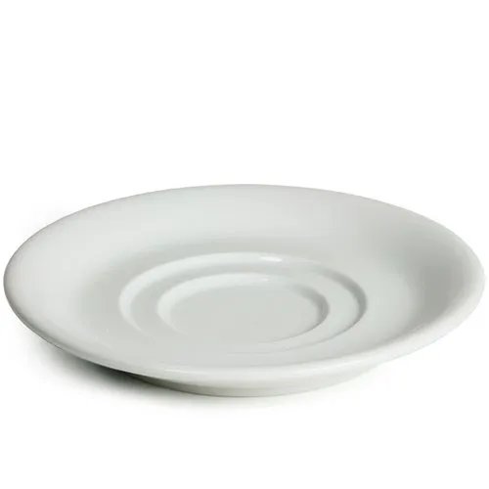
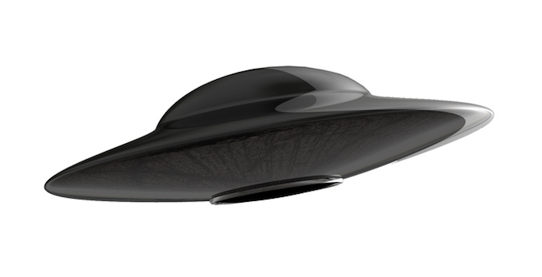
saucer /ˈsɔ:sə(r)/ n.茶碟;杯托
她切了一块馅饼，放在一个干净的茶托上递给他。
She cut a piece of the pie and served it to him on a clean saucer.
你不必像看到飞碟那样大惊小怪，我笑着又说到。
You wouldn't have to make a big deal out of; like seeing a flying saucer, I added with a smile.

Slide 33
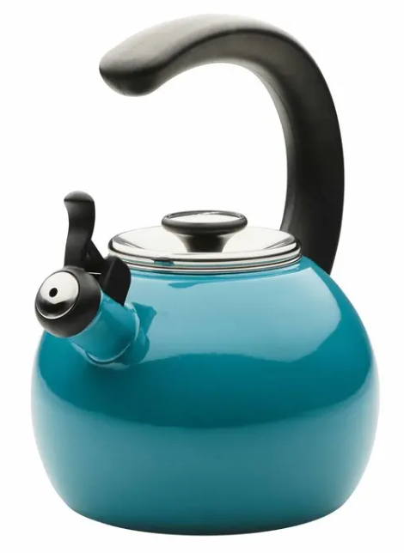
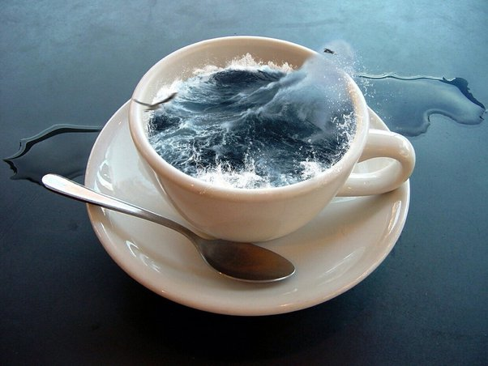
kettle /ˈketl/ n.(烧水用的)壶;水壶
他们进来的时候，一个茶壶已经在吹口哨了，女仆冲进厨房将它拎了起来。
A tea kettle was already whistling when they entered, and the maid rushed across the kitchen to grab it.
有一个持续的高音哨声，就像蒸汽火车吹响了汽笛，又或是一个正在唱歌的水壶。
There's a high-pitched continuous whistle, like a steam train sounding it's whistle, or a singing kettle.
Relevant Idioms
a different kettle of fish 截然不同的事
a storm in a teakettle 小题大做
the pot is calling the kettle black 锅嫌壶黑，五十步笑百步，半斤八两
I know you think you're some hotshot just because you worked in television once, but working on a film is a different kettle of fish.
I really think you're making a storm in a teakettle over this. It's just a tiny scratch on the car!
You're judging me for speaking too louder in the hall? That's the pot calling the kettle black, don't you think?

Slide 34
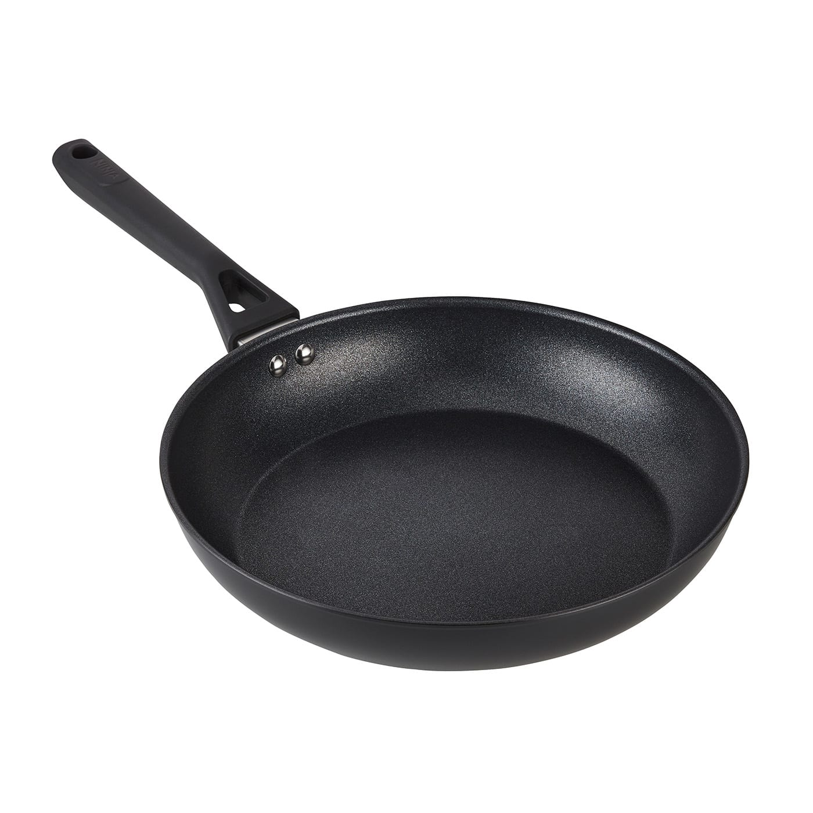
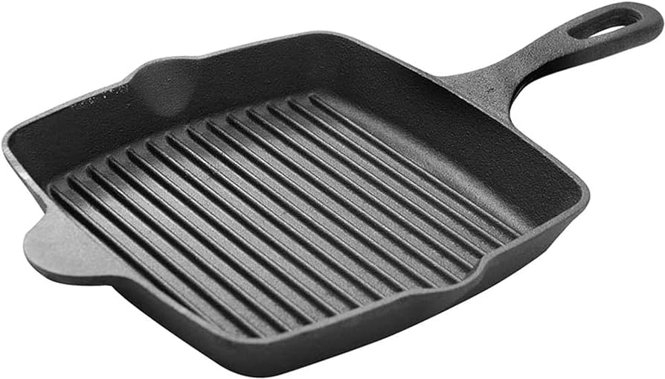
pan /pæn/ n.平底锅;烤盘
他蹲下来，两只手拿着锅，把锅半浸在小溪里。
He squatted down, holding the pan in his two hands, and partly immersing it in the stream.
亚历克斯走进来时，她在烤箱里烤着饼干，正在加热平底锅煎鸡蛋。
She had biscuits in the oven and was heating up a pan to fry some eggs when Alex walked in.
她把热锅架扔到柜台上，解开围裙。
Tossing the hot pan holder on the counter, she untied the apron.
在我这么做之前，还有一件家务事要做，尽管我对此非常紧张。
One chore remained before I'd do so， though I was as nervous as a fly on a fry pan about it.

Slide 35
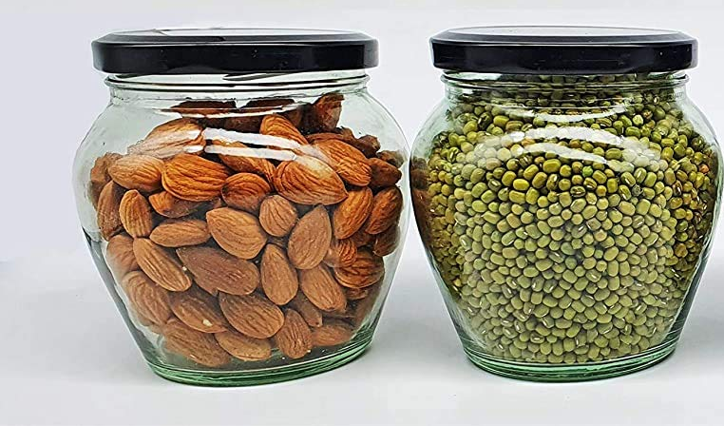
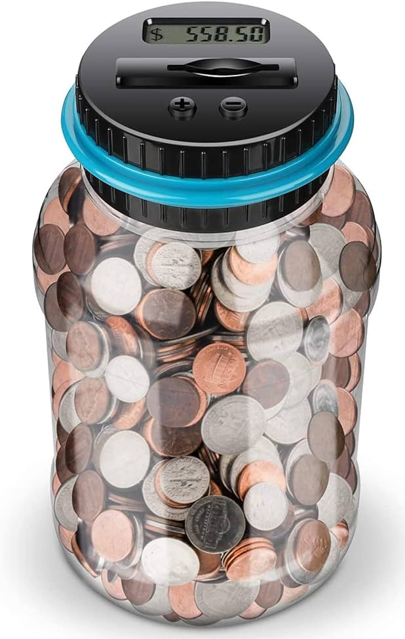
jar /dʒɑ:(r)/ n.罐子;坛子
零浪费在几年前是一场激进的生活方式运动。我记得我给父母看了一段比娅·约翰逊的视频，分享了我认为用罐子买杂货会有多酷，而且垃圾很少！
Zero waste was a radical lifestyle movement a few years back. I remember showing my parents a video of Bea Johnson, sharing how cool I thought it would be to buy groceries with jars, and have so little trash! (23年1月浙江)
每个住宅大厅都摆放着募捐箱和钱罐。
Boxes for donations and money jars were placed in every residence hall.
看着那张严厉的脸，她觉得自己就像一个把手伸进糖果罐的孩子。
Looking into that stern face, she felt like a child caught with her hand in the candy jar.

Slide 36

ripe /raɪp/ a.成熟的;时机成熟的
她觉得在音乐俱乐部进行她的个人音乐会的时机已成熟。
She found the music club ripe for her solo concert.
想象一下，一个盘子里装着两个外观相同的草莓。其中一个是从超市的盒子里出来的，这意味着它可能是在未成熟时收获的。
Imagine a plate holding two strawberries, identical in appearance. One came out of a supermarket box, meaning it was probably harvested when it was still unripe.
女孩们迅速爬上小山，来到树前，在篮子里装满了最成熟的樱桃。
The girls raced up the hill to the tree and filled the baskets with the ripest cherries.

Slide 37

grill /grɪl/ n.烤架;烤肉餐馆
当厨师在你面前的烤架上切块、切条、切丁和烹饪食物时，尽情享受娱乐吧！
Enjoy the entertainment while the chef chops, slices, dices and cooks the food on a grill right in front of you.
水位很高；它拍打着烤架，就像一个孩子在吮吸棒棒糖，充满爱意，充满渴望。
The water was high; it lapped the grill like a child sucking a lollipop, lovingly, longingly.
亚历克斯和乔纳森计划午餐烤牛排。
Alex and Jonathan planned to grill steaks for lunch.

Slide 38


doorway /ˈdɔ:weɪ/ n.门口;出入口;门道
如果你有这样的情况，你并不孤单。心理学家认为，穿过一扇门进入另一个房间会在大脑中产生“心理障碍”。这通常被称为门口效应。
If you have, you are not alone. Psychologists believe that walking through a door and entering another room creates a “mental block” in the brain. This is generally referred to as the doorway effect.
杰克尴尬地站在我病房的门口。他一声不吭地把一个包裹放在我旁边，里面放着几朵花苞。
Jack stood awkwardly in the doorway of my ward. Without a word he placed a package beside me, inside which lay several bulbs.
她冲下大厅，躲进楼梯间的门道。
She sprinted down the hall and ducked into the doorway to the stairwell.
她的父亲站在房子的门口，门厅的灯光将其框入其中。
Her father stood in the doorway of the house, framed against the light of the foyer.

Slide 39

leftover /ˈleftəʊvə(r)/ a.吃剩的;残留的 n.吃剩食物
记住你必须把剩下的火鸡放在冰箱里保存。
Remember you will have to store leftover turkey in the fridge afterward.
如果你有刷墙剩下的油漆，又不想购买额外的颜色，可以在剩下的油漆里加一点白色，直到得到合适的色调。
If you have leftover paint from the walls and don't want to purchase additional colors, add a little white to your leftover until you get the right shade.
最终，他取得了惊人的成功，获得了总额130万美元的34项奖学金，这些足以支付他多年的学费，还有一些剩余的可用来支付生活费。
In the end, he had amazing success, receiving 34 scholarships worth $1.3 million—enough to pay for years of school, plus cover his living expenses with some leftover to invest.

Slide 40

handshake /'hændʃeɪk/ n.握手
罗伯大胆地上下打量着他，他的握手坚定而持久。
Rob boldly looked him up and down, his handshake firm and lingering.
在讲台上微笑有点像向观众握手。
Smiling on the platform is a bit like offering a handshake to your audience.
当他用灿烂的微笑和真诚的握手迎接你时，你就知道你回家了。
When he greeted you with that great smile and hearty handshake, you knew you were home.
我感觉到他握手时眼神闪烁。
I felt the twinkle of his eye in his handshake.
Relevant Idiom
(one's) handshake is (one's) word 握手即承诺
汤姆的握手是他的保证，所以如果他说他会帮你的，他会的。
Tom's handshake is his word, so if he said he'd help you out with it, he will be.

Slide 41


drag /dræg/ vt.拖;拽 vt.缓慢费力地移动
他把40多台由多家科技公司捐赠给他们的回收电脑装在行李箱里拖到肯尼亚。
He physically dragged over 40 recycled computers that had been donated to them by various tech companies to Kenya in suitcases.
他放下鱼竿，拖着脚，像蜗牛一样向我走来。
He laid his fishing pole down and dragged his feet, moving toward me at a snail's pace.
那一小群人仍然热情高涨，使得乐队又加唱了几首。
The small crowd was still enthusiastic enough to drag several encores out of the band.
我知道清理车库很麻烦，但这是必须要做的。
I know cleaning out the garage is a drag, but it has to be done.

Slide 42

privilege /ˈprɪvəlɪdʒ/ n.优惠待遇;特权
如果你想讲述整个世界的历史，一段不偏袒人类的历史，你不能仅仅通过文本来完成。23年6月全国乙卷
If you want to tell the history of the whole world, a history that does not privilege one part of humanity, you cannot do it through texts alone.
我很荣幸与大家分享一道中国传统美食——红烧肉。
I'm privileged to share a traditional Chinese cuisine—red braised pork.
我非常高兴能从安妮那里得到另一颗宝石。
I am exceedingly glad that I am to have the privilege of another gem from Annie.

Slide 43

plug /plʌg/ vt.封堵;补足 n.堵塞物;插头
在按下机器上的播放按钮之前，你应该首先检查电源插头是否插好。
Before you press the play button on the machine, you should first check the power plug.
工作在我们的生活中确实非常重要，但我们也应该知道什么时候该停止工作。
Work is of great importance in our life indeed, yet we also should know when to pull the plug on ourselves.
一旦你拥有了自己的唱片/拷贝/副本，剩下的就是插上电源享受。
演出结束后，我们拔下乐器，走到后台。
Once you own your own copy, the only thing left is to plug in and enjoy.
After the performance, we unplugged our instruments and went backstage.

Slide 44

disabled /dɪsˈeɪbld/ a.有残疾的;丧失能力的
词缀：dis-否定前缀
词形变换：disable v.-disability n.
博物馆入口附近有残疾人停车位。
There are disabled parking bays adjacent to the Museum entrance.
“住家照顾者”是指在私人家庭中为儿童、老人或残疾人提供无人监督的照顾服务的人。
A " live-in caregiver " is someone who provides unsupervised care of children, the elderly or the disabled in a private household.
这次讨论的主题是：我们如何使课程适应残疾学生的需求？
The discussion is themed on: How can we adapt the curriculum to the needs of disabled learners?
一旦她禁用了她的翻译，他就无法与她交流。
Once she disabled her translator, he couldn't
communicate with her.

Slide 45

resign /rɪˈzaɪn/ vi.&vt.辞职;辞去
如果你决定辞职，你需要给雇主写一封正式的辞职信。
If you have decided to resign from your job, you'll need to write and submit a formal letter of resignation to your employer.
在网上购买旧书并不意味着你必须接受低于标准的书籍。
Buying used books online doesn't mean you have to resign yourself to receiving books below standard.
就连他的朋友马克也认为他太鲁莽了，而且他自己也很沮丧，希望辞职。
Even his friend Mark thought he was too rash, and was, moreover, himself discouraged and wished to resign.

Slide 46

deserve /dɪˈzɜ:v/ vt.值得;应得;应受
小孩子很容易被抛到空中再被抓住，这是他们应得的快乐。 22年6月浙江卷
Small children are easy to throw up in the air and catch – and they deserve it.
客人应享有一个安静而平和的旅程。
The guests deserve a quiet and peaceful visit.
我已经很久没有满足我的渴望了，我的勤奋值得奖励。
It's been so long since I've satisfied my cravings and I deserve a reward for my diligence.
尽管她本应该接受惩罚，但她的母亲还是欣然取消了。
Even though she didn't deserve it, her mother graciously took away the punishment.

Slide 47
lately /ˈleɪtli/ ad.最近;不久前;近来
最近，这个想法在我们自己的后院得到了应用。
Lately, the idea has been applied in our own backyard.
最近，她的好奇心已不满足于只对他的神秘家谱提一些常见问题。
Lately her curiosity had been going beyond the usual questions about his mysterious family tree.
她最近学到了很多关于义务如何在日常生活中发挥更大作用的知识。
She'd learned a lot lately about how obligation held more sway in the daily life.
形似词辨析：
late adj.& adv. 晚的/地,迟的/地
已故的
e.g. be late for
his late father
later adj.& adv. 后来; 后来地
latest adj.& n. 最新的;最新事物
at the latest adv. 迟，晚

Slide 48

input /ˈɪnpʊt/ n.情况;信息;投入 vt.输入
要轻松做到这一点，请输入您选择的关键词，例如棒球，并使用搜索选项。
To do this easily, input your chosen keyword, e.g. baseball, and use the search option.
如果你们不介意的话，我想我想听听你们的意见。
I guess I'd like a little input from you guys, if you don't mind.
我们现在希望任命一位经验丰富的成员为我们即将举行的活动提供相关意见。
We are now looking to appoint an experienced member to provide related input into our coming event.

Slide 49

tune /tju:n/ n.曲调;曲子vt.调音;调节
她微笑着，庆幸亚历克斯不知道他跑调了。
She smiled, grateful that Alex didn't know he was out of tune.
手机响了，刺耳的铃声把她吓得魂不附体。
The cell phone rang, its jangling tune startling her out of her thoughts.
伴着窗户缝隙中传来的阵阵微风，他们的身影摇曳着掠过远处一棵哨兵松树。
Shadows danced in tune with a slight breeze from the inch of open window and a sentinel pine tree beyond.
夏令营的学生们融入了音乐传统。
Summer camp students tune into musical tradition.
浏览摘要可以让你知道你错过了什么，这样当你再次参与时，你就能跟上进度。
Scanning a summary can let you know what you missed so that when you tune in again, you're caught up.

Slide 50

contract /ˈkɒntrækt/ vt.感染(疾病);与…订立合同
通常每年都要续签这份合同。
This contract is usually renewed from year to year.
大学毕业生受到了涌入就业市场的临时合同工的影响。
College graduates were affected by the temporary contract workers flooding the job market.
你应该在你的建筑合同中囊括所有的新规则。
You are supposed to include all the new rules in your construction contract.
她已在社区中心签约每周服务10小时。
She has contracted to serve 10 hours a week in the community center.

Slide 51

grant /grɑ:nt/ vt.同意;准许 n.拨款
他说，当一名教师会给人一种成就感和幸福感。
He says that being a teacher grants a sense of accomplishment and happiness.
她大约10年前开始学习舞蹈，被授予艺术传承人的称号。
She began to learn the dance around a decade ago，granted the title of inheritor of the art.
在我的忠实支持者妈妈的资助下，我开始了我的志愿者生涯。
With a grant from Mom, my loyal supporter, I went to work on my volunteering career.

Slide 52

take for granted /teɪk fə(r) ˈgrɑːntɪd/ 认为…是理所当然
许多观众留下评论说，他们从未意识到地理可以如此令人愉快，以及这些视频如何帮助他们从新的角度看待他们过去认为理所当然的事情。
Many viewers left comments saying they never realized geography could be so enjoyable and how the videos have helped them see things they used to take for granted in a fresh light.
一位参与者说：“这次比赛让我看到了短视频的魅力，以及它们如何帮助我们更好地欣赏我们认为理所当然的东西，并给我们思考的素材。”。
"This competition has let me see the charm of short videos and how they can help us better appreciate things we might take for granted and give us food for thought," a participant says.

Slide 53

cardiac /ˈkɑ:diæk/ a.心脏病的;心脏的
在即将到来的急救俱乐部活动中提供的课程涵盖了从肌肉特征到心脏活动的各个主题。
Lessons provided in the coming first aid club event cover topics ranging from muscle features to cardiac activities.
将在活动中发表演讲的教授是一位擅长心脏衰弱的外科医生。
The professor, who is about to deliver a lecture in the event is a surgeon with a specialty in cardiac weakness.

Slide 54

circuit /ˈsɜ:kɪt/ n.巡回;环形线路
它被古老的城墙包围，这些环形的城墙都保存得相当完好。
It is surrounded by its ancient walls, which for the greater part of the circuit are fairly well preserved.
当被带领进来之后，这个人先在房间里慢慢地转了一圈。
As he was led in, the man first made a slow circuit of the room.
耐心点！这是阻断时期，每个人都在订购。外卖程序一定是应接不暇，不堪重负。
Be patient! It’s Circuit Breaker, everybody is ordering in. The home delivery app must be swamped.
Circuit Breaker [电] 断路器，断路开关
自202年4月7日起，新加坡引入“阻断器”（Circuit Breaker）”限制居民非必要活动的外出，以阻止疫情升级。

Slide 55

disability /dɪsəˈbɪləti/ n.缺陷;障碍
词缀：dis-否定前缀，abili 能力 + -ity …状态,性质
这种疾病会导致残疾和死亡。
This disease causes disability and death.
几乎所有的儿童在中风后都能恢复独立行走的能力，除非有其他导致残疾的情况。
Almost all children recover the ability to walk independently after a stroke, unless there is another condition that causes disability.
超过100万名特殊教育班的儿童被归类为言语或语言残疾。
More than one million children in special education classes are categorized as having a speech or language disability.

Slide 56

consultation /ˌkɒnslˈteɪʃn/ n.咨询;咨询会
校徽的设计将在校园网上进行公众咨询。
There will be public consultation of the design of the school badge on the school website.
今天的研讨会标志着关于儿童战略的非正式协商的开始。
This workshop today marks the start of informal consultation on the children's strategy.
这次咨询为学生们提供了无与伦比的学习体验。
The consultation provided unparalleled learning experiences for the pupils.

Slide 57




capsule /ˈkæpsju:l/ n.胶囊;太空舱
阿波罗宇航员迫使美国国家航空航天局设计了一个进入太空舱的窗户，成本高昂。
Apollo astronauts forced NASA to design a window into the capsule at a very high cost.
此次活动的亮点是通过与所有参与者一起制作一个时间胶囊来使其成为一个值得纪念的夜晚。
The event was highlighted by creating a time capsule together with all the participant to make it a night to remember.
胶囊旅馆是日本最著名和独特的住宿类型之一。
Capsule hotels are one of Japan's best known and unique types of accommodation.

Slide 58

relay /ˈri:leɪ/ vt.转发;转播 n.接力赛
“趣味日”将在学校场地内举行四人接力赛。
FUN DAY " will consist of a 4 person relay race within the grounds of the school.
他的话刺激了她的神经，她下意识地把球传给了旁边的队员。
Nerves stimulated by his harsh words, she unconsciously relayed the ball to the member player beside her.
最重要的是，我们需要将新的指示传达给现场的工作人员。
Of primary note is that we need to relay the new instructions to the crew in the field.

Slide 59

复数: criteria 搭配：meet/ fulfill the criteria
criterion /kraɪˈtɪəriən/ n.标准;准则;原则
理性是最终的标准。
Reason is the ultimate criterion.
在我们进行项目之前，清楚地了解标准是很重要的。
It is important to understand clearly the criterion before we conduct the project.
海报比赛对参赛作品有特定的标准。
The poster competition has specific criteria on the submissions.
他认为最大幸福原则不是一种有吸引力的哲学，而是一种区分良莠不齐的标准。
He took up the greatest happiness principle not as an attractive philosophy, but as a criterion to distinguish good laws from bad.

Slide 60

stability /stəˈbɪləti/ n.稳定(性);稳固(性)
养成良好的学习习惯有助于学生维持稳定的学习状态。
Developing good learning habits helps students maintain the stability of their study.
这些住房为那些需要过渡生活安排并致力于健康生活的人带来了希望和稳定。
These homes give hope and stability to people who need transitional living arrangements and are committed to healthy living.
这对姐妹是由他们古怪的叔叔抚养长大的，她们本以为三十多岁将是一个幸福稳定的时期。
Brought up by their odd uncle, the sisters had assumed their mid-thirties would be a time of happiness and stability.
他们好像喝醉酒的人一样，摇摇晃晃。
They were like drunken men having no stability in themselves.

Slide 61

pray /preɪ/ vi.&vt.企盼;祈祷
那个可怜的女人一直到我这儿乞讨和祈祷。（蜂鸟/Hummingbird）
The poor woman has been to me begging and praying.
人们在飞溅的水中表演舞龙。用稻草制作的龙表演是重庆的一项非物质文化遗产，通常在节日期间进行，以祈祷一年中有好收成和好运。
People perform a dragon dance among splashed water. Performing with a straw-made-dragon is an intangible cultural heritage of Chongqing, which is often done in festive days to pray for a good harvest and fortune for the year.
很明显，对他来说，那里的任意球就像另一名球员的点球。你必须祈祷球出界，或者他在跑动中踢球的过程中摔倒。
It's obvious that for him a freekick around there is like a penalty kick for another player. You have to pray that the ball goes out of bounds or he falls in the run to kick the ball.

Slide 62

hypothetical /ˌhaɪpəˈθetɪkl/ a.假设的;假定的
词形变换：hypothetical- adv. hypothetically- n. hypothesis (pl. hypotheses)
假定的问题 / 情况 / 例子
a hypothetical question/situation/example
《假想》是一个喜剧游戏节目，由乔什·维迪科姆和詹姆斯·阿卡斯特主持，主要喜剧演员在节目中应对越来越荒谬的假想场景。
Hypothetical is a comedy game show, hosted by Josh Widdicombe and James Acaster, in which leading comedians are posed with increasingly absurd hypothetical situations.

