Slide 1


感恩遇见，相互成就，本课件资料仅供您个人参考、教学使用，严禁自行在网络传播，违者依知识产权法追究法律责任。
更多教学资源请关注
公众号：溯恩高中英语
知识产权声明

Slide 2

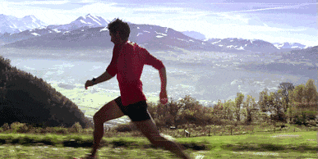

Slide 3
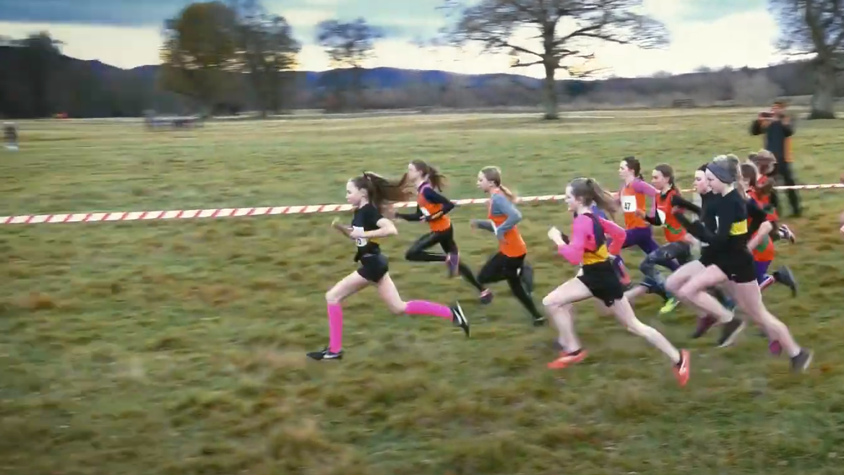
People pattern infographics
What sports do you like doing?
And why?
What difficulty have you met in doing sports? How do you deal with it?
A Cross-country Race
Sports: __________________________________

Slide 4
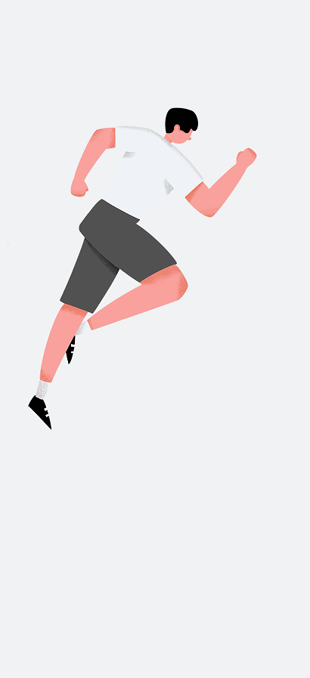
Pre-reading
plot the story
Para.1 However,without warning,my strength
was running out.
Para.2 I whispered,"I'm so sorry I disappointed
you, Dad."
problems
My failure
?
disappointed
Dad’s response
?

Slide 5
My dad and I had been looking forward to the State cross-country race of my senior year of high school, which would be the climax (顶点) of my existence. I was the fastest runner on my team,and I was supposed to make it into the top fifteen.We had been working towards this race for three years.It was everything to me,and it was everything to my dad.He was a runner and was wild with joy by my success in running.He made it to every race,even flying home early from business trips to see me run.I always listened for his voice,which rang above the crowd—telling me to relax my arms,calling out my time.He pushed me.He cheered for me.He believed in me.We spent countless hours on the sandy canals of Arizona.Breathing in the dust of the desert,the blossoms of the orange trees,and the terrible smell of the dairy farm,we made our way across the city.We pounded miles and miles into our running shoes,marking with every step the path to greatness.It was a journey that was just ours.A dream passed on from one generation to the next. Then the big day came.It was hotter than normal—too hot.My throat felt like a field of cotton,cracked with the summer heat,as I waited for the gun to fire.I gazed out at the crowd;dozens of familiar faces from church and school flickered across my view.They had come for me.They were counting on me.I saw my dad set his watch, worry and excitement etched across his face.With the sound of a gunshot,the race began. For the first two and half miles,I felt great.I had never before been so ready for something.The weeks leading up to the race were filled with hard practices and a strict diet.The scorching sun beat upon my back, blinding me with its brilliance.Nothing was going to stop me,though.

Slide 6

While-reading
Read for clues: What problems did I meet?
6
Para.3
It was hotter than normal—too hot. My throat felt like a field of cotton,cracked with the summer heat,as I waited for the gun to fire.
The scorching sun beat upon my back, blinding me with its brilliance.
my strength was running out.
1
2
5
4
3

Slide 7
People pattern infographics
While-reading
Read for clues: Would Dad scold me?
1. Running is more than a race for us
_________________________________________
para.2 I was the fastest runner on my team,and I was supposed to make it into the top fifteen.We had been working towards this race for three years.It was everything to me,and it was everything to my dad. He was a runner and was wild with joy by my success in running. He made it to every race,even flying home early from business trips to see me run.I always listened for his voice,which rang above the crowd—telling me to relax my arms,calling out my time.He pushed me.He cheered for me.He believed in me.We spent countless hours on the sandy canals of Arizona.Breathing in the dust of the desert,the blossoms of the orange trees,and the terrible smell of the dairy farm,we made our way across the city.We pounded miles and miles into our running shoes,marking with every step the path to greatness.It was a journey that was just ours.A dream passed on from one generation to the next.
Para 2.
I was the fastest runner on my team,and I was supposed to make it into the top fifteen.We had been working towards this race for three years.It was everything to me,and it was everything to my dad.He was a runner and was wild with joy by my success in running.He made it to every race,even flying home early from business trips to see me run.I always listened for his voice,which rang above the crowd—telling me to relax my arms,calling out my time.He pushed me.He cheered for me.He believed in me.We spent countless hours on the sandy canals of Arizona.Breathing in the dust of the desert,the blossoms of the orange trees,and the terrible smell of the dairy farm,we made our way across the city.We pounded miles and miles into our running shoes,marking with every step the path to greatness.It was a journey that was just ours.A dream passed on from one generation to the next.
Running is our shared passion, company and dream.

Slide 8
People pattern infographics
While-reading
Read for clues: Would Dad scold me?
2. I’ve been proactive
_________________________________________
Para.4
For the first two and half miles, I felt great. I had never before been so ready for something. The weeks leading up to the race were filled with hard practices and a strict diet. The scorching sun beat upon my back, blinding me with its brilliance. Nothing was going to stop me,though.
Para.4
For the first two and half miles, I felt great. I had never before been so ready for something. The weeks leading up to the race were filled with hard practices and a strict diet. The scorching sun beat upon my back, blinding me with its brilliance. Nothing was going to stop me,though.

Slide 9
People pattern infographics
While-reading
What message is delivered in the story?
Theme:
Victory isn’t defined by wins or losses. It is defined by effort. If you can truthfully say, “ I did the best I could,” then you are a winner.
Para.1
My dad and I had been looking forward to the State cross-country race of my senior year of high school, which would be the climax of my existence.
climax
push my limit
achieve my goal: make it into the top fifteen.
reshape my view
get a life lesson taught by sports

Slide 10
People pattern infographics
After-reading
replot the story
However,without warning,my strength was running out.
I whispered,"I'm so sorry I disappointed you,Dad."
衔接1
过渡
衔接2
Difficulties (leaking strength+waning confidence )
My efforts (dad’s unwavering encouragement+my rekindled hope)
My failure (unexpected result+a defeated heart)
Dad’s comfort (a hearty praise +a proud heart )
衔接3
过渡
主题
My response (a great relief+ a moved heart)
My reflection (a new understanding towards failure)

Slide 11
a Race
Difficulty Met
1
6
View Reshaped
2
5
3
4
Effort invested

Slide 12

People pattern infographics
Difficulty met (in the race) (遭遇困难)
(跟着原文学表达)
环境：
烈日It was hotter than normal—too hot. My throat felt like a field of cotton, cracked with the summer heat,as I waited for the gun to fire.
The scorching sun beat upon my back, blinding me with its brilliance.
身体：
体力不支 my strength was running out.
路线崎岖
天气突变
......
意外受伤
旧伤复发
......

Slide 13
People pattern infographics
Difficulty met (in the race) (遭遇困难)
(补充)
环境：
路线崎岖We made the turn from the dusty road onto the muddy, wooded trail that would go around the lake back to the field.
身体：
意外受伤：Through the trees, I tripped over a tree root and fall.
旧伤复发：For the first few laps I was taking the lead, but by lap 8 my once injured ankle hurt badly and I gradually fell behind.

Slide 14
People pattern infographics
Efforts invested (for the race) (付诸努力)
(跟着原文学表达)
刻苦训练+控制饮食 We had been working towards this race for three years...The weeks leading up to the race were filled with hard practices and a strict diet...We spent countless hours on the sandy canals of Arizona...We pounded miles and miles into our running shoes,marking with every step the path to greatness.
(pound [ V+ adv./prep.] to move with noisy steps咚咚地跑)

Slide 15
People pattern infographics
Efforts made (for the race) (付诸努力)
(补充)
咬紧牙关坚持 I gritted his teeth and pushed on./The last lap was a blur. But on I ran.
克服困难 Despite the eye-stinging light and the extreme heat I tottered across the valley./The trail was rugged and uneven, but I persevered through the challenge.
冲刺With an extra burst of energy, I charged off(猛跑起来)/ sprinted/ ran as fast as my legs could carry me.
自我激励Suddenly something inside me began saying,"Hold on! Time to speed up!"
不气馁Exhausted as I was, I swore to never give in to it.

Slide 16
People pattern infographics
Lessons learned (after the race) (直面失败)
真正的收获：The reward is not the score but what you learn./
A healthy body and a sound mind are what I earned through the sport.
突破自我 ：With Dad's encouragement and tough love, I’ve gone beyond my limit.
正确的态度：Learning to be humble in victory and generous in defeat are the valuable lessons sports can teach.学会在胜利中保持谦逊，在失败中保持慷慨是体育可以教给我们的宝贵经验。/It’s not whether you win or lose. It’s how you play the game.
正确看待挫折：Life is always going to have its ups and downs, and you can't let that determine how you act or appear in front of others.
正确看待前进路上的绊脚石: Though there may be some difficulties in front of you, just move forward and don't let the difficulties be the rock holding you back. They might be the ladder for you to see the beauty of life.

Slide 17
People pattern infographics
Lessons learned (after the race) (直面失败)
意识变化之光有天赋不够She acknowledged that talent alone was insufficient and that she needed to invest real work into tennis--drills, conditioning, practice matches.
意识变化之真正的勇气是战胜恐惧It hit me that courage wasn’t the absence of fear, but the victory over it.
意识变化之真正的成长来自于面对害怕和挑战I realized that true growth comes from facing fear and challenges.
意识变化之坚定的信念和勇气可创造奇迹 No matter how many challenges we face, with unwavering belief and courage, we can overcome adversity and reach heights we never dreamed of.
意识变化之在挫折助力成长After the storm, the rainbow appears; after setbacks, growth happens.

Slide 18
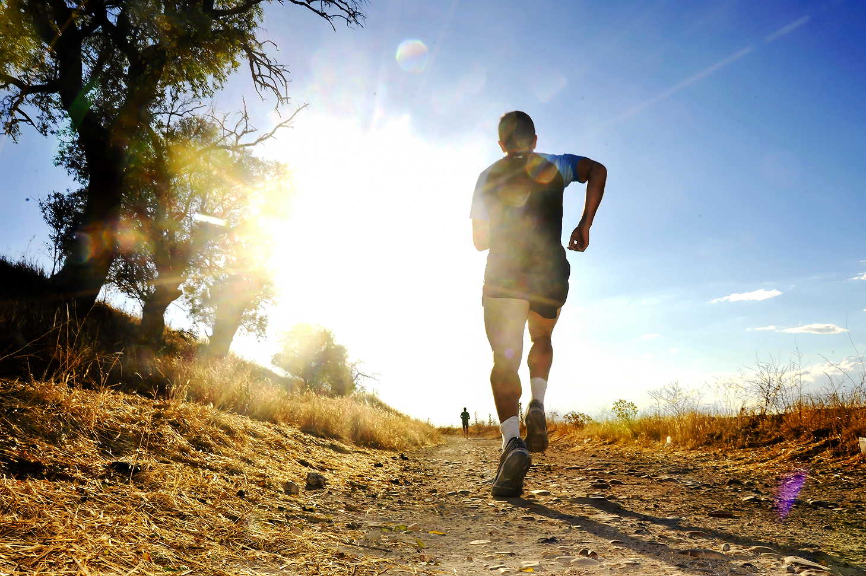
People pattern infographics
下水文
However, without warning, my strengths was running out. Coughing and wheezing, I felt as if the air had been strangled out of me. Yet, I trudged on with my heavy feet. Each passing minute drained my previous confidence. Just on the edge of giving up, I heard Dad’s familiar shouts of encouragement, which suddenly awoke me. I couldn’t let him down! With every bit of strength remaining, I sprinted towards the finish line, only to realize I didn’t make it to the top fifteen. My heart sank as I walked up to my Dad. I whispered, “I’m sorry I disappointed you, Dad.” Thinking of our countless days of tough practice together, I couldn’t hold back my tears. Unexpectedly, Dad didn’t scold me. Instead, he gathered me into his chest, wiped away my tears and softly stroked my hair. Then, he whispered back, “I’m proud of you! ” Seeing the confusion in my eyes, he shared with me his own story as a runner who also failed millions of times yet never gave up running. It suddenly dawned on me that to be a true runner is more than victory and Dad and Dad had been trying to teach me that lesson for many years.

Slide 19
People pattern infographics
范文
However,without warning,my strength was running out.My lungs fought to take in enough air,and my feet transformed into cement bricks.Neck and neck with one of my greatest rivals,I could see the finish line.I had begun the final sprint into glory when my knees buckled and my legs gave way.Nothing I could do would make them hold my weight. They were as weak as jelly.Even though I knew my dreams of victory had been destroyed,I had to finish the race.With all of the strength left in me,I got on my hands and knees and crawled,inch by inch,across the finish line.Shame pulsed through my veins as Dad squatted down and pulled me into his arms. I whispered,"Tm so sorry I disappointed you,Dad."He gave me a gentle smile and said,"You could never disappoint me.Sometimes these things just happen.All that matters is that you did your best."Lifting my face,I saw my dad's eyes,in which I saw the sweat,the time,and the work we had put into our dream.The miles we had run together,all for this race, flashed across my mind."But we worked so hard.What about our dream?"I asked.In that second,the world stood still.He reached over for my hand,holding back his own tears,and said,“Don't you know that you are my dream come true?”

Slide 20
同话题续写练习
202109浙江名校协作体
1. For me, it was normal to feel lost at the inter-camp track. Four camps of kids were ready to lead their teams to a blue ribbon and win the day. Not me. I was too little to be the leader and too skinny to be an athlete. I knew this by the time I was twelve, because my camp counselors（辅导员）and the other kids reminded me of it every chance they got. So when our camp needed a fourth runner in the two-mile race around the lake, I knew I was no one’s first choice. 2. I hid in the shade of a maple tree as they called the names of the runners, my body tensed as I heard a counselor call, “Fred! Where is Fred! He is in this race!” It was Barry. He spotted me under the tree. “Fred! We need a 12-year-old who hasn’t been in other events to run the two-mile!” 3. He gave me a push towards the starting line. Having no confidence and trying to save myself from the shame of taking the last place as four camps watched, I pleaded with him. 4. “But I don’t know the way around the lake!” 5. “You’re in. Just follow Bill!” Barry smiled. 6. Bill was my friend and the fastest runner in our camp. And then Barry said, “When you make it to the last stretch（最后一程）on the field, just throw your head back and run.” 7.At the starting line, I stood next to Bill and trembled. 8. “On your mark… Get set...” The gun cracked and sixteen of us took off. I stayed close on Bill’s heels, a little too close for Bill, I guess. He shouted at me, “Back off!” 9. I did. Two guys passed me, but I kept my eyes on Bill. 10. It was tiring. The distance was widening between Bill and me. We made the turn from the dusty road onto the muddy, wooded trail that would go around the lake back to the field. Through the trees, I saw Bill trip over a tree root and fall. A runner from another camp passed him. Paragraph 1 In a moment, Bill was up again and running. ____________________________________________ Paragraph 2 I didn’t know when I crossed the finish line. _____________________________________________

Slide 21
范文
In a moment, he was up again and running. He yelled to me, “Watch the roots!” Struggling to keep my legs moving, I looked down and saw the tree root. I puffed over it. Two hundred metres later, I scrambled up the hill, ready to see the rest of the pack crossing the finish line when I saw not the fifteen guys, but three. The crowd was roaring, but I could hear Barry over the rest of them, yelling “Run!” I threw my head back and told my legs to go and I knew I was winning.
I didn't know when I crossed the finish line. Barry caught me and I collapsed. “You flew! You flew, man! Second! You passed two guys!” There was a crowd of kids around me, patting me on the back, giving me high fives. I had come in second. Bill had finished first. With that and all the high fives and the cheers of the day, the best prize that I walked away with (轻易赢得)was my confidence. That year I discovered I could do a lot of things if I put my energy into them.

