Slide 1


感恩遇见，相互成就，本课件资料仅供您个人参考、教学使用，严禁自行在网络传播，违者依知识产权法追究法律责任。
更多教学资源请关注
公众号：溯恩高中英语
知识产权声明

Slide 2
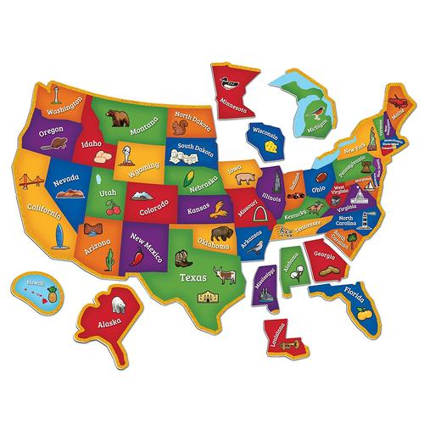
读后续写
湖丽衢2023年11月三地市高三英语

Slide 3
Read for basic information:
Who are the main characters?
Where did the story happen?
When did the story happen?

Slide 4
1. Andy's finger traced the lines on a blank United States map, each state represented by a number. He whispered to himself, “New Jersey is eating Pennsylvania, and Ohio is a chicken nugget.”...
2. “Ok, and Utah is the washing machine. No, Montana is the washing machine. Or North Dakota? Gah! They're all washing machines!” Andy was caught in his confusion.
3.This wasn't the first time his memory had failed him during a test. No matter how hard he studied, nothing seemed to stay in his brain for long. He had tried memory tricks, even spending nights examining an old paper map in his bedroom. ...
4.The time was up, and Mr. Crane began collecting the answer sheets. Andy quickly stuffed his blank test into the pile, wanting to forget about it. Unfortunately, his brain seemed to remember only the things it should forget. ...
5. Andy's friend Aaron shrugged, “You only need a 70 to pass.”
6. “Yeah, well it’s hard to get a 70 when you hand in a blank sheet of paper,” Andy mumbled, frowning.
7. Aaron popped a grape into his mouth. “Well, Mr. Crane will let you retake (补考) it tomorrow.
8. Andy was the only one standing at Mr. Crane’s desk after school. He apologized quickly, head drooping. But instead of scolding him, Mr. Crane patted his shoulder, saying, “I think you are trying, but you might learn better by being active. Just practice more!
9. Andy looked into Mr. Crane‘s eyes, finding comfort in the teacher’s understanding gaze. ...
during the test
after the test
Notes:
更多模板亮亮图文旗舰店：https://liangliangtuwen.tmall.com

Slide 5
What did Andy do?
During the test
What’s the result?
...traced the lines....
...whispered to himself...

Slide 6
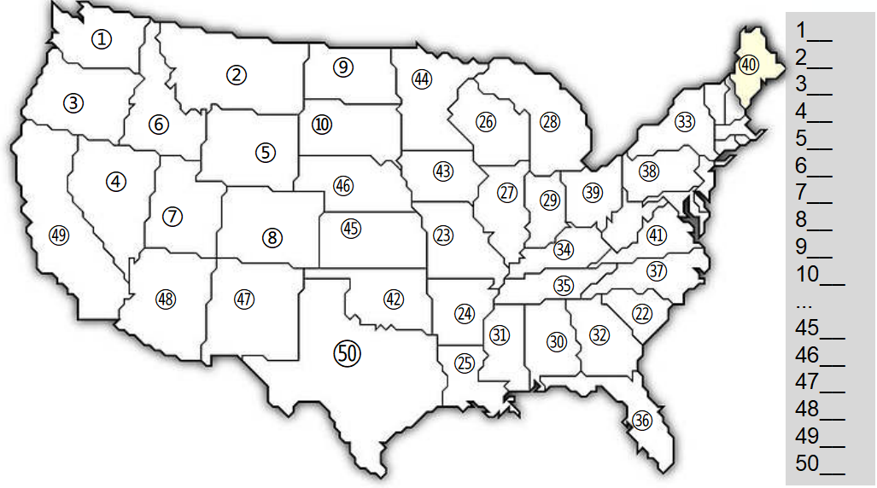
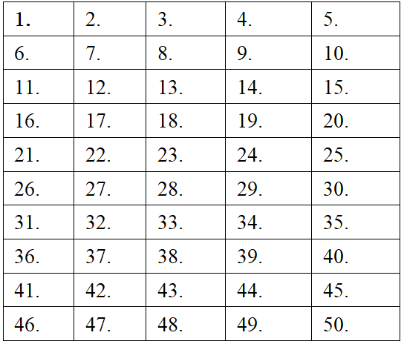

Slide 7
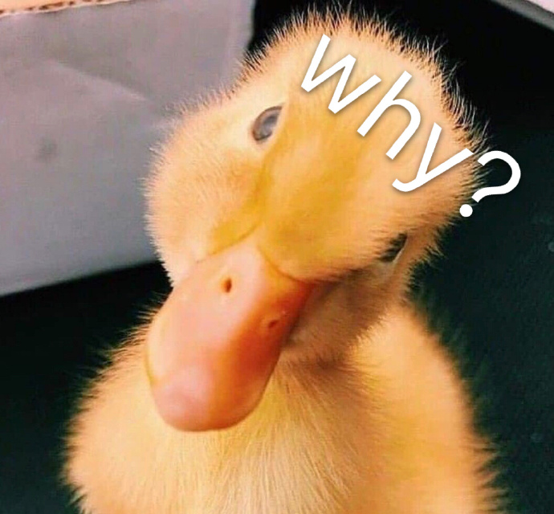
What did Andy do?
During the test
What’s the result?
failed the test
recited the rules
...traced the lines....
caught in his confusion
handed in a blank paper...
passive learning
...whispered to himself...
worked hard
...tried memory tricks,
...spending nights
...examining an old paper map
his memory
had failed him
failed the test
inappropriate
methods

Slide 8
What did Andy do?
During the test
What’s the result?
failed the test
recited the rules
...traced the lines....
caught in his confusion
handed in a blank paper...
passive learning
...whispered to himself...
worked hard
...tried memory tricks,
...spending nights
...examining an old paper map
his memory
had failed him
failed the test
inappropriate
methods
After the test
...apologized quickly...
...helped organize magnets
?

Slide 9
Comb the plot
Para.1 :As Andy arranged the magnets, an idea suddenly came into his minds.
climax
Andy apologized to Mr. Crane and was invited to arrange the magnets.
Para 2: When doing homework, Andy was told he scored an 88 on the retake.
Development
Resolution
Andy failed the test
Beginning
Ending

Slide 10
Weave the plot
Para.1 :As Andy arranged the magnets, an idea suddenly came into his minds.
Para 2: When doing homework, Andy was told he scored an 88 on the retake.
What was the idea?
What did Andy do?
What was Mr. Crane’s reaction?
Andy passed the retake.
How did Andy feel?
What did Andy do then?
What was Andy’s reflection?

Slide 11

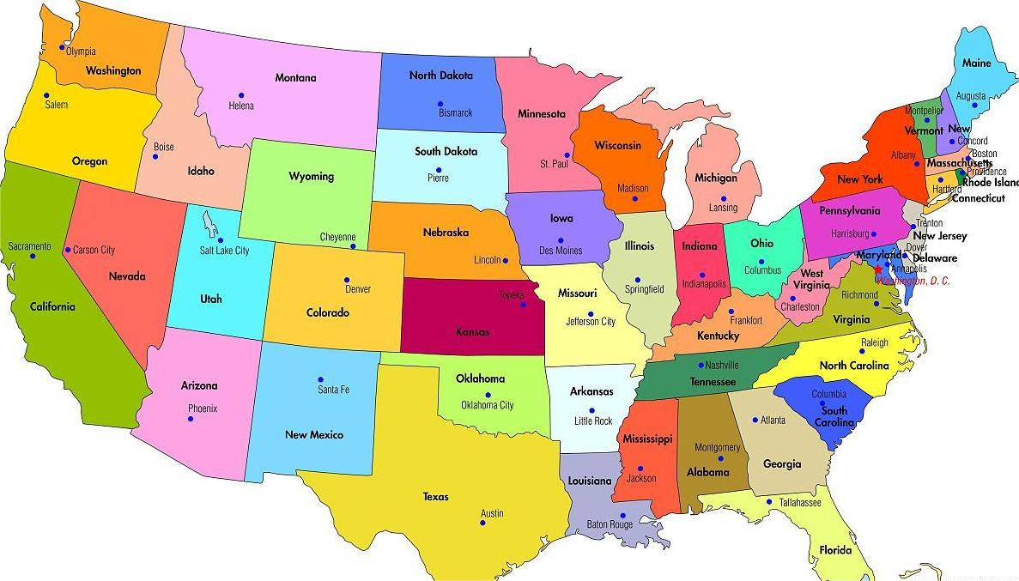
Thinking & Discussion
Para.1 :As Andy arranged the magnets, an idea suddenly came into his minds.
What was the idea?

Slide 12
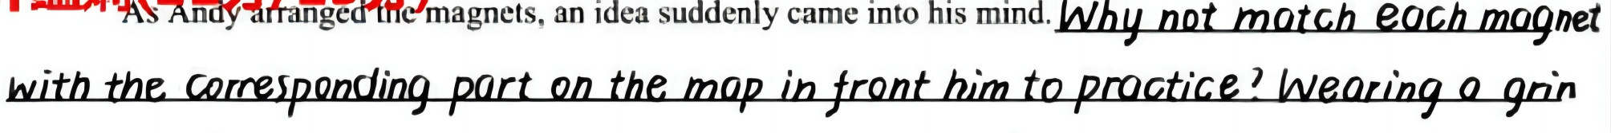
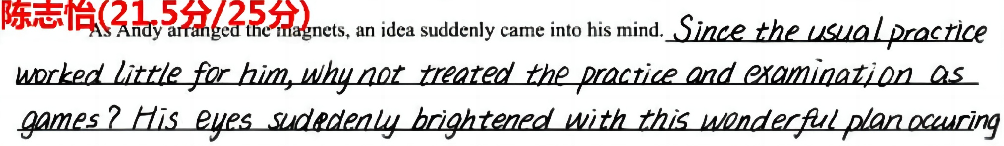
of

Slide 13
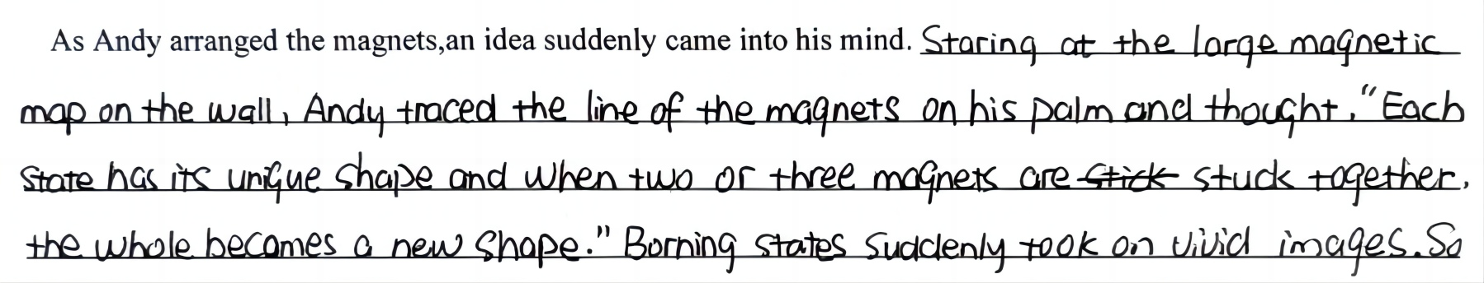
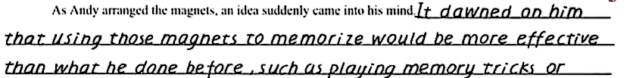

Slide 15

Para.1 :As Andy arranged the magnets, an idea suddenly came into his minds.
He placed Utah correctly and then proceeded to fix New Jersey and Pennsylvania. Then, he slapped the Montana magnet in place, declaring it as an old man with a beard. The words flowed effortlessly from his mind, each state taking on a unique identity.
He spent the rest of the afternoon arranging and re-arranging the magnets, whispering the names of the states to himself. Each state's shape and its position on the map started to become familiar, no longer a washing machine's confusion.

Slide 16
What did Andy do?
During the test
What’s the result?
failed the test
...traced the lines...
...whispered to himself...
recited the rules
caught in his confusion
handed in a blank paper...
passive learning
...tried memory tricks,
...spending nights
...examining an old paper map
worked hard
his memory
had failed him
inappropriate
methods
failed the test
After the test
...apologized quickly...
...helped organize magnets
?
... an idea suddenly came into his minds
active learning
Used the magenets &magnetic map to remember.
appropriate
methods

Slide 17
Thinking & Discussion
The Theme

Slide 18



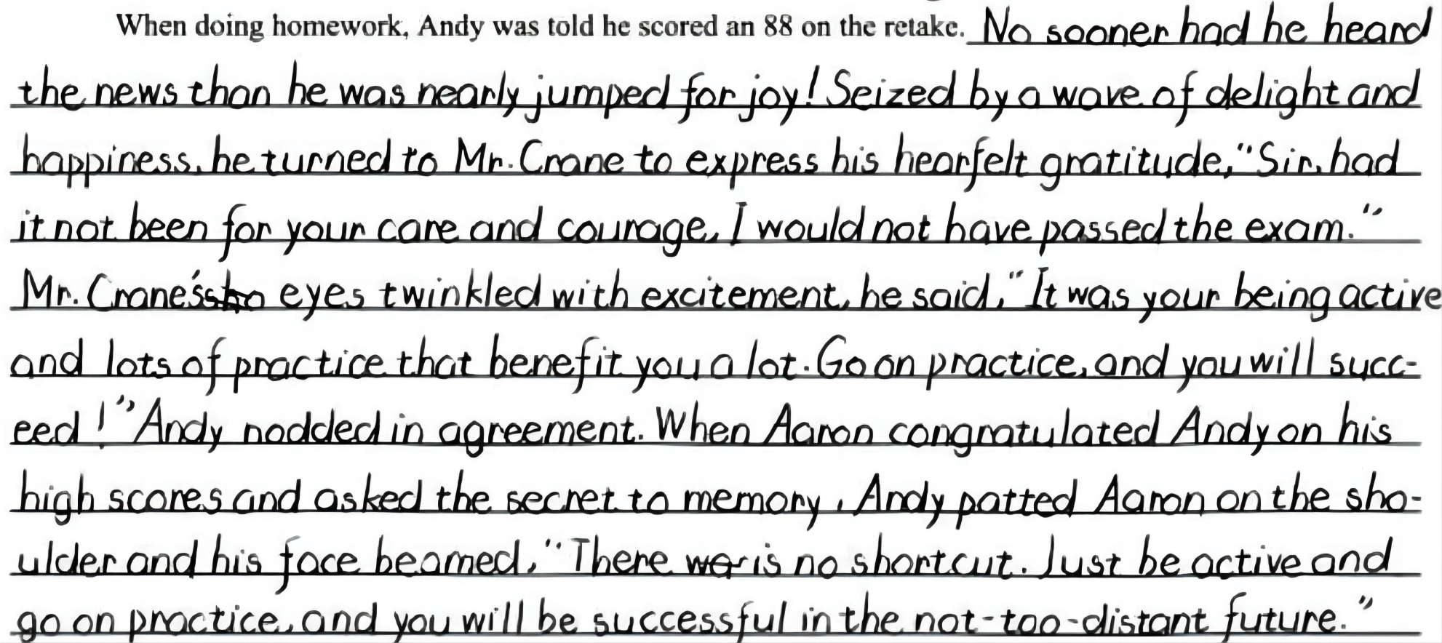
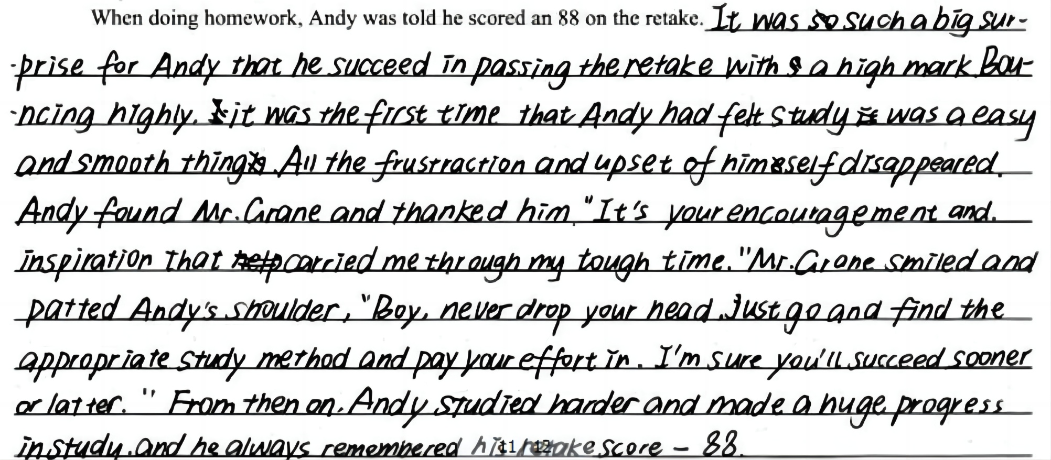



Excellent work appreciation

Slide 19
Get the theme
Be active
appropriate strategy
Practice makes perfect

Slide 20



Before reaching the ideal destination, it’s blessing to try a few wrong ways, so that when we finally get there, we will know how strong we actually are.
Never frown, even when you are frustrated, because you never know who is falling in love with your smile.

Slide 21
one possible SAMPLE
As Andy arranged the magnets, an idea suddenly came to his mind. He placed Utah correctly and then proceeded to fix New Jersey and Pennsylvania. A surge of confidence washed over him as he looked at the map. Inspired, he slapped the Montana magnet in place, declaring it as an old man with a beard. Each state's shape and its position on the map started to become familiar, no longer a washing machine's confusion. Mr. Crane, who had quietly observed Andy's progress, praised him for combining memory tricks with the physical act of moving pieces around the board. Encouraged by Mr.Crane, Andy pacticed repeatedly. This time, everything seemed to stick in his brain. Then he took the retake the next day. Feeling more prepared than ever, he finished the test soon.

Slide 22
one possible SAMPLE
While doing homework, Andy was told he scored an 88 on the retake. His eyes widened,and for a moment, he couldn't find the words to express his emotions. He had done it! Being active and engaging with the material had made a world of difference in his learning process. Andy couldn't wait to express his thanks to Mr.Crane for his support and guidance. As he walked out of the classroom,a weight seemed to have lifted off his shoulders. The sun shone brighter, and he noticed the vibrant colors of the world around him. The once daunting road ahead now seemed filled with endless possibilities. Andy's confidence soared, and he realized that the key to success was not just passively memorizing facts but truly understanding and actively connecting with the material.

Slide 23
Assignment
Read the article on your reference papersheet and finish writing Para.1

Slide 24
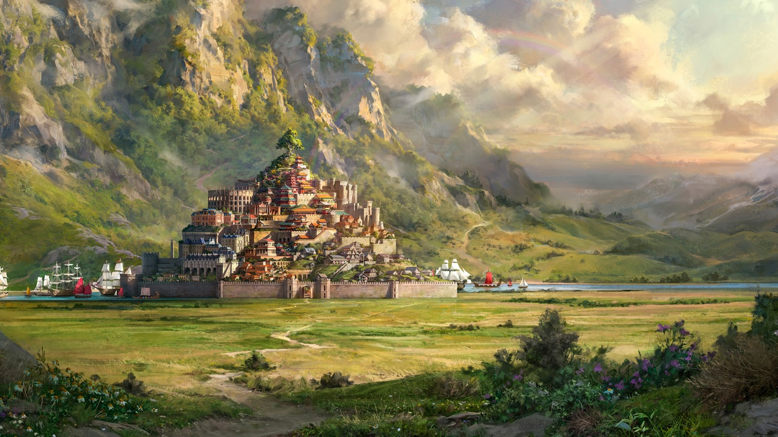


Thank you!

