Slide 1


感恩遇见，相互成就，本课件资料仅供您个人参考、教学使用，严禁自行在网络传播，违者依知识产权法追究法律责任。
更多教学资源请关注
公众号：溯恩高中英语
知识产权声明

Slide 2
2023年11月金华十校高三英语
试题讲评及二次开发
金华市孝顺高级中学 严晓倩

Slide 3
01
客观题概览
目录
02
分题型解析及语料梳理
CONTENT
03
总结与建议

Slide 4


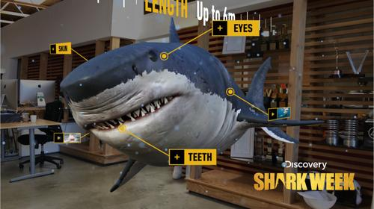

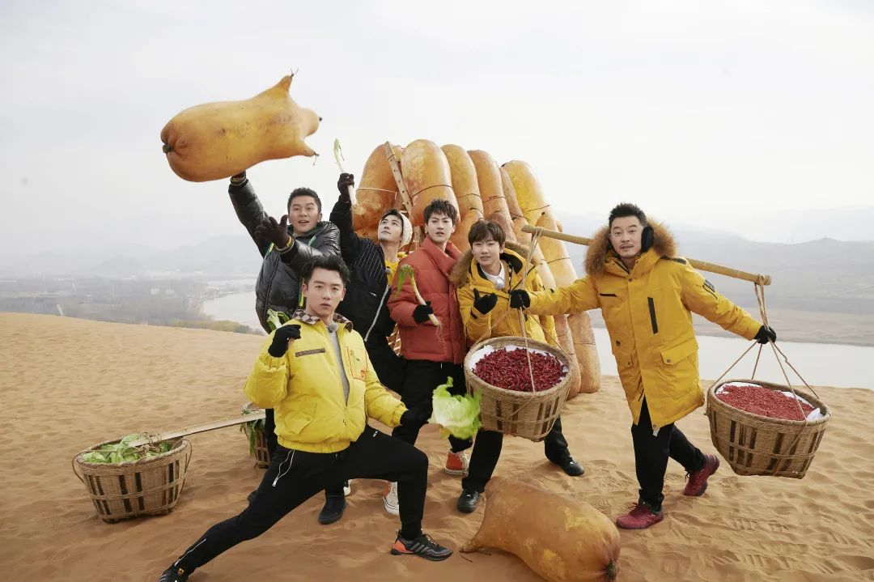
PART 01
客观题概览
题型 | 话题 | 体裁 | 词数 | 命题类型
阅读A | 人与社会： 莱茵河沿岸旅游推介 | 应用文 | 294+90 | 21，23细节理解 22推理判断
阅读B | 人与社会： 大学面试官的选人倾向 | 夹叙夹议 | 337+151 | 24，26，27推理判断 25写作意图
阅读C | 人与自然： 对鲨鱼的误解 | 说明文 | 305+121 | 28，29，30推理判断 31主旨大意
阅读D | 人与社会： 偏爱子女的负面影响 | 说明文 | 392+132 | 32，34细节理解 33词义猜测，35主旨大意
7选5 | 人与社会： 宣讲复杂信息 | 说明文 | 260+70 | 头1+中3+尾1
完型 填空 | 人与社会： 为朋友的成功欢呼 | 夹叙夹议 | 219+145 | 41,42,45,49,53,54动词46,48,50,52,55名词 43,44形容词 47逻辑连接词，51动词短语
语法 填空 | 人与社会： 羊皮筏子 | 说明文 | 214 | 56冠词，57连词， 58,59谓语动词，60,62单词转换61关系词， 63,65非谓语动词，64介词

Slide 5
PART 02 分题型解析及语料梳理
A篇
应用文，人与社会：莱茵河沿岸旅游推介
21. What do Amsterdam and Strasbourg have in common?【细节理解】
A. They have historical sites.
B. They have a relaxing French style.
C. They are home to big shopping malls.
D. They are famous for the picturesque scenery.
Amsterdam
... Grab a bicycle and enjoy an afternoon of cafes, art, and historical sites. ...
Strasbourg
... Be sure to visit picturesque Petite France, the historic quarter of town, ...
解题策略：扫读，快速抓取关键信息

Slide 6
PART 02 分题型解析及语料梳理
A篇
应用文，人与社会：莱茵河沿岸旅游推介
22. What might be the reason for Neuschwanstein Castle's popularity?【推理判断】
A. Its mysterious story. B. Its favourable location.
C. Its fairytale romance. D. Its inspiration for films.
此外，还要充分理解作者表达的逻辑。从前两句可以看出“新天鹅堡”最大的特点是具有童话色彩，而为电影提供灵感是作为一个具体例子来阐述的。
×
Neuschwanstein Castle
This fairytale castle is in the heart of Bavaria, Germany. Situated in the Black Forest, and conjuring up visions of princes and princesses, it is an extremely popular tourist attraction. It was in fact one of the inspirations for Walt Disney’s Sleeping Beauty Castle. ...
one film!
解题策略：咬文嚼字，细读信息

Slide 7
PART 02 分题型解析及语料梳理
A篇
应用文，人与社会：莱茵河沿岸旅游推介
23. Which stop would you recommend most to those who want to experience diverse cultures?【细节理解】
A. Amsterdam. B. Neuschwanstein Castle. C. Strasbourg. D. Basel.
Basel
.., Basel presents a fascinating combination of cultures, cuisines, and languages. ...
解题策略：同义词替换

Slide 8
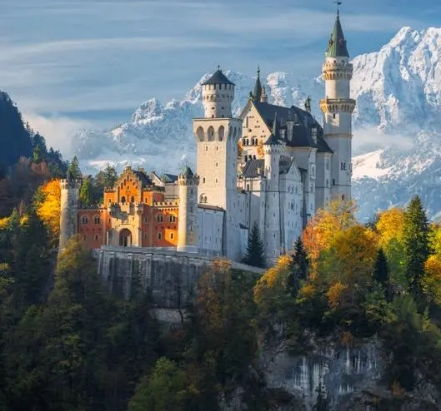
A篇语料梳理
介绍旅游景点的语料
1.浪漫的莱茵河从瑞士流向北海，全长700多英里，是欧洲最受欢迎的游轮航线之一，有很多游玩选择。
2.它坐落在黑森林里，让人联想到王子和公主，是一个非常受欢迎的旅游景点。
The romantic Rhine, which flows more than 700 miles from Switzerland to the North Sea, is one of the most popular cruising（巡游） rivers in Europe, with many options available.
Situated in the Black Forest, and conjuring up visions of princes and princesses, it is an extremely popular tourist attraction.

Slide 9
A篇语料梳理
介绍旅游景点的语料
3.the inspirations for ...的灵感
4.the historic quarter of town 镇上的历史街区
5.a fascinating combination of 一个...的迷人组合
描述旅游活动与特色的语料
6.river cruise邮轮之旅
7.cobblestoned streets铺满鹅卵石的街道
8.help with advance tickets 帮助预订门票
9.there’s a good chance that 很有机会...
10.walk in the footsteps of 跟随...的脚步
11.picturesque adj.风景如画的

Slide 10
PART 02 分题型解析及语料梳理
B篇
夹叙夹议，人与社会：大学面试官的选人倾向
24. What can we learn about the student in the first two paragraphs?【推理判断】
A. He is taught not to take risks.
B. He tries to avoid any chance of failure.
C. He cares little about his academic futures.
D. He is seldom allowed to take part in activities.
... I was astonished and delighted recently when a student replied, “I look forward to the possibility of failure.” ..., but this young man took a risk.
“You see, my parents have never let me fail,” he said. “When I want to take a chance at something, they remind me it’s not a safe route to take. Taking a more demanding course or trying an activity I may not succeed in, they tell me, will ruin my chances at college admission.”
解题策略：扫读，快速抓取关键信息

Slide 11
PART 02 分题型解析及语料梳理
B篇
夹叙夹议，人与社会：大学面试官的选人倾向
25. Why does the author mention the Chinese student in paragraph 3?【写作意图】
A. To emphasize the importance of hard work.
B. To compare students from different countries.
C. To give an example of the students he favors.
D. To illustrate the widespread stress on students.
example
I wish I could tell you this is an uncommon story, but kids all over the world admit they are under great pressure to be perfect. When I was traveling in China last fall and asked a Chinese student what she did for fun, she replied: “I thought I wasn’t supposed to tell you that? I wouldn’t want you to think I am not serious about my work!”
解题策略：注重前后文逻辑

Slide 12
PART 02 分题型解析及语料梳理
B篇
夹叙夹议，人与社会：大学面试官的选人倾向
26. What is probably admission officers’ attitude towards a perfect application?【推理判断】
A. Doubtful. B. Confused.
C. Favorable. D. Casual.
熟词生义：n.→v. 在该语境下译为“质疑”
In fact, admission officers tend to question students who present themselves as individuals without shortcomings.
解题策略：根据句子结构和“熟词”本义进行科学合理猜测

Slide 13
PART 02 分题型解析及语料梳理
B篇
夹叙夹议，人与社会：大学面试官的选人倾向
27. What is the key to success in college according to the author?
【推理判断】
A. A desire for perfection.
B. The ability to learn from defeats.
C. The opportunity of making mistakes.
D. An experience of defeat in high school.
We believe an error in high school should not define the rest of your life, but how you respond could shape you forever.
解题策略：细读，充分理解句意

Slide 14
B篇语料梳理
与考大学相关的语料
1.for admission to 准备进入....（大学/学院）
2.Institution n.（大学、银行等规模大的）机构
3.selective adj.严格筛选的
4.admission officers大学招生官
5.If their perspectives are of lessons learned, these applicants tend to jump to the top at highly selective colleges.
如果这些申请者的观点来自经验教训，那他们往往会在高要求的大学（录取名单）中名列前茅。

Slide 15
B篇语料梳理
描述做事艰难的语料
6.take a risk 冒险
7.take a chance at sth 试一试某事
8.be under great pressure to do
顶着巨大的压力做某事
9.go against 与...不符/相悖
10.stories of defeat 失败的故事

Slide 16
B篇语料梳理
熟词生义在句子理解中的运用
11.In fact, admission officers tend to question(v.) students who present themselves as individuals without shortcomings.
事实上，招生官倾向于质疑那些表现得没有缺点的学生。
12.We believe an error in high school should not define the rest of your life, but how you respond could shape(v.) you forever.
我们认为，高中时的一次错误不应该决定你的余生，但你的应对方式可能会永远影响你。

Slide 17
PART 02 分题型解析及语料梳理
C篇
说明文，人与自然：对鲨鱼的误解
28. What do most people think about sharks?【推理判断】
A. They are ugly. B. They are important.
C. They are violent. D. They are complicated.
The sharp fin（鳍）. The rows upon rows of sharp teeth. The large black eyes. The sharks you see on television in Jaws or Discovery’s “Shark Week” are not the friendliest looking creatures. They aren’t exactly an animal you want to find near you while swimming in the ocean. Despite their portrayals（刻画） in movies and popular culture, sharks are complicated, misunderstood creatures that are weaker than they appear.
解题策略：扫读，快速抓取关键信息，领悟主旨要义

Slide 18
PART 02 分题型解析及语料梳理
C篇
说明文，人与自然：对鲨鱼的误解
29. The author compares shark bites to lightning strikes to show they are __________.【推理判断】
A. deadly B. rare C. unavoidable D. unpredictable
Statistically, you are more likely to be struck by lightning than be bitten by a shark.
解题策略：扫读，抓住关键词汇

Slide 19
PART 02 分题型解析及语料梳理
C篇
说明文，人与自然：对鲨鱼的误解
30. Why should sharks be scared of humans according to the author?【推理判断】
A. Humans keep sharks to show off.
B. Humans kill sharks in large quantities.
C. Humans catch sharks for medical research.
D. Humans are greater in number than sharks.
Though sharks have a reputation for being very scary to humans, the sad truth is that they should be scared of humans. The number of sharks in the ocean is steadily dropping. There are a few reasons for this. For one, they mature quite slowly, over several years, and produce relatively few young. For another, overfishing of sharks is happening because more and more people want their fins. About 100 million sharks are killed every year according to National Geographic.
解题策略：细读，理解深层内涵

Slide 20
PART 02 分题型解析及语料梳理
C篇
说明文，人与自然：对鲨鱼的误解
31. Which of the following is the best title for the text?【主旨大意】
A. SOS: Save Our Sharks! B. Sharks: King of the Ocean
C. Shark Fins: An Ecological Crisis D. Sharks: Killers or Misunderstood?
解题策略：总览全文，抓住每段主旨大意
... Despite their portrayals（刻画） in movies and popular culture, sharks are complicated, misunderstood creatures that are weaker than they appear.
One very common misunderstanding about sharks is their desire to hunt humans....
Sharks are very important to the ocean as they are at the top of the food chain. Some sharks even control the balance of an ecosystem through fear alone. ...
Though sharks have a reputation for being very scary to humans, the sad truth is that they should be scared of humans. ... For another, overfishing of sharks is happening because more and more people want their fins. About 100 million sharks are killed every year ...

Slide 21

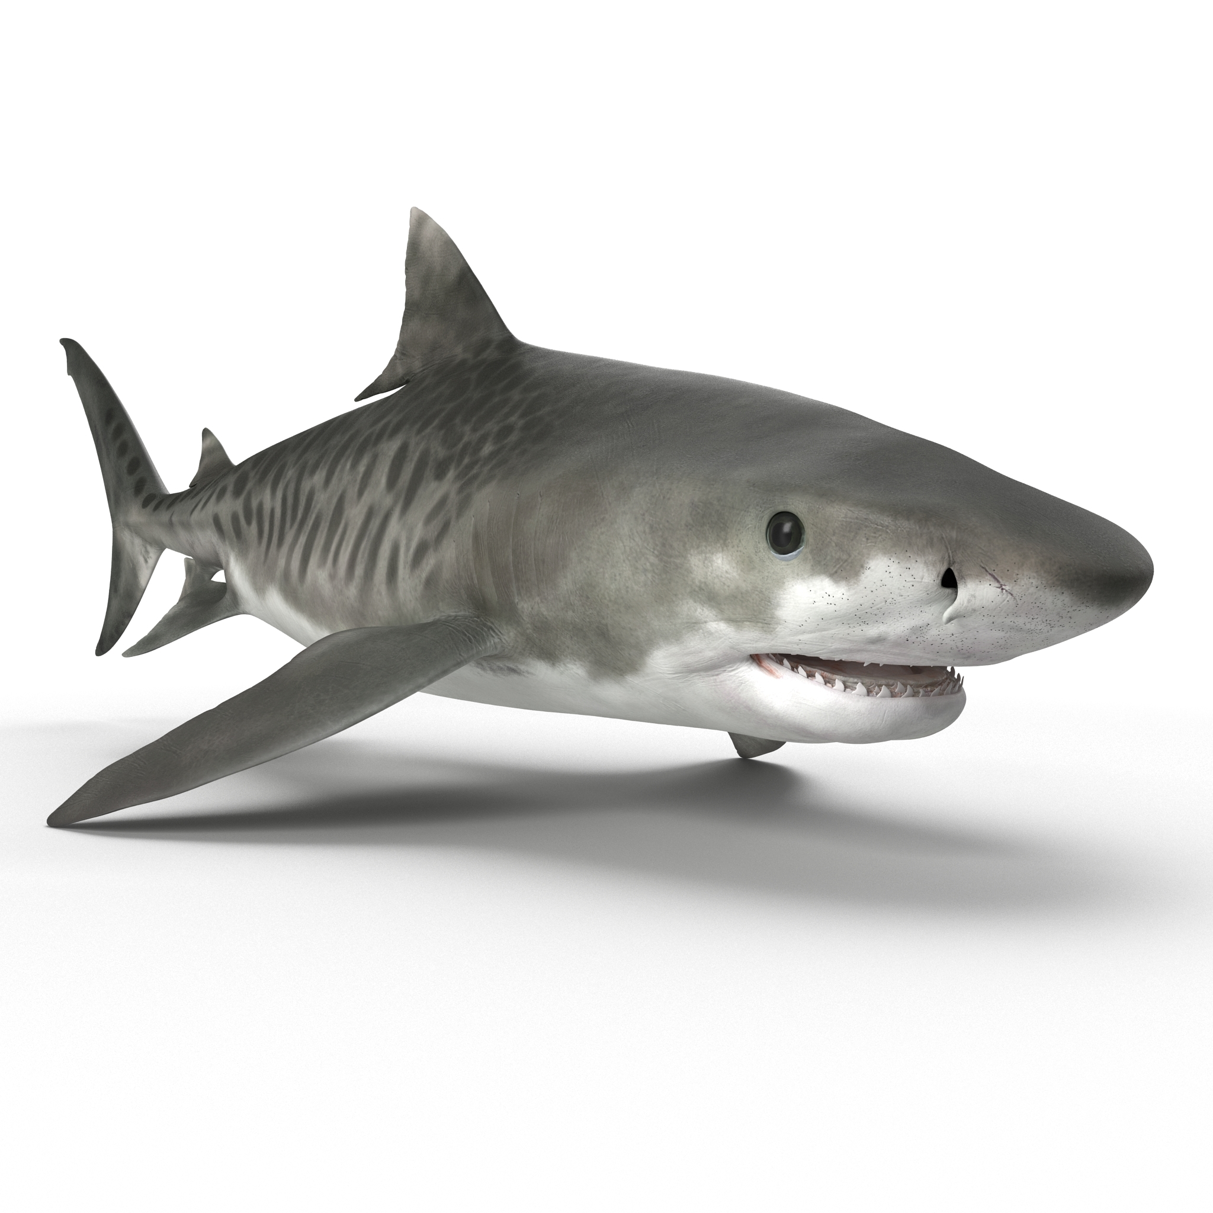
C篇语料梳理
与鲨鱼有关的背景知识
1.Jaws 《大白鲨》电影
2.Discovery’s “Shark Week”
《探索》频道的《鲨鱼周》节目
3.tiger sharks 虎鲨
4.National Geographic 《国家地理》杂志
5.complicated adj.复杂的
6.For one, they mature quite slowly, over several years, and produce relatively few young.
一方面，它们成熟得很慢，需要几年的时间，而且生的幼崽相对较少。
7.When tiger sharks are present though, the turtles are scared away, holding back their appetite for seagrass and protecting its growth.
然而，当虎鲨出现时，海龟会被吓跑，抑制它们对海草的胃口，保护海草的生长。

Slide 22
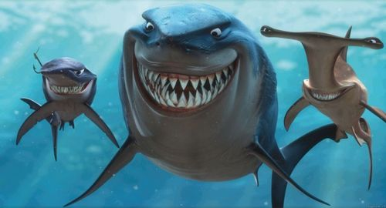
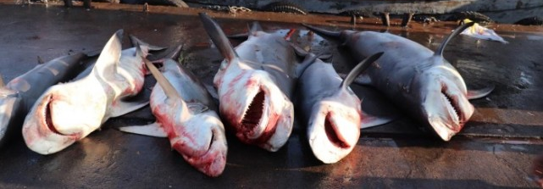
C篇语料梳理
大多数人对鲨鱼误解背后的真相
8.Statistically, you are more likely to be struck by lightning than be bitten by a shark.
据统计，你被闪电击中的可能性比被鲨鱼咬伤的可能性更大。
9.Though sharks have a reputation for being very scary to humans, the sad truth is that they should be scared of humans.
虽然鲨鱼对人类来说是非常可怕的，但可悲的事实是它们竟然害怕人类。

Slide 23
PART 02 分题型解析及语料梳理
D篇
说明文，人与社会：偏爱子女的负面影响
32. What can we learn about unfavored children?【细节理解】
A. They want to please their parents.
B. They care little about their siblings.
C. They tend to lack a sense of identity.
D. They hope to be the black sheep of the family.
"The unfavored child can feel defeated, and unmotivated, as a result of working hard to get parental support, with no success," ... "He or she may also suffer from depression and become angry, bitter, or jealous," ... They may also behave inappropriately, becoming the black sheep, ... "Unfavored children may have a hard time accepting who they are, since they do not feel accepted by their parents," adds Gidenko.
解题策略：扫读，快速抓取关键信息，精准理解词义

Slide 24
PART 02 分题型解析及语料梳理
D篇
说明文，人与社会：偏爱子女的负面影响
33. What does the underlined word “boon” in paragraph 4 mean?
【词义猜测】
A. Blessing. B. Challenge. C. Honor. D. Burden.
Favoritism is not exactly a boon for the favored child, either. Kids who feel that they are their parent's favorite sometimes translate that into a go pass for their behavior in future relationships. "Favored children may feel a sense of entitlement, and that rules do not apply to them," says Gidenko. This can negatively affect the way they act in school, at work, and in their friendships.
解题策略：上下文充分理解

Slide 25
PART 02 分题型解析及语料梳理
D篇
说明文，人与社会：偏爱子女的负面影响
34. What does Newman suggest parents do in the last paragraph?
【细节理解】
A. Treat their children equally.
B. Explain themselves to their children.
C. Strengthen their bond with their children.
D. Remove the differences between their children.
Newman urges parents to remember that it's not possible to treat children equally because they are all different. What parents can, and should do is talk to their kids about how, and why, they treat them the way they do. "According to research, parents don't talk about this. They don't say why one child gets more time than another. If they do, they are preserving their bond with each child," says Newman.
解题策略：准确理解相关单词的释义

Slide 26
PART 02 分题型解析及语料梳理
D篇
说明文，人与社会：偏爱子女的负面影响
35. What is the text mainly about?【主旨大意】
A. The solutions to parental favoritism.
B. The consequences of parental favoritism.
C. An analysis of why parents play favorites.
D. A contrast between favored and unfavored children.
...Newman warns that favoring one child ... can have a significantly negative effect.
"The unfavored child can feel defeated, and unmotivated, ...," ..."He or she may also suffer from depression and become angry, bitter, or jealous," she adds. .... They may also behave inappropriately, becoming the black sheep, .... "Unfavored children may have a hard time accepting who they are, ...," adds Gidenko.
Favoritism is not exactly a boon for the favored child, either. ....
It may seem absurd, but the opposite can also occur. ....
解题策略：找主题句，关键词

Slide 27
D篇语料梳理
描述亲子关系的语料
1.favor A over B比起B，更偏爱A
2.Favor v.偏爱 favoritism n.偏爱主义 adj. unfavored 不被偏爱的，favored 被偏爱的，favorite 最喜爱的
3.a sense of entitlement特权感
4.preserve one’s bond with sb 维护某人与某人的联系
5.They may also behave inappropriately, becoming the black sheep, which they believe their parents already see.
他们也可能表现得不得体，成为害群之马，他们认为父母已经看到了这一点。
6.Unfavored children may have a hard time accepting who they are, since they do not feel accepted by their parents.
不受宠爱的孩子可能很难接受自己，因为他们觉得自己不被父母接受。

Slide 28
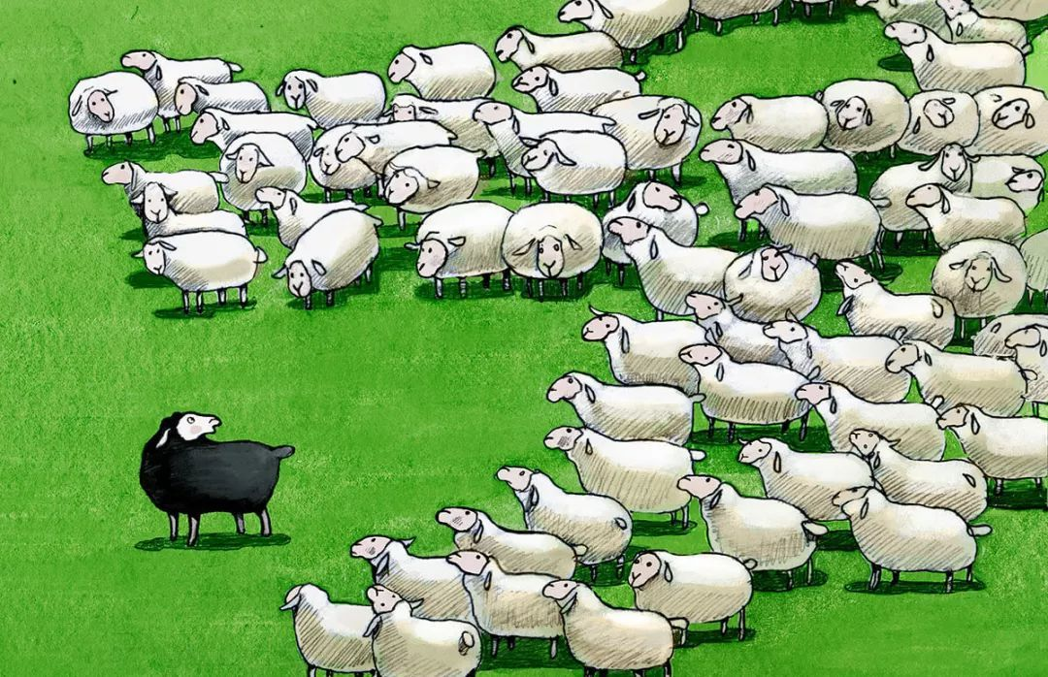
【文化知识补充】为什么称black sheep为“害群之马，败家子”？
①绵羊一般白色的多 如果有黑色的混到白羊群中会很显眼很容易招到狼
②白色羊毛可以染成各种颜色商业价值比较高，但黑羊不能商业价值比较低
③黑羊在羊群中有时候会吓唬白羊
④在18-19世纪的英格兰甚至黑羊被视为魔鬼的象征
Black Sheep

Slide 29
D篇语料梳理
其他语料
7.absurd adj.荒谬的
8.status n.地位
9.observant adj. 善于观察的
10.have a significantly negative effect有着巨大的负面影响
11.urge sb to do sth 敦促某人做某事
12.They know when they are getting praise for things they have not earned, such as being your favorite.
当他们因为不是自己赢得的东西而得到赞扬时，他们知道，比如成为你的最爱。
13.What parents can, and should do is talk to their kids about how, and why, they treat them the way they do.
父母能做的，也应该做的，是告诉他们的孩子，他们是如何对待他们的，以及为什么要这样对待他们。

Slide 30
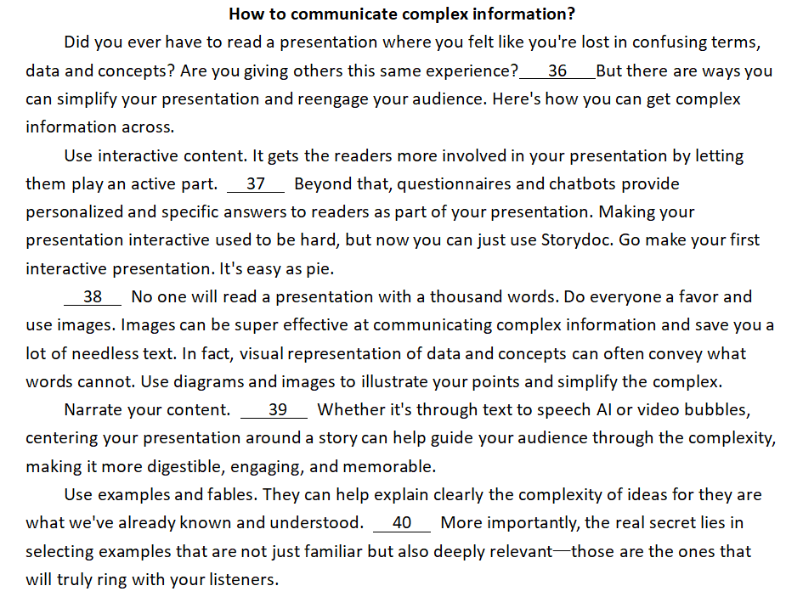
PART 02 分题型解析及语料梳理
5/7
说明文，人与社会：宣讲复杂信息
解题策略：先解决简单题，根据句子类型排除迷惑项
A. Show, don't tell.
B. Make every word count.
C. This makes the complex concepts less new and more familiar.
D. If you don't sound excited, the listeners won't feel excited either.
E. Storytelling is another powerful tool for communicating complex concepts.
F. Communicating complex information is a common challenge in presentations.
G. For example, allow them to choose the content route they wish to take and control the pace.

Slide 31
PART 02 分题型解析及语料梳理
5/7
说明文，人与社会：宣讲复杂信息
How to communicate complex information?
Did you ever have to read a presentation where you felt like you're lost in confusing terms, data and concepts? Are you giving others this same experience? 36 But there are ways you can simplify your presentation and reengage your audience. Here's how you can get complex information across.
C. This makes the complex concepts less new and more familiar.
D. If you don't sound excited, the listeners won't feel excited either.
E. Storytelling is another powerful tool for communicating complex concepts.
F. Communicating complex information is a common challenge in presentations.
G. For example, allow them to choose the content route they wish to take and control the pace.
解题策略：选项中圈出逻辑词和核心词，结合上下文匹配最佳项

Slide 32
PART 02 分题型解析及语料梳理
5/7
说明文，人与社会：宣讲复杂信息
How to communicate complex information?
Use interactive content. It gets the readers more involved in your presentation by letting them play an active part. 37 Beyond that, questionnaires and chatbots provide personalized and specific answers to readers as part of your presentation. Making your presentation interactive used to be hard, but now you can just use Storydoc. Go make your first interactive presentation. It's easy as pie.
C. This makes the complex concepts less new and more familiar.
D. If you don't sound excited, the listeners won't feel excited either.
E. Storytelling is another powerful tool for communicating complex concepts.
G. For example, allow them to choose the content route they wish to take and control the pace.
解题策略：根据逻辑词和核心词，结合上下文匹配最佳项

Slide 33
PART 02 分题型解析及语料梳理
5/7
说明文，人与社会：宣讲复杂信息
How to communicate complex information?
Narrate your content. 39 Whether it's through text to speech AI or video bubbles, centering your presentation around a story can help guide your audience through the complexity, making it more digestible, engaging, and memorable.
C. This makes the complex concepts less new and more familiar.
D. If you don't sound excited, the listeners won't feel excited either.
E. Storytelling is another powerful tool for communicating complex concepts.
解题策略：根据逻辑词和核心词，结合上下文匹配最佳项

Slide 34
PART 02 分题型解析及语料梳理
5/7
说明文，人与社会：宣讲复杂信息
How to communicate complex information?
Use examples and fables. They can help explain clearly the complexity of ideas for they are what we've already known and understood. 40 More importantly, the real secret lies in selecting examples that are not just familiar but also deeply relevant—those are the ones that will truly ring with your listeners.
C. This makes the complex concepts less new and more familiar.
D. If you don't sound excited, the listeners won't feel excited either.
解题策略：根据逻辑词和核心词，结合上下文匹配最佳项

Slide 35
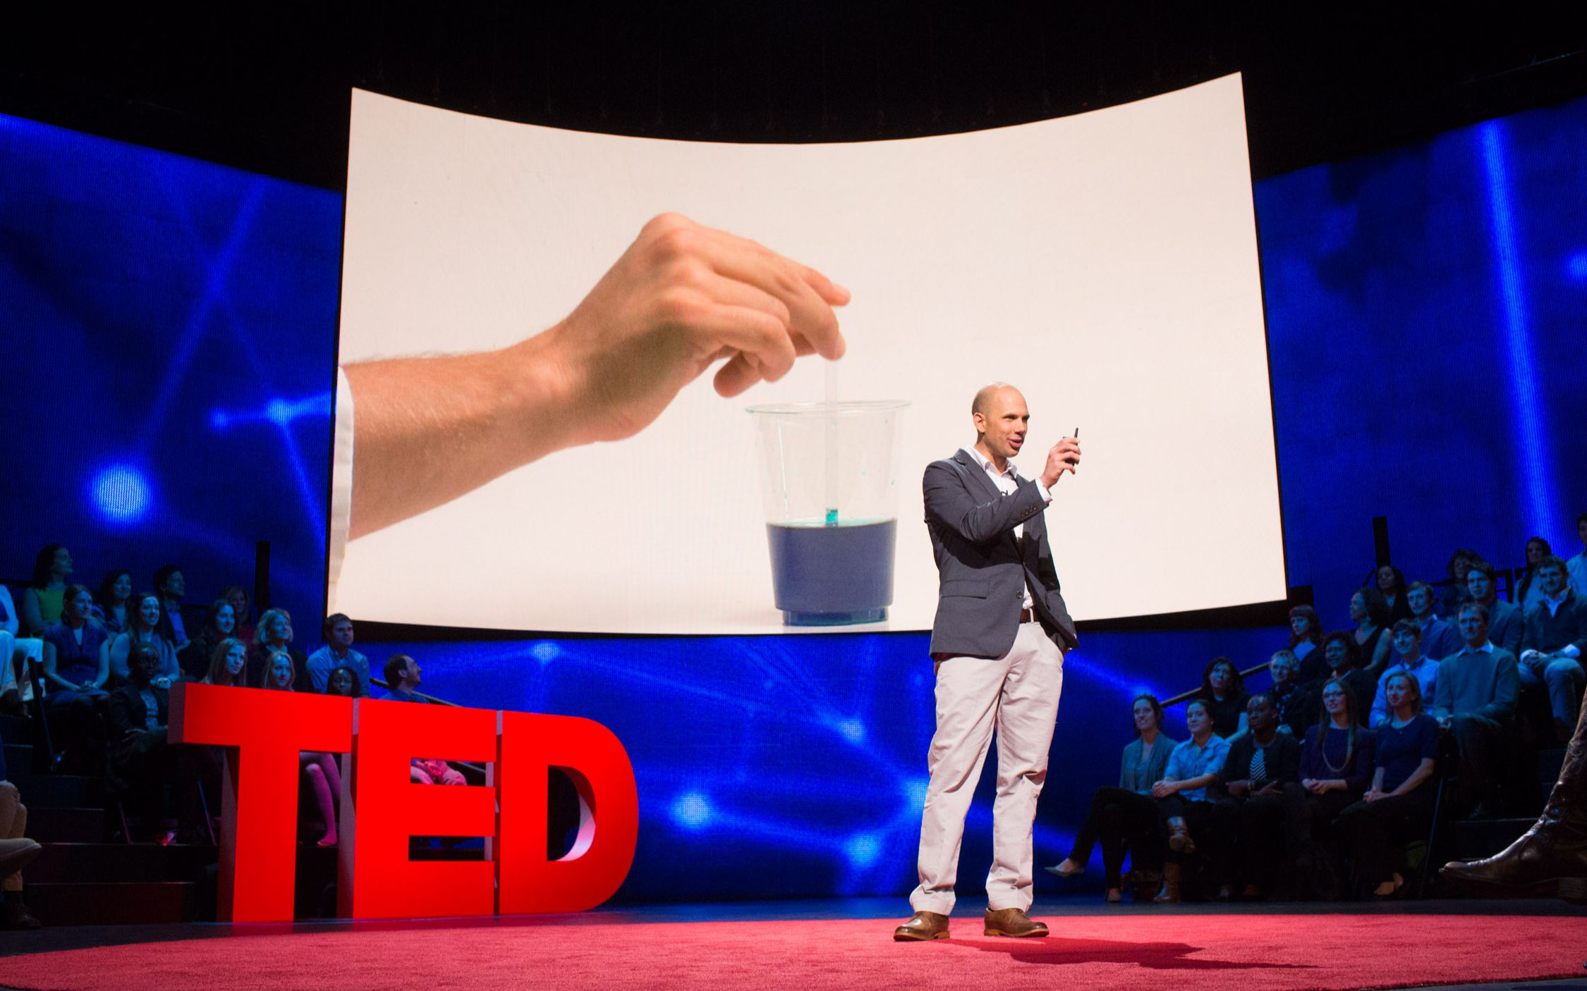
5/7语料梳理
描述简化复杂信息的语料
1.complex adj.复杂的 complexity n.复杂性
2.diagram n.图表
3.illustrate v.说明，阐明 【近义词】explain
4.simplify v.简化
5.Whether it's through text to speech AI or video bubbles, centering your presentation around a story can help guide your audience through the complexity, making it more digestible, engaging, and memorable.
无论是通过文本到语音人工智能还是视频，以故事为中心的演讲都可以帮助观众理解复杂内容，使其更容易理解、更吸引人、更难忘。
6.More importantly, the real secret lies in selecting examples that are not just familiar but also deeply relevant—those are the ones that will truly ring with your listeners.
更重要的是，真正的秘诀在于选择那些不仅熟悉且相关度极高的例子——那些能真正引起听众共鸣的例子。

Slide 36
5/7语料梳理
与人际互动有关的语料
7.reengage v.再次吸引，使...再次融入
8.Interactive adj.互动的
9.get sb. involved in 使某人投入的
10.questionnaire n.问卷
11.do sb. a favor 帮助某人
12.fable n.寓言故事
13.count v.起作用

Slide 37
PART 02 分题型解析及语料梳理
完型
夹叙夹议，人与社会：为朋友的成功欢呼
When Eugenie George first heard that her friend passed a financial exam, her heart sank. She'd 41 the same test weeks earlier.
"Envy was eating me up," recalls George. But anyway she 42 her friend. "And I told her I failed and admitted I was 43 ," she says. George knew that being 44 would ease her envy, but she was surprised that it also enabled her to 45 her friend's happiness and experience her own in turn.
41. A. taken B. passed C. failed D. prepared
42. A. congratulated B. forgave C. blamed D. ignored
43. A. badly-behaved B. over-burdened C. short-sighted D. green-eyed
44. A. tough B. honest C. tolerant D. optimistic
45. A. imagine B. understand C. share D. increase
解题策略：注重记叙文情节线和情感线

Slide 38
PART 02 分题型解析及语料梳理
完型
夹叙夹议，人与社会：为朋友的成功欢呼
Finding 46 in another person's good fortune is what social scientists call freudenfreude, the great joy we feel when someone else succeeds, 47 it doesn't directly involve us. Freudenfreude is like a kind of social 48 , says Catherine Chambliss, a professor of psychology. It makes relationships "closer and more enjoyable."
46. A. hope B. passion C. confidence D. pleasure
47. A. even if B. as if C. now that D. so that
48. A. platform B. glue C. booster D. routine
解题策略：注重前后文伏笔

Slide 39
PART 02 分题型解析及语料梳理
完型
夹叙夹议，人与社会：为朋友的成功欢呼
解题策略：注重前后呼应
Too often, we think our friends 49 us most during their hard times: a job 50 , getting divorced. In fact, how friends 51 our joy is even more important for us than how they respond to our 52 . Too often, we think of joy passively. We see it as something that come to us, instead of something we can 53 . While it can be difficult in practice, freudenfreude can lift us up and 54 our day. So celebrating our friends' 55 is a win-win to us all.
49. A. support B. annoy C. upset D. need
50. A. loss B. change C. interview D. application
51. A. look forward to B. contribute to C. get used to D. react to
52. A. envy B. complaints C. suffering D. mistakes
53. A. predict B. produce C. choose D. measure
54. A. fill B. start C. brighten D. balance
55. A. survival B. success C. recovery D. generosity

Slide 40
完形填空语料梳理
描述情绪的语料
1.eat sb up 吞噬某人
2.envy n./v.嫉妒 envious adj.嫉妒的【同义词】green-eyed adj.嫉妒的
3.ease one’s envy缓解某人的嫉妒之情
4.passively adv.被动地，消极地
5.lift sb up 振奋某人的精神
6.brighten one’s day 点亮某人的日子
7.a win-win to sb 对某人来说是双赢

Slide 41
完形填空语料梳理
如何对待朋友的成功与快乐
8.从另一个人的好运中找到快乐就是社会科学家所说的“freudenfreude”，即当别人成功时，我们感受到的巨大喜悦，即使这与我们没有直接关系。
Finding pleasure in another person's good fortune is what social scientists call freudenfreude, the great joy we feel when someone else succeeds, even if it doesn't directly involve us.
9.In fact, how friends react to our joy is even more important for us than how they respond to our suffering.
事实上对我们来说，朋友如何应对我们的快乐比他们如何应对我们的痛苦更重要。

Slide 42
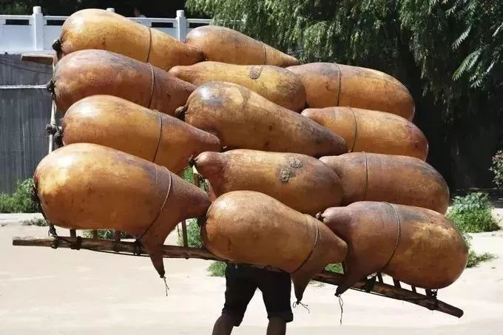
PART 02 分题型解析及语料梳理
语填
说明文，人与社会：羊皮筏子
The sheepskin raft, the oldest means of transportation along the Yellow River, has a history of nearly 2,000 years. The airbag of the raft is made of 56 whole sheepskin and goes through many processes including heating to remove hair, soaking in salty oil, sewing, drying 57 blowing. Then the airbags 58 (fasten) to a wooden stand, enabling its use for transporting people and goods across the water.
a
56.冠词
57.连词
and
are fastened
58.谓语动词被动

Slide 43
PART 02 分题型解析及语料梳理
语填
说明文，人与社会：羊皮筏子
59.谓语动词时态
consisted
It is said that the largest sheepskin raft in old times 59 (consist) of more than 600 sheepskin airbags, with an impressive length of 22 meters and a 60 (wide) of 7 meters. It was capable of carrying around 30 tons of goods and drifting over 200 kilometers in one day.
In the early 20th century, before the 1950s, 61 railways were not yet in operation and road traffic was 62 (convenient), the sheepskin raft served as the most important means of transportation for residents 63 (live) along the Yellow River.
width
60.词形转换
when
61.关系副词
inconvenient
62.词形转换
living
63.非谓语

Slide 44
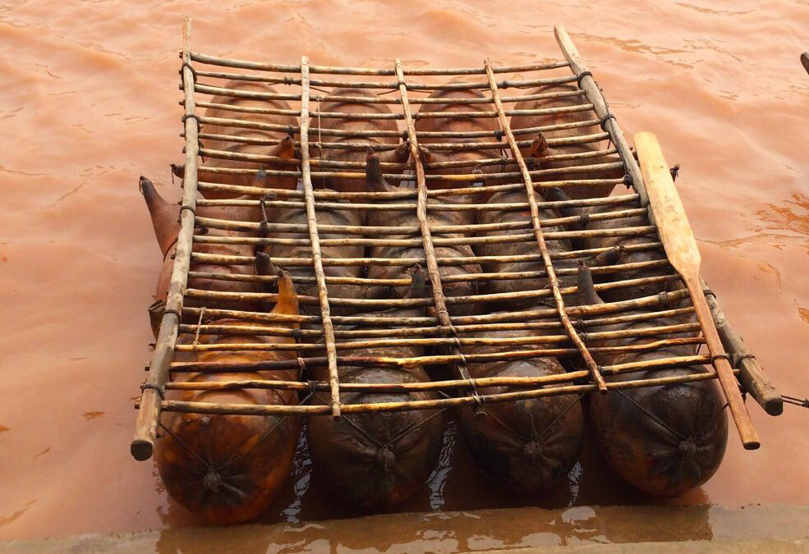
PART 02 分题型解析及语料梳理
语填
说明文，人与社会：羊皮筏子
However, with the rapid development of society, the sheepskin raft has largely played its historical role 64 transporting people and goods. Nowadays, it can only be found along the banks of the Yellow River in some cities in Gansu province. It has become a tool for people 65 (do) some sightseeing on the Yellow River.
in
64.介词
65.非谓语
to do

Slide 45
语法填空语料梳理
描述一个工具的制作与作用的语料
1.soak in 浸泡在...中
2.a wooden stand 一个木架子
3.consist of由...组成【无被动语态】
4.with a length of 22 meters and a width of 7 meters 有22米长，7米宽
5.be capable of doing sth有能力做某事
6.drift v.漂流，漂移
7.play a role in doing 在...中起作用
8.In the early 20th century, before the 1950s, when railways were not yet in operation and road traffic was inconvenient, the sheepskin raft served as the most important means of transportation for residents living along the Yellow River.
20世纪50年代以前，铁路尚未开通，公路交通不便，羊皮筏是黄河沿岸居民最主要的交通工具。

Slide 46
PART 03
总结与建议
逻辑思维
整体意识
关注语篇中的显性逻辑词
揣摩内容间的隐性逻辑关系
解题前，务必宏观把握语篇的主旨要义
句子分析
04
猜词能力
快速找出句子中的核心成分
准确分析修饰成分
词义猜测：看上下文
熟词生义：上下文+ “熟义”

Slide 47
Thank you
金华市孝顺高级中学 严晓倩

