Slide 1

感恩遇见，相互成就，本课件资料仅供您个人参考、教学使用，严禁自行在网络传播，违者依知识产权法追究法律责任。
更多教学资源请关注
公众号：溯恩高中英语
知识产权声明

Slide 2
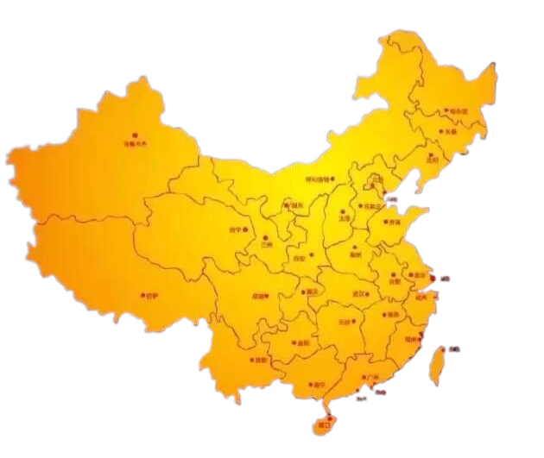


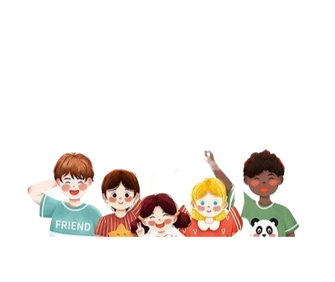
2023年11月杭州一模应用文讲评 --- 基于多元文化交流，促进学生核心素养的形成
杭二中树兰高级中学 郭合英

Slide 3


1. 认真审题
主要内容
2.框架构思
3. 语言积累
4. 范文解析

Slide 4
01
认真审题

Slide 5

个人与俱乐部的关系
假定你是李华，为迎接爱尔兰姐妹学校来访，你校英语俱乐部将举行学生活动图片展，现正向全校学生征集照片。你打算参与，请你写一封邮件，说明相关信息，内容包括：
1. 描述照片内容；
2. 选择该照片的理由；
3. 表达入选期望。
注意:
1.写作词数应为 80 个左右;
2.请按如下格式在答题卡的相应位置作答。
第一人称
一般将来时
第二人称
一般现在时
推荐照片
微
观
审
题
1
2
3
4
5
6
Dear English Club,
I’m Li Hua from Class 1,Senior 3.
Attached is the photo. Best wishes!
Yours,
Li Hua
审体裁
审关系
审人称
审时态
审要点
审回复
说明
+
推荐信
关系疏远，需做介绍
第一人称
第二人称
现在时（为主）
将来时
内容
理由
期望
根据交际原则，是期望对方回复的。

Slide 6



1
假定你是李华，为迎接 来访，你校英语俱乐部将举行学生活动图片展，现正向全校学生征集照片。你打算参与，请你写一封邮件，说明相关信息，内容包括：
1. 描述照片内容；
2. 选择该照片的理由；
3. 表达入选期望。
注意:
1.写作词数应为 80 个左右;
2.请按如下格式在答题卡的相应位置作答。
爱尔兰姐妹学校
照片可有意识地介绍爱尔兰文化，如国家背景，文化习俗等让学生理解文化内涵，比较文化异同，汲取文化精髓并运用得体语言进行跨文化交际。
该应用文涉及到中爱文化交流。文化知识的教学应以促进学生文化意识的形成和发展为目标。这是一个内化于心、外化于行的过程，既要感知中外文化知识，认同优秀文化，又要加深文化理解，形成文明素养。因此，照片的介绍要凸显以下两个方面：
宏观
审
题
注意：无论选择哪一方面的主题，照片内容都要贴近学生生活，让学生有话可说，有话可写。
2
照片可有意识地介绍中国传统文化，做中国传统文化的使者和传承人，在中外文化之间搭建一座桥梁，让中国文化走出国门，走向世界，从而坚定文化自信。
Dear English Club,
I’m Li Hua from Class 1,Senior 3.
Attached is the photo. Best wishes!
Yours,
Li Hua

Slide 7

02
框架构思

Slide 8
Para2：
照片介绍
+
选择理由
Para3：
表达谢意
+
期待入选
框
架
构
思
Para1：
自我介绍
+
写作目的
文章主线：
核心素养

Slide 9
03
语言积累
---开头部分

Slide 10
useful expression
1.爱尔兰
Ireland 缩写:IRL
2.姐妹学校
sister school
3.迎接
meet
welcome
greet
4.参观、访问
visit
pay a visit to
call at
drop in at
5.举行
hold
stage
take place
6.图片展
photo/picture exhibition
photo/picture show
7.征集照片
collect photos
recruit
call up

Slide 11
useful expression
我是来自高三1班的李华，为了欢迎爱尔兰姐妹学校来访，得知你们正在收集照片，我非常乐意分享一些珍贵的照片。
开头
I’m Li Hua from Class 1, Senior 3. Learning that you are collecting some photos concerning students’ activities with the aim of welcoming the sister school from Ireland. I would like to share some precious photos.

Slide 12
useful expression
我是来自高三1班的李华，为了欢迎爱尔兰姐妹学校来访，得知你们正在收集照片，我非常乐意分享我珍藏的照片。
开头
I’m Li Hua from Class 1, Senior 3. Aimed at welcoming the guests from Irish Sister School, I know that you are collecting photos, and I feel like sharing a photo that is treasured by me.

Slide 13
useful expression
我是来自高三1班的李华，为了欢迎爱尔兰姐妹学校来访，得知你们正在收集照片，我非常高兴参与这件事。
开头
I’m Li Hua from Class 1, Senior 3. Knowing that you are going to hold a picture show regarding the students’ activity for the coming guests from Irish Sister School, I’m no end exhilarated to anticipate in /get involved in it.

Slide 14
03
语言积累
---正文部分

Slide 15
环保类主题
学习与做人主题
拓展话题：
如举办环保讲座、一起植树、救助小动物等等
人与自然
拓展话题：
如夏令营期间发生在爱尔兰的趣事
以爱尔兰为主的照片推荐
人与社会
人与自我
与社会互动主题
拓展话题：
比做自愿者、参加各类竞赛，参演戏剧、诗歌等表演。

Slide 16
Picture-description | Recommended reasons
Shot last year as an exchange student in Ireland, the photo witnessed an unfortable party between the Ireland and China. The teachers and students danced Irish classical dance---Riverdance (大河之舞). In trun, I performed traditional Chinese face-changing.
What comes first concerning the reason is that it puts up a stage where people with different background can enjoy cultural exchange, which makes us gain a glimpse into the understanding of different culture. Additionally, it engages the foreigners’ interest in our traditional art, which offers a golden chance to enable the world to know about China.

Slide 17
如四大发明
如著名景点
科技工艺
拓展话题：
学生熟悉的著名旅游景点，如北京的长城和故宫，陕西秦始皇的兵马俑等。
拓展话题：
如航天科技馆，支付宝、或者中国的四大发明（四大发明课本学过，学生不会感到陌生）。
以我国文化为主的照片推荐
物质文化
如重大节日和民间艺术
非遗文化
拓展话题：
我国重大的节日，如春节、中秋等；学生熟悉的民间艺术如书法，剪纸等。
话题要贴近学生生活，让学生有话可说。

Slide 18
Picture-description | Recommended reasons
The photo recorded my family’s reunion on Lunar New Year's Eve. All the family members smiled from ear to ear, enjoying the elegant cuisine with Chinese characteristics lying on the table, ranging from dumplings to red braised pork, all of which were worth having a taste. And out of the window, the breathtaking fireworks were performing in the dark sky, which definitely added fablous atomosphere to the festival.
To begin with, not only can it allow the guests from sister school expose themselves to the traditional festival culture, but also they have a passion for the traditional food by showing this photo that is put forward by me. What’s more, it also offers a golden chance to build a bridge for culture exchange.

Slide 19
03
语言积累
---结尾部分

Slide 20
useful expressions
Gratitude will be overwhelmed with me if you can put my photo on show. Thanks a million.
结尾
I’m obliged if you can choose my photo to your exhibition. I’m convinced that my work will add colour to your activity.
It would be appreciative of you if you could make my photo into exhibition. In my opinion, it will be a big hit.

Slide 21
useful expressions
I’m more than thrilled if it’s adopted. I do hope it can bridge the gap between the two schools.
结尾
I’d appreciated it if you could take my photos into consideration. I hope this activity will be held successfully.

Slide 22
04
范文点评

Slide 23
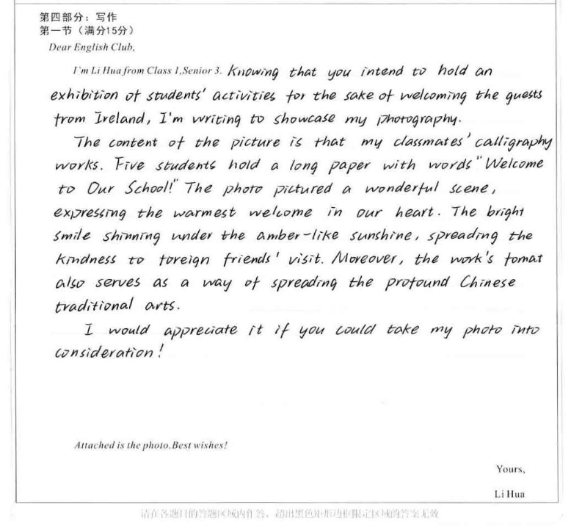
照片说明：传统书法
该生的推荐理由既表达了对爱尔兰朋友的欢迎又传播了中国的传统文化，彰显了学生思维品质，是学科知识和核心素养的巧妙融合

Slide 24
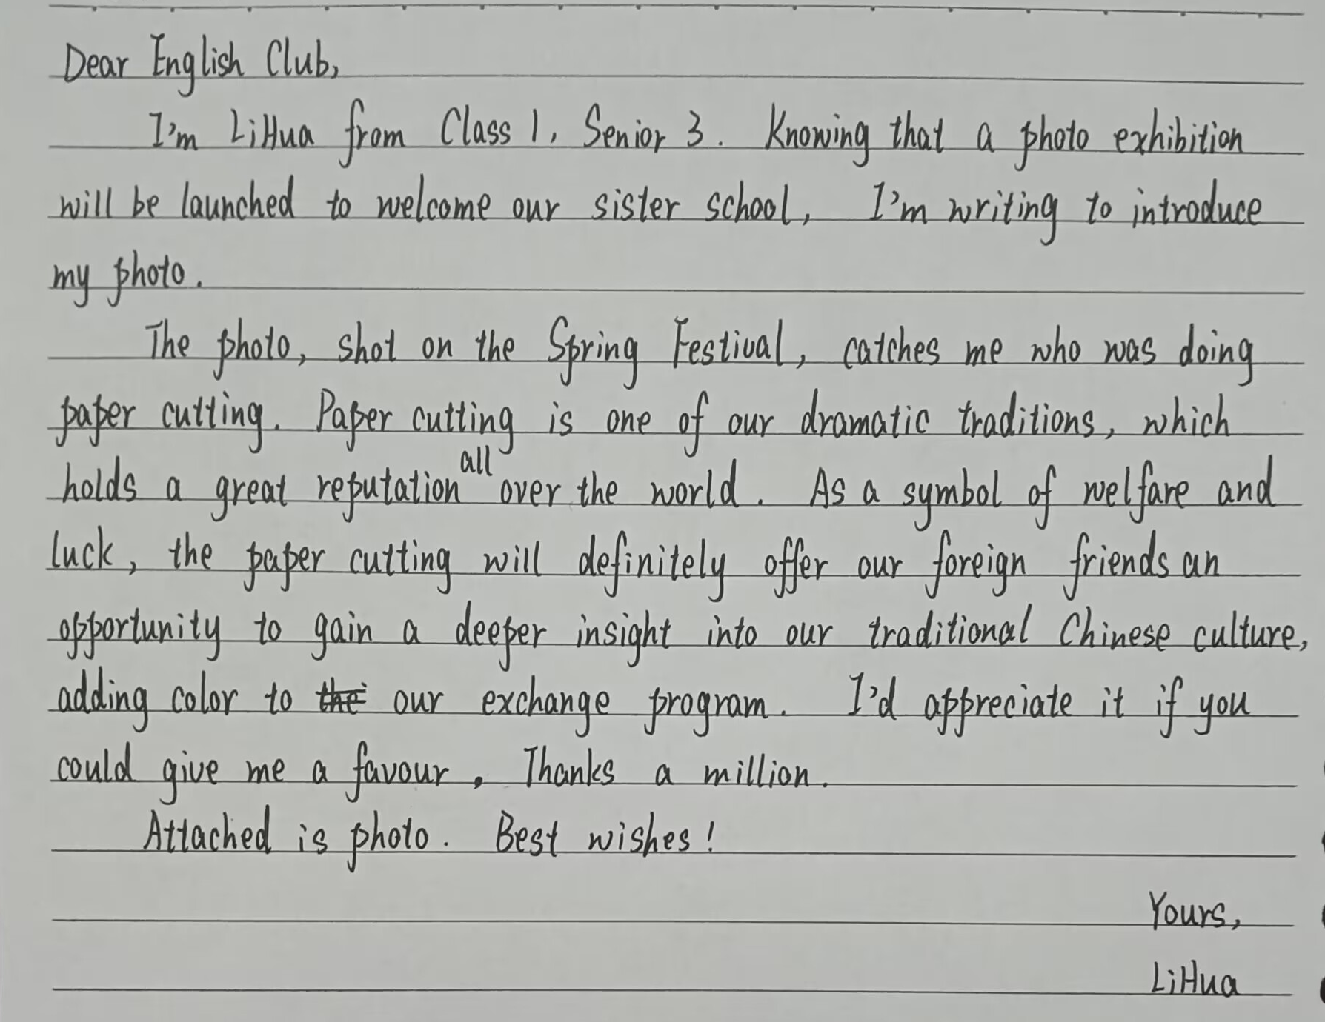
照片说明:传统剪纸
该生的推荐理是传播中国的传统文化--剪纸，让爱尔兰朋友进一步了解中国的文化，彰显了学生的思维品质和学科素养。

Slide 25
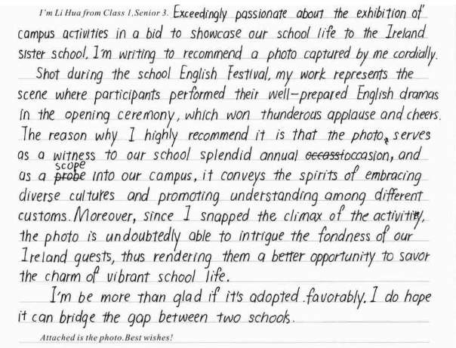
照片说明：
英语节跨文化
该生的推荐理由涉及了文化包容和文化理解，体现了学科核心素养。

Slide 26
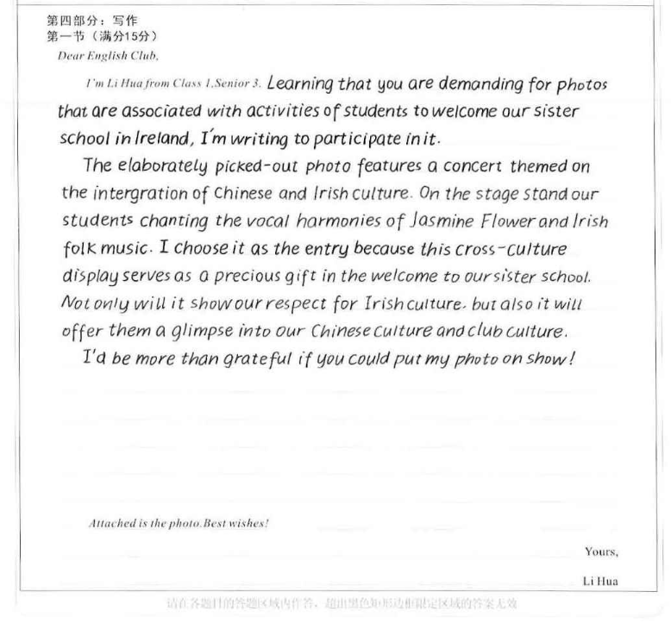
照片说明:跨文化交流
该生的推荐理由指出了对优秀文化的理解和认同，提现了核心素养的价值取向。

Slide 27
A possible reference
I’m Li Hua from Class 1, Senior 3. Thrilled to know that your club is collecting photos with the aim of welcoming the visitors from Ireland sister school, I can hardly wait to share a precious photo with you.
Shot during the summer camp in Ireland, the photo shows a warm scene--- an Irish girl and I were picking up trash when we participated in the Irish cross-country race. The reason why I will choose it is that it shows not only the friendship between transnational countries but also the responsibility of mankind --- to protect our common home --- the earth that is the home of human beings and animals.
It would be appreciative of you if you could make my photo into exhibition. In my opinion, it will be a big hit. Looking forward to your positive reply.
Attached is the photo. Best wishes!
Yours,
Li Hua

Slide 28

T
HANK YOU

