Slide 1

感恩遇见，相互成就，本课件资料仅供您个人参考、教学使用，严禁自行在网络传播，违者依知识产权法追究法律责任。
更多教学资源请关注
公众号：溯恩高中英语
知识产权声明

Slide 2
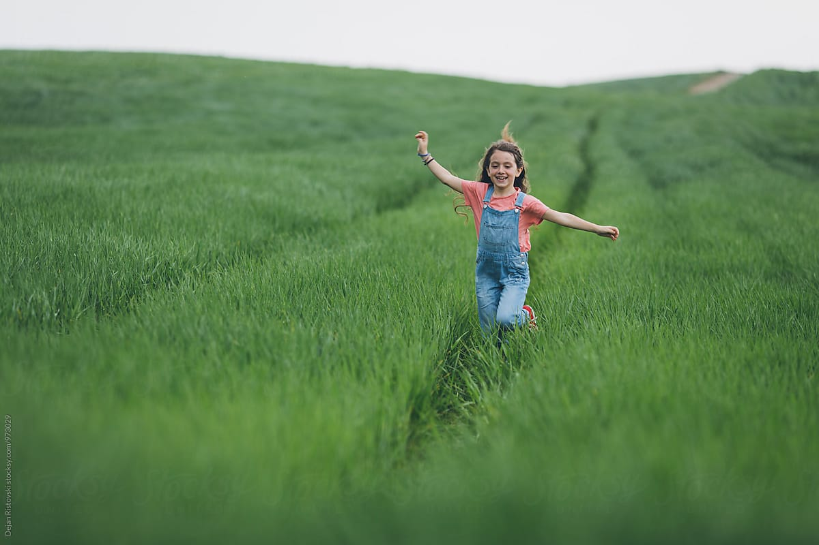
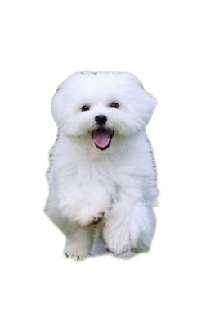
A Look into the Sample Version
2023学年第一学期浙江省名校协作体试题
高二年级英语读后续写

Slide 3
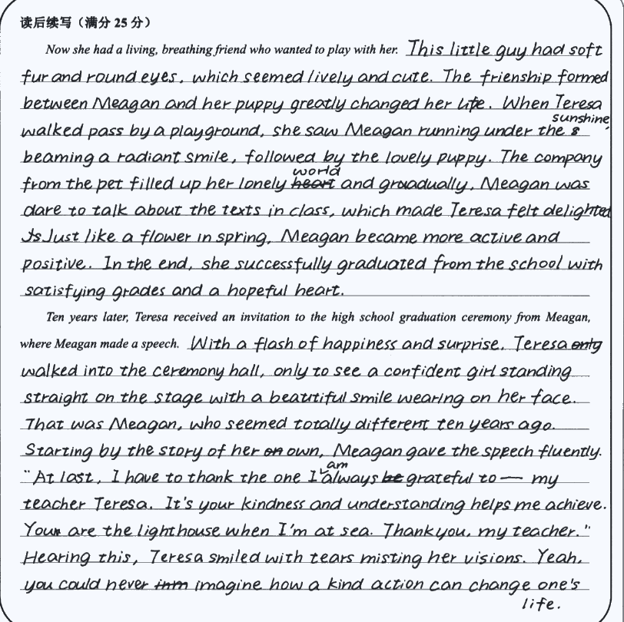
练字：整齐好辨认
情节:one paragraph one point
语言: vivid and to the point

Slide 4
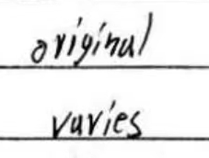
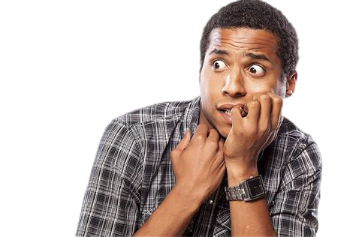

练字
A. original B. oviyinul C. oriyinal D. originul
A. ruvies B. vavies C. varies D. vuries
Can you recognize what he writes? Can the reader
of these words have a pleasant reading experience?
Make what you write down easily recognized by the reader.

Slide 5
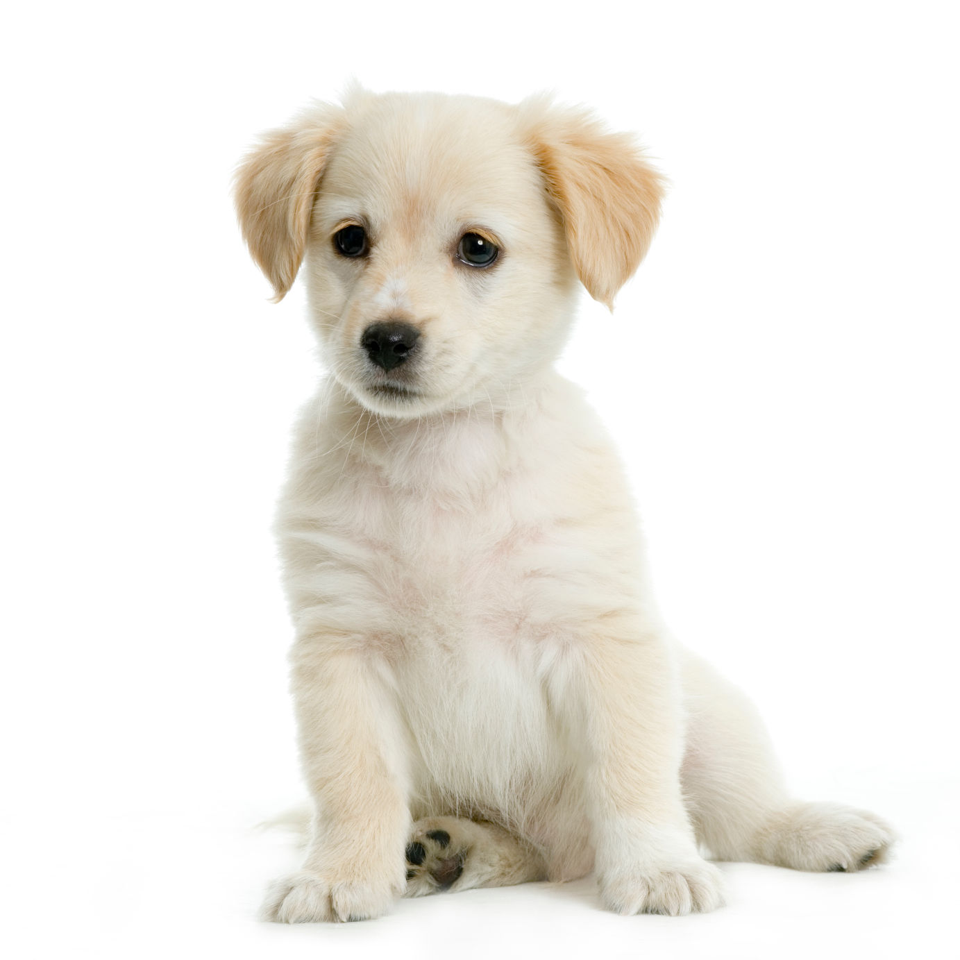
语言
情节
details vs. the storyline
❌堆砌辞藻
❌情节不积极阳光
✓自然运用已知表达方式
✓克服困难，拥抱生活
What did you write, a story or a pile of good expressions?

Slide 6
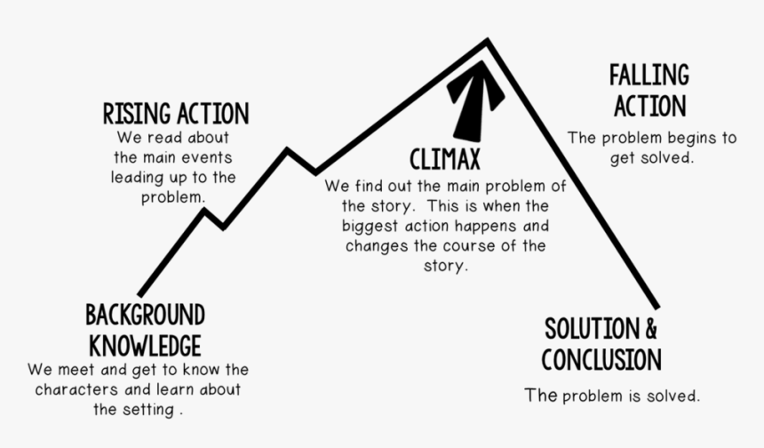

S
W
B
T
S

Slide 7
S sombody | W wanted | B but | S so | T then
who is the main character? | what did this character want? | what was the problem? | how was the problem solved? | what happened at the end?
Meagan, a third grade girl
not closed and hopeless look; not alone
kids isolate her;call her the fat pig;single- mother family and poor
let her take away a puppy
accept her invitation and have her speech
HOW?
perspective:
the third person, my wife Teresa
情节

Slide 8
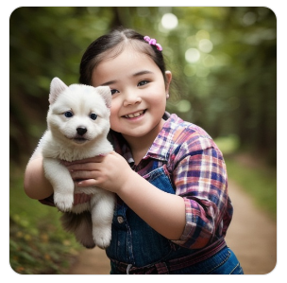
How was the problem solved when Teresa let her take away a puppy?
... Like any creature that has been cared about, Meagan gleamed(因兴奋而眼睛)发光 in her eyes and playfully开玩笑地 lifted the puppy almost off the ground. That day Meagan left the office with the puppy.
Now she had a living, breathing friend who wanted to play with her.
....
Ten years later, Teresa received an invitation to the high school graduation ceremony from Meagan, where Meagan made a speech.

Slide 9
How was the problem solved when Teresa let her take away a puppy?
... Like any creature that has been cared about, Meagan gleamed(因兴奋而眼睛)发光 in her eyes and playfully开玩笑地 lifted the puppy almost off the ground. That day Meagan left the office with the puppy.
Now she had a living, breathing friend who wanted to play with her.
in the moring ...
on her way to school ...
when she ...
how do they play?
how was the problem solved? (problem: kids isolate her;call her the fat pig;single- mother family and poor)
Ten years later, Teresa received an invitation to the high school graduation ceremony form Meagan, where Meagan made a speech.

Slide 10
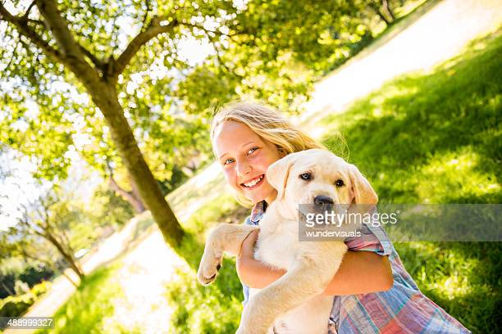
How was the problem solved when Teresa let her take away a puppy?
Now she had a living, breathing friend who wanted to play with her.
in the moring ...
on her way to school ...
when she ...
This little friend ...
general
general
how do they play?
their interaction
(specific)
how was the problem solved? (problem: kids isolate her;call her the fat pig;single- mother family and poor)
general

Slide 11
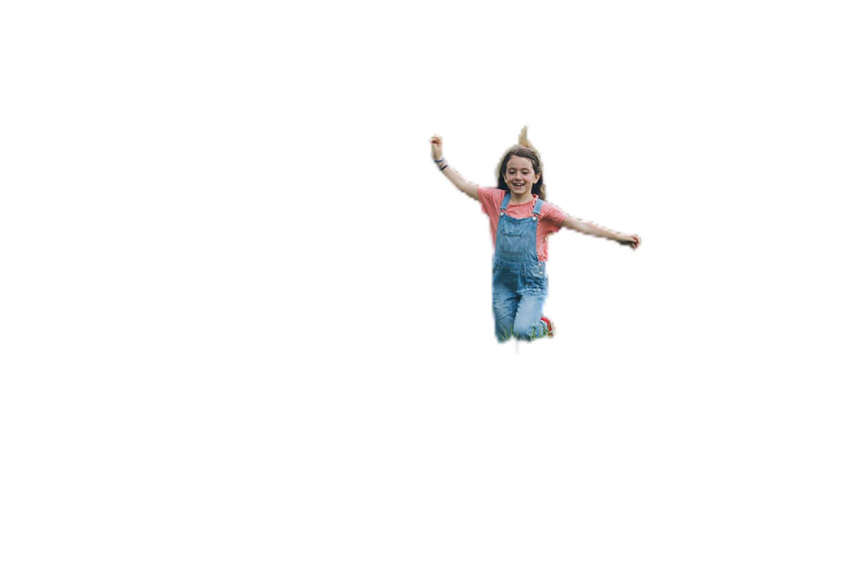
Now she had a living,breathing friend who wanted to play with her. The cute puppy loved to cuddle up next to her on the sofa and sleep next her on the bed.When Meagan came home from school, the puppy would rush to the door, and follow her from room to room through the house. They became close ones, being together whenever and wherever possible. Energized by the puppy’s unconditional love, limitless affection and loyalty,Meagan began to blossom. She did find fellow pet lovers who befriended her, and things began to improve for her physically, emotionally, and socially.
This little friend ...
their interaction
how was the problem solved? (problem: kids isolate her ...)

Slide 12
More expressions to help you make the scene more vivid.
1.The puppy leaped to his feet,wagging his tail and his eyes sparkling with excitement.
小狗跳起来,兴奋地摇着尾巴,眼睛闪闪发亮。
2.The dog stood up on its hind legs/raised its whole body on its hind legs and licked me affectionately as it used to do.
狗用后腿支起全身,像往常那样亲热地舔我。
3.At the sight of a stranger approaching, the dog watched him, ears up,head slightly cocked.
那只狗看到陌生人走近,竖起耳朵,微微拾起头,注视着他。
4.The dog locked its jaws on her leg and wouldn't let go.
那条狗咬住她的腿不放。
5.The dog stretched,shook himself and circled several times before dropping to the ground.
狗伸了一个懒腰，抖了抖身子，转了几圈才趴在地上。

Slide 13
The problem was solved (kids isolate her;call her the fat pig;single- mother family and poor)
what did this character want? not closed or hopeless look; not alone
what happened at the end? accept her invitation and have her speech (specific)
Ten years later, Teresa received an invitation to the high school graduation ceremony from Meagan, where Meagan made a speech.
How did M made the speech?
one person (from T's perspective)
What is her speech about?
T, M and the puppy ...
the end of the speech and end of the story
the audience (a lot of people)

Slide 14
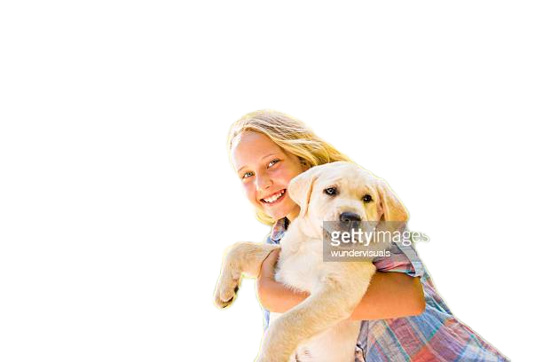
Ten years later, Teresa received an invitation to the high school graduation ceremony from Meagan, where Meagan made a speech. When Meagan strode to the platform,head high and beaming, Teresa hardly recognized her. She gave a speech on the importance of acceptance and friendship. She talked about the puppy and the great teacher she’d met in the third grade who had helped her climb the steep and treacherous slope of her childhood.It was the puppy who had comforted her when there wasn’t enough to eat in the house and who had stayed by her while she sobbed her heart out. At the conclusion of the speech,Meagan lifted her hands high,displaying a photograph of the puppy, saying,“Thank you, puppy, my close friend. Thank you,Teresa, my great teacher!”As she described,the crowd rose to their feet with cheers, laughter, and long, thunderous applause.
one person (from T's perspective)
T, M and the puppy
the audience (a lot of people)

Slide 15
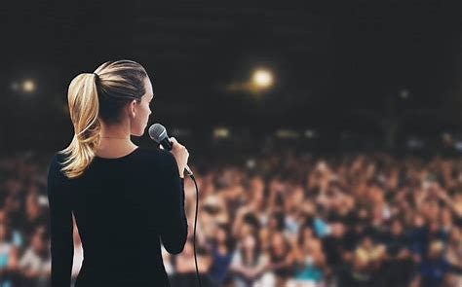
Can the 2nd paragraph develop otherwise?
⭕️ What to focus on?
In line with the previous part
⭕️ How to extend it?
Into it? Around it? Behind it?
⭕️ How to end it?
TIP: find one main point for each paragraph

Slide 16
What is the main point here? What details is written for it? The ending?

Slide 17
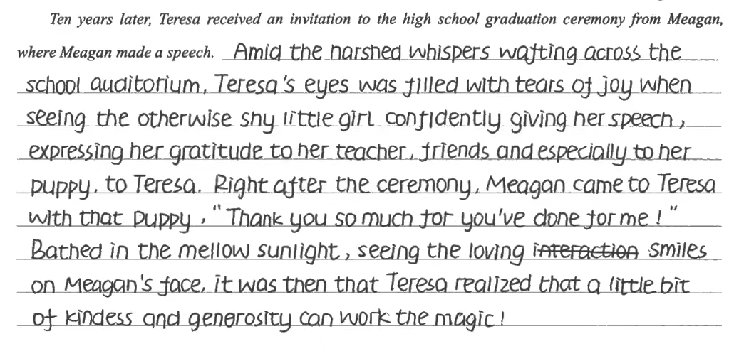
What is the main point here? What details is written for it? The ending? Can you develop it otherwise?

Slide 18
More expressions to help you make the scene more vivid.
1.Her heart beat fast,and the blood warmed and relaxed every inch of her body. 她的心跳加快,热血温暖了全身,身心完全地放松下来。
2.They looked at each other,and felt that a wave of relief went through/flooded over/washed over them. 他们凝视彼此,心中一阵宽慰。
3.I was blown away and my heart felt so full of pride and love for the brave boy. 我被震撼了,我心中满是对这个勇敢男孩的骄傲和爱。
4.Lucy's face wore a satisfied expression.
露西一脸的心满意足。
5.He nodded slowly and smiled with a look of gratitude.
他慢慢地点了点头,露出了感激的微笑。
6.Tears of gratitude welled up in her eyes as she accepted the flowers.
当她接过鲜花时,感激的泪水涌上了她的眼睛。
7.With grateful tears hanging in his eyes,he kept expressing his gratitude,“Thank you so much!” 他眼中满是感激的泪水,不停地说:“非常感谢!”

Slide 19
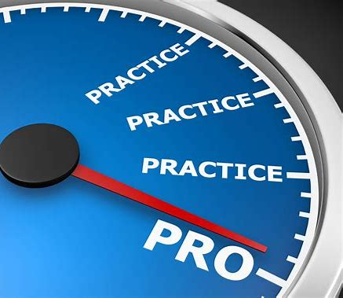
Homework:
Revise your work and write a 2nd draft.
Refer to your writing book and the samples for good expressions.

