Slide 1

感恩遇见，相互成就，本课件资料仅供您个人参考、教学使用，严禁自行在网络传播，违者依知识产权法追究法律责任。
更多教学资源请关注
公众号：溯恩高中英语
知识产权声明

Slide 2

2023.11金华十校
读后续写
What goes around
comes around.

Slide 3

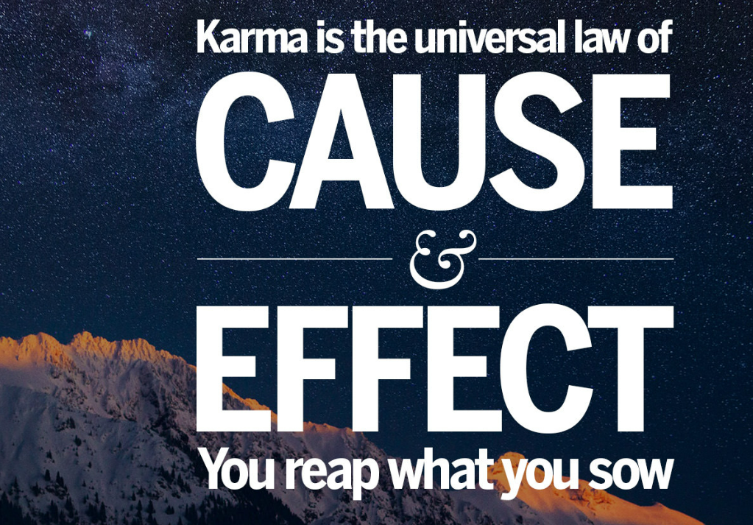
Karma is a concept with a few definitions, specifically in Hinduism and Buddhism, and the common sayings “what goes around comes around” and “what you sow is what you reap” are great examples of how karma works.
羯磨，业
因果报应

Slide 4

读原文 read the original text
语言风格 identify the linguistic features
抓矛盾和变化 focus on conflicts and changes
列提纲 draw an outline
难点突破 crack the difficult points

Slide 5

My father was the kind of person who could never pass by someone who needed help. He was a firm believer in the mantra (箴言): What goes around comes around. He believed that someday he might need help, and someone would return the favor. But I didn’t quite buy it.
One weekend, my father and I took a trip to Flaming Gorge Reservoir (水库). We loved to fish at Flaming Gorge. We owned a cabin boat that was about fifteen feet in length. We put our boat in at Sheep Creek Marina (游艇停泊港). Our goal was to go as far north as possible, spend the weekend in our boat, and fish until we had our limit.
Heading toward the Wyoming side of the reservoir, we traveled some distance before we began to fish. Frankly, the fishing wasn’t very good, but we loved being out on the boat together in such a beautiful place.
Suddenly, we saw a man on the far shore waving at us. Immediately, my father fired up the motor and went toward the other side of the reservoir, where the man was still waving at us. When we arrived, I was amazed to see a beautiful big yacht (游艇) pulled onto the shore.
The man introduced himself as Mat and then thanked us warmly for coming to his assistance. His battery was dead, and he wondered if we could help him. We did, and soon his big motor roared back to life. Mat and his family were very grateful. We lost an hour of fishing. Being an impatient teenager, I was a bit annoyed at the one-hour loss, but we were soon back out on the reservoir.
The next day the fishing didn’t improve. As a matter of fact, it was terrible, so we decided to call it quits and go back to the marina. We were about two miles from the marina when we found ourselves fighting a strong headwind that slowed our progress. The waves were kicking up, and suddenly our engine decided to quit.
Para. 1 We tried to get it running, but it simply wouldn’t start.
Para. 2 On our way home, I saw an old lady waving at our car by the roadside.
what GOes around
what COMEs around
change of attitude
→change of action

Slide 6

...our boat roared back to life
trembled a little bit and revived
impatient adj. 不耐烦的 n. impatience
limit n. 限制 adj. limited-limitless
a cabin boat 客舱船
a firm believer 忠实的信徒
in length/ width/ height/ size
长度/宽度/高度/尺寸为……
6. on the far shore 在遥远的海岸
7. pass by 经过而不被注意或采取行动
8. return the favor 回报恩情
His battery was dead. 电池没电。
His big motor roared back to life.大发动机轰鸣着发动起来了。
… we found ourselves fighting a strong headwind that slowed our progress.当我们发现自己在与一股强大的逆风作斗争时，我们的前进速度减慢了。
The waves were kicking up (海浪在翻腾), and suddenly our engine decided to quit.
9. fire up the motor 发动马达
buy it 买账
take a trip to 去旅行
travel some distance 走了一段距离
head toward 朝……方向前进
call it quits 认输，停止
find oneself doing/ done 发现自己……
slow one’s progress 放慢进度
a follower 信徒
a practitioner 实践者
personification

Slide 7


Para. 1 We tried to get it running, but it simply wouldn’t start.
Para. 2 On our way home, I saw an old lady waving at our car by the roadside.
“We felt helpless and hopeless at sea in a bad weather.”
what COMEs around
“Mat came to our rescue and successfully helped us back to land.”
change of attitude
Feeling of receiving help.
“I began to shake my previous belief and accept what father believed in.”
“She met a problem.”
→change of action
Feeling of offering help.
“I offered to help her.”
“I learnt a lesson from this experience and reflected on my life.”

Slide 8

How to show the CHANGE of feeling/ attitude/ action?
The previous annoyance gave way to/ was totally replaced with a mix of gratitude and shame. It was not until then that I came to understand what father’s mantra truly meant.
Instead of being a bystander, I urgently asked Dad to pull over and enquired her what I could do to help.

Slide 9
How to highlight the THEME?
The fishing wasn’t very good, but we harvested more than the fish-- practice (践行) of my father’s mantra and fulfilment (满足) from a random act of kindness.
It dawned on me that father was more of a practitioner (践行者) than just a believer in the mantra. And I was firmly convinced of its moral (寓意) and would spend the rest of my life living it (活学活用).

Slide 10

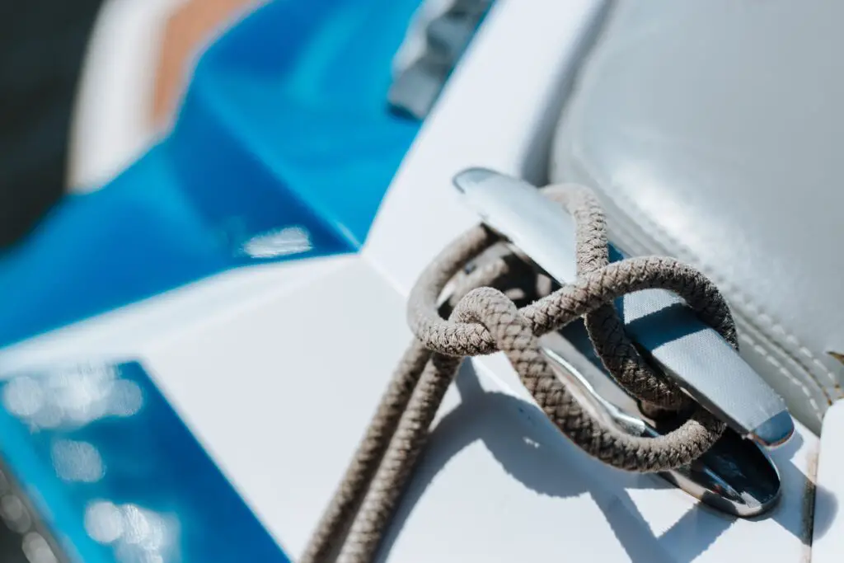
What’s the way out when stranded with (陷于某种困境) a dead battery at sea?
switch to the backup battery
get hooked to a boat
As luck would have it (说来也巧), Mat took a backup battery with him in case of that the same thing would happen. After meticulously (细致地) checking our boat, he installed (安装) the switched battery, and just for a short while, our boat trembled a little bit and revived.
We were waiting for a stroke of luck to fall upon us when the Mats showed up right in front of us, in their beautiful yacht. He pulled up alongside and jumped to ours to check if he could help. As the battery was dead, he fetched a rope, hooked our boat to his and drove/ navigated us back to the shore.

Slide 11
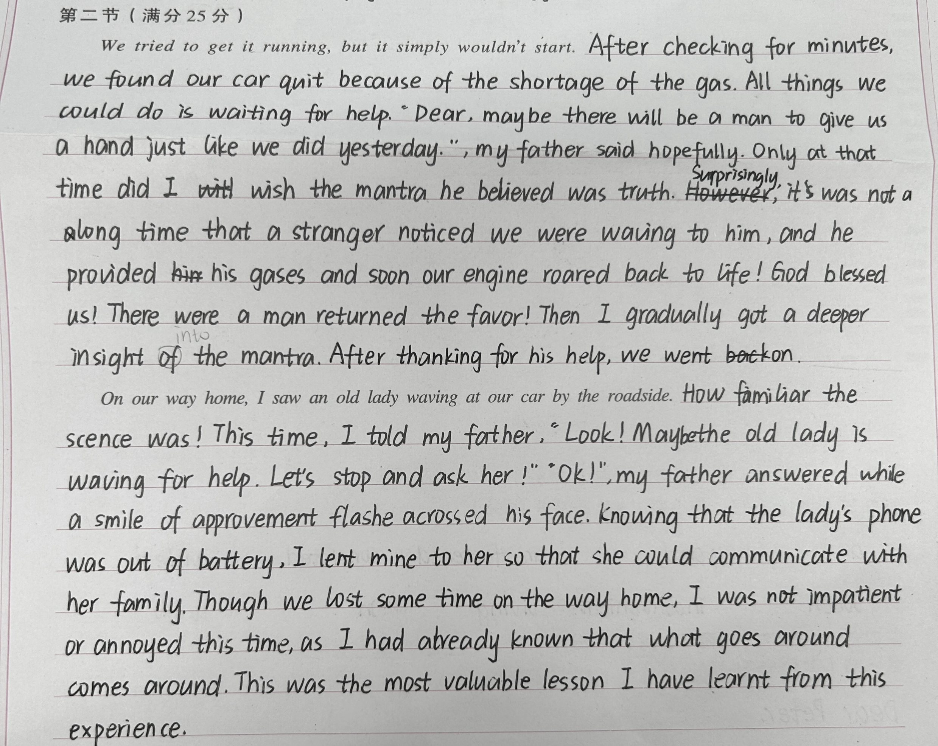
考场作文
考场得分15分
两处与原文内容不符，说明原文读的不够充分，情节无法按原文设置的框架开展。

Slide 12
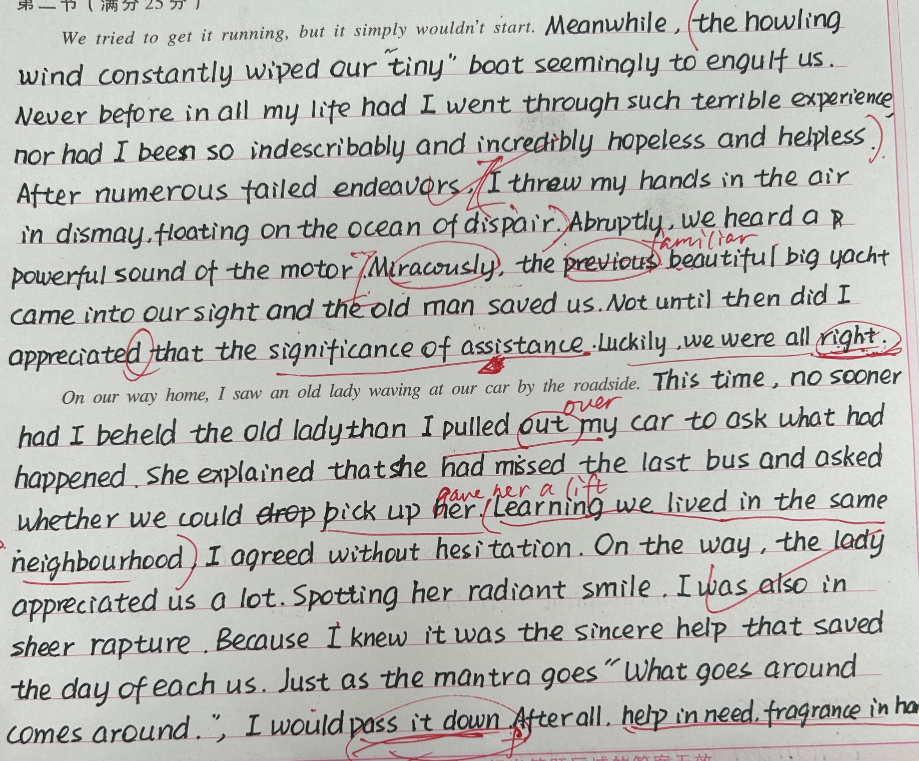
考场作文
考场得分19分
能够用比较准确丰富的语言来表达，情节合理，不仅做到与原文的协同，也能衔接自如。

Slide 13
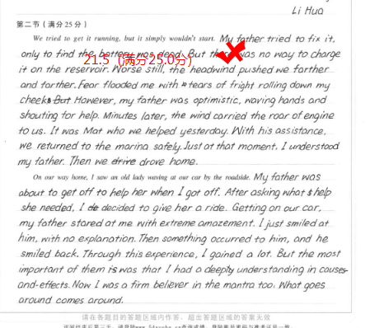
考场作文
考场得分21.5分
能够用准确丰富的语言来表达，情节顺畅合理，协同部分尤为恰当。

Slide 14
参考范文
We tried to get it running, but it simply wouldn’t start. With each unsuccessful attempt, our frustration mounted. The once-reliable engine now lay silent, leaving us adrift helplessly on the vast reservoir. (情绪变化) Suddenly, out of nowhere, Mat pulled up alongside us and asked if he could be of assistance. His friendly smile reassured us almost immediately, easing our worry. (救星出现) I was amazed that of all the people on the reservoir, Mat would be the person to show up to give us aid. (我的内心独白) Gratefully accepting his kind offer, we secured our boat to his. Chatting and laughing all the way, we returned to the marina safe and sound and were ready for home. (情节推进)
On our way home, I saw an old lady waving at our car by the roadside. Obviously, she was in need of help. (衔接) Without thinking twice, I asked my father to pull over beside her, which my father did immediately.(我的改变) As we approached the lady, her face lit up with a glimmer of hope. She explained that her car had broken down, leaving her trapped on the way. We assured her that we would help. As the engine roared back to life, the old lady’s gratitude overflowed. (问题描述+救助经过) As we waved the grateful lady goodbye, my heart swelled with a newfound understanding of my father’s mantra. What goes around really comes around. I finally had a chance to witness my father’s mantra in action and follow in his footsteps.(个人感悟)

Slide 15
下水范文
We tried to get it running, but it simply wouldn’t start. Whatever we tried, it failed, drifting us into an endless flow of desperation. Worse still, amid the fierce wind and rough waves, we feared our tiny boat would be overthrew. (情绪体现危机) As luck would have it, we were about to give in to fate when a fancy yacht came into our sight, on the prow of which was Mat waving excitedly at us. (转机) He pulled up alongside us, and after knowing what was going on, Mat jumped to ours to check if he could help. As the battery was dead, he fetched a rope, hooked our boat to his and navigated us back to the shore. (救助过程) Along the way, something began to change in my heart. (转变铺垫)
On our way home, I saw an old lady waving at our car by the roadside. Judging from her wrinkled face and exhausted figure, I guessed she was in urgent need of our help. (衔接+情况描述) Quickly we pulled over and lowered our windows, asking if we could be of some help. (行为转变) It turned out that she had waited here for about 8 hours to hitchhike to the city center. (问题描述) We readily invited her in and chatted happily on our ride. (行为转变/救助经过) When she arrived, she kept saying thanks, her eyes glinting with gratitude. It was then that I came to realize the real meaning of father’s mantra and that father was more of a practitioner than just a believer in the mantra. And I was firmly convinced of its moral and would spend the rest of my life living it. (个人感悟)

