Slide 1


感恩遇见，相互成就，本课件资料仅供您个人参考、教学使用，严禁自行在网络传播，违者依知识产权法追究法律责任。
更多教学资源请关注
公众号：溯恩高中英语
知识产权声明

Slide 2

B1U5
Reading and Thinking
The Chinese Writing System:
Connecting the Past and the Present

Slide 3







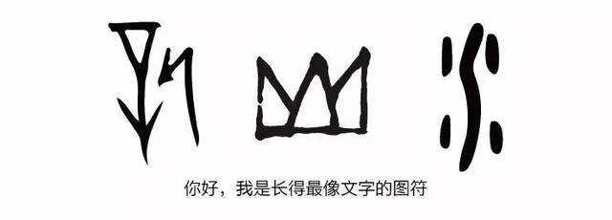

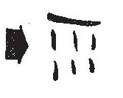

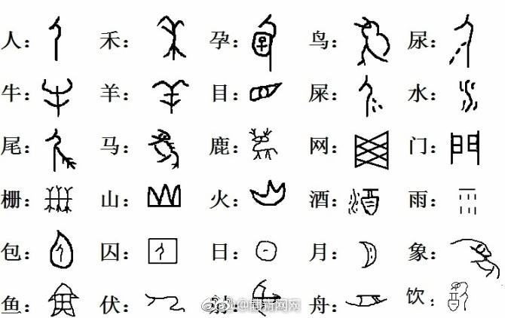




How do they develop over time?
Warming up
Warming up
Guessing
雨
火
山
水
pictographic characters
象形文字
Picture-based
Jiaguwen/oracles
carved on animal bones

Slide 4
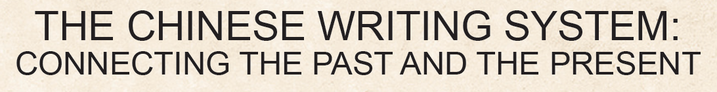
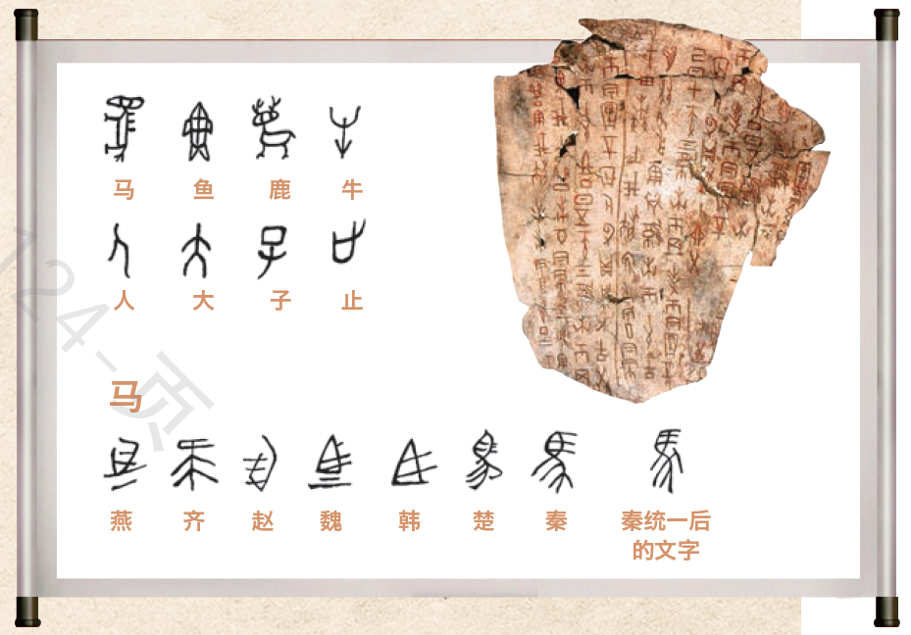
Pre-reading : Predict the content
Look at the title and picture below. Predict what the text will be about.
What will be talked about?
The passage is probably about the
—————————————
and
—————————————of Chinese writing system.
history/development
importance

Slide 5
While-reading
Activity 1: Read for main idea of each paragraph and structure
Para 1 | The Chinese writing system is one of the_______________________that help chinese civilisation survive into modern times.
Para 2 | Written Chinese was a _______________________________ at the beginning.
Para 3 | The Chinese writing system became ______________________.
Para 4 | The Chinese writing system became_____________.
Para 5 | Written Chinese connects China's __________with its ___________.
Para 6 | The Chinese language is helping to____________ China's culture and history to the world.
Main idea
Para
main factors
picture-based language
well-developed
unified
present
past
spread

Slide 6
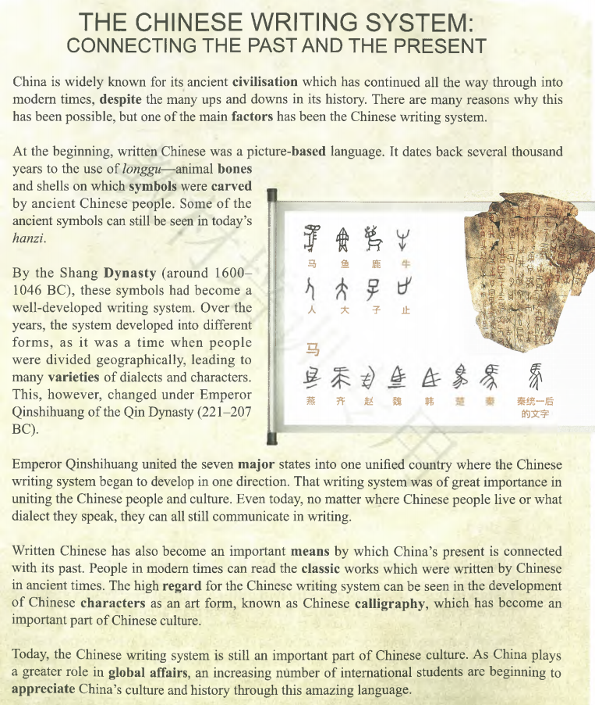

Activity 2: Read for text type and structure
What’s the type of the text?
A.Narration(叙述文) B.Argumentation(议论文) C.Exposition (说明文)
①
②
③
④
⑤
⑥
The introduction
The history
The importance

Slide 7
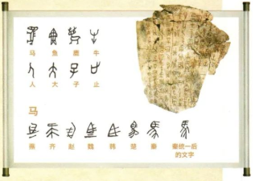
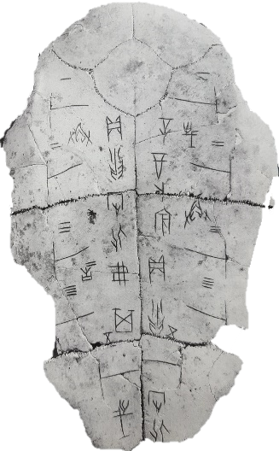
While-reading
Part 2
Activity 3: Focusing on the development
Para 2-4: the history/development of the Chinese writing system
Q1: What kind of words can show the development of the Chinese writing system clearly?
Q2: What happened to the Chinese characters at those important times?
Before life began
Long time ago
A picture-based language;
symbols carved on animal bones and shells
At the beginning
By the Shang Dynasty
Over the years
By the Qin Dynasty
Today

Slide 8
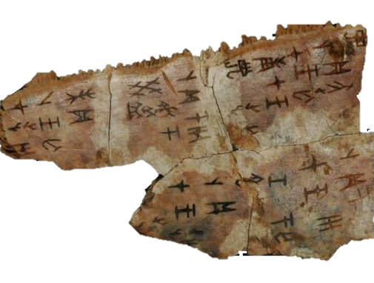
Activity 3: Focusing on the development
Part 2
Para 2-4: the history/development of the Chinese writing system
Read para2-4 to draw a mind map to show the development of the Chinese writing system.
Long time ago
At the beginning
By the Shang Dynasty
A well-developed writing system
Over the years
By the Qin Dynasty
Today

Slide 9
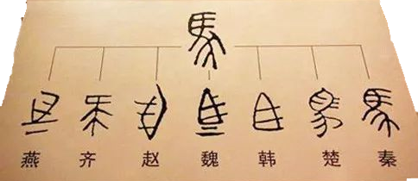
Activity 3: Focusing on the development
Part 2
Para 2-4: the history/development of the Chinese writing system
Read para2-4 to draw a mind map to show the development of the Chinese writing system.
At the beginning
By the Shang Dynasty
Developed into different forms
Divided geographically
Many varieties of dialects and characters
Over the years
By the Qin Dynasty
Today

Slide 10
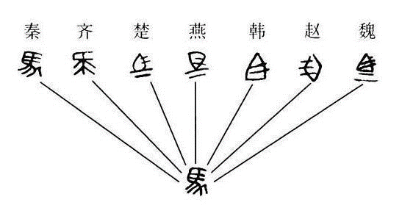
Activity 3: Focusing on the development
Part 2
Para 2-4: the history/development of the Chinese writing system
Read para2-4 to draw a mind map to show the development of the Chinese writing system.
At the beginning
By the Shang Dynasty
Over the years
By the Qin Dynasty
Developed in one direction
Today

Slide 11
Part 2
Para 2-4: the history/development of the Chinese writing system
Read para2-4 to draw a mind map to show the development of the Chinese writing system.
At the beginning
By the Shang Dynasty
Over the years
By the Qin Dynasty
Today
All Chinese people can communicate in writing

Slide 12
Activity 3: Focusing on the development
Retell the history/development of the Chinese writing system
Several thousand years ago
By the Shang Dynasty
(Over the years)
In the Qin Dynasty
Today
the Chinese writing system
picture-based symbols
a well-developed writing system
different forms
began to develop
in one direction
still an important part of culture

Slide 13
Part 3
Para 5-6: the significance/importance of the Chinese writing system
Read para 4-6 to underline sentences including “importance” or “important”.
Emperor Qinshihuang united the seven major states into one unified country where the Chinese writing system began to develop in one direction. That writing system was of great importance in uniting the Chinese people and culture. Even today, no matter where Chinese people live or what dialect they speak, they can all still communicate in writing.
Written Chinese has also become an important means by which China’s present is connected with its past. People in modem times can read the classic works which were written by Chinese in ancient times. The high regard for the Chinese writing system can be seen in the development of Chinese characters as an art form, known as Chinese calligraphy, which has become an important part of Chinese culture.
Today, the Chinese writing system is still an important part of Chinese culture. As China plays a greater role in global affairs, an increasing number of international students are beginning to appreciate China’s culture and history through this amazing language.

Slide 14
Part 3
Para 5-6: the significance/importance of the Chinese writing system
Read para 4-6 to underline sentences including importance or important.
Emperor Qinshihuang united the seven major states into one unified country where the Chinese writing system began to develop in one direction. That writing system was of great importance in uniting the Chinese people and culture. Even today, no matter where Chinese people live or what dialect they speak, they can all still communicate in writing.
Written Chinese has also become an important means by which China’s present is connected with its past. People in modem times can read the classic works which were written by Chinese in ancient times. The high regard for the Chinese writing system can be seen in the development of Chinese characters as an art form, known as Chinese calligraphy, which has become an important part of Chinese culture.
Today, the Chinese writing system is still an important part of Chinese culture. As China plays a greater role in global affairs, an increasing number of international students are beginning to appreciate China’s culture and history through this amazing language.

Slide 15
Part 3
Para 5-6: the significance/importance of the Chinese writing system
That writing system was of great importance in uniting the Chinese people and culture.
unite people and culture
Written Chinese has also become an important means by which China’s present is connected with its past.
the past and the present
connect
…in the development of Chinese characters as an art form, known as Chinese calligraphy, which has become an important part of Chinese culture.
an art form
make Chinese characters
foreigners
Today, the Chinese writing system is still an important part of Chinese culture.
make it possible for
to
appreciate China’s culture and history

Slide 16
What does each importance refer to?
Part 3
Para 5-6: the significance/importance of the Chinese writing system
unite people and culture
connect people and culture
the past and the present
connect the past and the present
connect
language and art
an art form
connect
make Chinese characters
foreigners
make it possible for
to
China and the world
appreciate China’s culture and history
connect

Slide 17
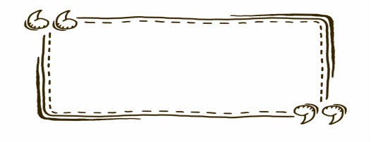
Summary
Introduction
the Chinese writing system
To introduce the topic: ___________________.
History
picture-based
well-developed
in one direction
use of longgu
different forms
connect people and culture
Importance
connect the past and the present
connect characters and art
connect China and the world

Slide 18
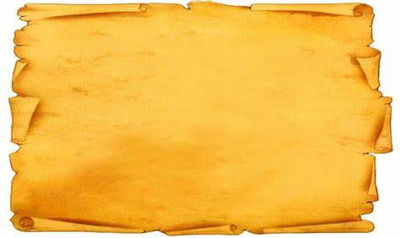
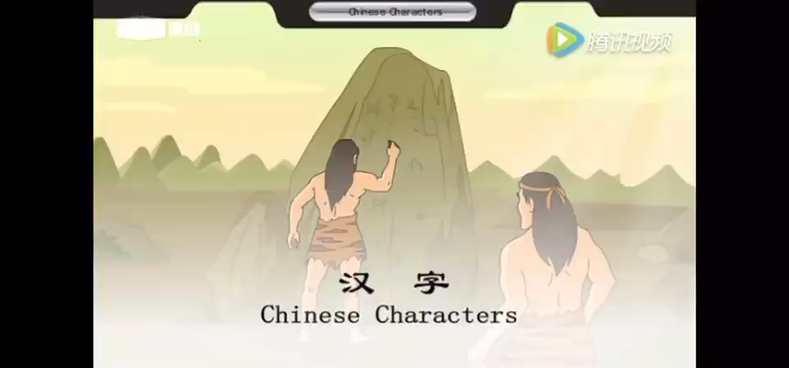
Warming up

Slide 19

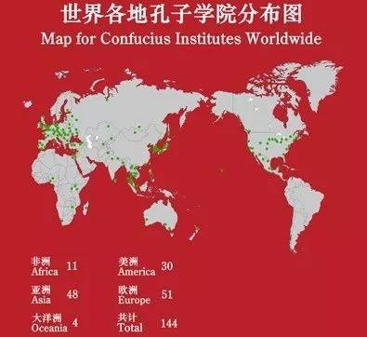
Post-reading：thinking and sharing
Para6: As China plays a greater role in global affairs, an increasing number of international students are beginning to appreciate China’s culture and history through this amazing language.
As teenagers, what can we do to help to preserve , inherit (传承) and spread the Chinese characters?
Improve our Chinese and English to guarantee smooth communication;
Have a good knowledge of Chinese culture and learn some traditional arts when interested;
Introduce Chinese culture including chinese calligraphy to foreigners if possible ;
To be a volunteer Chinese teacher for foreigners...

Slide 20
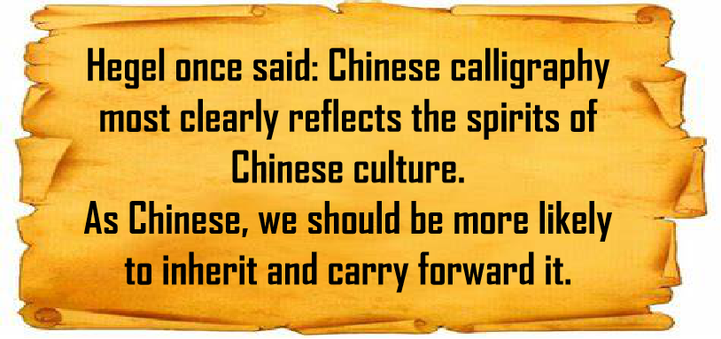

Slide 21
Assignment
Make a speech on the opening ceremony of the Festival of Chinese Characters in your school to call on students to make the Chinese writing system known to more people. Your speech should include:
① a topic;
② the development, function and importance of the Chinese writing system;
③ a conclusion.

Slide 22
One possible Version
Dear fellow students ,
Why can Chinese civilization continue all the way through into modern times ? The Chinese writing system have made a great difference in the process . So my topic is " Appreciate the Importance of Chinese Writing system.”
First of all , the Chinese writing system is of great importance in connecting the past and the present . It began as symbols carved on longgu several thousand years ago , some of which can still be seen in today ' s hanzi .It is also a very important means of connecting people and culture . In the Qin Dynasty , it developed in one direction . So , even today , people still can communicate with each other .

Slide 23
Besides , it can also connect with art , for Chinese characters have develope into an important art form --- Chinese Calligraphy . What ' s more , it even connects China and the world . Many foreign students are beginning to appreciate China ' s culture and history through it .
As a Chinese , I ' m really proud of the amazing Chinese writing system . It is a great achievement for us to write Chinese characters well . It ' s really an honor for us to do something to help develop it better .Wherever we go , written Chinese is our root , which carries our culture and history !We should be proud of our language , better promote our language , and better shoulder the responsibility of spreading our ancient civilization .
That ' s all . Thank you !

