Slide 1


感恩遇见，相互成就，本课件资料仅供您个人参考、教学使用，严禁自行在网络传播，违者依知识产权法追究法律责任。
更多教学资源请关注
公众号：溯恩高中英语
知识产权声明

Slide 2

XB4U5单词拓展
浙江省义乌市青岩书院：普薇薇

Slide 3


bounce /baʊns/ v.(使)弹起;上下晃动 n.弹性
孩子们听到他们将有额外一天的假期时开心地跳上跳下。
The kids started bouncing up and down when they heard they would have an extra day leave.
他还没决定去哪所大学，仍然在几个选择中犹豫。
He hasn't settled on a college yet, still bouncing back and forth between a few options.
此次活动将为参加者提供一个机会与志同道合的人们进行交流。
The activity will offer participants an opportunity to bounce ideas around with like-minded people.
参加者们在过程中交流想法，建立了愉快而又获益良多的关系。
Participants bounced ideas back and forth in the process, establishing a happy and fruitful relationship with each other.

Slide 4
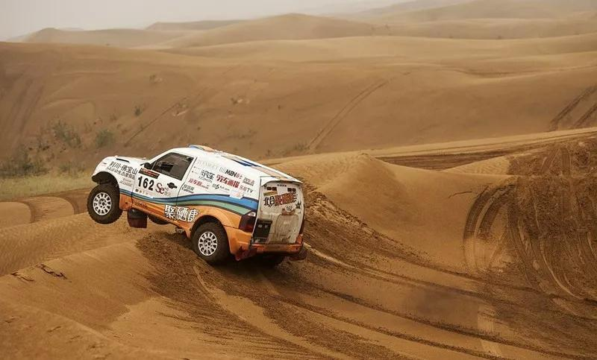
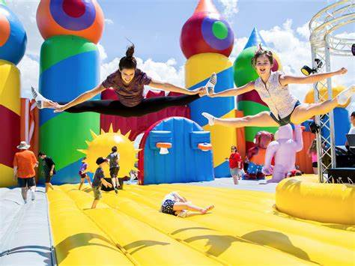
bounce around /baʊns əˈraʊnd/ 蹦来蹦去;弹来弹去
这些车十分颠簸。
These vehicles bounced around quite a bit.
他们会跳来跳去，希望能引发连锁反应。
They will bounce around and hopefully start a chain reaction.
从充气城堡到巨大的滑梯，最小的客人们整个下午都在院子里蹦蹦跳跳。
From air-filled castles to giant slides, littlest guests bounced around in the yard all afternoon.

Slide 5

aptitude /ˈæptɪtju:d/ n.天资;天赋
他表现出了高超的木工技艺。
He has demonstrated a great aptitude for carpentry skills.
他非凡的工作才能使他获得了学生会主席的职位。
His extraordinary aptitude for work secured for him the position of the chief of the Student Union.
通过所提供的课程，你将发展语言研究的特殊才能。
Via the course offered, you will develop special aptitude for linguistic studies.
从她早年起，她就表现出了很强的学习天赋、热情的精神和毋庸置疑的天赋。
From her early years she showed great aptitude for study, an ardent and enthusiastic spirit, and unquestionable talent.

Slide 6
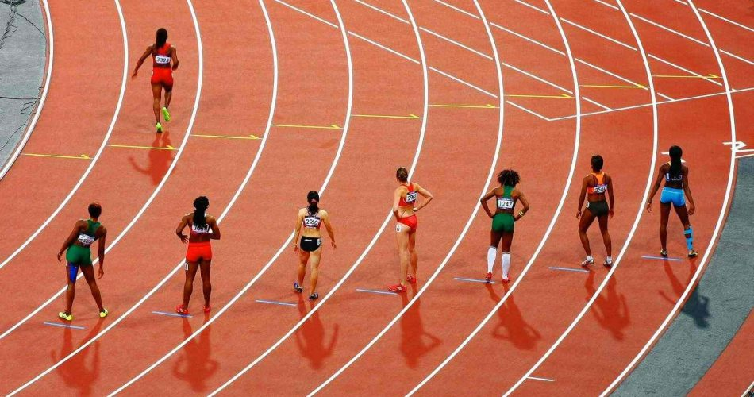
head start /hed stɑ:t/ 起步前的优势
作为一名新生，我想知道什么技能可以让我们在校园生活中领先一步。
As a freshman, I wonder what skills might give us a head start in our campus life.
能够说另一种语言使她比其他候选人领先一步。
Being able to speak another language has given her a head start over other candidates.
到初夏，她的游泳技术已经领先，而且她像水中的鱼一样灵活。
By early summer her swimming skill has a head start and she is as flexible as a fish in the water.

Slide 7

scenario /səˈnɑ:riəʊ/ n.设想;方案;预测
我们正在寻找最可行的方案。
We are looking for the most feasible scenario.
杰克逊咧嘴笑着说：“只要有一点提前的计划，我想你就会避免这种情况。”
Jackson grinned, "With a little advanced planning, I think you will avoid that scenario."
她在比赛中失败这样最坏的情况已经不可能了。
The worst case scenario – that she failed the race – was no longer possible.

Slide 8
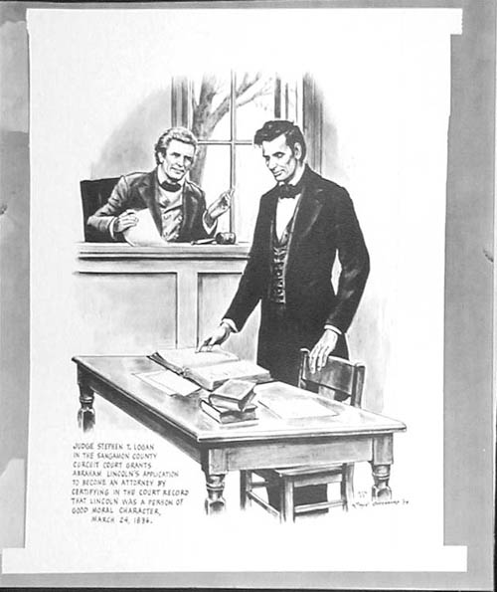
lawyer /ˈlɔ:jə(r)/ n.律师
安迪·克拉克是著名电视剧《好律师》的男主角。但自该剧最后一季播出以来，他的人气有所下滑。23年1月浙江卷
Andy Clarkes is the leading actor in The Good Lawyer — the famous TV series. But his popularity has slipped since the final season of the show.
林肯的法律生涯最初源于爱好，他喜欢去法院听一些优秀的演讲。不久后，他开始阅读法律书籍，并于1836年通过了一个律师小组的口试，获得了律师执照。
Lincoln’s career in law began as a hobby of visiting courthouses to hear examples of great discourse. Before long he began reading law books and in 1836 he passed an oral exam conducted by a panel of lawyers and received his law license.

Slide 9
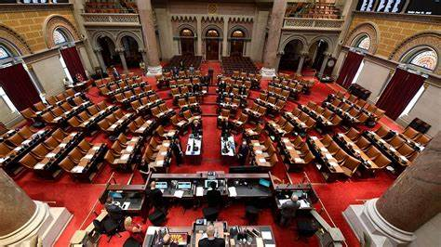
assemble /əˈsembl/ vt.组装;装配 v.收集;聚集
assembly n. 集会- assembling adj. 组合的
俱乐部决定制定一个学年会议计划。
The club decided to assemble a plan for meeting during the school year.
以下网站出售易于组装的科学工具包，这些工具包提供了激励所有年龄段的工艺爱好者所需的一切。
The following websites sell easy to assemble science kits that come complete with everything you need to inspire craft-lovers of all ages.
最后，我们都集合起来准备行动，然后嘟嘟作响地来到散布在该地区的各种峭壁上。
Eventually we all assemble ready for action and tootle off to various crags dotted around the area.

Slide 10
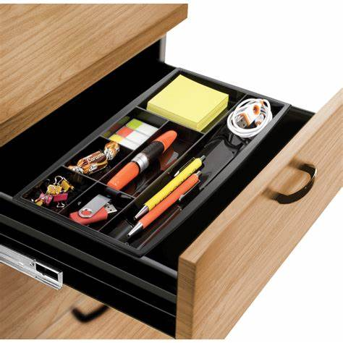
drawer /drɔ:(r)/ n.抽屉
我有一个抽屉，里面装满了给圣诞老人的信。每年我的孩子们都会写下他们的圣诞愿望清单。礼貌地索要最新的游戏或玩具。22年1月高考浙江卷
I have a drawer full of letters to Santa. Each year my children would write up their Christmas wish lists. They were polite requests for the latest game or toy.
她从抽屉里抓起一把衣服，扔进手提箱里。
She grabbed a handful of clothes from the drawer and threw them into the suitcase.
虽然有些善行可能会被尘封在抽屉里，但你的朋友每次去球场时都会想起你。
While some favors may end up in the back of a drawer, your friends will think of you every time they hit the course.

Slide 11
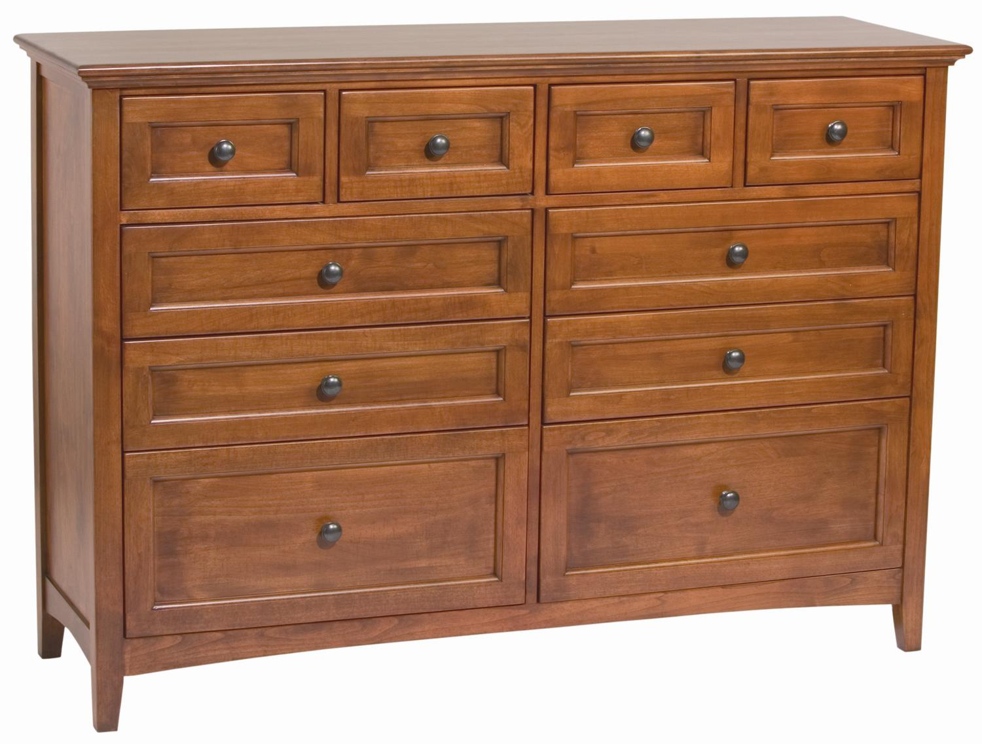
a chest of drawers /ə tʃest əv drɔ:z/ 抽屉柜
他的秘密趣味空间是一个刻有“火箭”、“外星人”和“激光”字样的抽屉柜。
His secret fun space features a chest of drawers inscribed with “Rockets”, “Aliens” and “Lasers”.
这儿有两个小抽屉柜、床头灯和一个嵌入式橱柜。
There are two small chests of drawers, bedside lamps, and a built-in cupboard.

Slide 12
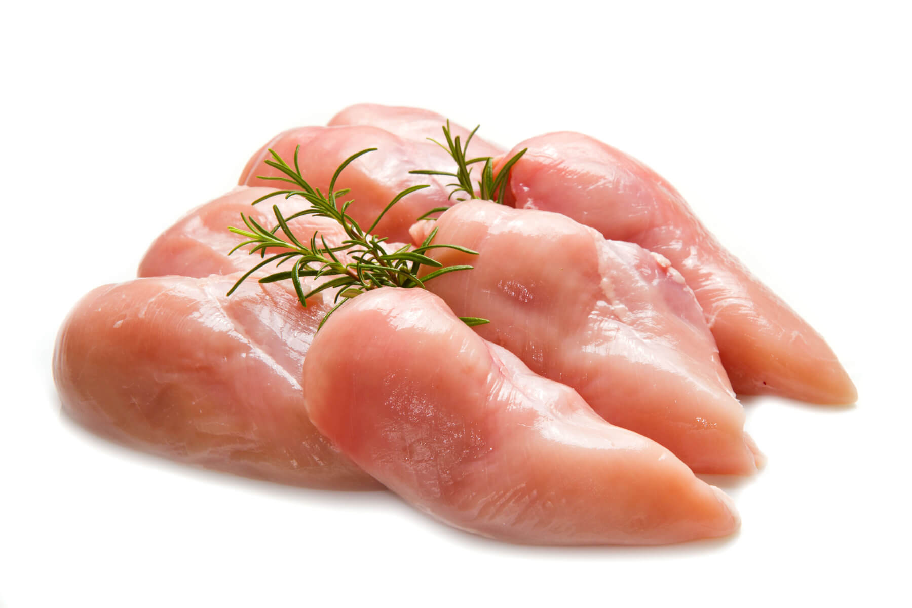
breast /brest/ n.乳房;胸部
简单地使用去皮的鸡胸肉可以减少你膳食中的脂肪量，这是健康的烹饪。
Simply using skinless chicken breast will reduce the amount of fat in your meal and that is healthy cooking.
他的脸上没有表情，但她感觉到了他心里的挣扎。
His face remained emotionless, but she sensed the struggle within his breast.
当Lily见到父亲时，她扑倒他怀里，抽泣起来。
When Lily met Dad, she fell on his breast, sobbing.
她的笑容消失了，胸中满是疼痛。
Her smile faded, pain filling her breast.

Slide 13

hydrogen /ˈhaɪdrədʒən/ n.氢;氢气
这种气体含有一定量的氢和碳氧化物，还含有微量的氮。
The gas contains a certain amount of hydrogen and oxides of carbon, also traces of nitrogen.
化学反应后氢仍然是透明的。
Hydrogen still remains transparent after the chemical reaction.

Slide 14
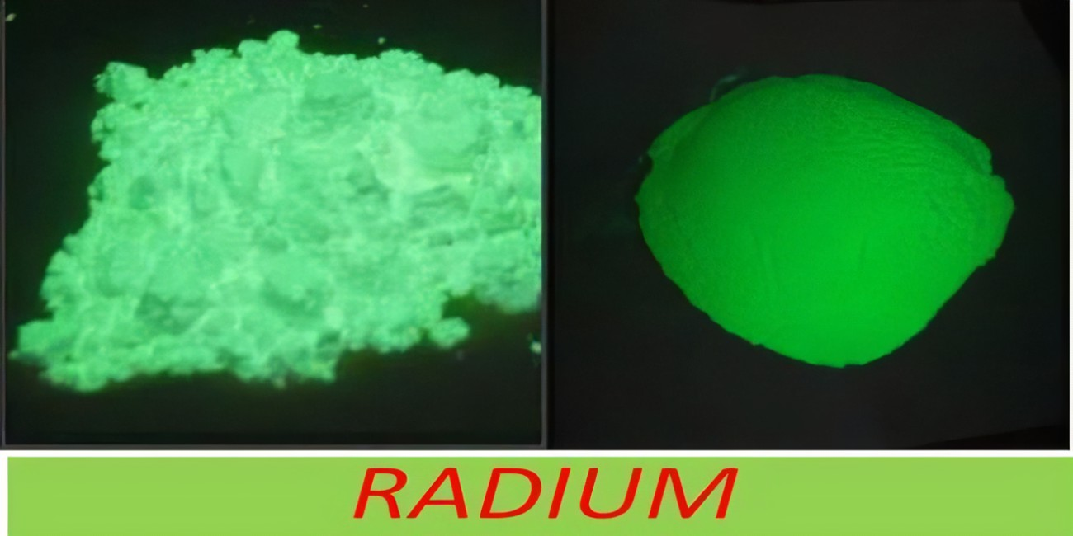
radium /ˈreɪdiəm/ n.镭
乍一看，优势的平衡似乎在于镭。
At first sight， the balance of advantages seems to lie with radium.

Slide 15
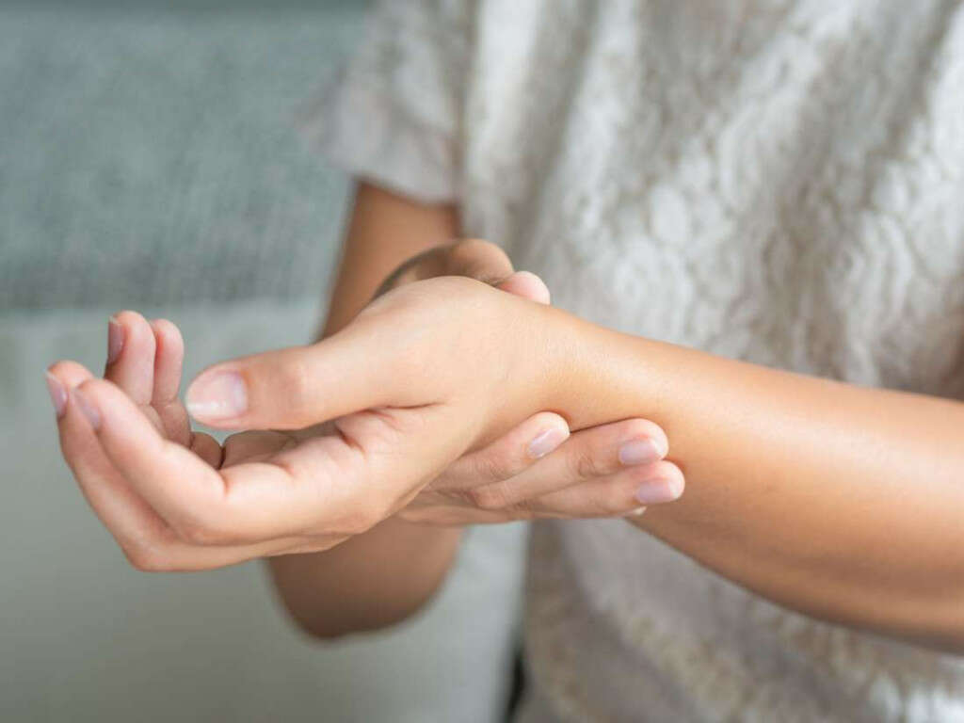
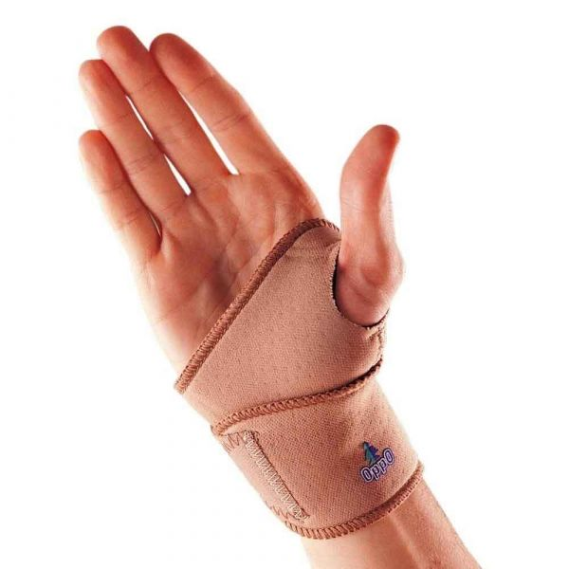
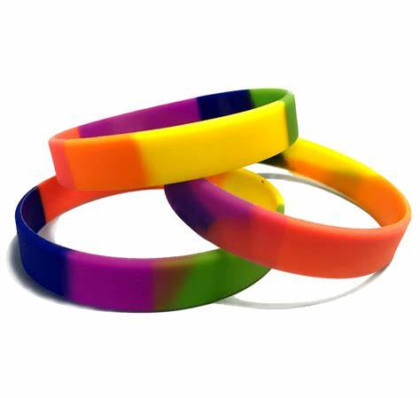
wrist /rɪst/ n.手腕;腕关节
他抓住她的手腕，眼中冒火。
He grabbed her wrist, his eyes flashing fire.
他紧紧抓住她的手腕，低下头。
He gripped her wrist hard, lowering his head.
她从受伤的手腕上抬起头来看着小Mike，棕色的眼中满是心疼。
She looked up at him from his hurt wrist, pain in her brown eyes.
(medical/ sport) wrist band
（医用/运动）腕带

Slide 16

bridegroom /ˈbraɪdgru:m/ n.新郎
bride 新娘
groomsman-groomsmen 伴郎
bridemaid(s) 伴娘
新郎新娘伴着喜悦的人们，走向城堡大门。
Bride and bridegroom, accompanied by the joyous crowd, proceeded to the castle gate.
当新娘和新郎走向讲台时，雨水打在他们的脸上。
The rain drove into the bride and bridegroom's faces as they passed to the podium.

Slide 17

geometry /dʒiˈɒmətri/ n.几何学;几何图形
学习形状是几何的入门。
Learning shapes is an introduction to geometry.
受邀参加即将到来的学术节的教授将会和我们分享几何的历史。
The professor invited to the coming academic festival will share the history of geometry with us.
他的一生致力于高等几何的研究和改革意大利更先进的数学教学。
His life was devoted to the study of higher geometry and reforming the more advanced mathematical teaching of Italy.

Slide 18

debt /det/ n.债务;欠款
在遭受损失后，他决心在五年内还清对父母的债务。
After his losses, he had determined to pay back his debt to his parents in five years.
如果你现在有很多债务悬在头上，这可能会让你感到绝望。
If you have a lot of debt hanging over your head right now, it might be making you feel hopeless.
Related Idioms:
owe a debt of gratitude： 对某人做的事情非常感谢
debt to nature：死亡
我们感谢你为我们所做的一切。
We owe you a debt of gratitude for all you have done for us.
当我离世时，我希望我身边有我的家人。
When I'm ready to pay my debt to nature, I hope I'm surrounded by my family.

Slide 19

categorise /ˈkætəɡəraɪz/ vt.把…分类(加以归类)
当你被一大堆资源淹没时，对它们进行分类将帮助你保持一切有序。
When you are overwhelmed to be presented with a huge list of resources, categorising them will help you keep everything in order.
有了详细的计划，Ricky把他的杂物进行了分类，把每一项任务都安排得井井有条。
With a detailed plan, Ricky categorised his groceries and arranged every task orderly.
对于那些将自己归类为“不感兴趣”的人来说，简单的图形使陈述立即变得吸引而又平易近人。
The simple graphics make presentation immediately appealing and approachable for someone who would categorise themselves as a "uninterested" guy.

Slide 20

profile /ˈprəʊfaɪl/ n.简介;概述 vt.扼要介绍
她的鹰钩鼻子，侧面看最明显，一定在小学时给她带来了无数的昵称。
Her hawk-shaped nose, most pronounced in profile, must have led to numerous grade school nicknames.
在初现的月光下，迪恩看到她那不安的侧影。
Dean could see her troubled profile in the emerging moonlight.
Related Idioms:
keep/ maintain a low profile
Tina多才多艺，却能保持低调，真是令人惊讶。
With her many talents, it's surprising that Tina has managed to keep a fairly low profile.
Sample Student’s Profile

Slide 21

participant /pɑ:ˈtɪsɪpənt/ n.参与者;参加者
participate v.参与,参加 -participation n. 参与,参加
你将听到这些参与者的故事，了解哪些策略对他们有效，以及他们遇到了什么陷阱，你应该避免。2023年6月全国高考英语卷I
You’ll hear these participants’ stories and learn what strategies worked well for them, and what traps they encountered that you should avoid.
研究人员检查了参与者在完成创造性思维测试时的各种噪音水平。2021年高考英语全国乙卷
The researchers examined various levels of noise on participants as they completed tests of creative thinking.
有价值的是为项目带来有效、可信数据的参与者。
Valuable is the participant who brings valid, credible data to the project.

Slide 22

code /kəʊd/ n.代码;密码 vt.编码
研究人员将参与者提交的材料分类。 2023年6月全国新高考卷I
The researchers code participant submissions into categories.
他破解了密码，进入了隐藏的金库。
He cracked the secret code and gained access to the hidden vault.
她对信息进行了编码，这样只有预定的收件人才能理解。
She coded the message so that only the intended recipient could understand it.
Related Idioms:
break/crack a/the code 破译代码
code red 红色警戒

Slide 23

orient /ˈɔ:rient/ vt.使适应;使面对;确定方向
她决定利用太阳来调整自己的方位，绕了几片茂密的黑莓灌木丛。
Deciding to use the sun to orient herself, she detoured around several dense patches of blackberry bushes.
当她试图再次调整自己的方向时，她的眼神飞到了警卫身上。
Her eyes flew up to the guard as she sought to orient herself once again.
乘坐东方快车的火车旅行——在最蓝的水面上放松或享受欧洲的生活方式，只是众多度假机会中的一小部分。
A train trip on the Orient Express, relaxing on the bluest water or enjoying the European lifestyle are just a few of the many vacation opportunities offered.

Slide 24
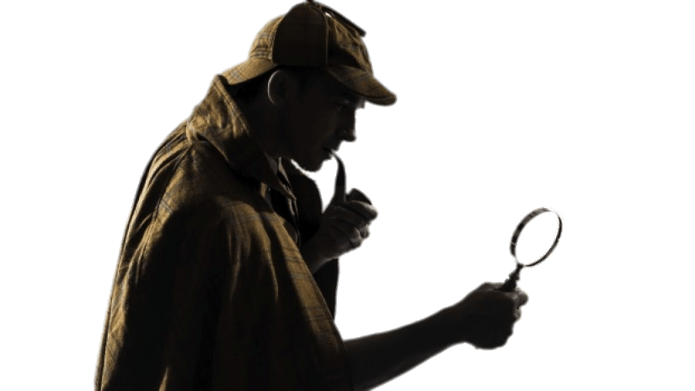
detective /dɪˈtektɪv/ n.侦探;警探
自19世纪末福尔摩斯出生以来，他一直是许多调查人物的灵感来源。
Detective Holmes has been the inspiration for many, many investigative characters since his birth in the late 1800s.
不错的侦探工作——我之前就预感凯特琳打碎花瓶，现在我确信了。
Nice detective work—I had a feeling Calvin broke the vase, and now I know for sure.
侦探看了我一眼，但什么也没说，他把我带下一条长长的走廊，来到一间黑暗的后屋。
The detective gave me a look but said nothing as he led me down a long corridor to a darkened back room.

Slide 25
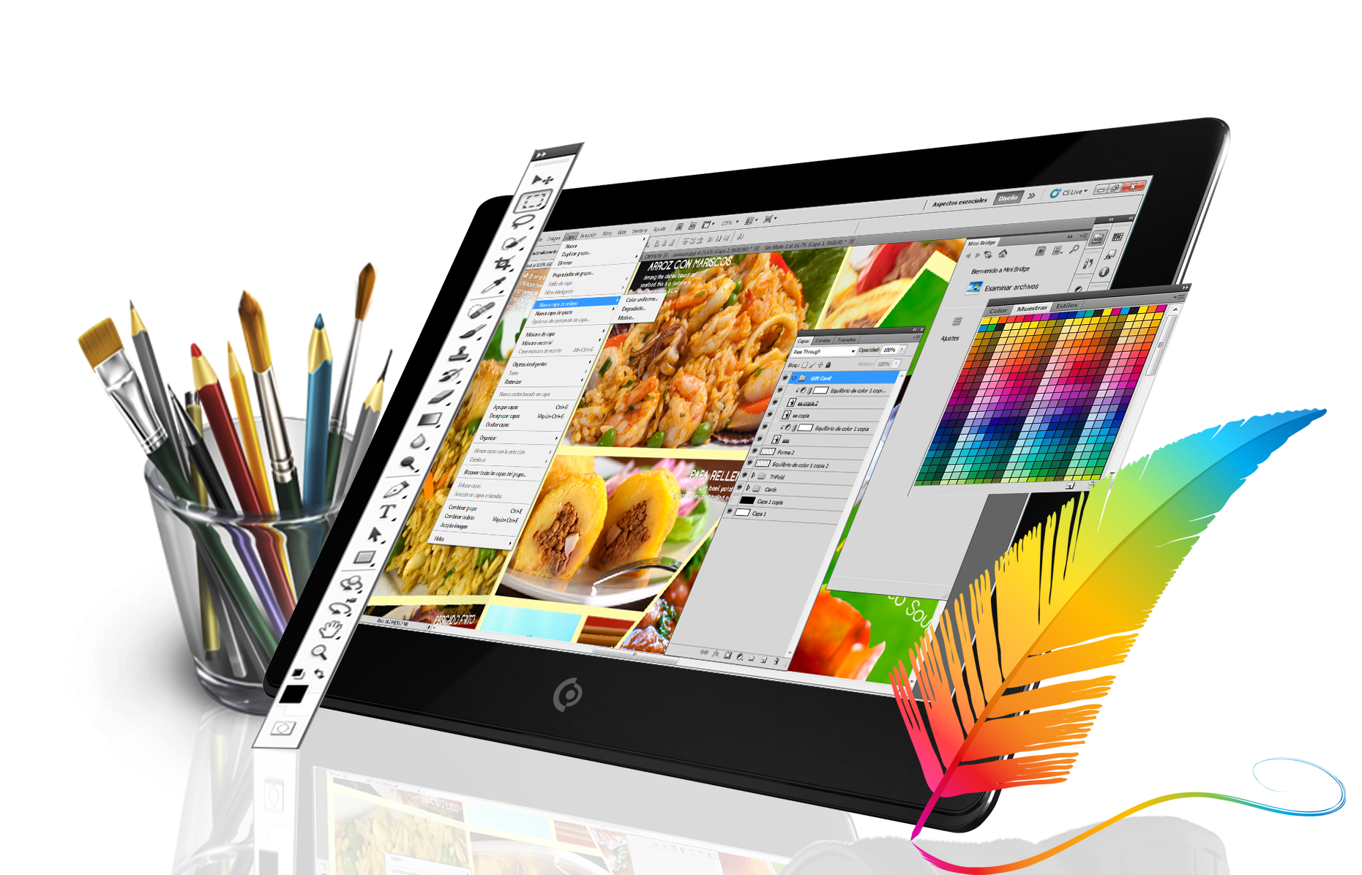
graphic /ˈgræfɪk/ n.图表;图形;图画 a.绘画的
平面设计师将艺术和技术相结合，通过图像、网站布局和印刷页面来传达思想。
Graphic designers combine art and technology to communicate ideas through images, and layout of the website and printed pages.
这种风格具有所有优秀信件写作的简洁、清新、生动、直接，不乏敏锐观察甚至精准解读的段落。
The style has the simple, yet fresh and graphic, directness of all good letter-writing, and there is no lack of passages of keen observation, and even shrewd interpretation.
设计作品中须包括图形和说明，并在截止日期前提交。
The design work, consisting of both graphics and captions, should be submitted before the deadline.

Slide 26
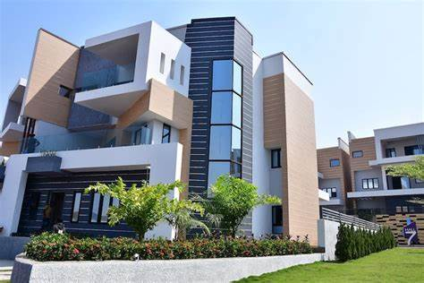
estate /ɪˈsteɪt/ n.庄园;住宅区;工业区
我们想要稳固的经济、合理的房地产成本和良好的学校制度。
We wanted a firm economy, reasonable real estate costs, and a good school system.
无论是爱还是血缘使得他的父亲坚持让亚历克斯继承遗产，亚历克斯都像王子一样被困住了。
Whether it was love or blood that made his father insist that Alex inherit the estate, Alex was as trapped as a prince.
他每天都和管家讨论庄园事务。
He discussed estate affairs every day with his chief steward.

Slide 27

real estate agent /ˈri:əl ɪˈsteɪt ˈeɪdʒənt/ 房地产经纪人
房地产是令人兴奋、有趣和有经济回报的。它也具有挑战性、竞争性和高要求。如果你想踏入这个行业的大门，没有比成为一名房地产经纪人更好的开始方式了。
Real estate is exciting, fun, and moneymaking. It’s also challenging, competitive, and demanding. If you want to get your foot in the door of this industry, there’s no better way to start than by becoming a real estate agent.

Slide 28

accountant /əˈkaʊntənt/ n.会计;会计师
我处理大数据的经验丰富。我想我完全能胜任这里的会计工作。2023年6月全国新高考英语甲卷
I have a large amount of experience working with big data. I think I'm well qualified for the accountant position here.
在过去的25年里，我与许多会计师和会计师事务所合作并建立了联系。
Over the past 25 years I have worked with and networked with many accountants and accounting firms.
对于许多会计师来说，突出他们的专业知识和独特价值是一项挑战。
For many accountants projecting their expertise and their unique value is challenging.

Slide 29

spy /spaɪ/ n.密探;间谍 v.从事间谍活动
她走进房间，回头看了一眼，就像一个窥探过去的间谍。
She came into the room, glancing over her shoulder like a spy on over time.
这一定会让你坐立不安，因为间谍总是有被抓住的危险。
It is bound to keep you on the edge of your seat, as the spies are always in danger of being caught.
Jess的母亲教导她窥探他人的隐私是不恰当的。
Jess was taught by her mother that it was improper to spy on others’ privacy.
部队侦查了洞穴，决定藏在那里是安全的。
The troops spied out the cave and decided it was safe to hide there.

Slide 30
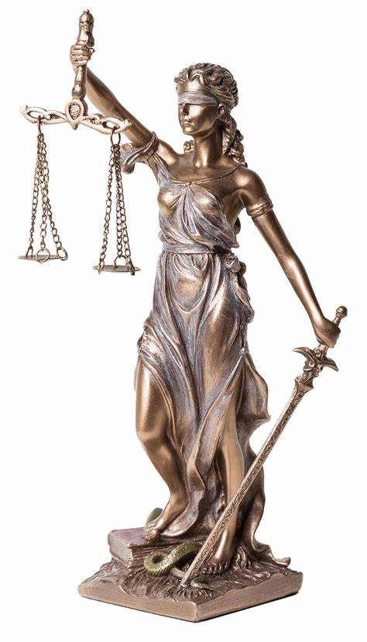
justice /ˈdʒʌstɪs/ n.公平;公正;合理
我们可以继续为理性、正义和爱发声。
We can remain a voice for reason, for justice, and for love.
由于正义无法伸张，他决定逃跑。
As he could not get justice he decided to escape.
封面上的图片没有真实呈现那艘旧船。
The picture on the cover didn’t do justice to the old ship.
正义女神的双刃剑意味着，裁决总是可依据双方提出的情况和证据选择任何一方。
The double-edged blade of Lady Justice’s sword signifies that rulings can always go either way, depending on the circumstance and evidence presented by both parties.

Slide 31

accuse /əˈkju:z/ vt.控告;控诉;谴责
我告诉沃辛顿小姐她不应该指责我，但我没有和她起任何争论。。
I told Miss Worthington I wasn't one to accuse, but I didn't argue with her none, neither.
他眯起眼睛，好像要指责我撒谎似的。
His gaze narrowed, as if about to accuse me of lying.
Related Idioms:
point the finger at 指责
事实上，在指责他人之前，我们应该好好审视自己。
Indeed, we should take a good look at ourselves before we point a finger at others.

Slide 32

come to a conclusion /kʌm tə ə kənˈklu:ʒn/ 得出结论
我得出的结论是，人类生活中最重要的元素是坚持。
I have come to the conclusion that the most important element in human life is perseverance.
评估你的生活方式，试着总结说明你的运动手表需要哪些功能。
Assess your lifestyle, and try to come to a conclusion about which features your need in your sports watch.
Related Idioms:
in summary
to review
in closing
in a nutshell
on a final note
to make a long story shot

Slide 33
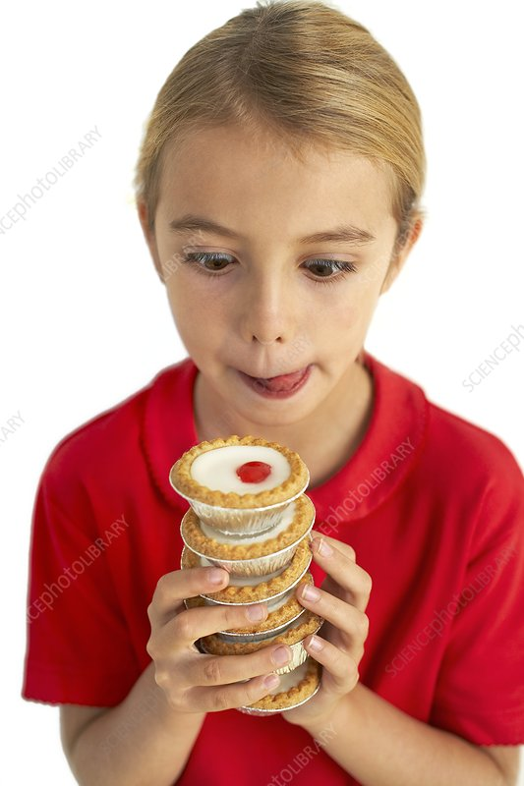
greedy /ˈgri:di/ a.贪婪的;贪心的
greedier-greediest
greedily-greediness
无论我在哪里买，一笼都不够，但两笼似乎太贪心，所以我总是恋恋不舍地想着下次要多点一些。2023年6月新高考英语全国卷I
No matter where I buy them, one steamer is rarely enough, yet two seems greedy, so I am always left wanting more next time.
她的烦躁情绪突然完全消失了，她焦虑的、哀求的眼睛贪婪地盯着他。
Her irritability had suddenly quite vanished, and her anxious, imploring eyes were fixed on him with greedy expectation.
如果你渴望创新，那么提醒自己最新的资讯更新是一个好主意。
If you're greedy for innovations, then alerting yourself of the latest updates is always a good idea.

Slide 34
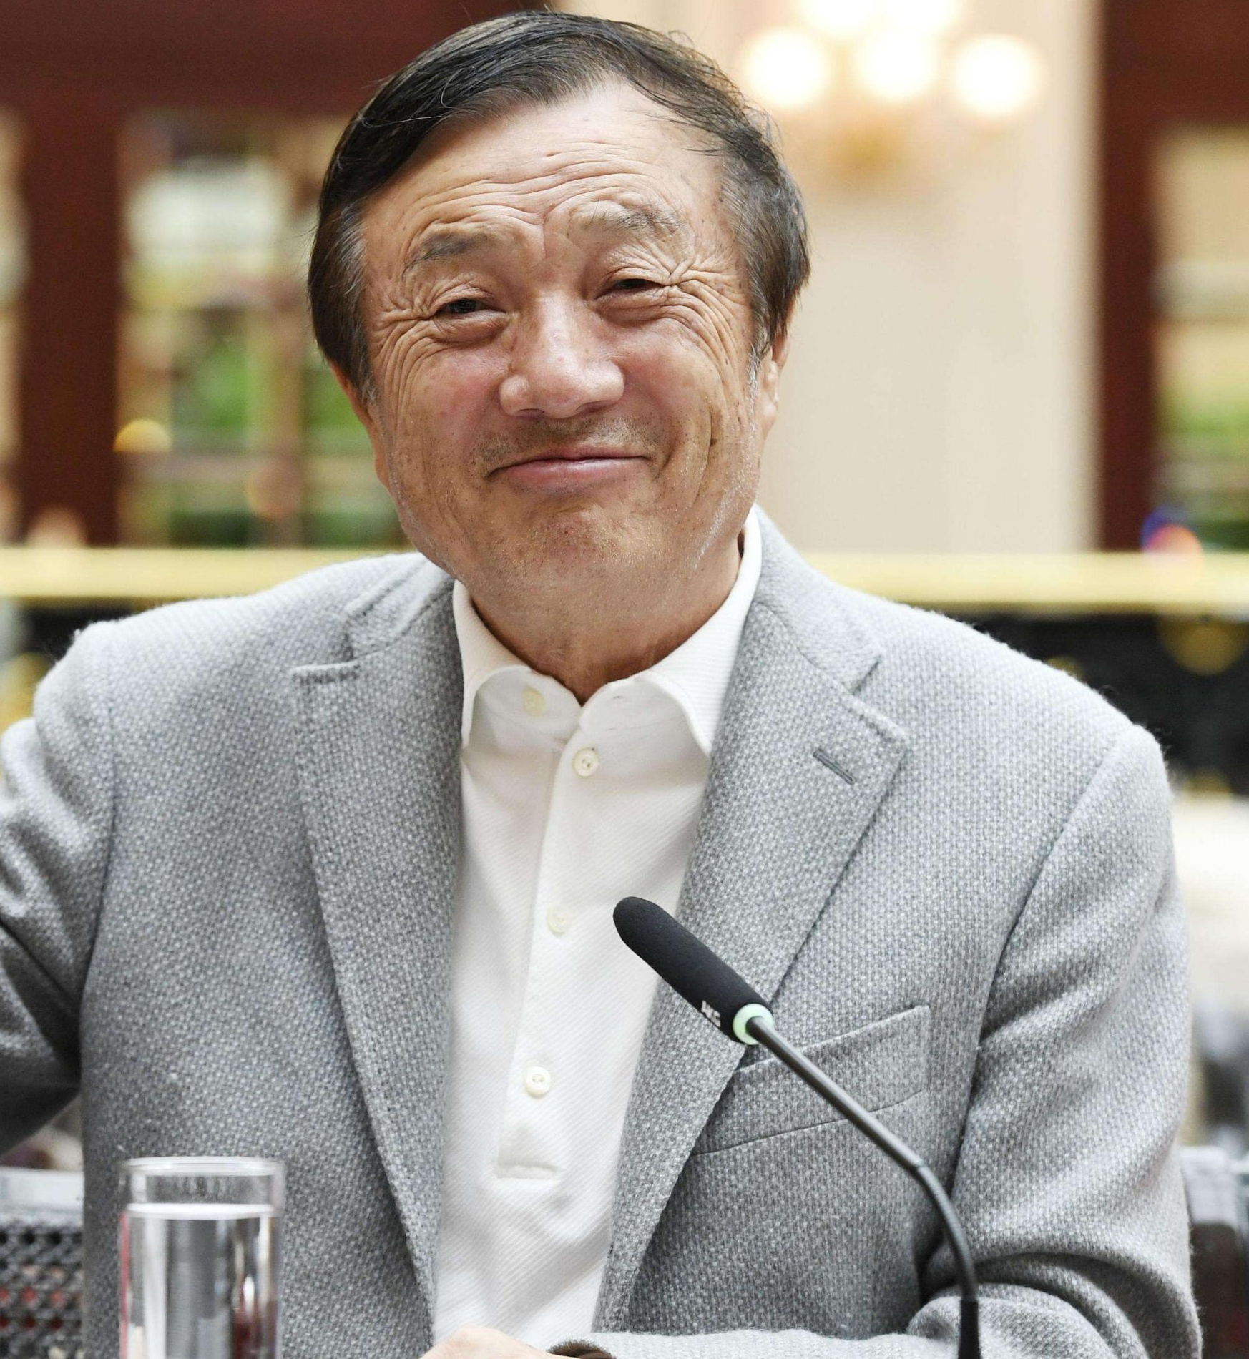
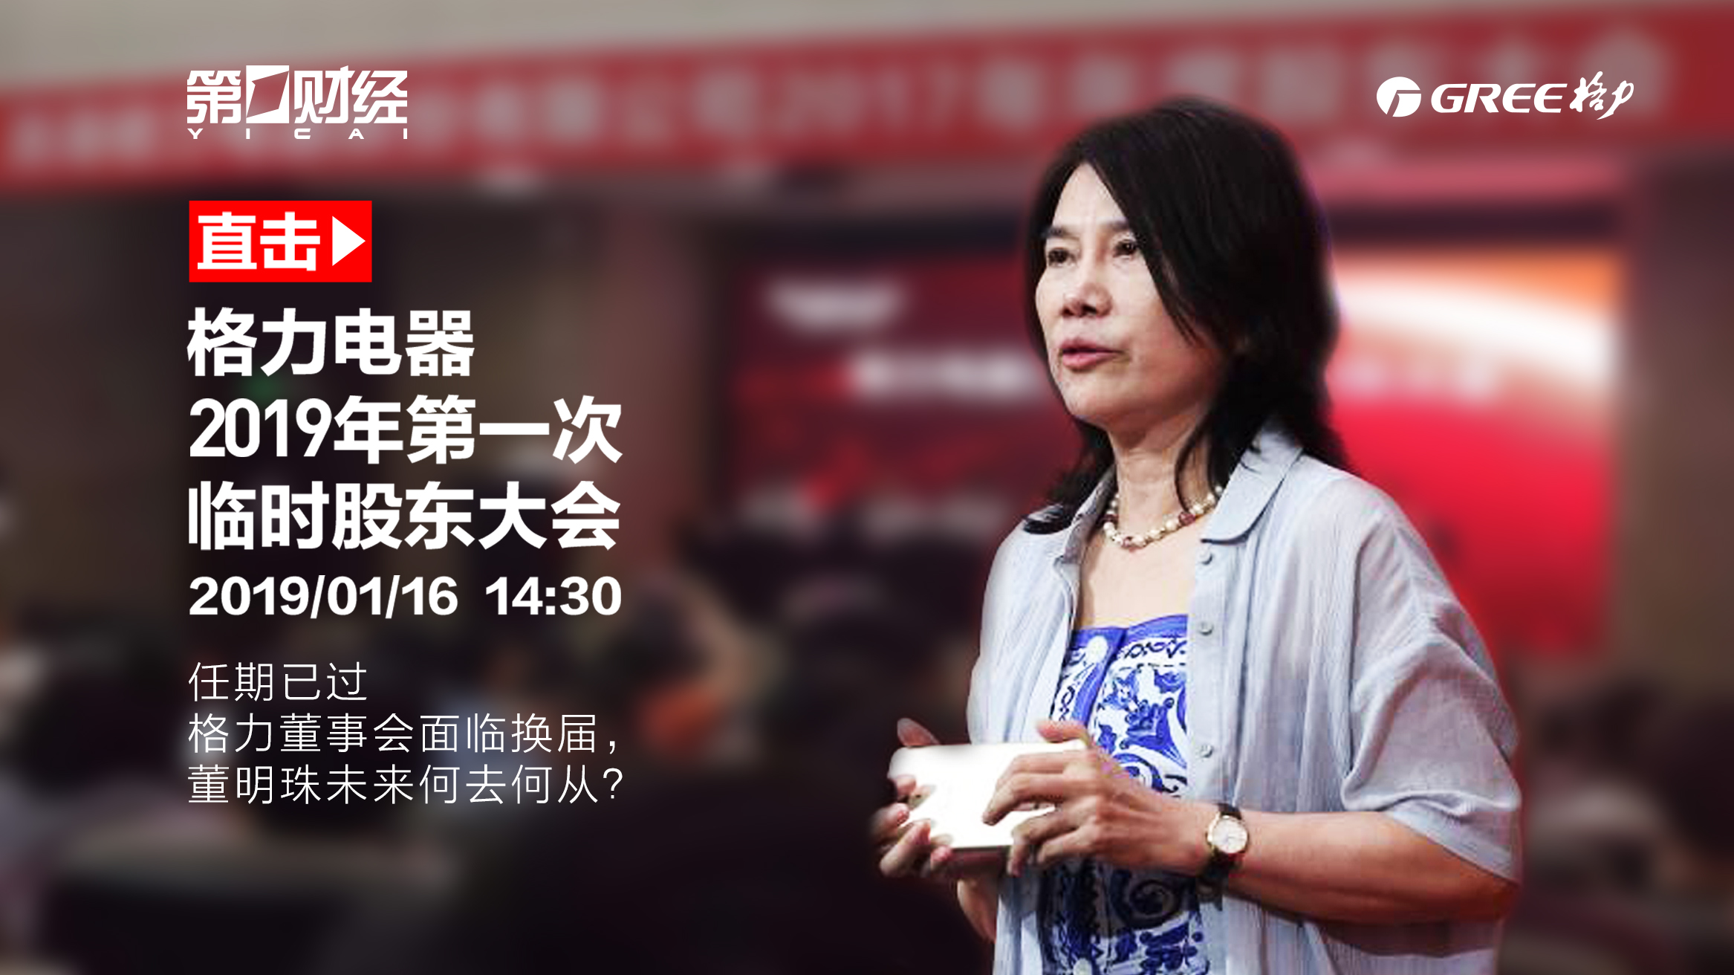
entrepreneur /ˌɒntrəprəˈnɜ:(r)/ n.创业者;企业家
要成为一名成功的企业家，你还可以通过学习企业界已取得成功的巨头们的最重要的特征来拓宽你的视野。
To be a successful entrepreneurs, you can also broaden your horizon by adopting the most important traits found in the giants of the corporate world that have achieved great prosperity.
激情是成功企业家的基本励志特质。
Passion is the fundamental inspirational trait in successful entrepreneurs.

Slide 35

receptionist /rɪˈsepʃənɪst/ n.接待员
我们希望立即填补即将到来的文化艺术节接待员的空缺——请您点击下方链接进行申请。
We are looking to fill immediate openings for receptionists of the coming cultural festival -- Tap the link below to apply.
我们广泛认可的接待员课程有两个级别的培训。这是为那些正在寻找第一份工作并获得基本接待技能和提高一般办公室技能的人准备的。
Our widely recognised Receptionist Courses have two levels of training available. This is for those who are looking for a first job and to gain fundamental reception skills and to increase general office skills

Slide 36
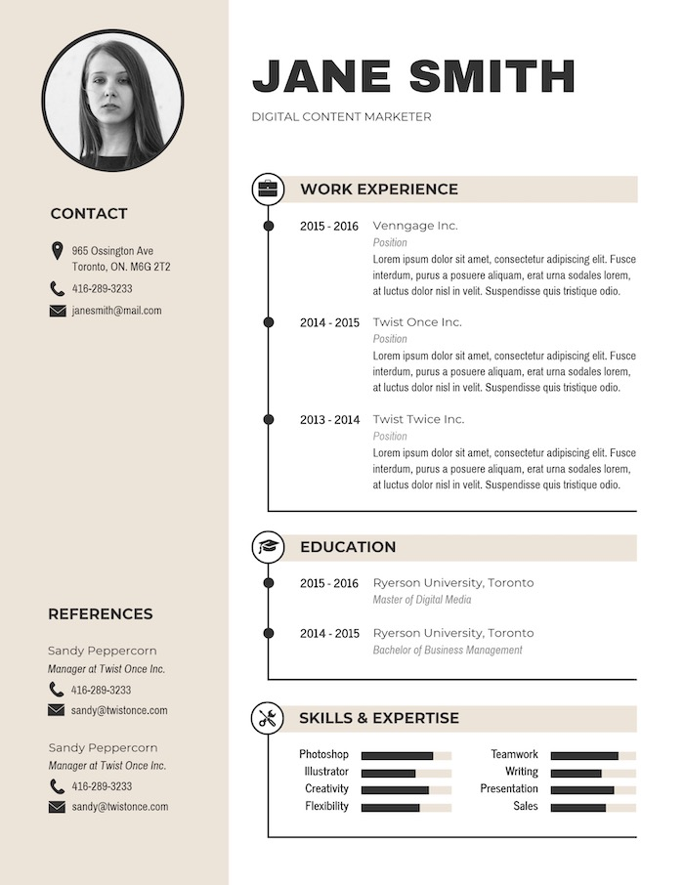
resume /rɪ'zju:m/ n.(求职用的)履历;简历
简历是对个人技能、资质和专业背景的简要总结，以一种能引起潜在雇主共鸣的方式展示这些技能、资质。
A resume serves as a concise summary of an individual’s skills, qualifications, and professional background, presenting them in a way that resonates with potential employers.
无论你在哪个行业，设计一份好的简历都是至关重要的。
Regardless of what industry you’re in, designing a good resume is of paramount importance.
打造一份引人注目的简历，建议谨慎注意细节。
To create a resume that stands out, it’s advised that careful attention is necessary to details.

Slide 37

socialist /ˈsəʊʃəlɪst/ a.社会主义的 n.社会主义者
她学生时代最早的政治活动与她出生的国家的社会主义运动有关。
Her earliest political activities in her student days were connected with the Socialist movement in the country of her birth.

Slide 38

communist /ˈkɒmjənɪst/ a.共产主义的 n.共产主义者
共产党和工人党以鼓掌方式通过了《布鲁塞尔宣言》和会议决议。
The communist and workers' parties approved by acclamation the Declaration of Brussels and the Resolution of the Conference.

Slide 39


dedicate /ˈdedɪkeɪt/ vt.把…奉献给
一旦你决定自定义自己的生活，你就必须全身心投入其中。
Once you’ve made your decision to design your own life, you must dedicate yourself to doing it.
只有完全专注于你的方向和决定，你才能确保你拥有实现人生目标所需的主要动力。
Only by being completely dedicated to your direction and decision will you ensure that you have the prime motivation to achieve your life goal.

Slide 40
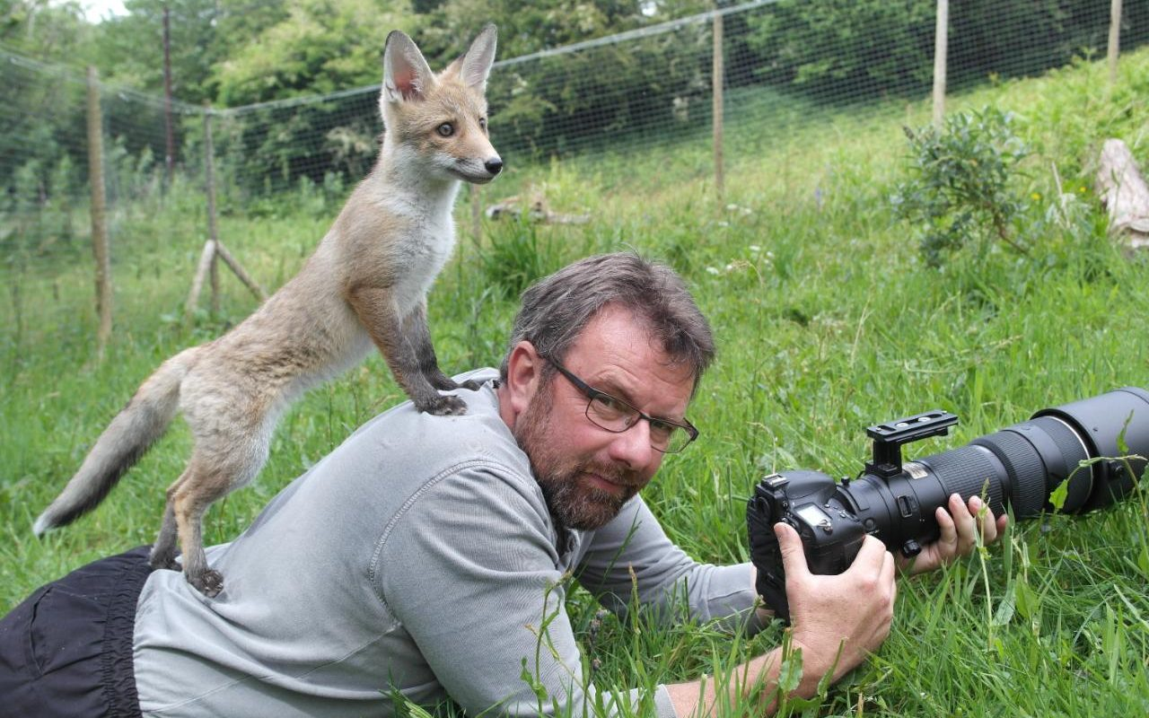
fox /fɒks/ n.狐狸;狡猾的人
我在北威尔士拜访野生动物摄影师Richard Bowler和他的宠物狐狸Hetty, 它奇特的麝香般的浓郁香气表明我们身处在野生环境中。
It is a strange, musky, deep aroma that suggests we are in the presence of something wild. I am in North Wales to visit the wildlife photographer Richard Bowler and his pet fox, Hetty，whose strange, musky, deep aroma that suggests we are in the presence of something wild..
那只受惊的狐狸以最快的速度逃跑了。
The frightened fox scampered away as fast as it could.
Related Idioms:
as crafty/sly/cunning as a fox 狡猾的像狐狸
这部小说围绕着一名警探和一名狡猾如狐狸的小偷之间的猫捉老鼠的追逐展开。
The novel centers around the cat-and-mouse chase between a police detective and a thief who is as sly as a fox.
她可能看起来笑容满面又阳光，但相信我——她狡猾得像只狐狸！
She may come off as nothing but smiles and sunshine, but trust me—she's sly as a fox!

Slide 41
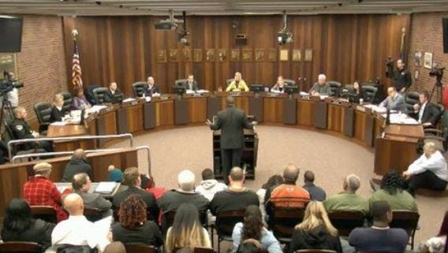
council /ˈkaʊnsl/ n.委员会;市政服务机构
在疫情期间，委员会在领导社区和为弱势群体提供重要的地方服务方面发挥了关键作用。
Councils have played a critical role leading their communities during the pandemic and delivering vital local services to vulnerable people.
那天晚上，成员举行了一次会议来决定他们应该做什么。
That night, members held a council to decide what they should do.
在学校家委会的全力支持下，学生们在劳动实践中发掘了自己的潜在兴趣，培养了坚持不懈的精神。
With full supports from the school family council, students explored their potential interests and fostered persistent spirit in the labor practice.

Slide 42


canal /kəˈnæl/ n.运河;灌溉渠
上海可能是公认的灌汤包之乡，但食品历史学家实际上会把你带到邻近的运河小镇南翔，那里是小笼包的诞生地。2023年6月新高考全国卷I
Shanghai may be the recognized home of the soup dumplings but food historians will actually point you to the neighboring canal town of Nanxiang as Xiao long bao’s birthplace.
骑自行车是探索这座城市最经济、最可持续、最有趣的方式，这里有美丽的运河、公园、广场和数不尽的灯火。
Cycling is the most economical, sustainable and fun way to explore the city, with its beautiful canals, parks, squares and countless lights.
在大运河的两侧都有许多宏伟的建筑，验证着了这个郡县的丰饶和美丽。
By each side of the Grand Canal there are many magnificent buildings that testify the richness and beauty of the county.

Slide 43

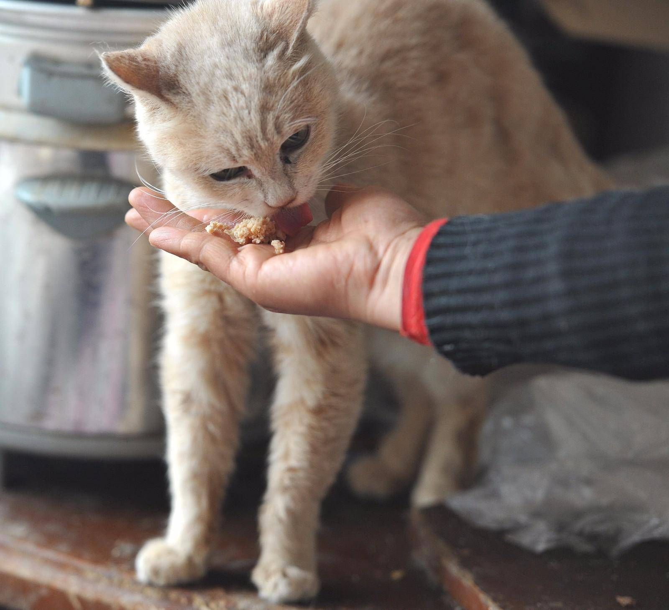
attend to /əˈtend tə/ 关怀;照料;处理
友好的酒店工作人员将为您的需求提供帮助。
The friendly hotel staff will helpfully attend to your needs.
让我们一起照顾需要帮助的人！来加入我们并提供帮助！
Let’s attend to the people in need together! Come to join us and help!
她细心而专注，日复一日地照顾着这位灰毛小朋友的一切，希望能帮助它尽快康复。
Careful and committed, she attended to everything of the little gray fur friend day after day, in the hope of assisting it to recover soon.

Slide 44


supervise /ˈsu:pəvaɪz/ vt.&vi.主管;指导;监督
他很乐意指导这两个领域的研究生。
He is very happy to supervise research students in either of these areas.
当你不在家监督时，宠物笼是让宠物远离麻烦和保持安全的完美方式。
A pet cage is the perfect way to keep your little friend out of trouble and safe when you aren't home to supervise them.

Slide 45

handwriting /ˈhændraɪtɪŋ/ n.书法;书写;笔迹
在这篇文章中，你会发现八个技巧可以帮助你改进书面形式的手写，还附有一个免费的学案。
In this article, you‘ll find eight tips to help you improve your handwriting in written form — plus a free worksheet.
手写训练往往简单但强大，你做得越多，你就会注意到更多的差异。
Handwriting drills tend to be simple but mighty, and the more you do them, the more of a difference you’ll notice.
John的笔迹很难辨认，又小又紧，因此他经常受到Johnson女士的批评。
John's handwriting was harder to read, tiny and tight, for which he was usually criticized by Ms. Johnson.

Slide 46

disk /dɪsk/ n.磁盘;盘
您应该定期复制磁盘作为备份。
You should make a copy of the disk as a back-up on a regular basis.
耳朵很短，眼睛周围的头发形成一个圆盘。
The ears are short, and the hair round the eyes forms a disk.
这种情况几乎让作为程序员的他感受到了硬盘烧焦的味道。
The situation almost makes him, the programmer, feel the burning smell of the hard disk.
Related Idioms:
disk jockey 音乐/电台节目主持人

Slide 47

parking /ˈpɑ:kɪŋ/ n.停车位;停车
当她进入停车场时，她发现了洛丽的车。
As she entered the parking lot, she spotted Lori's car.
更安全的自行车路线和更好的自行车停车场可以减少对火车和公共汽车的需求。
Safer bike routes and better cycle parking could reduce the demand on trains and buses.
免费停车的广告登在了电影节的海报上。
Free parking had been advertised on the festival poster.
按照他的话，他们开车不到两个街区，他就进入了一个公共停车场。
True to his word, they drove less than two blocks before he entered a public parking garage.

Slide 48
camel /ˈkæml/ n.骆驼
活动其他亮点包括沙漠营地和骑骆驼游览沙丘。
Other highlights include a desert camp and a camel ride into the dunes.
游牧民族和他们的骆驼站在一起，这些动物看起来和它们的主人一样充满期待。
The nomads were standing with their camels, the animals looking as expectant as their owners.
最近，摄影师们在一只名叫萨哈的骆驼的帮助下，漫步在沙漠中不容易到达或不宜居的地区。
Photographers recently enlisted the help of a camel named Sarha to wander areas in the desert that are not easily reachable or inhabitable.

Slide 49
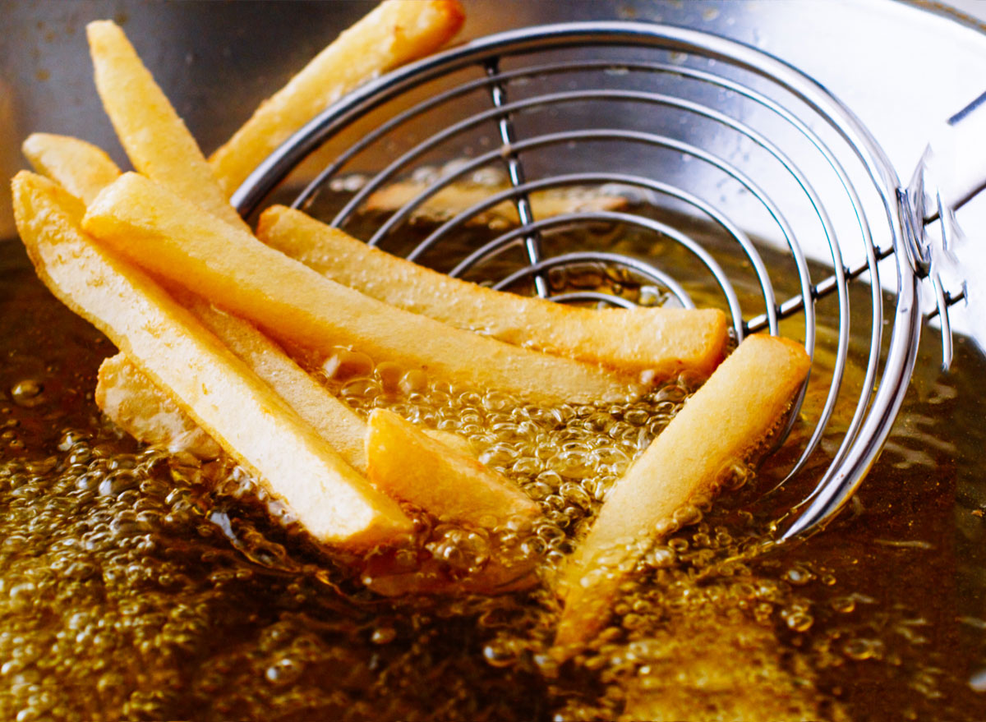
fry /fraɪ/ n.油煎的食物 v.油炸;油炒
罗马斗兽场高157英尺，有80个入口，可容纳50000人。然而，与该市容纳约25万人的马克西姆斯马戏团相比，这只是小菜一碟。2021年全国乙卷
Rome’s Colosseum was 157 feet tall and had 80 entrances, seating 50,000 people. However, that was small fry compared with the city’s Circus Maximus, which accommodated around 250,000 people.However, that was small fry compared with the city’s Circus Maximus, which accommodated around 250,000 people.
我们在厨房里炸了三天的鱼，但难闻的气味一直存在。2021年6月高考英语浙江卷
We deep fried fish three days agao in the kitchen, but the unpleasant smell stays.
Related Idioms:
french fries 薯条
Go fry an egg! 走开，别烦我！
have other/bigger fish to fry 有更重要的事做

Slide 50
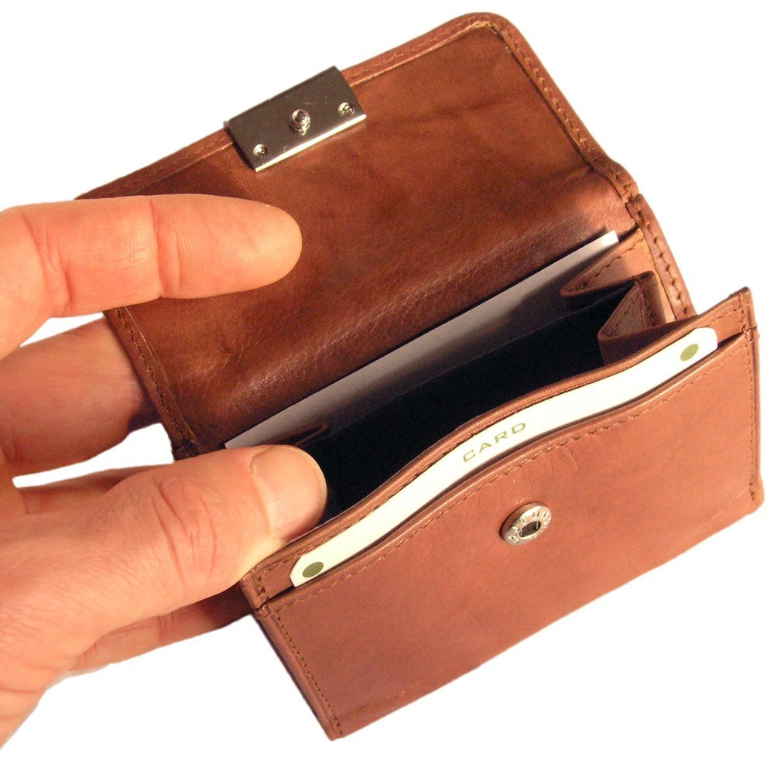
purse /pɜ:s/ n.钱包;皮夹子(尤指女用)
她抓起钱包，跑出了门。
Grabbing her purse, she ran out the door.
泪水夺眶而出，她在皮夹里翻找纸巾。
Tears flooding her eyes, she dug in her purse for a tissue.
Related Idioms:
loosen the purse strings 解囊相助
light purse makes a heavy heart 嚢中无钱心事重
尽管面临挑战，许多家庭仍然设法放松钱包，计划至少去两个海岸旅行一次，体验迪士尼度。
Despite the challenges, many families still manage to loosen the purse strings enough to plan at least one trip to either coast to experience the adventure that only comes from a Disney vacation.

Slide 51
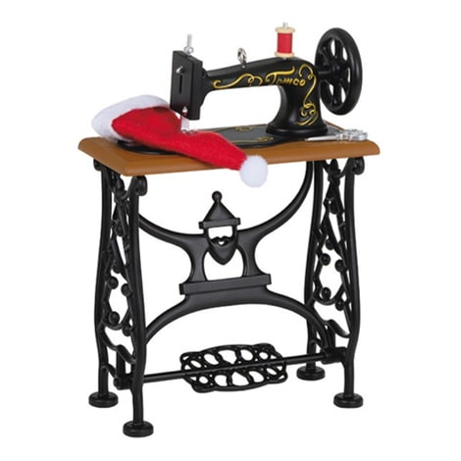
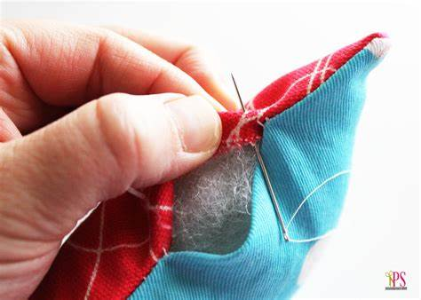
sew /səʊ/ vi.&vt.缝制;缝;做针线活
他的眼睛是用不整齐的红色缝线缝上的纽扣做成的。
His eyes are made of buttons sewn on with untidy red stitches.
她脸颊上的伤口很深，医生不得不缝几针才能把它补好。
The cut on her cheek was so deep that the doctor had to sew a few stitches to mend it together.
本教程的开头部分将向您展示如何手工缝制纽扣，但您知道吗，您也可以用缝纫机缝制小平面纽扣？
The beginning part of this tutorial will show you how to sew a button by hand, but did you know you can also use your sewing machine for small flat buttons?

Slide 52
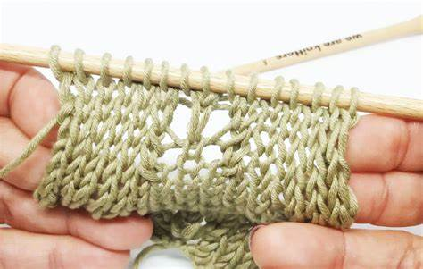
knit /nɪt/ v.编织;针织 n编织的衣服
看书、编织、做填字游戏，又或者只是看着窗外的世界在眼前铺陈开来。23年1月高考英语浙江卷
Read a book, knit, do a crossword puzzle, or simply watch the world unfold outside the window.
编织是一种令人惊奇又满足的爱好。多亏了互联网，开始这门奇妙的技艺变得前所未有的容易。
Knitting is an amazing and satisfying hobby. Thanks to the internet, it has never been easier to start this wonderful craft.

Slide 53
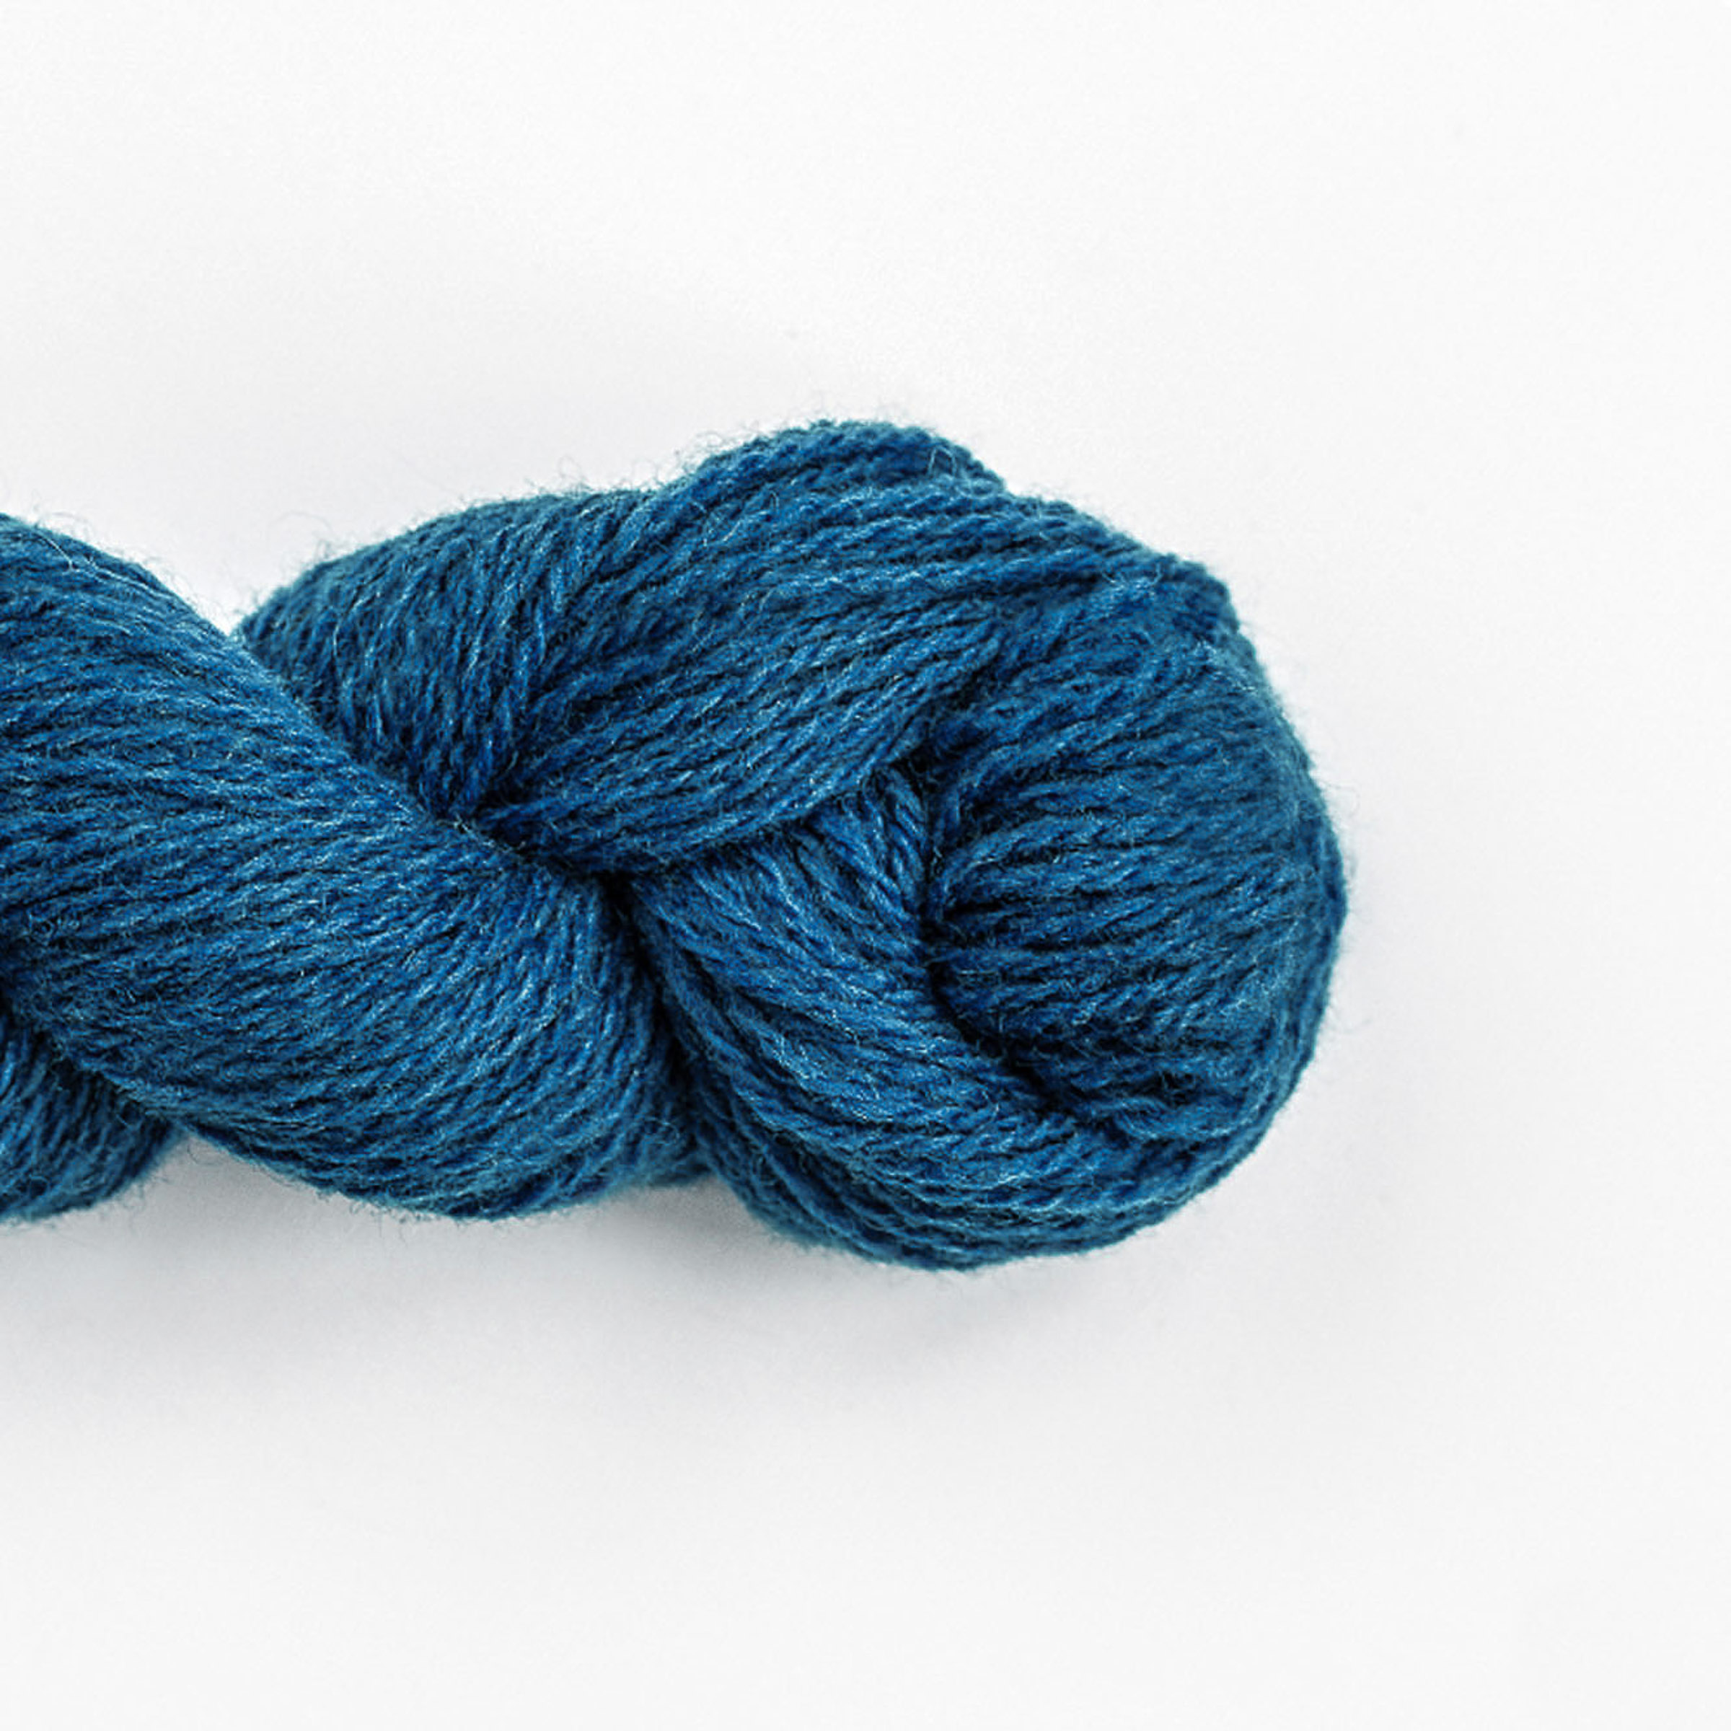
wool /wʊl/ n.毛;毛线;毛料
这几个月来，他听起来好像脑袋里塞满了棉絮。
He spends these months sounding as though his head is stuffed with cotton wool.
令我惊讶的是，它实际上效果很好，尤其是在我的羊毛衫上。
To my surprise, it actually works well, especially on my wool sweaters.
虽然羊毛没有一些植物纤维那么结实，但它有相当的弹性，使它更好地保持形状和抗皱。
Though not as strong as some vegetable fibers, wool is fairly resilient, making it more likely to retain its shape and resist wrinkling.
Related Idioms:
all wool and a yard wide 诚实可靠
我一直都知道Sara诚实可靠，所以一点儿也不惊讶她把丢失的钱包还给我。
I've always known Sara to be all wool and a yard wide, so I'm not surprised she returned the missing wallet.

Slide 54

intermediate /ˌɪntəˈmi:diət/ a.中级的;中等的;中间的
讲座中将介绍一些播客的中级技巧。
Some intermediate tips for podcasting will be introduced duing the lecture.
就难度而言，我认为这个谜题是中等难度的。
I'd rate the puzzle as intermediate in terms of difficulty.
价格适中，但根据我们的经验有点儿定价过高。
Price was intermediate but overpriced for our experience.

Slide 55

priority /praɪˈɒrəti/ n.优先事项;首要的事;优先
近年来，公园发展了以生态保护为重的旅游业。
The park has developed tourism with ecological preservation as top priority in recent years.
虽然我喜欢出去开心玩，但工作和账单支付比其他一切都重要。
Although I like to go out and have a good time, working and paying bills is a priority over everything else.
因为父母把小Rosa放在首位，Lucy经常感到被忽视和孤独。
Because parents give priority to little Rosa, Lucy often feels neglected and alone.

Slide 56
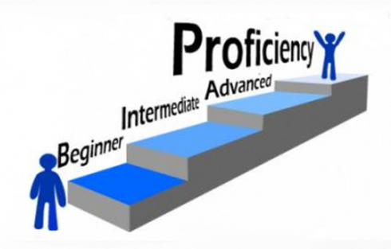
proficiency /prə'fɪʃnsɪ/ n.熟练;娴熟;精通
马修处理每件事都很细心和熟练.
Mathew handled everything with care and proficiency.
该项目的所有申请人都必须提交相应的专业技能证书电子档。
All applicants to the project must submit your professional skill proficiency certificate electronically.
有了语言能力，我们不仅可以有效地提高技能，还可以深入了解当地的生活和习俗。
With the language proficiency, we’ll not only improve our skills efficiently, but also gain valuable insights into the local lives and customs.

Slide 57
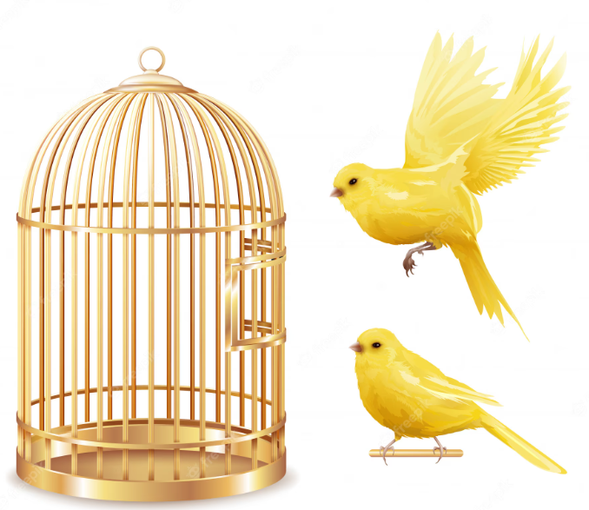
cage /keɪdʒ/ n.笼子 vt.关在笼子里
展览的其他亮点包括一个喂鸟器，把手连接在中国制造的竹制鸟笼上，其中的餐具是法国出品的瓷器。
Other highlights of the exhibit included a bird feeder, consisting of a handle attached to a bamboo bird cage made in China with ceramic dishes from France.
专家建议那些遇到受伤猛禽的人不要把它们关在笼子里，因为这会伤害它们的翅膀。
The expert advised people who come across injured raptors to not cage them, which will hurt their wings.
只有一点点灯光和音乐的帮助，李用他敏捷的动作把光秃秃的舞台变成了红彼得的家——非洲丛林、他的笼子、他的教室和他的讲台。
Only aided by a smattering of lighting and music, Li, with his agile movements, transformed the bare stage into Red Peter's home – the African jungle, his cage, his classroom, and his podium.

Slide 58
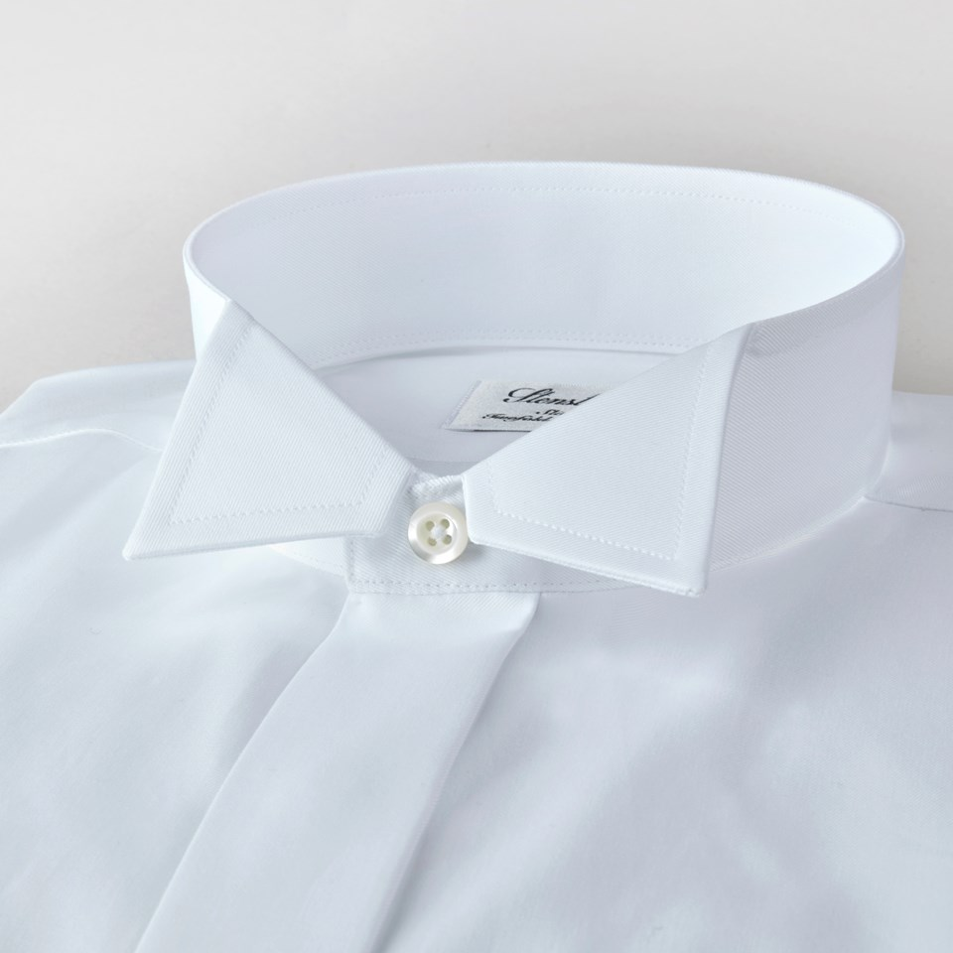
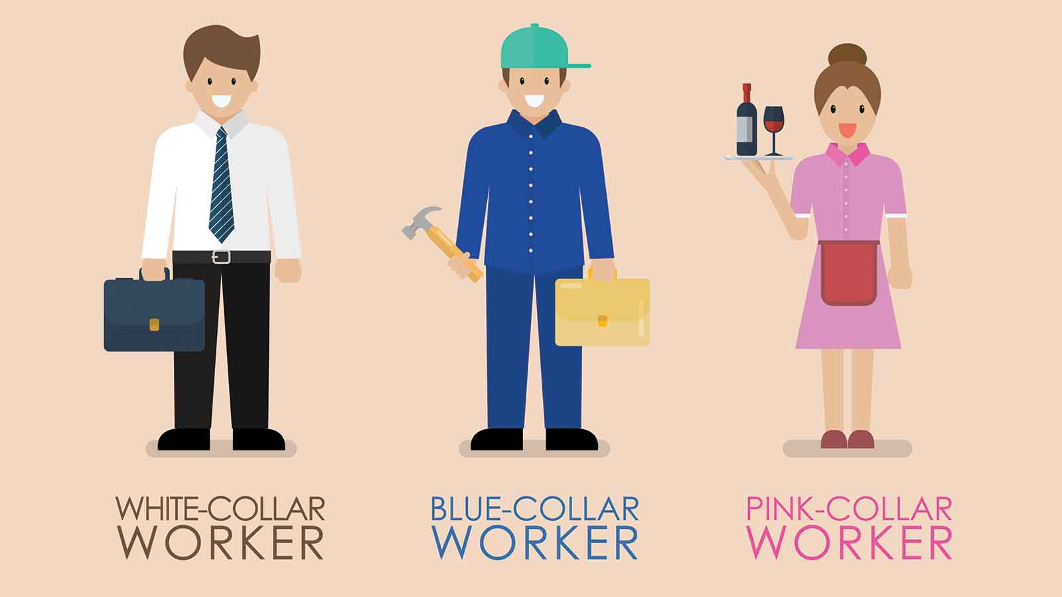
collar /ˈkɒlə(r)/ n.(动物)颈圈;衣领
他蜷缩在角落里，为了保暖，他把衣领翻了起来。
Hunkering down in the corner, he turned up his coat collar for extra warmth.
威尔逊以惊人的速度越过巴里，抓住他的衣领，差点把他拎离地面。
Wilson crossed over to Barry with surprising speed and grabbed him by the collar, nearly lifting him off the ground.
Related Idioms:
get hot under the collar: to become angry.
很抱歉我刚才很生气，我接受不了听到别人批评我的小说。
I'm sorry I got hot under the collar just then, I have a hard time hearing criticism about my novel.

Slide 59

flea collar /fli: ˈkɒlə(r)/ 灭蚤颈圈
这款跳蚤项圈由优质全天然成分制成，是保护你的四脚朋友免受这些微小昆虫威胁的安全有效的方法。
Made with high-quality, all-natural ingredients, this flea collar is a safe and effective way to protect your four-legged friend from these tiny threats.

Slide 60

finance /ˈfaɪnæns/ n.资金;财政 vt.提供资金
在获得大学金融学学位后，他再次渴望从事高尔夫球运动。
He had aspirations of playing golf again after getting a finance degree from the university.
该平台收集了包括财税、贸易、投资、交通和就业在内的各个方面的政策信息。
The platform gathers policy information from various aspects, including finance and taxation, trade, investment, transportation, and employment.
值得注意的是，大学实验室缺乏为他的项目提供全额资金的能力。
It is worth noting that the university laboratory lacks the capacity to fully finance his projects.

Slide 61
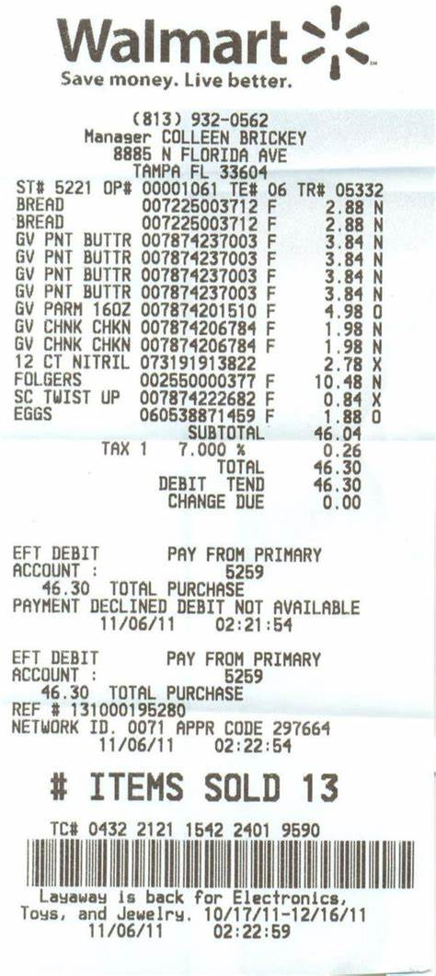
receipt /rɪˈsi:t/ n.收据;接收
近年来，扫码购物在中国变得很常见，因为它提高了效率并节省了收据纸张。
Scanning a QR code to order has become common in China in recent years, as it boosts efficiency and saves on receipt paper.
只要商品标签完好并且你有收据，就可以进行退换货。
You may be able to return or exchange the goods as long as they still have the tags and you have the receipt.
记得上课时带上您获批的收据！
Remember to bring your authorized receipt along to the course with you !

Slide 62

certificate /səˈtɪfɪkət/ n.合格证书;证明
certificated adj. :持有职业培训证书，有执业资格的 certification n. [u.] 证明,鉴定;课程结业证书
汉语水平考试(HSK)报告是官方唯一认可的外国人申请在中国大陆学习和/或工作的汉语能力证书。
The HSK exam report is the only officially recognized Chinese language proficiency certificate for foreigners applying to study and/or work in mainland China.
绿色合格证是利用可再生能源发电交易的证明。
Green certificate is proof of traded electricity generated from renewable sources.

Slide 63

employer /ɪmˈplɔɪə(r)/ n.雇主;老板;雇用者
这种类型的写作不会得到学校考官的嘉奖，也不会得到未来雇主或潜在客户的赞许。2022年6月高考英语浙江卷
This type of writing won't be rewarded by the school examiner, nor by a future employer or a potential client.
在许多职业科目中，雇主会意识到他们所在领域不同课程的差异。
In many vocational subjects, employers will be aware of the differences between courses in their field.
作为雇主，他纪律严明，但对厨师和服务员很慷慨。
As an employer he was firm on discipline but generous to his chefs and waiters.

Slide 64
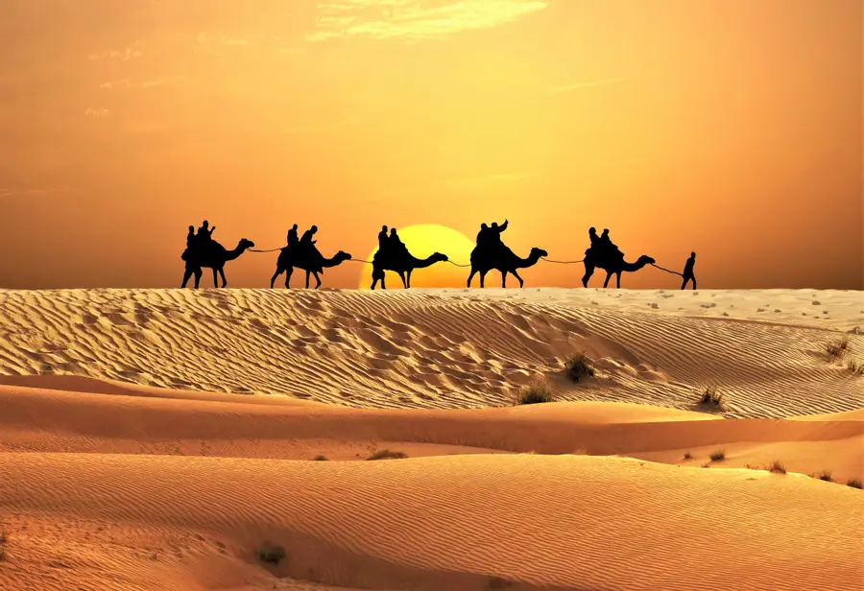
desert /ˈdezət/ n.沙漠;荒漠
她跟在后面，步入寒冷的沙漠之夜。
She trailed, stepping into the chilled desert night.
拟人 Personification ：
凉爽的海风冷静了沙漠的酷热，大大的苹果树为她遮去头顶的炎炎烈日。
The dry desert heat gave way to cool sea breeze, and a massive apple tree protected her from the sun overhead.
比喻 Metaphor ：
沙漠有时是戈壁，有时是撒哈拉，但总是一片无限的沙子，像层层潮水一样令人窒息地漂浮其中。
The desert was sometimes Gobi, sometimes Sahara, but always an infinite stretch of sand that floated up and up in a stifling layer, like the tide.
食物沙漠是一个地理区域，在那里，居民几乎没有方便的选择来获得负担得起的健康食品，尤其是新鲜水果和蔬菜。
Food deserts are geographic areas where residents have few to no convenient options for securing affordable and healthy foods — especially fresh fruits and vegetables.

Slide 65

acquire /əˈkwaɪə(r)/ vt.获得;购得
作为志愿者小组的一员，我获得了宝贵的实践经验。
I acquired invaluable practical experience as a member of the volunteering group.
他最近养成的一些锻炼习惯让我感到好奇。
Some of his recently acquired workout habits strike me as curious.
在充分准备的情况下，他们着手收购竞争对手。
With full preparations, they then set about acquiring rivals.

Slide 66
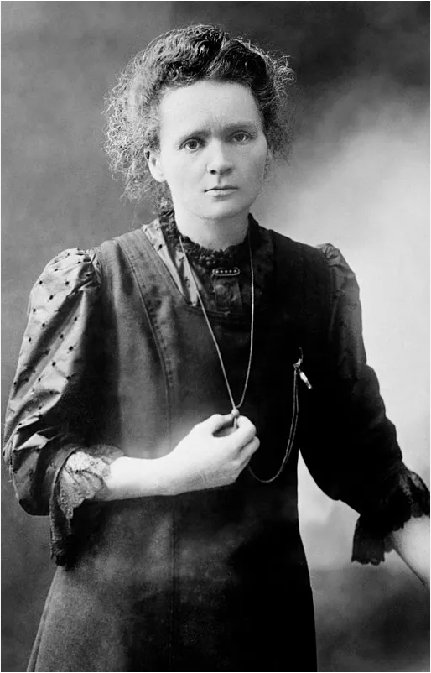
Marie Curie /məˈriː ˈkjʊəri/ 玛丽・居里(居里夫人)
玛丽·居里安静、端庄、谦逊，受到全世界科学家的高度尊重和钦佩。她获得了许多荣誉科学、医学和法律学位，并获得了世界各地学术协会的荣誉会员资格。
Marie Curie, quiet, dignified and unassuming, was held in high esteem and admiration by scientists throughout the world. She received many honorary science, medicine and law degrees and honorary memberships of learned societies throughout the world.

