Slide 1


感恩遇见，相互成就，本课件资料仅供您个人参考、教学使用，严禁自行在网络传播，违者依知识产权法追究法律责任。
更多教学资源请关注
公众号：溯恩高中英语
知识产权声明

Slide 2
2023 学年第一学期杭州市
高三年级教学质量检测试卷讲评
-By Lily 11/17/2023
Copyright by zizai powerpoint

Slide 3
Topics of the Texts
语篇 | 话题 | 类型 | 体裁
A | 入学报名须知 | 人与社会 | 应用文
B | Brave Barbie | 人与社会 | 记叙文
C | an extraordinary fossil | 人与自然 | 说明文
D | Stories to Think with | 人与社会 | 议论文
七选五 | advantages of van life | 人与社会 | 说明文
完形 | Dads on Duty | 人与社会 | 记叙文
语法填空 | 中国传统文化 Huishan clay figurines | 人与社会 | 说明文

Slide 4

A
人与社会：
入学报名须知
解题要求：
1. 快速明确文体、主题和写作目的
2. 精准定位答案出处

Slide 5
A
人与社会：入学报名须知
We are thrilled you are considering Marist School for your child’s next chapter. Marist has two primary entry points for students in 7th and 9th grades to which we typically accept 150 and 50 students respectively.
Marist School utilizes Ravenna, an application management system, for all aspects of the admissions process. Through Ravenna, parents can access the Marist application, submit supporting materials, track application status, and view admission decisions. Our application for the 2024-2025 school year will be available late September with a January 22,2024 deadline.
21. Who is this article mainly intended for?
A. Students in all grades.
B. Students in 6th or 8th grades.
C. Parents of children in 6th or 8th grades.
D. Parents of children in 7th to 9th grades.
把握细节信息和人称

Slide 6
A
人与社会：入学报名须知
We are thrilled you are considering Marist School for your child’s next chapter. Marist has two primary entry points for students in 7th and 9th grades to which we typically accept 150 and 50 students respectively.
Marist School utilizes Ravenna, an application management system, for all aspects of the admissions process. Through Ravenna, parents can access the Marist application, submit supporting materials, track application status, and view admission decisions. Our application for the 2024-2025 school year will be available late September with a January 22,2024 deadline.
22.What do we know about Ravenna?
A. It deals with entry applications.
B. It promotes school management.
C. It is accessible the whole school year.
D. It monitors the admissions process.
理解细节信息

Slide 7
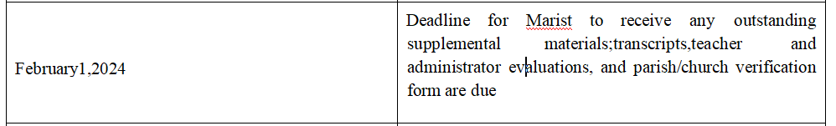
A
人与社会：入学报名须知
Important Dates
理解细节信息
23. Which can be a possible date for applicants to submit teacher evaluations?
A. August 30,2023. B. January 26,2024.
C. February 3,2024. D. March 30, 2024.

Slide 8
B
人与社会：社会力量
Brave Barbie

Slide 9
A
人与社会：社会力量：Brave Barbie
Handler wanted to create a toy that was different from the baby dolls that dominated little girls’ toy boxes. She wanted a doll that girls could project their future dreams upon and allowed for limitless clothing and career choices.
24. Why did Handler create Barbie?
A. To make a hit in the retail market.
B. To appeal to girls with her diverse outfits.
C. To do a project on women’s career choices.
D. To inspire girls to make choices as they wish.
理解细节信息，同义转换

Slide 10
情感态度推测题
There’s even a Barbie for cancer patients - Brave Barbie - a partnership between Mattel and CureSearch that sends a bald(光头的)Barbie to families affected by cancer. “Gifting my daughter a Barbie who suffered from cancer was tremendous, ” Michelle, a cancer survivor said, “We would play with that Barbie together and I’d heartbreakingly watch her pretend to take the doll to the hospital for chemo(化疗), or place its long wig on top of its head and tell the doll ‘It’s time to be beautiful again.”
25. How might Michelle feel when watching her daughter
with Brave Barbie?
A. Sad yet comforted. B. Envious yet proud.
C. Overwhelmed and ashamed. D. Heartbroken and regretful
情感态度推测定位人物的语言，定位情感色彩词汇

Slide 11
推测题
Bald Barbie was super brave and went on awesome adventures after chemo. Sometimes she felt sick and needed to sleep, but would feel much better after a rest. Bald Barbie always beat the cancer and went on to live a long and happy life with her family. That Barbie became so much more than a plastic doll - she was a means of communication and a coping mechanism during an extremely distressing time for little families.
26.What does Brave Barbie mean to Michelle’s family?
A. A reliable emotional support.
B. A glue for broken relationships.
C. An effective practical treatment.
D. A secret medium of negotiation.

Slide 12
文章出处推测题
There’s even a Barbie for cancer patients - Brave Barbie - a partnership between Mattel and CureSearch that sends a bald(光头的)Barbie to families affected by cancer. “Gifting my daughter a Barbie who suffered from cancer was tremendous, ” Michelle, a cancer survivor said, “We would play with that Barbie together and I’dheartbreakingly watch her pretend to take the doll to the hospital for chemo(化疗), or place its long wig on top of its head and tell the doll ‘It’s time to be beautiful again.”
27. Where is the text probably taken from?
A. A medical journal. B. A charity brochure.
C. A financial report. D. A story collection.
文章出处把握文章话题和文体特征：故事的特征具备故事六要素、叙述口吻。

Slide 13
C
人与自然：
an extraordinary
fossil

Slide 14
词义猜测题
转折
That dinosaurs ate the mammals(哺乳动物)that ran beneath their feet is not in doubt. Now an extraordinary fossil newly described in Scientific Reports, unearthed by a team led by Gang Han at Hainan Vocational University of Science and Technology in China, shows that sometimes the tables were turned.
28.Which idiom is closest in meaning to underlined part “the tables were turned”in paragraph 1?
A. The fittest survives. B. The hunters become hunted.
C. Fortune always favors the brave.
D. The truth will always come to light.
根据句间逻辑关系推测词义。

Slide 15
功能分析题：分析作者的写作技巧及功能
And Dr. Han and his colleagues point out that those mammals which eat dead bodies typically leave tooth marks all over the bones of the animals. The dinosaur’s remains show no such marks. There is also a chance the fossil could be a fake.
区分观点与事实，把握作者的观点。
29. Why does the author mention the “tooth mark” in paragraph 3?
A. To prove the fossil was fake.
B. To show the forming of the fossil.
C. To illustrate the process of hunting.
D. To suggest the dinosaur was hunted alive.

Slide 16
细节理解
There is also a chance the fossil could be a fake. More and more convincing fakes have emerged, as this one did - though Dr. Han and his colleagues argue that the complexly connected nature of the skeletons(骨骼) makes that unlikely, too.
根据句间逻辑关系定位，加以概括。
30.What makes Dr. Han think the fossil is genuine?
A. The size of the fossil.
B. The absence of fake fossils.
C. The complexity of the skeletons.
D. The consistency of the opinions.

Slide 17
功能分析题：分析作者的写作技巧及功能
Assuming it is genuine, the discovery serves as a reminder that not all dinosaurs were enormous during the Cretaceous and not all mammals were tiny. From nose to tail, the dinosaur is just 1. 2 meters long. The mammal is a bit under half a meter in length. Despite being half the size, the mammal has one paw firmly wrapped around one of its prey’s limbs, and another pulling on its jaw. It is biting down on the dinosaur’s chest, and has ripped off two of its ribs. Before they were interrupted, it seems that the mammal was winning.
31. What is the function of the last paragraph?
A. It offers a cause.
B. It highlights a solution.
C. It justifies the conclusion.
D. It provides a new discovery.
把握语篇标记词

Slide 18
D
人与社会：
Stories to Think with
议论文
1. Read for the topic
2. Read for the structure
and the skills
3. Read for the cultural background

Slide 19
1. Read for the topic
a usual situation/common sense
1. Philosophers have a bad reputation for expressing themselves in a dry and boring way. The ideals for most philosophical writing are precision, clarity, and the sort of conceptual analysis that leaves no hair un-split.
2. There is nothing wrong with clarity, precision, and the like - but this isn’t the only way to do philosophy. Outside academic journals, abstract philosophical ideas are often expressed through literature, cinema, and song. There’s nothing that grabs attention like a good story, and there are some great philosophical stories that delight and engage,rather than putting the reader to sleep.
3. One of the great things about this is that, unlike formal philosophy, which tries to be very clear, stories don’t wear their meanings on their sleeve - they require interpretation, and often express conflicting ideas for the reader to wrestle with.
6. Philosophically rich stories like this bring more technical works to life. They are stories to think with.
Tips: 关注作者话题的导入方式：
转折导入：关注语篇标记词：but; however
以及语篇的首尾段
the writer’s topic
the writer’s topic is repeated in the last paragraph.

Slide 20
2. Read for the structure
and skills
a usual situation/common sense
1. Philosophers have a bad reputation for expressing themselves in a dry and boring way. The ideals for most philosophical writing are precision, clarity, and the sort of conceptual analysis that leaves no hair un-split.
2. There is nothing wrong with clarity, precision, and the like - but this isn’t the only way to do philosophy. Outside academic journals, abstract philosophical ideas are often expressed through literature, cinema, and song. There’s nothing that grabs attention like a good story, and there are some great philosophical stories that delight and engage,rather than putting the reader to sleep.
3. One of the great things about this is that, unlike formal philosophy, which tries to be very clear, stories don’t wear their meanings on their sleeve - they require interpretation, and often express conflicting ideas for the reader to wrestle with.
4. Consider what philosophers call the metaphysics(形而上学) of race -an area of philosophy that explores the question of whether or not race is real. There are three main positions that you can take on these questions. You might think that a person’s race is written in their genes ( a position known as “biological realism”). Or you might think of race as socially real, like days of the week or currencies(“social constructionism”). Finally, you might think that races are unreal - that they’re more like leprechauns(一种魔法精灵)than they are like Thursdays or dollars (“anti- realism”).
5. A great example of a story with social constructionist taking on race is George Schuyler’s novel Black No More.In the book, a Black scientist named Crookman invents a procedure that makes Black people visually indistinguishable from Whites. Thousands of African Americans flock to Crookman’s Black No More clinics and pay him their hard-earned cash to undergo the procedure. White racists can no longer distinguish those people who are “really” White from those who merely appear to be White. In a final episode,Crookman discovers that new Whites are actually a whiter shade of pale than those who were born that way, which kicks off a trend of sunbathing to darken one’s skin - darkening it so as to look more White.
6. Philosophically rich stories like this bring more technical works to life. They are stories to think with.
the writer’s topic
What are good philosophical stories?
an example
an example
summary

Slide 21
3. Read for the cultural background 了解语言文化背景
What are good philosophical stories?
an example
4. Consider what philosophers call the metaphysics(形而上学) of race -an area of philosophy that explores the question of whether or not race is real. There are three main positions that you can take on these questions. You might think that a person’s race is written in their genes ( a position known as “biological realism”). Or you might think of race as socially real, like days of the week or currencies(“social constructionism”). Finally, you might think that races are unreal - that they’re more like leprechauns(一种魔法精灵)than they are like Thursdays or dollars (“anti- realism”).
5. A great example of a story with social constructionist taking on race is George Schuyler’s novel Black No More.In the book, a Black scientist named Crookman invents a procedure that makes Black people visually indistinguishable from Whites. Thousands of African Americans flock to Crookman’s Black No More clinics and pay him their hard-earned cash to undergo the procedure. White racists can no longer distinguish those people who are “really” White from those who merely appear to be White. In a final episode,Crookman discovers that new Whites are actually a whiter shade of pale than those who were born that way, which kicks off a trend of sunbathing to darken one’s skin - darkening it so as to look more White.
a story that inspires people to think
此故事呈现了一个悖论：a paradox
黑人为了不被歧视白化肤色；但又因为白人肤色更暗一点而选择晒黑一点
引发思考：所以种族歧视的本质是因为肤色吗？

Slide 22
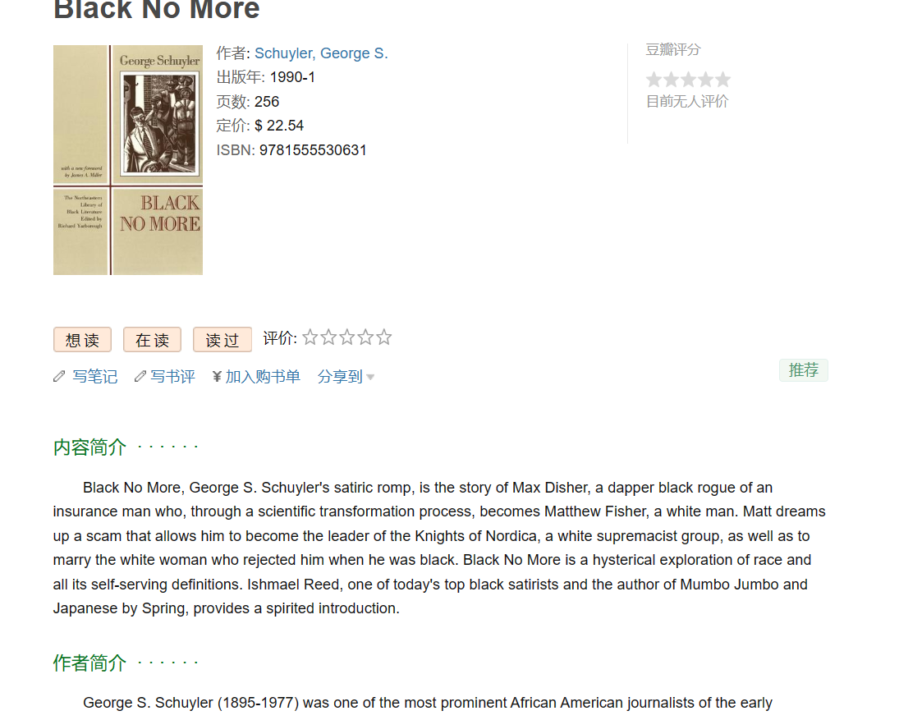
Black No More
从社会视角去探索Racism

Slide 23
细节理解
The ideals for most philosophical writing are precision, clarity, and the sort of conceptual analysis that leaves no hair un-split.
There is nothing wrong with clarity, precision, and the like - but this isn’t the only way to do philosophy. Outside academic journals, abstract philosophical ideas are often expressed through literature, cinema, and song. There’s nothing that grabs attention like a good story, and there are some great philosophical stories that delight and engage,rather than putting the reader to sleep.
One of the great things about this is that, unlike formal philosophy, which tries to be very clear, stories don’t wear their meanings on their sleeve - they require interpretation, and often express conflicting ideas for the reader to wrestle with.
把握作者观点的侧重
32. What does the author think of philosophical stories?
A. The meaning behind is very obvious.
B. They are extremely precise and formal.
C. They often cause conflicts among readers.
D. They are engaging and inspire critical thinking.

Slide 24
细节理解
Consider what philosophers call the metaphysics(形而上学) of race -an area of philosophy that explores the question of whether or not race is real. There are three main positions that you can take on these questions. You might think that a person’s race is written in their genes ( a position known as “biological realism”). Or you might think of race as socially real, like days of the week or currencies(“social constructionism”). Finally, you might think that races are unreal - that they’re more like leprechauns(一种魔法精灵)than they are like Thursdays or dollars (“anti- realism”).
33. Which category might “Christmas” fall into according to paragraph 4?
A. Social constructionism. B. Anti-realism.
C. Biological realism. D. Literary realism.

Slide 25
段落大意题
A great example of a story with social constructionist taking on race is George Schuyler’s novel Black No More.In the book, a Black scientist named Crookman invents a procedure that makes Black people visually indistinguishable from Whites. Thousands of African Americans flock to Crookman’s Black No More clinics and pay him their hard-earned cash to undergo the procedure. White racists can no longer distinguish those people who are “really” White from those who merely appear to be White. In a final episode,Crookman discovers that new Whites are actually a whiter shade of pale than those who were born that way, which kicks off a trend of sunbathing to darken one’s skin - darkening it so as to look more White.
与前文构成例证关系
关注语篇标记词汇，分析段间逻辑关系
Or you might think of race as socially real, like days of the week or currencies(“social constructionism”).
社会视角下的种族认知
34.What is Black No More in paragraph 5 mainly about?
A. Racial issues caused by skin colors.
B. A societal view on race and self-image.
C. Black people accepted by the white society.
D. The origin of sunbathing among white people.

Slide 26
最佳标题
Philosophically rich stories like this bring more technical works to life. They are stories to think with.
最佳标题应具有以下几个特征：
1.概括性 2. 针对性 3. 体裁风格一致性
解题策略：分析文章体裁，关注首尾段，把握主题词汇
35. What is the best title of the text?
A. Stories Made Easy
B. Stories to Think with
C. Positions in Philosoph
D. Nature of Philosophical Writing

Slide 27
七选五
人与社会：
advantages of van life
解题要求：
1. 把握文章主题
2. 分析挖空处功能
3. 根据衔接方式定位答案

Slide 28
人与社会：advantages of van life
a phenomenon
In a world that often feels fast-paced and restrained to routines, the desire for van(房车)life and mobile living has captured the hearts of many seeking an alternative lifestyle. 36 From the freedom to explore new horizons to fostering a minimalist mindset, here are some captivating advantages of embracing van life.
topic: the advantages of van Life
关注话题导入
G. The concept of van life offers benefits beyond just a change of scenery.
指代

Slide 29
小标题定主题
Liberation from Materialism
The confined space of a van encourages a minimalist lifestyle, where experiences are valued over possessions. 37__ With minimal monthly expenses, such as parking fees and fuel costs, van dwellers can allocate resources to experiences rather than high rent or house payments. This mobile living is supported by the degrowth movement, which believes that economies should focus on securing the minimal basic needs instead of consumption and consumerism.
C. Living in a van can often be more cost-effective.
跟前句构成解释关系，跟后句构成因果。

Slide 30
Exploration and Flexibility
The ability to follow adventure wherever it takes you is one of the most amazing aspects of living in a van. You can choose to wake up at dawn over the ocean one day and find yourself in a forested mountainside the next. Living in a van frequently involves being close to the outdoors surrounded by the beauty of nature. 38 E
Minimal Ecological Footprint
39 B They adopt solar panels and efficient water systems, further minimizing their impact on the environment. People who choose to live in mobile homes believe that eventually, global warming and extreme weather might bring an end to sedentary(定居的)living patterns.
Through the open road, the beauty of nature, and the friendship of fellow adventurers, van life presents a unique avenue for enriching the human experience. 40 F
总结概括
E. The natural world becomes an essential part of your daily life.
主题句
指代
进一步阐释
B. Many van lifers tend to go green.
F. Better yet, it offers a way to reconnect with the essence of living.
总结概括，递进

Slide 31
完形
人与社会：
Dads on Duty
解题策略：
根据限定条件定位答案：
limitations：
1. collocations
2. 逻辑关系
3. 词汇复现
4. 主题限定

Slide 32
cause
Gang(团伙)tensions were rising at Southwood High School. Some community activists held a(n) 41 meeting with parents and the principal. A group of the fathers 42 decided it was time to make their 43 known on campus.
That’s how Dads on Duty was born with its goal - make sure the kids are 44 . Around 40 men organized into six-person shifts, with two shifts on campus every day. They 45 the day after the meeting. These people 46 their own schedules and commitments without complaint. Some of them are fathers of kids at the school, while others are not but expect the youth in their community to know they have a(n) 47 village behind them.
41. A.regular B. difficult C. emergency D. scheduled
42. A.on duty B. in attendance C. at work D. under guard
43. A.voice B. status C. effort D. presence
44. A. safe B. hardworking
C. healthy D. equal
45. A. practiced B. started C. gathered D. prepared
46. A. check B. maintain C. sacrifice D. arrange
47. A. large B. wild C. entire D. local
后文同词复现
搭配逻辑限定
话题限定：社区力量

Slide 33
逻辑限定
Now, anyone who wants to enter the school with 48 will have to avoid energetic papa bears, big smiles and many dad jokes. It’s hard to be a tough guy when somebody’s uncle has just 49 you into checking your shoelaces for countless times, only to find that they are not, in fact, untied.
Since Dads on Duty arrived on campus, gang battles have 50 declined.“The school has been 51 ,you can feel it,” said one student. Another told the Washington Post, “They 52 all the kids like we’re their own children. ”
The dads aren’t meant to 53 security guards. If they do see a(n) 54 may occur, they get security on the scene as soon as possible. Their presence is meant to be more 55 than reactionary.
48. A. confusion B. anger
C. fright D. shock
49. A. Tricked B. persuaded
C. forced D. scared
50. A. never B. unexpectedly
C. further D. dramatically
51. A. happy B. curious
C. cautious D. innovative
52. A. yell at B. interact with
C. make fun of D. look up to
53. A. change B. post
C. replace D. criticize
54. A. debate B. theft
C. fight D. instance
55. A. practical B. extraordinary
C. temporary D. preventive
逻辑限定
因果逻辑限定
因果逻辑限定
主题限定
主题限定

Slide 34
语法填空
中国传统文化
Huishan clay figurines

Slide 35
Huishan clay figurines(泥人) are produced in the western suburb of Wuxi, Jiangsu Province, and are one of China’s most famous folk arts, having a history 56streching (stretch) back over a thousand years.
The craft originated in the Southem Dynasties and reached 57its (it) peak in the Qing Dynasty. During the Qing, an artist made five clay figurines for Emperor Qianlong (1711 - 1799)and 58was rewarded (reward) with high praise from the royal family.
非谓语动词作后置定语
形容词性物主代词
谓语动词：时态、语态、主谓一致

Slide 36
Huishan figurines differ from those of other localities in that they are always small and always feature a big head. They divide into two types-mold-pressed and hand-crafted. The 59 cheaper (cheap),molded figures often serve as children’s toys while the hand-crafted pieces are more refined and original.
The characters depicted(描绘)come 60 largely (large) from legends and Chinese opera plots. Da A Fu, a plump(微 胖的)boy holding a fish, is the most popular figure in Huishan clay art. The legend 61goes (go) that long, long ago, a god, disguised as a boy, beat a fierce lion 62and saved the children in Huishan.
63To express (express) appreciation, local people started to make clay figures of their boy savior Da A Fu. One- third of the overall figure is taken up by Da A Fu’s large head, 64 with a face round as a full moon and big ears reaching down to his shoulders. It is 65an image implying happiness and good fortune.
形容词比较级
词性转化：形容词变副词
谓语动词：一般现在时
非谓语动词作目的状语
并列连词
介词
冠词

Slide 37
Conclusion
阅读理解话题关注人与社会相关主题
短文填空话题关注中国传统文化
注重语义的理解
完形填空与七选五关注语篇内在的逻辑关系

Slide 38
THANKS!

