Slide 1


感恩遇见，相互成就，本课件资料仅供您个人参考、教学使用，严禁自行在网络传播，违者依知识产权法追究法律责任。
更多教学资源请关注
公众号：溯恩高中英语
知识产权声明

Slide 2

B4U4 Body Language
Reading for writing
Describe classroom body language
Jinyun High School Ma Lijia

Slide 3

Predict what the text talks about from the photo and the title.
How Do I Know My Students?
From the photo:
Occasion: In the classroom.
Characters: Teacher and students.
From the title:
Introducing some good ways for the teachers to know the students.

Slide 4
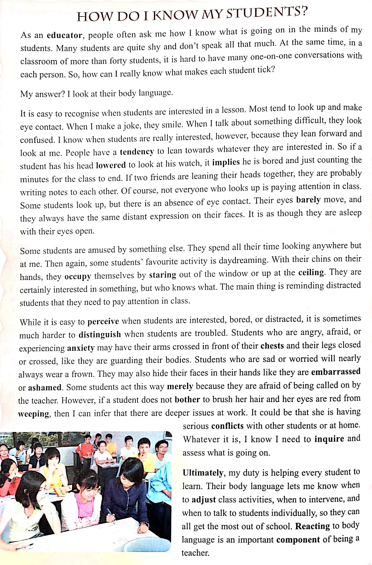







Global reading for structure
Part 1:
Paras.1-2
Introduction
interested & bored
Part 2:
Paras.3-5
Examples:
distracted
interested
bored
distracted
troubled
troubled
Part 3:
Para.6
Reaction

Slide 5
Intensive reading for content
As an educator, people often ask me how I know what is going on in the minds of my students. Many students are quite shy and don't speak all that much. At the same time, in a classroom of more than forty students, it is hard to have many one-on-one conversations with each person. So, how can I really know what makes each student tick?
My answer? I look at their body language.
P1
P2
a tough task
students’ unique character
restricted communication environment

Slide 6
Occasions | Feelings | Body Language (verb phrases)
when students are in a lesson (paras.3-4) | interested
 | bored
 | distracted
when students are troubled (para.5) | angry
 | worried
 | ashamed
 | deeply troubled
Reaction

Slide 7
Ocassions | Feelings | Body Language
when students are in a lesson (paras.3-4) | interested
 | bored
 | distracted
when students are troubled (para.5) | angry
 | worried
 | ashamed
 | deeply troubled
show / imply/ indicate
Occasions
recognize/ perceive/ distinguish
look up..., make eye contact,
look confused,
lean forward
smile,
lower the head, look at the watch, count minutes,
lean heads together,
eyes barely move, have distant expression
look anywhere but at the teacher,
rest their chins on their hands,
stare out of the window or up at the ceiling
cross their arms in front of chests, close or cross their legs
wear a frown
hide their faces in their hands
not bother to brush her hair, eyes are red from weeping

Slide 8
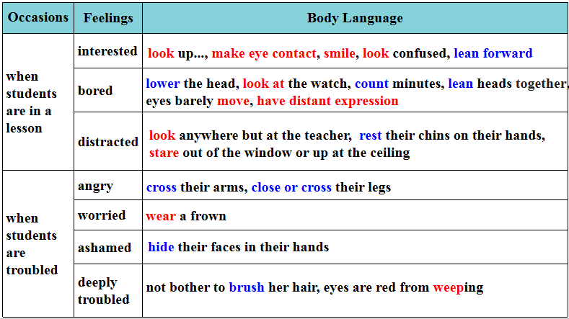
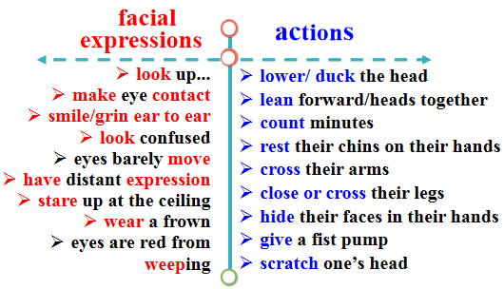
Better understanding, better communication, and better interaction!
The educator does know the students!
Students get the most out of school!
Body Language
Reaction
keep their interest
adjust class activities
remind them
inquire
assess
intervene
talk individually

Slide 9
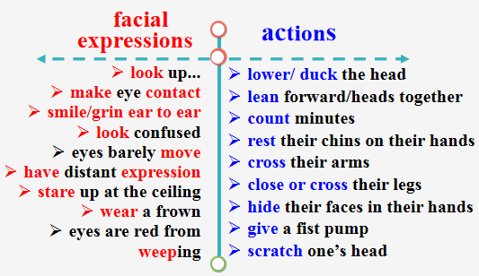
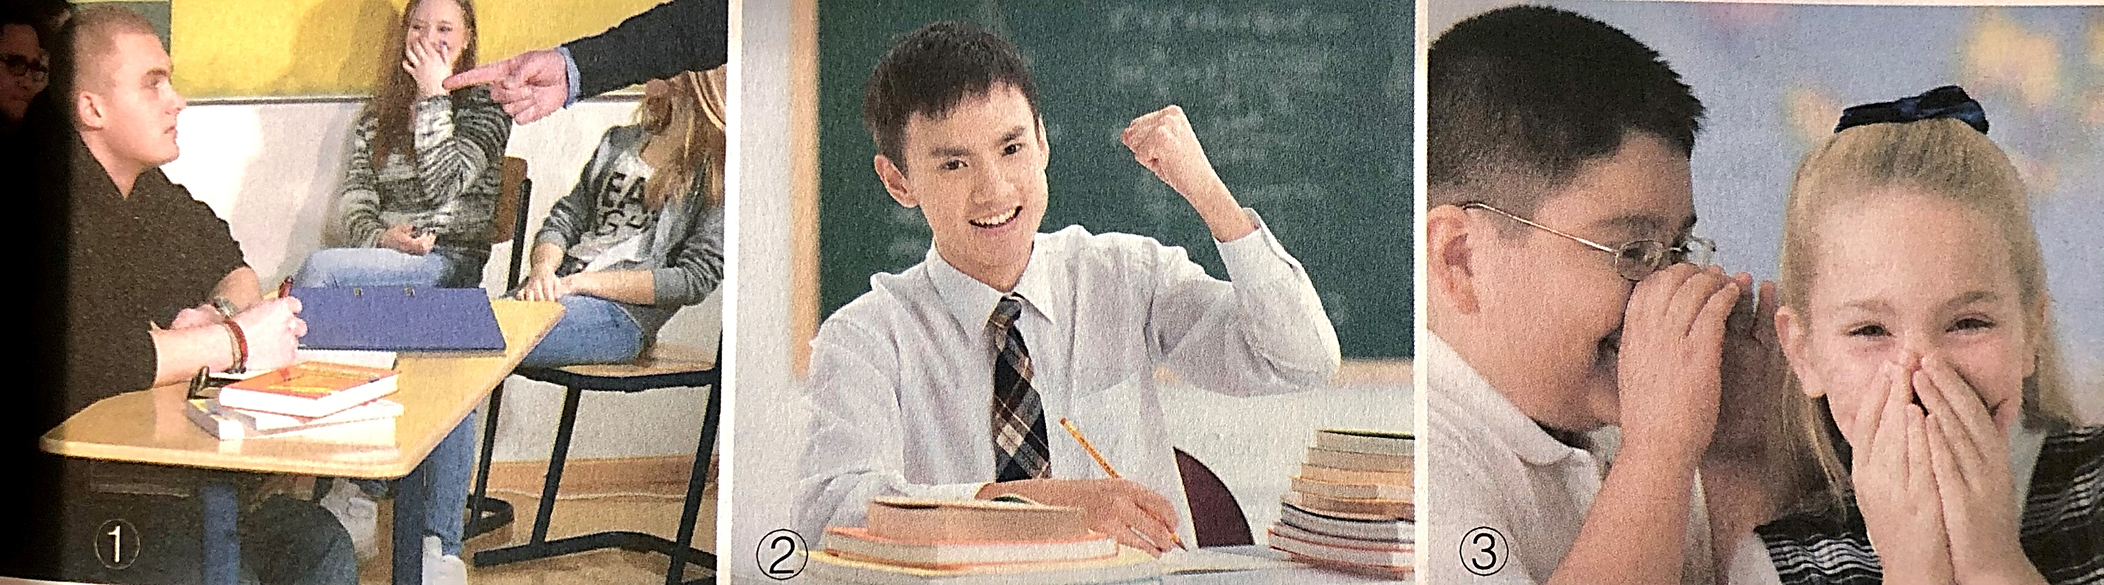

Micro writing: create a scene
Background
(Occassion)
Body Language
Feeling
Reaction
The ... expression on his / her face implied/ indicated/ showed / suggested he/ she was ....
From his/ her body language, it was easy to recognise / perceive/ distinguish....
Realizing /Sensing his/ her mood, I...
The main thing is doing....
Whatever it is, I know I need to ...
One day,....
The good/ bad news came that...
When...,
Jack
Tom

Slide 10
Today, as the results of the English exam were announced,Tom still couldn’t get a satisfying score though he had spared no efforts .
Staring at the paper, he was ducking his head with a frown, his hands scratching the head. His eyes were red from weeping with his eyelids drooping.The glum expression on his face indicated he was downcast. Realizing his low mood, I strode towards him and sat down, patting him on the shoulder. He simply looked down at the paper, biting his lips and saying nothing. Gently I turned him around, looking firmly into his eyes, and convinced him that he would definitely get paid for his efforts sooner or later. Half doubtful and half encouraged, he looked up and the next moment, the gloom on his face disappeared, totally replaced by the confidence to strive.
Background
A vivid micro scene
Body Language
Feeling
Reaction

Slide 11
Assess and revise
Checklist |  | Yes or No
Structure | Does it have a clear structure? (Background + Body Language + Feeling + Reaction)
Content | Does it give a clear and logical description?
 | Does it describe the person’s body language vividly?
Language | Does it use correct grammar, punctuation and spelling?
Handwriting | Does it have neat and clear handwriting ?

Slide 12
Assignment
Task1: Review what have been learnt in this lesson；
Task2: Revise and polish the draft written in class based on the checklist and the feedback given by your partner.

Slide 13
Thank you!

