Slide 1


感恩遇见，相互成就，本课件资料仅供您个人参考、教学使用，严禁自行在网络传播，违者依知识产权法追究法律责任。
更多教学资源请关注
公众号：溯恩高中英语
知识产权声明

Slide 2


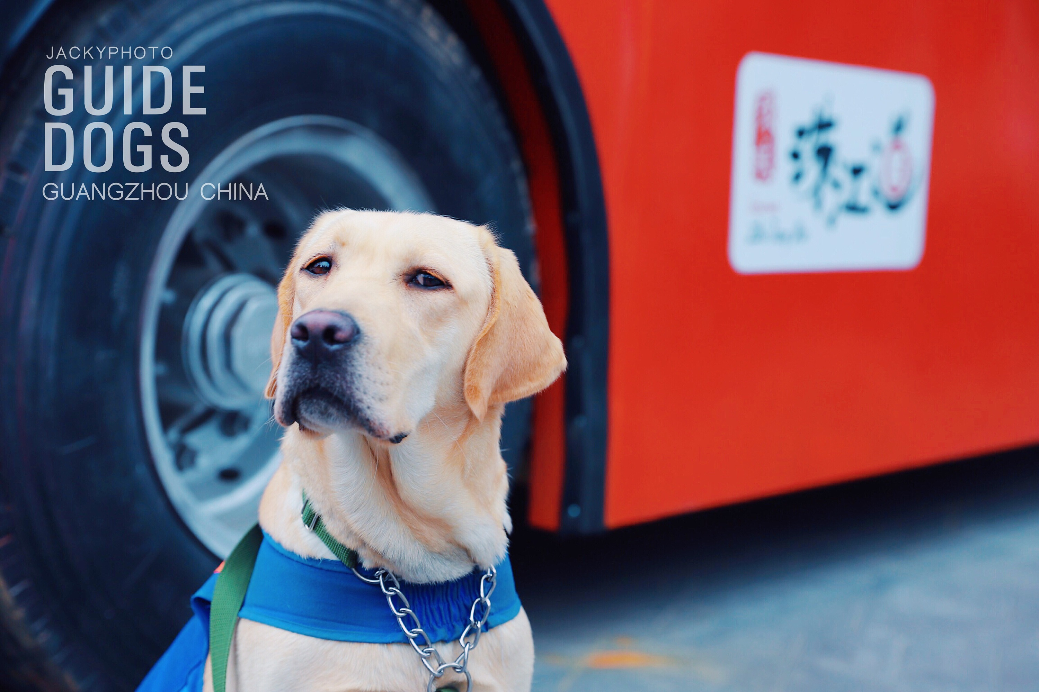
2023年12月 金丽衢十二校高三第一次联考 读后续写讲评

Slide 3
文本呈现
For courage,my fingers clung to the harness (背带、保护带) on Chó's broad back as we passed the fence of my neighbor Mr. Groll's yard.
Walking by Mr. Groll’s yard is the best part of our morning walk,and also the worst.It is the best part because the roses talk to us.“Good morning, Chó,”whisper the rose scents to my guide dog’s nose. Other roses shout to me, “Hello,Mai!”
Now comes the worst part: Mr.Groll.As usual,friendly Chó thumps her tail. But Cho is just a dog; how can she know that this neighbor does not like me at all?
“Hello,Mr.Groll.”I greeted him as I did every morning.And like every other morning, he did not answer me. But I knew he was there,watching, behind his fence.He always sounds out of breath, and the creaky gate swings nervously in his hand.
Maybe he’s afraid of me because I’m blind. Disabilities do scare grown-ups sometimes.Then I remembered: the other day I heard him playing checkers (西洋跳棋) with my friend Jimmy,who's in a wheelchair.

Slide 4
注意：
1. 续写词数应为150左右；
2. 请按如下格式在答题卡的相应位置作答。
Paragraph 1: The sound of it twisted my heart.
Paragraph 2: “It is Chó that scares my words away.”he replied.
Chó and I marched on,and my thoughts kept step.Why did Mr.Groll ignore me?It's a mystery to me.
Papa has told me that some folks do not like people from faraway places.Does this solve the mystery?Maybe Mr.Groll does not like neighbors from faraway places.No,that can't be it.Every Saturday Mr.Groll and my big brother,Lien,help each other with yard work.They are friends.
Well,then,I wondered,why wouldn't he talk to me?The toe of my shoe scuffed the sidewalk,and I think, maybe he didn't like me because I'm a girl.The sidewalk humed beneath my feet.A skateboard zoomed by. “Hello,Mai and Chó!” my friend Jana yelled.“Hi,Mr.Groll.”I waited.If Mr.Groll ignored Jana,then the mystery was solved.But his voice called out,"Hello,Jana!"

Slide 5
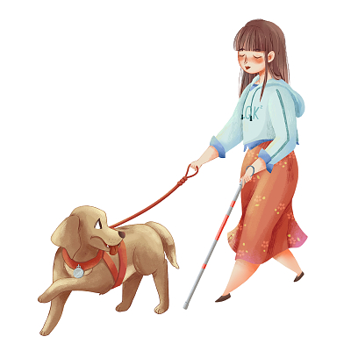
文本解读——可迁移性短语
1. cling to
1. 紧紧握住（抓住不放；贴近）
2. 甩尾巴
3. 气喘吁吁
4. 继续前进
5. 边走路边思考
6. 我的鞋尖刮擦着人行道
7. 人行道在我的脚下发出嗡嗡声
8. 滑板快速经过
9. 把...吓跑
2. thump her tail
3. out of breath
4. march on
5. my thoughts kept step
6. The toe of my shoe scuffed the sidewalk.
7. The sidewalk humed beneath my feet.
8. A skateboard zoomed by.
9. scare sb./sth. away

Slide 6
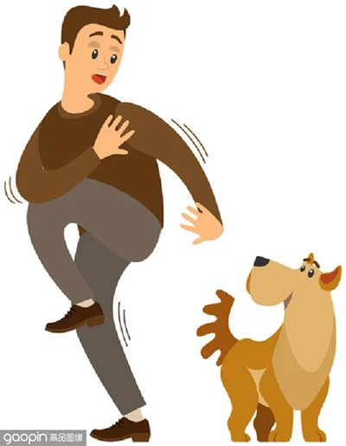







文本解读——情节理解
ending
development
climax
beginning

Slide 7
文本解读——原文怎么“说”？
“Good morning, Chó,” whisper the rose scents to my guide dog's nose. | "whisper" 描述玫瑰花香对导盲犬 Chó 的轻声说话。
Other roses shout to me, “Hello, Mai!” | "shout" 表示其他的玫瑰对主角大声说话。
“Hello, Mr. Groll.” I greeted him as I did every morning. | "greeted" 表示主角向 Mr. Groll 问好，是一种礼貌的说话方式。
And like every other morning, he did not answer me. | 虽然这句话并没有直接用到表示说话的动词，但 "answer" 暗示了通常在说话中的互动。
Maybe he's afraid of me because I'm blind. | 这句话是主角的内心猜想，并不是直接的说话表达，但它反映了主角对情境的理解。
The other day I heard him playing checkers with my friend Jimmy, who's in a wheelchair. | "heard" 在这里说明主角听到 Mr. Groll 和 Jimmy 在玩西洋跳棋，涉及到说话的场景。
“Hello, Mai and Chó!” my friend Jana yelled. | "yelled" 描述 Jana 大声向主角和她的导盲犬打招呼。
“Hi, Mr. Groll.” I waited. | 这里 "Hi" 是主角对 Mr. Groll 的简短问候。
But his voice called out, "Hello, Jana!" | "called out" 描述 Mr. Groll 对 Jana 的回应，他大声地说出了问候语。

Slide 8
文本解读
1. What is the author's favorite part of the morning walk with her guide dog Chó, and why?
2. How does Mr. Groll typically treat the author based on his attitude and behavior described in the text?
3. Why does the author think Mr. Groll might not like her? What possible reasons does she list?
4. Does Mr. Groll have the same attitude towards all neighbors according to the information in the text? Provide evidence.
5. What response does Mr. Groll give when Jana greets him, and how does this help solve the mystery the author is pondering?
6. Which details in the text illustrate the author's feelings and thought process?
7. It is inferred that the author and her family are from a faraway place. What textual evidence supports this inference?

Slide 9
1. The author's favorite part of the morning walk is passing by Mr. Groll's yard because the scents of the roses greet her and her guide dog, Chó.
2. Mr. Groll typically ignores the author; he does not respond to her morning greetings, even though she knows he is there watching from behind his fence.
3. The author considers several reasons why Mr. Groll might not like her: she wonders if it is because she is blind, as disabilities sometimes scare adults. She also thinks it might be because she is from a faraway place or possibly because she is a girl.
4. No, Mr. Groll does not have the same attitude towards all neighbors. The text provides evidence that he interacts with others, such as playing checkers with Jimmy, who is in a wheelchair, and doing yard work with the author's brother, Lien, suggesting they are friends.

Slide 10
5. When Jana greets Mr. Groll, he responds with "Hello, Jana!" This reaction suggests that Mr. Groll's refusal to acknowledge the author is not due to a general unfriendliness but is specific to the author for some reason.
6. The author’s inner feelings and thought processes are illustrated through details such as her clinging to Chó's harness for courage, her questioning why Mr. Groll ignores her, and the description of how she pays attention to different sounds and sensations, like the creaky gate and the humming sidewalk.
7. The text suggests that the author and her family are from a faraway place when it mentions her father's comment about some folks not liking people from faraway places, which the author considers as a possible reason for Mr. Groll's behavior towards her.

Slide 11
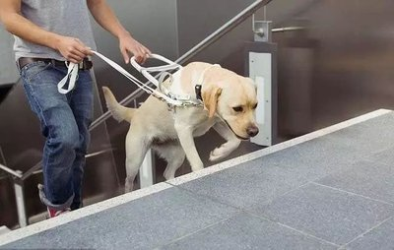
写作思路
根据原文，我们可以看到Mai正在尝试理解和解决一个社会性的谜题：为什么Mr.Groll会选择性地忽视某些人。这种探索不仅展示了Mai对于自我认知和社会互动的敏感性，也反映了她的思维过程是开放和多角度的。她没有立即下结论，而是通过观察、回忆和逻辑推理来逐步剖析问题，并且在这个过程中保持了对他人的尊重和理解。尽管Mai是盲人，但她展现了对周围世界的深刻洞察力和强烈的求知欲，这是故事中非常重要的主题。

Slide 12
写作思路
从段首句看，Mr. Groll的沉默并非是因为他不喜欢Mai，而是因为他害怕Chó，也就是Mai的导盲犬。这个揭示出来的答案与Mai之前的种种猜测完全不同，她曾经以为Mr. Groll可能因为她的盲目、她的性别，或者她来自遥远的地方而对她产生敌意。但实际上，Mr. Groll对她的冷淡只是因为他害怕她的导盲犬。
这个结果让Mai感到心痛，可能是因为她一直把Chó当作自己的朋友和伙伴，而现在却发现Chó成为了她与邻居交流的障碍。这是一个关于误解、预设观念和真实理解之间差距的故事，提醒我们在对待他人的行为时，应该保持开放和理解的态度，而不是立即做出判断。

Slide 13
写作思路
1. 社会排斥与接纳的复杂性：Mai的困惑指向了社会互动中的一个普遍现象，即人们有时会基于某些不明显的偏见或个人喜好来选择性地接纳或排斥他人。Mr. Groll选择回应Jana而忽视Mai，这种行为可能基于多种原因，包括但不限于性别、年龄、残疾、种族或甚至是个人的性格特征等。
2. 沟通与误解：Mai尽管是盲人，但她通过其他感官和直觉来感知世界，并试图与他人建立联系。她对Mr. Groll的问候是一种沟通的尝试，但是没有得到回应。这可能意味着Mr. Groll有他自己的问题或误解，导致他不愿意与Mai交流。
3. 内省与成长：Mai在面对社会挑战时展现出了内省的品质。她不断地自我反思并尝试从不同的角度理解Mr. Groll的行为。这种内省不仅帮助她更好地理解自己在他人眼中的形象，也可能促进她的情感和心理成长。

Slide 14
4. 友谊与同情：文中提到了Mai的哥哥Lien和Mr. Groll之间的友谊，这表明即使在存在社会隔阂的情况下，人与人之间的关系也可以是多样化和复杂的。此外，Mai的朋友Jana的出现和问候则体现了同龄人之间的友谊和支持。
5.预设与突破：Mai尝试打破关于残疾人的预设看法，她的行为和思考方式挑战了社会对盲人能力的传统认知。她的主动性和勇气，以及对周围环境的高度敏感，都表明残疾并不妨碍一个人充分地参与社会生活。
总而言之，这段文字不仅是一个关于Mai个人经历的叙述，也是对人类社会行为模式和心理机制的深入探讨。通过Mai的视角，读者被邀请去思考人与人之间相互作用的复杂性，以及如何在面对不理解和排斥时保持尊严和积极性。

Slide 15
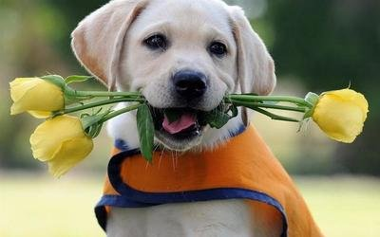
参考范文
Para.1
The sound of it twisted my heart. It confirmed that his silence was intentional and selective, but the reason behind it still eluded（不被…理解）me. I felt a pang of rejection, wondering what I could have possibly done to deserve such treatment. Chó seemed to sense my mood change, nuzzling her head against my hand in an attempt to offer comfort. Despite the warmth of the sun and the sweet fragrance of the roses, a shadow had been cast on our morning walk, and I couldn't help but feel a little less welcome in my own neighborhood.

Slide 16
Para.2
“It is Chó that scares my words away,” he replied. His unexpected response caught me by surprise, and for a moment, I was unsure how to react. Could it really be that my guide dog, my eyes, and my companion, was the source of Mr. Groll's discomfort? A mix of emotions washed over me: relief that it wasn't something I had done, confusion as to why Chó would intimidate him, and a budding hope that maybe this was a misunderstanding that we could overcome. I wanted to learn more, to see if there was a way to bridge this gap and transform our silent neighbor into a friend.

Slide 17
Para.1
The sound of it twisted my heart. It was a confirmation of my fears that the issue was with me, an invisible wall between us that I had not known how to scale. My thoughts swirled with questions and theories, each as unlikely as the next. Was it my blindness, or something else about me that kept him at such a distance? Chó’s steady presence at my side was a comforting weight against the sting of rejection, her loyalty a silent promise that not all connections were so easily broken.

Slide 18
Para.2
“It is Chó that scares my words away,” he replied. This revelation（披露的真相） startled me, as Chó had always been a gentle guide and companion, never once a source of fear. I wondered if perhaps there had been an incident in Mr. Groll's past that had left him wary of dogs. Understanding began to replace the hurt I had felt; this wasn't about me, but rather his own fears. A dialogue had opened, a chance to address the unspoken tension, and maybe, with time, we could find common ground.

Slide 19


