Slide 1


感恩遇见，相互成就，本课件资料仅供您个人参考、教学使用，严禁自行在网络传播，违者依知识产权法追究法律责任。
更多教学资源请关注
公众号：溯恩高中英语
知识产权声明

Slide 2

活用教材词汇，靶向高考写作
B7U3单词拓展
武汉经开区汉阳三中：廖英

Slide 3


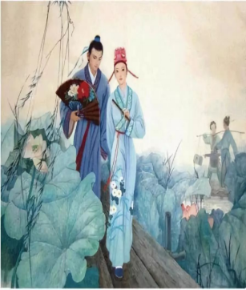



tale/teɪl/ n.故事;叙述
1.多年来，中国民间故事深受中国人民的喜爱，并被反复讲述。在众多
的民间故事中，有四个故事特别受欢迎，它们被称为中国四大民间故事，
分别是《梁山伯与祝英台》、《白蛇传》、《牛郎织女》和《孟姜女哭长城》。
For years, Chinese folktales are loved and repeatedly retold by Chinese people. Among numerous folktales, four stories are particularly popular and they are called Four Great Chinese Folktales, including Butterfly Lovers, Legend of the White Snake, the Cowherd and Weaving Girl and Lady Meng Jiang.

Slide 4
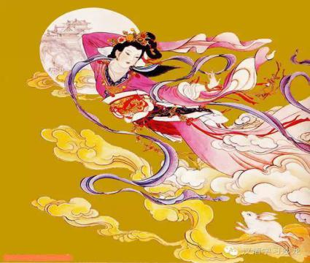
tale/teɪl/ n.故事;叙述
2.七夕是中国著名的情人节。它与美丽的民间故事《牛郎织女》密切相关，在这个故事中，一个仙女和她的凡人牛郎丈夫被放逐到“银河”的两端，每年只在农历七月初七见面一次。
The Double Seventh Day, or QiXi Festival, is renowned as Chinese Valentine’s day. It is closely linked to the beautiful folktales of The Cowherd and the Weaving Girl, in which a fairy and her mortal cowherd husband were banished to opposite ends of the “Silver River” and met only once a year on the seventh day of the seventh lunar month.
3.为了解释中国古代的奥秘，人们创造了神话和传说，
并代代相传。其中一个故事是关于嫦娥的，她服用了
长生不老药，飞向天空，飞向月球。
In an attempt to explain the mysteries in ancient China,
myths and legends were created, and were passed down
from generation to generation. One such tale is that of Chang’e,who took an elixir of immortality and flew up into the sky to the moon.

Slide 5
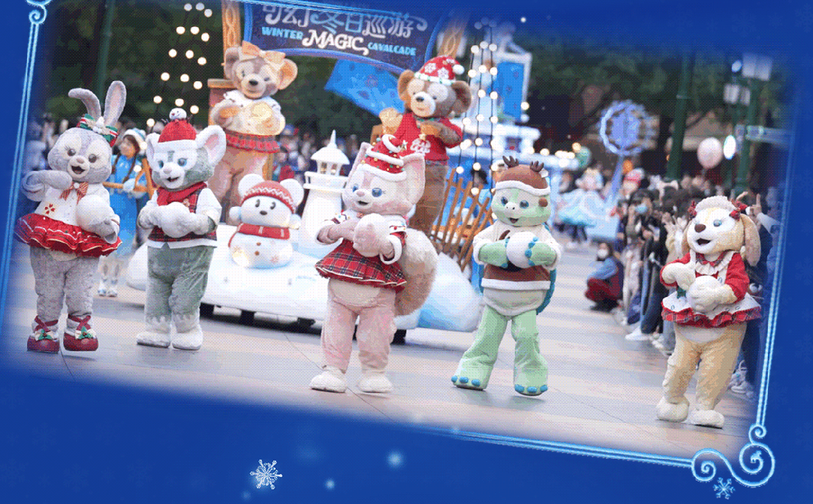

tale/teɪl/ n.故事;叙述
4. 上海迪士尼乐园位于上海市浦东新区，占地面积约为390万平方米。它于2016年6月正式开园，是世界上第六个迪士尼主题乐园。它拥有七大主题园区，两大主题公园，一些全球首发的游乐项目。作为一个充满幻想的地方，上海迪士尼乐园将带你进入一个神奇的世界，在那里你可以亲眼看到童话般的城堡和穿着特定服装的心爱卡通人物。
Located in the Pudong New Area of Shanghai, Shanghai Disneyland covers an area of 3.9 million square metres. Officially opened in June 2016, it is the sixth Disney theme park in the world. Shanghai Disneyland consists of seven theme parks, two theme hotels and many of the world's first rides. As a place full of fantasy, Shanghai Disneyland will bring you into a magical world, where you can see fairytale castles and beloved characters in costume in person.

Slide 6


那些年我们读过的故事
story指虚构的故事，或者指对真实事件通过口头叙述而讲出来的故事。
tale指涉及魔法、带有玄幻色彩的神话故事。
myth指古代人民对于自然现象或宗教信仰的理解而创造的故事。
legend指人们口头传下来的故事，可能具有真实性。
fable指通过动物或人讲述一个短篇的道德故事。
那些年我们读过的故事
安徒生童话 Hans Christian Andersen's Fairy tales
丑小鸭 The Ugly Duckling
海的女儿 The Little Mermaid
卖火柴的小女孩 The Little Match Girl
格林童话 Grimm's Fairy Tales 伊索寓言 Aesop's Fables
白雪公主 Snow White 龟兔赛跑 The Tortoise and the Hare
灰姑娘 Cinderella 农夫与蛇 The Farmer and the Viper
青蛙王子 The Frog Prince 乌鸦喝水the Crow and the Pitcher
thought-provoking
fables about morals

Slide 7
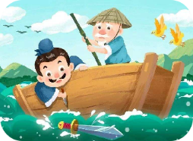

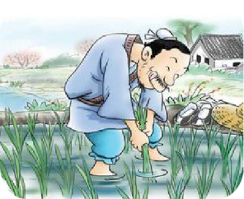
那些年我们读过的故事
To mark on a
moving boat
for a sunk sword
刻舟求剑
Be flexible to deal with things accordingly as the circumstances change.
the Fox and
the Crow
狐狸和乌鸦
If you only like to listen to good words, you are likely to be cheated. Use your mind to analyze things. Don't believe others' words easily.
To try to help the shoots grow by pulling them upward
揠苗助长
People should follow the laws of nature. Being too eager for something always makes it worse.

Slide 8


set sail/set seɪl/ 起航;开航
1.小船平稳地驶过湖面。
The dinghy sailed smoothly across the lake.
2.她像一艘开足马力的船一样快速地走开了。
She moved away like a ship in full sail.
3.明朝希望加强与一些西方国家的联系，1405年，郑和率领的七支大船队从中国南海
起航。
The Ming Dynasty desired to strengthen the bonds with some western countries and in 1405 seven large fleets under the command of Zheng He set sail from the South China Sea.
4.目标的重要性怎么强调都不为过。就像海上的水手一样，目标就像
指南针，指引我们前进的方向，没有它，我们就会感到迷失和漫无目的。
The significance of a goal can never be overemphasized.
Like a sailor in sea, a goal serves as a compass which points to the way
he needs to take, without which we would feel lost and aimless.

Slide 9

set sail/set seɪl/ 起航;开航
5.平静的大海练不出熟练的水手。/波涛汹涌的大海造就伟大的水手。
Smooth seas never make a skilled sailor./Rough seas make great sailors.
6.我想和大家分享沃尔特·惠特曼的一首诗:“
做世界的水手，航行到所有的港口。”中国一位伟大
的诗人李白也有类似的说法:“长风破浪会有时，
直挂云帆济沧海”。我希望我们能永远志存高远，
自由地航行世界!
I would like to share with you a line from a poem by
Walt Whitman: “To be a sailor of the world, bound for
all ports.” There is a similar quote from one of the greatest
Chinese poet Li Bai: “长风破浪会有时，直挂云帆济沧海
（A time will come to ride the wind and cleave the waves,
I will set my cloudlike sail to cross the sea which raves)”.
I hope we will always aim high and be free to sail the world!

Slide 10

extend/ɪkˈstend/ vt.扩展;使伸长;延长
1.长江绵延约6300公里，为游客提供了各种壮丽的景观。
The Yangtze River, extending as long as about 6,300 kilometers,
provides different kinds of splendid landscapes for visitors.
2.如果您认为最后期限不够，我们可以延长期限。
We will extend the deadline if you consider the deadline is not enough.
3.苏轼的遗产不仅限于他的文学成就。他也是一个非常正直和勇
敢的人，他不害怕对不公正的事情发表意见。^{2023全国甲卷应用文“介绍中国历史人物征文稿”}
Su Shi’s legacy extends beyond his literary achievements. He was also
a man of great integrity and courage, who was not afraid to speak against injustice.
4.疫情发生期间，中国向世界许多国家伸出了援助之手。
During the epidemic outbreak, China extended its helping hand to
many other countries around the world.

Slide 11



extend/ɪkˈstend/ vt.扩展;使伸长;延长
5.我是李华，是我们学校“有说有说”广播节目的主持人。我诚挚地邀请您成为我们节目的嘉宾。^{2022新高考I卷“访谈邀请信”}
I’m Li Hua, host of the “Talk and Talk” radio show at our school. I’d like to extend a warm invitation to you to be a guest on our show.
6.只有通过广泛的阅读，我们才能积累英语的基础
知识，开阔我们的视野。^{2022全国乙卷图表类应用文---“针对课外英语}
^{学习调查结果的短文投稿”}
Only through extensive reading can we accumulate the basic
knowledge of English and broaden our horizon.
7.他最初是以六个月的签证入境的，后来又获得了六个
月的延期。
He first entered the country on a six-month visa, and was
given a further extension of six month.

Slide 12


negotiate/nɪˈgəʊʃieɪt/ vt.商定;达成协议 vi.谈判
1.参加课外活动使我们学会了与同学谈判和合作。
Participating in extra-curricular activities enables us to
learn to negotiate and cooperate with fellow students.
2.我已经和老板谈妥了加薪百分之五的事。
I’ve managed to negotiate a five percent pay increase
with my boss.
3.据报道，谈判破裂是因为一方拒绝遵守规则。
It is reported that the negotiation broke out because
one side refused to keep the rule.
4.与客户协商的一份合同准备好的。
A contract is prepared in negotiation with our clients.

Slide 13
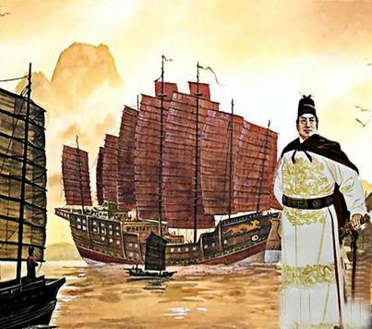
fleet/fli:t/ n.舰队;机群;车队
1.郑和的船队由300多艘船组成，并带来了丝绸、瓷器和其他贵重物品，这些物品可以沿途交换当地的产品，如香料和象牙。在整个航行中，郑和和他的船队还与许多国家建立了外交关系。^{2023全国甲卷应用文“介绍中国历史人物征文稿”}
Zheng He’s fleet consisted of over 300 ships and brought with silk, porcelain and other valuable goods, which were exchanged for local products, such as spices and ivory, along the journey. Throughout the voyage, Zheng He and his fleet also established diplomatic relations with numerous kingdoms.
2.总之，李白的诗歌不断地提醒着我们，继续激励着
一代又一代的读者，包括我自己。他的诗教会了我欣
赏稍纵即逝的美，发掘自己的创造力，并通过写作表
达自己的情感。^{2023全国甲卷应用文“介绍中国历史人物征文稿”}
In a word, LiBai’s poetry serve as a timeless reminder,
continuing to inspire generations of readers, including
myself. His poems have taught me to appreciate the fleeting
moments of beauty, explore my own creativity and express
my feelings through writing.

Slide 14
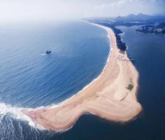
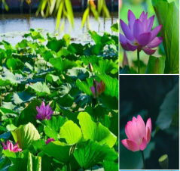
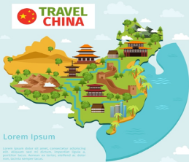
behold/bɪˈhəʊld/ vt.看;看见
1.去年夏天，我们参观了印度洋上的一个岛屿，那里的岩石
海岸线和长长的金色海滩令人叹为观止。
Last summer, we visited an island in the Indian Ocean, whose
rocky coastline and long golden beaches were a sight to behold.
2.大明湖的荷花是一种令人叹为观止的美景，因为它们展示了
济南如画的魅力。
The lotus flowers at Daming Lake are a stunning sight to behold,
as they showcase the picturesque charm of Jinan.
3.从高耸的山脉到蜿蜒的河流，从茂密的森林到崎岖的海岸线，
中国的自然之美真是令人惊叹，必须亲身经历才能相信。
From the soaring mountains to the winding rivers, from the lush
forests to the rugged coastline, China’s natural beauty is truly
a marvel to behold and something that must be experienced to
be believed.
4.情人眼里出西施。
Beauty is in the eyes of the beholder.

Slide 15
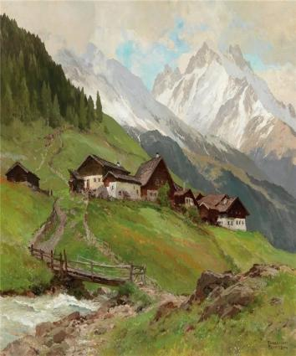
美丽风景的描述方法：
1.经过一夜的长途驾驶，山上的日出真是令人心旷神怡。
The sunrise over the mountain was a sight for sore eyes
after a long night for driving.
2.当我们到达山顶时，迎接我们的是下面广阔山谷的壮丽景色。
When we reached the mountaintop, we were greeted by a
breathtaking view of the expansive valley below.
3.坐落在山上的小村庄看起来就像一张完美的明信片。
The little village nestled in the hills looked like a picture-perfect postcard.
4.秋天树叶的鲜艳色彩使森林看起来像一幅栩栩如生的画。
The vibrant colors of the autumn leaves made the forest look like a painting come to life.
5.植物园里五颜六色的花朵和郁郁葱葱的草木真是一场赏心悦目的盛宴。
The botanic garden was a true feast for the senses with its colorful flowers and lush greenery.

Slide 16
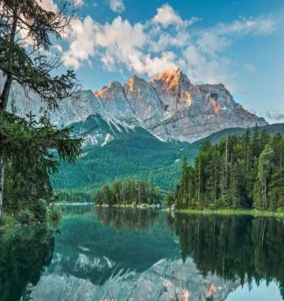

美丽风景的描述方法：
6.站在洁白的沙滩上，海水如水晶般清澈，仿佛找到了人间天堂。
Standing on the white sand beach with crystal-clear waters, it felt like we had found heaven on earth.
7.从山顶上，我们看到了连绵起伏的丘陵和波光粼粼的湖泊延伸到远处的壮丽景色。
From the top of the hill, we were treated to a glorious vista of rolling hills and sparkling lakes stretching into the distance.
8.从白雪皑皑的喜马拉雅山到肥沃的长江流域，中国是一片充满多样性和奇观的土地，一定会让你流连忘返。
From the snow-capped peaks of the Himalayas to the fertile valleys of the Yangtze River, China is a land of diversity and wonder, which is sure to keep you spellbound.

Slide 17
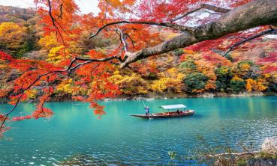
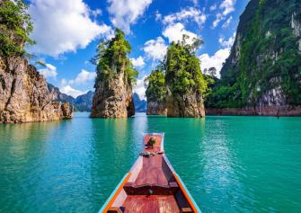
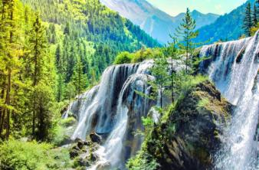
美丽风景的描述方法：
9.读他的诗，你会发现自己迷失在一个风景如画的世界里，诗中所描述的一切都将呈现在你面前。
Reading his poetry, you will find yourself lost in a picturesque world where everything described in the poem will be presented just ahead of you.
10.我们乘出租车去了湖边，那里碧蓝的湖水以其独特的美丽让他们惊叹不止。
We took a taxi to the lake, where the blue water literally took their breath away with its exceptional beauty.
11.看着美丽的风景，他们都认为这是他们所经历过的最美好的旅行。
Looking at the beautiful scenery, they both agreed that it was the most awesome journey they had ever taken.

Slide 18
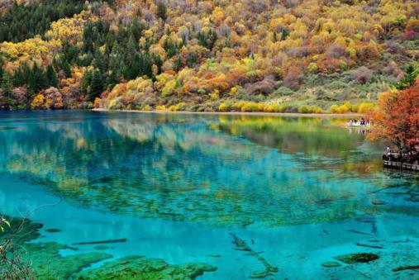
美丽风景的描述方法：
12.九寨沟位于四川省北部，是中国最著名的旅游景点之一。它以其色彩斑斓的湖泊、壮观的瀑布、令人叹为观止的山脉以及独特的野生动物而闻名。1992年被联合国教科文组织列为世界自然遗产，其迷人的自然风光吸引着游客。
Located in the north of Sichuan Province, Jiuzhaigou Valley is one of the most famous tourist attractions in China. It is best known for its colorful lakes, splendid waterfalls, breathtaking mountains as well as unique wildlife. It was named as a World Natural Heritage Site by UNESCO in 1992 and its charming natural scenery appeals to visitors.
attractive adj.吸引人的
appealing adj.有吸引力的；令人感兴趣的
fascinating adj.极有吸引力的；迷人的
eye-catching adj.惹人注意的；引人注目的
gorgeous adj.美丽动人的
enchanting adj.迷人的；令人陶醉的
charming adj.令人着迷的；吸引人的
spectacular adj.壮观的;令人惊叹的
delightful adj.令人愉悦的，宜人的

Slide 19

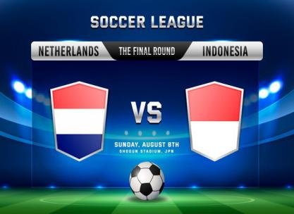
league/li:g/ n.等级;水平;联合会;联赛
in a league of one’s own/ɪn ə li:g əv wʌnz əʊn/ 独领风骚
1.下周我们将与联赛冠军队比赛。
We are playing against the league champions next week.
2.作为画家，他独树一帜。
As a painter, he is in a league of his own( much better than others).
3.中国跳水选手陈玉曦和全洪禅的动作近乎完美，独树一帜。
Chinese diver Chen Yuxi and Quan Hongchan are in a league
of their own with nearly flawless moves.
4那样的房子不是我们买的起的。
A house like that is out of our league.
5.说到做饭，我可比不上她。
When it comes to cooking, I am not in her league.

Slide 20
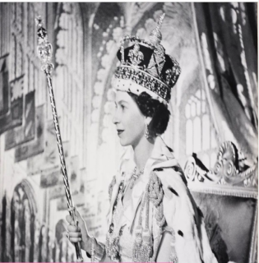

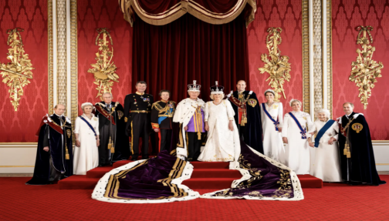
royal/ˈrɔɪəl/ a.皇家的;王室的;高贵的
1.求学无坦途。
There is no royal road to learning.
2.当你在英超联赛中预订招待门票时，
你会得到皇家般的待遇，因为你可以
得到免费的食物和饮料，还可以欣赏
到精彩的比赛景色。
You get the royal treatment when you
book hospitality tickets in the Premier
League as you can get free food and
drinks and an amazing view of the match.

Slide 21
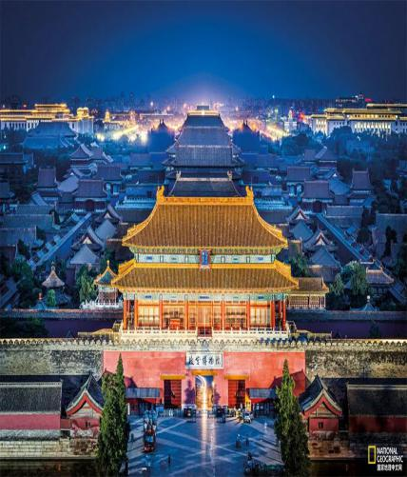
royal/ˈrɔɪəl/ a.皇家的;王室的;高贵的
3.我们可以从紫禁城开始我们的旅行，紫禁城是一个巨大的古代皇宫建筑群，曾经是明清皇帝的住所。然后，我们可以去长城，它是中国强大国防力量的象征。之后，我们还可以参观天坛，这是中国古代人们祈求丰收的地方。最后，我们可以去颐和园，这是中国古代皇室休息和举行宴会的地方。
We can start our tour at the Forbidden City, a vast
palace complex of ancient royal residence that once
housed emperors from the Ming to the Qing Dynasties,
Then, we can go to the Great Wall, which is a symbol of
China’s strong defense power. After that, we can also visit
the Temple of Heaven, which is a place where ancient Chinese
people prayed for a good harvest. Finally, we can go to the
Summer Palace, which is a place where Chinese royal family
used to rest and hold banquets.

Slide 22
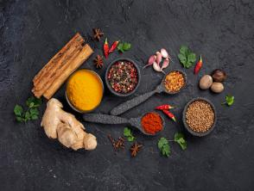
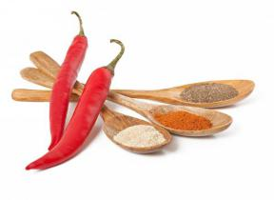
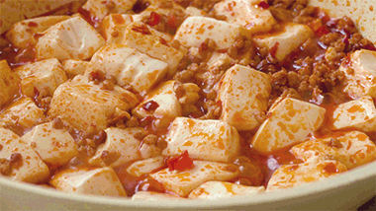
spice/spaɪs/ n.(调味)香料
1.我在食谱里加了些香料，使它更好吃。
I added some spice to the recipe to make it taste better.
2.它不仅通过各种栏目拓宽了我的视野，也为我枯燥的
日常学校生活增添了乐趣。2021年新高考I卷应用文“youth英语报创刊十周年短文征稿”
Not only does it broaden my horizons with various columns,
but also adds spice to my dull routine school life.
3.中国食物的味道传统上分为五种口味:酸、甜、苦、辣和咸。
中国人强调五味和谐。
Tastes of Chinese food are traditionally categorized into five flavors:
sour, sweet, bitter, spicy and salty. Chinese emphasize the harmony
of the five flavors.
4.川菜以麻辣可口而闻名。最著名的菜肴之一是麻婆豆腐，
它是用豆腐和肉末在辣酱中制成的。
Sichuan cuisine is known for its spicy and flavorful dishes. One
of the most famous dishes is mapo tofu, which is made with tofu
and minced meat in a spicy sauce.

Slide 23
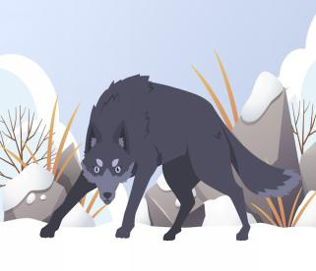
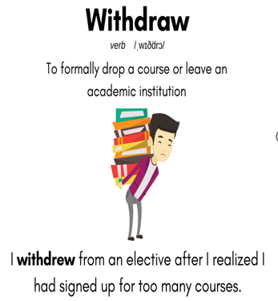
withdraw/wɪðˈdrɔ:/ vi.＆vt.(使)撤回;撤离
withdraw from/wɪðˈdrɔ: frəm/ 退出;撤回
1.面对这四个强壮的人，狼可能感到了威胁，开始撤退。
不久，它跑进了森林，消失在远处。^{201706浙江卷读后续写“骑自行车遇狼袭击”}
Facing the four strong men, the wolf might feel threatened,
starting to withdraw. Soon it ran off into the forest and
disappeared in the distance.
2.在病房里，护士在他的手臂上扎了一根针。
然后她取出来，在伤口上放了一块棉絮。
In the ward, the nurse stuck a needle in his arm.
Then she withdrew it and placed a pad of cotton wool
over the spot.
3.这位网球运动员因伤退出了几场比赛。
The tennis player withdrew from several tournaments
due to injury.

Slide 24
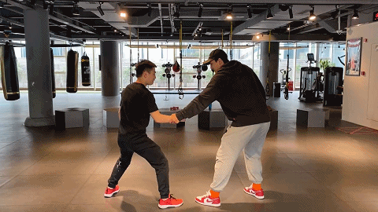

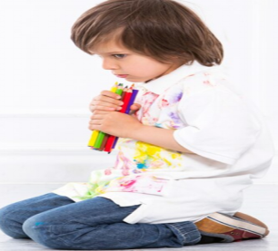
withdraw/wɪðˈdrɔ:/ vi.＆vt.(使)撤回;撤离
withdraw from/wɪðˈdrɔ: frəm/ 退出;撤回
4.她挣脱他的手，冲了出去。
She withdrew her hands from his grasp and dashed out.
5.意识到我和他的父亲几乎入不敷出，他毫不犹豫地从银行
取出了一年的积蓄，即使这意味着他必须申请学生贷款来实
现他的大学梦想。
Aware that his father and I could hardly make ends meet,
he didn’t hesitate to withdraw his year-long saving from
the bank, even if it meant he had to apply for a student
loan to achieve his university dream.
6.这个学生沉默寡言，很少说话。
The student is withdrawn/reserved
and speaks very little.

Slide 25

channel/ˈtʃænl/ n.航道;海峡;频道
1.我弟弟很淘气，当我看电视的时候，他喜欢从一个频道跳到另一个频道。
My brother is very naughty who likes to hop from channel to channel when I’m watching TV.
2.电子商务每年增长15%，在线渠道在许多行业中占据主导地位。
The online channel has assumed a dominant role in
many industries, result of a 15% annual growth in e-commerce.
3.音乐是释放情绪的好渠道。
Music is a great channel for releasing your emotions.
4.其次，学校应该为受害者和欺凌者保持清晰的沟
通渠道，这样他们就不会压抑自己的感情。^{2020无锡高三}
^{期末应用文“校园霸凌”}
Second, it is urged that schools should maintain clear channels
of communication for both victims and bullies so that they
do not bottle up their feelings.

Slide 26


bond/bɒnd/ n.纽带;关系 v.增强信任关系
1.他们之间播下了友谊的种子。
A bond of friendship has been forged between them.
2.他意识到，尽管他的爷爷死于阿尔茨海默病，但
这永远不会剥夺他们彼此之间深厚的感情。
He realized that even though he had lost his grandpa
to Alzheimer’s disease, never would it deprive the deep
bond they had for each other.
3.“一带一路”倡议的目标是促进丝绸之路沿线地区的
合作和贸易，加强中国与世界其他国家的联系。
The aim of the Belt and Road Initiative is to encourage
cooperation and trade across the historic Silk Road areas,
and strengthen the bond between China and the rest of
the world.

Slide 27


in hand/ɪn hænd/ 在手头;可供使用
1.保持积极性可以帮助你专注于手头的工作并取得成功。
Staying motivated can help you focus on the work in hand and achieve success.
2.我坐在温暖的夜晚，手里拿着一杯冷饮，回想着这一天
——这是神奇的一天!
I am sitting in the warm night air with a cold drink in my hand
and reflecting on the day---a day of pure magic!
3.同时，你最好随身携带一本字典，查找不熟悉的单词。
Meanwhile, you’d better keep a dictionary close at hand to
look up unfamiliar words.
4.如果我有困难，迈克总是愿意帮助我。
If I am in trouble, Mike is always willing to lend/give me a hand
/do me a favor.

Slide 28
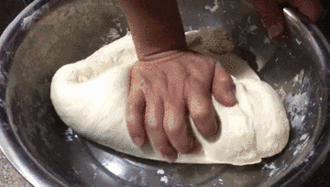
in hand/ɪn hænd/ 在手头;可供使用
5.一方面，共享单车使人们出行非常方便，有助于实现低碳生活方式。另一方面，随意停车经常给人们带来困扰，一些共享单车甚至因不明原因被损坏。
On the one hand, bike sharing makes it very convenient for people to travel and contribute to a low carbon lifestyle. On the other hand, random parking frequently bothers people, and some shared bikes are even left damaged for unknown reasons.
6.在小笼包的故乡南翔，你会发现它们的制作方法不同——饺子多，汤少，而且饺子皮是用手压而不是卷起来的。^{2023全国卷I语篇填词“中华美食小笼包”}
In Nanxiang, Xiao long bao’s birthplace,you will find
them prepared differently more dumpling and less soup,
and the wrappers are pressed by hand rather than rolled.
7.她拉着我的手，把我领进了山洞。
She took me by the hand and led me into the cave.
8.婴儿用她的小手抓住我的手指。
The baby gripped my finger with her tiny hand.

Slide 29


动作描写之“手”
1把某物给某人
2.伸出一只手
3.牵某人的手
4.伸手去抓住她的手
5.手里拿着钥匙
6.抓住我的手
7.拍手
8.举手
9.摊开手
10.搓手
11.用一只手接住球
12.与……握手
13.将……捧在手心
14.挥手
15.把双手深深插进口袋里
16.把手从他手里抽出
1.hand sth to sb
2.extend/hold/stretch /reach out a hand
3.take one’s hand
4.reach for her hand
5.hold the key in his hand
6.take hold of/seize my hand
7.clap one’s hands
8.raise/put up one’s hands
9.spread one’s hands
10.rub her hands together
11.catch the ball in one hand
12.shake hands with
13.cup...in one’s hands
14.wave one’s hand
15.dig his hands deep into his pockets
16.withdraw his hands from his grasp

Slide 30

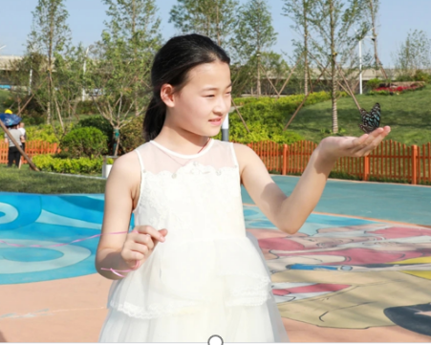

动作描写之“手”
17.我弯下腰，尽可能轻轻地把蝴蝶捧在手里。
我把它的腿抬起来，它突然自由了。我摊开双手，
让它飞向蓝天。
I bent down and cupped the butterfly in my hands as
gently as I could. I lifted its leg up and suddenly it was
free. I spread my hands and up flew it towards the blue sky.

Slide 31
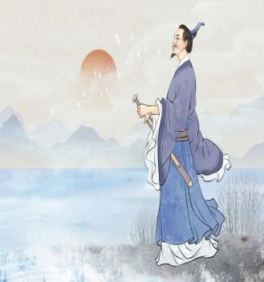

politics/ˈpɒlətɪks/ n.政治;政治观点
1.孔子相信教育和道德价值的重要性。几个世纪以来，他的哲学影响了中国的政治、教育和社会规范。^{2023全国甲卷应用文“介绍中国历史人物征文稿”}
Confucius believed in the importance of education and moral values. His philosophy has influenced Chinese politics, education and social norms for centuries.
2.屈原，一位伟大的中国诗人和政治家，以他的
爱国主义和对国家的忠诚而闻名。屈原非常关心
国家的政治形势，并试图说服国王采取更公平的
政策。^{2023全国甲卷应用文“介绍中国历史人物征文稿”}
Qu Yuan, a great Chinese poet and politician, is widely
known for his patriotism and loyalty to his country.
Qu Yuan was deeply concerned about the political
situation of his country and tried to persuade the
king to adopt a more fairer policy.

Slide 32

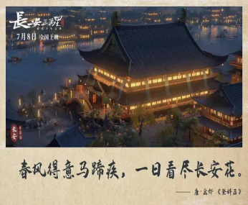
politics/ˈpɒlətɪks/ n.政治;政治观点
3.电影中的48首唐诗展现了当时最优秀的诗人，以及他们的政治抱负和理想。
The 48 poems Tang poems featured in the movie present a panorama of the most excellent poets of that time as well as their political aspirations and ideals.
4.唐朝因其经济繁荣和文化融合而被视为中国
历史上的黄金时代。
Tang era is often seen as a golden age in Chinese
history due to its economic prosperity and
cultural integration.
5.科技进步极大地改善了我们的日常生活。
Technological advancement has greatly
improved our daily lives.

Slide 33

profession/prəˈfeʃn/ n.职业;行业
1.受他老师的启发，乔尼决定进入教师行业。
Inspired by his teacher, Jonny has decided to enter the teaching profession.
2.你在我们的节目中提供了各种各样的演讲技巧和创造性的建议，真是太好了。正是在您的专业指导下，参与者们展示了烹饪、园艺等技能。^{2023湖南名校联盟5月联考应用文“外教活动指导感谢信”}
It is so nice of you to have offered a variety of presentation
skills and creative suggestions on our show. It was under your
professional guidance that the participants showed their skills
of cooking,gardening, etc.
3.通过对专业特点和前景的分析，专家们将告诉我们就业市场
需要什么样的素质和能力。
Through analyzing the professional characteristics and outlook,
the experts will bring home to us what qualities and abilities are
required by the job market.
4.在此过程中，专业人员将协助我们，以便我们在需要时及时获得帮助。
Professionals will assist us during the process so that we can get timely help if needed.

Slide 34
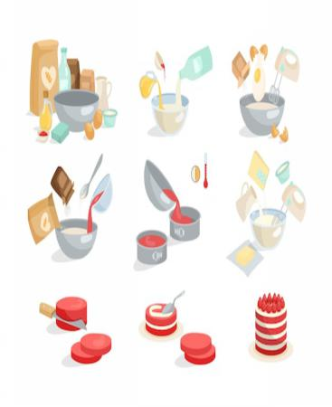
mixture/ˈmɪkstʃə(r)/ n.混合;结合体;混合物
1.这座城市是古建筑和现代建筑的混合体。
The city is a mixture of ancient and modern buildings.
2.当我的名字被宣布获得第一名时，一种复杂的情感
吞没了我——骄傲、喜悦和一丝难以置信。^{2023新高考I卷读后续写“参加写作比赛”}
When my name was announced for the first-place
award, a mixture of emotions engulfed me---pride,
joy, and a pinch of disbelief.
3.首先，在一个碗里把所有的材料混合在一起。
First, mix all the ingredients together in a bowl.

Slide 35

mixture/ˈmɪkstʃə(r)/ n.混合;结合体;混合物
4.他太紧张了，把讲稿弄混了。
He was so nervous that he got the speech pages all mixed up.
5.我想你一定是把我和别人搞混了。
I think you must be mixing me up with someone else.
6.首先，我建议你创建一个混合的室内和室外活动，
突出环境保护的重要性。^{2023北京夏季高考应用文“绿色北京主题}
^{社团活动策划建议信”}
To start, I’d recommend you create a mix of indoor and
outdoor activities that highlight the importance of
environmental conservation.

Slide 36

coverage/ˈkʌvərɪdʒ/ n.新闻报道;覆盖范围
1.今晚有高尔夫球赛的电视实况转播。
There is a live TV coverage of golf tournament tonight.
2.这一事件一定会引起新闻界的广泛报道。
The event is bound to attract wide press coverage.
3.中央电视台将报道这次比赛的所有主要比赛。
The CCTV will cover all the major games of the tournament.
4.低云笼罩着山腰，山腰上长满了茂密的草。
Low clouds envelop the mountainsides, which are covered with thick grass.
5.孩子们满身是土，从花园里走了进来。
The children came in from the garden, covered in dirt.

Slide 37


coverage/ˈkʌvərɪdʒ/ n.新闻报道;覆盖范围
6.他望着黑暗，不停地叹气，然后用枕头蒙住了头。
He looked into the darkness and kept sighing, then covering his head with the pillow.
7.这项调查涵盖了我们学校生活的各个方面。
The survey covers all aspects of our school life.
8.你的父母必须支付你的学费。
Your parents will have to cover your tuition fees.
9.到日落时，我们已经走了三十英里。
By sunset we had covered thirty miles.
10.他笑以掩饰他的紧张。
He laughed to cover /hide his nervousness.
11.这个故事让我想起一句谚语:“不要以貌取人。”
The story reminds me of a saying that “Never judge
a book by its cover.”

Slide 38
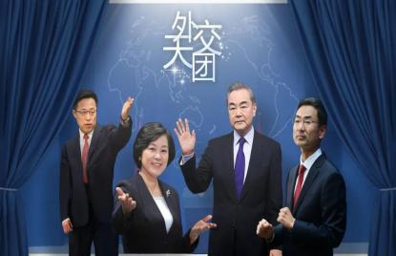


press conference/pres ˈkɒnfərəns/ 记者招待会;新闻发布会
1.手头有了足够的资料，我们就可以着手举行新闻发布会了。
Having enough data in hand, we can set out to hold the press conference.
2.报纸和电视都报道了这件事。
The story was reported in the press and in television.
3.他按了一下按钮，门开了。
He pressed a button and the door opened.
4.他们催促我们尽快作出决定。
They are pressing us to make a quick decision.

Slide 39


applaud/əˈplɔ:d/ vt.＆vi.鼓掌 vt.称赞;赞赏
1.我们称赞他有勇气承认错误。
We applaud him for having the courage to admit his mistake.
2.最后，当他越过终点线时，他举起了胜利的双臂，迎接他的是热烈的欢呼和雷鸣般的掌声。^{2022新高考全国卷I读后续写“脑瘫学生参加跑步比赛”}
At last, he raised him arms in triumph as he crossed the finish line, greeted with wild cheers and thunderous applause.
3.“我想感谢我的老师，他一直鼓励我要自信。现在我的坚持终于有了成果，”我说，然后热烈的掌声回荡在学校的礼堂里。^{2023新高考I卷读后续写“参加写作比赛”}
“I want to say thanks to my teacher, who keeps encouraging me to be confident. Now my perseverance has finally borne fruit,” I said, and then overwhelming applause echoed the school auditorium.

Slide 40

submersible/səbˈmɜːsəbl/ n.潜水器;可潜船
1.以神话中的龙命名，蛟龙是中国的第一艘载人深海研究潜水器，它可以潜到7020米。
Named after a mythical dragon, Jiaolong is China’s first manned deep-sea research submersible, which can create a dive to 7020 meters.
2.潜水艇潜入海面以下。
The submarine submerged beneath the surface of the ocean.

Slide 41
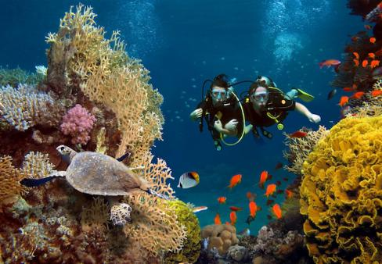
水上、水下运动动词总结：
1.今天早上我在近海的礁石上浮潜，这是我做过的最奇妙的事情。
I went snorkeling on the reef offshore this morning and it was the most fantastic thing I have ever done.
2.天鹅优雅的在湖面滑行。
The swan glided gracefully across the lake.
3.戴水肺的潜水员潜入深海探索珊瑚礁。
The scuba diver dove into the deep ocean to
explore the coral reef.
4.孩子们喜欢在游泳池里用充气圈漂浮。
The children enjoyed floating on inflatable tubes in the swimming pool.
5.她沿河划着皮艇，欣赏着宁静的景色。
She paddled her kayak along the river, enjoying the peaceful scenery.

Slide 42

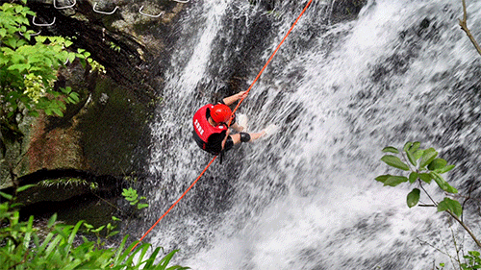
水上、水下运动动词总结：
6.孩子们在水池里玩耍时笑个不停，溅起了水花。
The children giggled as they splashed around in the pool.
7.他们趟过浅浅的小溪，感受着凉水打在脚上的感觉。
They waded through the shallow stream, feeling the cool
water on their feet.
8.漫长的一天后，他喜欢泡热水澡放松肌肉。
He liked to soak in warm baths to relax his muscles after a long day.
9.那个胆大的人从悬崖上跳入下面的深水中。
The daredevil plunged off the cliff into the deep water below.
10.在炎热的夏天，他们决定到附近的河里洗澡降温。
They decided to bathe in the nearby river to cool down
on a hot summer day.

Slide 43
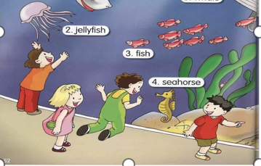
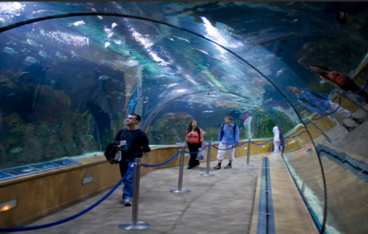
underwater/ˌʌndəˈwɔ:tə(r)/ ad.在水下 a.水下的
1.当我们走进水族馆探索海底世界时，我们被周围所
有鲜艳的颜色——紫色、红色、橙色、黄色、蓝色和
绿色——惊呆了。珊瑚太奇妙了——它们的形状像扇子、
盘子、大脑、花边、蘑菇、树枝、鹿角。各种各样小巧、
整齐、优雅的鱼在珊瑚里和周围游来游去。看到如此不
寻常的美丽，我想我身体里的每一个细胞都被唤醒了。
这就像发现了生活的一个全新维度。
When we came into the aquarium and explore the
underwater world, we were amazed by all the vivid colors
around us---purples, reds, oranges, yellows ,blues and greens.
The corals were fantastic--- they were shaped like fans, plates,
brains, lace, mushrooms, the branches of trees, the horns of
deer. And all kinds of small, neat and elegant fish were
swimming in and around the corals. Seeing such extraordinary
beauty, I think every cell in my body woke up. It was like
discovering a whole new dimension of life.
walk through an underwater corridor

Slide 44
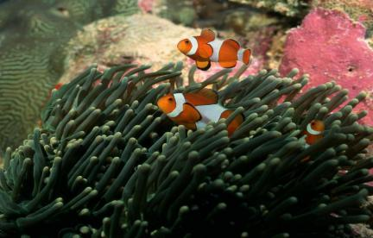
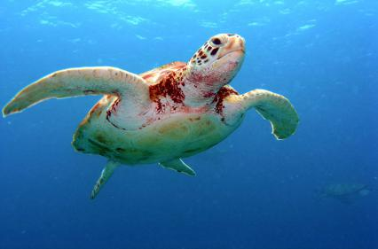
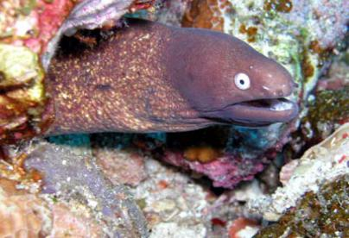
underwater/ˌʌndəˈwɔ:tə(r)/ ad.在水下 a.水下的
2.橙色和白色的小鱼躲在波浪般的长海藻中。
The little orange and white fish is hiding in the waving long seaweed.
3.一只看起来很聪明的大乌龟离我很近，我几乎可以摸到它。
A large wise-looking turtle was passing so close to me that I could have touched it.
4.一条鳗鱼长着锋利的牙齿，只有头从洞里露出来，正在寻找美味的鱼。
An eel with its strong sharp teeth, with only its head showing from a hole, is watching for a tasty fish.

Slide 45
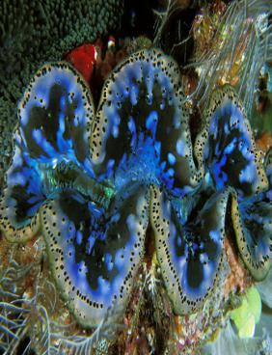
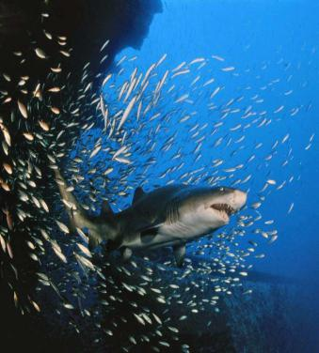

underwater/ˌʌndəˈwɔ:tə(r)/ ad.在水下 a.水下的
5.巨大的蛤蜊半埋着，等待着有什么东西在它厚厚的绿色嘴唇之间游来游去。
Giant clam half buried, waiting for something to swim in between its thick green lips.
6.两条长约一米半的灰礁鲨突然从一些珊瑚后面出现。
Two grey reef sharks, each about one and a half meters long, suddenly appeared from behind some coral.

Slide 46
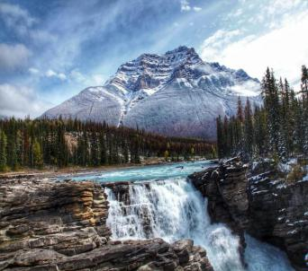
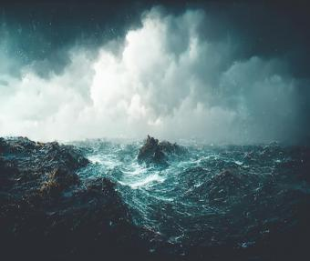
与“河海”相关的自然环境与背景衬托：
1.清冷的溪水蜿蜒而下。
The cold, clear water of the stream wound down the mountains.
2.他能听到远处小溪的潺潺声。
He could hear the soft bubbling of a stream in the distance.
3.这条小溪清澈如镜，蜿蜒曲折地穿过森林。
Clear and as smooth as glass, the stream twisted and
turned through the forest.
4.他被汹涌的大海和狂风暴雨的天空包围着。
He was surrounded by a black blanket of swirling/rough sea
and stormy sky.
5.天空中乌云密布，海浪冲击着岩石。
Dark clouds were gathering in the sky, waves crashing against the rocks.

Slide 47
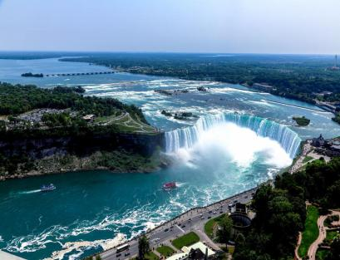
与“河海”相关的自然环境与背景衬托：
6.站在远处，他们惊讶地看到大雾从大尼亚加拉瀑布升起。
Standing in the distance, they were astonished to see
misty clouds rising from the great Niagara Falls.
7.广袤无垠的苍穹在头上静止不动，奔流不息的海水在脚下汹涌
澎拜。孩子们相聚在无 尽世界的海边，叫着，跳着。---泰戈尔
The infinite sky is motionless overhead and the restless water is boisterous. On the
seashore of endless worlds the children meet with shouts and dances.---Tagore
8.大海欢笑着翻腾浪花，而海滩的微笑荡漾着淡淡的光芒。
凶险的惊涛骇浪，对孩子们唱着无意义的歌谣，仿佛母亲
在晃悠婴儿入睡时的哼唱。---泰戈尔
The sea surges up with laughter, and pale gleams the smile
of the sea beach. Death-dealing waves sing meaningless
ballads to the children, even like a mother while rocking her
baby's cradle. --- Tagore

Slide 48

meanwhile/ˈmi:nwaɪl/ ad.与此同时;两方面对比之下
1.医生下星期再给你看病。同时，你必须尽可能多地休息。
The doctor will see you again next week. Meanwhile, you must rest as much as possible.
2.不可否认，校园欺凌不仅给社会带来了危害，而且对受害学生也产生了负面影响。这 会让他们遭受虐待，甚至死亡，对他们的自尊造成永久性的伤害。同时，它还会导致恶霸和旁观者产生错误的价值观和信念，从而加剧暴力行为。^{2020无锡高三期末应用文“校园霸凌”}
There’s no denying that campus bullying not only brings harm to society, but also has
negative impacts on the victimized students. It’ll lead to them suffering from abuse, even
death, causing permanent damage to their selfesteem. Meanwhile, it results in wrong
values and beliefs of bullies and bystanders, which will reinforce violent behavior.
3.我们的一个小举动可以让孩子们感到温暖和被爱，
同时，我们也能感受到贡献的快乐。
A small act of us can make the children feel warm and
beloved, in the meanwhile/meantime, we can feel the
joy of contribution.

Slide 49

注意句间衔接词，强化逻辑思维
1.有些人把幸福与财富联系在一起，而另一些人则认为幸福与社会关系有关。
Some people link happiness to wealth, whereas/while others think it lies in social relationships.(表对比）
2.由于不同的熟练程度和学习风格，随机配对可能无效。^{2023年全国卷I应用文“外教随机分组反馈信”}
Random pairing may not be effective due to varying proficiency levels and learning styles.（表因果）
3.尽管如此，掌握计算机技能对儿童的好处是不容否认的。
In spite of this, the benefits of computer skills for children cannot be denied（表让步）
4.这些孩子常常被宠坏了，不是在爱和关心方面，而是在更多的物质方面——也就是说，他们被允许想要什么就有什么。
These children are often spoiled, not in terms of love and attention but in more material ways---that is to say/in other words, they are allowed to have whatever they want.(表解释）

Slide 50

注意句间衔接词，强化逻辑思维
5.我建议组织一次环绕北京的绿色之旅，比如，参观公园、花园
和环保建筑等地方。 ^{2023北京夏季高考应用文“绿色北京主题社团活动策划建议信”}
I suggest organizing a green tour around Beijing, visiting places such as parks, gardens and eco-friendly buildings.(表举例）
6.只要你坚持不懈地努力，很快就会取得进展。
Progress will soon be seen on condition that you make consistent efforts.（表假设）
7.海洋不仅给我们提供了充足的食物，而且维护大自然的平衡。
^{2022年全国甲卷应用文“世界海洋日征文投稿”}
Not only does ocean offer us sufficient food, but also it maintains the balance of nature.（表并列）

Slide 51

注意句间衔接词，强化逻辑思维
8.总而言之，现在是我们致力于保护海洋的时候了。保护我们的海洋是保护自己。^{2022全国甲卷应用文“世界海洋日征文稿”}
All in all, it is high time that we devoted ourselves to protecting our oceans. To protect our oceans is to protect ourselves.(表总结）
9.起初，我觉得制作饺子皮和饺子馅料很难。^{2023全国乙卷应用文“暑假新技能学习投稿”}
At first, I found it challenging to make the dough and wrap the filling inside.（表次序）
10.噪音是令人不愉快的，尤其是当你试图睡觉时。
Noise is unpleasant, especially when you are trying to sleep.（表强调）
11.同样，保险费用也呈上升趋势。
Similarly, the cost of insurance saw a rising trend.（表相似）

Slide 52

用好衔接过渡词来表逻辑关系：
1. 转折：but, while, however, whereas, in contrast, still, instead, yet, nevertheless, on the contrary，unlike
2. 因果：since, as, for the reason that, because, owing to ,due to, consequently, hence, thus, as a result （of this）,for this reason, so that, as a consequence, so, therefore, accordingly
3. 让步：but even so, even though, though, although, despite, in spite of, regardless of
4. 澄清：that is, I mean, put it another way, in other words, specifically
5. 举例：such as, particularly, especially, for example, like, in particular, for instance
6. 条件：if, provided that, as long as, unless, on condition that
7. 递进：not only...but also; moreover, what is more, furthermore, not to mention ,besides, in addition, additionally
8. 总结：to conclude, as a final point, in a nutshell, in a word, to sum up, on the whole, in summary, in short, in brief, in conclusion
9.次序：first, first of all, to begin/start with, in the first place, first and most
important, second, third, then, finally, above all, last but not least
10. 强调：indeed, more importantly,actually,in fact,especially,clearly, obviously, apparently,
surely, certainly, undoubtedly, anyway, above all
11. 相似：similarly, in the same way/manner, equally, likewise

Slide 53

exploit/ɪkˈsplɔɪt/ vt.开发;利用;剥削
1.开发海洋对我们的未来很重要，因为那里可能蕴藏着大量的资源，不仅有石油和天然气，还有宝贵的矿产。
Exploiting the sea is important for our future, as there are probably vast amounts of resources, not just oil and gas but also valuable minerals.
2.她充分发挥了她在剧中角色的幽默。
She fully exploits the humor of her role in the play.
3.但我们应该考虑的是如何在保护和开发海洋
之间取得平衡。
But what we should take into account is
how to strike a balance between the protection
and exploitation of ocean.

Slide 54

murder/ˈmɜ:də(r)/ vt.谋杀;凶杀 n.谋杀;凶杀
1.小说围绕着发生在豪华列车“东方快车”上的一起谋杀案展开。它讲述了侦探波洛的故事，他在致命的火车上解开了许多谜团，最终在12名嫌疑人中找出了真正的凶手。
The novel revolves around a murder on the Orient Express, a luxury train.It tells the story of detective Poirot, who makes his way through many mysteries on the deadly train, and finally identifies the real murderer among 12 suspects.
2.当他被指控谋杀时，他声称那是正当防卫。
When he was accused of murder, he claimed that
it was self-defense.
3.这部电影讲述了一名高中生陈年的故事，他在
校园里被欺负，后来被卷入了一起谋杀案。
The movie tells the story of a high school student Chen Nian,
who is bullied on campus and later gets caught up in a murder case.
4.校园欺凌会使欺凌者进一步相信暴力并犯下诸如谋杀和
绑架等罪行。^{2020无锡高三期末应用文“校园霸凌”}
School bullying can make the bully go further to believe
in violence and commit crimes, such as murder and kidnapping.

Slide 55

mercy/ˈmɜ:si/ n.仁慈;宽恕;恩惠
1.她没有受重伤，真是谢天谢地。
It is a mercy that she wasn’t seriously injured.
2.虽然他们并不富裕，但他们总是对穷人表示同情，并且总是愿意在任何可能的时候伸出援助之手。
Although they are not well off, they always show mercy to the poor and are always willing to extend a helping hand whenever possible.
3.海上的小船受恶劣天气的摆布。
Small boats on the sea are at the mercy of violent weather.
4.幸运的是，每个人都安然无恙地准时到达。
Mercifully, everyone arrived on time safe and sound.
5.他受不了外面那无情的骄阳。
He couldn’t stand the merciless heat of the sun outside.

Slide 56

possession/pəˈzeʃn/ n.[pl.]个人财产;拥有;控制
1.海洋是生命的繁殖地，而不是人类的领地。
The sea provide a breeding ground for life, not human beings’ possession.
2.据说，由于可怕的洪水，那些人失去了家园和财产。
It is said that those people have lost their homes and
possessions due to the terrible flood.
3.由于外国游客被要求持有护照，所以在出发前一定
要带好护照。
As foreign visitors are required to be in possession of a
passport, make sure you take it before departure.

Slide 57
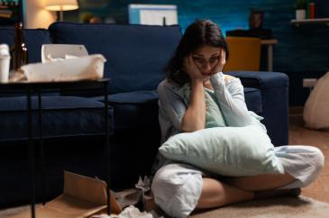

possession/pəˈzeʃn/ n.[pl.]个人财产;拥有;控制
4.由于考试不及格，我感到非常失望。
Disappointment took possession of me due to the failure of my exam.
5.你在职业规划专栏写的这篇文章是关于我们应该具备
什么样的素质来满足不同工作的要求。
^{2023黄冈5月模拟考应用文“职业规划专栏约稿信”}
The article you write in Career Planning column is
designed to deal with what qualities we should possess
to satisfy the requirements of different jobs.
6.恐惧攫住了他，使他动弹不得。
Fear possessed/seized him and prevented him for moving.
7.她具有非凡的专注力。
She was possessed of exceptional powers of concentration.

Slide 58


opponent/əˈpəʊnənt/ n.反对者;对手;竞争者
1.你能做的最糟糕的事情就是低估你的对手。
The worst thing you can do is underestimate your opponents.
2.反对在公共场合杀害动物的行为是有道理的。
It is justifiable to oppose the act of killing animals in public.
3.她仍然强烈反对移居国外的想法。
She remained bitterly opposed to the idea of moving abroad.
4.她是一个好选手，而不是一个伟大的选手。
She is a good player, as opposed to a great one.
5.日本不顾反对，开始向海洋排放受核污染的水。
Despite opposition, Japan starts releasing
nuclear-contaminated water into ocean.

Slide 59
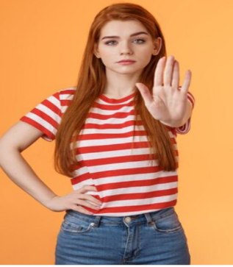
opponent/əˈpəʊnənt/ n.反对者;对手;竞争者
6.如果没有人反对，我们将把会议推迟到下周。
If nobody objects, we will postpone the meeting till next week.
7.我非常反对停车收费。
I really object to being charged for parking.
8.这场运动为抗议战争提供了一个渠道。
The campaign provided a channel for protest against the war.
9.当听说由于疫情的影响，我们要通过远程教育进行学习时，
我反对这个做法，因为我们只能通过电子设备联系。
On hearing that we would study through remote education as a consequence of the epidemic, I was against the idea because we could only contact through electronic devices.
10.有些人支持开采资源的想法，但有些人不赞成这件事。
Some people embrace/favor/advocate/support the ideas of
mining for resources, but others frown upon/disapprove of this matter.

Slide 60

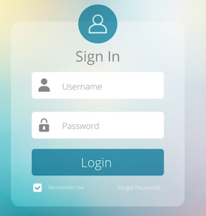
log/lɒg/ vt.把…载入记录 n.正式记录
1.锻炼结束后，他更新了自己的健身日志。
After finishing his workout, he updated his fitness log.
2.他们把每个人和每件事都记录在博客上。
They log everyone and everything on the blog.
3.如果你想获得更多的信息，你可以登录我们在互联
网上的主页。
If you want to get further information, you can log in our
home page on the Internet.
4.篝火欢快地燃烧着。
The log fire was blazing merrily.
5.《逃出大英博物馆》由两位中国视频博主执导，
讲述了一件中国文物如何从大英博物馆逃出并回到
中国的故事。
Directed by two Chinese vloggers, Escape from the British
Museum tells the story of how a Chinese cultural relic escape
from the British Museum and finds its way back to China.

Slide 61


marine/məˈri:n/ a.海的;海产的;海生的
1.海洋覆盖了地球表面的70%以上，对维持地球上的生命起着关键作用。首先，海洋影响着我们的气候，对人类的生存至关重要。此外，海洋还支持着大量海洋生物，它们对维持生态平衡至关重要。此外，海洋是全球数百万人的重要食物来源。^{2022年全国甲卷应用文“世界海洋日征文投稿”}
Covering over 70% of the Earth’s surface, oceans play a key role in sustaining life on our planet. First and foremost, oceans influence our climate, making them essential for human survival. Additionally, oceans support a vast array of marine life, which are a vital for maintaining ecological balance. Moreover, oceans are a crucial source of food for millions of people globally.(海洋重要性）

Slide 62
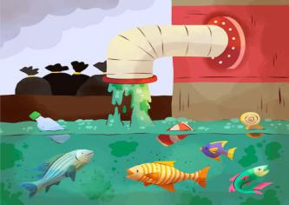
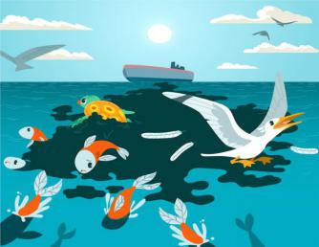

marine/məˈri:n/ a.海的;海产的;海生的
2.不幸的是，我们的海洋正面临各种威胁，
如过度捕捞、石油泄漏、塑料污染和栖息地破坏。
^{2022年全国甲卷应用文“世界海洋日征文投稿”}
Unfortunately, our oceans are under various threats,
such as overfishing, oil spilling, plastic pollution and
habitat destruction. （海洋面对的危机）
3.首先，迫切需要让人们意识到保护海洋的重要性。
同时，我们赞赏政府采取切实措施保护海洋生态的共
存。^{2022年全国甲卷应用文“世界海洋日征文投稿”}
First of all, there is an urgent need to make people aware
of the importance of protecting the ocean.Meanwhile,
we applaud the government for taking practical measures
to preserve the co-existence of marine ecology.（海洋保护措施）

Slide 63



marine/məˈri:n/ a.海的;海产的;海生的
4.首先，通过支持减少塑料污染和应对气候变化等举措，我们可以帮助确保我们的海洋仍然是地球上所有生命的奇迹和生计之源。更重要的是，我们也可以分发传单，呼吁更多的人保护海洋。^{2022年全国甲卷应用文“世界海洋日征文投稿”}
First, by supporting initiatives like reducing plastic pollution and combating climate change, we can help to ensure that our oceans remain a source of wonder and sustenance for all life on Earth. What’s more, we can also hand out leaflets to call on more people to protect the ocean. （海洋保护措施）
5.总之，保护海洋是我们的共有的一份责任。值此庆祝世界海洋日之际，让我们承诺采取大大小小的行动，为子孙后代保护我们的海洋。^{2022年全国甲卷应用文“世界海洋日征文投稿”}
In conclusion, preserving oceans is our collective duty. As we celebrate World Oceans Day, let’s commit to actions, both big and small to safeguard our oceans for future generations.（海洋保护的呼吁）

Slide 64


arrest/əˈrest/ n.逮捕;拘留 vt.逮捕;拘留
1.他因与抢劫案有关而被捕。
He has been arrested in connection with the robbery.
2.正在这时，一阵低沉的敲门声引起了他的注意。
At that moment, a low knocking at the door arrested
his attention.
3.那个小男孩被最新的电子玩具吸引住了，一动不动
地站在窗前。
Arrested by the latest electronic toys, the little boy stood
in front of the windows without moving.

Slide 65


http://www.sunedu.com
Thank You!

