Slide 1


感恩遇见，相互成就，本课件资料仅供您个人参考、教学使用，严禁自行在网络传播，违者依知识产权法追究法律责任。
更多教学资源请关注
公众号：溯恩高中英语
知识产权声明

Slide 2

The World
November 16th-30th, 2023

Slide 3
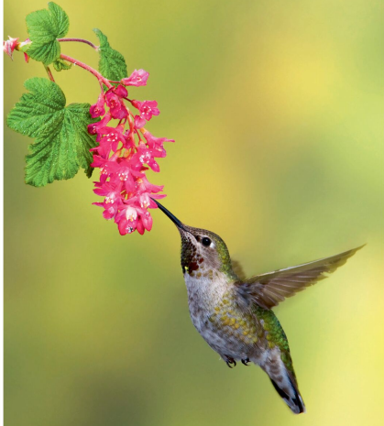
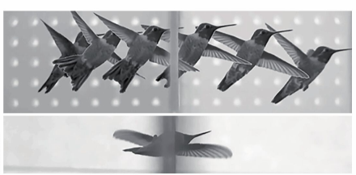
1. Hummingbirds have two ways to fly through tiny gaps
蜂鸟有两种方法可以穿过微小的缝隙

Slide 4
Text Completion
New Scientist (18th November 2023 Page 14)
which
High-speed cameras have revealed how hummingbirds fit through tiny gaps, ______ happens too quickly for the human eye to properly see.
Hummingbirds feed on nectar and often fly through small gaps in cluttered foliage as they flit from flower to flower. When one of the birds does this, “it looks like it literally just teleported”, says Marc Badger at the University of California, Berkeley. ____________ (investigate) how it happens, he and his colleagues filmed at 500 frames a second as Anna’s hummingbirds (Calypte anna) passed through a gap between two compartments, ____ tracked the position of each bird’s bill and wing tips. The humming birds’ wingspans were about 12 centimetres and the gap could __________ (shrink) to just 6 cm wide.The birds used two strategies. One was to approach the gap slowly, hover near and then travel through sideways. The other was to approach quickly, fold their wings back and shoot through like a spear, before _______ (open) their wings again.
The slower strategy tended to give way to the ________ (speedy) approach as the birds became more familiar _____ the set-up. But a 6-cm aperture forced them to use the braver strategy immediately. Badger thinks the birds risk _______ (injure) by hitting the edges of the hole with their wings while going sideways.With wings tucked in, this danger is reduced, so there is ___ incentive to use the faster technique if possible. “Their amazing wings make them good at hovering and good at flying fast, but that _______ (mean) they have to cope in tight situations,” says Christopher J.Clark at the University of California, Riverside. “The manoeuvres these birds do to navigate through tight spaces put them in a class of their own.”
To investigate
and
be shrunk
opening
speedier
with
injury
an
means

Slide 5
Vocabulary
1. flit: to move lightly and quickly from one place or thing to another 轻快地从一处到另一处；掠过
In the fading light we saw bats flitting about in the garden. 天色渐暗时，我们看到蝙蝠在花园里飞来飞去。
2. incentive: something that encourages you to do sth 激励；刺激；鼓励
There is no incentive for people to save fuel. 没有使人们节约燃料的鼓励办法。
Translation
蝴蝶在花丛中飞来飞去。
Butterflies flitted from flower to flower.
Translation
几乎或根本没有鼓励来采取这样的措施。
There is little or no incentive to adopt such measures.

Slide 6
Translation
The birds used two strategies.One was to approach the gap slowly, hover near and then travel through sideways. The other was to approach quickly, fold their wings back and shoot through like a spear, before opening their wings again.
这些鸟采用了两种策略。一种是慢慢靠近缺口，在附近盘旋，然后侧身穿过。另一种是迅速靠近，收起翅膀，像长矛一样射过去，然后再张开翅膀。
Badger thinks the birds risk injury by hitting the edges of the hole with their wings while going sideways. With wings tucked in, this danger is reduced, so there is an incentive to use the faster technique if possible.
Badger认为鸟儿在侧身飞行时用翅膀撞到洞的边缘会有受伤的危险。收起翅膀，这种危险就降低了，所以如果可能的话，鸟儿就有动力使用更快的技巧。

Slide 7

2. One in seven adults advised by NHS to go private
七分之一的成年人被NHS建议去私立医院

Slide 8
Text Completion
The Observer (26th November 2023 Page 2)
The health and social care champion for England has warned that patients face a two-tier system, as a new poll revealed one in seven people _______________ (visit) by an NHS professional in the past year to consider ______ (pay) for private healthcare.
Healthwatch England, which gathers the views of health and social care users in England, says it is concerned that some health services are now only available to those _____ can afford it. It says more work __________ (require) to overcome the barriers to care in deprived areas.
Louise Ansari, chief executive of Healthwatch England, said:“ With access to NHS care remaining the most significant challenge people report to us nationwide, we’re seeing a two-tier system emerge where ______ (time) access to services is often available faster to those with money to pay for it.
“Our polling shows that people who are more __________ (financial) comfortable are much more likely to be able to access free or discounted private GP appointments through their work. “We know that many people, especially those ____ lower incomes, disabled people, carers and younger people, face real challenges accessing care. And, if they can access services, they sometimes choose not to attend GP or dental appointments or buy prescription medications _______ (avoid) extra costs.”
Data from the Private Healthcare Information Network (PHIN), an independent ___________ (organize), shows there were 227,000 private healthcare admissions in the first three months of this year, the highest since the net-work started collecting data.There were 17,000 more private admissions than in ____ same quarter in 2022.
had been advised
paying
who
is required
timely
financially
on
to avoid
organisation
the

Slide 9
Vocabulary
1. deprived: without enough food, education, and all the things that are necessary for people to live a happy and comfortable life 贫穷的；贫困的；穷苦的
These measures are intended to help people from a deprived background. 这些措施旨在帮助贫困家庭的人们。
2. prescription: an official piece of paper on which a doctor writes the type of medicine you should have, and which enables you to get it from a chemist's shop/drugstore 处方；药方
Antibiotics are only available on prescription. 抗生素只能凭处方购买。
Translation
应当优先考虑贫困地区。
Priority should be given to deprived regions.
Translation
这种新药不需要医生的处方。
The new drug will not require a physician’s prescription.

Slide 10
Translation
The health and social care champion for England has warned that patients face a two-tier system, as a new poll revealed one in seven people had been advised by an NHS professional in the past year to consider paying for private healthcare.
英国卫生和社会保健冠军警告说，病人面临双重体系，因为一项新的民意调查显示，在过去的一年中，七分之一的人被NHS专业人员建议考虑支付私人医疗费用。
We know that many people, especially those on lower incomes, disabled people, carers and younger people, face real challenges accessing care. And, if they can access services, they sometimes choose not to attend GP or dental appointments or buy prescription medications to avoid extra costs.
我们知道，许多人，特别是低收入者、残疾人、护理人员和年轻人，在获得医疗服务方面面临着真正的挑战。而且，如果他们可以获得服务，他们有时会选择不去看全科医生或牙医，或者购买处方药，以避免额外的费用。

Slide 11
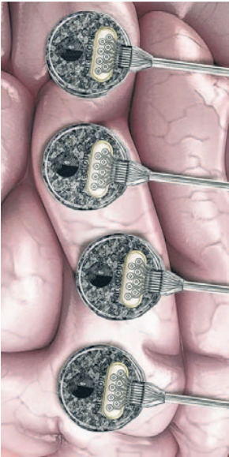
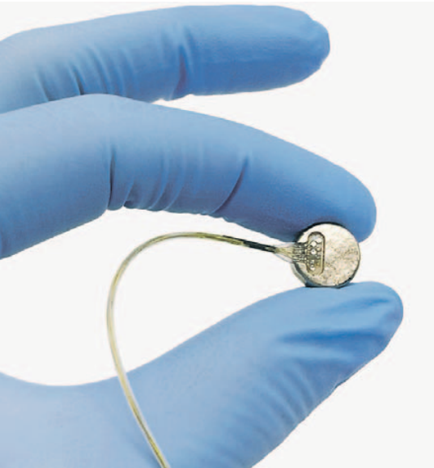
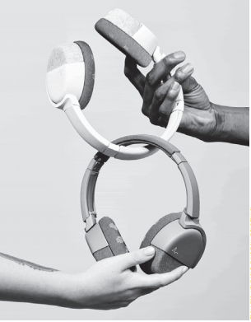
3. Devices Aim to Make Brain Work Better 设备让大脑更好地工作

Slide 12
Text Completion
The Wall Street Journal (21st November 2023 B1 &B4)
You’re feeling _________ (distract) and can’t get your work done despite a looming deadline. Your headphones detect your lack of focus and suggest you take __ break, while a headband beams signals to adjust your brain activity and energize you. Crisis averted.
That is the future technologists imagine, and a variety of devices are being developed to enhance the _______ (brain) performance in day-to-day life.
The market for devices that can read brain activity and translate it into actions ___(be) in its infancy. But, thanks in part to Elon Musk’s startup Neuralink, ______ is developing implantable brain-computer interfaces—or BCIs—that can record data from thousands of brain cells, investment and interest in these devices ___________ (soar) in recent years.
New wearable devices build on implantable BCIs used for medical interventions, as well as decades of research into _____ the brain works. Efforts on implantable devices focus on restoring function. Applications ______ (aim) at allowing communication and movement have been in development for decades to help paralyzed patients, and research -ers have made major leaps with implantable devices in recent years. Implants are ________ (likely) to become blockbuster mass-market consumer products anytime soon because of medical-device ___________ (regulate), high costs and the inherent risks of brain surgery.
distracted
a
brain’s
is
which
have soared
how
aimed
unlikely
regulations

Slide 13
Vocabulary
1. loom: o appear as a large shape that is not clear, especially in a frightening or threatening way 赫然耸现；（尤指）令人惊恐地隐现
You’ve got to be able to make decisions on the fly as deadlines loom.
你必须能够立刻作出决定，因为最后期限迫在眉睫。
2. soar: to rise very quickly 急升；猛增
Shares soared on the New York stock exchange.
纽约证券交易所股票暴涨。
Translation
一个黑糊糊的影子隐隐出现在我们的前面。
A dark shape loomed up ahead of us.
Translation
他的市场份额不断高涨。
His market share continues to soar.

Slide 14
Translation
Your headphones detect your lack of focus and suggest you take a break, while a headband beams signals to adjust your brain activity and energize you.
你的耳机会发现你注意力不集中，并建议你休息一下，而头带会发出信号来调整你的大脑活动，让你充满活力。
But, thanks in part to Elon Musk’s startup Neuralink, which is developing implantable brain-computer interfaces—or BCIs—that can record data from thousands of brain cells, investment and interest in these devices have soared in recent years.
但是，部分由于伊隆·马斯克(Elon Musk)的创业公司Neuralink正在开发可植入的脑机接口(bci)，可以记录数千个脑细胞的数据，近年来，对这些设备的投资和兴趣激增。

Slide 15
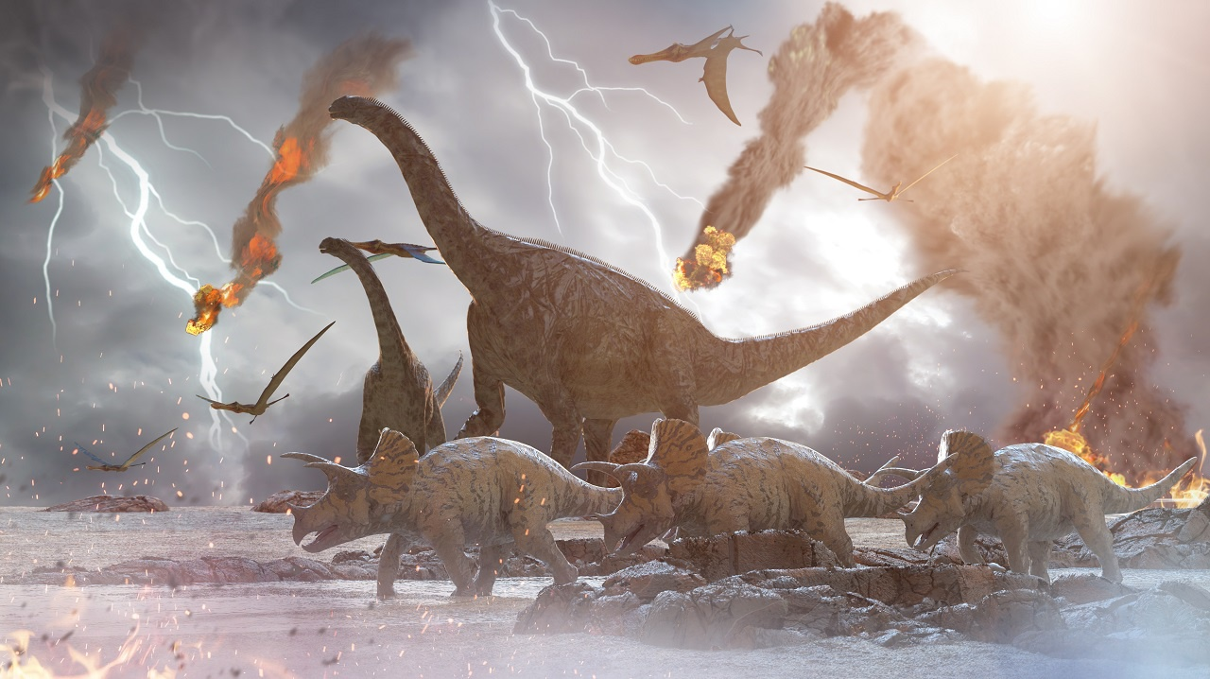
4. Dust is what killed the dinos 恐龙灭绝的罪魁祸首：尘埃

Slide 16
Text Completion
The Week (17th November 2023 Page 21)
We know the dinosaurs died out after a _______ (mass) asteroid smashed into Earth 66 million years ago, plunging the planet into a long winter _________ killed off 75 percent of all living species. ____ theories differ over what ______ (exact) blocked the sunlight, reports SmithsonianMag.com. Was it dirt from the asteroid impact, or sulfur aerosols? New research indicates it was dust. Scientists examined fine-grain samples from fossils created in the impact and ___ (run) the data through a computer climate model. They found that a huge plume of pulverized granite would have been hurled into the atmosphere, ________ (block) out sunlight for two full years and preventing plants from photosynthesizing. Plants died, the many animals that ate them starved ___ death, and so on up the food chain. Global temperatures plummeted by 27 degrees Fahrenheit. The researchers concluded that while soot and sulfur also played __ part in blocking the sun, those particles didn’t float in the air for as long. “The dust-induced _________ (disrupt) in photosynthetic activity is huge,” says co-author Cem Berk Senel. “Much larger than _____ we anticipated.”
massive
that/which
But
exactly
ran
blocking
to
a
disruption
what

Slide 17
Vocabulary
1. plummet: to fall suddenly and quickly from a high level or position
暴跌；速降
The President’s popularity has plummeted to an all-time low in recent weeks.
总统的支持率在近几个星期已骤跌至前所未有的低点。
2. induce: to cause sth 引起；导致
Doctors said surgery could induce a heart attack.
医生们说手术有可能引起心脏病发作。
Translation
一想到又要见到他，她的心情便直往下沉。
Her spirits plummeted at the thought of meeting him again.
Translation
这个药可能使人昏昏欲睡。
The drug can induce sleep.

Slide 18
Translation
We know the dinosaurs died out after a massive asteroid smashed into Earth 66 million years ago, plunging the planet into a long winter that killed off 75 percent of all living species.
我们知道恐龙是在6600万年前一颗巨大的小行星撞击地球后灭绝的，这颗小行星使地球进入了漫长的冬季，75%的生物物种灭亡。
They found that a huge plume of pulverized granite would have been hurled into the atmosphere, blocking out sunlight for two full years and preventing plants from photosynthesizing.
他们发现，一团巨大的花岗岩粉状物被抛入大气，阻挡了整整两年的阳光，阻止了植物的光合作用。

Slide 19

5. BBC News 11/28/2023

Slide 20

Dictation
With the _________ ceasefire in Gaza into its fourth and final scheduled day, there are reports both Israel and Hamas have raised ________ over the lists of Israeli hostages and Palestinian prisoners set to be released on Monday. It comes amid indications the truce might be ________.
Leaked documents obtained by the BBC suggest the United Arab Emirates has been using its role as host of this year’s UN ___________ as an opportunity to strike oil and gas _____. The COP28 summit begins on Thursday in Dubai.
Officials in western India say at least 24 people have been killed in lightning strikes and rains during ____________ in the state of Gujarat. Meteorologists say such heavy rains are not common in the state of winter and the fierce downpour ___________________. The rains have damaged houses and killed ________.
Health officials in Pakistan have launched a nationwide polio _________ to immunize children under five. They expect to vaccinate about _________ children during the next five days. Pakistan and Afghanistan are the two countries where the wild poliovirus is still endemic. Five cases have been reported in Pakistan so far this year.
temporary
concerns
extended
climate talks
deals
intense storms
caught many off guard
livestock
campaign
40 million

Slide 21
Vocabulary
1. ceasefire: a time when enemies agree to stop fighting, usually while a way is found to end the fighting permanently （通常指永久性的）停火，停战
Observers have reported serious violations of the ceasefire.
观察员报告说停火协议遭到严重破坏。
2. endemic: regularly found in a particular place or among a particular group of people and difficult to get rid of 地方性的; (某地或某集体中)特有的,流行的
Polio was then endemic among children my age.
那时小儿麻痹症在我这个年纪的孩子中很常见。
Translation
经过3年的冲突，他们已经同意停火。
They have agreed to a ceasefire after three years of conflict.
Translation
疟疾(malaria)是许多气候炎热国家的流行病。
Malaria is endemic in many hot countries.

Slide 22
Translation
Leaked documents obtained by the BBC suggest the United Arab Emirates has been using its role as host of this year's UN climate talks as an opportunity to strike oil and gas deals.
BBC获得的泄露文件显示，阿拉伯联合酋长国一直在利用其作为今年联合国气候谈判东道主的角色，作为达成石油和天然气协议的机会。
Officials in western India say at least 24 people have been killed in lightning strikes and rains during intense storms in the state of Gujarat (古吉拉特邦). Meteorologists say such heavy rains are not common in the state of winter and the fierce downpour caught many off guard.
印度西部官员说，古吉拉特邦遭遇强风暴，至少24人在雷击和暴雨中丧生。气象学家说，这样的大雨在冬季并不常见，这场猛烈的倾盆大雨让许多人措手不及。

