Slide 1


感恩遇见，相互成就，本课件资料仅供您个人参考、教学使用，严禁自行在网络传播，违者依知识产权法追究法律责任。
更多教学资源请关注
公众号：溯恩高中英语
知识产权声明

Slide 2
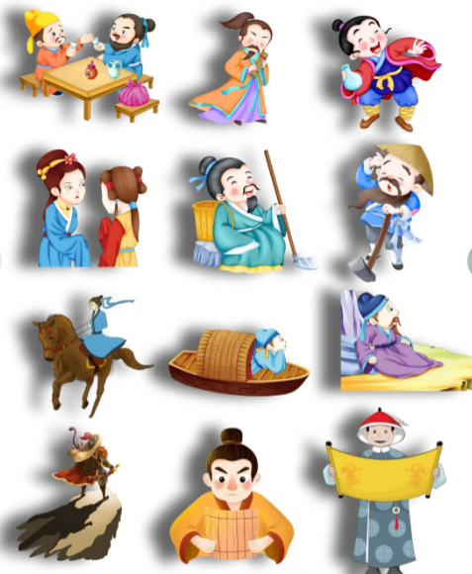
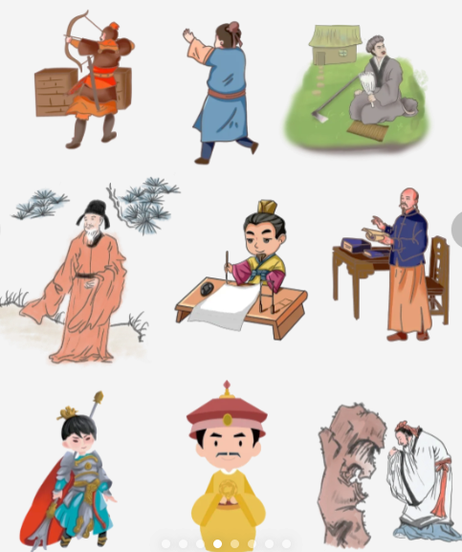
Chinese Traditional Figures

Slide 3
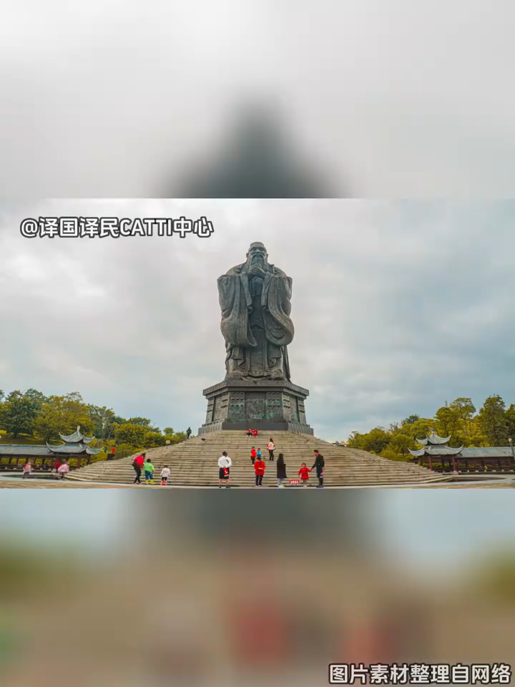
Confucius
a distinguished thinker, politician and educator

Slide 4
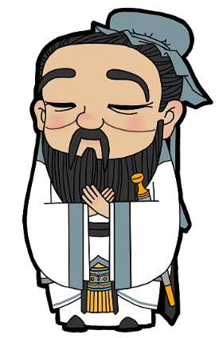
Born in 551 BC in Shandong Province, China, Confucius was a 1____________(distinguish) thinker, politician and educator who established Confucianism, a 2____________(philosophy) tradition that has played a pivotal role in shaping Chinese culture and society.
Throughout his life, Confucius was deeply committed to the cause of education. He gathered a group of 3____________(dedicate) disciples and immersed himself in teaching during his middle years. In his later years, Confucius dedicated 4____________(he) to the 5____________(scholar) endeavor of compiling ancient texts, including the book of songs, the book of documents and the spring and Autumn Annals. 6____________(follow) his death, Confucius's disciples meticulously compiled his teachings, along with their own insights into the analects, a text 7____________ is fundamental to Confucianism.
Confucius's teachings, particularly his 8____________(emphasize) on benevolence, propriety and the Paramount importance of education 9____________(leave) an enduring legacy on Chinese culture. These teachings continue to shape the 10____________(value) and principles of people in China and around the world to this day.
distinguished
philosophical
delicated
himself
scholarly
Following
that
emphasis
have left
values
Blank-filling

Slide 5
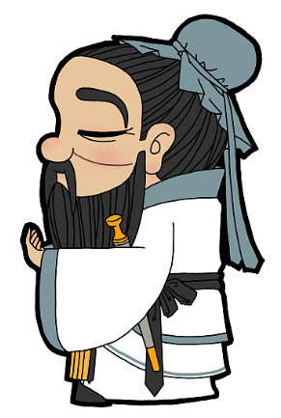
Words and expressions
distinguished / dɪˈstɪŋɡwɪʃt / 卓越的，杰出的
Confucianism/ kənˈfjuːʃənɪzəm /儒家思想，孔子学说
philosophical / ˌfɪləˈsɒfɪk(ə)l /哲学的；达观的
pivotal / ˈpɪvət(ə)l /中枢的，关键的
dedicated / ˈdedɪkeɪtɪd /专心致志的，献身的；专用的，
disciple / dɪˈsaɪp(ə)l / 追随者，门徒
scholarly / ˈskɒləli /学术的；博学的
endeavor / ɪnˈdevə(r) /努力；尽力
compile / kəmˈpaɪl /汇编，编纂
benevolence / bəˈnevələns /慈善，仁慈
propriety / prəˈpraɪəti /行为，道德）正当，得体
emphasis / ˈemfəsɪs /重要性，重点强调；
paramount / ˈpærəmaʊnt /至为重要的；至高无上的

Slide 6
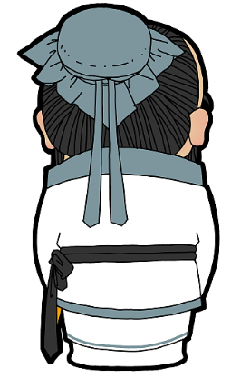
Words and expressions
play a pivotal role in 在…方面发挥关键作用
Be deeply committed to the cause of education 深耕教育事业
immerse oneself in doing sth.，让…沉浸在…
dedicate oneself to 奉献自己
be fundamental to sth.是…的基础
lay emphasis on 强调
leave an enduring legacy on留下不朽的遗产
shape the values and principles of people in China塑造中国人的价值观和处事准则

Slide 7
Born in 551 BC in Shandong Province, China, Confucius was a distinguished thinker, politician and educator who established Confucianism, a philosophical tradition that has played a pivotal role in shaping Chinese culture and society.
Throughout his life, Confucius was deeply committed to the cause of education. He gathered a group of dedicated disciples and immersed himself in teaching during his middle years. In his later years, Confucius dedicated himself to the scholarly endeavor of compiling ancient texts, including the book of songs, the book of documents and the spring and Autumn Annals. Following his death, Confucius's disciples meticulously compiled his teachings, along with their own insights into the analects, a text that is fundamental to Confucianism.
Confucius's teachings, particularly his emphasis on benevolence, propriety and the Paramount importance of education have left an enduring legacy on Chinese culture. These teachings continue to shape the values and principles of people in China and around the world to this day.
Passage reading

Slide 8


Slide 9

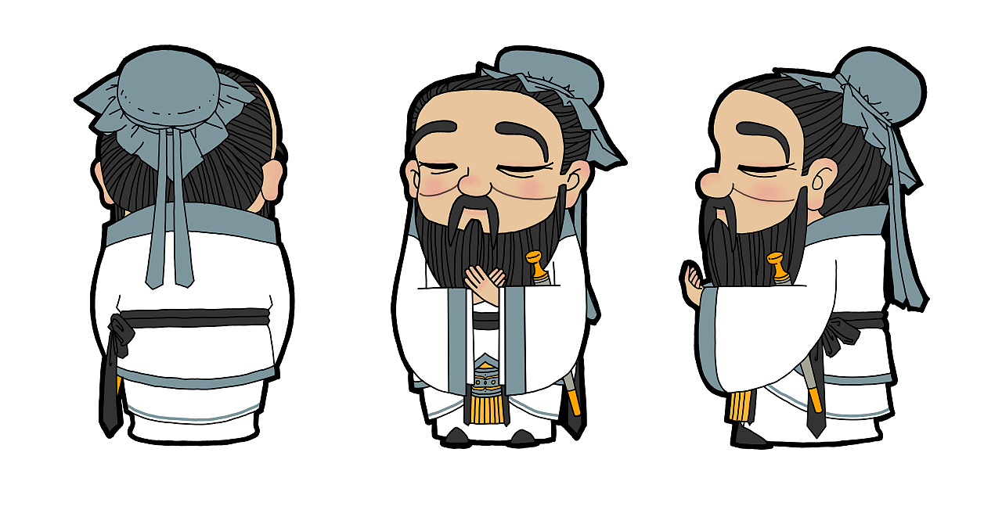
Learning without thinking is useless, thinking without learning is perilous.
学而不思则罔，思而不学则殆。

