Slide 1

感恩遇见，相互成就，本课件资料仅供您个人参考、教学使用，严禁自行在网络传播，违者依知识产权法追究法律责任。
更多教学资源请关注
公众号：溯恩高中英语
知识产权声明

Slide 2
浙江Z20联盟高三
第二次联考应用文讲评
2023年12月
校英文论坛发帖——科技馆研学活动

Slide 3
CONTENTS
01
pre-writing 审题明确方向
02
pre-writing 教材溯源语料
03
while-writing 分步写作建构
04
post-writing 写后优文开发

Slide 4
审题明确方向
PART 1
pre-writing

Slide 5
原题呈现
假定你是李华，上周末你参加了学校组织的市科技馆研学活动。请你在校英文论坛发表一篇帖子，分享此次经历，内容包括：
1.活动过程；
2.个人感悟；
3.期待评论。
注意：
1.写作词数应为 80 左右；
2.请按如下格式在答题卡的相应位置作答。
An Unforgettable Tech Exploration Tour
______________________________________________________________________________________________________________________________________________

Slide 6
审题分析
文体体裁：
写作人：
人称时态： | £第一人称 | £第二人称 | £一般过去时 | £一般现在时
写信语气： | £偏正式 | £非正式 | £均可
写作背景：
写作目标：
注意点：
校园英文论坛发帖
李华——身份为学生参与者
√
√
√
√
“我”上周末参加学校组织的去市科技馆的一次研学活动，于此中感悟良多，写帖分享经历，期待其他参与者有共鸣，获得论坛的评论（跟帖）。
准确连贯地描述研学活动的过程，灵活使用科技类话题的词汇，生动地表达出自己浸润在科技氛围中的感悟，最后传达帖子的交际性。
① 充分挖掘利用题干中的所有基本信息，如“学校”“上周末”“科技馆”
②“活动过程”这一要点的内涵和外延需要思虑精详，使用逻辑关系词
③“个人感悟”尽可能突出自己的亲身感受，可使用递进结构

Slide 7
框架形成
首段述概况
01
转述题干提供的背景信息，即说清楚本次论坛帖写作的主题，开门见山直接指出“我”参与了本次研学活动，尽可能将题干中的信息进行充分利用，字数控制在两句话左右。
次段述主体
02
第二段是整篇应用文写作的核心部分，也就是所说的“主体”（body），在这段中，必须紧密围绕题干给出的要点进行写作，即围绕“活动过程”“个人感悟”两大维度，添加细节丰富内容；字数控制在四句话左右，可各自分配两句话，该部分对语言精炼要求较高。
尾段表期待
03
根据题目要求，作为论坛帖子，要结合论坛这一场景的特征，“期待评论”就是本文写作的真实性体现，论坛帖往往下面会有评论，这一要求就是结合这一特征进行设计的。写作时可用“疑问句+祈使句”结合。

Slide 8
教材溯源语料
PART 2
pre-writing

Slide 9
话题语料溯源
本题渗透的话题是“科技”，对应教材主题语境为“ 科技发展与信息技术创新，科学精神”
单元对应为
人教版：
必修二U3: The Internet
选择性必修一U2: Looking into the future
外研版：
必修三U3：The world of Science
选择性必修三U4：A glimpse of the future

Slide 10
教材语料开发使用
下列素材来自人教版、外研版教材
remote control 遥控器
automatic equipment 自动设备
integrated 各部分密切协调的
artificial intelligence 人工智能
virtual reality 虚拟现实
wearable tech 可佩戴技术
flexible battery柔性电池
3D printers 3D打印机
important advances 重要进展
in medicine and environmental science 在药学与环境领域
be capable of 能够
the real spirit of invention 发明的真正精神
contribute towards later scientific discoveries 推动最新科学发现
cultivate an incredible desire to think and create 培养对思考和创造有着一种极度的渴望
make groundbreaking progress in 取得突破性进展
there is a possibility that/Chances are that…… 有可能
effective measures to tackle problems 解决问题的有效措施
embrace a bright and promising future of technology 拥抱光明和充满希望的科技未来

Slide 11
分步写作建构
Q-A结构
PART 3
while-writing

Slide 12
首段述概况
假定你是李华，上周末你参加了学校组织的市科技馆研学活动
Q1：市科技馆如何表达？
City Science and Technology Museum
Q2：研学活动如何表达？
A Tech Exploration Tour
Last week, I had the incredible opportunity to participate in a school-organized exploration tour to the City Science and Technology Museum. It was a captivating journey into the realm of innovation and discovery.
Last week I participated in a fabulous tech exploration tour in the city science museum which was impeccably organized by our school.
Word Bank: incredible 极好的 capticating 吸引人的 realm领域
innovation 创新 fabulous 极好的 impeccably 完美地

Slide 13
次段述主体
内容包括：1.活动过程；2.个人感悟
Q3:活动过程包括什么？
活动的时间、地点、参与者（第一段写明）
活动的内容、环节、顺序、活动事项的意义
Q4:活动环节可设计什么？
研学活动可以包括：展馆参观、展览观看、科技实验、
科技讲座、动手体验
①参观与观展：
It began with an insightful guided tour through the museum's interactive exhibits, showcasing cutting-edge technologies and scientific breakthroughs. From virtual reality to hands-on experiments, every moment felt like a fascinating exploration of the wonders of science.
Word Bank: insightful 富有洞察力的 interactive 交互的
cutting-edge 前沿的

Slide 14
次段述主体
②动手实验：
One highlight of the trip was the hands-on experiments that allowed us to experience science firsthand. We had the opportunity to build simple circuits, conduct chemical reactions, and even control robots using coding. It was truly exhilarating to see theoretical concepts come to life right before our eyes.
③虚拟现实：
Additionally, the museum offered virtual reality simulations that transported us to different environments and eras. From exploring the depths of the ocean to walking on the moon, these simulations allowed us to experience the wonders of science in a wholly new way.
Word Bank: firsthand 直接地 build simple circuits构建简单的电路
exhilarating 令人激动的 conduct chemical reactions 开展化学反应
era 时代

Slide 15
点睛：How to describe the process of an activity
It bagan with/kicked off with/commenced with …… ，followed by……
One highlight of the tour was……, which thoroughly……
What impressed me most was ……
With a lecture on …… , the tour was brought to an end.

Slide 16
次段述主体
内容包括：1.活动过程；2.个人感悟
Q5:个人感悟可以从什么方面入手
科技类研学活动的感悟一般可以写：
先进技术带来的震撼、科技进步背后的思考、对国家先进技术的自豪
培育科学精神与意志、体会科技进步背后的辛勤付出 等。
①震撼与信念：
Personally, this experience left me awe-inspired and ignited a newfound curiosity for the endless possibilities that technology holds. Witnessing the impact of scientific advancements on our daily lives was both enlightening and motivating. It reinforced my belief in staying curious and embracing the ever-evolving world of technology.
Word Bank: awe-inspired 敬畏的 ignite a newfound curiosity 激起深深的好奇心
enlightening 有启发性的 reinforce 深化 ever-evolving 始终进步的

Slide 17
次段述主体
②自豪与信念扎根：
Appealing and illuminating, the tour not only instilled me with a sense of pride in our scientific advances but also planted in my heart a seed of scientific exploration.
③丰富体验与思考：
Throughout the tour, knowledgeable guides provided explanations and answered our questions, making the experience even more enriching. They encouraged us to think critically and to consider the potential applications of the technologies we encountered.
④寓教于乐：
Overall, the activity was a remarkable blend of education and entertainment. It not only expanded our knowledge of science and technology but also fostered a sense of wonder and curiosity within us.
Word Bank: illuminating 有启发性的 instill 徐徐滴入 enriching 丰富的
blend 融合 foster 促进

Slide 18
尾段表期待
为校英文论坛写一篇帖子，分享经历……………… 期待评论
Q6:如何理解第三个要点
鉴于论坛的性质，发帖子后的评论(comments)往往可能代表同样参与活动人或论坛网友的感受。
①Anybody who shares the same feeling with me? Eagerly anticipating your comments!
② Please feel free to share your thoughts and experiences from the trip. Let's continue this conversation and inspire each other with the limitless potential of science and technology!
③Does anyone resonate with me? Eagerly anticipate your like-minded comments！
Word Bank: resonate with 与……产生共鸣 like-minded 志趣相投的

Slide 19
写后优文开发
PART 4
post-writing
他评与自评

Slide 20
参考范文
本文作者：原命题人
An Unforgettable Tech Exploration Tour
Last weekend I participated in a fabulous tech exploration tour in the city science museum organized by our school.
It kicked off with an exhibition of the history of Chinese science, unfolding the awe-striking wisdom behind. What followed was a hands-on experience, which uncovered the secrets of science. With a lecture on the prospect of science, the tour was brought to an end. Not only did the tour instill me with a sense of pride in our scientific advances, but it also planted in my heart a seed of scientific exploration.
Anybody who shares the same feeling? Anticipating your comments!
范文点评：
本篇范文首句开门见山直入主题，间接明了；中段描述活动过程条理清晰，使用很多表示先后关系的逻辑性词，对活动事项的描述很有深度，在阐发个人感受时上升到家国情怀的维度，具有写作格局，尾段期待评论的语气和态度自然而亲切。

Slide 21
优生例文
本文作者：张展驰
An Unforgettable Tech Exploration Tour
In the city museum, last weekend saw a tech exploration tour impeccably organized by our school, from which I grasped a more profound insight into the scientific field.
The tour commenced with an extraordinary exhibition, which acquainted participants with the remarkable achievements throughout the history of Chinese science. What followed next was a practical hands-on session. Under the informative guidance of professors, I unveiled the mystery of science by conducting intriguing experiments. Ultimately, the highlight was definitely the interactive technologies, ranging from virtual reality to 3D displays, which showcased the cutting-edge scientific outcomes of China.
Jubilantly, I was blessed with this chance to immerse myself in shifting among multifarious scenes of verisimilitude. This refreshing experience was so fruitful and memorable!
Does anyone resonate with me? Eagerly anticipate your like-minded comments！
范文点评：
本篇例文全文逻辑线明朗，段落推进自然，该学生使用了很多科技话题方面的专有词汇，体现其极深的储备。由于部分词汇的使用，全文行文略有不自然之处，但瑕不掩瑜，本文仍旧是一篇难得的佳作。

Slide 22
下水作文
特邀作者：陈星可老师
An Unforgettable Tech Exploration Tour
Last weekend, I took a long-anticipated tech exploration tour in the City Sci-tech
Museum, which was eyeopening and uplifting.
Our first stop was at the “Admirable Achievements” section, where I was spellbound by how the scientists in our city, against all odds, made stunning accomplishments within a short period of time. Especially amazing were the interactive exhibits and hands-on activities, offering e a deeper insight into how modern technology influences and shapes our life. As the last leg of the tour, I attended an informative lecture on the promising prospects of technology exploration/innovations, greatly motivated.
The tour was truly a learning experience, inspiring me to strive to make our country a technology power. Are you also motivated? Looking forward to hearing your voices/ Please post your comments below!
范文点评：
本篇下水作文很有条理，第二段划线部分体现了研学活动的过程井然有序，每项活动皆有详细生动的扩展内容。全文用词体现出很高的语言水平和家国情怀，个人感悟上升至家国维度体现了思想的深刻性。文末结尾期待评论自然贴近，全文完全达到了预期的写作目的，读之让人印象深刻。

Slide 23
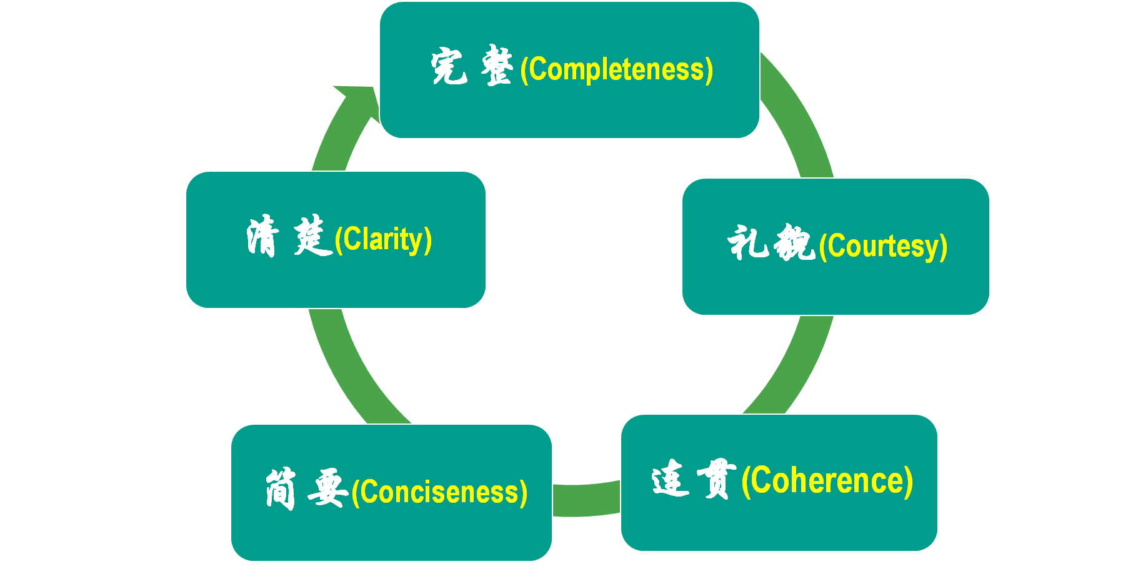
Self-evaluation 自评
Directions:
After reading these excellent compositions, please note down the materials that will be useful to your writing. Then revise and polish your own articles according to the following 5 aspects of reference.
应用文写作的5C原则

Slide 24
相似背景链接（议论性质）
你刚在某英文科技论坛中加入一个讨论组，讨论内容是“Should we fight against ChatGPT?”，网友们意见不同。请你就该问题在讨论组中发帖，表达自己的看法，内容包括：
1. ChatGPT的优势；
2. ChatGPT的劣势；
3. 你的看法。
注意：
1. 写作词数应为80个左右；
2. 请按如下格式在答题卡的相应位置作答。
Should we fight against ChatGPT?
ChatGPT-4 has gained popularity as a chatbot capable of generating human-like responses in natural language conversations.
_____________________________________________________________________________________________________________________________________________________________________________

Slide 25
参考范文
ChatGPT-4 has gained popularity as a chatbot capable of generating human-like responses in natural language conversations. While it offers several benefits, there are also drawbacks that need to be considered.
Its multiple advantages contribute to its widespread use. Firstly, it saves users’ time by providing quick and accessible information. Secondly, it offers assistance in learning and problem-solving, which is particularly valuable for students seeking immediate guidance.
Despite its benefits, ChatGPT has certain limitations like the potential for misinformation or biased responses. Another issue is the lack of empathy, so it sometimes provides insensitive or inadequate answers, diminishing the quality of the conversation.
In conclusion, ChatGPT-4 is a powerful new AI technology that has the potential to revolutionize the future. Simultaneously, given its disadvantages, it is crucial to address these challenges critically and cultivate responsible, safe, and beneficial use of ChatGPT.
Word Bank: drawback 缺点 biased 有偏见的 empathy 同理心
revolutionalize 变革 simultaneously 同时

Slide 26
话题热点语料：AI 科技拓展
素材融通：24届温州一模
integration
The _____________(融合) of artificial intelligence(AI)in educational technology(EdTech)has brought _______________(compare) convenience and _______________(效率) to classrooms worldwide. However,despite these advancements, it is crucial ______________(recognize) the challenges these AI-driven tools pose to the autonomy and professional _____________(judge) of instructors.
incomparable
efficiency
to recognize
judgement
However, AI-driven tools restrict their ability to do so effectively,
_________(result) in a one-size-fits-all approach that fails to inspire students to reach their maximum ______________(潜力).
resulting
potential
By decreasing the role of instructors as _______________(facilitate) of meaningful educational interactions, we run the risk of preventing the growth of ______________________________
(批判性思维与解决问题的能力) among students.
facilitators
critical thinking and problem-solving

Slide 27
Thanks !
Let’s embrace a bright and promising future positively revolutionalized by science and tech!

