Slide 1


感恩遇见，相互成就，本课件资料仅供您个人参考、教学使用，严禁自行在网络传播，违者依知识产权法追究法律责任。
更多教学资源请关注
公众号：溯恩高中英语
知识产权声明

Slide 2

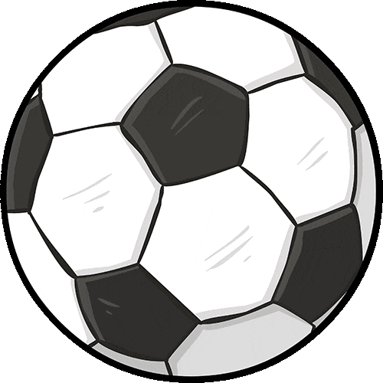

Slide 3
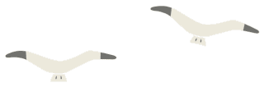

阅读理解基本策略
1. 用有限的词汇 获取 最有用信息
用有限的时间 获取 最精准答案
2. 科学打开阅读理解的方式：
① 找到主题句/文章主旨大意（一般在第一段）
② 了解文章的框架结构/语篇组织（what/ why/ how/ whether），见下页PPT
③ 做题与看文章同步交替进行（题目=阅读提纲）
3. C、D篇：
①科学研究类说明文往往第一段呈现研究发现或结论（文章主旨）
● ②路标词，带出作者真正写作意图：However, but, in fact, actually；
studys find out (研究发现/表明…)
4. 先做 单点信息题（猜词，态度、段落或文章主旨）
再做 多点信息题（细节理解；文章主旨）
Notes:
联系 系统 真实挑战
应用 迁移
大概念不是法则，从左到右，先算个位后算十位，从低位到高位。 乘除法规则运算：先分后合
最核心的是什么？
基于知识技能 高于知识技能 的思想 理念 认识 准则
自主学习能力
选择不同的工具进行测量，能够准确表示。高楼 大树 不能测量可以选择参照物估测。
真实的 挑战性
教室的高 楼房的高
大概念可以是各种形式的体现：一个词、一个短语、一个句子或者一个问题
站位很高，长远的目标，指向学生核心素养，抓住大概念，抓住基本问题，实现预期结果和目标

Slide 4

高分策略——快速厘清CD篇说明文的篇章结构
2023年英语高考全国卷应用文写作试题的新动向预示着今后英语写作教学应着重培养以下几方面能力：
用英语描述事件、描述个人经历和事物特征的能力；
描述、概括真实的经验和事实的能力；
传递信息、论证观点、表达情感的能力；
对观点、事件、经验进行阐释和评论的能力等。
因此，今后的英语写作教学既要关注如何写，更要关注写什么；既要关注写作结果，更要注重写作过程；既要关注写作的准确性，更要关注写作的流畅性；既要有适当的模仿和借鉴，但更要有创造，要使学生能够用英语进行真实表达。
1.主张-反主张模式
(Claim–counterclaim pattern)
Whether…or not?
2. 先破后立模式
(Break- establish pattern)
篇章组织
结构模式
Why not?
3.提问解答模式
(Question-answer pattern)
What?/ Why?
4.问题解决模式
(Problem-solution pattern)
What?/ Why?
How?
Notes:
联系 系统 真实挑战
应用 迁移
大概念不是法则，从左到右，先算个位后算十位，从低位到高位。 乘除法规则运算：先分后合
最核心的是什么？
基于知识技能 高于知识技能 的思想 理念 认识 准则
自主学习能力
选择不同的工具进行测量，能够准确表示。高楼 大树 不能测量可以选择参照物估测。
真实的 挑战性
教室的高 楼房的高
大概念可以是各种形式的体现：一个词、一个短语、一个句子或者一个问题
站位很高，长远的目标，指向学生核心素养，抓住大概念，抓住基本问题，实现预期结果和目标

Slide 5
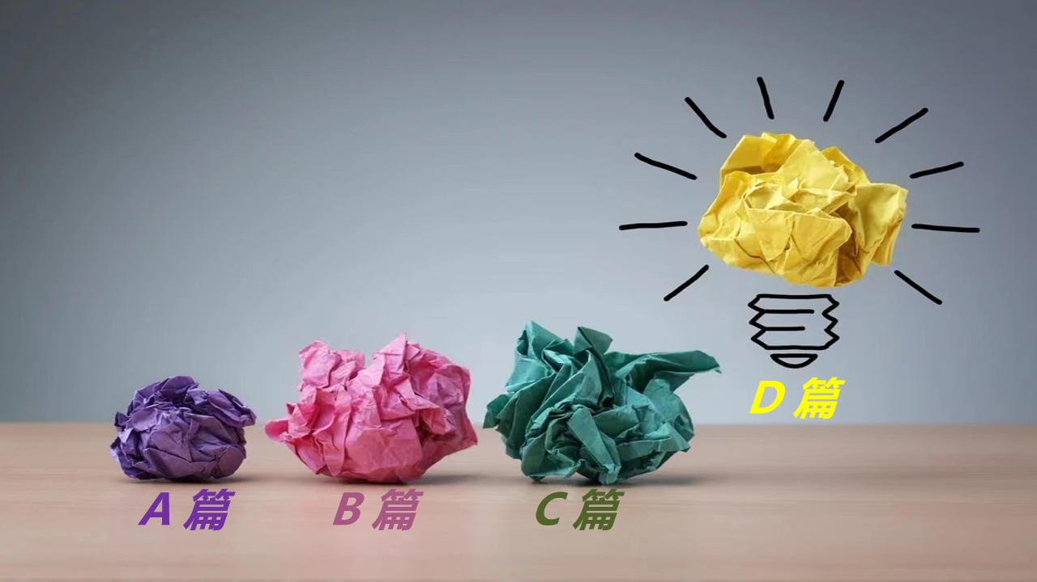
阅读理解满分策略
5.精通词义延伸方式和过程：
①主题句本身会包含核心话题和决定语篇发展方向的控制性信息，主要陈述部分则需要将控制性信息进行语义延展，为支撑主题句服务。
②利用关键词重复来突出并强化主旨。核心关键词存在复现的关系，围绕同一主题前后呼应，形成词汇链和语义链，使文本语际间实现语义上的衔接和连贯。
③利用语义场保证主题和语义传递取得统一（信息流flow的桥梁通道）
阅读过程中要善于扫描同词/同话题词，建构语义场，搭建信息流flow的通道。尤其注意paraphrase(释义，改述，换说)的地方往往是题眼。
Notes:
联系 系统 真实挑战
应用 迁移
大概念不是法则，从左到右，先算个位后算十位，从低位到高位。 乘除法规则运算：先分后合
最核心的是什么？
基于知识技能 高于知识技能 的思想 理念 认识 准则
自主学习能力
选择不同的工具进行测量，能够准确表示。高楼 大树 不能测量可以选择参照物估测。
真实的 挑战性
教室的高 楼房的高
大概念可以是各种形式的体现：一个词、一个短语、一个句子或者一个问题
站位很高，长远的目标，指向学生核心素养，抓住大概念，抓住基本问题，实现预期结果和目标

Slide 6
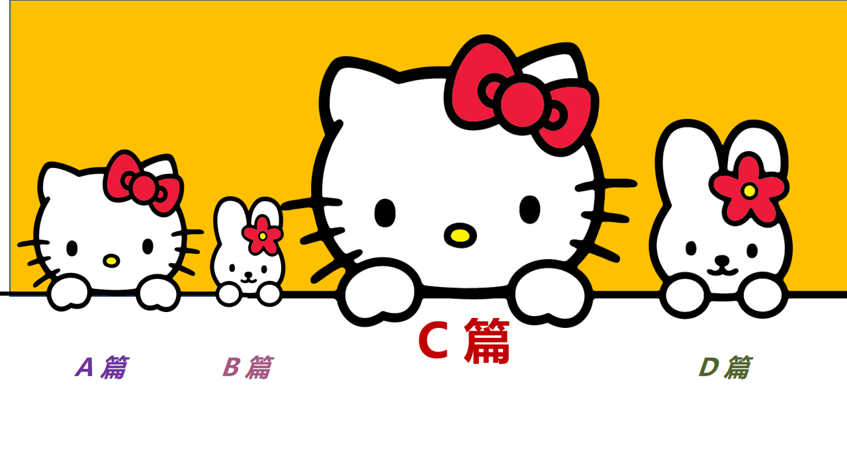
阅读理解满分策略
6.主旨大意/标题类题目解题策略：
①从特性角度：
（1）概括性：涵盖全文内容；
特征：范围大而包容；
（2）针对性：高频词（即关键词）应在标题类题目中出现；
特征：范围小而有针对性
（3）醒目性：吸引读者的关注；
特征：运用文学中的修辞，尤其是双关语
②从语篇结构角度：
与首段中转折连接词后的主旨大意在词汇换说上的吻合度
Notes:
联系 系统 真实挑战
应用 迁移
大概念不是法则，从左到右，先算个位后算十位，从低位到高位。 乘除法规则运算：先分后合
最核心的是什么？
基于知识技能 高于知识技能 的思想 理念 认识 准则
自主学习能力
选择不同的工具进行测量，能够准确表示。高楼 大树 不能测量可以选择参照物估测。
真实的 挑战性
教室的高 楼房的高
大概念可以是各种形式的体现：一个词、一个短语、一个句子或者一个问题
站位很高，长远的目标，指向学生核心素养，抓住大概念，抓住基本问题，实现预期结果和目标

Slide 7

2022年1月浙江卷 C篇阅读理解高分突破思维策略
The benefits of regular exercise are well documented but there's a new bonus to add to the ever-growing list. New research found that middle-aged women who were physically fit could be nearly 90 percent less likely to develop dementia(失智症)in later life --- and if they did, it came on a decade later than less sporty women.
Lead researcher Dr Helena Hörder, of the University of Gothenburg in Sweden, said: "These findings are exciting because it's possible that improving people's cardiovascular(心血管的) fitness in middle age could delay or even prevent them from developing dementia."
For the study, 191 women with an average age of 50 took a bicycle exercise test until they were tired out to measure their peak (最大值的) cardiovascular capacity. The average peak workload was measured at 103 watts.
A total of 40 women met the criteria for a high fitness level with a capacity of 120 watts or higher, while 92 women were in the medium fitness category. A total of 59 were of low fitness level, with a peak workload of 80 watts or less, or having their tests stopped because of health problems.
These women were then tested for dementia six times over the following four decades. During that time, 44 of the women developed dementia. Five percent of the highly fit women developed dementia, compared to 25 percent of the women with medium fitness and 32 percent of the women with low fitness.
“However, this study does not show cause and effect between cardiovascular fitness and dementia, it only shows an association," said Hörder. "More research is needed to see if improved fitness could have a positive effect on the risk of dementia and also to look at when during a lifetime a high fitness level is most important. " She also admitted that a relatively small number of women were studied, all of whom were from Sweden, so the results might not be applicable to other groups.
厘清语篇框架结构
核心话题决定着语篇发展方向的控制性信息，本篇需要借助语篇宏观结构和文脉逻辑连贯特征进行解读。按照提问解答模式: What--why --whether 组织语篇和设问。
27. What is on the ever-growing list mentioned in the first paragraph?
A. Positive effects of doing exercises.
B. Exercises suitable for the middle-aged.
C. Experimental studies on diseases.
D. Advantages of sporty woman over man
28. Why did the researchers ask the woman to do bicycle exercise?
A. To predict their maximum heart rate.
B. To assess their cardiovascular capacity
C. To change their habits of working out
D. To detect their potential health problems
29. What do we know about Dr.Horder's study?
A. It aimed to find a cure for dementia.
B. Data collection was a lengthy process.
C. Some participants withdrew from it.
D. The results were far from satisfactory.
30. Which of the following is the best title for the text?
A. More Women Are Exercising to Prevent Dementia
B. Middle-Aged Women Need to Do More Exercise
C. Fit Women Are Less Likely to Develop Dementia
D. Biking Improves Women's Cardiovascular Fitness

Slide 8
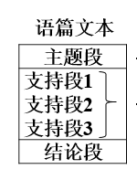
把握阅读理解CD篇的语篇结构特点：
英语语篇通常属于演绎型的直线型思维模式，这种思维模式对语篇的影响直接体现在段落结构和篇章结构。常见的语篇形式图式是：主题段/句→支持段/句→结论段/句。
阅读理解CD语篇的论点较明显地体现在语篇首段或末段之中，“首段开门见山，落笔入题；结尾卒章显志，篇末点题”（诸孝正）。论点通常清楚明了；主体部分以恰当的方式对论点进行论证，逻辑严谨，推理自然，结构清晰，例证典型；结尾不是对开头的简单重复，而是对前面内容的总结和升华。
Notes:
联系 系统 真实挑战
应用 迁移
大概念不是法则，从左到右，先算个位后算十位，从低位到高位。 乘除法规则运算：先分后合
最核心的是什么？
基于知识技能 高于知识技能 的思想 理念 认识 准则
自主学习能力
选择不同的工具进行测量，能够准确表示。高楼 大树 不能测量可以选择参照物估测。
真实的 挑战性
教室的高 楼房的高
大概念可以是各种形式的体现：一个词、一个短语、一个句子或者一个问题
站位很高，长远的目标，指向学生核心素养，抓住大概念，抓住基本问题，实现预期结果和目标

Slide 9
2022年1月浙江卷 C篇阅读理解高分突破思维策略
精通词义延伸方式和过程
The benefits of regular exercise are well documented but there's a new bonus to add to the ever-growing list. New research found that middle-aged women who were physically fit could be nearly 90 percent less likely to develop dementia(失智症)in later life --- and if they did, it came on a decade later than less sporty women.
Lead researcher Dr Helena Hörder, of the University of Gothenburg in Sweden, said: "These findings are exciting because it's possible that improving people's cardiovascular(心血管的) fitness in middle age could delay or even prevent them from developing dementia."
For the study, 191 women with an average age of 50 took a bicycle exercise test until they were tired out to measure their peak (最大值的) cardiovascular capacity. The average peak workload was measured at 103 watts.
A total of 40 women met the criteria for a high fitness level with a capacity of 120 watts or higher, while 92 women were in the medium fitness category. A total of 59 were of low fitness level, with a peak workload of 80 watts or less, or having their tests stopped because of health problems.
These women were then tested for dementia six times over the following four decades. During that time, 44 of the women developed dementia. Five percent of the highly fit women developed dementia, compared to 25 percent of the women with medium fitness and 32 percent of the women with low fitness.
“However, this study does not show cause and effect between cardiovascular fitness and dementia, it only shows an association," said Hörder. "More research is needed to see if improved fitness could have a positive effect on the risk of dementia and also to look at when during a lifetime a high fitness level is most important. " She also admitted that a relatively small number of women were studied, all of whom were from Sweden, so the results might not be applicable to other groups.
第27题属于单点信息题，很容易形成benefits of regular exercise 和 a new bonus 语义链，与A选项Positive effects 同义信息匹配，秒杀正确答案。
另外，第六段 a positive effect 也与首段呼应。
考生要深谙词义延伸方式和过程：核心关键词存在复现的关系，围绕同一主题前后呼应，形成词汇链和语义链，使文本语际间实现语义上的衔接和连贯。
27. What is on the ever-growing list mentioned in the first paragraph?
A. Positive effects of doing exercises.
B. Exercises suitable for the middle-aged.
C. Experimental studies on diseases.
D. Advantages of sporty woman over man
30. Which of the following is the best title for the text?
A. More Women Are Exercising to Prevent Dementia
B. Middle-Aged Women Need to Do More Exercise
C. Fit Women Are Less Likely to Develop Dementia
D. Biking Improves Women's Cardiovascular Fitness
首段的主旨句与文章标题有很强吻合度
考生要善于选择最佳解题路径：首段路标词New research found that 引出的文章主旨句，在词汇换说上与A选项Fit Women Are Less Likely to Develop Dementia的吻合度强。

Slide 10
2022年1月浙江卷 C篇阅读理解高分突破思维策略
The benefits of regular exercise are well documented but there's a new bonus to add to the ever-growing list. New research found that middle-aged women who were physically fit could be nearly 90 percent less likely to develop dementia(失智症)in later life --- and if they did, it came on a decade later than less sporty women.
Lead researcher Dr Helena Hörder, of the University of Gothenburg in Sweden, said: "These findings are exciting because it's possible that improving people's cardiovascular(心血管的) fitness in middle age could delay or even prevent them from developing dementia."
For the study, 191 women with an average age of 50 took a bicycle exercise test until they were tired out to measure their peak (最大值的) cardiovascular capacity. The average peak workload was measured at 103 watts.
A total of 40 women met the criteria for a high fitness level with a capacity of 120 watts or higher, while 92 women were in the medium fitness category. A total of 59 were of low fitness level, with a peak workload of 80 watts or less, or having their tests stopped because of health problems.
These women were then tested for dementia six times over the following four decades. During that time, 44 of the women developed dementia. Five percent of the highly fit women developed dementia, compared to 25 percent of the women with medium fitness and 32 percent of the women with low fitness.
“However, this study does not show cause and effect between cardiovascular fitness and dementia, it only shows an association," said Hörder. "More research is needed to see if improved fitness could have a positive effect on the risk of dementia and also to look at when during a lifetime a high fitness level is most important. " She also admitted that a relatively small number of women were studied, all of whom were from Sweden, so the results might not be applicable to other groups.
建构语义场，形成秒杀答案
善于捕捉一些意义相同、相似、相反的词，联系在一起，形成语义场。28题B选项中的“ assess”与文中3-5段反复出现的“test”和“ measure”形成语义场，秒杀答案。
28. Why did the researchers ask the woman to do bicycle exercise?
A. To predict their maximum heart rate.
B. To assess their cardiovascular capacity
C. To change their habits of working out
D. To detect their potential health problems
29. What do we know about Dr Horder's study?
A. It aimed to find a cure for dementia.
B. Data collection was a lengthy process.
C. Some participants withdrew from it.
D. The results were far from satisfactory.
科技论文的结论要客观严谨
第29题错误率较高，错选D选项的考生较多。D选项是一个主观性很强的答案。本题要根据文章中的对研究结果的表述做出客观的判断。
本题很好地考查了学生严谨科学，求真务实的思维品质。对实验结果的结论要不偏不倚，不夸大其词，不 妄下结论。

Slide 11
2021年6月浙江卷 C篇 阅读理解高分突破思维策略
If you ever get the impression that your dog can "tell" whether you look content or annoyed, you may be onto something. Dogs may indeed be able to distinguish between happy and angry human faces, according to a new study.
Researchers trained a group of 11 dogs to distinguish between images（图像）of the same person making either a happy or an angry face. During the training stage, each dog was shown only the upper half or the lower half of the person’s face. The researchers then tested the dogs’ ability to distinguish between human facial expressions by showing them the other half of the person’s face or images totally different from the ones used in training. The researchers found that the dogs were able to pick the angry or happy face by touching a picture of it with their noses more often than one would expect by random chance.
The study showed the animals had figured out how to apply what they learned about human faces during training to new faces in the testing stage. "We can rule out that the dogs simply distinguish between the pictures based on a simple cue, such as the sight of teeth," said study author Corsin Muller. "Instead, our results suggest that the successful dogs realized that a smiling mouth means the same thing as smiling eyes, and the same rule applies to an angry mouth having the same meaning as angry eyes.”
"With our study, we think we can now confidently conclude that at least some dogs can distinguish human facial expressions," Muller told Live Science.
At this point, it is not clear why dogs seem to be equipped with the ability to recognize different facial expressions in humans. "To us, the most likely explanation appears to be that the basis lies in their living with humans, which gives them a lot of exposure to human facial expressions," and this exposure has provided them with many chances to learn to distinguish between them, Muller said.
厘清语篇框架结构
快速了解本文的框架结构是解题关键：第一段according to a new study，捕捉what；第二段的test，检测结论是否成立whether；第3、5段分别出现关键词how和why。从而形成What--whether--how--why 问题链，符合 “提问-解答”的篇章模式，搭建了信息流flow的通道。
建构语义链
快速扫描同词/同义词，建构语义链，本文中tell, distinguish , pick , recognize构成一条“识别，分辨”的语义链，与选项B中的 make sense of 同义信息匹配。注意：paraphrase(释义，改述，换说)的地方往往是秒杀正确答案的突破点。
28. The new study focused on whether dogs can_________.
A. distinguish shapes B. make sense of human faces
C. feel happy or angry D. communicate with each other

Slide 12
基于语义连贯的阅读理解满分策略
1. 概念成分上的照应性
构建
语义链和语义场
2. 命题发展的索引性
(命题发展的线条，信息互有关联）
3. 语用推理上的顺应性
4. 语篇信息在逻辑上的链接性
What?/ Why?
Notes:
联系 系统 真实挑战
应用 迁移
大概念不是法则，从左到右，先算个位后算十位，从低位到高位。 乘除法规则运算：先分后合
最核心的是什么？
基于知识技能 高于知识技能 的思想 理念 认识 准则
自主学习能力
选择不同的工具进行测量，能够准确表示。高楼 大树 不能测量可以选择参照物估测。
真实的 挑战性
教室的高 楼房的高
大概念可以是各种形式的体现：一个词、一个短语、一个句子或者一个问题
站位很高，长远的目标，指向学生核心素养，抓住大概念，抓住基本问题，实现预期结果和目标

Slide 13
2021年6月浙江卷 C篇 阅读理解高分突破思维策略
Researchers trained a group of 11 dogs to distinguish between images（图像）of the same person making either a happy or an angry face. During the training stage, each dog was shown only the upper half or the lower half of the person’s face. The researchers then tested the dogs’ability to distinguish between human facial expressions by showing them the other half of the person’s face or images totally different from the ones used in training. The researchers found that the dogs were able to pick the angry or happy face by touching a picture of it with their noses more often than one would expect by random chance.
29. What can we learn about the study from paragraph 2?
A. Researchers tested the dogs in random order.
B. Diverse methods were adopted during training.
C. Pictures used in the two stages were different
D. The dogs were photographed before the test.
微观结构的逻辑分析
1.细节理解题，理解文中具体信息，考查逻辑性思维。
2. 29题的难点在“the two stages”的理解，联结词语反映语篇内部的逻辑关系，根据 联结词then 作出判断和推理。要加强微观组织结构的逻辑关系分析能力。
"With our study, we think we can now confidently conclude that at least some dogs can distinguish human facial expressions," Muller told Live Science.
At this point, it is not clear why dogs seem to be equipped with the ability to recognize different facial expressions in humans. "To us, the most likely explanation appears to be that the basis lies in their living with humans, which gives them a lot of exposure to human facial expressions," and this exposure has provided them with many chances to learn to distinguish between them, Muller said.
30. What is the last paragraph mainly about?
A. A suggestion for future studies. B. A possible reason for the study findings.
C. A major limitation of the study D. An explanation of the research method.
段际的逻辑连贯
1. 善于从段际、句际、句内的逻辑关系去解读和建构语篇内含的衔接连贯。
2. 30题尽管设问最后一段，但 At this point，指引读者要阅读上一段的研究发现，导出最后一段“狗能识别人脸的可能性原因”。

Slide 14
2021年1月浙江卷 C篇阅读理解高分突破思维策略
Researchers say they have translated the meaning of gestures that wild chimpanzees (黑猩猩) use to communicate. They say wild chimps communicate 19 specific messages to one another with a “vocabulary” of 66 gestures. The scientists discovered this by following and filming groups of chimps in Uganda, and examining more than 5,000 incidents of these meaningful exchanges. Dr Catherine Hobaiter, who led the research, said that this was the only form of intentional communication to be recorded in the animal kingdom. Only humans and chimps, she said, had a system of communication where they deliberately sent a message to another group member. “That’s what’s so amazing about chimp gestures,” she said. “They’re the only thing that looks like human language in that respect.” Although previous research has shown that apes and monkeys can understand complex information from another animal’s call, the animals do not appear to use their voices intentionally to communicate messages. This was a significant difference between calls and gestures, Dr Hobaiter said. Chimps will check to see if they have the attention of the animal with which they wish to communicate. In one case, a mother presents her foot to her crying baby, signalling: “Climb on me.” The youngster immediately jumps on to its mother’s back and they travel off together. “The big message from this study is that there is another species (物种) out there that is meaningful in its communication, so that’s not unique to humans,” said Dr Hobaiter. Dr Susanne Shultz, an evolutionary biologist from the University of Manchester, said the study was praiseworthy in seeking to enrich our knowledge of the evolution of human language. But, she added, the results were “a little disappointing”. “The vagueness of the gesture meanings suggests either that the chimps have little to communicate, or we are still missing a lot of the information contained in their gestures and actions,” she said. “Moreover, the meanings seem to not go beyond what other animals convey with non-verbal communication. So, it seems the gulf remains.”
精通词义延伸方式和过程
第27题属于单点信息题，扫描同义词，很容易形成intentional / deliberately 语义链，与A选项on purpose 同义信息匹配，秒杀正确答案。
做题与看文章同步交替进行，paraphrase同义信息匹配：
only / look like – have in common;
intentional / deliberately– on purpose;
send a message-– communicate messages
27. What do chimps and humans have in common
according to Dr Hobaiter?
A. Memorizing specific words.
B. Understanding complex information.
C. Using voices to communicate.
D. Communicating messages on purpose.

Slide 15
2021年1月浙江卷 C篇阅读理解高分突破思维策略
Researchers say they have translated the meaning of gestures that wild chimpanzees (黑猩猩) use to communicate. They say wild chimps communicate 19 specific messages to one another with a “vocabulary” of 66 gestures. The scientists discovered this by following and filming groups of chimps in Uganda, and examining more than 5,000 incidents of these meaningful exchanges. Dr Catherine Hobaiter, who led the research, said that this was the only form of intentional communication to be recorded in the animal kingdom. Only humans and chimps, she said, had a system of communication where they deliberately sent a message to another group member. “That’s what’s so amazing about chimp gestures,” she said. “They’re the only thing that looks like human language in that respect.” Although previous research has shown that apes and monkeys can understand complex information from another animal’s call, the animals do not appear to use their voices intentionally to communicate messages. This was a significant difference between calls and gestures, Dr Hobaiter said. Chimps will check to see if they have the attention of the animal with which they wish to communicate. In one case, a mother presents her foot to her crying baby, signalling: “Climb on me.” The youngster immediately jumps on to its mother’s back and they travel off together. “The big message from this study is that there is another species (物种) out there that is meaningful in its communication, so that’s not unique to humans,” said Dr Hobaiter. Dr Susanne Shultz, an evolutionary biologist from the University of Manchester, said the study was praiseworthy in seeking to enrich our knowledge of the evolution of human language. But, she added, the results were “a little disappointing”. “The vagueness of the gesture meanings suggests either that the chimps have little to communicate, or we are still missing a lot of the information contained in their gestures and actions,” she said. “Moreover, the meanings seem to not go beyond what other animals convey with non-verbal communication. So, it seems the gulf remains.”
精通词义延伸方式和过程
第28题关注路标词but，扫描意义相同、相似、相反的词聚合在一起，形成统一语义特征的情感态度语义场“a little disappointing，little ，still missing a lot of the information，not go beyond ”，与B选项limited 同义信息匹配，秒杀正确答案。
28. What did Dr Shultz think of the study?
A. It was well designed but poorly conducted.
B. It was a good try but the findings were limited.
C. It was inspiring but the evidence was unreliable.
D. It was a failure but the methods deserved praise.
29. What does the underlined word “gulf” in the last paragraph mean?
A. Difference. B. Conflict.
C. Balance. D. Connection.
运用篇章模式理论
运用语篇分析手段，从语境、信息、结构等层面分析文本，理清文本内在的错综复杂的关系，本篇属于“正反议论”的语篇模式。
最后一段强调科学家提出异议，认为这与人类交流的不同，存在差异。最后一句“So, it seems the gulf remains”呼应前文。

Slide 16
2021年1月浙江卷 C篇阅读理解高分突破思维策略
Researchers say they have translated the meaning of gestures that wild chimpanzees (黑猩猩) use to communicate. They say wild chimps communicate 19 specific messages to one another with a “vocabulary” of 66 gestures. The scientists discovered this by following and filming groups of chimps in Uganda, and examining more than 5,000 incidents of these meaningful exchanges. Dr Catherine Hobaiter, who led the research, said that this was the only form of intentional communication to be recorded in the animal kingdom. Only humans and chimps, she said, had a system of communication where they deliberately sent a message to another group member. “That’s what’s so amazing about chimp gestures,” she said. “They’re the only thing that looks like human language in that respect.” Although previous research has shown that apes and monkeys can understand complex information from another animal’s call, the animals do not appear to use their voices intentionally to communicate messages. This was a significant difference between calls and gestures, Dr Hobaiter said. Chimps will check to see if they have the attention of the animal with which they wish to communicate. In one case, a mother presents her foot to her crying baby, signalling: “Climb on me.” The youngster immediately jumps on to its mother’s back and they travel off together. “The big message from this study is that there is another species (物种) out there that is meaningful in its communication, so that’s not unique to humans,” said Dr Hobaiter. Dr Susanne Shultz, an evolutionary biologist from the University of Manchester, said the study was praiseworthy in seeking to enrich our knowledge of the evolution of human language. But, she added, the results were “a little disappointing”. “The vagueness of the gesture meanings suggests either that the chimps have little to communicate, or we are still missing a lot of the information contained in their gestures and actions,” she said. “Moreover, the meanings seem to not go beyond what other animals convey with non-verbal communication. So, it seems the gulf remains.”
科技论文的结论推断要客观严谨
第30题属于批判性思维能力和辩证思维能力的高阶思维能力考查。
科学研究类说明文往往第一段呈现研究发现或结论（文章主旨），即研究结论：“黑猩猩能够用来有目的的手势来交流，就像人一样”，但结合全文分析，这个结论 其实是有争议的。
本题很好地考查了学生严谨科学，求真务实的思维品质。对实验结果的结论要不偏不倚，措辞严谨。
夸大其词吸引眼球（如选项A），歪曲事实妄下结论（如选项B），主观臆断凭空杜撰（如选项C）都是不严谨的科学态度。
30. Which of the following is the best title for the text?
A. Chimpanzee behaviour study achieved a breakthrough
B. Chimpanzees developed specific communication skills
C. Chimpanzees: the smartest species in the animal kingdom
D. Chimpanzee language: communication gestures translated

Slide 17
2023年6月全国新课标I卷C篇阅读理解高分突破思维策略
The goal of this book is to make the case for digital minimalism, including a detailed exploration of what it asks and why it works, and then to teach you how to adopt this philosophy if you decide it’s right for you.
To do so, I divided the book into two parts. In part one, I describe the philosophical foundations of digital minimalism, starting with an examination of the forces that are making so many people’s digital lives increasingly intolerable, before moving on to a detailed discussion of the digital minimalism philosophy.
Part one concludes by introducing my suggested method for adopting this philosophy: the digital declutter. This process requires you to step away from optional online activities for thirty days. At the end of the thirty days, you will then add back a small number of carefully chosen online activities that you believe will provide massive benefits to the things you value.
In the final chapter of part one, I’ll guide you through carrying out your own digital declutter. In doing so, I’ll draw on an experiment I ran in 2018 in which over 1,600 people agreed to perform a digital declutter. You’ll hear these participants’ stories and learn what strategies worked well for them, and what traps they encountered that you should avoid.
The second part of this book takes a closer look at some ideas that will help you cultivate (培养) a sustainable digital minimalism lifestyle. In these chapters, I examine issues such as the importance of solitude (独处) and the necessity of cultivating high-quality leisure to replace the time most now spent on mindless device use. Each chapter concludes with a collection of practices, which are designed to help you act on the big ideas of the chapter. You can view these practices as a toolbox meant to aid your efforts to build a minimalist lifestyle that works for your particular circumstances.
核心概念模糊时：围点打援
第28题涉及本篇的核心概念，是阅读障碍词块，我们可以先放下，做后面的题，相信核心关键词存在复现的关系，围绕同一主题会前后呼应，形成词汇链，使文本语际间实现语义上的衔接和连贯，让核心概念逐渐明朗清晰。
28. What is the book aimed at?
A. Teaching critical thinking skills. B. Advocating a simple digital lifestyle.
C. Solving philosophical problems. D. Promoting the use of a digital device.

Slide 18
核心概念模糊时：围点打援，成合围之势
2023年英语高考全国卷应用文写作试题的新动向预示着今后英语写作教学应着重培养以下几方面能力：
用英语描述事件、描述个人经历和事物特征的能力；
描述、概括真实的经验和事实的能力；
传递信息、论证观点、表达情感的能力；
对观点、事件、经验进行阐释和评论的能力等。
因此，今后的英语写作教学既要关注如何写，更要关注写什么；既要关注写作结果，更要注重写作过程；既要关注写作的准确性，更要关注写作的流畅性；既要有适当的模仿和借鉴，但更要有创造，要使学生能够用英语进行真实表达。
2023年6月全国新课标I卷CD篇均出现小众话题——“ digital minimalism”，“wisdom of crowds” effect，话题不熟无相关背景知识，信息缺省认知不足，
单词不明核心概念模糊，导致语篇发展方向不清晰，阅读难度增大。
解决核心概念模糊需要进行信息“搭桥”，建议考生采取“围点打援”的阅读战术，先攻克单点信息题，激活语篇的已有信息，不断创造关联性，并通过已有信息激活概念之间的照应关系，建立话语之间的语义关联，成合围之势，统一认知世界，获得语篇或话语的连贯性，如C篇28题“ digital minimalism”，我们可以先做后面的题，构建核心概念的语义场“adopt this philosophy, a small number of carefully chosen online activities, a sustainable digital lifestyle, replace the time most now spent on mindless device use. ”，让核心概念逐渐明朗清晰，最后攻克之。
Notes:
联系 系统 真实挑战
应用 迁移
大概念不是法则，从左到右，先算个位后算十位，从低位到高位。 乘除法规则运算：先分后合
最核心的是什么？
基于知识技能 高于知识技能 的思想 理念 认识 准则
自主学习能力
选择不同的工具进行测量，能够准确表示。高楼 大树 不能测量可以选择参照物估测。
真实的 挑战性
教室的高 楼房的高
大概念可以是各种形式的体现：一个词、一个短语、一个句子或者一个问题
站位很高，长远的目标，指向学生核心素养，抓住大概念，抓住基本问题，实现预期结果和目标

Slide 19
2023年6月全国新课标I卷C篇阅读理解高分突破思维策略
The goal of this book is to make the case for digital minimalism, including a detailed exploration of what it asks and why it works, and then to teach you how to adopt this philosophy if you decide it’s right for you.
To do so, I divided the book into two parts. In part one, I describe the philosophical foundations of digital minimalism, starting with an examination of the forces that are making so many people’s digital lives increasingly intolerable, before moving on to a detailed discussion of the digital minimalism philosophy.
Part one concludes by introducing my suggested method for adopting this philosophy: the digital declutter. This process requires you to step away from optional online activities for thirty days. At the end of the thirty days, you will then add back a small number of carefully chosen online activities that you believe will provide massive benefits to the things you value.
In the final chapter of part one, I’ll guide you through carrying out your own digital declutter. In doing so, I’ll draw on an experiment I ran in 2018 in which over 1,600 people agreed to perform a digital declutter. You’ll hear these participants’ stories and learn what strategies worked well for them, and what traps they encountered that you should avoid.
The second part of this book takes a closer look at some ideas that will help you cultivate (培养) a sustainable digital minimalism lifestyle. In these chapters, I examine issues such as the importance of solitude (独处) and the necessity of cultivating high-quality leisure to replace the time most now spent on mindless device use. Each chapter concludes with a collection of practices, which are designed to help you act on the big ideas of the chapter. You can view these practices as a toolbox meant to aid your efforts to build a minimalist lifestyle that works for your particular circumstances.
精通词义延伸方式和过程
核心关键词存在复现的关系，实现语义上的衔接和连贯， 通过adopt this philosophy的复现，我们可知minimalism与 declutter同义，并建构语义场“ step away from， a small number of.., replace...”解释所猜词义“Clear-up.”
29. What does the underlined word “declutter” in paragraph 3 mean?
A. Clear-up. B. Add-on. C. Check-in. D. Take-over.

Slide 20
2023年6月全国新课标I卷C篇阅读理解高分突破思维策略
The goal of this book is to make the case for digital minimalism, including a detailed exploration of what it asks and why it works, and then to teach you how to adopt this philosophy if you decide it’s right for you.
To do so, I divided the book into two parts. In part one, I describe the philosophical foundations of digital minimalism, starting with an examination of the forces that are making so many people’s digital lives increasingly intolerable, before moving on to a detailed discussion of the digital minimalism philosophy.
Part one concludes by introducing my suggested method for adopting this philosophy: the digital declutter. This process requires you to step away from optional online activities for thirty days. At the end of the thirty days, you will then add back a small number of carefully chosen online activities that you believe will provide massive benefits to the things you value.
In the final chapter of part one, I’ll guide you through carrying out your own digital declutter. In doing so, I’ll draw on an experiment I ran in 2018 in which over 1,600 people agreed to perform a digital declutter. You’ll hear these participants’ stories and learn what strategies worked well for them, and what traps they encountered that you should avoid.
The second part of this book takes a closer look at some ideas that will help you cultivate (培养) a sustainable digital minimalism lifestyle. In these chapters, I examine issues such as the importance of solitude (独处) and the necessity of cultivating high-quality leisure to replace the time most now spent on mindless device use. Each chapter concludes with a collection of practices, which are designed to help you act on the big ideas of the chapter. You can view these practices as a toolbox meant to aid your efforts to build a minimalist lifestyle that works for your particular circumstances.
搭建信息流flow的通道
善于扫描同义词/同话题词，快速捕捉一些意义相同、相似、相反的词，联系在一起，建构语义场，促进语篇理解，秒杀正确答案。
”strategies worked well, what traps... avoid“形成语义场，与 ”Practical“同义信息匹配。
“ participants’ stories”与“examples ”形成同义信息匹配。
30. What is presented in the final chapter of part one?
A. Theoretical models. B. Statistical methods. C. Practical examples. D. Historical analyses.

Slide 21
2023年6月全国新课标I卷C篇阅读理解高分突破思维策略
The goal of this book is to make the case for digital minimalism, including a detailed exploration of what it asks and why it works, and then to teach you how to adopt this philosophy if you decide it’s right for you.
To do so, I divided the book into two parts. In part one, I describe the philosophical foundations of digital minimalism, starting with an examination of the forces that are making so many people’s digital lives increasingly intolerable, before moving on to a detailed discussion of the digital minimalism philosophy.
Part one concludes by introducing my suggested method for adopting this philosophy: the digital declutter. This process requires you to step away from optional online activities for thirty days. At the end of the thirty days, you will then add back a small number of carefully chosen online activities that you believe will provide massive benefits to the things you value.
In the final chapter of part one, I’ll guide you through carrying out your own digital declutter. In doing so, I’ll draw on an experiment I ran in 2018 in which over 1,600 people agreed to perform a digital declutter. You’ll hear these participants’ stories and learn what strategies worked well for them, and what traps they encountered that you should avoid.
The second part of this book takes a closer look at some ideas that will help you cultivate (培养) a sustainable digital minimalism lifestyle. In these chapters, I examine issues such as the importance of solitude (独处) and the necessity of cultivating high-quality leisure to replace the time most now spent on mindless device use. Each chapter concludes with a collection of practices, which are designed to help you act on the big ideas of the chapter. You can view these practices as a toolbox meant to aid your efforts to build a minimalist lifestyle that works for your particular circumstances.
抓住关键词复现与呼应
核心关键词存在复现的关系，围绕同一主题会前后呼应，形成词汇链，使文本语际间实现语义上的衔接和连贯，文末 that works for your particular circumstances与首段 if you decide it’s right for you呼应，与选项A的as needed信息同义匹配。
而且，尾段呼应了首段的how to adopt，与collection of practices，a toolbox 构建语义场，与选项A的Use them信息同义匹配。
31. What does the author suggest readers do with the practices offered in part two?
A. Use them as needed. B. Recommend them to friends.
C. Evaluate their effects. D. Identify the ideas behind them.

Slide 22
2023年6月全国新课标I卷D篇阅读高分突破思维策略
On March 7, 1907, the English statistician Francis Galton published a paper which illustrated what has come to be known as the “wisdom of crowds” effect. The experiment of estimation he conducted showed that in some cases, the average of a large number of independent estimates could be quite accurate.
This effect capitalizes on the fact that when people make errors, those errors aren’t always the same. Some people will tend to overestimate, and some to underestimate. When enough of these errors are averaged together, they cancel each other out, resulting in a more accurate estimate. If people are similar and tend to make the same errors, then their errors won’t cancel each other out. In more technical terms, the wisdom of crowds requires that people’s estimates be independent. If for whatever reasons, people’s errors become correlated or dependent, the accuracy of the estimate will go down.
But a new study led by Joaquin Navajas offered an interesting twist (转折) on this classic phenomenon. The key finding of the study was that when crowds were further divided into smaller groups that were allowed to have a discussion, the averages from these groups were more accurate than those from an equal number of independent individuals. For instance, the average obtained from the estimates of four discussion groups of five was significantly more accurate than the average obtained from 20 independent individuals.
In a follow-up study with 100 university students, the researchers tried to get a better sense of what the group members actually did in their discussion. Did they tend to go with those most confident about their estimates? Did they follow those least willing to change their minds? This happened some of the time, but it wasn’t the dominant response. Most frequently, the groups reported that they “shared arguments and reasoned together.” Somehow, these arguments and reasoning resulted in a global reduction in error. Although the studies led by Navajas have limitations and many questions remain, the potential implications for group discussion and decision-making are enormous.
核心概念模糊时：围点打援
第32题涉及本篇的核心概念“wisdom of crowds” effect，是阅读障碍词块，我们可以先放下，做后面的题，相信核心关键词存在复现的关系，围绕同一主题形成词汇链，使文本语际间实现语义上的衔接和连贯，如文末的group discussion and decision-making让核心概念逐渐明朗清晰，再通过本段表明工作原理的语义场“when..., if..., resulting in..., the accuracy...will go down. ”与选项B的underlying logic信息同义匹配。
32. What is paragraph 2 of the text mainly about?
A. The methods of estimation. B. The underlying logic of the effect.
C. The causes of people’s errors. D. The design of Galton’s experiment.

Slide 23
2023年6月全国新课标I卷D篇阅读高分突破思维策略
On March 7, 1907, the English statistician Francis Galton published a paper which illustrated what has come to be known as the “wisdom of crowds” effect. The experiment of estimation he conducted showed that in some cases, the average of a large number of independent estimates could be quite accurate.
This effect capitalizes on the fact that when people make errors, those errors aren’t always the same. Some people will tend to overestimate, and some to underestimate. When enough of these errors are averaged together, they cancel each other out, resulting in a more accurate estimate. If people are similar and tend to make the same errors, then their errors won’t cancel each other out. In more technical terms, the wisdom of crowds requires that people’s estimates be independent. If for whatever reasons, people’s errors become correlated or dependent, the accuracy of the estimate will go down.
But a new study led by Joaquin Navajas offered an interesting twist (转折) on this classic phenomenon. The key finding of the study was that when crowds were further divided into smaller groups that were allowed to have a discussion, the averages from these groups were more accurate than those from an equal number of independent individuals. For instance, the average obtained from the estimates of four discussion groups of five was significantly more accurate than the average obtained from 20 independent individuals.
In a follow-up study with 100 university students, the researchers tried to get a better sense of what the group members actually did in their discussion. Did they tend to go with those most confident about their estimates? Did they follow those least willing to change their minds? This happened some of the time, but it wasn’t the dominant response. Most frequently, the groups reported that they “shared arguments and reasoned together.” Somehow, these arguments and reasoning resulted in a global reduction in error. Although the studies led by Navajas have limitations and many questions remain, the potential implications for group discussion and decision-making are enormous.
抓住核心关键词复现与呼应
本文多次核心关键词independent 复现，在Navajas’ study处出现路标词but，该研究不同点在于 further divided into smaller groups，结果 average accuracy could increase。group discussion与 not fully independent信息同义匹配。
33. Navajas’ study found that the average accuracy could increase even if ________.
A. the crowds were relatively small B. there were occasional underestimates
C. individuals did not communicate D. estimates were not fully independent

Slide 24
2023年6月全国新课标I卷D篇阅读高分突破思维策略
On March 7, 1907, the English statistician Francis Galton published a paper which illustrated what has come to be known as the “wisdom of crowds” effect. The experiment of estimation he conducted showed that in some cases, the average of a large number of independent estimates could be quite accurate.
This effect capitalizes on the fact that when people make errors, those errors aren’t always the same. Some people will tend to overestimate, and some to underestimate. When enough of these errors are averaged together, they cancel each other out, resulting in a more accurate estimate. If people are similar and tend to make the same errors, then their errors won’t cancel each other out. In more technical terms, the wisdom of crowds requires that people’s estimates be independent. If for whatever reasons, people’s errors become correlated or dependent, the accuracy of the estimate will go down.
But a new study led by Joaquin Navajas offered an interesting twist (转折) on this classic phenomenon. The key finding of the study was that when crowds were further divided into smaller groups that were allowed to have a discussion, the averages from these groups were more accurate than those from an equal number of independent individuals. For instance, the average obtained from the estimates of four discussion groups of five was significantly more accurate than the average obtained from 20 independent individuals.
In a follow-up study with 100 university students, the researchers tried to get a better sense of what the group members actually did in their discussion. Did they tend to go with those most confident about their estimates? Did they follow those least willing to change their minds? This happened some of the time, but it wasn’t the dominant response. Most frequently, the groups reported that they “shared arguments and reasoned together.” Somehow, these arguments and reasoning resulted in a global reduction in error. Although the studies led by Navajas have limitations and many questions remain, the potential implications for group discussion and decision-making are enormous.
搭建信息流flow的通道
善于扫描同义词/同话题词/小句，快速捕捉一些意义相同、相似、相反的词/小句，联系在一起，建构语义场，促进语篇理解，秒杀正确答案。
本题重点在what the group members actually did in their discussion的理解，通过下文小句关系Did they...?Did they...? they “shared arguments and reasoned together. 形成语义概括 discussion process，并与actually did信息同义匹配。小句关系是逻辑-语义连贯的重要形式，考生要善于将语篇中一个或一组小句与另一个或一组小句之间建构逻辑-语义关系。
34. What did the follow-up study focus on?
A. The size of the groups. B. The dominant members.
C. The discussion process. D. The individual estimates.

Slide 25
2023年6月全国新课标I卷D篇阅读高分突破思维策略
On March 7, 1907, the English statistician Francis Galton published a paper which illustrated what has come to be known as the “wisdom of crowds” effect. The experiment of estimation he conducted showed that in some cases, the average of a large number of independent estimates could be quite accurate.
This effect capitalizes on the fact that when people make errors, those errors aren’t always the same. Some people will tend to overestimate, and some to underestimate. When enough of these errors are averaged together, they cancel each other out, resulting in a more accurate estimate. If people are similar and tend to make the same errors, then their errors won’t cancel each other out. In more technical terms, the wisdom of crowds requires that people’s estimates be independent. If for whatever reasons, people’s errors become correlated or dependent, the accuracy of the estimate will go down.
But a new study led by Joaquin Navajas offered an interesting twist (转折) on this classic phenomenon. The key finding of the study was that when crowds were further divided into smaller groups that were allowed to have a discussion, the averages from these groups were more accurate than those from an equal number of independent individuals. For instance, the average obtained from the estimates of four discussion groups of five was significantly more accurate than the average obtained from 20 independent individuals.
In a follow-up study with 100 university students, the researchers tried to get a better sense of what the group members actually did in their discussion. Did they tend to go with those most confident about their estimates? Did they follow those least willing to change their minds? This happened some of the time, but it wasn’t the dominant response. Most frequently, the groups reported that they “shared arguments and reasoned together.” Somehow, these arguments and reasoning resulted in a global reduction in error. Although the studies led by Navajas have limitations and many questions remain, the potential implications for group discussion and decision-making are enormous.
建构语义场，形成秒杀答案
善于扫描同义词/同话题词，快速捕捉一些意义相同、相似、相反的词，联系在一起，建构语义场，促进语篇理解，秒杀正确答案。
通过“a global reduction in error; the potential implications... are enormous.”建构情感态度的语义场，精准获得语篇观点、意图和态度 “Approving”。
35. What is the author’s attitude toward Navajas’ studies?
A. Unclear. B. Dismissive. C. Doubtful. D. Approving.

Slide 26
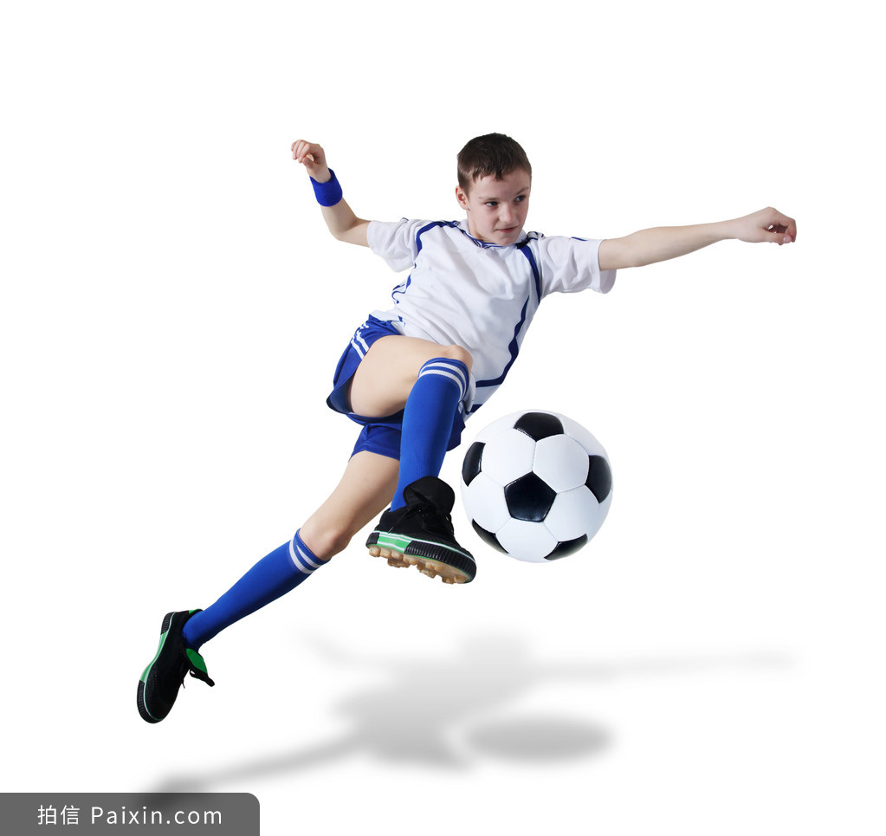
CD篇阅读理解 高分突破思维策略
奇迹总在拼搏之后；
成功蕴于进取之中。
基于提升英语核心素养的高考精准科学备考指导

