Slide 1


感恩遇见，相互成就，本课件资料仅供您个人参考、教学使用，严禁自行在网络传播，违者依知识产权法追究法律责任。
更多教学资源请关注
公众号：溯恩高中英语
知识产权声明

Slide 2
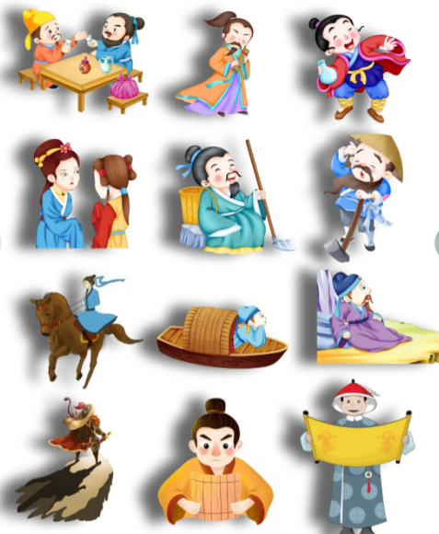
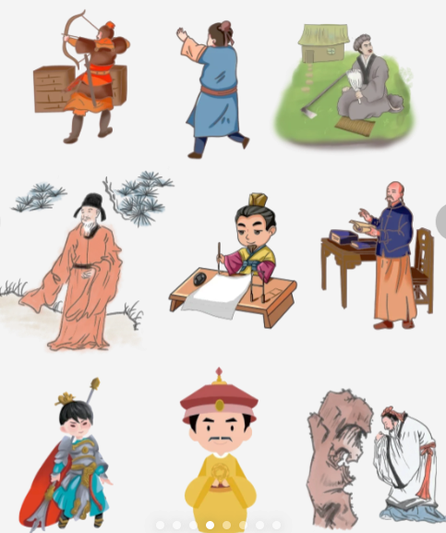
Chinese Traditional Figures

Slide 3
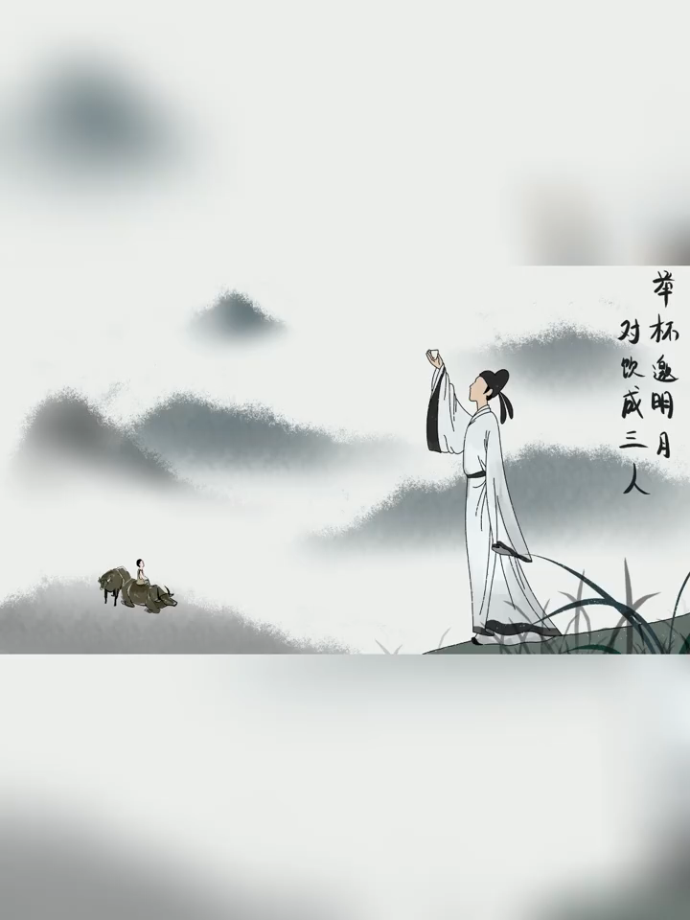
Li Bai
a great Chinese romantic poet of the Tang Dynasty

Slide 4
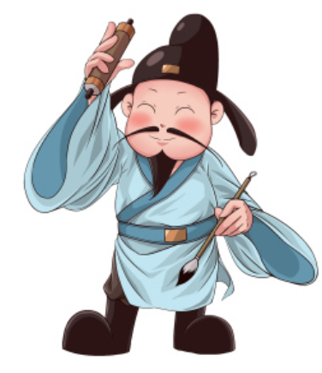
Li Bai, also known as Li Taibai, was a great Chinese romantic poet of the Tang Dynasty. He was born in 701 AD in the Tang Dynasty. Li Bai was a free-spirited and outgoing person 1__________ loved to drink and make friends. He was a man of great talent and 2__________(create) and his work is characterized by its 3__________(bold), imagination and passion.
Li Bai was once 4__________(favor) by Emperor Xuan Zong of Tang and served as 5__________ scholar in the Imperial Academy. However, he was eventually exiled from the court due to his outspokenness. He then traveled throughout China 6__________(meet) with other poets and scholars. Li Bai‘s most famous poems such as Viewing the Waterfalls at Mount Lu, the Difficulties of Travel, Bring in the Wine and Departing Early from Baidi Town 7__________(consider) to be among the 8__________(great) in Chinese literature. Li Bai is often referred to 9__________the poet immortal and 10__________（pair） with Du Fu, the Poet Sage, as Li Du.
who
creativity
boldness,
Blank-filling
favored
a
meeting
are considered
greatest
as
is paired

Slide 5
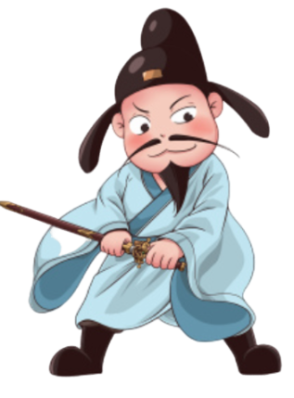
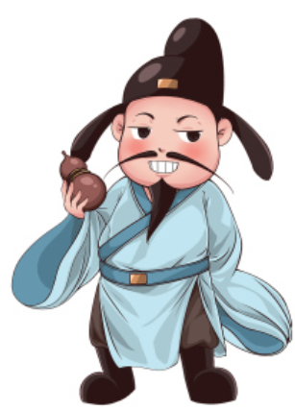
Words and expressions
free-spirited | / ˌfriː ˈspɪrɪtɪd / | adj.无拘无束的;自由奔放的
characterize | / ˈkærəktəraɪz / | v.描述，刻画；成为…的特征，是…的典型
boldness | / ˈbəʊldnəs / | n.大胆；冒失；显著
exile | / ˈeksaɪl / | v.流放；使离开
outspokenness | / aʊtˈspəʊkənnəs / | n.坦白；直言相告
immortal | / ɪˈmɔːt(ə)l / | n.追随者，门徒

Slide 6
Words and expressions
Be favored by | 受到青睐：被人们喜爱、支持或赞同。
the Imperial Academy | 翰林院
Be referred to as | 被称为
be paired with | 与……搭配：指两种或多种物品、人或概念之间的组合或配对。

Slide 7
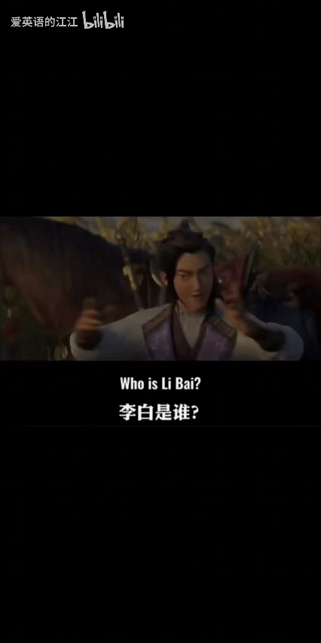
Li Bai, also known as Li Taibai, was a great Chinese romantic poet of the Tang Dynasty. He was born in 701 AD in the Tang Dynasty. Li Bai was a free-spirited and outgoing person who loved to drink and make friends. He was a man of great talent and creativity and his work is characterized by its boldness, imagination and passion.
Li Bai was once favored by Emperor Xuan Zong of Tang and served as a scholar in the Imperial Academy. However, he was eventually exiled from the court due to his outspokenness. He then traveled throughout China meeting with other poets and scholars. Li Bai's most famous poems such as Viewing the Waterfalls at Mount Lu, the Difficulties of Travel, Bring in the Wine and Departing Early from Baidi Town are considered to be among the greatest in Chinese literature. Li Bai is often referred to as the poet immortal and is paired with Du Fu, the Poet Sage, as Li Du.
Passage reading

Slide 8
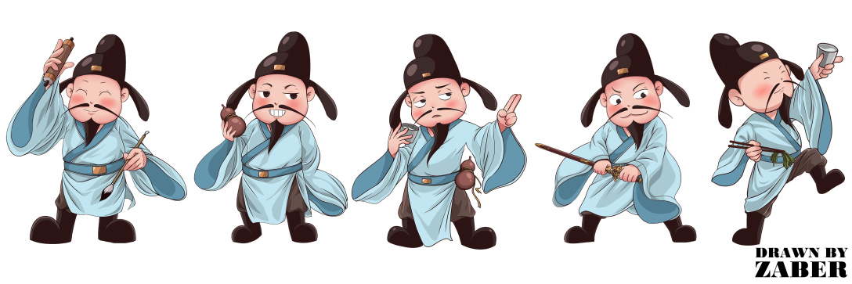
Before my bed a pool of light —
Can it be hoar-frost on the ground?
Looking up, I find the moon bright;
Bowing, in homesickness I’m drowned.

