Slide 1

感恩遇见，相互成就，本课件资料仅供您个人参考、教学使用，严禁自行在网络传播，违者依知识产权法追究法律责任。
更多教学资源请关注
公众号：溯恩高中英语
知识产权声明

Slide 2

How to write an argumentative essay
选择性必修二 unit 2 using language 2
江西省于都中学 杨晨芳

Slide 3

Learning Objectives
By the end of the class, students will:
be able to find out the “OREO” structure of an argumentative letter and apply it to write an argumentative essay.
be able to use connectors as well as sentence patterns to make argumentative letter in a logical order.
be able to develop critical thinking about the thing around them.
be able to cooperate with other students to work out a problem.

Slide 4


Recently, An internet influencer who chooses to study abroad share his daily routine on social media platform. What do you think of studying abroad?

Slide 5


Opinion from students
opinion | Yes | No
gain a good education
come across “cultural shock”
see a bigger world
suffer from homesickness
Improve language skill
have great economic pressure

Slide 6
01
Read for General Information

Slide 7
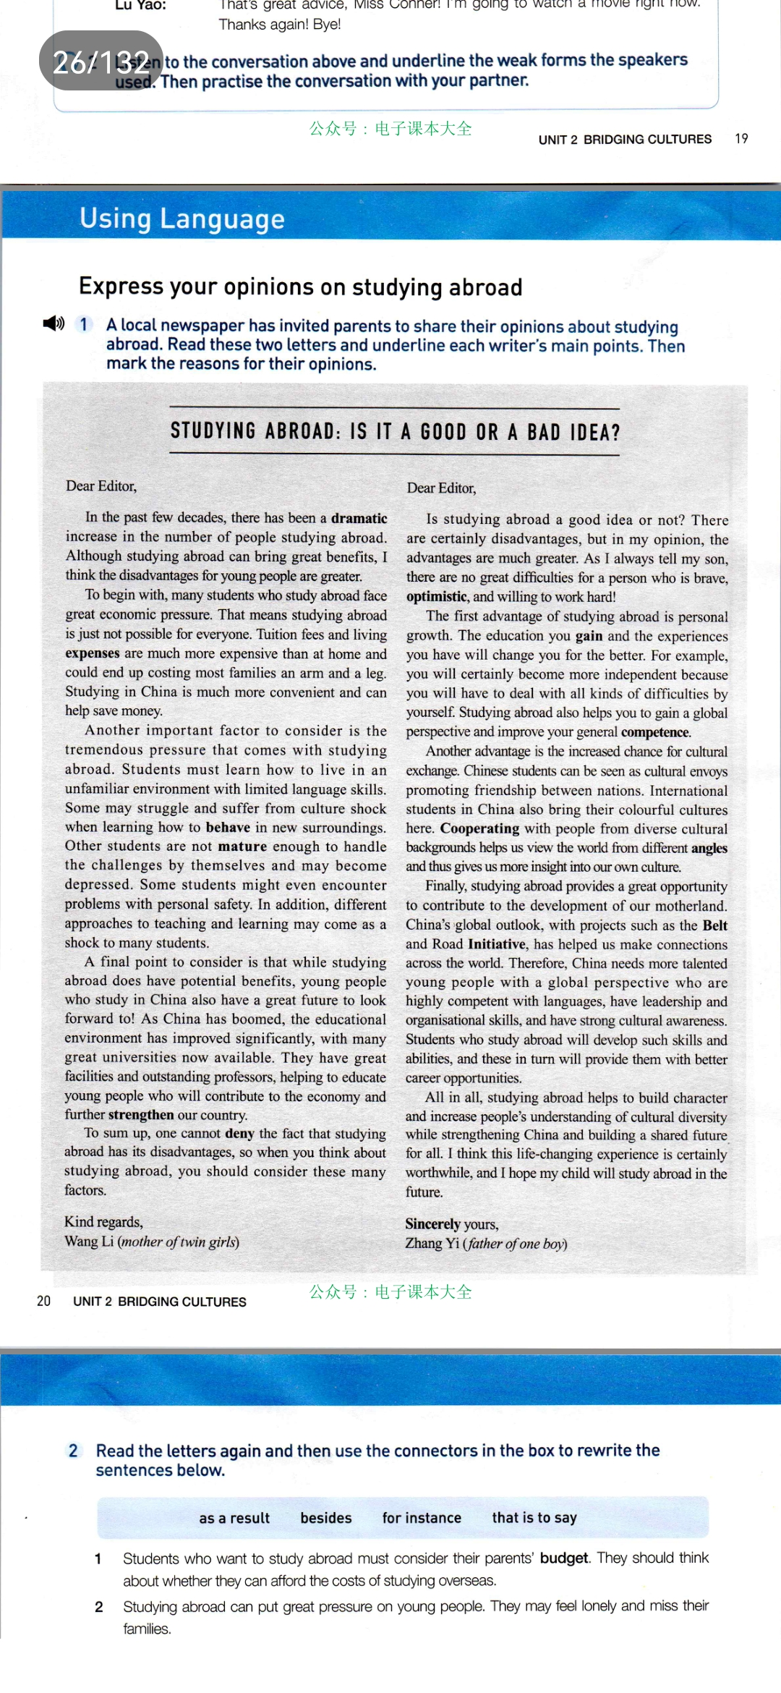
Read for text type
Skim the title quickly and the passage quickly
1. What is the genre（题材） of the passage?
Argumentative letter

Slide 8
Read for structure
2. What is the general structure of the passage?
Introduction
body
General-Specific-General
Conclusion

Slide 9
02
Read for More Details

Slide 10

Jigsaw Reading
(拼图阅读)
Group A：
Read the first letter and finish task 1-4
Group B：
Read the second letter and finish task 1-4.

Slide 11

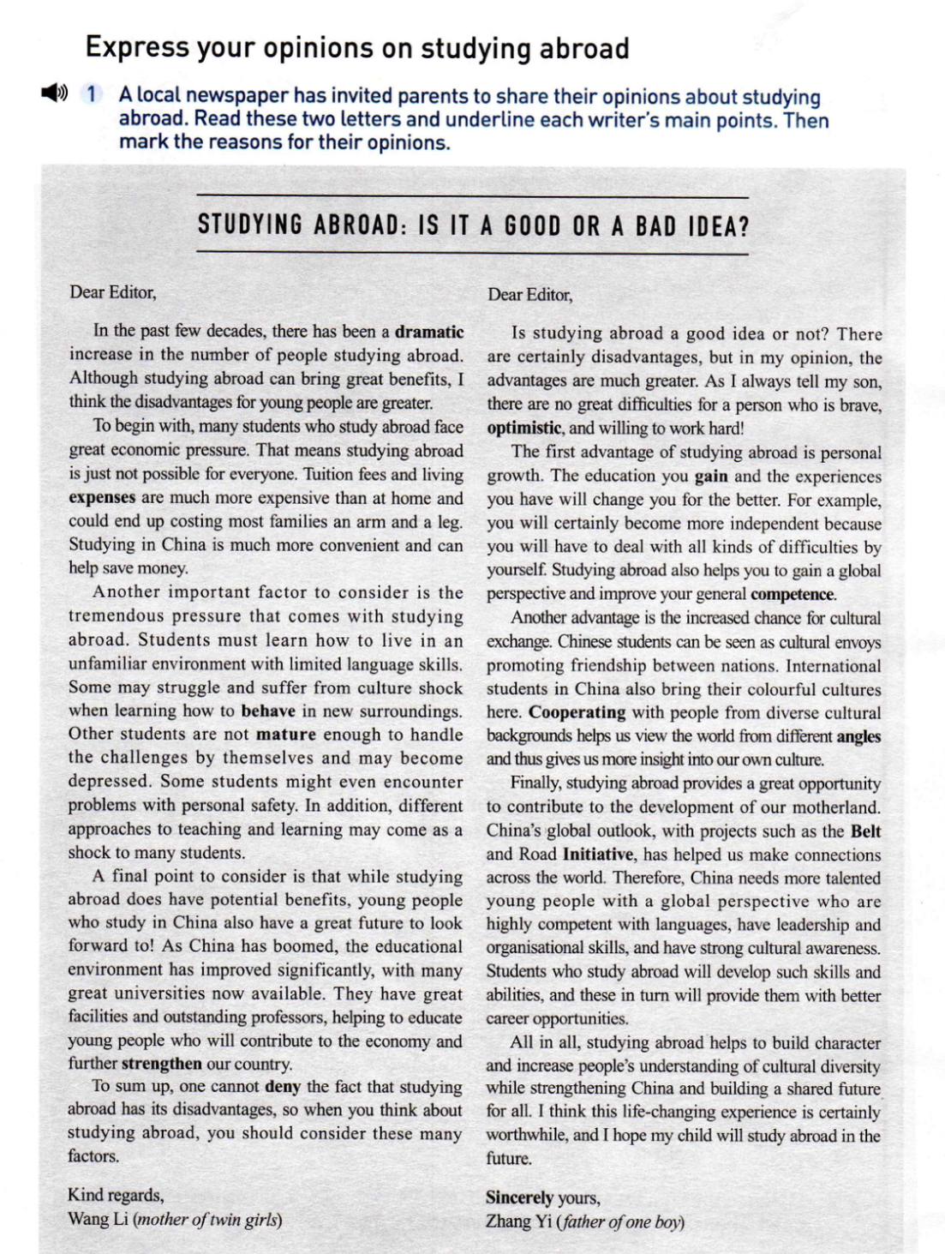
Read for Opinions
Read para. 1 carefully and answer the following question.
What are the writers’ opinions?
How does the writers introduce their opinions?
great & sudden
fact
question
opinion
opinion

Slide 12

Read for Reasons
Read para. 2 to para. 4 and try to find out the reasons.
 | Letter A | Letter B
Para. 2 reason
Para. 3 reason
Para. 4 reason
To begin with, many students who study abroad face great economic pressure.
The first advantage of studying abroad is personal growth.
Another advantage is the increased chance for cultural exchange.
the tremendous pressure that comes with study abroad
Young people who study in China also have a great future to look forward to
contribute to the development of motherland

Slide 13

Read for explanations
How does the writers explain the reasons?
by listing examples
by showing evidence
so expensive that sb can’t afford
Studying in China
by making comparison

Slide 14
Read for explanations
How does the writer explain the reasons?
by listing examples
students
Chinese students
International
some
students
Other students
Some students
In addition

Slide 15
Read for explanations
How does the writer explain the reasons?
by listing an example
by showing evidence

Slide 16
Read for Opinions
Read para. 5 carefully and answer the following questions.
What are the final opinions of the two writers?
What is the function of this paragraph?
opinion
opinion
To make a summary of the opinion

Slide 17
Summary
How to write an argumentative letter
Opinion
a fact/a question
opinion
Reason
Reason 1
Reason 2
Reason 3
Explanation
Explanation
1
Explanation
2
Explanation
3
Opinion
restate opinion

Slide 18
03
Read for Language Features

Slide 19
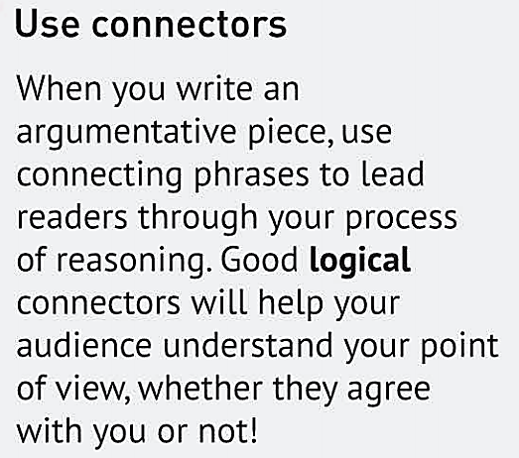
THINKING
What is the key to write a logical argumentative essay?

Slide 20
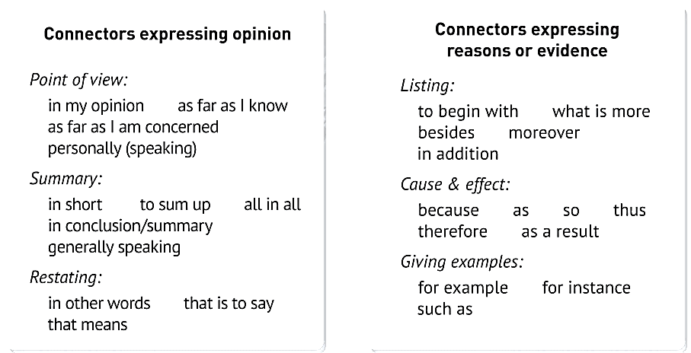
 | Letter A | Letter B
State an opinion
Give reasons and evidence to support an opinion
State a conclusion
I think
in my opinion
To begin with
In addition
as
For example
Finally
Therefore
to sum up
all in all

Slide 21
Sentence pattern
Read the letters again, find out the sentence pattern that we can use to express opinions and views
Another important factor to consider is tremendous pressure
系表
结构
The first advantage of studying abroad is personal growth
Another advantage is the increased chance for cultural exchange
表语
从句
A final point to consider is that while studying abroad does have potential benefits, young people…
同位语
从句
One cannot deny the fact that studying abroad has its advantage…
Ving作
主语
Studying abroad provides a great opportunity
Studying abroad helps to build character and increase people’s….

Slide 22
04
Writing Task

Slide 23

Recently, school require students to wear school uniform, which causes a hot discussion. What about your opinion? It is a good or bad idea to wear school uniform in school?

Slide 24
Writing tips
Opinion
In my opinion/as far as I’m concerned/ personally speaking
To begin with/in addition/what’s more/
Reason
A final point /an important factor to consider is that…
The first/second advantage of studying abroad is…
Studying abroad provides a great opportunity…
For example/for instance
Explanation
in addition/what’s more/therefore
Opinion
To sum up/In short/in conclusion
One cannot deny the fact that…

Slide 25
Use the checklist to help you improve your letter.
Items |  | Grade (ABC) | Improve
Structure | Do you use the “OREO” structure?
 | Is your main idea clear?
 | Is the body part logical and convincing?
 | Is your conclusion clear?
Language | Do you use any connectors?
 | Do you use the sentence patterns?
Grammar | Are there any grammatical errors?

Slide 26
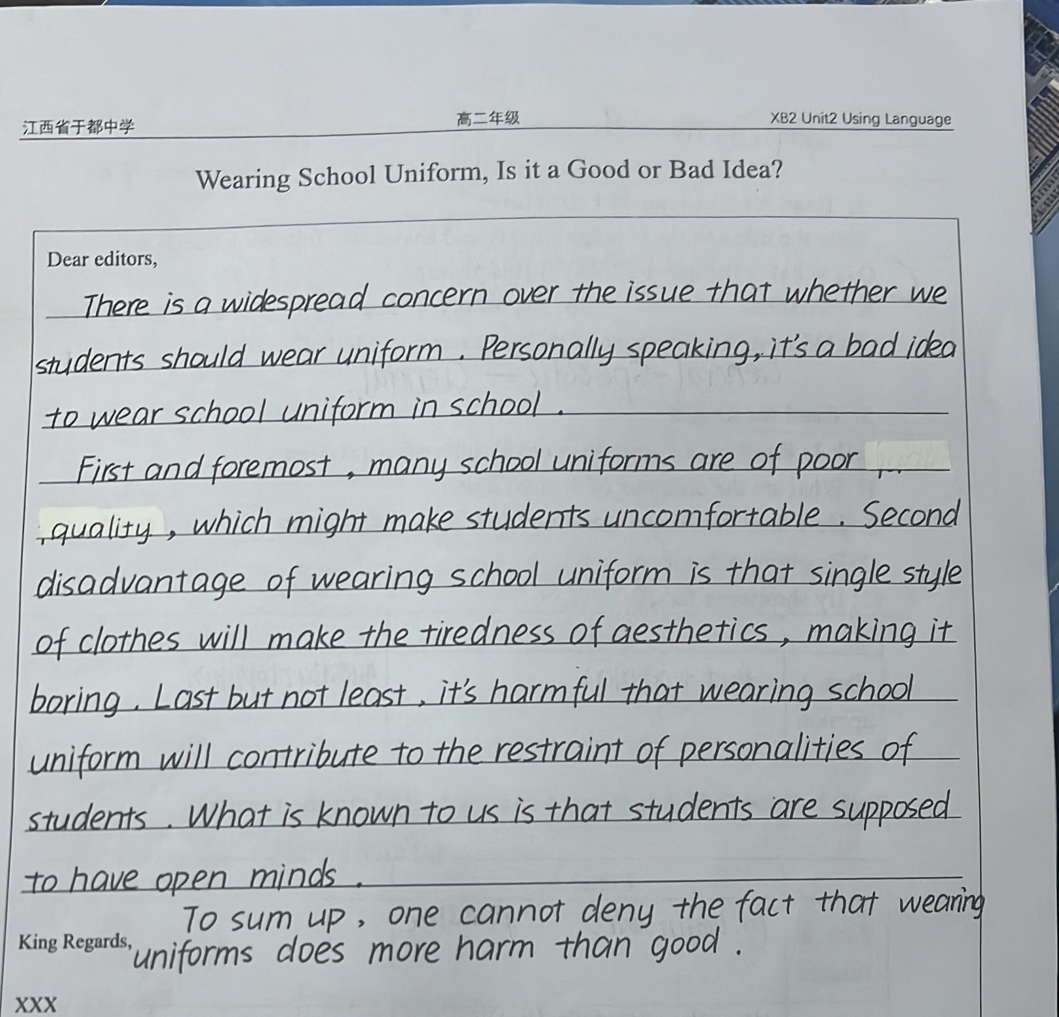
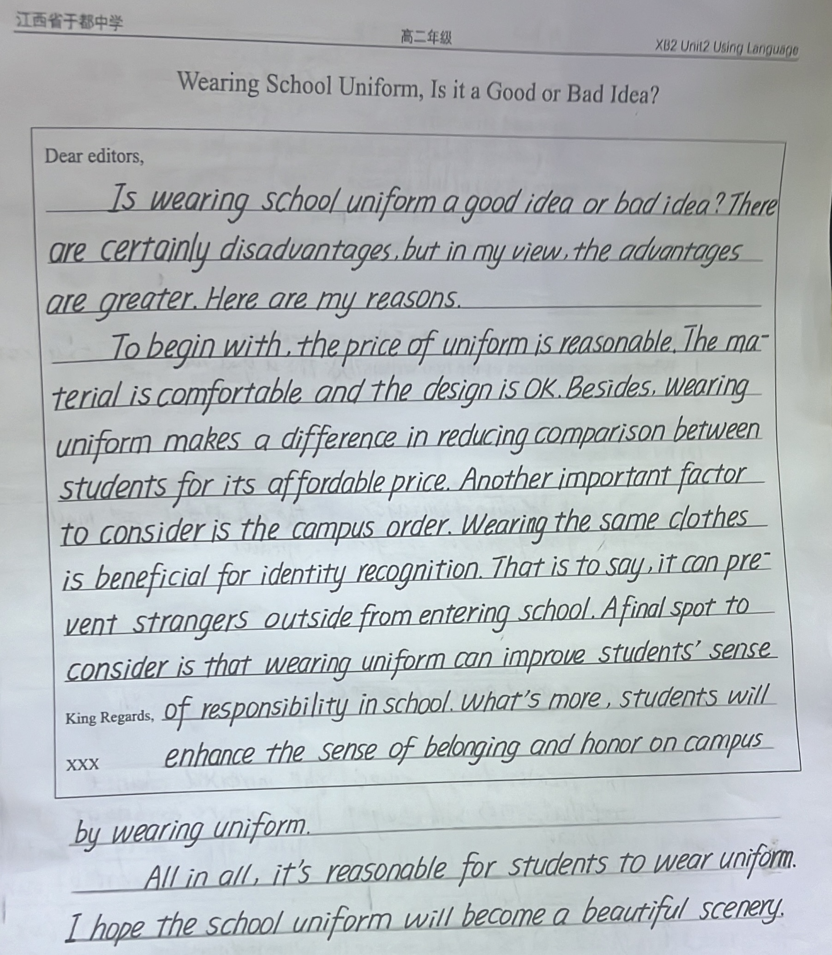
SHOW TIME

Slide 27
Sample
Should all students be required to wear a uniform? As far as I’m concerned, school uniform are the better choice.
To begin with, wearing school uniform would help make students’ lives simpler. Uniforms would not only save time but also would reduce the stress that often associated with this chore. Another important factor to consider is that school uniform influences students to act responsibly in groups and as individuals. For instance, Uniform gives students the message that school is a special place for learning. In addition, uniform creates a feeling of unity among students. A final point to consider is that wearing uniform would help make all the students feel equal. Some students are well-off while others are not. Therefore, wearing uniform would raise the self-esteem of students who cannot afford to wear expensive clothing.
In conclusion, one cannot deny the fact that students learn better and act more responsibly when they wear uniform. Public schools should require uniform in order to benefit both the students and society as a whole.

Slide 28

THINKING
Besides the opinions of the passage, what else did you learn from this class?

Slide 29
THANKS!

