Slide 1


感恩遇见，相互成就，本课件资料仅供您个人参考、教学使用，严禁自行在网络传播，违者依知识产权法追究法律责任。
更多教学资源请关注
公众号：溯恩高中英语
知识产权声明

Slide 2
活用教材，靶向高考
B5U2 Bridging Culture
福州闽侯八中 郭文昇

Slide 3
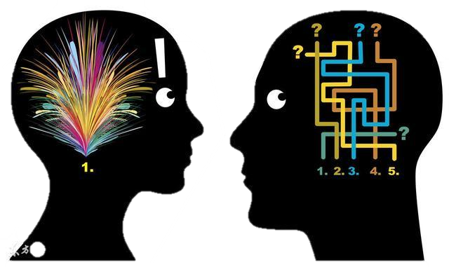
1. complex /ˈkɒmpleks a.复杂的;难懂的;复合的
这些小型研究提供了灵感，可能是未来更复杂工作的跳板。(2023全国卷Ⅱ)
These small studies provide inspiration and may be a springboard for more complex works in the future.
这部电影的情节太复杂了，我看不懂。（续写）
The film's plot was so complex that I couldn't follow it.
我很难清理如此复杂的问题。（续写）
I find it hard to get my mind round such complex issues

Slide 4

1. complex /ˈkɒmpleks a.复杂的;难懂的;复合的
complex侧重内在关系的复杂，需通过仔细研究与了解才能掌握和运用，英文释义为Something that is complex has many different parts, and is therefore often difficult to understand。
例如：...in-depth coverage of today's complex issues.
…对当今复杂问题的深入报道。
complicated与complex的含义接近，但语气更强，着重极其复杂，很难分析、分辨或解释，英文释义为If you say that something is complicated, you mean it has so many parts or aspects that it is difficult to understand or deal with。
例如：The instructions look very complicated.
这说明书看起来很难懂。
语义场
助力
词汇学习

Slide 5

2. recall /rɪˈkɔ:l vt.&vi.记起;回想起
孩子们回忆道，在家时，他羡慕剪草工的清静。（续写）
At home, his children recall, he prized the solitude of his lawnmower.
这位老人回忆起战前这座城市的样子。（续写）
The old man recalled the city as it had been before the war.
当他遇到生动的描述，他回忆起在乡村度过的快乐时光。（续写）
When he came across the vivid description, he recalled those happy days spent in the countryside.

Slide 6
3. qualification /ˌkwɒlɪfɪˈkeɪʃn n.(学习课程)资格;学历
我确信就资历、能力和经验而言，你是做这份工作最合适的人选。（应用文）
I feel sure that in terms of qualification, ability and experience, I are suited to the position you have in mind.
qualify /ˈkwɒlɪfaɪ v.(使)具备资格;(使)合格
本培训课程将使你能胜任更好的工作。（应用文之宣传稿）
This training course will qualify you for a better job.
qualified adj. 合格的
我相信我能胜任这份志愿者工作。（应用文）
I do believe that I am very qualified for this voluntary work.

Slide 7

4. ambition /æmˈbɪʃn / n.追求的目标;夙愿;野心
她的雄心和顽强的决心确保了她登上职业生涯的巅峰。（续写）
Her ambition and dogged determination ensured that she rose to the top of her profession.
为此，在本文中，我们确定了该领域工作背后的主要研究动机和抱负。
To this end, in this article, we identify the main research motivations and ambitions behind work in the field.

Slide 8

5. ambitious /æmˈbɪʃəs a.有野心的;有雄心的
即使作为一个年轻人，他也雄心勃勃且自信。（续写）
Even as a young man he was ambitious and self-assured.
随着一切变好，我已经变得更有动力,更有抱负。（续写）
With everything changing for the better, I have become more motivated and a lot more ambitious.

Slide 9

6. adaptation /ˌædæpˈteɪʃn / n.适应;改编本
这些改编的目的是让年轻读者更容易读懂经典。（应用文）
The intention of these adaptations is to make the classics more accessible to young readers. （外研选修二）
adapt to 使适应
埃塞俄比亚高地上的人们已经适应了高海拔地区的生活。（2020全国卷Ⅲ）
People in Ethiopian highlands have adapted to living at high altitudes.
adapt…from根据…改编
电影《博物馆奇妙夜》改编自米兰•崔克的小说,生动地再现了恐龙在地球上漫步的世界。
Adapted from Milan Trenc's novel, the film Night at the Museum brings to life a world where dinosaurs wander the earth.

Slide 10

7. comfort /ˈkʌmfət/ n.安慰;舒服 vt.安慰;抚慰
微风轻抚着他的头，仿佛在安慰他所有的疲惫。（续写）
The gentle breeze stroked his head as if comforting all his tiredness.
她以丈夫过几天就会回来的想法来安慰自己。（续写）
She comforted herself with the view that her husband would come back in a few days.
当我沮丧时，父亲总是拍拍我的肩膀安慰我。（续写）
When I was depressed, my father would pat me on the shoulder to comfort me.

Slide 11
7. 安慰与鼓励的多样表达
1).表安慰与鼓励相关短语:
pat sb. on the shoulder拍某人的肩膀
hold/take sb. in one’s arms 拥在怀里
throw one’s arms around sb tightly without hesitation毫不犹豫地紧紧拥抱某人
cast comforting glance at sb安慰地瞥某人一眼
语义场
助力
词汇学习

Slide 12
7. 安慰与鼓励的多样表达
2). 通过肢体动作表达安慰与鼓励
1.He stroked her fingers through my hair,and said,”things are going to be fine.”
他用手指抚摸着我的头发并且说一切都会好起来的
2.After hearing the reason,his mom gently combed her fingers through his hair, saying,”To me,your letter is better than a thousand shopping sprees(购物券).”
听到原因后,他的妈妈轻轻地用手指梳理他的头发,她说,“对我来说,你的信胜过千张购物券。”
3. “Thank you,my dear!” She sniffled, hugging Jim more tightly.Leaning against his mother’s shoulder,Jim slowly explained why he chose to write a letter as a gift.
“谢谢你,亲爱的!”她抽泣着,紧紧拥抱着吉姆。靠在母亲的肩膀上,姆慢慢地解释了为什么他选择写信作为礼物.

Slide 13
7. 安慰与鼓励的多样表达
3).通过间接表达的方式表达安慰与鼓励
1.He reached out his hand,with his thumb and index finger forming a “heart”, saying “I will always be there with you.”他伸出手,用拇指和食指形成了一颗心,说,“我会一直陪在你身边。”
2.She swept her son into her arms with her eyes wet. 她眼睛湿润,把儿子拥进怀里。
4).通过习语表达安慰与鼓励
1.Life is not all roses. 人生并不是康庄大道
2.All things come to those who wait. 苍天不负有心人
3.Cease to struggle and you cease to live. 生命不止,奋斗不息
4.Nothing is impossible for a willing heart. 心之所愿,无所不成
5.We must accept finite disappointment, but we must never lose infinite hope.
我们必须接受失望,因为它是有限的,但千万不可失去希望,因为它是无限的
6.It takes a lot of hard work to be amazing. 要得惊人艺，须下苦功夫。
7.Only those who constantly seek opportunities will seize them in time.
只有不断找寻机会的人才会及时把握机会

Slide 14
7. 安慰与鼓励的多样表达
5).通过面部表情来表达安慰与鼓励
1.The woman was staring tenderly at the girl, wiping out tears from her cheeks.
那个女子温柔地盯着那个女孩，擦去女孩脸颊上的泪水
2.She didn’t say a word, but smiled a watery smile and held my hand tightly.
她一句话也没说，但是他淡然一笑并且紧紧握住我的手
3.My beloved mom, wearing a shining smile on her scarlet face, encourages me always from the early age.
鲜红的脸上带着灿烂的微笑,我亲爱的妈妈从小就鼓励我。
4.He rested her cheek on her shoulder.
他把她的脸颊靠在她的肩上
语义场
助力
词汇学习

Slide 15
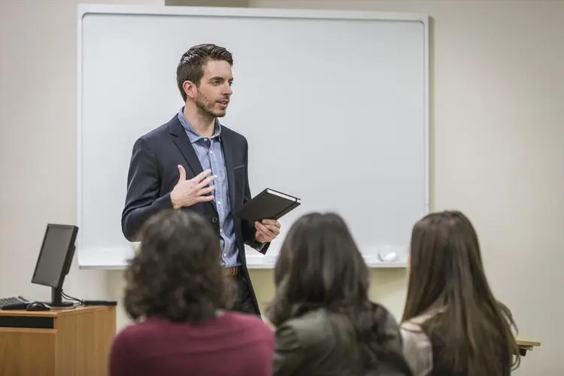
8. tutor /ˈtju:tə(r)/ n.(英国大学)助教;导师
他的父母请了一位私人教师来辅导他的数学。（续写）
His parents got him a tutor to help with his maths.
生病期间有一系列的家庭教师给我辅导。（续写）
During my illness, I was taught by a series of home tutors.

Slide 16
9. cite /saɪt / vt. 引用;引述
可以引用更多基于这两个概念隐喻的语言表达。
Many more linguistic expressions could be cited which are grounded in these same two conceptual metaphors.
他因为勇敢而受到嘉奖。（续写）
He was cited for bravery.

Slide 17
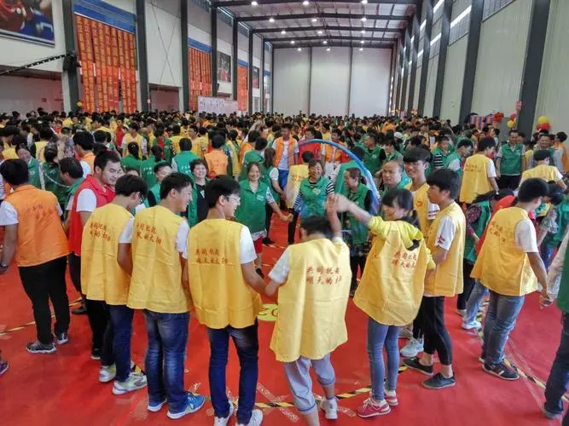
10. participation /pɑ:ˌtɪsɪˈpeɪʃn n.参加;参与
期待你的积极参与。（应用文之邀请）
Looking forward to your active participation.
participate /pɑ:ˈtɪsɪpeɪt vi.参加;参与
participate in /pɑ:ˈtɪsɪpeɪt ɪn 参加;参与
为了鼓励学生积极参加体育运动，我们学校上周六下午在学校体育馆举办了一场篮球比赛。（应用文）
In order to encourage students to actively participate in sports, our school held a basketball game in the school gym last Saturday afternoon.
希望你能参加比赛,因为你的参与一定能帮助我们获得冠军。(应用文之邀请信)
Hopefully, you can participate in the game, as your participation can surely help us win the championship.

Slide 18

11. presentation /ˌpreznˈteɪʃn/ n.报告;陈述;出示;拿出
这次的演讲是班上所有孩子共同努力的成功。（续写）
The presentation was a collaborative effort by all the children in the class.
演示文稿将演讲者的信息传达给观众。
A presentation conveys information from a speaker to an audience.
赞扬和支持如雨点般落在我的演讲上。
Praise and support snowed down upon my presentation. （续写）
该项目要求每个团队提出一个假设，建立一个实验来验证假设，进行统计分析并展示结果。(2022年1月浙江首考)
The project required each team to develop a hypothesis, set up an experiment to test the hypothesis, do the statistical analysis and present the findings. （续写）

Slide 19

12. speak up /spi:k ʌp / 大声点说;明确表态
我们将为我们的权利大声疾呼，希望通过我们的声音带来改变。（续写）
We will speak up for our rights and hope to bring change through our voices.
如果你认为那不公平，为什么不说出来呢？（续写）
If you thought that wasn’t fair, why didn’t you speak up?

Slide 20

13. feel at home /fi:l ət həʊm / 舒服自在;不拘束
再次全面检查一下每张PPT的动画
到一周快结束时，她开始适应新工作了。（续写）
By the end of the week, she was beginning to feel at home in her new job.
但正是在这里，在希尔克雷斯特医院，他感到宾至如归。（续写）
But it is here, at this Hillcrest hospital, where he feels at home.
通过你的努力和他人的帮助,我相信一切会变得更好,最终你会觉得舒适自在。（续写）
With your efforts and others’ help, I’m certain everything will change for the better and you will end up feeling at home.

Slide 21
14. engage /ɪnˈgeɪdʒ v参加;参与 vt.吸引注意力
engage in /ɪnˈgeɪdʒ ɪn (使)从事;参与
双胞胎和他们的父亲在厨房为母亲做早餐。(2021新高考Ⅰ卷读后续写)
The kitchen witnessed the twins and the father engage themselves in making breakfast for their mother.
这种新的学习方法能够吸引学生的兴趣，提高学习效率。（应用文）
This new approach to learning manages to engage students’ interest and enhance learning efficiency.
从事探索灿烂的中国文化给了他一个充当文化使者的机会。（应用文）
Engaging in exploring splendid Chinese culture gives him a chance to act as a cultural messenger.
他爸爸请了一位家庭教师给她补习数学。
Her father engaged a tutor to improve her maths.

Slide 22
14. engage /ɪnˈgeɪdʒ v参加;参与 vt.吸引注意力
engaged adj. 忙于
be engaged/ busy/ occupied in doing sth
虽然你忙于学习，但你应该留出一些时间参加户外活动。（续写）
Although engaged in your study, you should set aside some time to engage in outdoor activities.
我完全投入学习中，很少关注母亲的感受。
I was totally engaged in my study and seldom paid attention to my mother’s feelings.
engagement n.婚约，订婚；约会
他们突然解除了婚约。
They've broken off their engagement.

Slide 23

15. involve /ɪnˈvɒlv/ vt.包含;需要;涉及;影响
We all need to get involved in saving energy whether it's at work, at home, or at school. 我们都需要参与到节约能源中来，无论是在工作中，在家里还是在学校。(2021·天津卷3月)
get （actively /deeply/ totally） involved in 参与;卷入;与…有关联
All the teachers and students got actively involved in the cross­-country running race. 所有的老师和学生都积极参加了越野跑比赛。（应用文之报道）

Slide 24

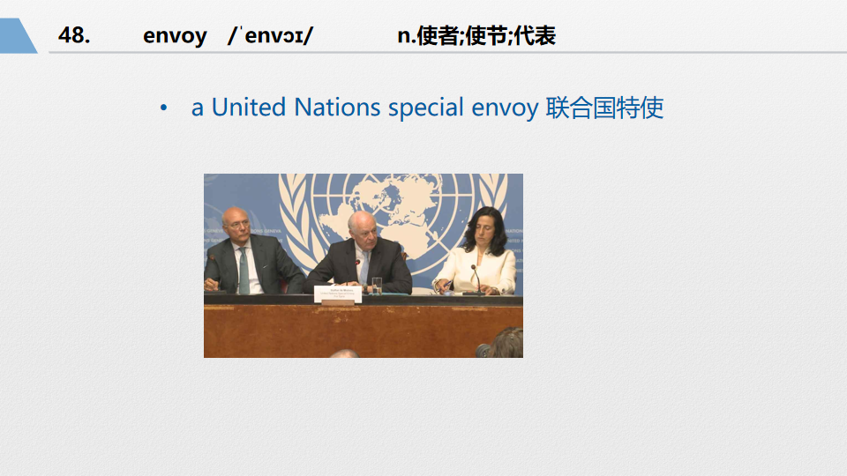
16. messenger /ˈmesɪndʒə(r)/ n.送信人;信使
信使弯身挠膝盖上被带子擦痛的地方。（续写）
The messenger bent and scratched at his knee where the strapping chafed.
他通过邮递员发出订单。（续写）
He sent the order by messenger.
两张可以放在一起

Slide 25

17. edition /ɪˈdɪʃn / n.(报纸)一份;(广播)一期
她收集了19世纪作家的第一版。
She collected first editions of 19th -century authors.
古代作品的译本和版本是随机拼凑在一起的。
Translations and editions of ancient works are randomly thrown together.

Slide 26

18. culture shock /ˈkʌltʃə(r) ʃɒk / 文化冲击
但当我们走过那个画廊时，挂在那里的照片带来了文化冲击。（续写）
But then we walk through that gallery, and the pictures hanging there are a culture shock.

Slide 27
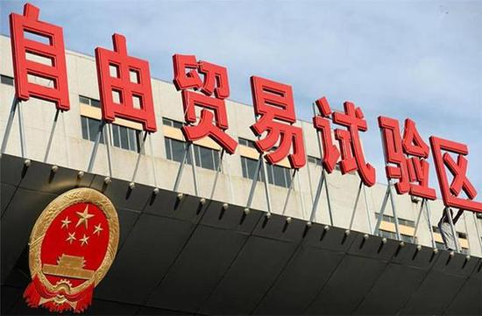
19. zone /zəʊn n.(有别于周围)地区;地带
新条约设立了自由贸易区。
The new treaty establishes a free trade zone.
comfort zone /ˈkʌmfət zəʊn 舒适区;舒适范围
他们有能力走出自己的舒适区，以完全不同的方式行事。（续写）
They have the ability to venture outside of their comfort zone and act as someone completely different.

Slide 28
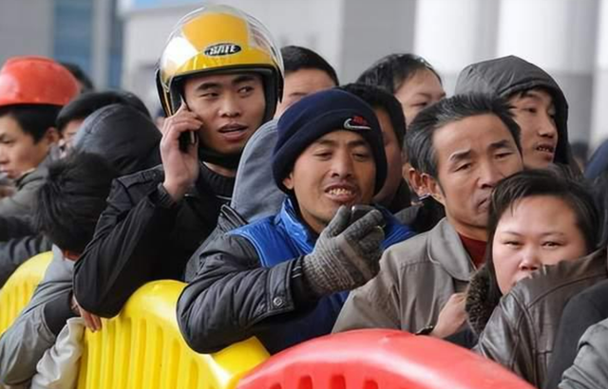
20. overwhelming /ˌəʊvəˈwelmɪŋ/ a.无法抗拒的;巨大的
the overwhelming majority 绝大多数
可能有个别案例是出于不同的考虑，但绝大多数都是关于信任的。
There may have been individual cases that arose out of different concerns, but the overwhelming majority were about trust.
绝大多数与会者都赞同这个计划。（续写）
The overwhelming majority of those present were in favour of the plan.
她赢得比赛时感到一种压倒性的喜悦。（续写）
She felt an overwhelming sense of joy when she won the competition.
突然收到好消息时，所感受到的无比喜悦，犹如在阴郁的日子里突然出现了一道阳光，顿时让你精神焕发。（续写）
The overwhelming delight of unexpectedly receiving good news is like a burst of sunshine on a gloomy day, instantly brightening your spirits.

Slide 29

21. homesickness /'həʊmsɪknəs / n.思乡病;乡愁
思乡之情快让我受不了了。（续写）
I was almost overcome with homesickness.
许多移民现在回国了，他们是被机会吸引，而不是想家。（应用文）
Many of the emigrants are now returning, drawn by opportunity, not homesickness.
他因怀念故土而返乡。（续写）
He returned to his native land of homesickness.

Slide 30

22. motivate /ˈməʊtɪveɪt / vr.成为…的动机;激发
她非常擅长激励她的学生。（续写）
She's very good at motivating her students.
你应该重新评估你的目标，并激励自己设定一个新的目标。(2019全国Ⅱ)
You should reassess your goals, and motivate yourself to set a fresh goal.
这个计划旨在促使员工更加卓有成效地工作。
The plan is designed to motivate employees to work more efficiently.
motivated /'məʊtɪveɪtɪd a.积极的;主动的
我们的员工工作勤奋，积极性高。
Our staff members are hard-working and highly motivated.

Slide 31
22. motivate /ˈməʊtɪveɪt / vr.成为…的动机;激发
motivation /ˌməʊtɪ'veɪʃn n.动力;积极性;动机
动机和目标设定是同一枚硬币的两面。(2019全国Ⅱ)
Motivation and goal setting are the two sides of same coin.
他很聪明，但缺乏积极性。
He's intelligent enough but he lacks motivation.
有了父母的激励，我们对于人们改变的能力很乐观。
Given parental motivation, we are optimistic about the ability of people to change.

Slide 32

23. advisor /əd'vaɪzə / n.顾问
几年之内，他成为最受欢迎的老师之一，也是最受欢迎的论文导师之一。（续写）
Within a few years, he was one of the most popular teachers, and one of the most popular thesis advisors.
他极力保护自己的顾问角色。
He was extremely protective of his
role as advisor.

Slide 33

24. reasonable /ˈri:znəbl / a.有道理的;合情理的
如果你把发生的事情说给他听，我相信他一定会理解的——他是个通情达理的人。
If you tell him what happened, I'm sure he'll understand - he's a reasonable man.
我们以公道的价格出售优质食品。
We sell good quality food at reasonable prices.

Slide 34

25. expectation /ˌekspekˈteɪʃn / n.期望;预期;期待
这对夫妇被接受为看护人的成功率很高，他们总是超出房主的期望。(2022新高考全国Ⅱ卷)
The couple has a high success rate in getting accepted as house sitters and they always go beyond the homeowner's expectations.
为了不辜负家长的希望，大多数孩子必须努力学习，甚至在假期也如此。（应用文）
In order to meet their parents' expectations, most of the kids have to study hard even over vacations.
我相信我的热情和投入一定不会辜负您的期望。(应用文之申请信)
I am convinced that my enthusiasm and devotion will come/live up to your expectations.
我完全没想到这段视频在数小时内获得了数千次点击和评论。(2021·浙江卷读后续写)
The video got thousands of clicks and reviews within hours, which was totally beyond my expectations.
expected adj.预料的，预期的
出乎意料的是，我和她面对面，她开始扯着嗓子尖叫。（2018全国卷Ⅲ续写）
Unexpectedly, I'm face-to-face with her, who begins screaming at the top of her lungs.

Slide 35

26. applicant /ˈæplɪkənt / n.申请人
面试为应聘者提供了一个了解工作和公司的机会，并发现这份工作是否适合他或她。（译林选修四）
An interview provides an opportunity for the applicant to learn more about the job and the company, and to discover whether this job is right for him or her.
apply for 申请
得知中国国画展览需要一名志愿者，我写信申请这个职位。（2019・全国卷Ӏ）
Learning that a volunteer is needed for an exhibition of traditional Chinese painting, I am writing to apply for the post.

Slide 36
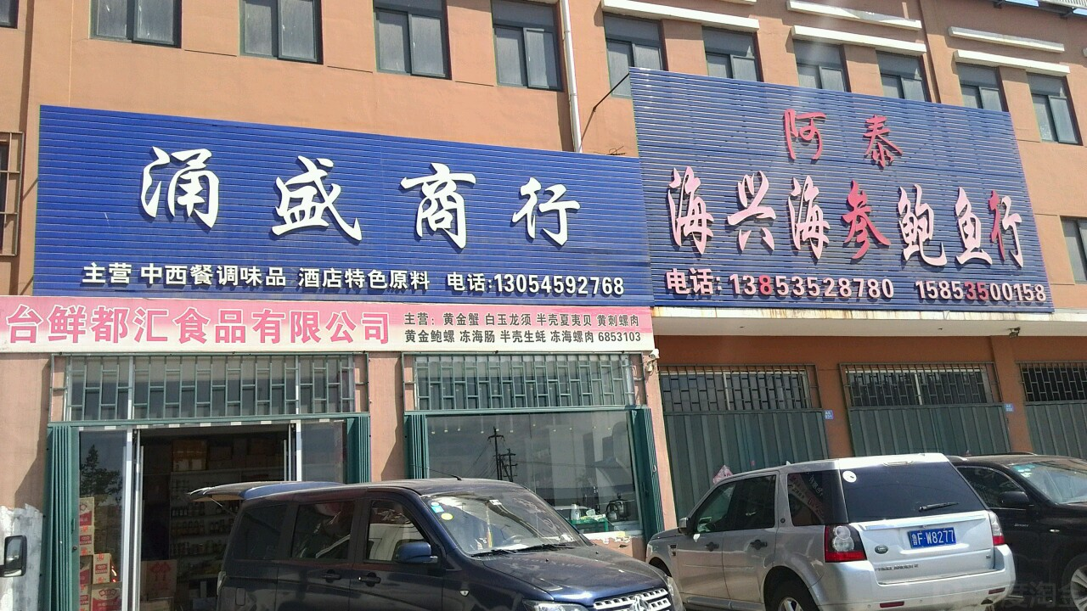
27. firm /fɜ:m / n.公司;商行 a.结实的
由于环境的不确定性，企业可能会破产。
Because of the uncertain environment, firms may go bankrupt.
我们有坚实的科学基础去解决这个问题。
We have a firm scientific foundation for approaching the problem.
我宁愿睡硬床，也不要软的。
I'd rather sleep on a firm mattress than a soft one.

Slide 37
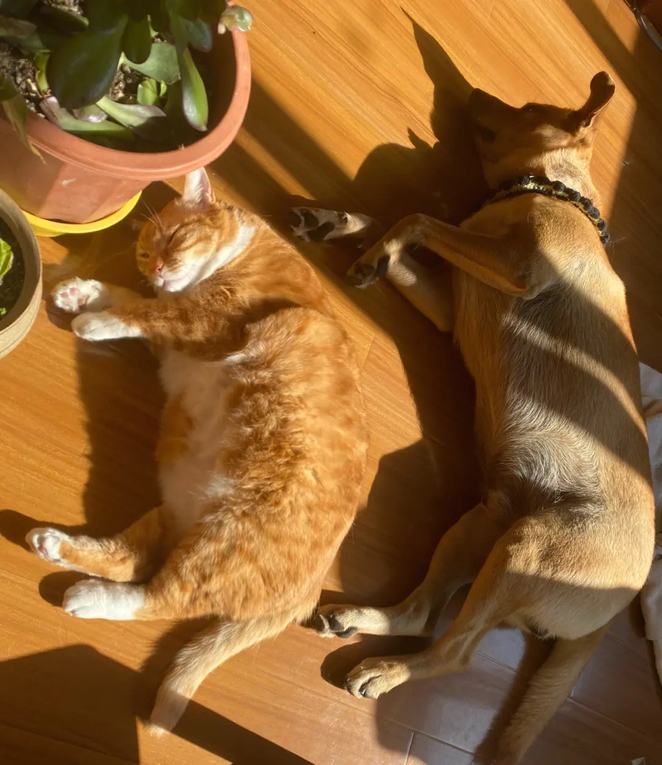
28. exposure /ɪkˈspəʊʒə(r)/ n.接触;体验;暴露;揭露
没有可信的证据表明皮肤癌与暴露在阳光下有关。
There is convincing evidence that skin cancer is linked to exposure to the sun.
expose /ɪk'spəʊz vt.使接触;使体验;显露
在中国，许多人接触英语的机会有限。这使得学习和练习它变得格外困难。(2021 •浙江6 月考)
Many people in China have limited exposure to English. That makes it extra hard to learn and practice it.
我从小接触国画,能让游客更加了解国画。(应用文之申请信)
Having been exposed to Chinese paintings since my childhood, I can get visitors to know more about them.
看到我们走近,她笑逐颜开,露出了漂亮的小白牙。(续写)
Seeing us approaching, she smiled joyfully, exposing nice little teeth.
据说接触古典音乐对提高青少年的品位是有帮助的。(应用文之活动类)
It is said that being exposed to classic music may be helpful in improving teenagers' taste.

Slide 38

29. insight /ˈɪnsaɪt / n.洞察力;眼光
這是一本有趣的书，充满了对人际关系独到的见解。
It was an interesting book, full of fascinating insights into human relationships.
受访者的回答让我们深入了解了教师认为最有价值的支持形式。
Responses from interviewees give some insight into the forms of support found most valuable by teachers.

Slide 39

30. departure /dɪˈpɑ:tʃə(r)/ n.离开;启程;出发
听说你要离开了，我写信是为了对你的慷慨帮助表示衷心的感谢。（2019年6月浙江省新高考应用文写作）
Hearing your departure, I’m writing to express my sincere gratitude for your generous help.
由于天气不好，我们的出发时间延后了。
Our departure was delayed because of bad weather.
他神不知、鬼不觉地离开了。（续写）
His departure passed unnoticed.

Slide 40

31. setting /ˈsetɪŋ/ n.环境;背景;小说情节背景
他们的房屋地处恬静宜人的乡村环境。（续写之环境描写）
Their house is in an idyllic country setting.
这部戏的背景是战争时期的战俘营。
The play has its setting in a wartime prison camp.

Slide 41


32. grasp /grɑ:sp vi.理解;领会;抓紧
罗西突然抓住了我的手。（续写之动作描写）
Rosie suddenly grasped my hand.
婴儿伸出一只小手，紧紧抓住我的手指。（续写之动作描写）
The baby stretched out a tiny hand and grasped my finger tightly.
我觉得我理解到演讲的要点。（应用文之申请）
I think I managed to grasp the main points of the lecture.
读后续写“抓”的花式表达？catch/ seize/ grasp/ grab
They had hardly seized me by the arm when the surging waves returned to carry all of us quite a few meters away.
他们刚一抓住我的胳膊，汹涌的海浪就卷土重来，把我们大家都带走了好几米远。

Slide 42
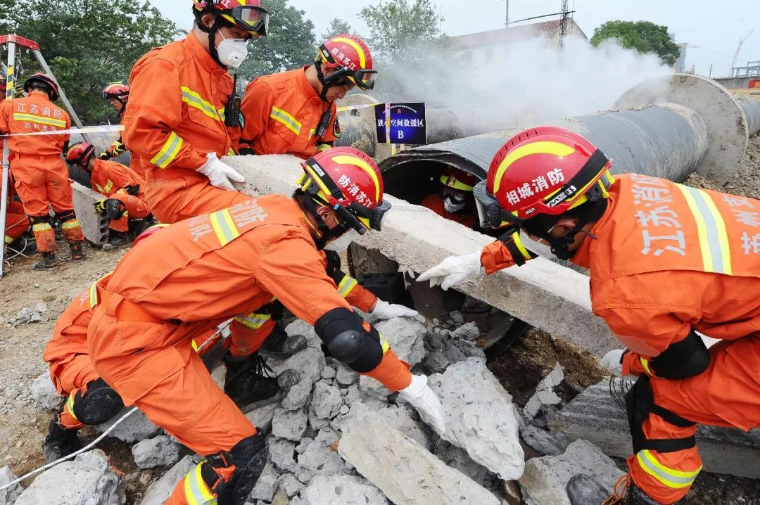
33. dramatic /drəˈmætɪk/ a.巨大的;突然的;急剧的
a dramatic change/improvement 戏剧性的变化／改善
进城务工的年轻人数量的增加对乡村的人口结构产生了巨大的影响。（应用文之人口迁移）
The increase in the number of young people leaving to work in the cities has had a dramatic impact on the demography of the villages.
他在比赛结束前半分钟攻入一球，为英格兰队取得了戏剧性的胜利。
He secured a dramatic victory for England by netting the ball half a minute before the end of the game.
我们在新闻中看到了惊心动魄的救援场面。
We watched scenes of the dramatic rescue on the news.

Slide 43

34. expense /ɪkˈspens/ n.费用;花费;开销
在我看来，你们最好给这次旅行的费用定一个限度。
In my opinion, you had better set a limit to the expense of the trip.
我们刚用了很多钱盖一座新车库。
We've just had a new garage built at great expense.

Slide 44

35. cost an arm and a leg /kɒst ən ɑ:m ənd ə leg/ (使)花一大笔钱
英文解释If you say that something costs an arm and a leg, you mean that it is very expensive.
我想周游欧洲，但是机票可能要花我一大笔钱。
I’d like to travel all over Europe, but the air fare might cost me an arm and a leg.

Slide 45
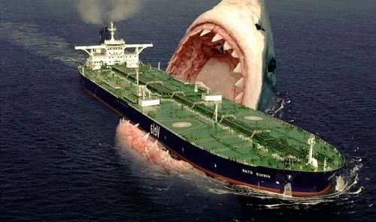
36. tremendous /trəˈmendəs a.巨大的;极大的
昨晚他们弄出的噪音震天响。（续写）
They were making a tremendous amount of noise last night.
过去的几个月了，她给我的帮助极大。（续写）
She's been a tremendous (= very great) help to me over the last few months.
你贏了？太棒了！（续写）
You won? That's tremendous!

Slide 46

37. behave /bɪˈheɪv vt.表现 vi.&vi.表现得体
我母亲要求我在容人们面前举止得体，我按照她说的做了。（续写）
My mother asked me to behave myself before the guests and I did as she said.
令他们非常吃惊的是,汤姆表现得像个孩子,而艾丽斯却很负责任。(续写)
To their great surprise, Tom behaved like a child while Alice behaved in a very responsible way.
behavior n.行为，举止
教师和监护人应该为小组树立良好的行为榜样，并始终与学生在一起。(2022 •新高考全国I卷)
Teachers and chaperones should model good behavior for the group and remain with students at all times.
所有参与者在博物馆都应注意自己的举止。(应用文之通知)
Every participant is expected to mind his behavior in the museum.

Slide 47

38. surroundings /səˈraʊndɪŋz / n.[pl.]环境;周围的事物
surrounding /səˈraʊndɪŋ / a.周围的;附近的
当你慢慢探索周围的环境时，你会开始挖掘线索，让你更好地理解这首诗。（译林选修一）
As you slowly explore your surroundings, you will start to dig up clues that give you a greater understanding of the poem.
（2020• 全国卷Ⅲ）当他看到河上升起的薄雾和山顶周围柔软的云时，他流下了眼泪。（续写）
When he saw the mists rising from the river and the soft clouds surrounding the mountain tops, he was reduced to tears.

Slide 48

39. mature /məˈtʃʊə(r)/ a.成熟的
从采访中 可以看出她是一个自信、成熟的学生。（续写）
The interview showed her as a self-assured and mature student.
我们能以成熟的方式讨论这个问题吗？
Can we discuss this in a mature manner?

Slide 49

40. depress /dɪˈpres vt.使沮丧;使忧愁
这种天气让我感到心情忧郁。（续写）
This weather depresses me.
想到十年后很可能还在做同样的工作，我就感到非常沮丧。（续写）
It depresses me to think that I'll probably still be doing exactly the same job in ten years' time.
depressed /dɪˈprest a.沮丧的;意志消沉的
昨天我们通电话时，他听起来很沮丧。（续写之情感）
He sounded very depressed when we spoke on the phone yesterday.

Slide 50

41. boom /bu:m/ vi.&n.迅速发展;繁荣
烟花的轰隆声打破了寂静的夜晚。（续写）
The stillness of night was broken by the boom of fireworks.
自去年以来，这个村子的农业就已经快速发展起来了。
Since last year, the agriculture in this village has been booming.

Slide 51

42. strengthen /ˈstreŋθn/ vi.&vt.加强;增强;巩固
定期锻炼可以增强心脏功能，从而降低心脏病发作的风险。（应用文）
Regular exercise strengthens the heart, hereby reducing the risk of heart attacks.
留学有助于加强你的跨文化交流能力。（应用文）
Studying abroad can help you strengthen your abilities in cross⁃cultural communication.

Slide 52

43. deny /dɪˈnaɪ/ vi.否认;否定;拒绝
他昨晚发表了一份简短声明，否认报纸的报道。（续写）
He issued a short statement last night denying the report from the newspaper.
在法庭上接受询问时，该男子否认拿了老太太的项链。（续写）
While being questioned on the court, the man denied taking the old lady's necklace.
令她失望的是，去年她被德克萨斯大学拒之门外。（续写）
To her disappointment, she was denied admission to the University of Texas last year.

Slide 53

44. optimistic /ˌɒptɪˈmɪstɪk/ a.乐观的
她对贏得金牌很乐观。
She is optimistic about her chances of winning a gold medal.
医生表示，她对手术结果持乐观态度，但在早期阶段拒绝做出任何承诺。
The doctor said she was optimistic about the outcome of the operation but forbore to make any promises at this early stage.

Slide 54

45. gain /geɪn/ vi.获得;赢得 n.好处;增加
通过这次活动，我们不仅获得了园艺知识，而且对大自然有了更好的了解。（应用文）
Not only did we gain knowledge of gardening but we also had a better understanding of nature from this activity.
如果我们到国外旅行，我们可以拓宽视野，获得从书本上得不到的知识。（应用文）
If we go on a trip abroad，we can broaden our view and gain knowledge we cannot get from books.

Slide 55

46. perspective /pəˈspektɪv n.(思考问题的)角度;观点
但这一次，我有了自己的看法，没有让自己陷入恐慌。（2023北京卷）
But this time I had the perspective (视角) to keep it from sending me into panic.
Her attitude lends a fresh perspective to the subject.她的态度为这个问题提供了新的视角。
您正在从完全不同的角度来处理问题。
You're approaching the problem from a completely different perspective.

Slide 56

47. competence /ˈkɒmpɪtəns/ n.能力;胜任;本领
教师必须不断更新他们的知识，以保持他们的专业能力。
Teachers have to constantly update their knowledge in order to maintain their professional competence.
他的英语能力已经达到了一定水准。
He reached a reasonable level of competence in his English.
competent /ˈkɒmpɪtənt a.有能力的;称职的
我虽然不会说他是才华横溢，可他还是能胜任工作的。
I wouldn't say he was brilliant but he is competent at his job.

Slide 57

49. cooperate /kəʊ'ɒpəreɪt/ vi.合作;协作;配合
黑猩猩以某种方式进行合作，比如参加战争团体来保护自己的领土。（2017江苏）
Chimps (黑猩猩) will cooperate in certain ways, like gathering in war parties to protect their territory.
两家公司在过去几年中合作经营合资企业。
The two companies have cooperated in joint ventures for the past several years.
我们必须学会合作和竞争。
We have to learn to cooperate and compete.
他同意配合警方调查。
He agreed to cooperate with the police investigation.
cooperative adj.合作的，协作的；乐于配合的；
另一方面，人类儿童是天生地合作。（2017江苏）
Human children, on the other hand, are naturally cooperative.

Slide 58
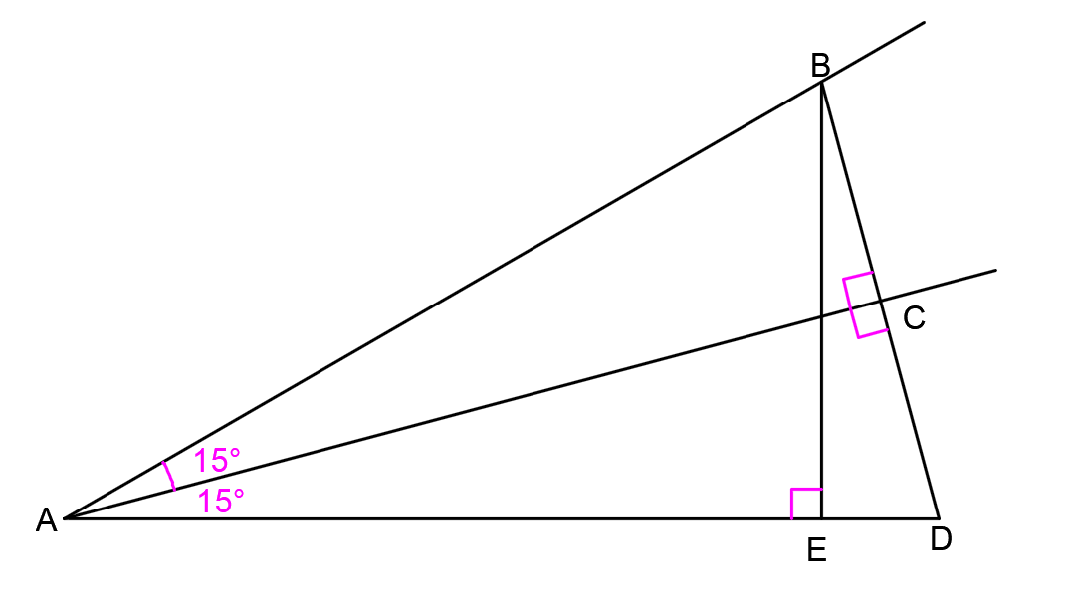
50. angle /ˈæŋgl n.角;角度;立场
他以一种活泼的角度戴着帽子。
He wore his hat at a jaunty angle.
尝试从另一个角度/从我的角度看问题。
Try looking at the problem from another angle/from my angle.

Slide 59

51. outlook /ˈaʊtlʊk n.前景;可能性;观点
经济前景暗淡。
The outlook for the economy is bleak.
从塔顶俯视，这座城市的景色令人叹为观止。
From the top of the tower, the outlook over the city was breathtaking.

Slide 60
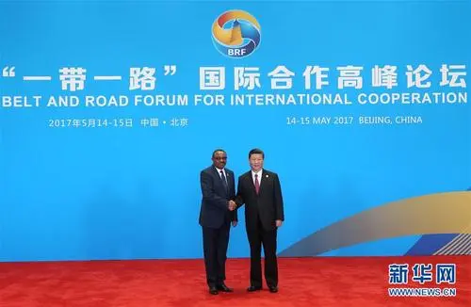
52. belt /belt/ n.腰带;地带
“一带一路”倡议 the Belt and Road Initiative
我们住在通勤者居住带。
We live in the commuter belt.

Slide 61

53. initiative /ɪˈnɪʃətɪv n.倡议;新方案
在仪式上发布的“第一届国际茶日茶路合作倡议”呼吁茶叶行业的人们走到一起，促进国际合作和文化交流。（2022全国乙卷）
The "First International Tea Day Tea Road Cooperative Initiative" issued（发布）at the ceremony calls for people working in the tea industry to come together to promote international cooperation 67 cultural exchanges.
the Belt and Road Initiative“一带一路”倡议
The Belt and Road Initiative is a massive China-led infrastructure project that aims to stretch around the globe. “一带一路”倡议是中国主导的，旨在向全球延伸大型基础设施项目。

Slide 62
53. initiative /ɪˈnɪʃətɪv n.倡议;新方案
take the initiative to主动采取行动
Having a growth mindset of interest can help job seekers expand their interests and become more adaptable to different fields, and take the initiative to learn new skills.
拥有兴趣增长型思维有助于求职者拓展兴趣，更好地适应不同领域，并主动学习新技能。（应用文）

Slide 63

54. sincerely /sɪnˈsɪəli ad.真诚地;诚实地
我真诚地相信，在帮助我们理解如何在许多学科中设计和实现一系列计算机系统方面，代理将具有价值。
I sincerely believe that agents will have value in helping us to understand how to design and implement a range of computer systems, in many disciplines.
我衷心希望目前的谈判能够取得成功。
I sincerely hope that the present negotiations will succeed.
最后，我们衷心感谢参与本研究的患者的贡献。
Finally, we sincerely appreciate the contributions of the patients who participated in this study.

Slide 64
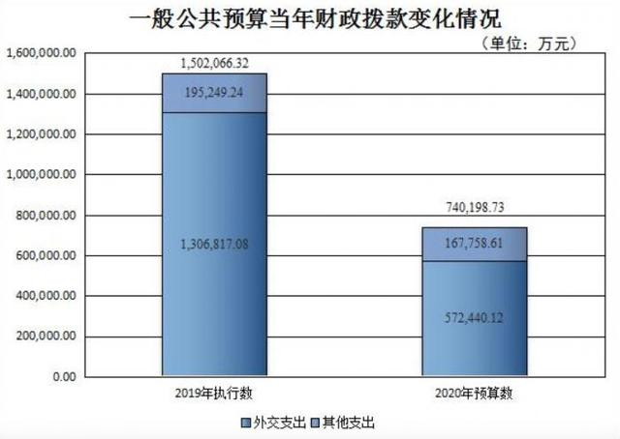
55. budget /ˈbʌdʒɪt n.预算
他们不得不搬到弗吉尼亚，但他们的预算非常紧张。（2023全国卷Ⅱ）
They had to move to Virginia but they were on a very tight budget.
The firm has drawn up a budget for the coming financial year.
公司草拟了下一财政年度的预算方案。
A budget holiday/hotel/price
廉价旅行度假／廉价旅馆／低廉的价格
资金不足的表达：tighten the belt束紧腰带/
on a tight budget在有限的资金预算下/
struggle to make ends meet勉强维持生计

Slide 65

56. side with /saɪd wɪð 支持;站…的一边
英文解释This phrase means that someone agrees with and encourages others' opinions or behaviors.
你是我最好的朋友，你必须支持我。
You are my best friend, so you have to side with me.
我真的很好奇Tom为什么支持她。
I really wonder why Tom sided with her.
我和弟弟吵架时，我母亲从不偏袒任何一方。
My mother never takes sides when my brother and I argue.

Slide 66

57. logical /ˈlɒdʒɪkl a.合乎逻辑的;合情合理的
他成功的关键在于他的逻辑思维。（续写）
The key to his success is his logical mind.
附件有住宅区，新的超级市场选址在此是合理的。
It’s logical site for a new supermarket. With the housing development nearby.
侦探必须通过逻辑教育来发现凶手。
The detective has to discover the murderer by logical education.

Slide 67

58. as far as I know /əz fɑ:(r) əz aɪ nəʊ 据我所知
据我所知如果你想要变得健康，你必须少吃点心，也要少喝饮料。（应用文）
As far as I know, if you want to be healthy, you have to cut down on desserts, and cut out sweet drinks altogether.
据我所知，它已经推迟到下周了。
As far as I know it's been postponed till next week.

Slide 68

59. as far as I am concerned /əz fɑ:(r) əz aɪ əm kənˈsɜ:nd 就我而言;依我看来
就我个人而言，不花太多时间玩智能手机是明智的。（应用文）
As far as I am concerned, it’s wise not to spend much time playing with smartphone.
依我看来，我们学生应减少看屏幕的时间，参与到广泛的业余活动中去。（应用文）
As far as I am concerned, we students should cut down on screen time and get involved in a wider of leisure activities.
concerned adj 关切的
路易斯安那州的科学家非常担心，因此他们决定按每条尾巴5美元的价格支付给猎人报酬。（2020全国卷Ⅲ）
Scientists in Louisiana were so concerned that they decided to pay hunters $5 a tail.

Slide 69
60. in summary /ɪn ˈsʌməri / 总的来说;总之
总之，我认为只有勇敢地承担失败的责任我们才会成功，而不是责怪他人。（应用文）
In summary, I realize only by bravely taking full responsibility for failure rather than blaming others can we succeed.
总之,抓住这个机会参与这个项目。（应用文）
In summary, grasp the opportunity and get involved in this programme.

Slide 70
61. generally speaking /ˈdʒenrəli 'spi:kɪŋ / 一般来说
一般来说，导致这个现象的原因有几个。（应用文）
Generally speaking, there are several reasons accounting for this phenomenon.
一般来说，花钱多，买的东西就多。
Generally speaking, the more you pay, the more you get.

Slide 71

62. outcome /ˈaʊtkʌm / n.结果;效果
这一结果完全在我的意料之中。（续写）
The outcome didn't surprise me at all.
因此，语言接触的结果至少在一点上存在质的差异：过去分词。
Thus, there is a qualitative difference between the outcome of language contact with respect to at least one point: the past participles.
他对这次会议的结果充满希望。
He was hopeful about the outcome of the meeting.

Slide 72
Thank you

