Slide 1


感恩遇见，相互成就，本课件资料仅供您个人参考、教学使用，严禁自行在网络传播，违者依知识产权法追究法律责任。
更多教学资源请关注
公众号：溯恩高中英语
知识产权声明

Slide 2
强化审题，
建构思维
浙江四校联盟2023年12月联考应用文讲评
告知信——短视频征集活动

Slide 3
Contents.
01.强化审题意识
02.建构思维框架
03.语料积累运用
04.赏读话题迁移

Slide 4
PEPORT ON WORK
01
强化审题意识
审题是布局的基础

Slide 5
原题呈现
假定你是李华，写信给留学生朋友James，告知他国际学生服务中心(International Students Service Center)正面向留学生开展主题为“My China Surprise”的短视频征集活动，内容包括:
1.活动介绍；
2.视频要求；
3.鼓励参加。
注意：
1.写作词数应为 80 左右；
2.请按如下格式在答题卡的相应位置作答。
Dear James,
______________________________________________________________________________________________________________________________________________
Yours,
Li Hua

Slide 6
基本信息把握
文体体裁：
写信对象：
人称时态： | £第一人称 | £第二人称 | £一般过去时 | £一般现在时
写信语气： | £偏正式 | £非正式 | £均可
写作背景：
写作目标：
注意点：
告知信
留学生朋友 James
√
√
√
√
国际学生服务中心正面向留学生开展主题为My China Surprise的短视频征集活动，“我”写信告知James,向他介绍活动及要求，并鼓励他参加。
用清晰准确的语言传达出活动的基本内容讯息及参赛作品的要求，结合文化意识的核心素养建构关于“China Surprise”的创造性内容。
① 关注部分微妙的字眼，如题干要求中的“正””面向留学生“
② 三大要点的篇幅长短需要根据其在整体信件中的重要性有所取舍。
③ 鼓励参加的口吻和语气要适切平等，姿态不能过高，亦不能过低。

Slide 7
审题误区1：错用时态
How is it going？Our International Students Service Center hosted a video shooting contest themed “My China Surprise” .
错用过去时态
Good luck! Our International Students Service Center will carry out a short video contest themed “My China Surprise” .
错用将来时态
题干：告知他国际学生服务中心(International Students Service Center)正面向留学生开展
We should use the present continuous tense and simple present tense.
Tip 1 for observation: figure out the right tense to write.

Slide 8
审题误区2：目的-文体混淆
Knowing that our International Students Service Center is launcing a a video shooting contest, I am writing to invite you to make one with me.
错写成邀请信
Considering our International Students Service Center is collecting short videos, I am writing to recommend the contest to you.
不妥，纯推荐信
题干：假定你是李华，写信给留学生朋友James，告知他……
We should say “I am writing to/would like to inform you of the contest and
hope you can have a try/shot”
Tip 2 for observation: figure out the writing purpose and genre.

Slide 9
审题误区3：要点混淆
1.活动介绍；2.视频要求；3.鼓励参加。
The contest is aimed to collect videos shot by foreign students, whose requirement is to ignite foreign students’ recognition of China.
This sentence involves both the first point and the second point but neither of them is abundant enough.Plus, the requirement stated is actually the goal of the activity. It may trigger disorder in the whole paragraph.
Tip 3 for observation:
handle the relationship between two points seriously and avoid conflicts and imbalance.

Slide 10
审题误区4：语气态度
1.活动介绍；2.视频要求；3.鼓励参加。
What has been stated above is relevant information I can offer. I will be highly appreciated that you can have a brilliant try and make great success.
Please evaluate the last paragraph composed by this student.Give some comments
Possible Answers:
The tone is quite rigid and cold, not corresponding to their relationship.
The sentence pattern makes the person who writes the letter too humble or even inferior.
The whole paragraph is not nature and full of clichés（陈词滥调）.
Tip 4 for observation:
Pay attention to the relationship between the writer and the receiver and use the proper writing tone.

Slide 11
PEPORT ON WORK
02
建构思维框架
布局呈现思维的骨架

Slide 12
框架形成
首段复现背景
01
转述题干提供的背景信息，即国际学生服务中心正面向留学生开展主题为My China Surprise的短视频征集活动，尽可能将题干中的信息进行充分利用，字数控制在两句话左右。
次段陈述主体
02
第二段是整篇应用文写作的核心部分，也就是所说的“主体”（body），即围绕活动介绍与视频要求两大维度，前者可以写“是什么-为什么”等，后者可针对视频本身展开，即”时长、清晰度、要素“ 字数控制在四句话左右，可各自分配两句话，该部分对语言精炼要求较高。
尾段表示鼓励
03
根据题目要求，可以用一句话来体现鼓励的含义，不一定直译，最好有参加，参与等字眼的出现。

Slide 13
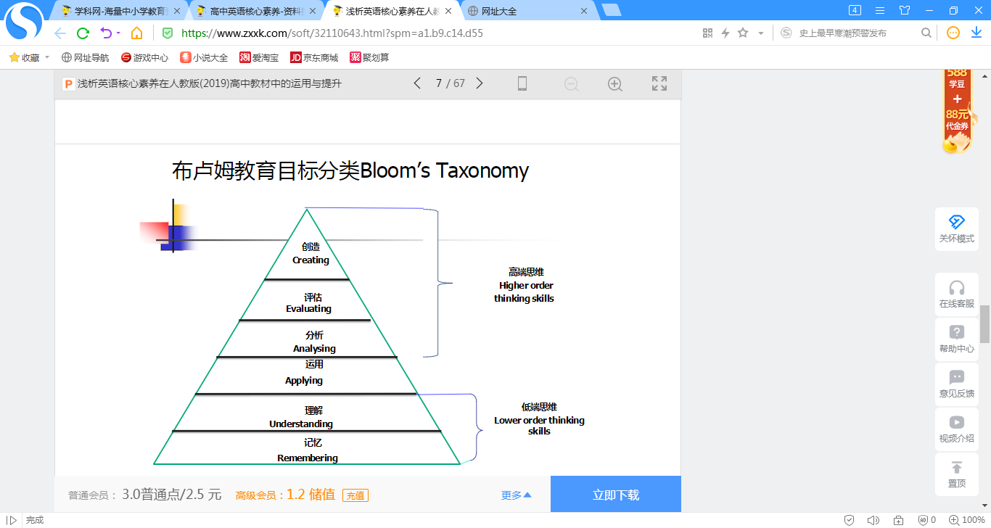
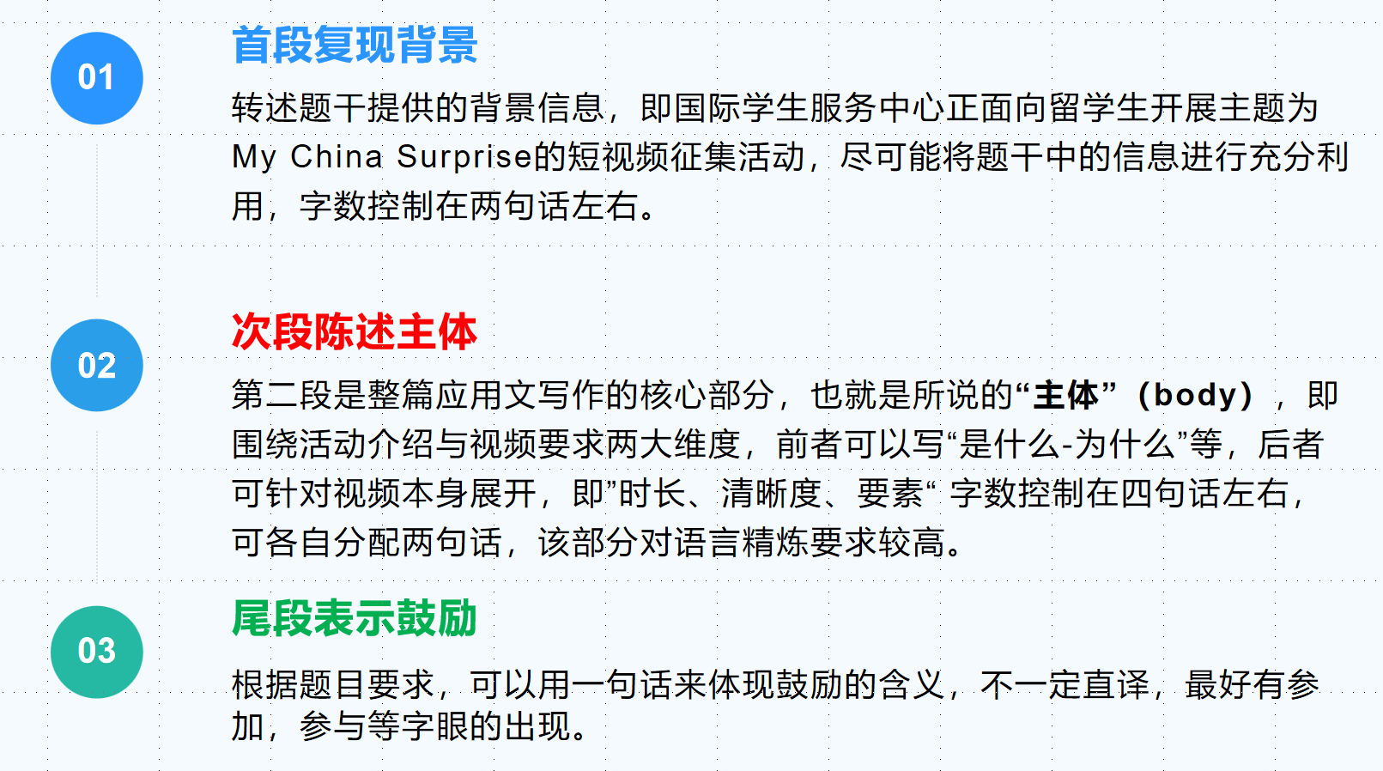
理解、分析等思维；
分析、创造思维
运用思维

Slide 14
PEPORT ON WORK
03
语料积累运用
写作是语料的重组变换

Slide 15
首段写作
Q:首段如何表达两大目的-告知与鼓励参与？
Good news! The International Students Service Center is organizing a video shooting contest themed “My China Surprise” and I strongly recommend you give it a shot.
I hope this letter finds you well. I am writing to share the exciting news with you – the International Students Service Center is organizing a short video contest centered around "My China Surprise." and expect/anticipate your extraordinary entry!
Comment:
第一种写法开门见山，直接用“and”链接两大目的，第二种写法稍显委婉，用期待看到你的参赛作品同义替换了“鼓励参赛”的内容，亦可。

Slide 16
Expansion:Different occasions to inform
1. How is everything? I’m so glad that you show great passion for learning Chinese and that your excellent performance won applause in the Chinese speech contest. Now I’m writing to inform you of the details of our next class.
2. Knowing /Having learned that you’re very interested in my recent study trip organized by my school, I am writing/quite willing to share/give some relevant information with/to you.
3. I am more than delighted that you are so interested in the latest developments in the Chinese countryside. Now I’m writing to tell you something about it.
4. I’m very pleased to receive your letter asking about the popularity of American TV dramas among Chinese middle school students. And I’m quite/perfectly willing to share with you some information about that.

Slide 17
次段写作
Q:活动介绍主要可以写什么方面？
活动目的：
The activity is meant to invite international students to showcase their unique experiences in China through short videos. It's a great opportunity to highlight the diverse and enriching aspects of life here.
活动目的：
The purpose of this activity is to showcase the personal experiences, cultural encounters, and memorable moments in China through the eyes of international students.
呈现方式：With the theme of My China Surprise, the project welcomes stories about life in China from foreigners’ perspectives. It can involve various segments, such as speech clips and interview clips.
总结“目的是”的表达:
In an effort to In an attempt to be meant to be designed to
In a bid to in order to be aimed at in pursuit of

Slide 18
次段写作
Q:视频要求有什么角度与方面？
Differents perspectives : content; length; deadline etc.
Participants are encouraged to create videos capturing special moments of their life in China. The videos should be creative, informative, and no longer than 3 minutes
In terms of video requirements, the length should be no longer than 3 minutes. It can be creative, humorous, or even documentary-style. The video should capture interesting scenes or challenges that you have faced in China, and most importantly, demonstrate the surprises you encountered during the stay.
Submission is open until Jan. 15th, 2024, and there are very exciting prizes awaiting the winners.

Slide 19
尾段写作
I strongly encourage you to take part in this fantastic initiative. It's not only a chance to express your experiences but also an opportunity to connect with the international community and witness the beauty of cultural exchange.
Considering your colorful life, singular creativity and considerable expertise in photography, your video will definitely make a very competitive entry. I’m looking forward to your excellent performance in the contest! Best wishes!
总结“参与”的表达:
take part in
get involved in
participate in
get engaged in
积极参与：take an active part in vigorously participate in

Slide 20
成文 Possible Version
Dear James.
Good news! The International Students Service Center is organizing a video shootingcontest themed “My China Surprise” , and I strongly recommend you give it a shot.
All foreign students living in China are welcome to share their unexpected adventures,surprising moments and cultural revelations through the lens. There are no strict restrictions on the topics, allowing participants ample freedom to capture whatever they find captivating and intriguing. Submission is open until Jan. 15th, 2024, and there are very exciting prizes awaiting the winners.
Considering your colorful life, singular creativity and considerable expertise in photography, your video will definitely make a very competitive entry. I'm looking forward to your excellent performance in the contest! Best wishes!
Yours
Li Hua
词汇解密:
lens眼睛；镜片 captivating 吸引人的
intriguing 有趣的 await =wait for considerable 可观的

Slide 21
优生作文
Dear James,
Here comes fantastic news! The International Students Service Center is organizing a short video shooting contest with the theme of “My China Surprise” , which is worth your vigorous participation.
Without explicitly stipulated restrictions, all overseas students in China are encouraged to create works to promote cultural interaction. The activity requires participants to capture their colorful life, ranging from fortuitous adventures to memorable moments with cultural revelations. Even trivial but surprising moments in daily dribs and drabs can take on a refreshing effect through your unique lens-selection. The deadline for submission is on Jan 15th, 2024. Simultaneously, great presents are awaiting the winners.
Your ingenious idea, abundant life and expertise in photography is bound to make you stand out. Highly anticipate your performance! Best wishes.
Yours,
Li Hua

Slide 22
PEPORT ON WORK
04
赏读话题迁移
迁移是命题生命的延展

Slide 23
体裁迁移1：通知
假定你是校英文网站的编辑李华。八十周年校庆之际，校英文网站将举办主题为“Discovering our beautiful campus”的短视频、摄影作品征集活动。请你写一则通知，发布在校英文网站上，内容包括：
1. 作品要求；
2. 奖项设置；
3. 截止时间。
注意：
1. 词数100左右；
2. 可以适当增加细节，以使行文连贯。
参考词汇：八十周年校庆the 80th anniversary of the school
Notice
________________________________________________________________________________________________________________________________________________

Slide 24
参考范文 Possible Version
Notice
Our school’s English website will collect short videos and photographs of our campus for an online exhibition during the 80th anniversary of the school. The theme of the activity is discovering our beautiful campus.
Your works can focus on wonderful landscapes or unforgettable moments. And the English description of each work should be no less than 100 words. There are three first prizes, five second prizes and ten third prizes in this activity. Please submit your works to our website no later than May 30, 2023.
It’s a great chance to display your talent. Seize the chance!
The School’s English Website

Slide 25
体裁迁移2：投稿
假定你是某国际学校的学生李华，你校的视频制作俱乐部（Video Production Club）正在征集关于春节记忆的短视频以供展示. 请你给该活动的负责人Alan写封邮件并投稿，内容包括：
1. 表明意图；
2. 介绍作品；
3. 表达期望。
注意：
1. 词数100左右；
2. 可以适当增加细节，以使行文连贯。
参考词汇：八十周年校庆the 80th anniversary of the school
________________________________________________________________________________________________________________________________________________

Slide 26
参考范文 Possible Version
Dear Alan,
I'm Li Hua, a senior 3 student. Learning that your club is collecting short videos about memories of the Spring Festival for show, I'm writing to submit a relevant short video made by myself.
The 3-minute-long reunion-themed video, which is attached below, shows several sweet moments at the Spring Festival when all my family members were spending the traditional festival together. Among them, my favorite moment is when my grandfather watched all the other family members making jiaozi and smiled. For most Chinese people like me, family reunion is the sweetest memory of the festival.
I hope my short video can be selected to spread love and warmth. I'm looking forward to your reply.
Yours sincerely,
Li Hua

Slide 27
谢谢观看
THANK FOR YOU WATCHING
By 郭烨辉

