Slide 1

感恩遇见，相互成就，本课件资料仅供您个人参考、教学使用，严禁自行在网络传播，违者依知识产权法追究法律责任。
更多教学资源请关注
公众号：溯恩高中英语
知识产权声明

Slide 2


Slide 3

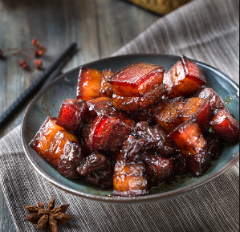

Do you like eating red braised pork? Why or why not?
cuisine

Slide 4
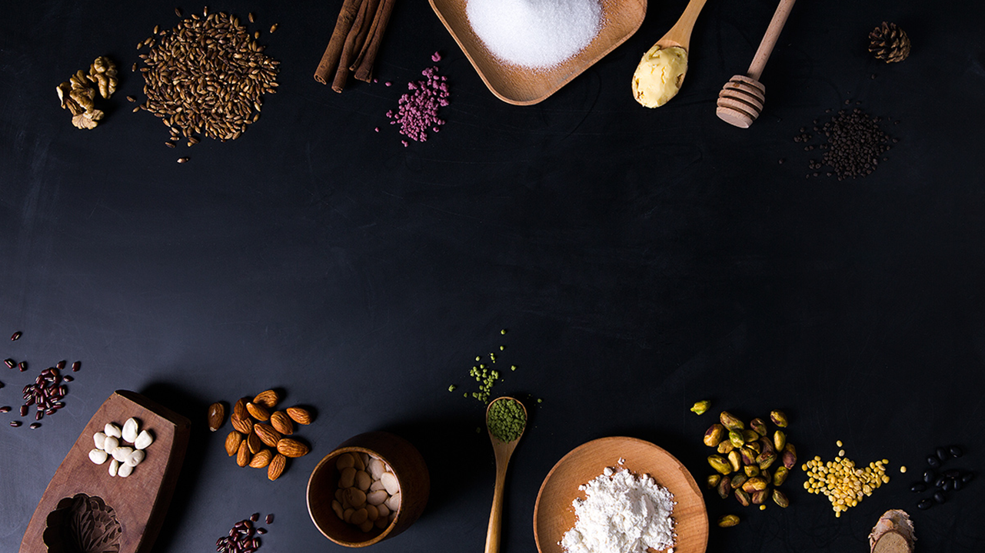
CULTURE AND CUISINE
Jefffery

Slide 5
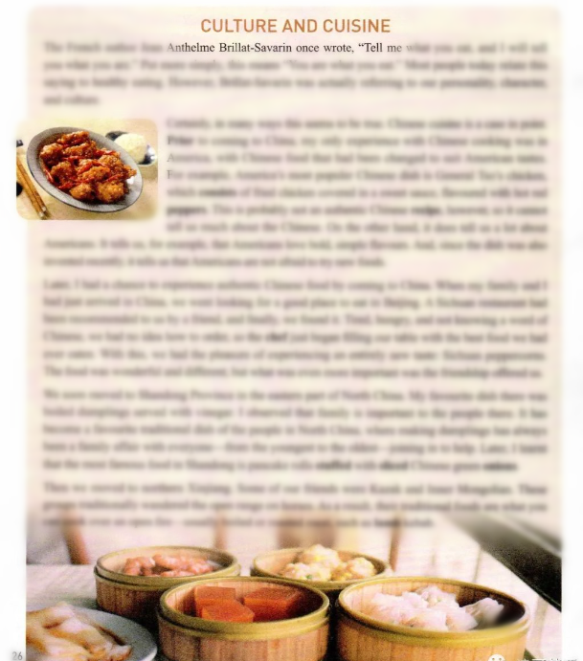
What will the passage talk about?

Slide 6
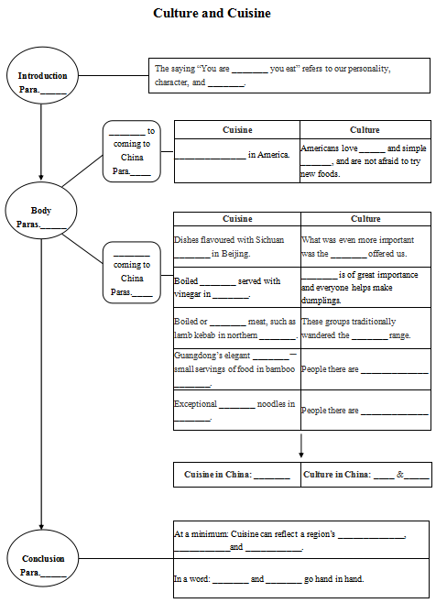
Reading
Read the whole passage to:
1. check your prediction.
2. finish the mindmap in the worksheet
or draw your own mindmap.

Slide 7
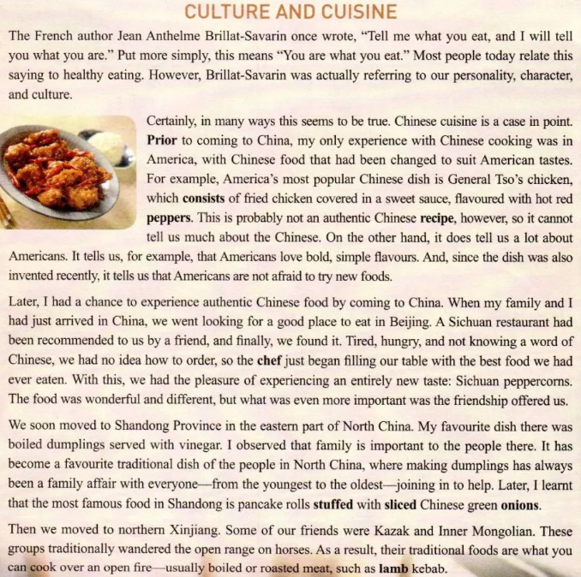
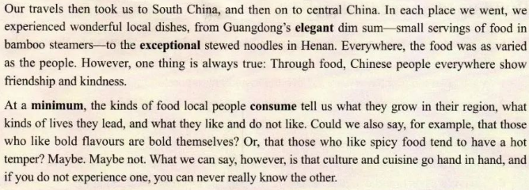
Introduction
1
2
3
Body
4
5
6
Conclusion
7

Slide 8
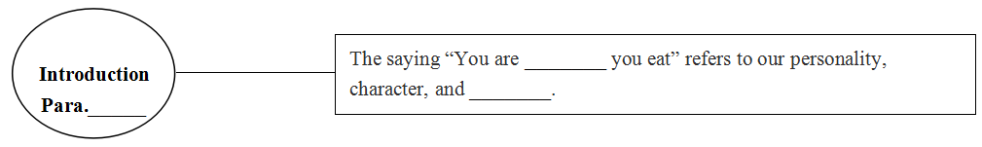
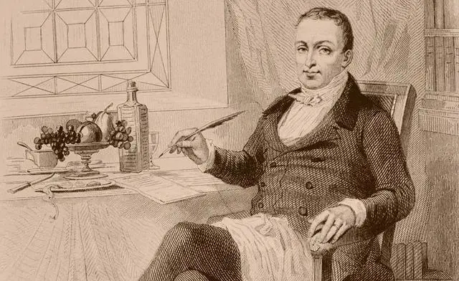
what
culture
1
Cuisine is a m that reflects our personality, character, and culture.
mirror
Jean Anthelme Brillat-Savarin

Slide 9
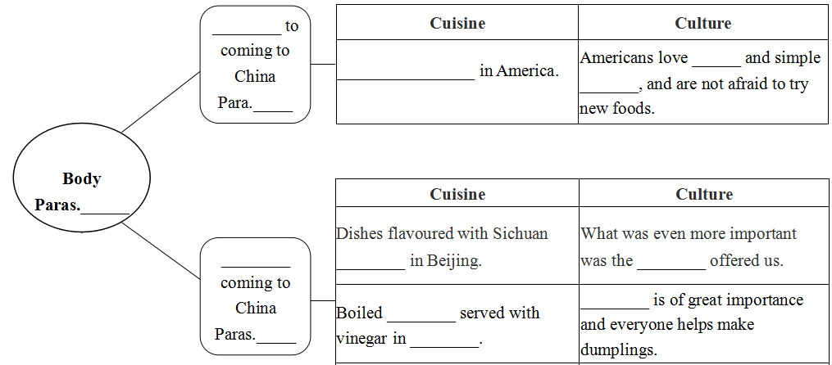
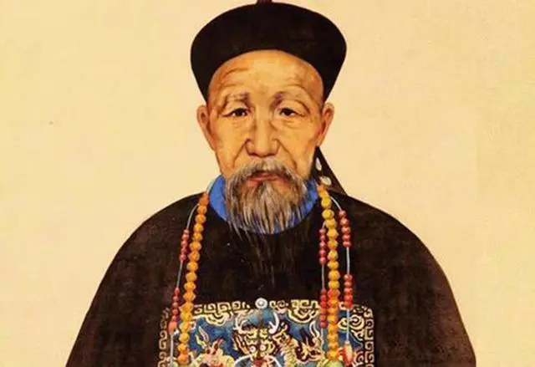
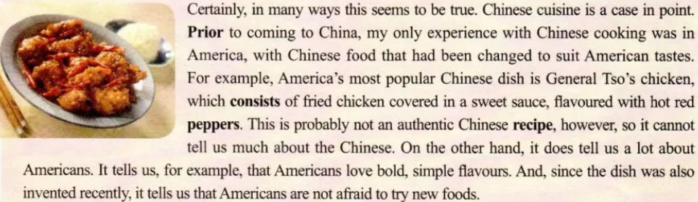
prior
Problems
General Tso's chicken
bold
flavours
2
2-6
Is it an authentic Chinese recipe?

Slide 10
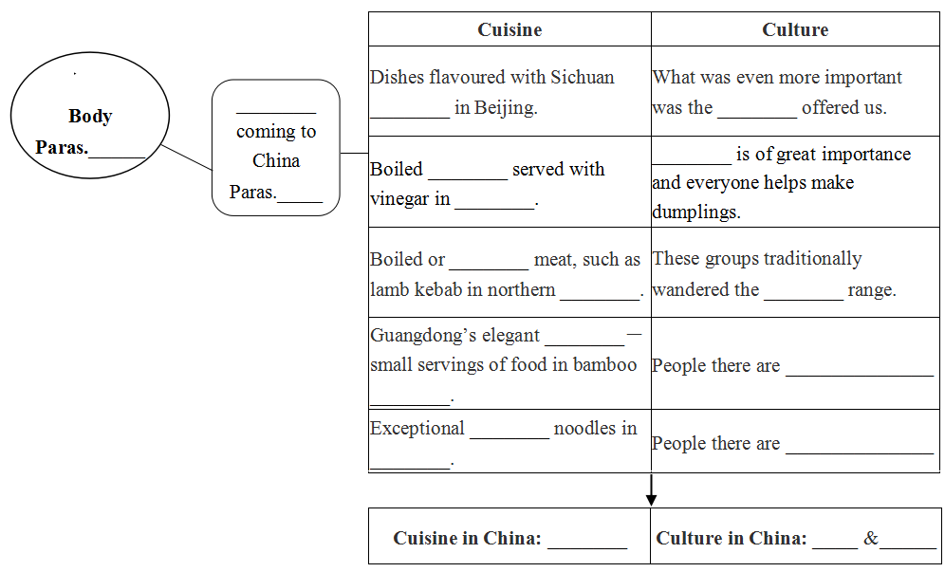
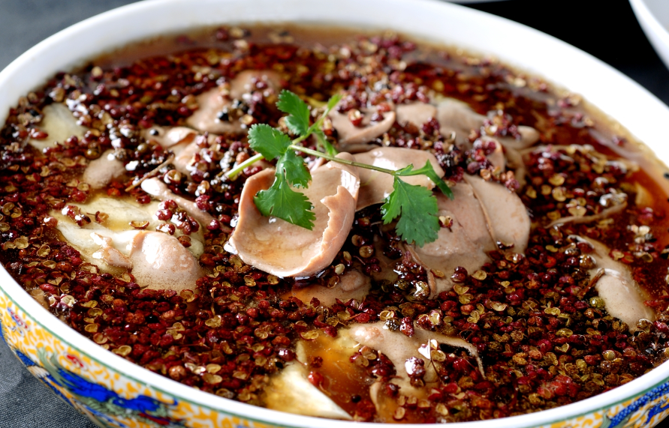
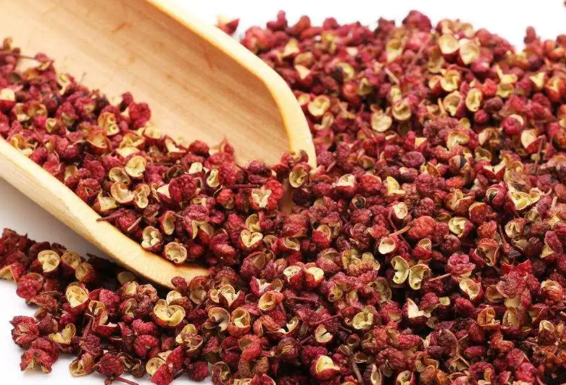
after
peppercorns
friendship
2-6
3-6

Slide 11
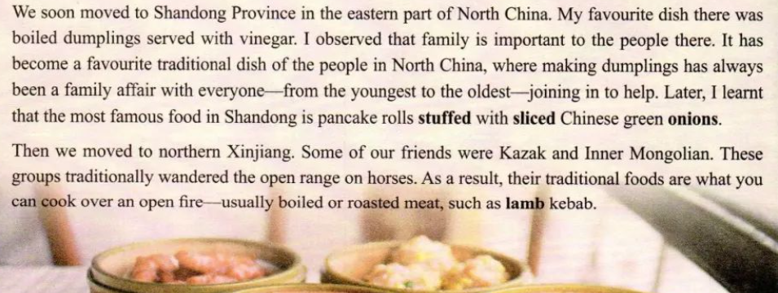
after
peppercorns
friendship
2-6
dumplings
Family
3-6
Shandong
What is the position (地位）of making dumplings in North China?

Slide 12

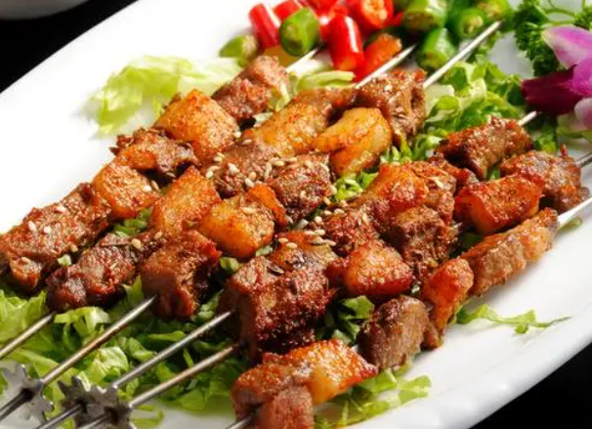
open 坦率的，开放的
after
peppercorns
friendship
2-6
dumplings
Family
3-6
Shandong
roasted
Xinjiang
open

Slide 13
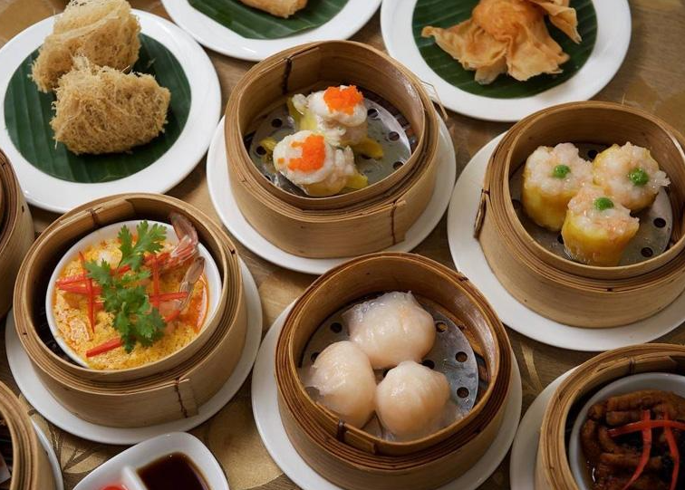
after
peppercorns
friendship
2-6
dumplings
Family
3-6
Shandong
roasted
Xinjiang
open
dim sum
elegant.
steamers

Slide 14
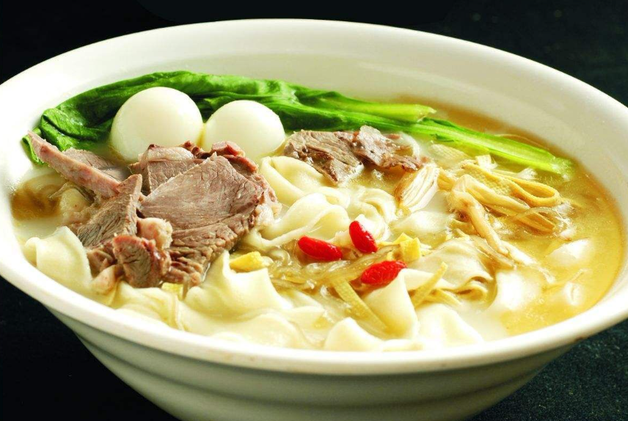
quail egg
鹌鹑蛋
peppercorns
friendship
after
vegetable
2-6
dumplings
Family
3-6
Shandong
bean curd sheets 千张
hodgepodge 大杂烩
roasted
Xinjiang
open
mutton
羊肉
dim sum
elegant.
fructus lycii
枸杞
steamers
stewed
embracing(包容的）.
Henan

Slide 15
after
peppercorns
friendship
2-6
dumplings
Family
3-6
Shandong
roasted
Xinjiang
open
dim sum
elegant.
steamers
stewed
embracing(包容的）.
Henan
varied
friendly
kind

Slide 16
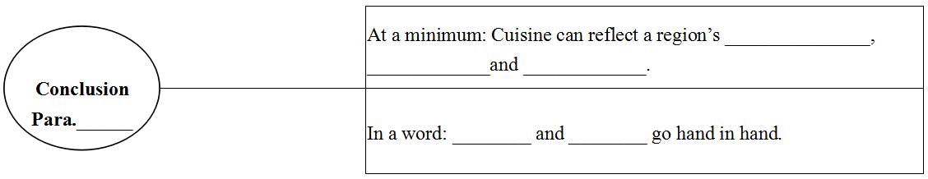
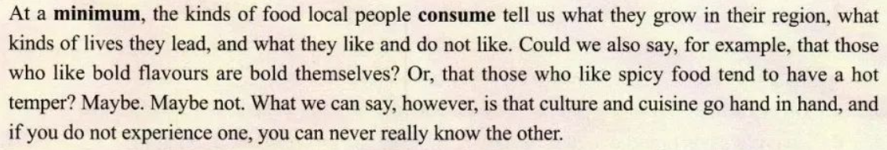
agriculture
lifestyle
preference
7
culture
cuisine

Slide 17

The passage mainly talks about the
r between culture and cuisine.
relationship

Slide 18
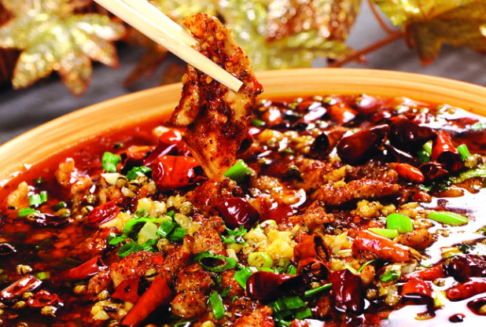
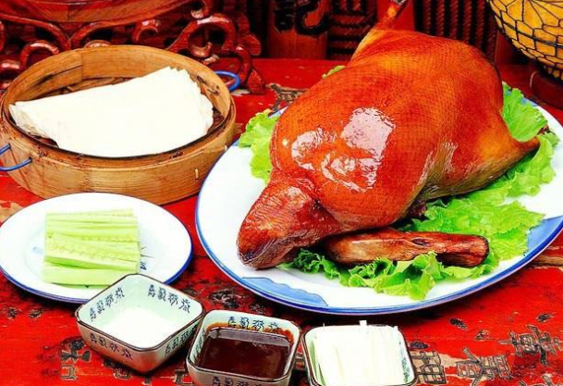
Thinking
What is Beijing's typical dish?
What kind of food did the writer eat in Beijing?
What can you learn from that?

Slide 19
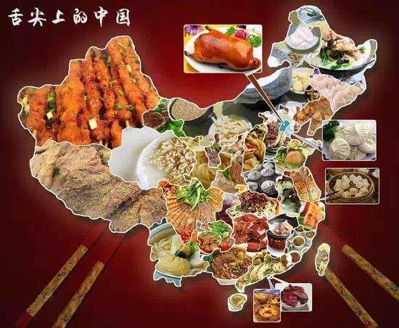

Chinese cuisine and culture coexist in harmony and diversity. (和而不同)
cuisine diversity
culture diversity
Chinese cuisine is a cultural bridge that connects China and the world.

Slide 20
Speaking
A Bite of Culture (舌尖上的文化) column invites you to give a presentation on Chinese cuisine and culture.
Hello, everyone, I am so honored ... To begin with, Chinese cusine...go hand in hand. For example, Shandong people... which shows ... What's more...in harmony and diversity. Finally, ...cultural bridge...Thanks.

Slide 21
Possible version
Hello, everyone, I am so honored to be here. To begin with, Chinese cusine and culture go hand in hand. For example, Shandong people always make dumplings together, which shows that they are very united and attach great importance to family. What's more, Chinese cuisine and culture coexist in harmony and diversity, although they are quite different. Finally, Chinese cuisine is a cultural bridge that connects China and the world. That's all, thank you.

Slide 22
Assignment
Write a letter to invite the author to have a taste of cuisine in your hometown (80 words).
Search for information about Western cuisine and culture.

Slide 23


