Slide 1


感恩遇见，相互成就，本课件资料仅供您个人参考、教学使用，严禁自行在网络传播，违者依知识产权法追究法律责任。
更多教学资源请关注
公众号：溯恩高中英语
知识产权声明

Slide 2
2023年12月浙江省四校联盟联考
增强原文融洽度和全文连贯性的读后续写讲评
一个小孩的决心--独眼狗狗洗澡记
浙江省衢州第二中学
徐芳红

Slide 3
Part 1 文本分析
Part 2 写作讲评
Part 3 例文展示
Part 4 原文欣赏

Slide 4
Part 1 文本分析

Slide 5
It was a hot day in Florida. The school year had just ended and it was time for summer vacation. We had just gotten a little black dog who we named One-Eyed. We chose that name because he could only see out of one eye.
Everybody wanted to do something for the dog: feed him, teach him tricks and take long walks with him. Everybody was so happy to have this active, playful and shaggy new addition to our family. Everybody, that is, except my mom and me.
All my mom saw when she looked at the dog was someone else to clean up after. Shedding, messy, muddy, he pounced all over the house. All Mom seemed to care about was getting the house cleaned. My mom began to put Clorox (高乐氏漂白水) in the bathtub. There was no messing with Mom when she started cleaning, so I decided to move out of the way, Actually, getting out of the way is a move I'd been practicing for a long time.
Being the youngest in my family has had its advantages, of course. More than a few times I was spoiled or everyone said I was the cutest. But being the youngest also came with its fair share of troubles. "You're too young!“ "You'll mess this up!" they'd often say. I knew that my family loved me but I couldn't wait to show them I could do things by myself.
Every time I asked my brother or my sister if I could pet One-Eyed, they would shout, "No!" or tell me that I had germs and if I touched One-Eyed he would die! I really believed them. Once I even confessed to my mom that I touched the dog when no one noticed. At first, my mom seemed very confused about what I was telling her, but then she realized. My mom scolded my brother and sister, "You better stop teasing your little brother!" Little brother! That's exactly what I was. That really got my blood boiling! Secretly, I decided, "I'll show them what a little kid can do !"
Para 1: That afternoon, I took the dog and sneaked into the bathroom.
Para 2: I thought my mom would punish me, but she was just standing there and laughing.

Slide 6
读后续写思维导图
理解原文情节
分析情节线索
构思写作情节
文本分析
增强原文融洽度
巧用实用表达
增强全文连贯性

Slide 7
It was a hot day in Florida. The school year had just ended and it was time for summer vacation. We had just gotten a little black dog who we named One-Eyed. We chose that name because he could only see out of one eye.
Everybody wanted to do something for the dog: feed him, teach him tricks and take long walks with him. Everybody was so happy to have this active, playful and shaggy new addition to our family. Everybody, that is, except my mom and me.
All my mom saw when she looked at the dog was someone else to clean up after. Shedding, messy, muddy, he pounced all over the house. All Mom seemed to care about was getting the house cleaned. My mom began to put Clorox (高乐氏漂白水) in the bathtub. There was no messing with Mom when she started cleaning, so I decided to move out of the way, Actually, getting out of the way is a move I'd been practicing for a long time.
Being the youngest in my family has had its advantages, of course. More than a few times I was spoiled or everyone said I was the cutest. But being the youngest also came with its fair share of troubles. "You're too young!“ "You'll mess this up!" they'd often say. I knew that my family loved me but I couldn't wait to show them I could do things by myself.
Every time I asked my brother or my sister if I could pet One-Eyed, they would shout, "No!" or tell me that I had germs and if I touched One-Eyed he would die! I really believed them. Once I even confessed to my mom that I touched the dog when no one noticed. At first, my mom seemed very confused about what I was telling her, but then she realized. My mom scolded my brother and sister, "You better stop teasing your little brother!" Little brother! That's exactly what I was. That really got my blood boiling! Secretly, I decided, "I'll show them what a little kid can do !"
Para 1: That afternoon, I took the dog and sneaked into the bathroom.
Para 2: I thought my mom would punish me, but she was just standing there and laughing.
基于“矛盾冲突”的原文情节梳理
The summer vacation just began, the family got a little black dog with only one eye. My mother didn’t seem to like him because she had to do the cleaning. I couldn’t pet him because my brother and sister thought I was too young and teased me. The family all thought I was just a little kid, which made me feel determined to prove myself by…

Slide 8
It was a hot day in Florida. The school year had just ended and it was time for summer vacation. We had just gotten a little black dog who we named One-Eyed. We chose that name because he could only see out of one eye.
Everybody wanted to do something for the dog: feed him, teach him tricks and take long walks with him. Everybody was so happy to have this active, playful and shaggy new addition to our family. Everybody, that is, except my mom and me.
All my mom saw when she looked at the dog was someone else to clean up after. Shedding, messy, muddy, he pounced all over the house. All Mom seemed to care about was getting the house cleaned. My mom began to put Clorox (高乐氏漂白水) in the bathtub. There was no messing with Mom when she started cleaning, so I decided to move out of the way, Actually, getting out of the way is a move I'd been practicing for a long time.
Being the youngest in my family has had its advantages, of course. More than a few times I was spoiled or everyone said I was the cutest. But being the youngest also came with its fair share of troubles. "You're too young!“ "You'll mess this up!" they'd often say. I knew that my family loved me but I couldn't wait to show them I could do things by myself.
Every time I asked my brother or my sister if I could pet One-Eyed, they would shout, "No!" or tell me that I had germs and if I touched One-Eyed he would die! I really believed them. Once I even confessed to my mom that I touched the dog when no one noticed. At first, my mom seemed very confused about what I was telling her, but then she realized. My mom scolded my brother and sister, "You better stop teasing your little brother!" Little brother! That's exactly what I was. That really got my blood boiling! Secretly, I decided, "I'll show them what a little kid can do !"
基于段首句衔接的写作情节构思
Para 1: That afternoon, I took the dog and sneaked into the bathroom.
What happened in the bathroom?
What did I do to the dog?
What mess did I make? (connection to the 2nd para)
Para 2: I thought my mom would punish me, but she was just standing there and laughing.
How did I feel?
What did I do?
How did mom react?

Slide 9
It was a hot day in Florida. The school year had just ended and it was time for summer vacation. We had just gotten a little black dog who we named One-Eyed. We chose that name because he could only see out of one eye.
Everybody wanted to do something for the dog: feed him, teach him tricks and take long walks with him. Everybody was so happy to have this active, playful and shaggy new addition to our family. Everybody, that is, except my mom and me.
All my mom saw when she looked at the dog was someone else to clean up after. Shedding, messy, muddy, he pounced all over the house. All Mom seemed to care about was getting the house cleaned. My mom began to put Clorox (高乐氏漂白水) in the bathtub. There was no messing with Mom when she started cleaning, so I decided to move out of the way, Actually, getting out of the way is a move I'd been practicing for a long time.
Being the youngest in my family has had its advantages, of course. More than a few times I was spoiled or everyone said I was the cutest. But being the youngest also came with its fair share of troubles. "You're too young!“ "You'll mess this up!" they'd often say. I knew that my family loved me but I couldn't wait to show them I could do things by myself.
Every time I asked my brother or my sister if I could pet One-Eyed, they would shout, "No!" or tell me that I had germs and if I touched One-Eyed he would die! I really believed them. Once I even confessed to my mom that I touched the dog when no one noticed. At first, my mom seemed very confused about what I was telling her, but then she realized. My mom scolded my brother and sister, "You better stop teasing your little brother!" Little brother! That's exactly what I was. That really got my blood boiling! Secretly, I decided, "I'll show them what a little kid can do !"
基于呼应原文伏笔的写作情节构思
Para 1: That afternoon, I took the dog and sneaked into the bathroom.
Para 2: I thought my mom would punish me, but she was just standing there and laughing.
I wanted to give the dog a bath to prove myself, but made a mess while bathing him.
思路：段一的首句里面的两个角色是“I”和“One-Eyed”，因此在情节上要多关注我与狗之间的互动。
I wanted to prove myself by bathing the dog but messed it up, so I felt frustrated and sad. Mom saw the mess I had made and found it amusing.
思路：段二的首句里面的两个角色是“I”和“my mom”，因此在情节上要多关注我与妈妈之间的互动。并且注意本文是第一人称视角，所以不能描写妈妈的心理活动。并且该故事主要是童年趣事，不建议在消极情绪有过多着墨。)

Slide 10
分析实用表达
读后续写评分时，主要从内容、语言表达和篇章结构三个方面考查具体为
（ 1 ） 续 写 内 容 的 质 量 、 续 写 的 完 整 性 以 及 与 原 文 情 境 的 融 洽 度 。
（ 2 ） 所 使 用 词 汇 和 语 法 结 构 的 准 确 性 、 恰 当 性 和 多 样 性 。
（ 3 ） 上 下 文 的 衔 接 和 全 文 的 连 贯 性 。
为了增加考生写作与原文情境是融洽度和全文的连贯性，考生可以从原文中挖掘描写时可借鉴的表达，并且在后文写作中进行适当修改使用。

Slide 11
分析实用表达
It was a hot day in Florida. The school year had just ended and it was time for summer vacation. We had just gotten a little black dog who we named One-Eyed. We chose that name because he could only see out of one eye.
Everybody wanted to do something for the dog: feed him, teach him tricks and take long walks with him. Everybody was so happy to have this active, playful and shaggy new addition to our family. Everybody, that is, except my mom and me.
All my mom saw when she looked at the dog was someone else to clean up after. Shedding, messy, muddy, he pounced all over the house. All Mom seemed to care about was getting the house cleaned. My mom began to put Clorox (高乐氏漂白水) in the bathtub. There was no messing with Mom when she started cleaning, so I decided to move out of the way, Actually, getting out of the way is a move I'd been practicing for a long time.
Being the youngest in my family has had its advantages, of course. More than a few times I was spoiled or everyone said I was the cutest. But being the youngest also came with its fair share of troubles. "You're too young!“ "You'll mess this up!" they'd often say. I knew that my family loved me but I couldn't wait to show them I could do things by myself.
Every time I asked my brother or my sister if I could pet One-Eyed, they would shout, "No!" or tell me that I had germs and if I touched One-Eyed he would die! I really believed them. Once I even confessed to my mom that I touched the dog when no one noticed. At first, my mom seemed very confused about what I was telling her, but then she realized. My mom scolded my brother and sister, "You better stop teasing your little brother!" Little brother! That's exactly what I was. That really got my blood boiling! Secretly, I decided, "I'll show them what a little kid can do !"

Slide 12
原文句子
后文借鉴思路
The puppy raised his head and gazed at me with his only eye sparkling innocence and trust…
The playful and shaggy dog shook his body and splashed the water everywhere.
Now, One-Eyed was no longer a shedding, messy and muddy puppy, but a clean, tidy and neat cutie.
I stood in the bathtub, lowering my head, and confessed to my mom that I messed this up again.
That really got my heart sinking.
he could only see out of one eye.
this active, playful and shaggy new addition
Shedding, messy, muddy, he pounced all over the house.
I even confessed to my mom
That really got my blood boiling!

Slide 13
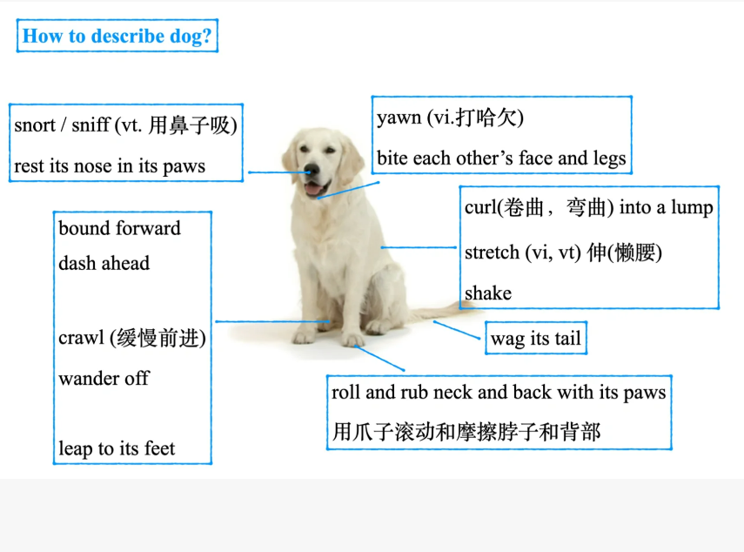
狗狗相关表达补充
bark (v. 犬吠)
lick （v.舔）

Slide 14
Part 2 写作讲评

Slide 15
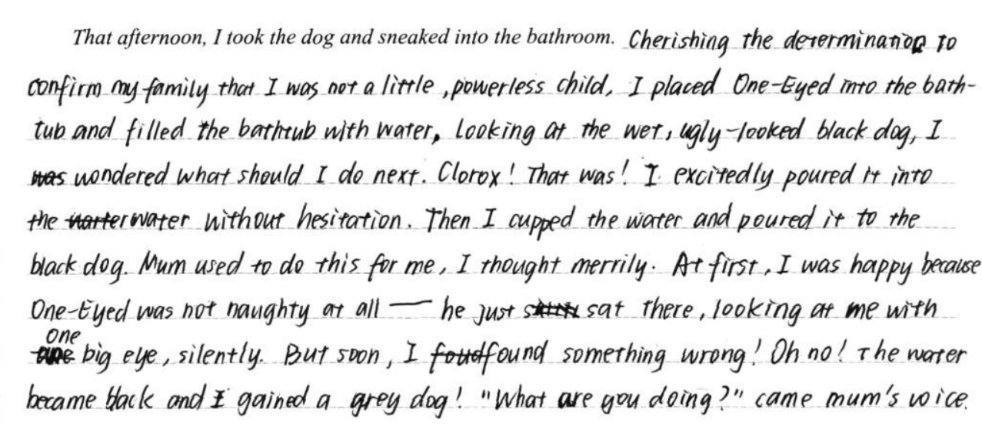
1
行为动机介绍得很清楚，和前文形成密切呼应。句式为非谓结构中嵌套从句再加主句，属于加分句型。
2
2. 线索使用到位，道具使用合理。
3
3. 小孩子学习大人的做事方法，还很沾沾自喜的心理描写得很到位。
4
5
4. 呼应前文小狗特殊特点，one eye.
6
5. 对闯祸的描写简短又好笑。
6. 引出新人物的出场，很好地衔接了下文。

Slide 16
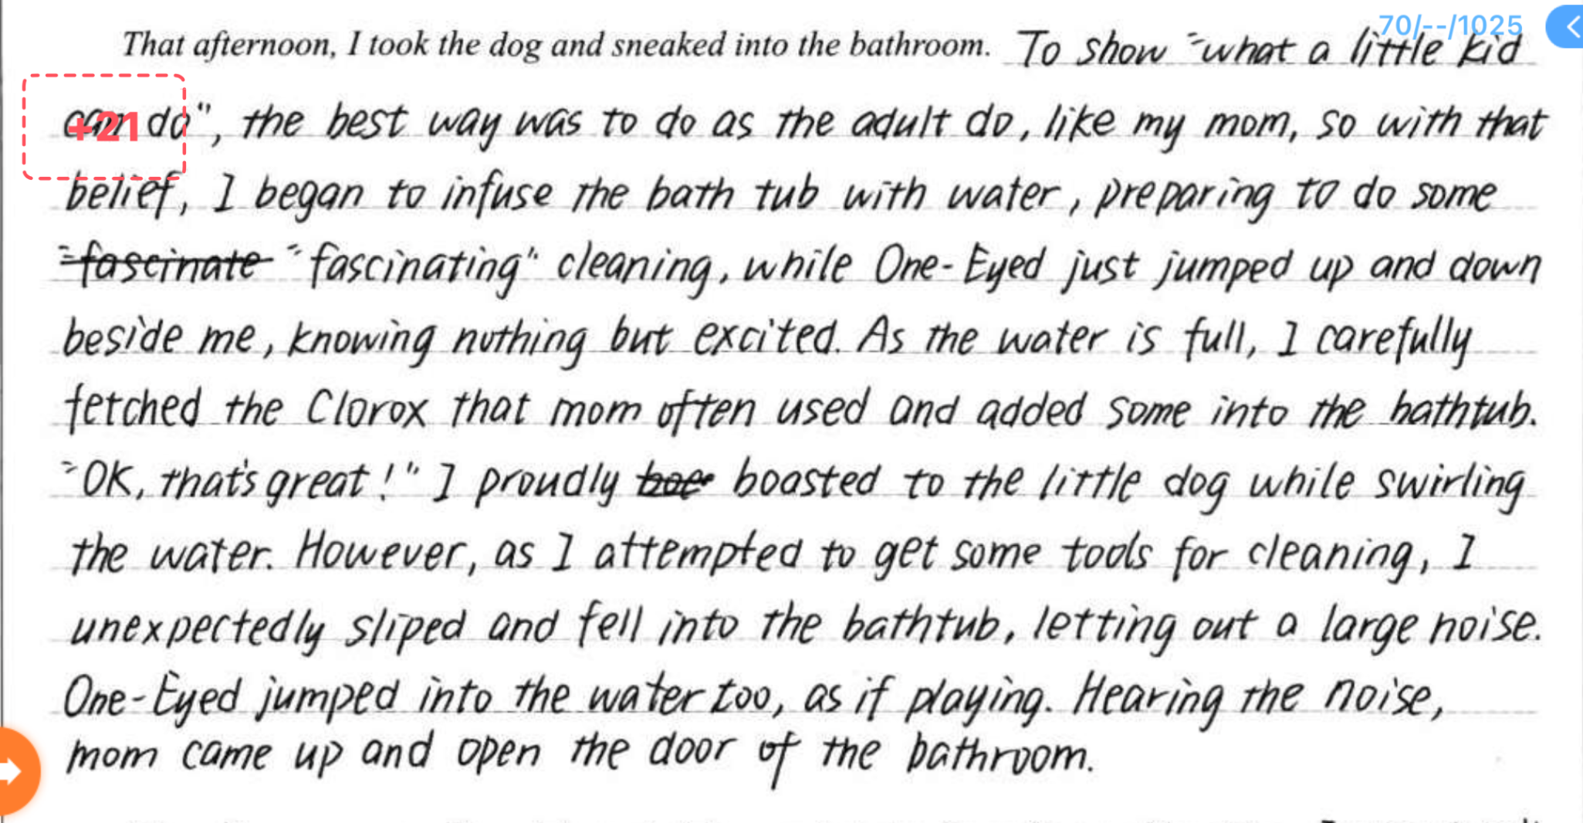
1
1. 开头第一句是一个超级难句，以目的状语开头描写小孩心理，后接主句加so引导的结果状语从句，从句中有高级表达infuse，后用while对比小狗此时的状态，十分精彩的一个开头。
2
2. 并且是小孩子学大人样子做的，非常符合小孩的心理。
3
3. 意外发生了，衔接下段开头中的I thought mom would punish me。
4
4. 引出新人物的出场。

Slide 17
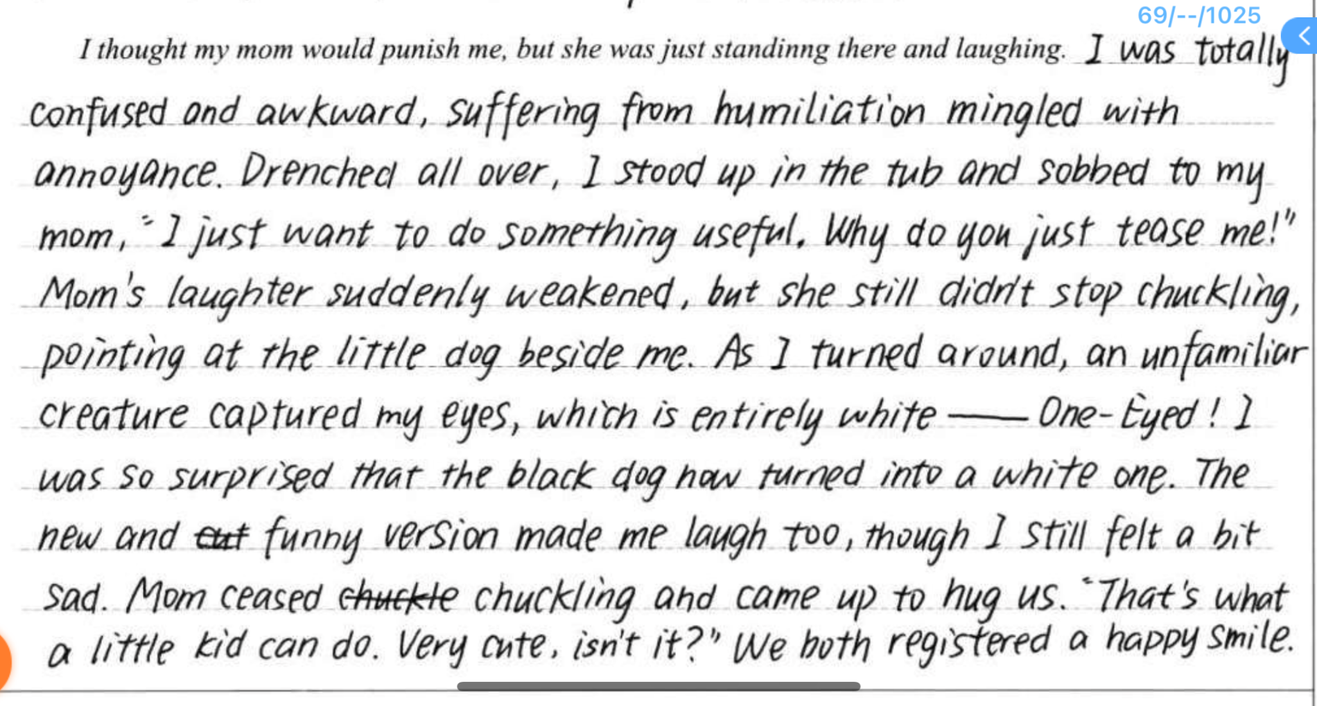
1. 段2的开头句没有和段1一样复杂的长难句，降低堆砌感。但是衔接得也很恰当，妈妈没有骂我还在笑哈哈，我又困惑又尴尬，还有一些恼怒和屈辱感。几个表示情绪的词用得十分到位，并且还有humiliation和annoyance这样的高级情绪单词，加上动词mingle，而且都拼写正确！
1
2
3
2. Drenched all over和段1中掉进水里形成呼应，本段加了一个直接引语，增加了故事的生动性，为读者加了一个听到的感觉。
4
3. 揭露妈妈大笑的原因，童年趣事的描写更生动了。
4.妈妈温情和睿智地化解我的不开心，不是只会生气的“泼妇”。

Slide 18
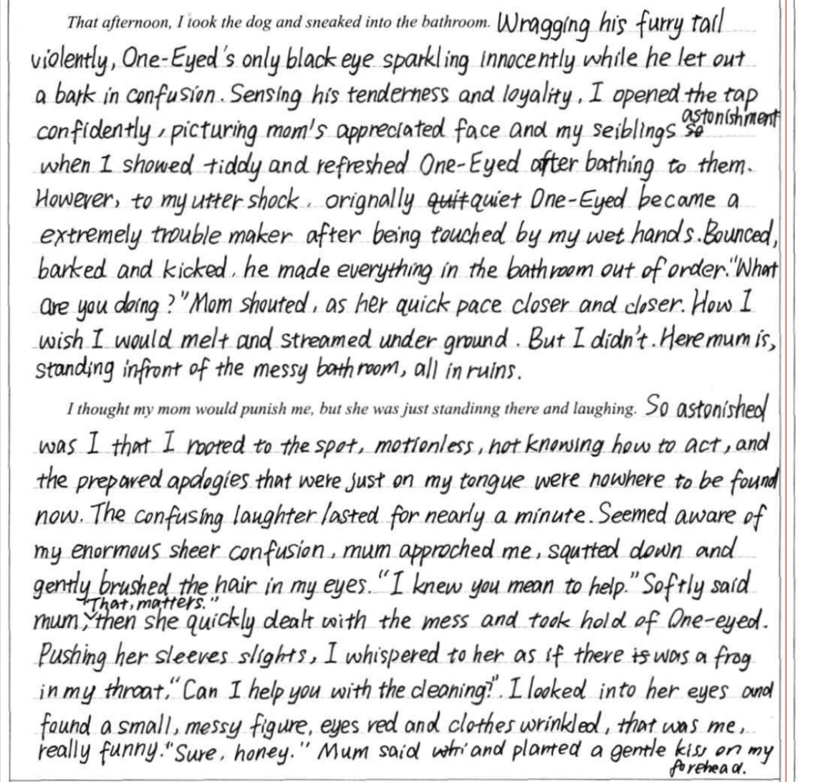
1
段1中，我与狗之间的互动描写得很到位。
续写积累的狗的动作（wagging tail, let out a bark）以及与上文呼应的furry, only black eye.
2. 小孩得意的心理刻画得很生动。
3. 动词用得很生动，mess的来源。
4. 背诵积累的表达和基于上下文的场景描写的有效结合。
5. 很难得的一句语法和意思都到位的直接引语。（I know you meant well. 我知道你本意是好的。）
2
3
4
5
不建议在续写中写很冗长的直接引语。直接引语作为口头表达，如果使用很复杂的语法结构又不符实际情况，但是使用大量简单句又不能增加文章表达的多样性，不能为作文加分。

Slide 19
Task：
除了上述优点，该篇作文在语法，描写和情节上还有一些不足之处，请同学们思考并且结合本堂课内容提出自己的修改建议。

Slide 20
Part 3 例文展示

Slide 21
Para 1--That afternoon, I took the dog and sneaked into the bathroom. Gently I put the shedding, messy and muddy puppy into the bathtub and hushed him so that my secrete mission wouldn’t be spoiled. Wagging his furry tail violently, One-Eyed raised his head and gazed at me with his only eye sparkling innocence and trust. Sensing his loyalty and also his Clorox-like smell, I opened the tap, confidently picturing mom’s appreciative face and my siblings’ astonishment when I presented a tidy, clean and refreshed cutie little dog after bath. I poured the shampoo into the bathwater like mom had done, and meticulously cupped the water to wet the dog. However, to my utter shock, the quiet puppy turned to a trouble maker after being touched. Bouncing, barking and kicking, he uncontrollably made everything in the bathroom a really mess. “What are you doing?” hearing the noise, mom opened the bathroom door and caught us on site.

Slide 22
Para 2-- I thought mom would punish me, but she was just standing there and laughing. I was standing soaked, sobbing in a mixture of confusion and awkwardness, mingled with humiliation and annoyance. My prepared apologies on the tip of my tongue were no where to be found. The confusing laughter lasted for nearly a minute with mom pointing at the another soaked creature in the bathroom. As I turned around, a strange but familiar creature captured my eyes- One-Eyed turned into a messy dog dripping water. The unexpected new version of One-Eyed also amused me, though I still felt a bit sad of being of no help. Mom quickly dealt with the mess and squatted down, brushing my hair with her tender fingers, “I know you meant to help.” I looked into her eyes and found a messy me through the reflection. “Now let me help my little cutie with the bath!” She said and planted a gentle kiss on my forehead.

Slide 23
Part 4 原文欣赏

Slide 24
It was a hot day in Florida, The school year had just ended and it was time for summer vacation. We had just gotten a little black dog who we named One-Eyed. We chose that name because he could only see out of one eye.
Everybody wanted to do something for the dog: feed him, teach him tricks and take long walks with him. Everybody was so happy to have this active, playful, shaggy, sable-coated new addition to our family. Everybody ,that is ,except my mom and me.
All my mom saw when she looked at the dog was someone else to clean up after. Shedding, messy, muddy, he pounced all over the house. All Mom seemed to care about was getting the house cleaned. My mom began to put Clorox in the tub. There was no messing with Mom when she started cleaning, so I decided to move out of the way. Actually ,getting out of the way is a move I'd been practicing for a long time.
Being the youngest in my family has had its advantages, of course. I won't deny that. More than a few times I was spoiled or everyone was convinced that I was the cutest. It wasn't all bad to get this attention. But being the youngest also came with its fair share of troubles. I was often told what I couldn't do and why. I realize that I practiced getting out of the way because most of the time I was being pushed out of the way. “You're too young!” “You're too little! ” You’ll mess this up!“ they'd often say.
I also knew that my family loved me. They always tried to protect me, help me and take care of me ,but I couldn't wait to show them I could do things by myself.
Every time I asked my brother or my sister if I could pet One-Eyed, they would shout, “No!“ or tell me that I had germs. Once, they even convinced me that I had so many germs, if I touched One-Eyed he would die! I really believed them and was scared that something terrible would happen to the dog. Once I even confessed to my mom that I touched the dog when no one noticed. At first ,my mom seemed very confused about what I was telling her, but then she realized that they were playing a joke on me to keep me away from the dog. My mom scolded my brother and sister, “You better stop teasing your little brother!“ Little brother! That's exactly what I was. That really got my blood boiling. I was so mad, I wanted to break something!

Slide 25
I wasn't going to let them make me move out of their way this time! I took one look at the dog and decided ,“I’ll show them what a little kid can do!“ I took the dog into the bathroom. “I'm going to give you a bath!” I said. One-Eyed looked at me strangely; he obviously didn't understand what I was saying. I looked at the sink. Too small, I thought. I looked at the tub. “It stinks like Clorox.“ Then I saw it, The perfect place for a dog bath-the toilet!
I took my sister's shampoo and poured it into the toilet. Then I put the dog in. I was scrubbing all the dirt off the dog with our towels. The finishing touch was to pull down the lever, which I did. But the sound of the toilet made the dog panic like crazy! He tried to escape, but the shampoo was too slippery. While the water was going down, One-Eyed’s legs were going down with it. I was scared, and I didn't want One-Eyed to get hurt. I didn't want to get into trouble or for anyone to find out. I went running down to the garage.
My mom was standing there and laughing, as if she was expecting me, I didn't know what to say, I tried to catch my breath. Then I told her what just happened! thought she would punish me. l didn't expect my mom would be ...laughing.
As it turns out, I later discovered that my mom knew what was happening all along. She always seemed to be a pretty good spy, I guess.
Oh, and if you're wondering, One-Eyed was fine: but he did stay away from me for a while. Even though we never actually had a conversation about my being the youngest ,I think Mom understood what I was trying to do. l was trying to make my own place in our family... trying, maybe some-times in a weird way to declare my independence. Flushing the dog down the toilet might not sound like a Declaration of Independence, but for a six-year-old well, it was my best shot!
Pier Novelli ,twelve

Slide 26
感谢观看！

