Slide 1

感恩遇见，相互成就，本课件资料仅供您个人参考、教学使用，严禁自行在网络传播，违者依知识产权法追究法律责任。
更多教学资源请关注
公众号：溯恩高中英语
知识产权声明

Slide 2
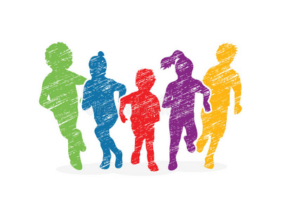
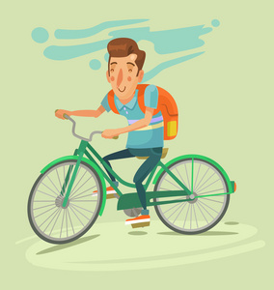
2023.12
2023年12月北斗星联盟
读后续写讲评
----a backpack full of frozen
chicken on a hot summer day

Slide 3
原文呈现
It was a warm summer morning. I was reading the glossary specials in the paper when I found a particularly good deal--the bonus chicken packs: chicken quarters packed in family sizes. But if I drove over to the store for just one item, wouldn't the gas cost cut into the savings?
Five minutes later, I was headed to the store on my bike: helmet on my head and old package on my back. As I rode the two miles to the store, I noticed the temperature seemed to have gone up a little. When I entered the store, I headed straight to the chicken counter. I picked a package weighing slightly over ten pounds, and then headed for the checkout.
After getting outside, reality set in when the air hit my face. It was really hot. I realized I didn't have the car, so the chicken would be riding on my back. I put it into my backpack and thought to myself, “It's only two miles. If I concentrate, I will be home in no time.” Actually the partially frozen chicken felt cold against my back, but the rest of me was beginning to sweat.
As I approached a signal light, it turned yellow so I stopped. Suddenly, I heard a woman screaming. The light turned green but the cars didn't move. Maybe there had been an accident? I looked behind me even though I never heard any cars crash.
What I saw was a small crowd of people coming up the road towards me. I heard someone yell, “I'm a nurse.” I looked around again and still, no accident. Moving faster, this crowd of folks started talking loudly in my direction. “Are you all right? We are here to help.” “Who are they talking to?” I wondered. “Can we help you?” They all asked. Out of the corner of my eye, I saw traffic piling up. I was confused! “No!” I told the crowd. “I'm fine.”
Para1: It was their turn to look confused.
Para2: I pointed to the backpack as I started to laugh.

Slide 4
Read for the characters
It was a warm summer morning. I was reading the glossary specials in the paper when I found a particularly good deal--the bonus chicken packs: chicken quarters packed in family sizes. But if I drove over to the store for just one item, wouldn't the gas cost cut into the savings?
Five minutes later, I was headed to the store on my bike: helmet on my head and old package on my back. As I rode the two miles to the store, I noticed the temperature seemed to have gone up a little. When I entered the store, I headed straight to the chicken counter. I picked a package weighing slightly over ten pounds, and then headed for the checkout.
After getting outside, reality set in when the air hit my face. It was really hot. I realized I didn't have the car, so the chicken would be riding on my back. I put it into my backpack and thought to myself, “It's only two miles. If I concentrate, I will be home in no time.” Actually the partially frozen chicken felt cold against my back, but the rest of me was beginning to sweat.
As I approached a signal light, it turned yellow so I stopped. Suddenly, I heard a woman screaming. The light turned green but the cars didn't move. Maybe there had been an accident? I looked behind me even though I never heard any cars crash.
What I saw was a small crowd of people coming up the road towards me. I heard someone yell, “I'm a nurse.” I looked around again and still, no accident. Moving faster, this crowd of folks started talking loudly in my direction. “Are you all right? We are here to help.” “Who are they talking to?” I wondered. “Can we help you?” They all asked. Out of the corner of my eye, I saw traffic piling up. I was confused! “No!” I told the crowd. “I'm fine.”
Para1: It was their turn to look confused.
Para2: I pointed to the backpack as I started to laugh.
Characters:
I
who rode to the store for bonus chicken packs on the summer morning
the crowd
warm-hearted passers-by who flocked towards me to offer me help

Slide 5
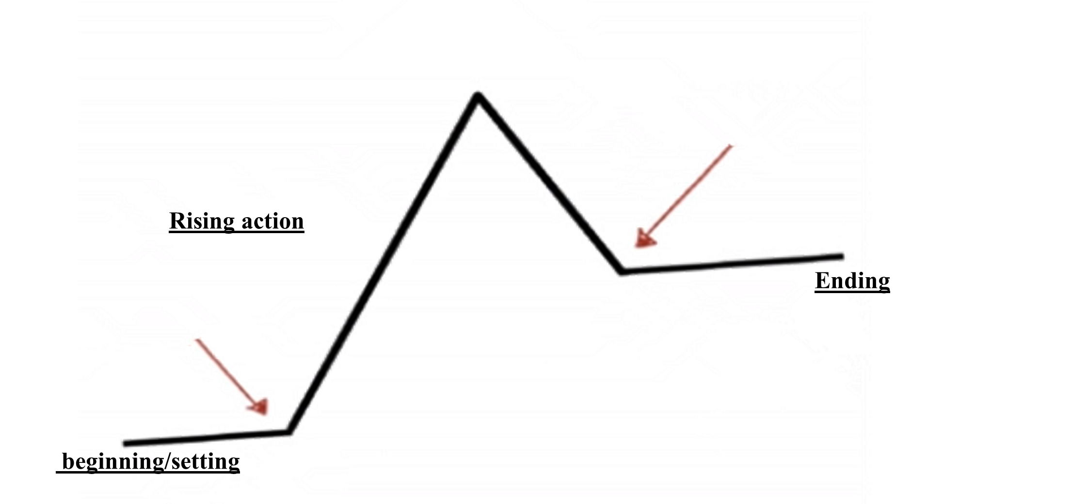
Read for plot
①
It was a warm summer morning. I was reading the glossary specials in the paper when I found a particularly good deal--the bonus chicken packs: chicken quarters packed in family sizes. But if I drove over to the store for just one item, wouldn't the gas cost cut into the savings?
Five minutes later, I was headed to the store on my bike: helmet on my head and old package on my back. As I rode the two miles to the store, I noticed the temperature seemed to have gone up a little. When I entered the store, I headed straight to the chicken counter. I picked a package weighing slightly over ten pounds, and then headed for the checkout.
After getting outside, reality set in when the air hit my face. It was really hot. I realized I didn't have the car, so the chicken would be riding on my back. I put it into my backpack and thought to myself, “It's only two miles. If I concentrate, I will be home in no time.” Actually the partially frozen chicken felt cold against my back, but the rest of me was beginning to sweat.
As I approached a signal light, it turned yellow so I stopped. Suddenly, I heard a woman screaming. The light turned green but the cars didn't move. Maybe there had been an accident? I looked behind me even though I never heard any cars crash.
What I saw was a small crowd of people coming up the road towards me. I heard someone yell, “I'm a nurse.” I looked around again and still, no accident. Moving faster, this crowd of folks started talking loudly in my direction. “Are you all right? We are here to help.” “Who are they talking to?” I wondered. “Can we help you?” They all asked. Out of the corner of my eye, I saw traffic piling up. I was confused! “No!” I told the crowd. “I'm fine.”
②
③
④
⑤
Climax
para4-5: A crowd of people came towards me trying to offer help, which made me really confused.
para3: I had to put the chicken into my package and because of the hot weather, I soon bagan to sweat.
para1: It was their turn to look confused.
falling action
para2: I pointed to the backpack as I started to laugh.
para1-2: I rode to the store to buy the bonus chicken packs on a summer morning.

Slide 6
Read for the foreshadowings(伏笔/铺垫)
It was a warm summer morning. I was reading the glossary specials in the paper when I found a particularly good deal--the bonus chicken packs: chicken quarters packed in family sizes. But if I drove over to the store for just one item, wouldn't the gas cost cut into the savings?
Five minutes later, I was headed to the store on my bike: helmet on my head and old package on my back. As I rode the two miles to the store, I noticed the temperature seemed to have gone up a little. When I entered the store, I headed straight to the chicken counter. I picked a package weighing slightly over ten pounds, and then headed for the checkout.
After getting outside, reality set in when the air hit my face. It was really hot. I realized I didn't have the car, so the chicken would be riding on my back. I put it into my backpack and thought to myself, “It's only two miles. If I concentrate, I will be home in no time.” Actually the partially frozen chicken felt cold against my back, but the rest of me was beginning to sweat.
As I approached a signal light, it turned yellow so I stopped. Suddenly, I heard a woman screaming. The light turned green but the cars didn't move. Maybe there had been an accident? I looked behind me even though I never heard any cars crash.
What I saw was a small crowd of people coming up the road towards me. I heard someone yell, “I'm a nurse.” I looked around again and still, no accident. Moving faster, this crowd of folks started talking loudly in my direction. “Are you all right? We are here to help.” “Who are they talking to?” I wondered. “Can we help you?” They all asked. Out of the corner of my eye, I saw traffic piling up. I was confused! “No!” I told the crowd. “I'm fine.”
Para1: It was their turn to look confused.
Para2: I pointed to the backpack as I started to laugh.
？
the hot weather
the partially frozen chicken in my packpack
I began to sweat when riding back home
Why did the crowd kept asking me if I was all right/if I needed help?
？

Slide 7
Design the following plot based on 3Qs
Para1: It was their turn to look confused.
Para2: I pointed to the backpack as I started to laugh.
Q1 ___________________________________________________(与第一段首句衔接)
Q2____________________________________________________(情节推动)
Q3____________________________________________________(与第二段首句衔接)
What would they do and say?(Why were they confused)
What would I do?
Why did I point to the backpack?
Q1 __________________________________________________(与第二段首句衔接)
Q2___________________________________________________(情节推动)
Q3___________________________________________________(文章主题)
Why did I start to laugh? (What might I say)
What might their reaction be?
What is the theme of the experience?
(the purpose of my sharing story)

Slide 8
首尾呼应
It was a warm summer morning. I was reading the grocery specials in the paper when I found a particularly good deal--the bonus chicken packs: chicken quarters packed in family sizes.
这是一个暖和的夏日早晨。我在读报纸上的食品杂货特辑时，我发现了一笔特别划算的交易——鸡肉套餐:按家庭大小打包的鸡肉。
开头
这是一个意想不到的凝聚时刻，而这一切都是由炎热夏天里的一个装满冷冻鸡肉的背包所引发的。
结尾
It was an unexpected moment of community, all sparked by a backpack full of frozen chicken on a hot summer day.

Slide 9
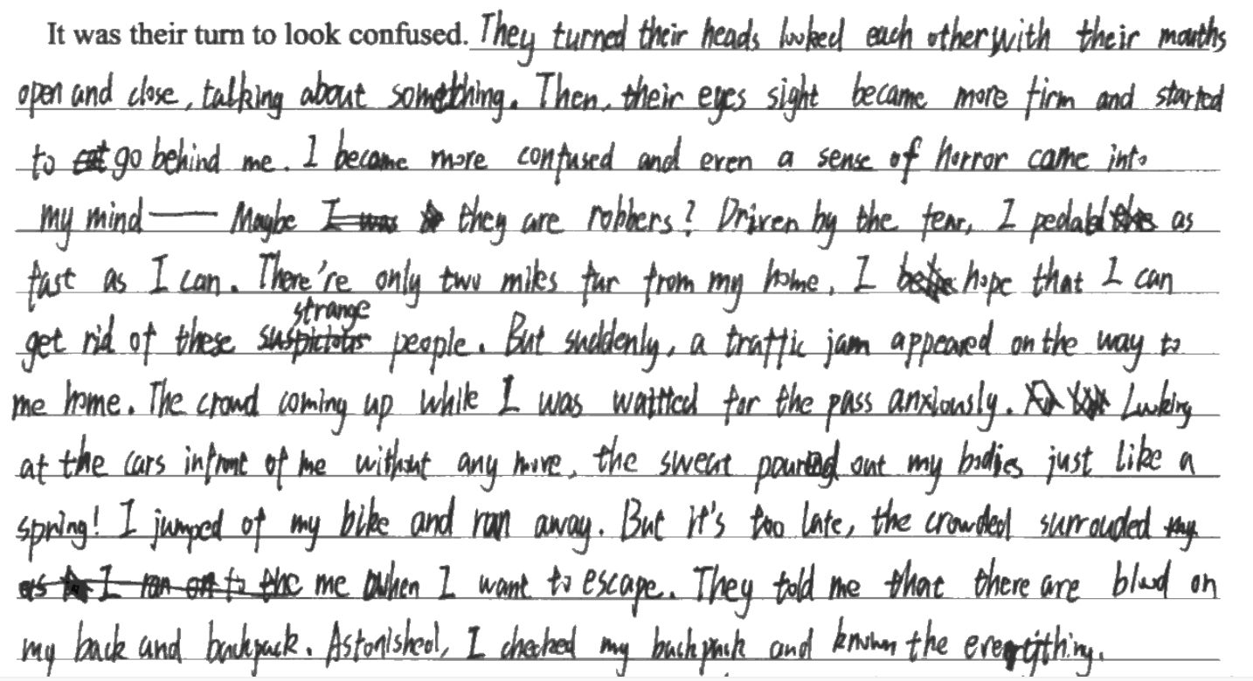
学生考场作文问题
Para 1:
红色划线： 均为不恰当情节或无效情节(所有的情节必须与原文及两个段首句协同；必须与主题协同)

Slide 10
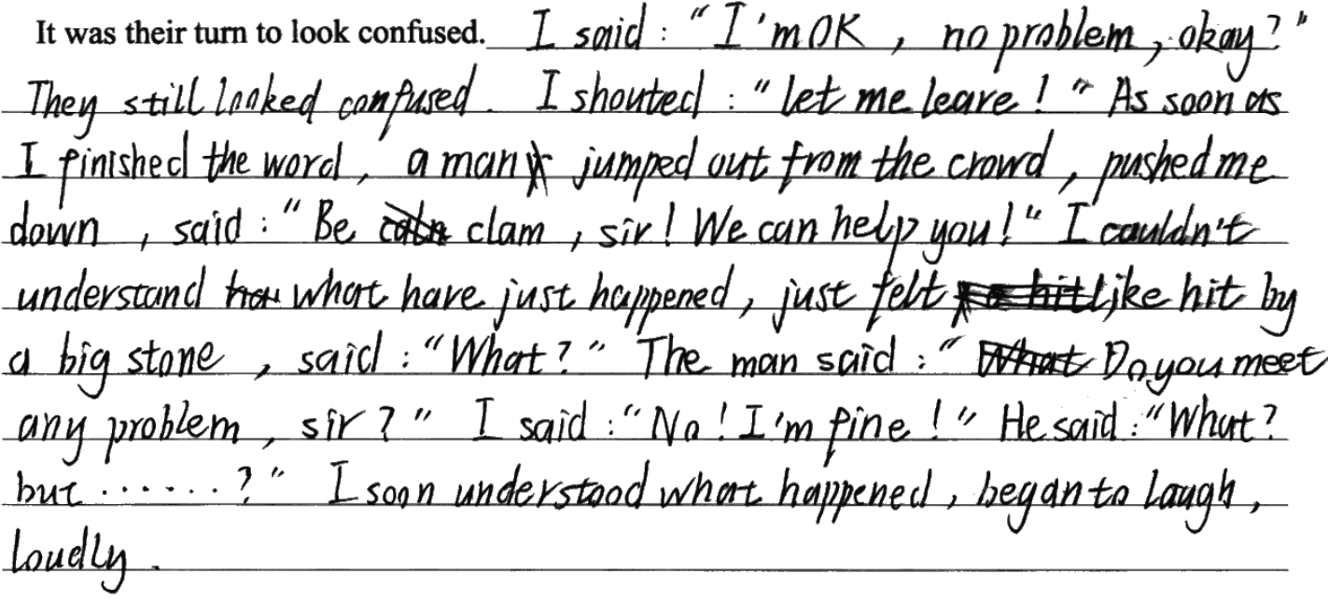
学生考场作文问题
Para 1:
红色划线： 整个段落几乎由你问我答的对话组成，而且对话生硬。

Slide 11
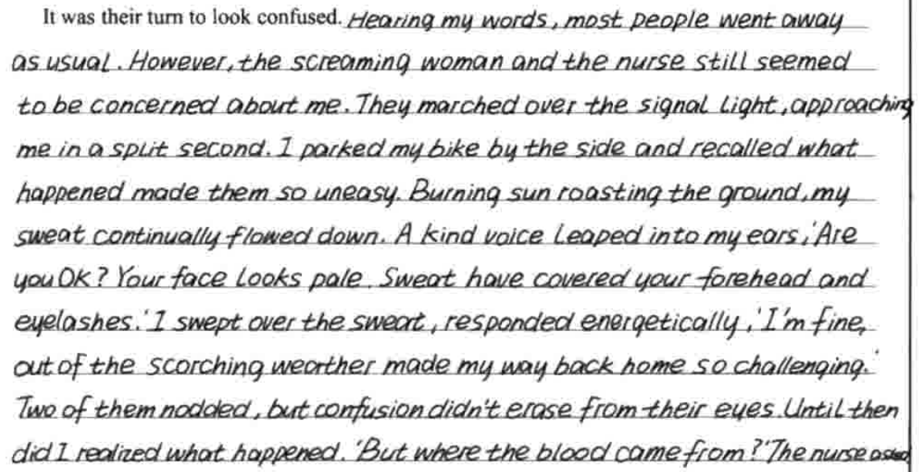
学生考场作文问题
Para 1:
红色划线：为不恰当情节或无效情节，原因：没有抓住关键点-人群为什么会来问我是否受伤(受伤的外在表现)。

Slide 12
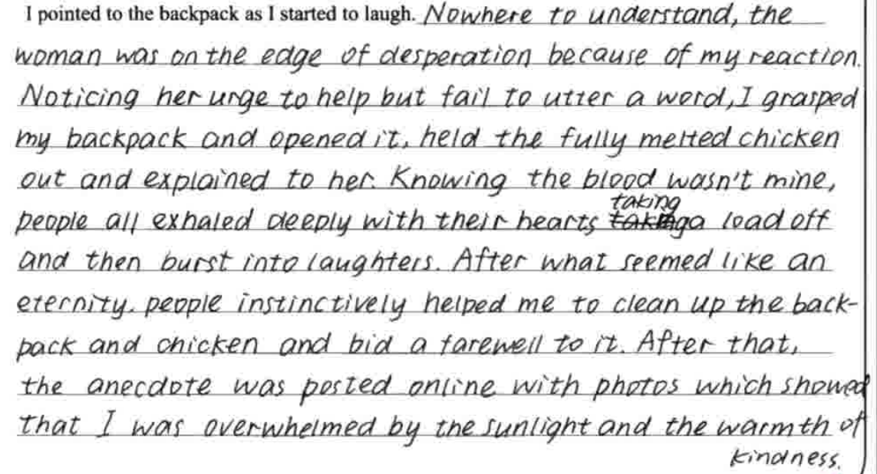
学生考场作文问题
Para 2:
红色划线：与段首句衔接不合理（根据段首句“I started to laugh”，接下来应该写“我”而不是“人群”或某个“路人”）

Slide 13
学生考场作文问题
第一段：
部分学生全部或大量使用“直接引语”，使第一段缺乏画面感和镜头感。
花大篇幅继续描写the crowd和我之间的相互观望和好奇，情节详略处理不当，原因：没有把握第一段首句的关键信息。
部分学生增添了情节，例如鸡是活鸡，鸡在发出声音，我真的受伤了，或者真的发生了车祸等，原因：没有读懂原文，没有遵循读后续写的“读-析-构-写”。
第二段：
部分学生在文章结尾写到作者邀请the crowd（当时在马路上可能各自有事）去家里一起吃鸡（10磅=9.0718474 斤），不符合逻辑。
整体：
语言准确性欠佳，低级错误例如时态错误，拼写错误，搭配错误等很多。
语言丰富性欠佳，有些学生通篇是简单的主谓宾结构。
情节欠妥，没有把握原文关键内容及两个段首句，导致续写内容与原文及主题不协同。

Slide 14
Para 1: It was their turn to look confused.
Q1: What would they do and say? (Why were they confused)
1-1.人群中有人大声说：“但是你浑身都在流血！你为什么不下车检查一下呢?”
spoke up
are bleeding all over
Someone in the crowd _________, “But you _______________________!
Why ________________ your bike and ________?”
don't you get off
check
Q2: What would I do?-What would the crowd do?
2-1.听到这些，我感到很惊讶，我照做了.
Surprised at what I had heard
what he suggested
__________________________, I did ____________________.
2-2.我刚下车，人群就围住了我(no sooner)，有人帮我扶自行车，另一个人帮我把背包拿下来。
No sooner had I got off than the crowd gathered around me
helping
___________________________________________________, someone ________ me ____ my bike _____ another person _________ me __________ my backpack _____ .
hold
while
assisting
in getting
off
2-3.其他人用手指着我的背，一脸担忧地问:“你出车祸了吗?”你受伤了吗?”
pointed at
with their faces full of concern
Others _________ my back and asked ___________________________, “ ________________ a car accident? ________________?”
Have you been in
Are you injured

Slide 15
Para 1: It was their turn to look confused.
Q3: Why did I point to the backpack?
3-1.被奇怪的问题包围着，我跟着他们担忧的目光，扭头看了看自己的背。令我震惊的是，我发现我的背上和胳膊上都有血迹。
followed their worried gazes
twisted to see
_____________ strange questions, I ________________________ and _____________ my back. ____________ , I _____________________ on my back __________ on my arms.
Peppered with
To my shock
discovered blood stains
as well as
3-2.然后我无意中瞥了一眼躺在地上的背包，却发现(only)它周围也有一个红圈。直到那时我才意识到发生了什么事。(强调句)
lying on
And then I ____________________________ my backpack __________ the ground, ____________ that there was also a red ring around it. ______________________ I realized __________________.
unintentionally cast a glance at
only to find
It was not until then that
what had happened

Slide 16
Para 2: I pointed to the backpack as I started to laugh.
Q1: Why did I start to laugh? (What might I say and do)
1-1.“是我的鸡肉（的原因），”我告诉这群吓坏了的人。
told
frightened
“It's my chicken,” I ______ the ___________ group of people.
1-2.我一边解释一边打开背包.映入他们眼帘的是十磅重的鸡块,里面的冰已经严重融化了.(定语从句)
as
What came into their view
I explained ____ I opened my backpack. _________________________ was the ten-pounds chicken parts, the ice of _______ _______________________ .
which
had seriously melted
1-3.很明显,水和血的混合物浸透了我的背包,溅了我一身,这就是为什么我看起来像个事故受害者。
It was apparent that
mixture
had run through
__________________ the ________ of water and blood ________________ my backpack and all over me, _____________________ I _________ an accident _______.
which is the reason why
looked like
victim
Q2: What might their reaction be?
2-1.在短暂的沉默和惊讶之后，人群突然爆发出笑声。
a brief moment
silence and astonishment
After ______________ of __________________________, the crowd suddenly ____________________________.
erupted/burst into laughter
Q3: What is the theme?
3.突然的关心所引起的紧张变成了共同的乐趣。这是一个意想不到的凝聚时刻，在炎热的夏天，一个装满冷冻鸡肉的背包引发了这一切。
tension
sudden concern
transformed into shared amusement
The _________ from the _____________ _______________________________. It was an __________ moment of ___________, all ___________ a backpack full of _______ chicken on a hot summer day.
unexpected
community
sparked by
frozen

Slide 17
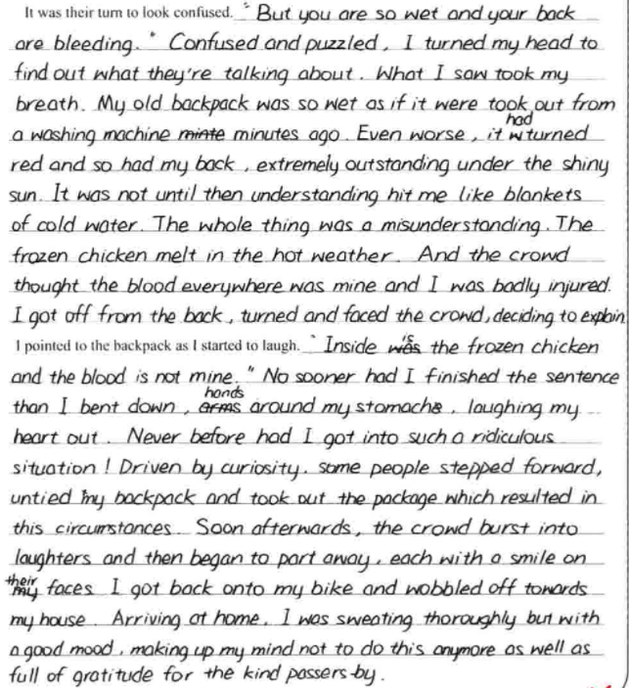
高分作文赏析
该考生在读懂原文的基础上，对两段进行了情节合理的续写，既体现了陌生人的关心担忧，也描写了造成这个误解的原因，情节合理；而且语言结构丰富，语言错误少，语言句式结构丰富，可读性强。

Slide 18
下水作文
Para 1: It was their turn to look confused. Someone in the crowd spoke up, “But you are bleeding all over! Why don't you get off your bike and check?”Amazed at what I had heard, I did what he suggested. No sooner had I got off than the crowd gathered around me, someone helping me hold bike while another person assisting me in getting my backpack off. Others pointed at my back and asked with their faces full of concern, “ Have you been in a car accident? Are you injured?” Peppered with strange questions, I followed their worried gazes and twisted to see my back. To my shock, I discovered blood stains on my back as well as on my arms and legs. And then I unintentionally cast a glance at my backpack lying on the ground, only to find that there was also a red ring around it. It was not until then that I realized what had happened.
Para 2: I pointed to the backpack as I started to laugh.“It's my chicken,” I told the frightened group of people. I explained as I opened my backpack. What came into their view was the ten-pounds chicken parts, the ice of which had seriously melted. It was apparent that the mixture of water and blood had ran through my backpack and all over me, which is the reason why I looked like an accident victim. After a brief moment of silence and astonishment, the crowd suddenly erupted/burst into laughter. The tension from the sudden concern transformed into shared amusement. It was an unexpected moment of community, all sparked by a backpack full of frozen chicken on a hot summer day.

Slide 19
续写结尾
Para 1: It was their turn to look confused. Someone spoke up, “You are bleeding all over! Why don't you get off your bike and check?” I got off my bike. Willing hands held my bike and helped me get my backpack off. “Were you in an accident? Were you wounded?” I was peppered with strange questions. Then I looked down at my backpack, sitting now on the white concrete line of road. There was a red ring around it! I realized my arms and legs also had “blood” on them.
Para 2: I pointed to the backpack as I started to laugh. “It's my chicken,” I told the frightened group of people. They opened my backpack not knowing what to expect. And they found ten pounds of chicken parts, the ice of which had seriously melted. The mixture of water and blood ran through my backpack and all overme. I looked like an accident victim. Suddenly, everyone was laughing out of relief. The tension from the sudden concern transformed into shared amusement. It was an unexpected moment of community, all sparked by a backpack full of frozen chicken on a hot summer day.

