Slide 1


感恩遇见，相互成就，本课件资料仅供您个人参考、教学使用，严禁自行在网络传播，违者依知识产权法追究法律责任。
更多教学资源请关注
公众号：溯恩高中英语
知识产权声明

Slide 2



Slide 3

阅读理解满分思维策略——精通词义延伸方式和过程
2023年英语高考全国卷应用文写作试题的新动向预示着今后英语写作教学应着重培养以下几方面能力：
用英语描述事件、描述个人经历和事物特征的能力；
描述、概括真实的经验和事实的能力；
传递信息、论证观点、表达情感的能力；
对观点、事件、经验进行阐释和评论的能力等。
因此，今后的英语写作教学既要关注如何写，更要关注写什么；既要关注写作结果，更要注重写作过程；既要关注写作的准确性，更要关注写作的流畅性；既要有适当的模仿和借鉴，但更要有创造，要使学生能够用英语进行真实表达。
①主题句本身会包含核心话题和决定语篇发展方向的控制性信息，主要陈述部分则需要将控制性信息进行语义延展，为支撑主题句服务。
②利用关键词重复来突出并强化主旨。核心关键词存在复现的关系，围绕同一主题前后呼应，形成词汇链和语义链，使文本语际间实现语义上的衔接和连贯。
③利用语义场保证主题和语义传递取得统一（信息流flow的桥梁通道）。 阅读过程中要善于扫描同词/同话题词，建构语义场，搭建信息流flow的通道。尤其注意paraphrase(释文，改述，换说)的地方往往是题眼。
Notes:
联系 系统 真实挑战
应用 迁移
大概念不是法则，从左到右，先算个位后算十位，从低位到高位。 乘除法规则运算：先分后合
最核心的是什么？
基于知识技能 高于知识技能 的思想 理念 认识 准则
自主学习能力
选择不同的工具进行测量，能够准确表示。高楼 大树 不能测量可以选择参照物估测。
真实的 挑战性
教室的高 楼房的高
大概念可以是各种形式的体现：一个词、一个短语、一个句子或者一个问题
站位很高，长远的目标，指向学生核心素养，抓住大概念，抓住基本问题，实现预期结果和目标

Slide 4

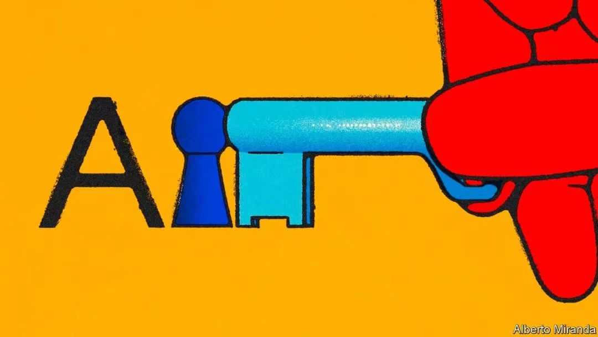

A篇阅读理解满分秒杀策略
1. 快速打开A篇阅读理解的方式：
①快速读取文章标题/主题句/文章主旨大意（一般在第一段）
②浏览文章的框架结构/语篇组织（达成宏观把握，方便定位信息）
③题干关键词快速回到原文定位信息源（题目=阅读提纲）
2. 先做直接辨认型：
单点直接信息题（带问题寻读跳读---获取文本信息--选项对号入座）
3. 再做间接辨认型：
多点信息题（多点信息群---注重对特定细节的筛选、类比、综合，加工转换--正确释义）
Notes:
联系 系统 真实挑战
应用 迁移
大概念不是法则，从左到右，先算个位后算十位，从低位到高位。 乘除法规则运算：先分后合
最核心的是什么？
基于知识技能 高于知识技能 的思想 理念 认识 准则
自主学习能力
选择不同的工具进行测量，能够准确表示。高楼 大树 不能测量可以选择参照物估测。
真实的 挑战性
教室的高 楼房的高
大概念可以是各种形式的体现：一个词、一个短语、一个句子或者一个问题
站位很高，长远的目标，指向学生核心素养，抓住大概念，抓住基本问题，实现预期结果和目标

Slide 5
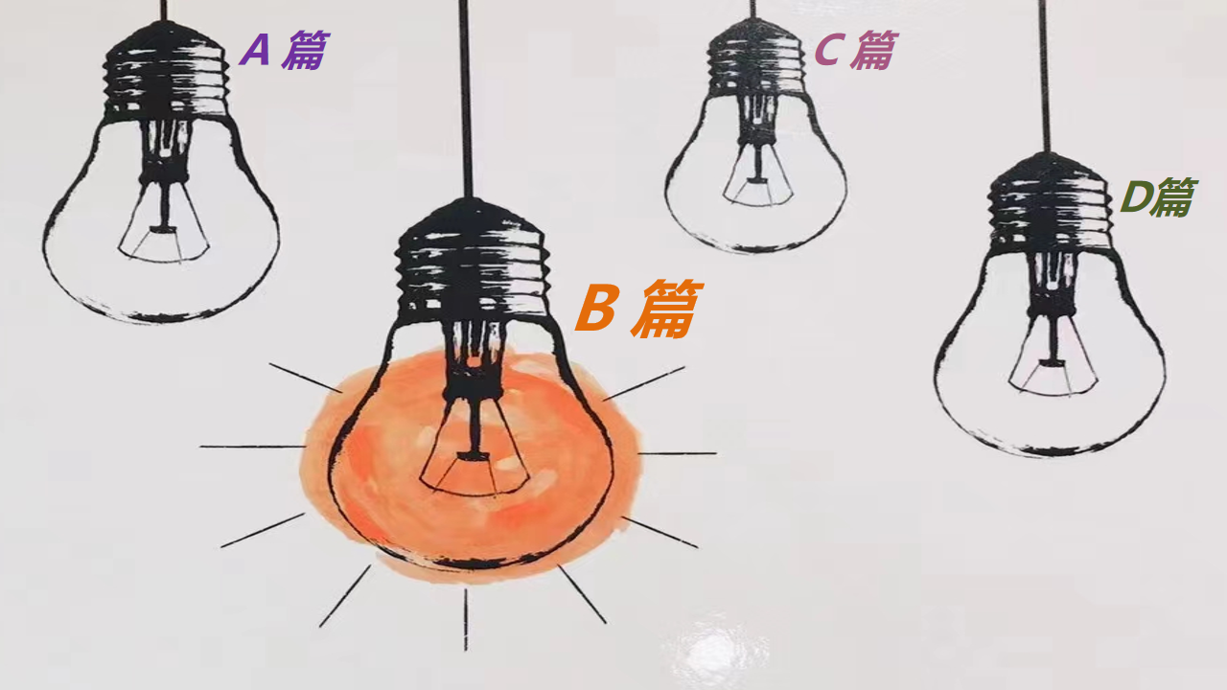
B篇阅读理解满分秒杀策略
1.B篇阅读要强化“作者意识”：
B篇阅读，多为体现立德树人，语言表现力强的记叙文，常常以细腻的语言呈现一个暖心或是励志的故事，考生需强化“作者意识_{含命题者}”，体验不同情感，感受正确的人生观和价值观。
作为阅读者，唯有站在作者的立场上，试着从作者的角度_{（命题人的角度多半也是作者的角度）}出发，去揣测、想象、推敲作者要表达的真实意图，把握人物特征，才能秒懂语言组织之道，才能洞悉文本内涵之妙，并快速精准答题。
Notes:
联系 系统 真实挑战
应用 迁移
大概念不是法则，从左到右，先算个位后算十位，从低位到高位。 乘除法规则运算：先分后合
最核心的是什么？
基于知识技能 高于知识技能 的思想 理念 认识 准则
自主学习能力
选择不同的工具进行测量，能够准确表示。高楼 大树 不能测量可以选择参照物估测。
真实的 挑战性
教室的高 楼房的高
大概念可以是各种形式的体现：一个词、一个短语、一个句子或者一个问题
站位很高，长远的目标，指向学生核心素养，抓住大概念，抓住基本问题，实现预期结果和目标

Slide 6
B篇阅读理解满分秒杀策略
2.快速从尾段获取评议，精准读懂文章：
快速从尾段获取人物、情节、情感的主题信息到位。
根据拉波夫叙事模式， B篇记叙文的尾段通常包括评议、结局、回应。 评议是叙事者或故事中人物对事件的看法和态度；结局是故事的完结；回应是故事与现实生活的纽带，用来点明主旨，升华主题。
直接从尾段阅读能快速激发直觉的情感体验，把握文脉走向，预测全文大意，找准文本的情感契合点。情感体验是一种全方位、全历程、全情境的整体性体验，通过后文尾段初步体验（基本可以解决 第27题），再依据试题题干指引，构建语义场，深化文本主题的感悟，分析作者所表达的思想情感，领悟作者的立意。
Notes:
联系 系统 真实挑战
应用 迁移
大概念不是法则，从左到右，先算个位后算十位，从低位到高位。 乘除法规则运算：先分后合
最核心的是什么？
基于知识技能 高于知识技能 的思想 理念 认识 准则
自主学习能力
选择不同的工具进行测量，能够准确表示。高楼 大树 不能测量可以选择参照物估测。
真实的 挑战性
教室的高 楼房的高
大概念可以是各种形式的体现：一个词、一个短语、一个句子或者一个问题
站位很高，长远的目标，指向学生核心素养，抓住大概念，抓住基本问题，实现预期结果和目标

Slide 7
B篇阅读理解满分秒杀策略
3.主旨大意标题类/人物事件特征类的
解题策略：
①从词汇特性角度体现情感上的概括性：
浏览全文，扫描有关描述人或事特征的相关词汇，建构主题相关的语义场。
②从语篇结构角度体现评价上的吻合度：
与尾段人物或事件评价在词汇换说上的吻合度
Notes:
联系 系统 真实挑战
应用 迁移
大概念不是法则，从左到右，先算个位后算十位，从低位到高位。 乘除法规则运算：先分后合
最核心的是什么？
基于知识技能 高于知识技能 的思想 理念 认识 准则
自主学习能力
选择不同的工具进行测量，能够准确表示。高楼 大树 不能测量可以选择参照物估测。
真实的 挑战性
教室的高 楼房的高
大概念可以是各种形式的体现：一个词、一个短语、一个句子或者一个问题
站位很高，长远的目标，指向学生核心素养，抓住大概念，抓住基本问题，实现预期结果和目标

Slide 8

1
一分钟精准秒杀A篇阅读理解
—— 先主题框架，再题干关键词，
后原文快速定位信息源
Part

Slide 9
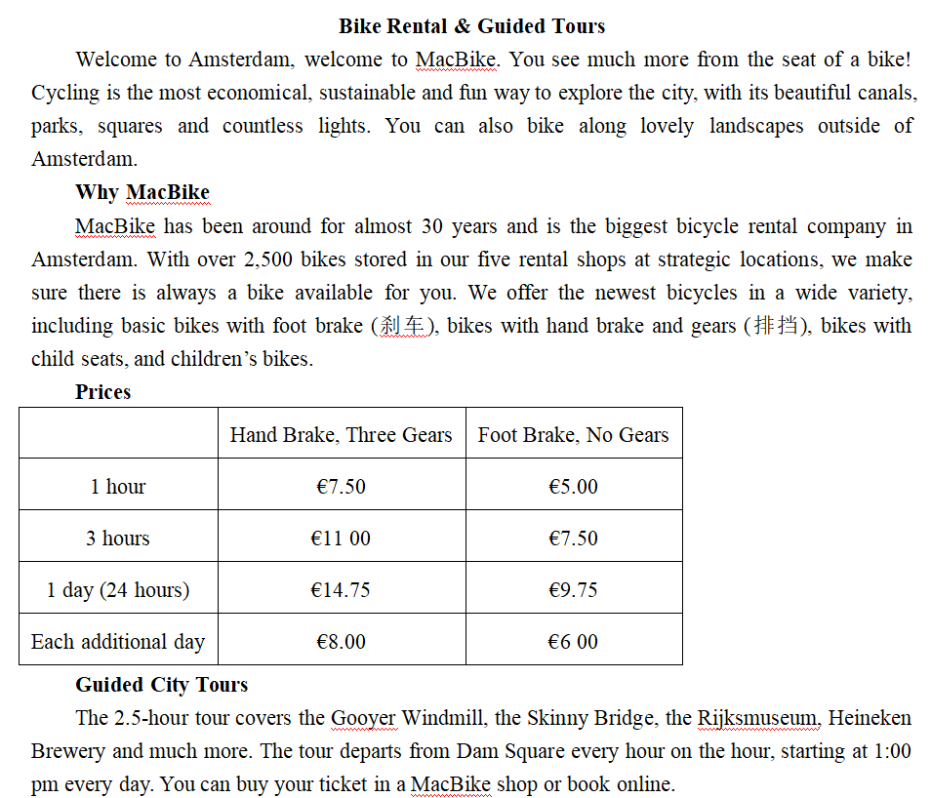
2023年6月全国Ⅰ卷A篇满分秒杀思维策略
1.快速浏览文章的框架结构
标题统领语篇，获取文本大意“自行车租赁和导游观光”的广告。
快速浏览文章的框架结构，把握宏观语篇组织，方便定位信息，形成秒杀。
21. What is an advantage of MacBike? A. It gives children a discount.
B. It of offers many types of bikes. C. It organizes free cycle tours.
D. It has over 2,500 rental shops. 22. How much do you pay for renting a bike with hand brake and three gears for two days? A. €15.75. B. €19.50.
C. €22.75. D. €29.50. 23. Where does the guided city tour start? A. The Gooyer, Windmill.
B. The Skinny Bridge. C. Heineken Brewery.
D. Dam Square.

Slide 10
2023年6月全国Ⅰ卷A篇满分秒杀思维策略
2.根据题干关键词
快速回到原文定位信息源
找到题干在原文中的出处，和选项进行比较和信息对等。做题时，根据所提问题用寻读的方法实现秒杀正确答案。
1. What is an advantage of MacBike? A. It gives children a discount.
B. It of offers many types of bikes. C. It organizes free cycle tours.
D. It has over 2,500 rental shops. 2. How much do you pay for renting a bike with hand brake and three gears for two days? A. €15.75. B. €19.50.
C. €22.75. D. €29.50. 3. Where does the guided city tour start? A. The Gooyer, Windmill.
B. The Skinny Bridge. C. Heineken Brewery.
D. Dam Square.

Slide 11
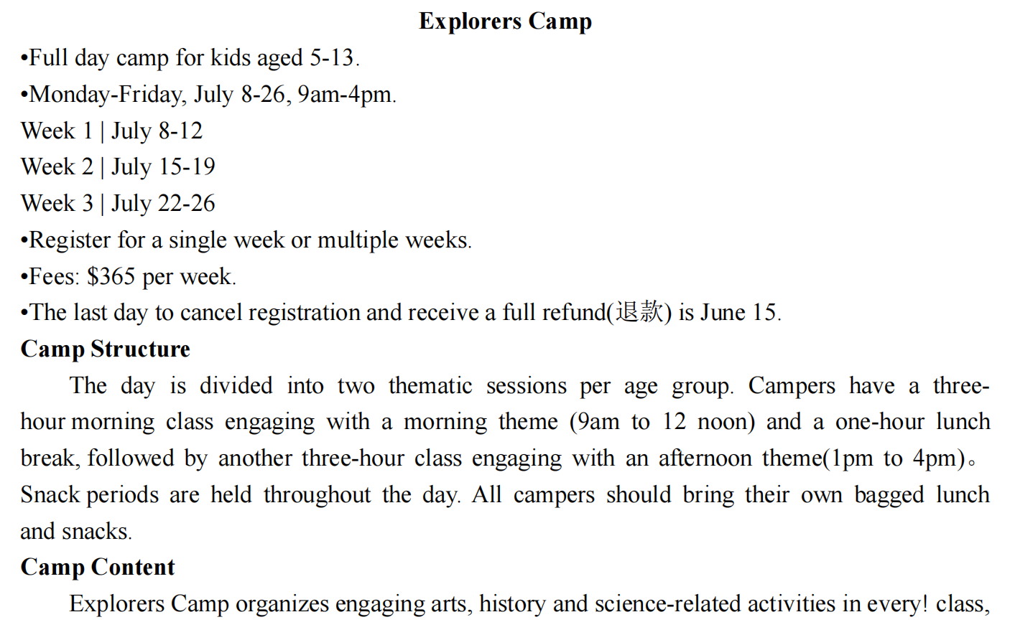
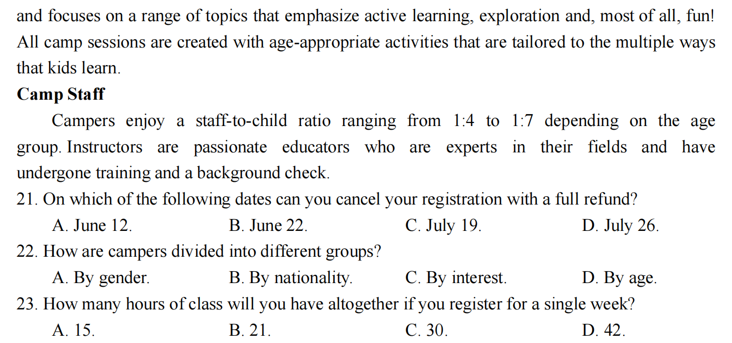
2023年1月浙江高考A篇满分秒杀思维策略
带问题快速寻读信息，筛选加工
题号 | 考查要点 | 信息采集点
21 | 日期推算 Which date? | 信息点对点，带问题寻读---获取文本信息---选项对号入座
22 | 分组依据 How divided? | 快速扫描多点信息群（age）---关联并综合
23 | 数字计算 How many hours? | 信息综合以及数字计算题。 快速对文本寻读，筛选的信息进行分析、关联和阐释，将非连续性文本传递的信息完整化、逻辑化。 a single week共5天，每天上下午 各3hours, 共计30hours。

Slide 12
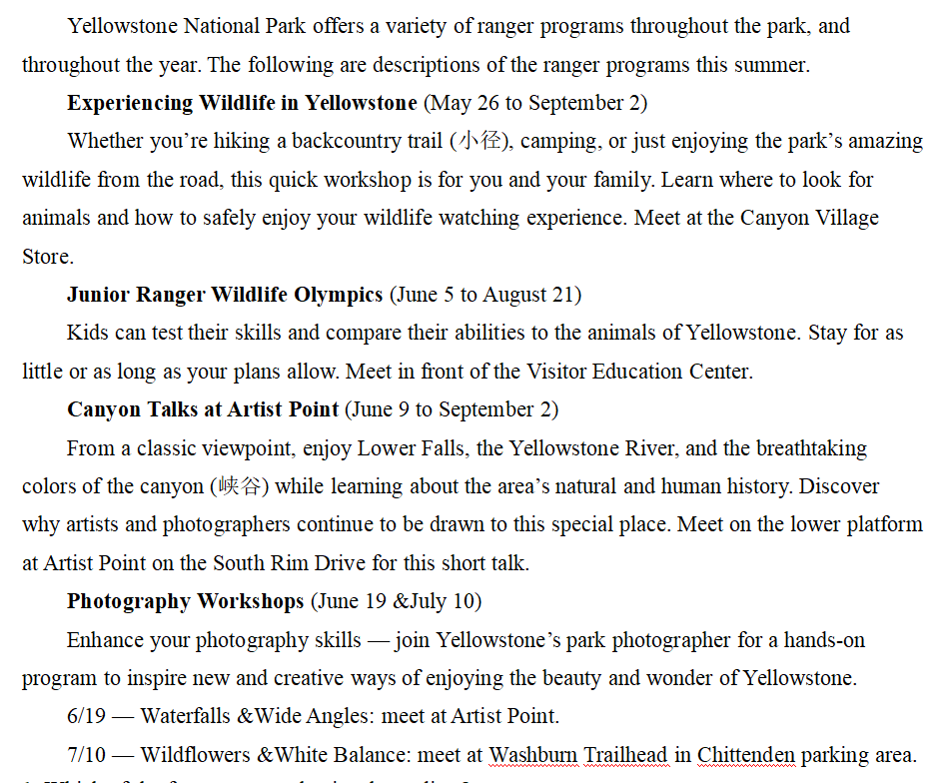
2023年6月全国Ⅱ卷A篇满分秒杀思维策略
快速打开A篇的科学方式
1.快速读取第一段获取文章主题句
2. 浏览文章的框架结构: 4个护林员项目（达成宏观把握，方便定位信息）
3. 题干关键词快速回到原文定位信息源：21和23题（带问题寻读---获取文本信息--选项对号入座）
21. Which of the four programs begins the earliest? A. Photography Workshops.
B. Junior Ranger Wildlife Olympics. C. Canyon Talks at Artist Point.
D. Experiencing Wildlife in Yellowstone. 23. Where will the participants meet for the July 10 photography workshop? A. Artist Point.
B. Washburn Trailhead. C. Canyon Village Store.
D. Visitor Education Center.

Slide 13
2023年6月全国Ⅱ卷A篇满分秒杀思维策略
敏感捕捉关键信息
第22题解题关键是this/the short talk 与 Canyon Talks的指代关系，因此敏感捕捉题干设问为整段的信息的处理和概括。
从原文信息enjoy ... while learning about the area’s natural and human history可敏感捕捉本段特色关键信息history。因此具备敏感捕捉关键信息的意识与能力是秒杀的基础。
22. What is the short talk at Artist Point about? A. Works of famous artists.
B. Protection of wild animals. C. Basic photography skills.
D. History of the canyon area.

Slide 14

2
两分钟精准秒杀B篇阅读理解
—— 快速从尾段获取人物、情节、情感到位，
建构语义场，秒杀正确答案
Part

Slide 15
2023年6月全国新课标I卷B篇满分秒杀思维策略
从尾段快速获取主题信息
When John Todd was a child, he loved to explore the woods around his house, observing how nature solved problems. A ditry stream, for example, often became clear after flowing through plants and along rocks where tiny creatures lived. When he got older, John started to wonder if this process could be used to clean up the messes people were making.
After studying agriculture, medicine, and fisheries in college, John went back to observing nature and asking questions. Why can certain plants trap harmful bacteria (细菌)? Which kinds of fish can eat cancer-causing chemicals? With the right combination of animals and plants, he figured, maybe he could clean up waste the way nature did. He decided to build what he would later call an eco-machine.
The task John set for himself was to remove harmful substances from some sludge (污泥). First, he constructed a series of clear fiberglass tanks connected to each other. Then he went around to local ponds and streams and brought back some plants and animals. He placed them in the tanks and waited. Little by little, these different kinds of life got used to one another and formed their own ecosystem. After a few weeks, John added the sludge.
He was amazed at the results. The plants and animals in the eco-machine took the sludge as food and began to eat it! Within weeks, it had all been digested, and all that was left was pure water.
Over the years John has taken on many big jobs. He developed a greenhouse-like facility that treated sewage (污水) from 1,600 homes in South Burlington. He also designed an eco-machine to clean canal water in Fuzhou, a city in southeast China.
“Ecological design” is the name John gives to what he does. “Life on Earth is kind of a box of spare parts for the inventor,” he says. “You put organisms in new relationships and observe what’s happening. Then you let these new systems develop their own ways to self-repair.”
从尾段快速获取人物、情节、情感的主题信息到位。如：
人物：John，the inventor，observe
情节：Ecological designdevelop their own ways to self-repair.
情感： in new relationships，new systems
快速锁定27题A选项repair itself，再迅速扫描第一段observing how nature solved problems与尾段these new systems develop their own ways to self-repair的呼应，秒杀A选项。
建构语义场，秒杀正确答案
26. What is the author’s purpose in mentioning Fuzhou?
A. To review John’s research plans. B. To show an application of John’s idea.
C. To compare John’s different jobs. D. To erase doubts about John’s invention.
27. What is the basis for John’s work?
A. Nature can repair itself. B. Organisms need water to survive.
C. Life on Earth is diverse. D. Most tiny creatures live in groups.
26题善于捕捉一些意义相同、相似的词，联系在一起，形成语义场。如“ many big jobs”与“1,600 homes in South Burlington”和“ also ... in Fuzhou, ... China”形成语义场，列举数字，世界各地的地名，综合说明其环保发明及理念的推广应用“application”，从而秒杀正确答案B选项。

Slide 16
2023年6月全国新课标I卷B篇满分秒杀思维策略
When John Todd was a child, he loved to explore the woods around his house, observing how nature solved problems. A ditry stream, for example, often became clear after flowing through plants and along rocks where tiny creatures lived. When he got older, John started to wonder if this process could be used to clean up the messes people were making.
After studying agriculture, medicine, and fisheries in college, John went back to observing nature and asking questions. Why can certain plants trap harmful bacteria (细菌)? Which kinds of fish can eat cancer-causing chemicals? With the right combination of animals and plants, he figured, maybe he could clean up waste the way nature did. He decided to build what he would later call an eco-machine.
The task John set for himself was to remove harmful substances from some sludge (污泥). First, he constructed a series of clear fiberglass tanks connected to each other. Then he went around to local ponds and streams and brought back some plants and animals. He placed them in the tanks and waited. Little by little, these different kinds of life got used to one another and formed their own ecosystem. After a few weeks, John added the sludge.
He was amazed at the results. The plants and animals in the eco-machine took the sludge as food and began to eat it! Within weeks, it had all been digested, and all that was left was pure water.
Over the years John has taken on many big jobs. He developed a greenhouse-like facility that treated sewage (污水) from 1,600 homes in South Burlington. He also designed an eco-machine to clean canal water in Fuzhou, a city in southeast China.
“Ecological design” is the name John gives to what he does. “Life on Earth is kind of a box of spare parts for the inventor,” he says. “You put organisms in new relationships and observe what’s happening. Then you let these new systems develop their own ways to self-repair.”
建构语义场，秒杀正确答案
24题善于从词汇特性角度概括情感性格特征，浏览全文，扫描有关描述人或事特征的相关词汇，建构主题相关的语义场。如“loved to explore”“observing”与“ studying”和“ asking questions”，高度抽象整合对等信息“an inquiring mind”，从而秒杀正确答案C选项。
25题解题阅读过程中要善于扫描同词/同话题词，建构语义场，搭建信息流flow的通道：First---Then---Little by little---After a few weeks---He was amazed at the results说明实验测试test过程。再通过eco-machine的同词复现，秒杀正确答案D选项。
24. What can we learn about John from the first two paragraphs?
A. He was fond of traveling. B. He enjoyed being alone.
C. He had an inquiring mind. D. He longed to be a doctor.
25. Why did John put the sludge into the tanks?
A. To feed the animals. B. To build an ecosystem.
C. To protect the plants. D. To test the eco-machine.

Slide 17
2023年6月全国新课标Ⅱ卷B篇满分秒杀思维策略
Turning soil, pulling weeds, and harvesting cabbage sound like tough work for middle and high school kids. And at first it is, says Abby Jaramillo, who with another teacher started Urban Sprouts, a school garden program at four low-income schools. The program aims to help students develop science skills, environmental awareness, and healthy lifestyles. Jaramillo’s students live in neighborhoods where fresh food and green space are not easy to find and fast food restaurants outnumber grocery stores. “The kids literally come to school with bags of snacks and large bottles of soft drinks,” she says. “They come to us thinking vegetables are awful, dirt is awful, insects are awful.” Though some are initially scared of the insects and turned off by the dirt, most are eager to try something new. Urban Sprouts’ classes, at two middle schools and two high schools, include hands-on experiments such as soil testing, flower-and-seed dissection, tastings of fresh or dried produce, and work in the garden. Several times a year, students cook the vegetables they grow, and they occasionally make salads for their entire schools. Program evaluations show that kids eat more vegetables as a result of the classes. “We have students who say they went home and talked to their parents and now they’re eating differently,” Jaramillo says. She adds that the program’s benefits go beyond nutrition. Some students get so interested in gardening that they bring home seeds to start their own vegetable gardens. Besides, working in the garden seems to have a calming effect on Jaramillo’s special education students, many of whom have emotional control issues. “They get outside,” she says, “and they feel successful.”
26. Which of the following best describes the impact of the program? A. Far-reaching. B. Predictable. C. Short-lived. D. Unidentifiable. 27. What can be a suitable title for the text? A. Rescuing School Gardens
B. Experiencing Country Life C. Growing Vegetable Lovers
D. Changing Local Landscape
从尾段快速获取主题信息
从尾段快速获取人物、情节、情感的主题信息到位。
27题标题与尾段事件评价在词汇换说上的吻合度强，且“grow”双关语“种植”和“成长，逐步变得”，形成秒杀。 26题与”benefits go beyond” ”emotional control””feel successful”形成语义场，表明内在深远的影响，快速秒杀。

Slide 18
2023年6月全国新课标Ⅱ卷B篇满分秒杀思维策略
Turning soil, pulling weeds, and harvesting cabbage sound like tough work for middle and high school kids. And at first it is, says Abby Jaramillo, who with another teacher started Urban Sprouts, a school garden program at four low-income schools. The program aims to help students develop science skills, environmental awareness, and healthy lifestyles. Jaramillo’s students live in neighborhoods where fresh food and green space are not easy to find and fast food restaurants outnumber grocery stores. “The kids literally come to school with bags of snacks and large bottles of soft drinks,” she says. “They come to us thinking vegetables are awful, dirt is awful, insects are awful.” Though some are initially scared of the insects and turned off by the dirt, most are eager to try something new. Urban Sprouts’ classes, at two middle schools and two high schools, include hands-on experiments such as soil testing, flower-and-seed dissection, tastings of fresh or dried produce, and work in the garden. Several times a year, students cook the vegetables they grow, and they occasionally make salads for their entire schools. Program evaluations show that kids eat more vegetables as a result of the classes. “We have students who say they went home and talked to their parents and now they’re eating differently,” Jaramillo says. She adds that the program’s benefits go beyond nutrition. Some students get so interested in gardening that they bring home seeds to start their own vegetable gardens. Besides, working in the garden seems to have a calming effect on Jaramillo’s special education students, many of whom have emotional control issues. “They get outside,” she says, “and they feel successful.”
24. What do we know about Abby Jaramillo?
A. She used to be a health worker.
B. She grew up in a low-income family.
C. She owns a fast food restaurant.
D. She is an initiator of Urban Sprouts.
25. What was a problem facing Jaramillo at the start of the program?
A. The kids’ parents distrusted her.
B. Students had little time for her classes.
C. Some kids disliked garden work.
D. There was no space for school gardens.
强化“作者意识”
从作者的角度（命题人也是充分理解作者的写作意图）出发，去揣测推敲作者要表达的真实意图，才能秒懂语言组织之道，才能洞悉文本内涵之妙，并快速精准答题。25题三个“awful”的排比复现，作者意图十分明确，强调孩子们不喜欢种菜，为后文的反转埋下伏笔。

Slide 19
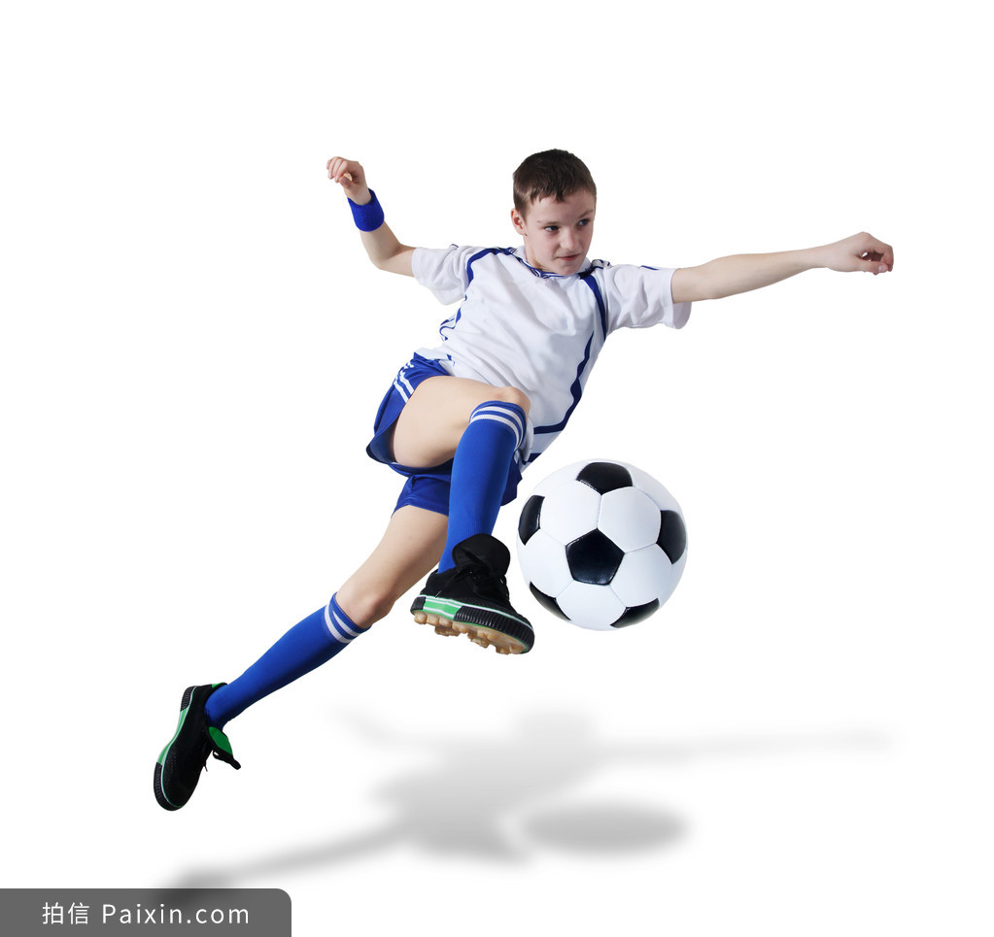

AB篇阅读理解 满分秒杀思维策略
奇迹总在拼搏之后；
成功蕴于进取之中。
基于提升英语核心素养的高考精准科学备考指导

