Slide 1


感恩遇见，相互成就，本课件资料仅供您个人参考、教学使用，严禁自行在网络传播，违者依知识产权法追究法律责任。
更多教学资源请关注
公众号：溯恩高中英语
知识产权声明

Slide 2






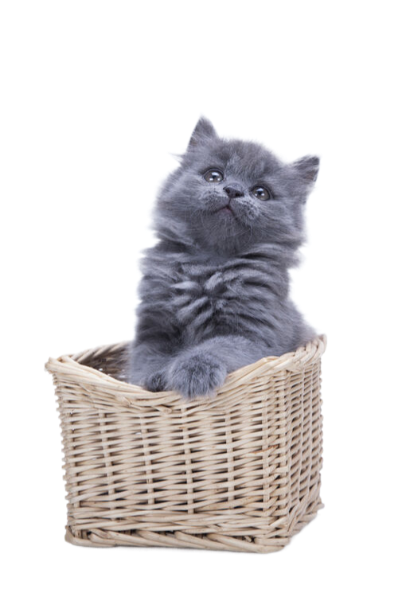
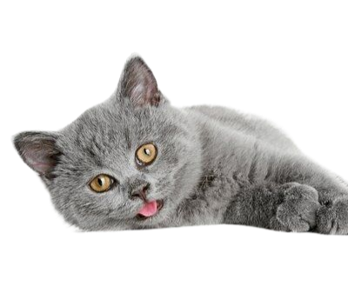

利用“契科夫法则”，巧推读后续写的故事情节
---9+1联盟高三期中考试读后续写
杭州二中树兰高级中学 郭合英

Slide 3

续写文本解读
续写情节推理
Learning objectives
续写语言积累
续写范文欣赏

Slide 4

1
续写文本解读

Slide 5
9+1联盟高三期中考试读后续写
“This Saturday, we'll be visiting cats at the animal shelter. If you'd like to join us, here's an application form", said Ms. Delgado, the school librarian who had held the reading engagement event for students. Ben loved cats and he had always wanted one, so he hurried to take an application form. Then Ms. Delgado added, “We'll be reading to the cats and award readers who make most progress.” Ben stopped. Reading aloud can be a challenging task. Ben might feel his heart racing, his palms sweating, and his voice shaking as he read. He might stumble over words or lose his place in the text. He might feel like everyone was watching him and judging him. Still, he really wanted to visit the cats, so he took an application form anyway. On Saturday, Ben arrived at the shelter with some of his classmates. “This is Max,” the shelter worker told Ben as she handed him a gray cat. Ben carried Max to a beanbag chair and sat down. Max settled onto his lap. He took a book he'd been working on and started reading. Max, very different from other cats walking around the room while the kids read, purred （发出呼噜声）on his lap as if he had understood what Ben read.

Slide 6
“I'm glad Max is staying and listening to my reading and he is the best cat ever,” Ben told Dad excitedly.“I'm glad you two are friends,” Dad said. All week, Ben's heart was filled with anxiety as he waited for Saturday to arrive. He was eager to read to Max and the anticipation of spending time with his feline（猫咪的）friend made him restless and nervous. When it arrived, Ben got to read to Max again. “What if someone adopts Max?” Ben asked Dad later. “I guess you'd read to a different cat,” Dad said.“But I don't want a different cat. I wish we could adopt Max,” Ben said to Dad. He knew they couldn't because Mom had allergies(过敏). Ben loved the cat so much that he even told his next-door neighbor, Mrs. Patel, about Max. “Max sounds like a special cat,”said Mrs. Patel.
Para1: Week by week, Ben realized that reading seemed easier with Max’s company.
Para2: But on Saturday, Ben couldn’t find Max at the shelter.

Slide 7
完成语法填空，了解大意
The school librarian told Ben he could visit cats for the reading engagement event held for students at the animal shelter this Saturday on condition that he had to fill in 1 application form and read to the cats. Hearing this, Ben hesitated. He loved cats a great deal, 2 , it was a big challenge to read, 3 made him very nervous because he was afraid to read in public. Still, he 4_ (real) wanted to visit the cats, so he took an application form anyway.
On Saturday, Ben arrived at the shelter with some of his 5 (classmate). The shelter worker handed Ben a gray cat named Max. Ben carried Max to a beanbag chair, 6 (start) reading. Max purred on his lap as if he 7_ (understand) what Ben read while Ben read. Ben lost his heart 8 the cat.
On returning home, he begged his father 9 (adopt) the cat. But his father kept him 10 (inform) that they couldn't because Mom had allergies. Ben even told his next-door neighbor, Mrs. Patel, about Max. Ben made much progress in reading with Max’s company , But one Saturday, Ben couldn’t find Max at the shelter……
an
however
which
really
classmates
starting
had understood
to
to adopt
informed

Slide 8

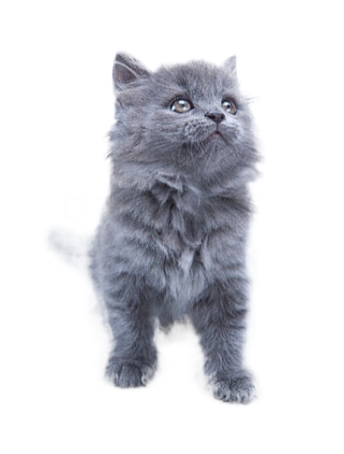
基本要素分析
“This Saturday, we'll be visiting cats at the animal shelter. If you'd like to join us, here's an application form", said Ms. Delgado, the school librarian who had held the reading engagement event for students. Ben loved cats and he had always wanted one, so he hurried to take an application form. Then Ms. Delgado added, “We'll be reading to the cats and award readers who make most progress.” Ben stopped. Reading aloud can be a challenging task. Ben might feel his heart racing, his palms sweating, and his voice shaking as he read. He might stumble over words or lose his place in the text. He might feel like everyone was watching him and judging him. Still, he really wanted to visit the cats, so he took an application form anyway. On Saturday, Ben arrived at the shelter with some of his classmates. “This is Max,” the shelter worker told Ben as she handed him a gray cat. Ben carried Max to a beanbag chair and sat down. Max settled onto his lap. He took a book he'd been working on and started reading.Max, very different from other cats walking around the room while the kids read, purred （发出呼噜声）on his lap as if he had understood what Ben read.
“I'm glad Max is staying and listening to my reading and he is the best cat ever,” Ben told Dad excitedly.“I'm glad you two are friends,” Dad said. All week, Ben's heart was filled with anxiety as he waited for Saturday to arrive. He was eager to read to Max and the anticipation of spending time with his feline（猫咪的）friend made him restless and nervous. When it arrived, Ben got to read to Max again. “What if someone adopts Max?” Ben asked Dad later. “I guess you'd read to a different cat,” Dad said.“But I don't want a different cat. I wish we could adopt Max,” Ben said to Dad. He knew they couldn't because Mom had allergies(过敏). Ben loved the cat so much that he even told his next-door neighbor, Mrs. Patel, about Max. “Max sounds like a special cat,”said Mrs. Patel.
who
when
where
Para1: Week by week, Ben realized that reading seemed
easier with Max’s company.
Para2: But on Saturday, Ben couldn’t find Max at the shelter.
what
family
why
how

Slide 9


情感分析
Ben loved cats and he had always wanted one, so he hurried to take an application form.
We'll be reading to the cats and award readers who make most progress.said Ms. Delgado
Still, he really wanted to visit the cats, so he took an application form anyway.
eager
(Because he lovd cats)
worried
(Reading was a challenge.)
determined
(Accepting the challenge)
“I'm glad Max is staying and listening to my reading and he is the best cat ever,” Ben told Dad excitedly.
anxious
(He failed to see Max.)
But on Saturday, Ben couldn’t find Max at the shelter.
exhilarated
(He lost his heart to Max.)
I wish we could adopt Max. But he knew they couldn't because Mom had allergies.
anxious
(He feared Max was adopted
by others.)
Ben's heart was filled with anxiety as he waited for Saturday to arrive. He was eager to read to Max …
disappointed
(He failed to adopt Max.)
“What if someone adopts Max?” Ben asked Dad later.
eager
(He longed to see Max.)

Slide 10
利用“契科夫法则”，
巧推读后续写的故事情节
2
续写情节推理

Slide 11

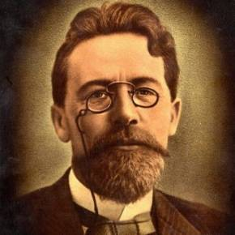
什么是契科夫法则？
1.Who said the
sentence?
2. What’s the
meaning?
3. What is the Chekhov’s Law?
契科夫法则是一种文学写作技巧。
契科夫法则是指在故事开头出现的事物一定会在故事后面再次出现。否则，它前面就不应该出现。
意思就是戏剧中的一切细节都要发挥作用。
如果在第一幕里边出现一把枪的话，那么在第三幕枪一定要响。

Slide 12
利用契科夫法则，找出读后续写隐含的矛盾冲突
……
Then Ms. Delgado added, “We'll be reading to the cats and award readers who make most progress.” Ben stopped. Ben might feel his heart racing, his palms sweating, and his voice shaking as he read. He might stumble over words or lose his place in the text. He might feel like everyone was watching him and judging him. Still, he really wanted to visit the cats, so he took an application form anyway.
…… I wish we could adopt Max,” Ben said to Dad. He knew they couldn't
“Max sounds like a special cat,”said Mrs. Patel.
矛盾冲突1：Ben害怕阅读。
解决冲突1：Ben realized that reading seemed easier with Max’s company.
Reading aloud can be a challenging task.
矛盾冲突2：因为妈妈过敏，无法收养这只猫。
解决冲突2:
because Mom had allergies(过敏).
Ben loved the cat so much that he even
told his next-door neighbor, Mrs. Patel, about Max.

Slide 13
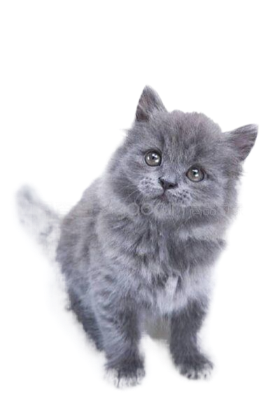
利用契诃夫法则，提高续文与原文故事情节发展的契合度
……
so he hurried to take an application form . ……
“I'm glad Max is staying and listening to my reading and he is the best cat ever,” Ben told Dad excitedly.“I'm glad you two are friends,” Dad said. All week, Ben's heart was filled with anxiety as he waited for Saturday to arrive. He was eager to read to Max and the anticipation of spending time with his feline（猫咪的）friend made him restless and nervous. When it arrived, Ben got to read to Max again.
“What if someone adopts Max?” Ben asked Dad later … Ben said to Dad. He knew they couldn't because Mom had allergies(过敏). Ben loved the cat so much that he even told his next-door neighbor, Mrs. Patel, about Max. “Max sounds like a special cat,”said Mrs. Patel.
Para1: Week by week, Ben realized that reading seemed easier with Max’s company. Para2: But on Saturday, Ben couldn’t find Max at the shelter.
暗含故事的发展：Ben可能会收养这只猫。
Ben loved cats and he had always wanted one,
此三词写出了Ben对猫的喜欢
可是妈妈过敏无法收养这只猫，怎么办？
“I wish we could adopt Max.”
欧亨利式结尾
邻居收养，Ben可以天天到邻居家给猫读书。

Slide 14


利用契诃夫法则，提高续文与原文故事情节发展的契合度
Ben was awarded the award for his progress.
Ben loved cats and he had always wanted one, so he hurried to take an application form. Then Ms. Delgado added, “We'll be reading to the cats and award readers who make most progress.” Ben stopped. Reading aloud can be a challenging task. Ben might feel his heart racing, his palms sweating, and his voice shaking as he read. He might stumble over words or lose his place in the text. He might feel like everyone was watching him and judging him. Still, he really wanted to visit the cats, so he took an application form anyway.
Ben accepted the challenging work. Ultimately, reading was a piece of cake for Ben.

Slide 15
利用契科夫法则，做到续文与原文的语言协同
Reading aloud can be a challenging task. Ben might feel his heart racing, his palms sweating, and his voice shaking as he read. He might stumble over words or lose his place in the text. He might feel like everyone was watching him and judging him.
…… Max settled onto his lap. He took a book he'd been working on and started reading. Max, very different from other cats walking around the room while the kids read, purred （发出呼噜声）on his lap as if he had understood what Ben read.
初始阅读时的紧张：心跳加快，掌心出汗，声音颤抖，甚至在阅读时磕磕绊绊……
Ben在读书时猫的表现：猫坐在他腿上，发着呼噜声好像听懂了他读给他的一切……
Para1: Week by week, Ben realized that reading seemed easier with Max’s company. Each time he read to Max, the cat always settled onto his lap, purring, which made Ben be sedate to read. It was the quiet company of the cat that made him feel as if he were in a paradise, letting his thoughts fly. With time ticking by, Ben got the better of himself , reading wasn’t be a challenging task, but a piece of cake. He savored the book without his heart racing, his palms sweating, and his voice shaking.
标出来的均为原文语言的产出

Slide 16
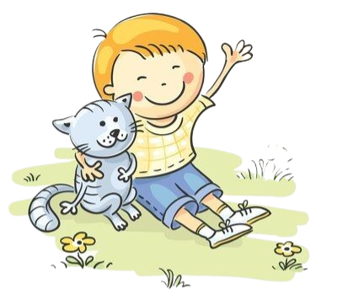
根据契诃夫法则进行情节推理
Para1: Week by week, Ben realized that reading seemed easier with Max’s company.
Para2: But on Saturday, Ben couldn’t find Max at the shelter.
1. What were the feelings when Ben
couldn’t find Max?
1. Who did Ben blame his
improvement in reading on?
Max
2. Who appeared and told the truth?
2. What did Ben get after reading had
been improved?
award
3. How did Ben behave?
3. Who did Ben want to share the
good news that he got the award?
4. What theme can be
learned from the story?
Max

Slide 17
3
续写语言积累

Slide 18
语言积累
每当Ben给Max读书时，他总是坐在Ben的腿上打着呼噜好像他已经听懂了Ben所读的一切，这使Ben能够静下心来去读他想读的一切。
Each time Ben read to Max, the cat always settled onto his lap, purring as if he had understood what Ben read, which made Ben compose himself down to read what he wished to.

Slide 19
语言积累
随着时间的流逝，Ben逐渐战胜了自己。阅读对他来说不再是一种挑战，而是小菜一碟。
As time went on, Ben gradually outdid himself. Reading was no longer a challenge for him, but a piece of cake.
With time ticking by, Ben came to/got to get the better of himself. Reading wasn’t be a challenging task, but a piece of cake.

Slide 20
语言积累
他完全陶醉在阅读之中，品味着书香，没有了阅读时的心跳加快，掌心出汗和声音颤抖。也许是猫静谧的的陪伴让他有了仿佛在世外桃源的感觉，他放飞了思绪。阅读丰富了他的世界，也丰富了他和猫的故事。
He was completely intoxicated with reading, savoring the aroma of the book without his heart racing, his palms sweating, and his voice shaking as he read. Perhaps it was the quiet company of the cat that made him feel as if he were in a paradise, which let his thoughts fly. Reading enriched his world and his story with the cat.

Slide 21
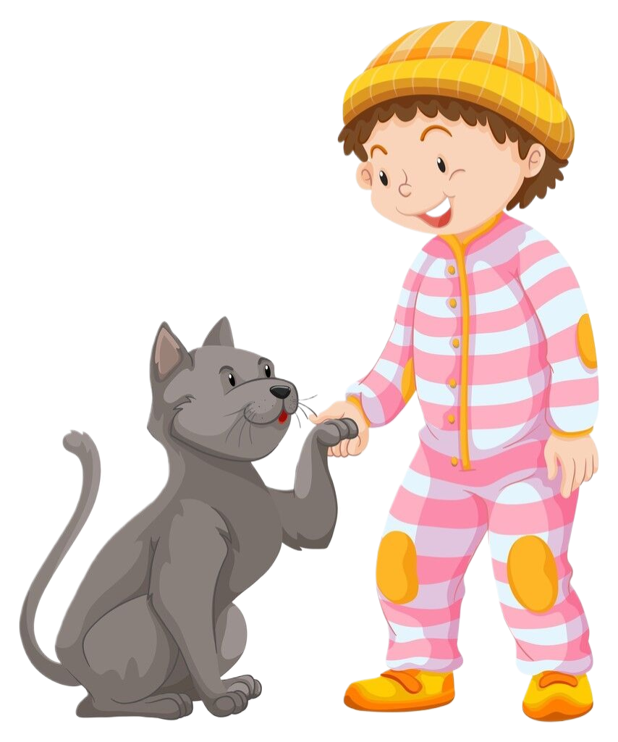
语言积累
他被颁发了最佳阅读奖，这使他异常开心仿佛在空中飘一样。他迫不及待地想要和他最爱的猫分享这个好消息。
He was presented the best readers who made most progress, which made him in high spirits as if floating on the air. He couldn’t hardly wait to share the good news with his beloved cat.

Slide 22
语言积累
尽管搜遍了每一个角落，仍然未能捕捉到Max的一丝影子，Ben认为一定已经有人收养了他的猫朋友，这让他非常沮丧，眼噙泪水，他的心陷入了悲伤的海洋。
Though searching every concer , still failing to capture a ripple of shadow of Max, Ben reckoned someone must have adopted his feline friend, which made him overwhelmingly frusted, with tears sparkling in his eyes and his broken heart sinking into the sad ocean.

Slide 23
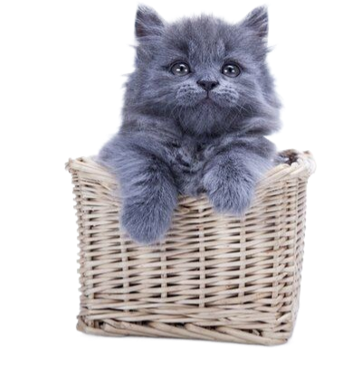

语言积累
就在这个时候，爸爸进来了，他神秘地微笑着，告诉Ben由于妈妈过敏，他的邻居收养了Max.
Just at this moment, Dad entered, and he smiled mysteriously, telling Ben it was Mrs. Patel, the next-door neighbor that had adopted Max due to Mom’s allergies.

Slide 24

语言积累
爸爸的话就像一缕阳光，神奇地抚慰着Ben的悲伤。Ben像离弦的箭一样跑到Mrs. Patel家。Ben决定给她一个熊抱，因为她收养了这只特别的猫: 一个和Ben心有灵犀的猫，一个帮助Ben爱上阅读的猫。
Dad’s words were like a ray of sunshine, soothing Ben’s grief magically. Ben ran to Mrs. Patel’s home like an arrow off a string. Ben decided to give her a bear hug because she had adopted this special cat: a cat who had chemistry with Ben; a cat who helped Ben fall for reading.

Slide 25
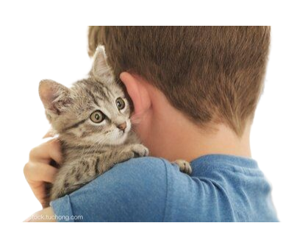

What was the theme?
温馨画面定格
当Ben急急忙忙跑到邻居家时，一看到那只猫，Ben就紧紧地抱住他就像一位母亲看到远行归来的游子。小灰猫睁开钻石般的眼睛盯了Ben一会儿，然后扑向Ben的怀里，伸出他那毛绒绒的爪子趴在Ben的肩头一动不动。此刻，阳光沐浴着他们，Ben的心里暖暖的，从心底感激着邻居为他所做的一切。
When Ben hurried to the neighbor's house, No sooner had Ben seen the cat than he caught him tightly just like a mother who sees a wanderer returning from a long journey. The little gray cat opened his diamond-like eyes, staring at Ben for a moment. Then he threw himself into Ben’s arms and laid his furry paws on Ben’s shoulder without moving. At this moment, the sun bathing them, Ben’s heart was warm. He thanked his neighbor from the bottom of his heart for what she had done for him.

Slide 26

What was the theme?
人生感悟篇
正是在那个时刻，Ben突然明白了：人和动物之间有真正的精神寄托。在猫的陪伴下，Ben 能够静下心来，安逸地享受阅读，犹如蜜蜂在花园里辛勤地采蜜，Ben的阅读能力快速提升。猫也享受着陪伴Ben的温馨时刻，“喵喵”地在Ben面前撒着娇。
It was at that moment that it dawned on Ben that there was a real spiritual connection between man and animals. With the company of the cat, Ben could at peace enjoy reading like bees in the garden to gather honey, which made Ben’s reading ability improve quickly. The cat also enjoyed the warm moment that accompanied Ben, pouting prettily(撒娇) in front of Ben with “Meow, Meow” .

Slide 27

What was the theme?
虚拟语气结尾
没有这只猫，Ben 浮躁的心就无法安静下来; 没有这只猫，阅读可能依然是Ben的拦路虎。此刻Bem明白了：人和动物之间是有真挚情感的，就如同Max和他一样。
Without this cat, Ben’s restless heart wouldn’t be sedate; Without this cat, reading might still be a hindrance for Ben. Presently, it dawns on Ben that there are genuine feelings between people and animals, just like Max and him.

Slide 28
4
融洽度不高的
学生作品分析

Slide 29
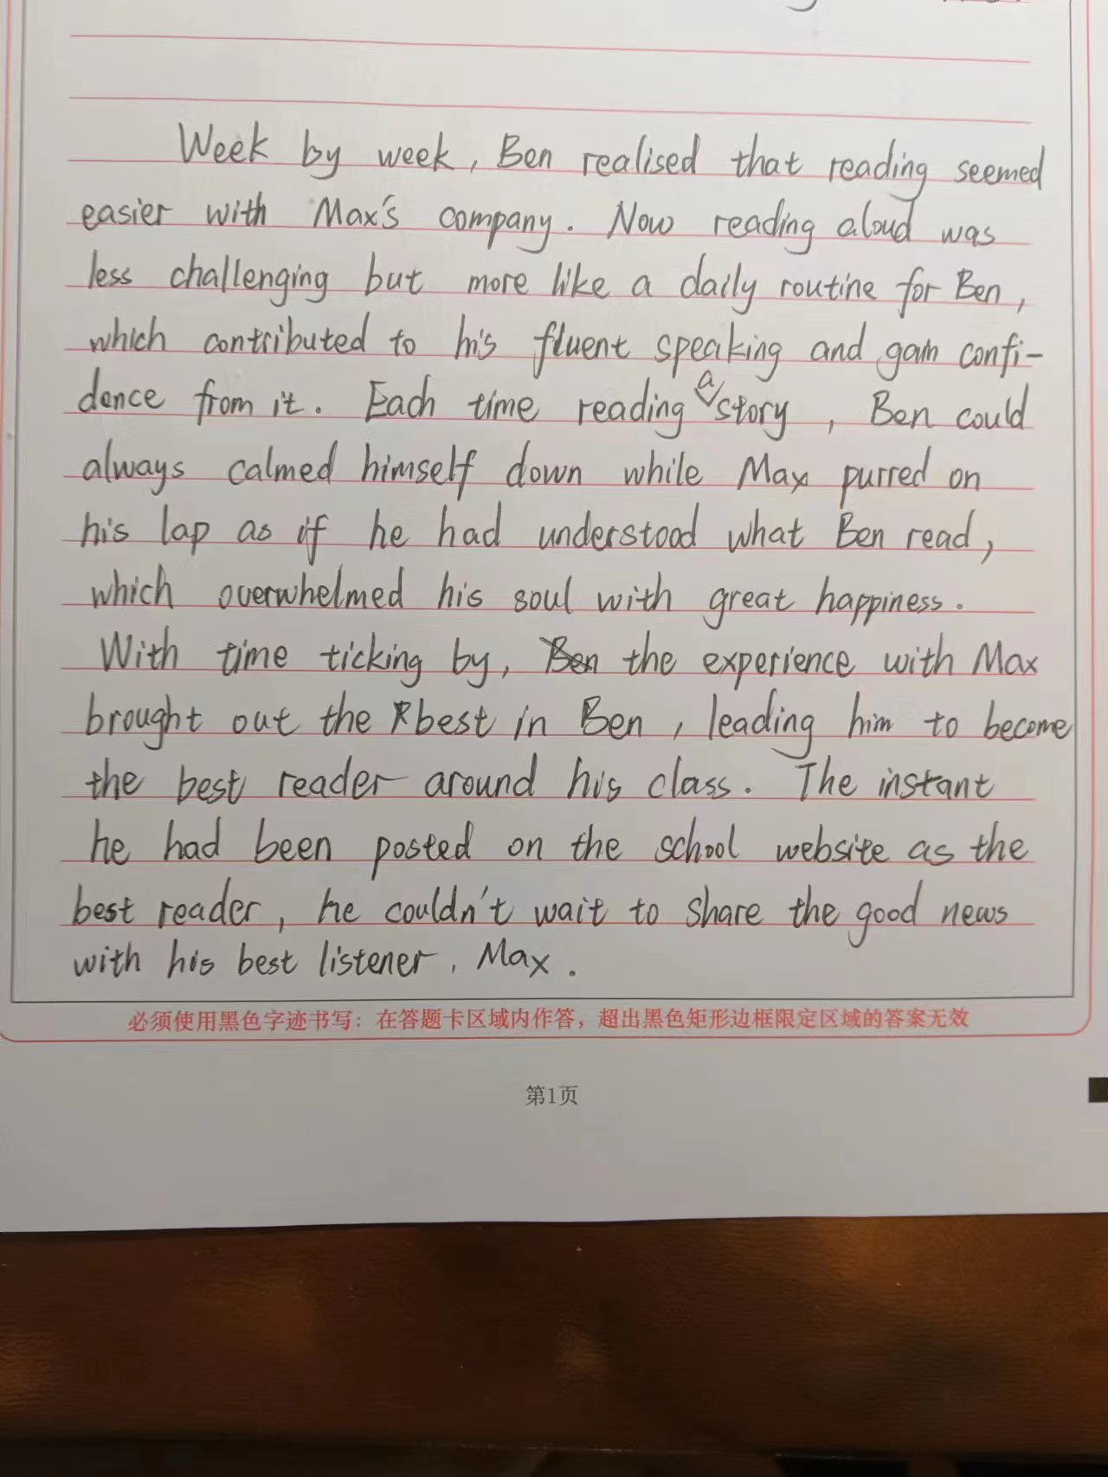
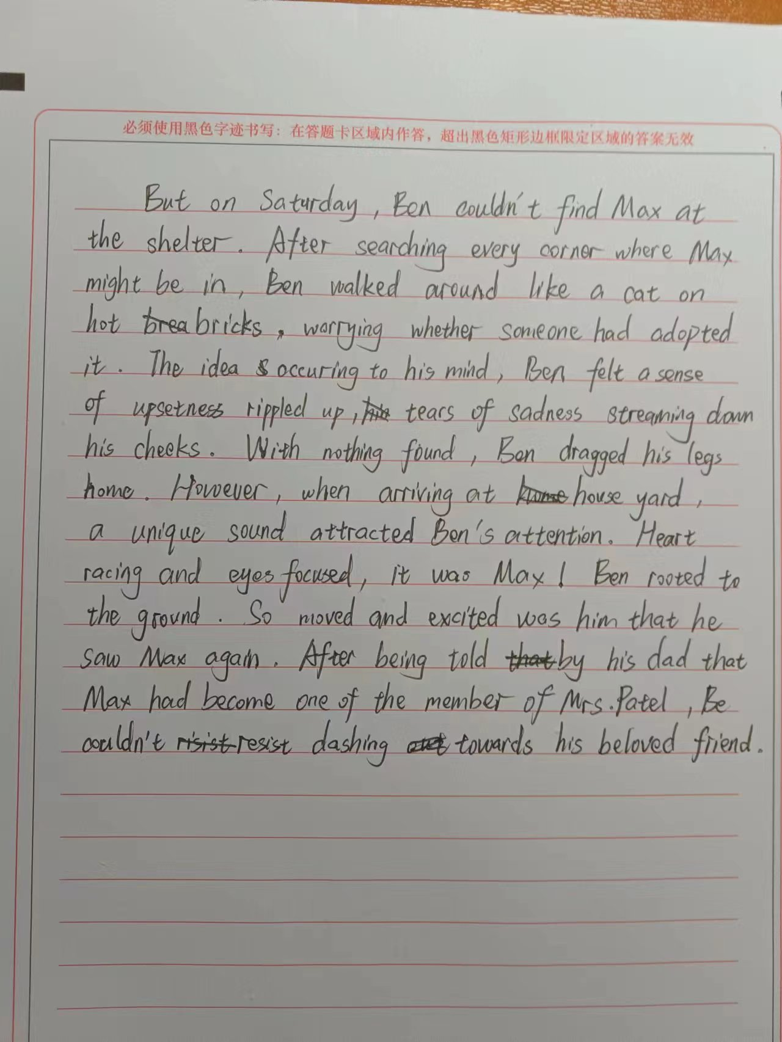
融洽度不高的作文分析
总评：
第一段学生解决了原文伏笔的一个矛盾：在猫的陪伴下，阅读不再是一种挑战，同时因为阅读能力的提升被颁发了奖，这与原文的融洽度还是比较高的，最后Ben迫不及待地和Max分享获奖的好消息又很好地呼应了第二段的开头。
第二段开头写出看不到猫的伤心，这也挺好。可问题在于当Ben回到家的时候，Max居然出现在自家院子里，最后爸爸告诉他说邻居收养了这只猫。如果是邻居收养最好出现在邻居家的院子，如果出现在Ben家的院子，就会与原文中妈妈过敏相矛盾，很显然，学生没注意到此细节，导致与原文的融洽度不高。
契诃夫法则应用---
解决矛盾冲突：Reading aloud can be a challenging task.
写出了找不到Ben时的着急和伤心，但是情感表达泼墨稍多。
没有应用契诃夫法则导致的细节错误：学生没有注意到原文线索 “Mom had allergies（过敏）.” 由此可知，猫不应该出现在Ben家的院子里。
人和猫互动的效果：
Ben阅读时，Max的陪伴让他能够静下心来，这呼应文章：Reading seemed easier with Max’s company.
虽是欧亨利式的反转，但是却是前后矛盾：邻居收养了Max,为什么出现在自己的院子？（明知妈妈过敏）
契诃夫法则应用---
呼应下文：Ben跑到动物救助站，可是Ben couldn’t find Max at the shelter
由于前面的情感泼墨较多，导致最后升华没有地方写了，仓促收尾，达不到言有尽而意无穷的效果。
契诃夫法则应用---
呼应原文：award readers who make most progress.

Slide 30
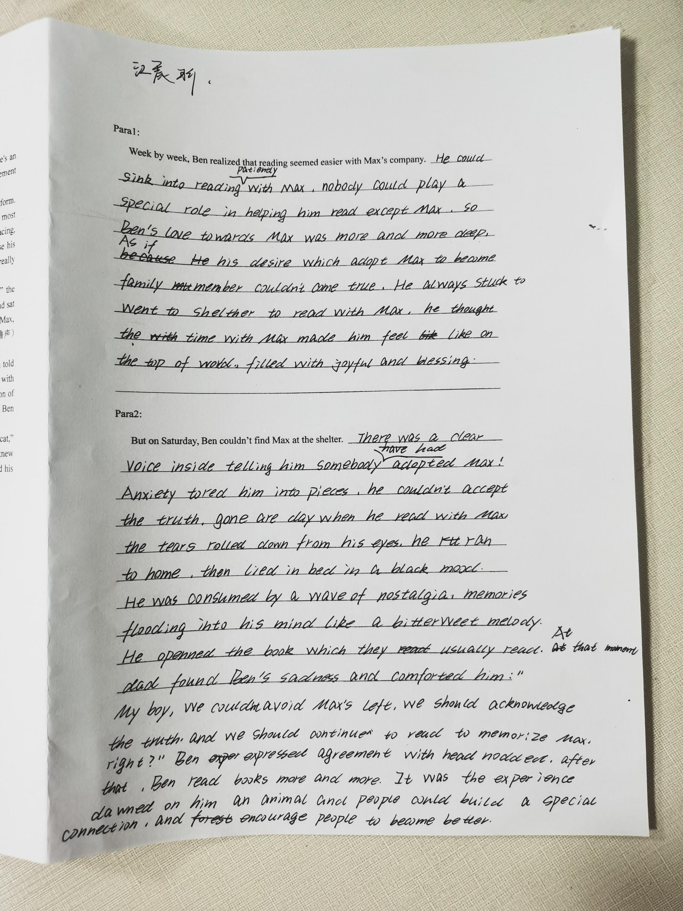
融洽度不高的作文分析
本文存在的问题：
由于对契诃夫法则不太了解导致续文与原文的契合度不高。
第一段：写出了Max对Ben的帮助，却忽略了原文线索：We'll be reading to the cats and award readers who make most progress.
第二段：Ben的猫朋友Max不见了，而不是被他的邻居，忽略了原文线索：Ben loved the cat so much that he even told his next-door neighbor, Mrs. Patel, about Max.
如果不是被邻居收养，那么这句话就不应该在文章中出现。

Slide 31
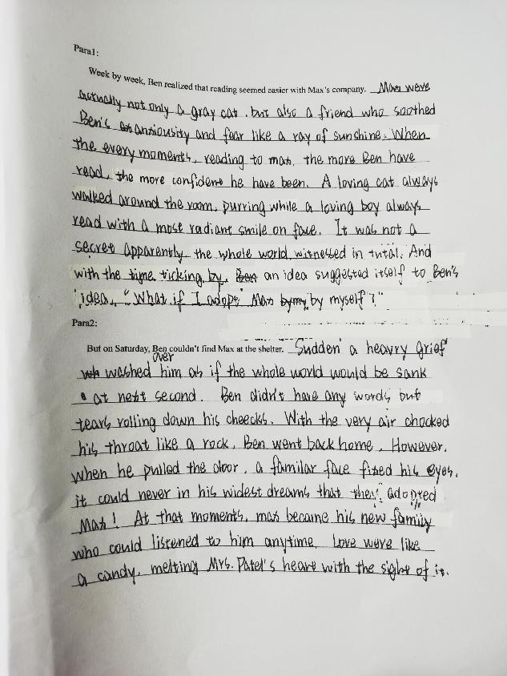
融洽度不高的作文分析
本文存在的问题：
Max变成了他们的家庭成员，这与原文妈妈过敏相违背。
为什么会融化邻居的心呢？文章缺少交代。

Slide 32
4
融洽度较高的
学生作品分析

Slide 33
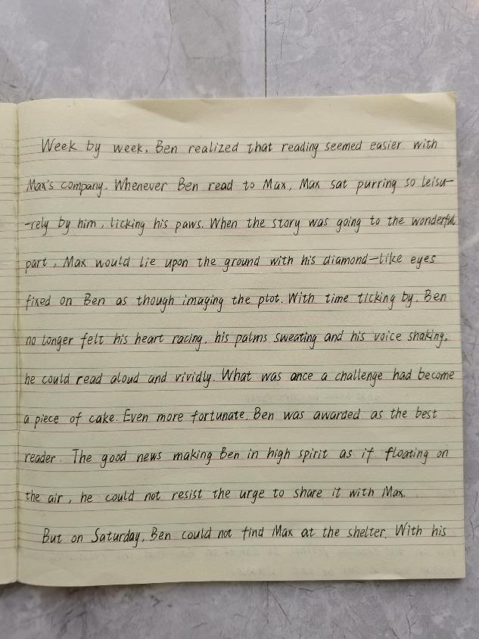
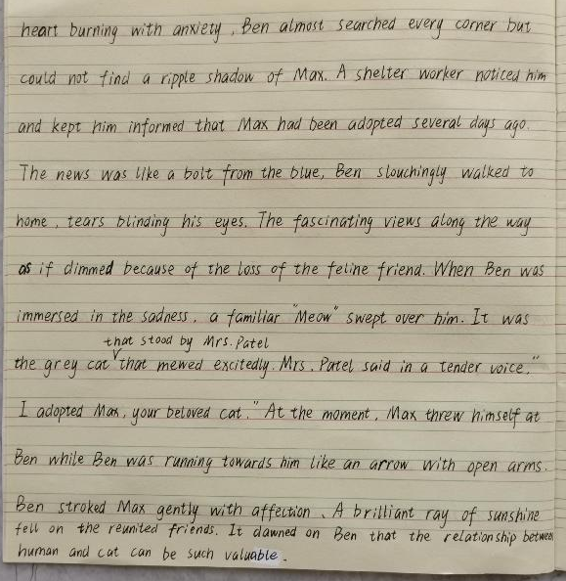
契合度较高的学生作品分析
契诃夫法则运用：
写出了猫的陪伴给Ben带来的变化：阅读不再是挑战，而是小菜一碟。
写出了找不到猫时的沮丧心情。
契诃夫法则运用：
邻居收养了Max, 呼应原文：Ben loved the cat so much that he even told his next-door neighbor, Mrs. Patel, about Max.
契诃夫法则运用：
（award readers who make most progress.）
Ben在阅读上的变化，使他获得了奖。
契诃夫法则运用：
呼应下文：Ben couldn’t
find Max at the shelter。
契诃夫法则运用：
呼应主题：人和动物之间是有真挚情感的。

Slide 34
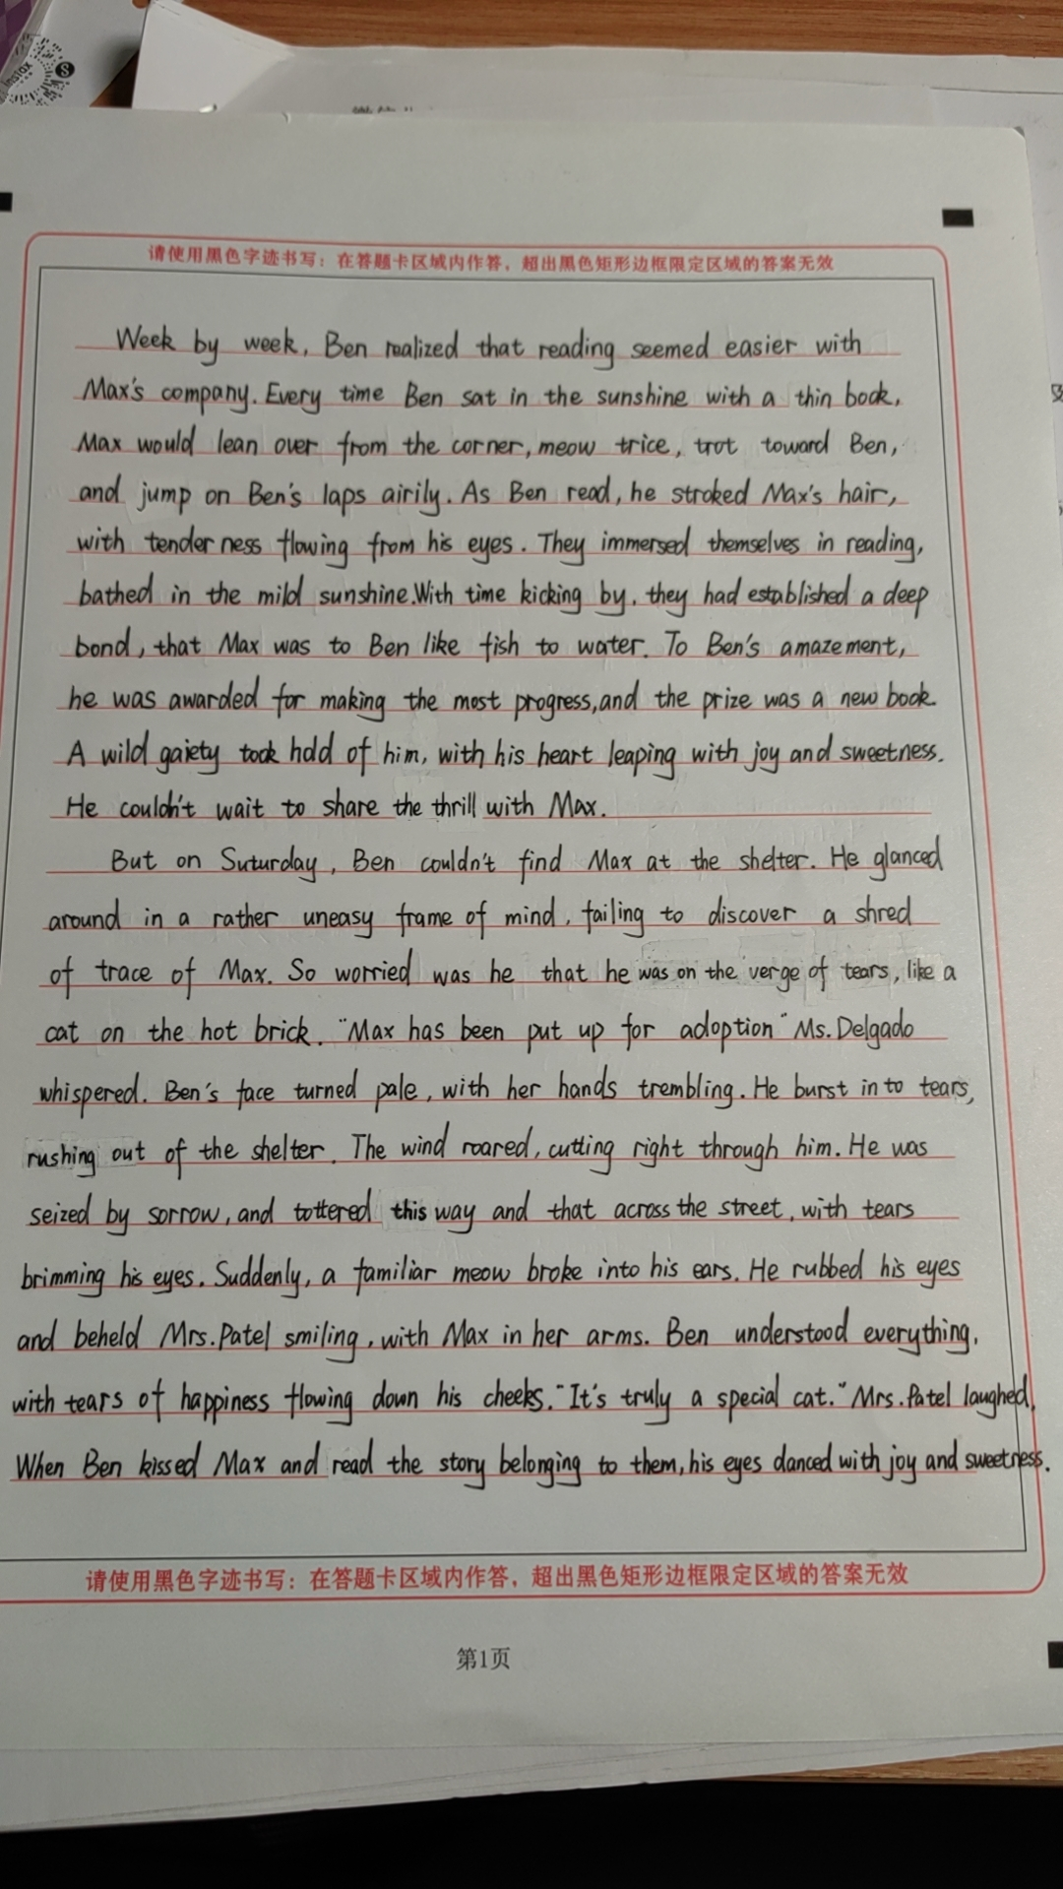
融洽度较高的学生作品分析
写出了猫的陪伴给Ben带来了阅读上的变化，同时，Max和Ben之间也建立了深厚的感情。
Ben找不到Max时的焦急心情：犹如热锅上的蚂蚁。
契诃夫法则运用：
Ben得奖了，这呼应原文：award readers who make most progress.
写出了猫被人收养时Ben的伤心。
契诃夫法则运用：
采用了欧亨利式结尾：邻居收养了Max这只特别的猫,解决了Ben妈妈过敏这个问题。
此句承上启下，引出下文：他迫不及待地去和Max分享这个好消息，结果Max找不到了……

Slide 35

原创作品
Week by week, Ben realized that reading seemed easier with Max’s company. Each time Ben read, Max always settled onto his lap, purring, which made Ben be sedate to read. It was the quiet company of the cat that made him feel as if he were in a paradise, letting his thoughts fly. Ben savored the book without his heart racing, his palms sweating, and his voice shaking. Never in his wildest dreams was he presented the best readers , which made him in high spirits as if floating on the air. He couldn’t hardly wait to share the good news with his beloved cat.
But on Saturday, Ben couldn’t find Max at the shelter. Though searching every concer , still failing to capture a a ripple of shadow of Max, Ben was overwhelmingly frustrated, with tears sparkling in his eyes and his broken heart sinking into the sad ocean. Just then, Dad entered, and he smiled mysteriously, telling Ben it was Mrs. Patel, the next-door neighbor that had adopted Max due to Mom’s allergies. Dad’s words were like a ray of sunshine, soothing Ben’s grief magically. He ran to Mrs. Patel’s home like an arrow off a string. He decided to give her a bear hug because she had adopted this special cat: a cat who had chemistry with Ben; a cat who helped Ben fall for reading.

Slide 36
参考范文
Week by week. Ben realized that reading seemed easier with Max’s company. The presence of the gray cat made him feel more relaxed and comfortable. He noticed that Max’s purring had a calming effect on him, allowing him to focus better on the words in front of him. Ben was amazed by how much he enjoyed reading aloud to Max. Still, he was surprised when Ms. Delgado gave him the Most Improved Reader award. Ben felt a sense of pride and accomplishment as he held the certificate in his hands. He couldn’t wait to show it to Max.
But on Saturday, Ben couldn’t find Max at the shelter. He looked around the room, hoping to catch a glimpse of his feline friend. However, Max was nowhere to be found. Ben’s heart sank as he realized that someone might have adopted Max. Just then, Mrs. Patel walked into the visitors’ room, carrying Max. " I’m adopting him," Mrs . Patel said " You can come over every day to read to him. " Hearing what Mrs. Patel said, Ben jumped with excitement and threw his arms around Mrs. Patel. Of course, he didn’t forget to hug Max tightly who gave a contented purr.

Slide 37


