Slide 1


感恩遇见，相互成就，本课件资料仅供您个人参考、教学使用，严禁自行在网络传播，违者依知识产权法追究法律责任。
更多教学资源请关注
公众号：溯恩高中英语
知识产权声明

Slide 2
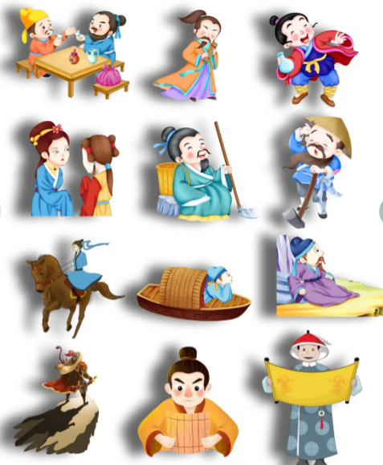
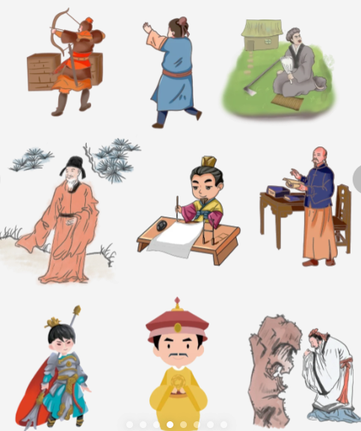
Chinese Traditional Figures

Slide 3

I'll Make A Man Out Of You

Slide 4

Mulan
a legendary heroine who is known for her bravery and strength

Slide 5
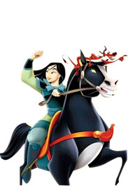
Mulan is a 1___________(legend) Chinese who is known for her bravery, 2___________(selfless) and filial piety. Her story 3_______________(tell) for centuries.
In the story, Mulan is a young woman who lives in China 4___________ the Northern Wei Dynasty. The government of the Northern Wei Dynasty required every household to send one man to fight in the war. Mulan's father was old and sick, and her younger brother was too young to fight. So Mulan decided to disguise herself 5________ a man and take her father's place in the army.
Fighting on the border was a difficult task for many men, and it was even 6_____________（ difficult ）for Mulan, who had to hide her identity and fight alongside her comrades. After many years of fighting, Mulan finally returned home 7___________（ victory）. The emperor was so impressed by her bravery that he pardoned her for impersonating a man and offered her a position in the government. 8___________, Mulan declined, 9___________（say） that she needed to return home to care for her 10___________（age） parents.
The story of Mulan is a reminder of the strength and courage of women. It is also a reminder of the importance of family and duty.
legendary
selflessness
has been told
during
as
Blank-filling
more difficult
victorious
However
saying
aging

Slide 6
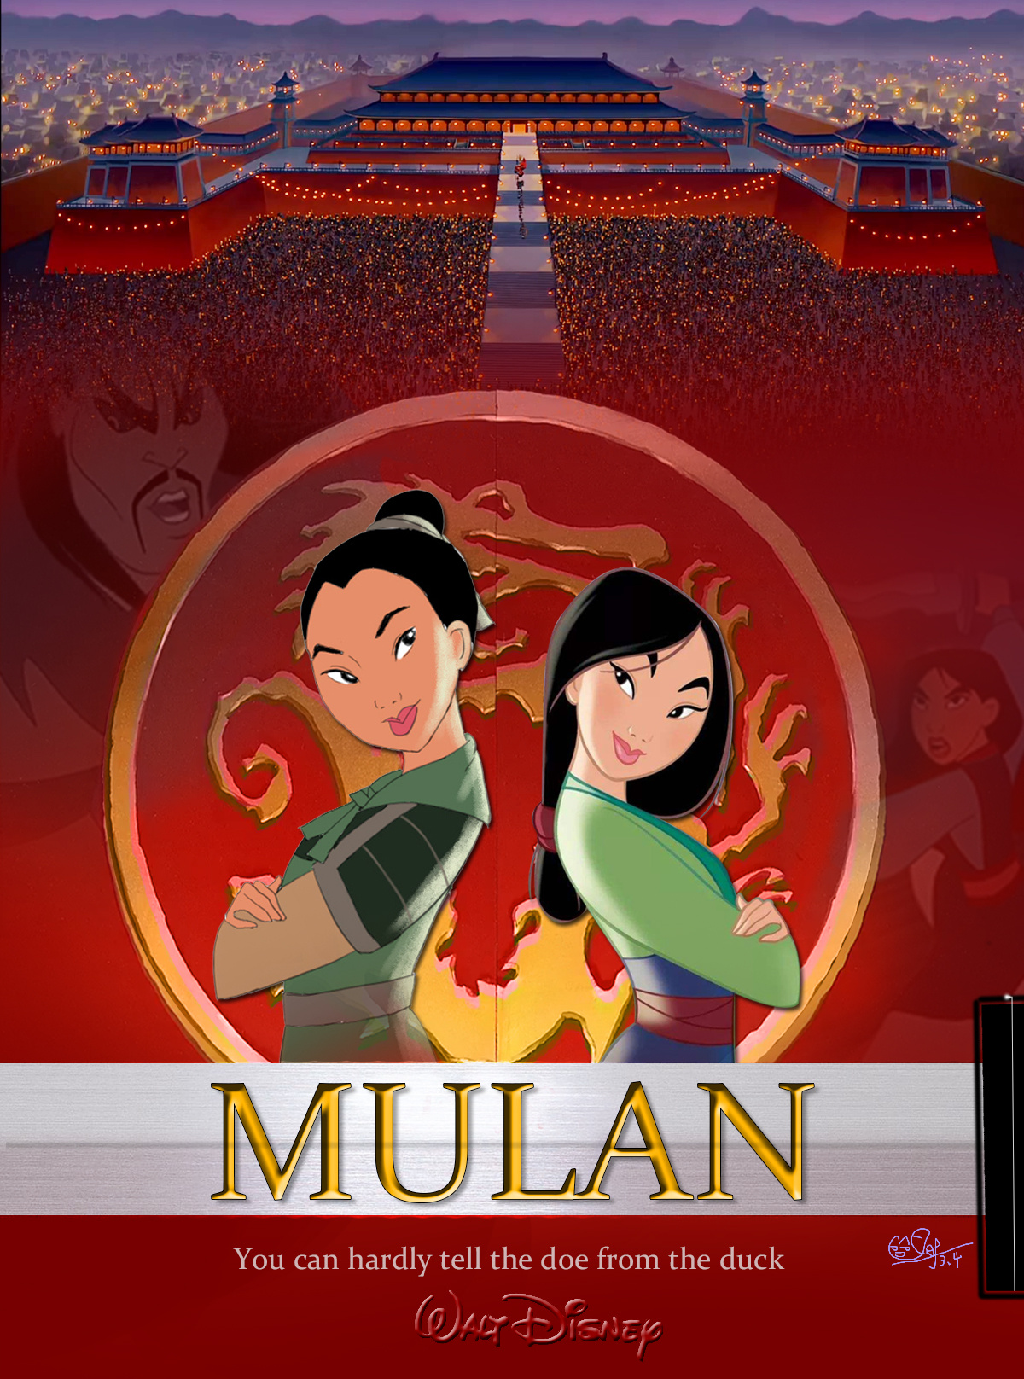
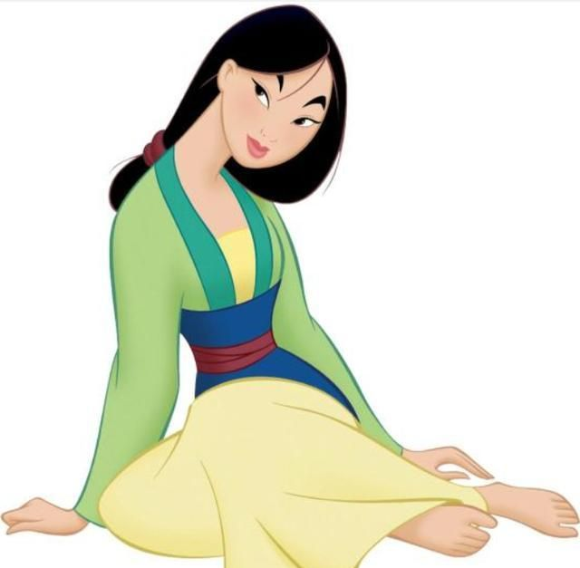
Further-reading
7
What is the main message conveyed by Mulan's story?
A. Women are equal to men in every aspect.
B. Filial piety is the most important virtue.
C. Family duty should always come before personal desires.
D. War and violence should be avoided at all costs.

Slide 7
Words and expressions
legendary | / ˈledʒəndri / | adj.非常有名的，大名鼎鼎的
filial piety | / ˈfɪliəl ˈpaɪəti / | 孝道
disguise | / dɪsˈɡaɪz / | v.假扮，伪装；掩饰
comrade | / ˈkɒmreɪd / | n.伙伴，战友；同志
victorious | / vɪkˈtɔːriəs / | adj.胜利的
impersonate | / ɪmˈpɜːrsəneɪt / | vt.扮演；模仿；拟人，人格化
decline | / dɪˈklaɪn / | v.下降，衰退；拒绝，谢绝
aging | / ˈeɪdʒɪŋ / | adj.变老的，变旧的
Take one’s place 替代某人的位置 Be impressed by被……所感动；印象深刻 hide one’s identity 隐藏身份 identify 认出，识别；查明 care for照顾，照料；喜欢，享受

Slide 8
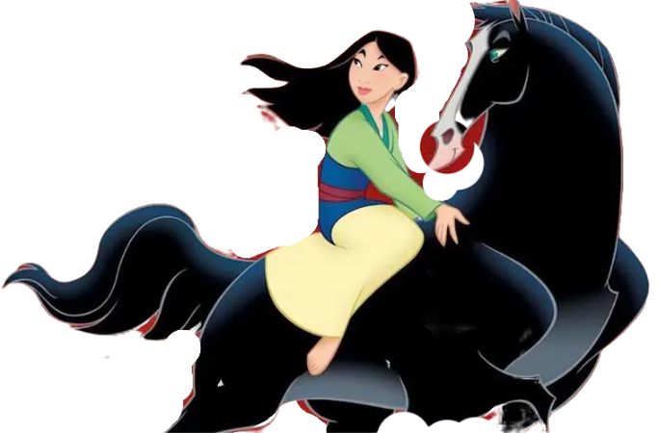
Mulan is a legendary Chinese who is known for her bravery, selflessness and filial piety. Her story has been told for centuries.
In the story, Mulan is a young woman who lives in China during the Northern Wei Dynasty. The government of the Northern Wei Dynasty required every household to send one man to fight in the war. Mulan's father was old and sick, and her younger brother was too young to fight. So Mulan decided to disguise herself as a man and take her father's place in the army.
Fighting on the border was a difficult task for many men, and it was even more difficult for Mulan, who had to hide her identity and fight alongside her comrades. After many years of fighting, Mulan finally returned home victorious. The emperor was so impressed by her bravery that he pardoned her for impersonating a man and offered her a position in the government. However, Mulan declined, saying that she needed to return home to care for her aging parents.
The story of Mulan is a reminder of the strength and courage of women. It is also a reminder of the importance of family and duty.
Passage reading

Slide 9
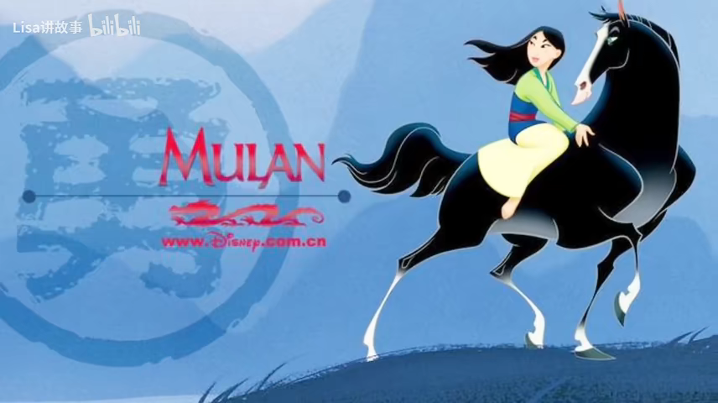

Slide 10

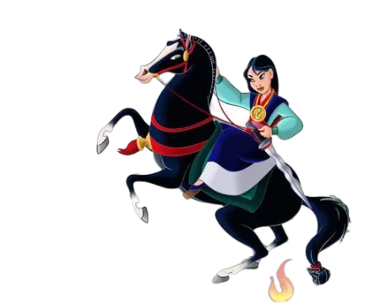
The flower that blooms in adversity is the most rare and beautiful of all.
逆境中绽放的花朵，才是最珍贵、最美丽的。

