Slide 1

感恩遇见，相互成就，本课件资料仅供您个人参考、教学使用，严禁自行在网络传播，违者依知识产权法追究法律责任。
更多教学资源请关注
公众号：溯恩高中英语
知识产权声明

Slide 2
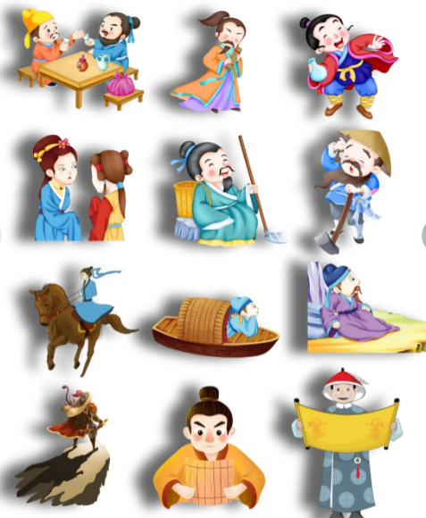
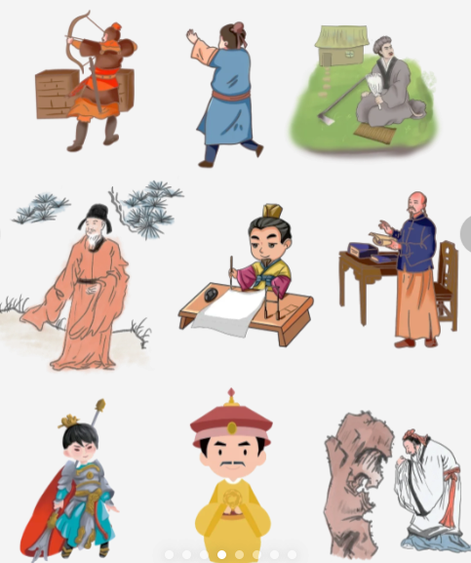
Chinese Traditional Figures

Slide 3
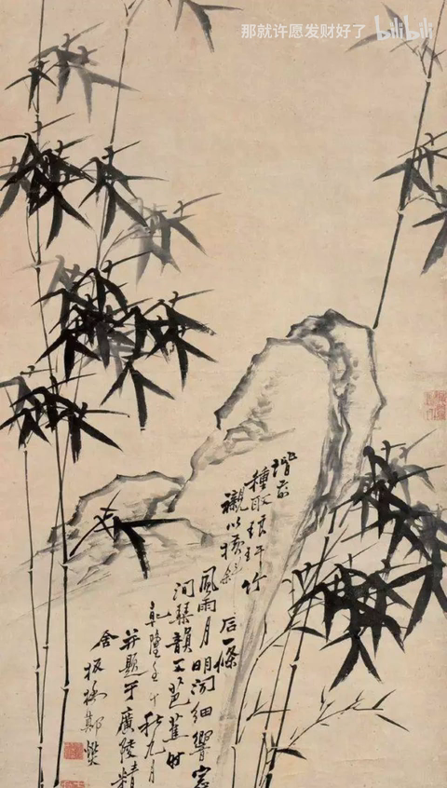
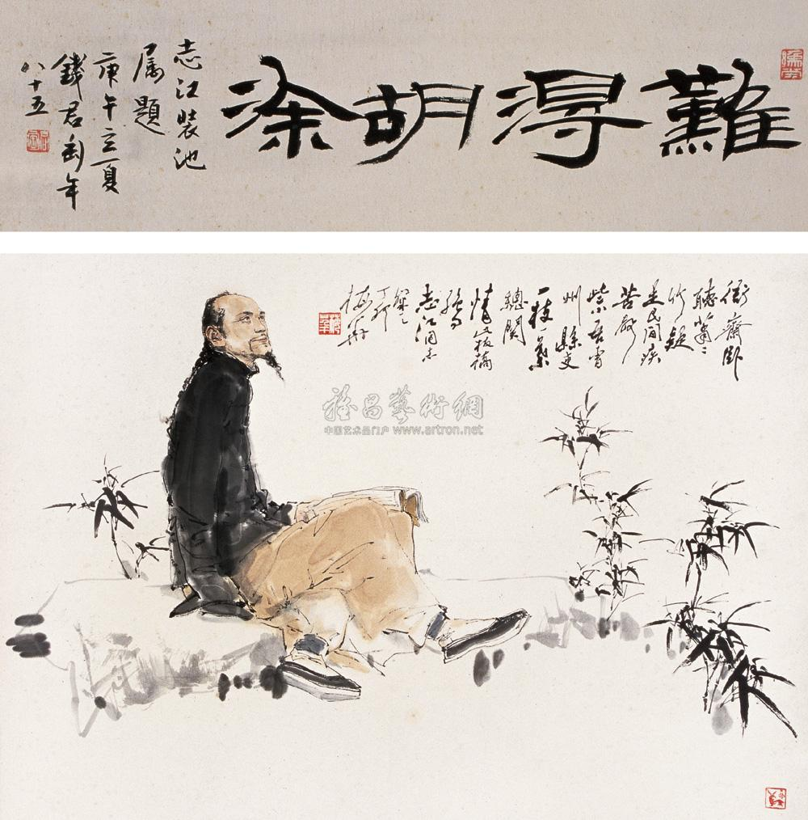
Ignorance is a rare blessing.

Slide 4
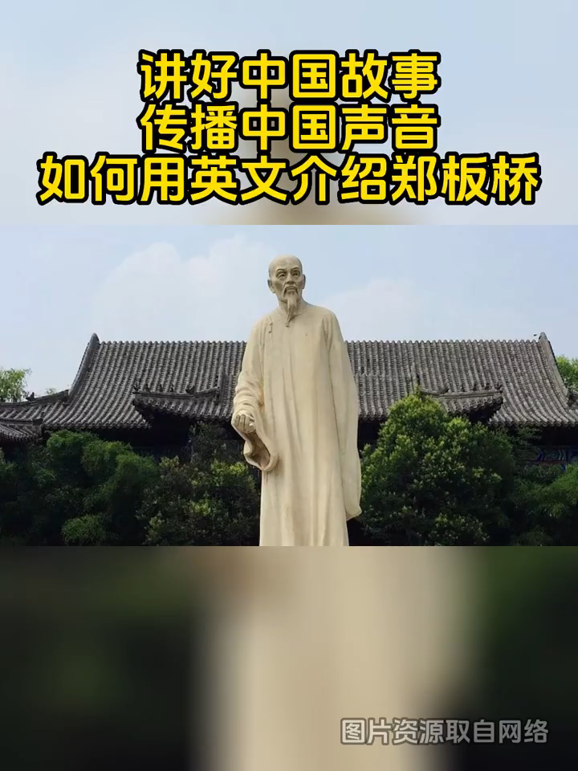
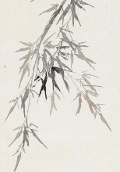
Zheng Banqiao
a famous Chinese painter, calligrapher and poet of the Qing Dynasty

Slide 5
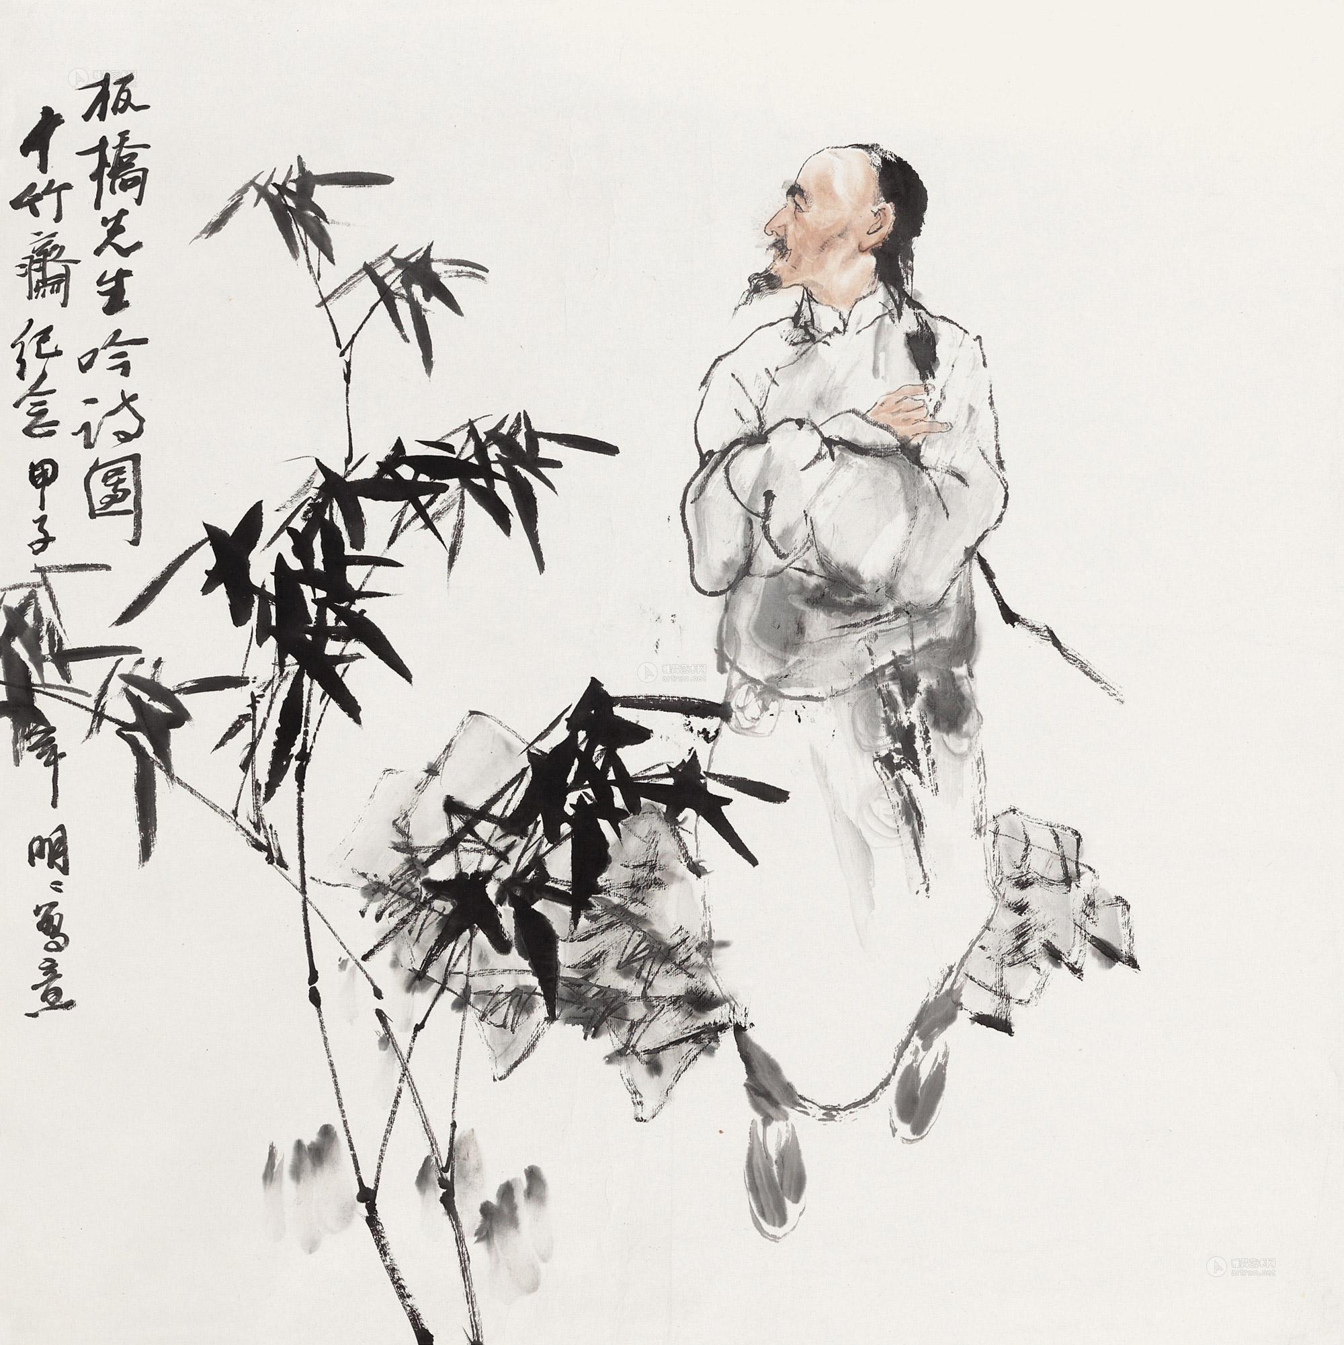
Zheng Banqiao was a famous Chinese painter, calligrapher and poet of the Qing Dynasty. He was born in Xinghua, Jiangsu Province. Zheng Banqiao was known for his paintings of bamboo, orchids and rocks. His paintings were characterized by their simple brushwork, fresh style and 1__________(live) composition. He often used bamboo 2______________(symbolize)his own upright character and unyielding spirit. Zheng created his own style of calligraphy, 3______________ he called six-and-a-half script. His calligraphy was characterized by his 4______________(flow) lines and vibrant energy.
Zheng Banqiao's poems were known for their fresh and humorous style. He often wrote about his 5______________(observation) of life and his thoughts on the meaning of 6______________(exist).
Zheng Banqiao was a man of integrity who was not afraid to speak his mind, he was also a man of poverty, 7______________ he never gave up his ideals. Zheng Banqiao’s 8______________(art) achievements had a profound impact 9______________ later generations. He is considered one of the most important 10______________(art) of the Qing Dynasty.
lively
to symbolize
which
flowing
observations
existence
but
artistic
on
artists
Blank-filling

Slide 6
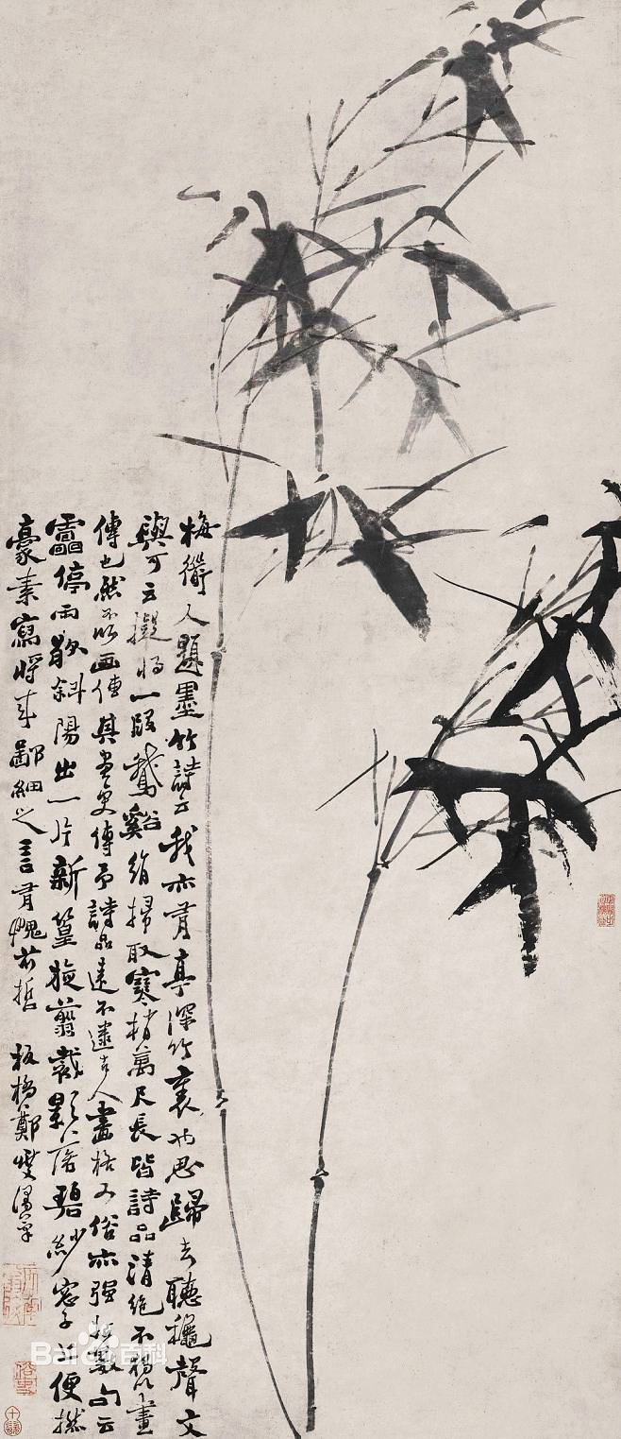
Words and expressions
calligrapher | / kəˈlɪɡrəfə(r) / | n.书法家
orchid | / ˈɔːkɪd / | n.兰科植物，兰花；淡紫色
characterize | / ˈkærəktəraɪz / | v.描述，刻画；成为……的特征
symbolize | / ˈsɪmbəlaɪz / | v.象征，用符号代表；采用象征
unyielding | / ʌnˈjiːldɪŋ / | adj.不屈的；坚强的
vibrant | / ˈvaɪbrənt / | adj.充满活力的，充满生机的
integrity | / ɪnˈteɡrəti / | n.正直，诚实
profound | / prəˈfaʊnd / | adj.（影响）深刻的，极大的
be characterized by以……为特征：描述某事物或现象的特征或特点 speak one’s mind直言不讳

Slide 7
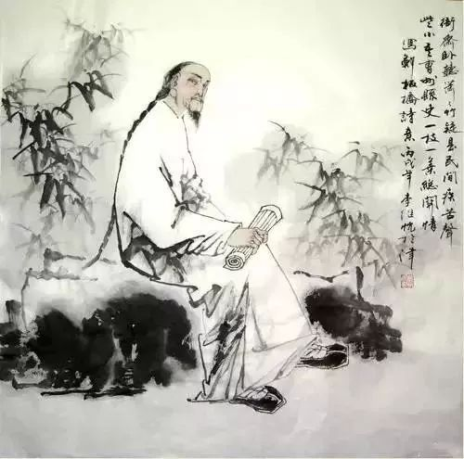
Zheng Banqiao was a famous Chinese painter, calligrapher and poet of the Qing Dynasty. He was born in Xinghua, Jiangsu Province. Zheng Zheng Banqiao was known for his paintings of bamboo, orchids and rocks. His paintings were characterized by their simple brushwork, fresh style and lively composition. He often used bamboo to symbolize his own upright character and unyielding spirit. Zheng created his own style of calligraphy, which he called six-and-a-half script. His calligraphy was characterized by its flowing lines and vibrant energy.
Zheng Banqiao's poems were known for their fresh and humorous style. He often wrote about his observations of life and his thoughts on the meaning of existence.
Zheng Banqiao was a man of integrity who was not afraid to speak his mind, he was also a man of poverty, but he never gave up his ideals. Zheng Banqiao’s artistic achievements had a profound impact on later generations. He is considered one of the most important artists of the Qing Dynasty.
Passage reading

Slide 8
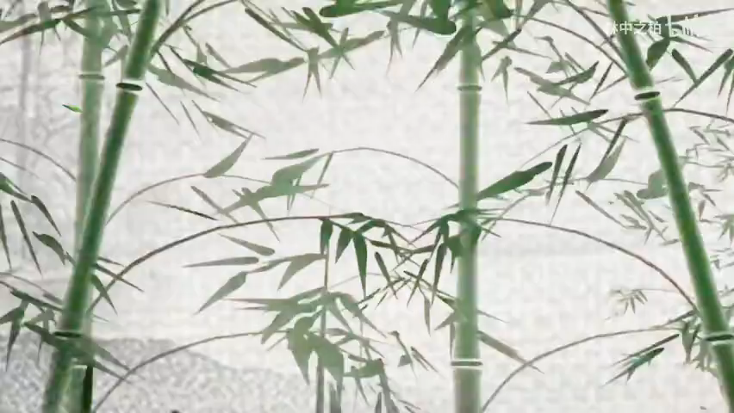

Slide 9
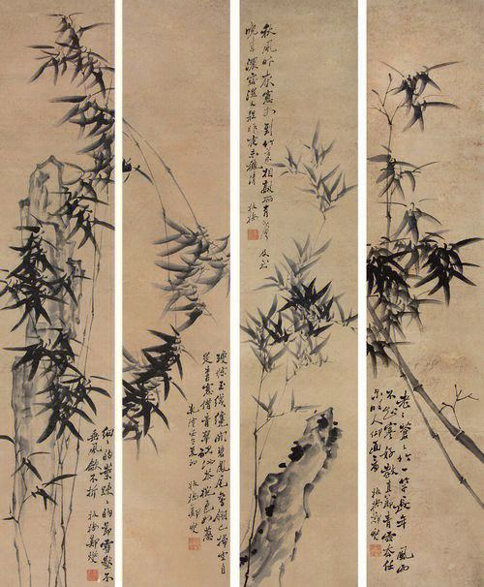
竹石 BAMBOO IN THE ROCK
郑燮 Zheng Xie
咬定青山不放松，Upright stands the bamboo amid green mountains steep;
立根原在破岩中。Its toothlike root in broken rock is planted deep.
千磨万击还坚劲，It’s strong and firm though struck and beaten without rest,
任尔东西南北风。Careless of the wind from north or south, east or west.

