Slide 1

感恩遇见，相互成就，本课件资料仅供您个人参考、教学使用，严禁自行在网络传播，违者依知识产权法追究法律责任。
更多教学资源请关注
公众号：溯恩高中英语
知识产权声明

Slide 2

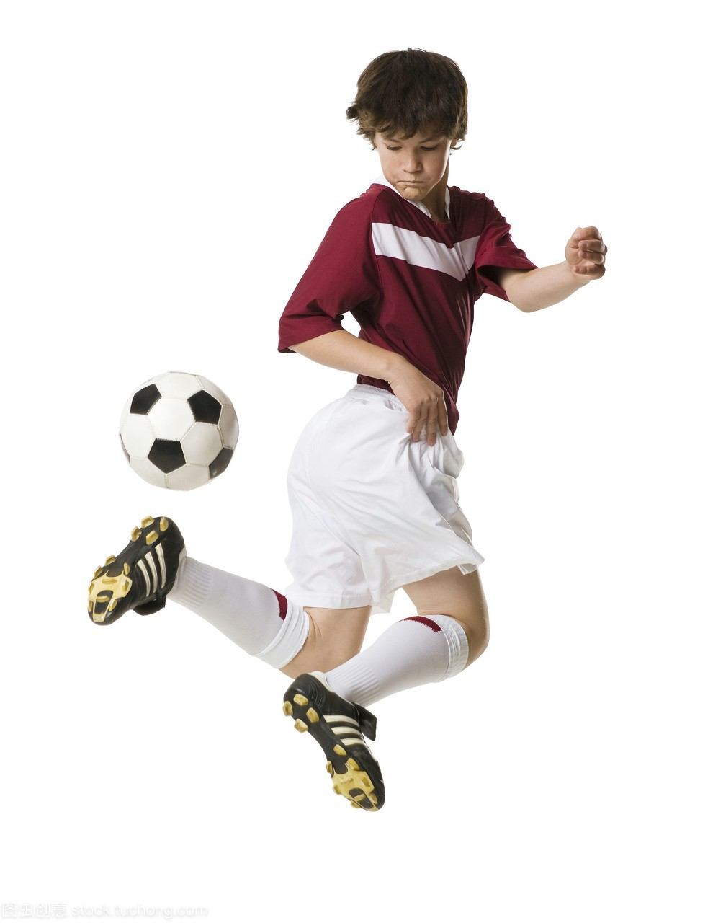




基于语义连贯的读后续写讲评
The Rockers Build a Soccer Field
——学生球队为理想的足球场而打工筹钱和基建劳动
高考临门一脚读后续写押题
浙江省常山一中
吴俊峰
2023学年第一学期高三年级越秀区调研测试：学生球队为理想的足球场而打工筹钱和基建劳动

Slide 3
1. 基于语义连贯
理顺叙事元素
深度解读语篇

Slide 4
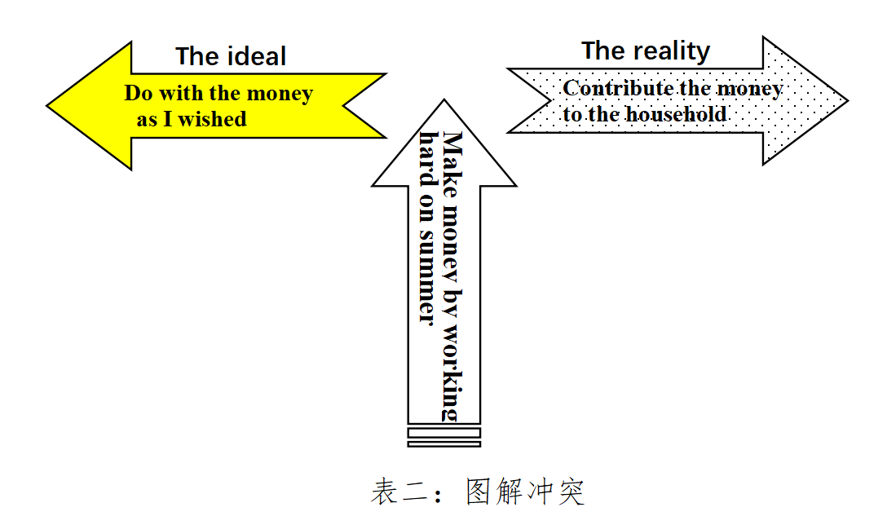
基于语义连贯的 读后续写准确读题和快速构思
1.确定关键词：肯定会同/近义词的高频复现，以增强原文和续文的语义连贯性、语言协同性、主题关联性。
2.确定反义表达：以厘清矛盾和冲突，在具体的情节中相互交织或独立推动情节发展。构建“冲突-危机-解决模式”的叙事模式。
3.确定主题词：前后呼应（隐喻/语义链），拓展语义，升华主题
_{(以2021年6月浙江高考读后续写“我的假日薪水”为例)}

Slide 5
Read and analyze
^{基于语义连贯，理顺叙事元素}
^{读原文，能否划出哪些关键词汇/词组/句子？有什么依据吗？}
“Good morning, Betty,” Mr. Edmond greeted his daughter at the breakfast table. “How is everything going?”
“I slept very well, Papa. I had a dream that I scored the winning goal on a brand new soccer field!”
Mr. Edmond smiled and said, “Your dream could be a sign that River Edge will finally get a regulation soccer field. Maybe you have special insight into what will happen at tonight’s Town Council meeting. Remember, we must get the whole team there to convince them we need a better field.”
That night, Betty and her father arrived at the meeting hall to find it filled to capacity. They sat with the other River Edge Rockers, their community soccer team. Councilwoman Maloof opened the discussion, and Mr. Boyd, the Rockers manager, spoke first. “Our team currently practices in a tiny school yard, and only when it’s not already booked.” The team nodded quickly.
Mrs. Smith, owner of Something Sushi, walked to the podium(讲台). “I Believe the town owns an empty lot next to my restaurant,” she said. “Couldn’t that be a soccer field?” The Rockers applauded.
“A soccer field would be a good use for that lot,” Councilwoman Maloof said. But the town simply doesn’t have the money to build and maintain one.”
“The Rockers can do it!” Jamil spoke up.
“Jamil’s right,” Mr. Edmond said. He began to negotiate with the Council. “If the town lets the Rockers use the empty lot, we will turn it into a soccer field.”
After some discussion, the Council reached a decision. “We thus approve using the vacant lot nearby to Something Sushi for a community soccer field!” Betty looked nervously at her cheering teammates, then at her father. Mr. Edmond winked at her, as if to say, “Didn’t you have a dream?”
The following day, the team got together to share ideas for raising money.
A week later, the team gathered at the lot, carrying tools purchased with their earnings.
故事背景 setting | When/where
 | Who
 | What
That night→at the meeting hall ; The following day; A week later→ at the lot,
Betty, a member of the River Edge Rockers; her soccer teammates
realize a dream -- a new community soccer field
2023学年第一学期高三年级越秀区调研测试

Slide 6
2. 基于语义连贯
设置问题驱动
合理发展情节

Slide 7
Read and analyze
^{根据段首句,通过词汇的有效衔接, 设置问题驱动}
^{实现语义连贯和逻辑衔接, 合理发展情节}
“Good morning, Betty,” Mr. Edmond greeted his daughter at the breakfast table. “How is everything going?”
“I slept very well, Papa. I had a dream that I scored the winning goal on a brand new soccer field!”
Mr. Edmond smiled and said, “Your dream could be a sign that River Edge will finally get a regulation soccer field. Maybe you have special insight into what will happen at tonight’s Town Council meeting. Remember, we must get the whole team there to convince them we need a better field.”
That night, ....
Mrs. Smith, owner of Something Sushi, walked to the podium(讲台). “I Believe the town owns an empty lot next to my restaurant,” she said. “Couldn’t that be a soccer field?” The Rockers applauded.
“A soccer field would be a good use for that lot,” Councilwoman Maloof said. But the town simply doesn’t have the money to build and maintain one.”
“The Rockers can do it!” Jamil spoke up.
“Jamil’s right,” Mr. Edmond said. He began to negotiate with the Council. “If the town lets the Rockers use the empty lot, we will turn it into a soccer field.”
After some discussion, the Council reached a decision. “We thus approve using the vacant lot nearby to Something Sushi for a community soccer field!” Betty looked nervously at her cheering teammates, then at her father. Mr. Edmond winked at her, as if to say, “Didn’t you have a dream?”
The following day, the team got together to share ideas for raising money.
A week later, the team gathered at the lot, carrying tools purchased with their earnings.
Q1. Why did the team share ideas for raising money?
To use the empty lot to build a soccer field.
Q2. What were their ideas to earn money by part-time jobs ? How did the team carry out their ideas?
Q3. What did they purchase to build the soccer field?
2023学年第一学期高三年级越秀区调研测试：：学生球队为理想的足球场而打工筹钱和基建劳动

Slide 8
Read and analyze
^{根据段首句,通过词汇的有效衔接, 设置问题驱动}
^{实现语义连贯和逻辑衔接, 合理发展情节}
“Good morning, Betty,” Mr. Edmond greeted his daughter at the breakfast table. “How is everything going?”
“I slept very well, Papa. I had a dream that I scored the winning goal on a brand new soccer field!”
Mr. Edmond smiled and said, “Your dream could be a sign that River Edge will finally get a regulation soccer field. Maybe you have special insight into what will happen at tonight’s Town Council meeting. Remember, we must get the whole team there to convince them we need a better field.”
That night, ....
Mrs. Smith, owner of Something Sushi, walked to the podium(讲台). “I Believe the town owns an empty lot next to my restaurant,” she said. “Couldn’t that be a soccer field?” The Rockers applauded.
“A soccer field would be a good use for that lot,” Councilwoman Maloof said. But the town simply doesn’t have the money to build and maintain one.”
“The Rockers can do it!” Jamil spoke up.
“Jamil’s right,” Mr. Edmond said. He began to negotiate with the Council. “If the town lets the Rockers use the empty lot, we will turn it into a soccer field.”
After some discussion, the Council reached a decision. “We thus approve using the vacant lot nearby to Something Sushi for a community soccer field!” Betty looked nervously at her cheering teammates, then at her father. Mr. Edmond winked at her, as if to say, “Didn’t you have a dream?”
The following day, the team got together to share ideas for raising money.
A week later, the team gathered at the lot, carrying tools purchased with their earnings.
Q1. Why did the team share ideas for raising money? Q2. What were their ideas to earn money by part-time jobs ? How did the team carry out their ideas? Q3. What did they purchase to build the soccer field?
Q1. After gathering at the lot, what jobs were they doing to build the soccer field?
Q2. Is it an easy job? How did they overcome all the difficulties?
Q3. Did they realize their dream? What did the story tell the readers?
2023学年第一学期高三年级越秀区调研测试：：学生球队为理想的足球场而打工筹钱和基建劳动

Slide 9
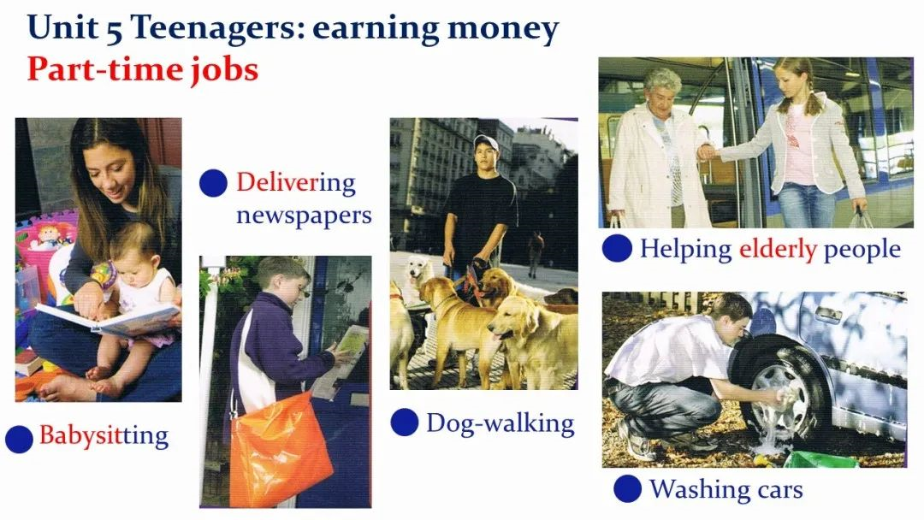
激活话题词汇同现
1- Q2. What were their ideas to earn money by part-time jobs ? How did the team carry out their ideas?
How do teenagers earn money by part-time jobs in the western countries?
Performances, car wash and even a candy sale were suggested but none seemed practical. Suddenly Betty cried excitedly, "Maybe we can convince Mrs. Lorries to offer us some jobs in the pet shop." All her teammates agreed it was a great idea as it would not only raise enough money but could afford them good time with cute dogs. Things turned out as they had expected. The following days witnessed their efforts feeding, washing and walking dogs and they were handsomely rewarded.
大家建议演出、洗车、甚至卖糖果，但似乎都不现实。突然，贝蒂兴奋地喊道:“也许我们可以说服罗瑞丝太太在宠物店给我们提供一些工作。”她所有的队友都认为这是个好主意，因为这不仅能筹到足够的钱，还能让他们和可爱的狗狗们共度美好时光。事情的结果正如他们所预料的那样。在接下来的几天里，他们努力喂狗、洗狗、遛狗，得到了丰厚的回报。
2023学年第一学期高三年级越秀区调研测试：：学生球队为理想的足球场而打工筹钱和基建劳动

Slide 10
激活话题词汇同现
1- Q2. What were their ideas to earn money by part-time jobs ? How did the team carry out their ideas?
How do teenagers earn money by part-time jobs in the western countries?
One idea after another popped up, all of which sounded practical. So they divided themselves into several groups and were each assigned to one particular task. One undertook the newspaper-delivering in the neighborhood, and one group were up to taking care of the gardens for the busy neighbors. Amazingly, Batty managed to find a job at the pet store, where she would feed, walk and wash the dogs. Money seemed to roll in, but it was still far from enough. To make up for the difference, the Rockers organized a charity performance in the community, asking for donations to the soccer field. Their efforts finally paid off and a soccer field of their own was on the way.
一个又一个主意冒了出来，听起来都很实用。所以他们把自己分成了几个小组，每个小组都被分配到一个特定的任务。一组负责在附近送报纸，一组负责为忙碌的邻居打理花园。令人惊讶的是，贝蒂设法在宠物店找到了一份工作，她在那里喂狗、遛狗和给狗洗澡。钱似乎滚滚而来，但还远远不够。为了弥补差额，Rockers在社区组织了一场慈善演出，要求为足球场捐款。他们的努力终于得到了回报，他们自己的足球场即将建成。
2023学年第一学期高三年级越秀区调研测试：：学生球队为理想的足球场而打工筹钱和基建劳动

Slide 11
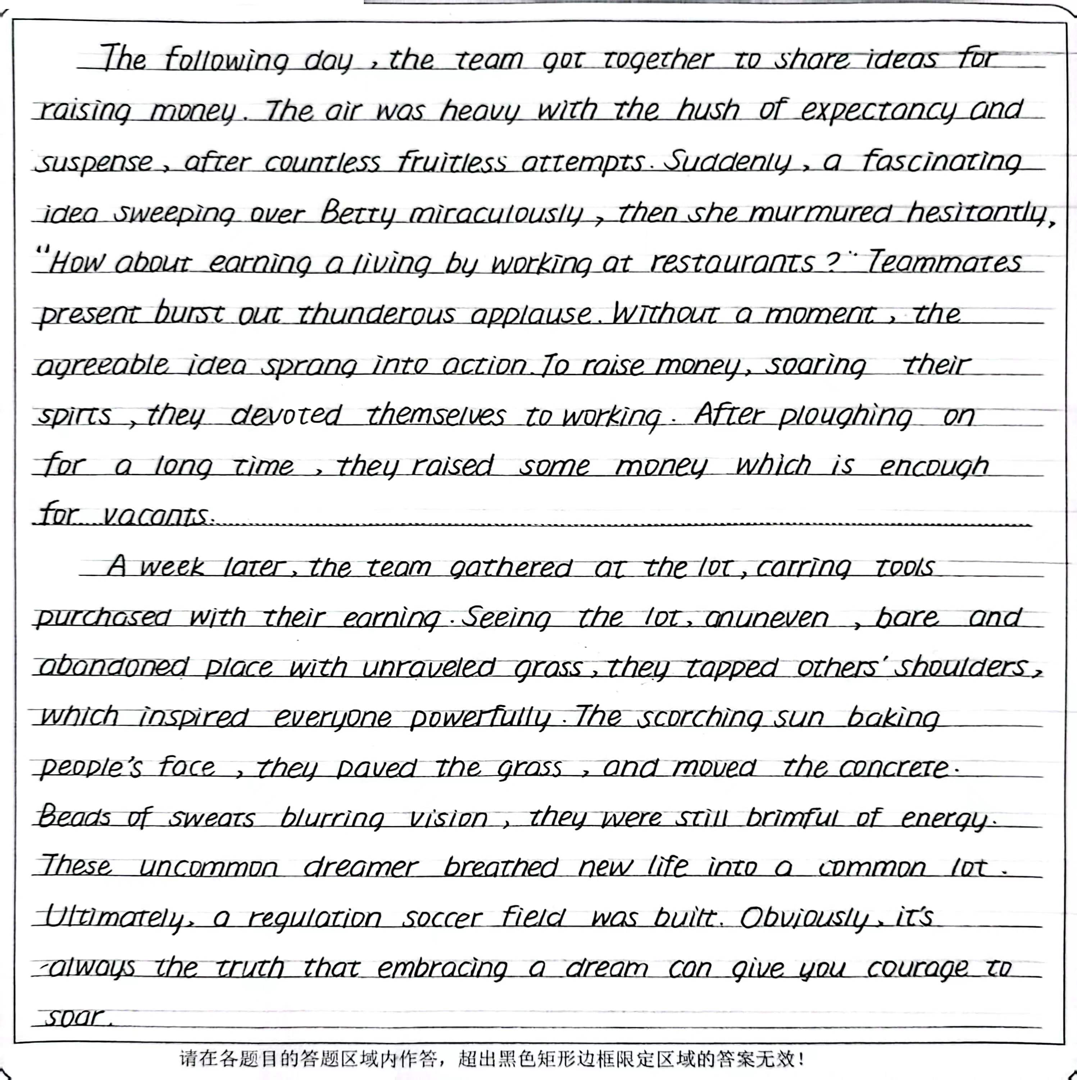
激活话题词汇同现
1- Q2. What were their ideas to earn money by part-time jobs ? How did the team carry out their ideas?
How do teenagers earn money by part-time jobs in the western countries?
1.本段提出的“餐馆打工”与原文“the town owns an empty lot next to my restaurant”呼应；
2. 运用“近义词复现”和“话题词汇同现”等词汇衔接手段 “expectancy → countless fruitless attempts →fascinating idea → thunderous applause → sprang into action →soaring their spirts → devoted themselves to working →ploughing on 建立了一个贯穿语篇的“劳动挣钱的艰辛而充满激情的过程”语义链和逻辑主线。
2023学年第一学期高三年级越秀区调研测试：：学生球队为理想的足球场而打工筹钱和基建劳动

Slide 12
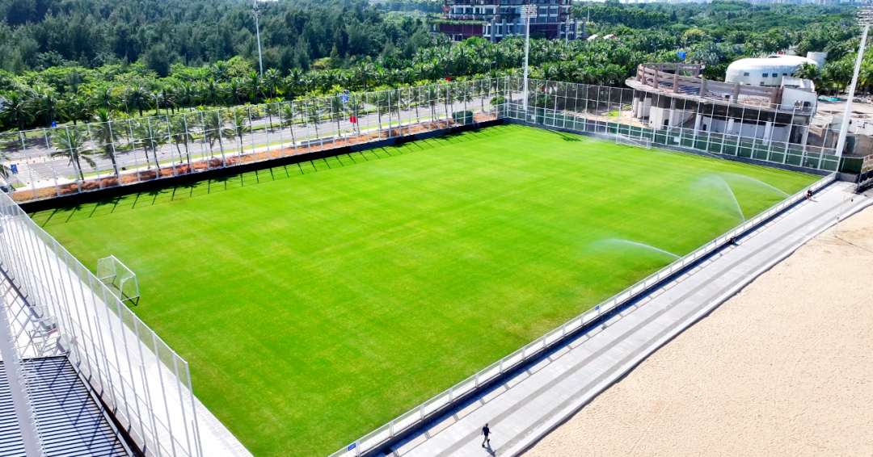
激活话题词汇同现
2-Q1. After gathering at the lot, what jobs were they doing to build the soccer field?
How did they overcome all the difficulties?
Overgrown weeds and large rocks were really a challenge for these soccer enthusiasts.
杂草丛生，岩石巨大，对这些足球爱好者来说真是一个挑战。
Seeing the field covered with dirt, rubble, and weeds, Maria kicked into action with her teammates, scooping up debris and depositing it in a rented truck.
看到田地被泥土、碎石和杂草覆盖，贝蒂和她的队友们开始行动起来，把碎片铲起，放在租来的卡车上。
Then they removed the large rocks together from the field and filled the holes left by the rocks with enough soil. After they lay the new sod on it, they were enthralled by the new standard pitch.
然后他们把大石头一起从地里搬走，用足够的泥土填满石头留下的洞。在上面铺上新草皮后他们被新的标准球场迷住了。
2023学年第一学期高三年级越秀区调研测试：：学生球队为理想的足球场而打工筹钱和基建劳动

Slide 13
激活话题词汇同现
2-Q1. After gathering at the lot, what jobs were they doing to build the soccer field?
How did they overcome all the difficulties?
Seeing the lot, an uneven, bare and abandoned place with unraveled grass, they tapped others' shoulders, which inspired everyone powerfully . The scorching sun baking people's face, they paved the grass, and moved the concrete. Beads of sweats blurring vision, they were still brimful of energy. These uncommon dreamer breathed new life into a common lot. Ultimately, a regulation soccer fieid was built. 本段描述将改造空地的艰难，劳动的艰辛，团队的激励有机地结合，突显劳动的意义，真正的成长，在于，全力以赴地实现理想。
2023学年第一学期高三年级越秀区调研测试：：学生球队为理想的足球场而打工筹钱和基建劳动

Slide 14
3. 基于语义连贯
增强语境关联
促成协同效应

Slide 15
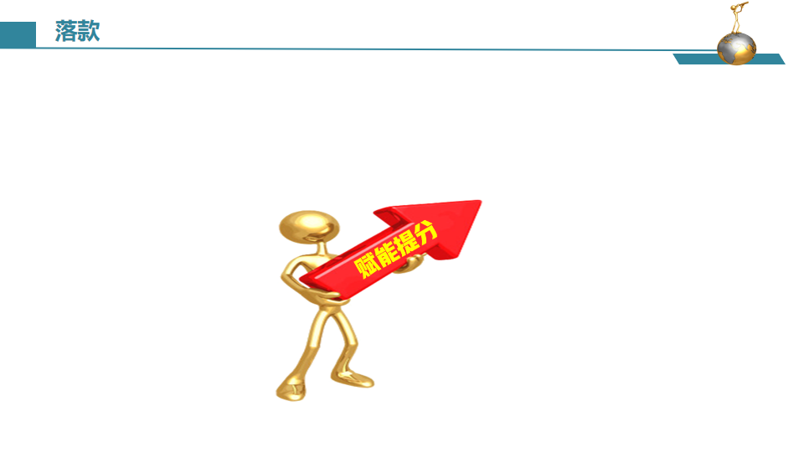


语篇衔接的三个“一定”
根据衔接连贯理论，通过词汇的有效衔接（词汇同现或词汇复现）实现语义连贯和逻辑衔接。
第一段结尾
①一定要有与第二段段首句中的同词或同义词。
②实现无缝衔接
第一、二段开头
①一定要把段首句的名词或动词（尤其是后半句），用在写作开头，实现语义连贯。
②力争高分开头
第二段结尾
①一定要呼应原文中体现主题或伏笔的关键词。
②实现主题升华

Slide 16
语篇衔接的三个“一定”
原文伏笔 | I had a dream that I scored the winning goal on a brand new soccer field! Your dream could be a sign that River Edge will finally get a regulation soccer field. Mr. Edmond winked at her, as if to say, “Didn’t you have a dream?” （dream在原文中三次复现，本文旨在突显“实现梦想过程中不畏艰难、团结协作”的主题）
第 一 段 | The following day, the team got together to share ideas for raising money. One idea after another popped up, all of which sounded practical. ... .... ...After ploughing on for a week, they raised some money which is encough for vaconts.
第 二 段 | A week later, the team gathered at the lot, carrying tools purchased with their earnings. Overgrown weeds and large rocks at the lot were really a challenge for these soccer enthusiasts, but with the dream of a soccer field in mind, they immediately set out to work. ... ... .... With all the work done, a soccer field of their own was finally born. "We made it. Together we turned a rough lot into our dream soccer field." Betty exclaimed, bursting with pride.

Slide 17
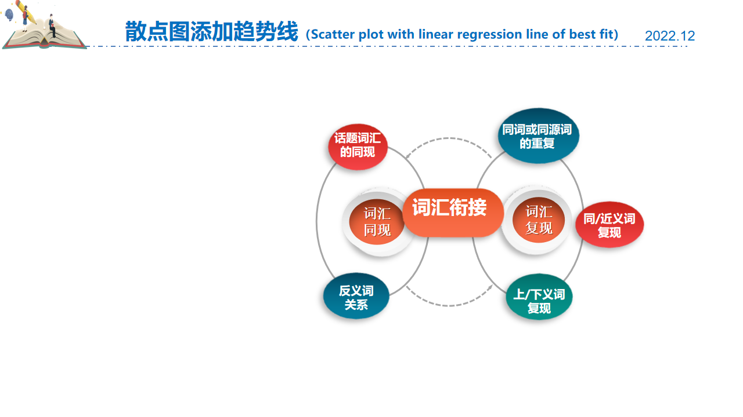
基于语义连贯的读后续写
词汇衔接 | 原文选词 | 续文协同
1. 同词复现 | Betty; the empty/vacant lot; the River Edge Rockers; brand new; the team/teammates
2. 同义复现 | ① a soccer field ② raising money/ their earnings | ①the new standard pitch the perfect regulation destination for soccers ② paycheck — $750; the pay;
3.反义复现 | in a tiny school yard, and only when it’s not already booked. | ①No advance reservation necessary, it would be the perfect regulation destination for soccers and some workout.
4. 话题拓展 | ①share ideas for raising money ② the lot | ①newspaper-delivering; babysitting; dog-walking; washing cars ②overgrown weeds; large rocks; rubble; sod
5. 意义升华 | dream | with the dream of a soccer field in mind,... Together we turned a rough lot into our dream soccer field. These uncommon dreamer breathed new life into a common lot. embracing a dream can give you courage to soar.
2023学年第一学期高三年级越秀区调研测试：：学生球队为理想的足球场而打工筹钱和基建劳动

Slide 18
范文赏析
The following day, the team got together to share ideas for raising money. One idea after another popped up, all of which sounded practical. So they divided themselves into several groups and were each assigned to one particular task. One undertook the newspaper-delivering in the neighborhood, and one group were up to taking care of the gardens for the busy neighbors. Amazingly, Maria managed to find a job at the pet store, where she would feed, walk and wash the dogs. Money seemed to roll in, but it was still far from enough. To make up for the difference, the Rockers organized a charity performance in the community, asking for donations to the soccer field. Their efforts finally paid off and a soccer field of their own was on the way.
A week later, the team gathered at the lot, carrying tools purchased with their earnings. Overgrown weeds and large rocks were really a challenge for these soccer enthusiasts, but with the dream of a soccer field in mind, they immediately set out to work. The next few days witnessed the group removing the overgrown weeds and digging out the large rocks from the lot and having them taken away. After smoothing the field with the soil brought somewhere else, they took one step further by planting grass on it. With all the work done, a soccer field of their own was finally born. Looking at the field, the teammates exchanged an understanding smile, imagining themselves sending the ball through the air, and toward the goal!
本文对筹钱和建足球场的过程情节设计合理，叙事真实，与原文契合度高，达成较好的协同效应。
点评
2023学年第一学期高三年级越秀区调研测试：：学生球队为理想的足球场而打工筹钱和基建劳动

Slide 19
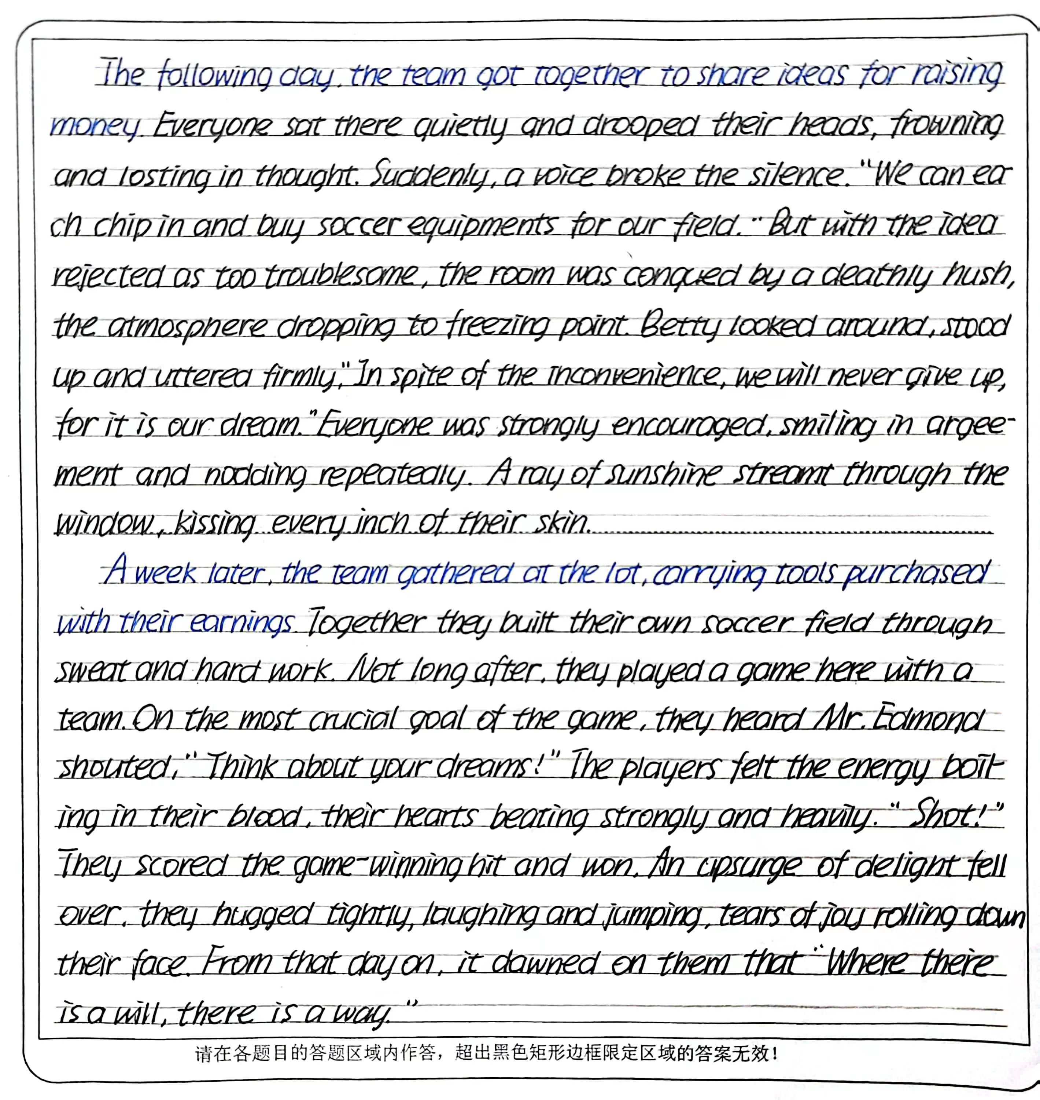
学生习作点评
点评
本篇习作没有读懂原文，习作严重脱离偏离原文主线。
第一段一直在讨论ideas，没有体现通过劳动筹钱的过程，与第二段段首句中的with their earnings未能形成有效衔接，语义和逻辑不连贯。
第二段对建造足球场一笔带过，蜻蜓点水，而大篇幅描写足球比赛获胜的梦想。
显然，习作者未能懂得原文中soccer field的多次复现形成文章的主线，未能掌握语义连贯的读写技巧。
该习作建议得分12分。
2023学年第一学期高三年级越秀区调研测试：：学生球队为理想的足球场而打工筹钱和基建劳动

Slide 20
学生习作点评
点评
本篇习作的质量很高，内容丰富、主题明确，故事情节设计自然流畅、合乎逻辑。与原文契合度好，高度协同。
第一段运用“词汇复现”和“话题词汇同现”等词汇衔接手段建立了一个贯穿语篇的“劳动挣钱的艰辛而充满激情的过程”语义链和逻辑主线（见之前PPT-11分析）。
第二段对变荒芜的空地为正规的球场的表述很精彩，用词生动准确，尤其是主题升华句“These uncommon dreamer breathed new life into a common lot”和“embracing a dream can give you courage to soar”非常自然，水到渠成，熟练地掌握了语义连贯的读写技巧。
该习作建议得分23分。
2023学年第一学期高三年级越秀区调研测试：：学生球队为理想的足球场而打工筹钱和基建劳动

Slide 21

Self-evaluation and mutual-evaluation form
Specific item | Self-evaluation | Mutual-evaluation
1.你在读原文时，能否划出哪些关键词汇/词组/句子？有什么依据吗？
2.你在本篇写作中使用了多少种词汇衔接的方法使续文中哪些词汇/词组/句子与原文或续文的上下文有衔接？这些衔接是否促成了连贯? (在续文的相关表达下划线）
3.你是如何利用段首句信息，运用词汇衔接的三个“一定”，实现实现情节发展的严谨性？
4.你是如何对故事的起因、过程及结果进行渗透性评议，增强故事的感染力和思想性？
5.从词汇衔接的角度，文中有哪些词汇运用的失误？(将续文的相关不妥当的表达圈出）修改后，语篇各个部分与语义、主题和语境更关联?（用红笔修改）

Slide 22

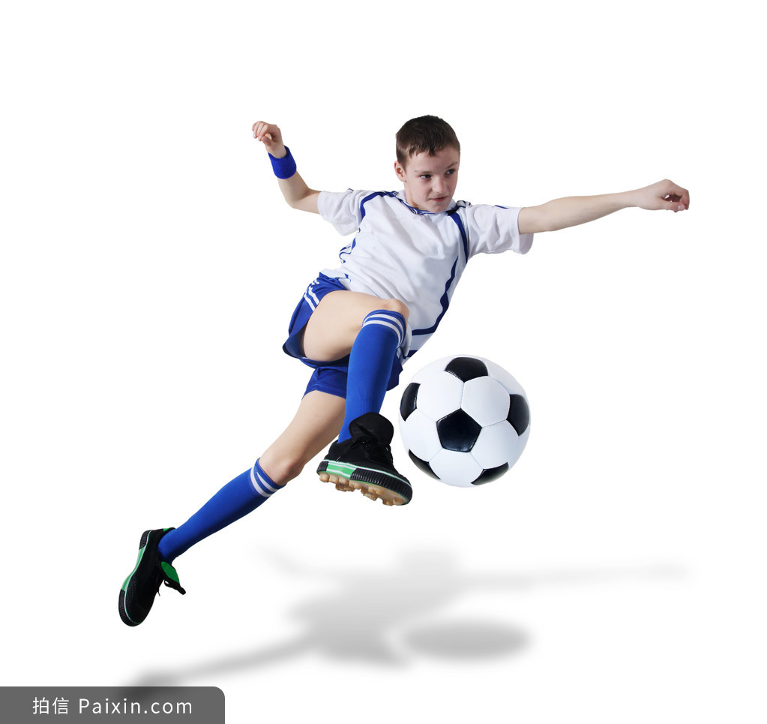

奇迹总在拼搏之后；
成功蕴于进取之中。
2023学年第一学期高三年级越秀区调研测试：：学生球队为理想的足球场而打工筹钱和基建劳动

