Slide 1


感恩遇见，相互成就，本课件资料仅供您个人参考、教学使用，严禁自行在网络传播，违者依知识产权法追究法律责任。
更多教学资源请关注
公众号：溯恩高中英语
知识产权声明

Slide 2
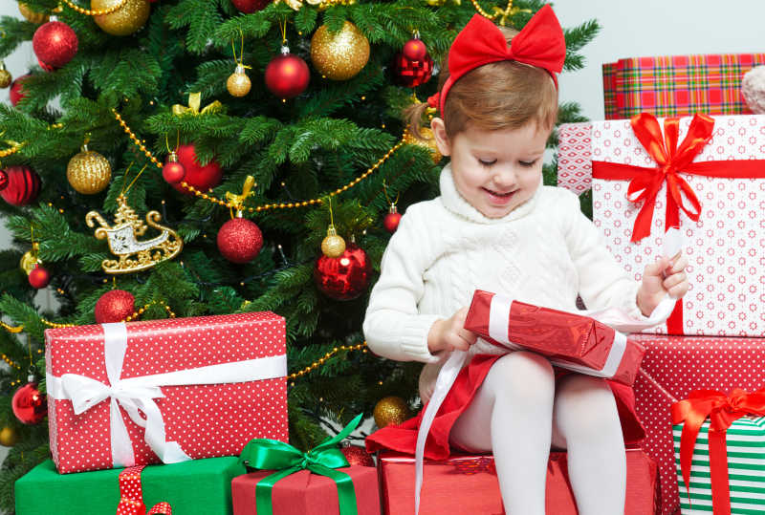

Slide 3
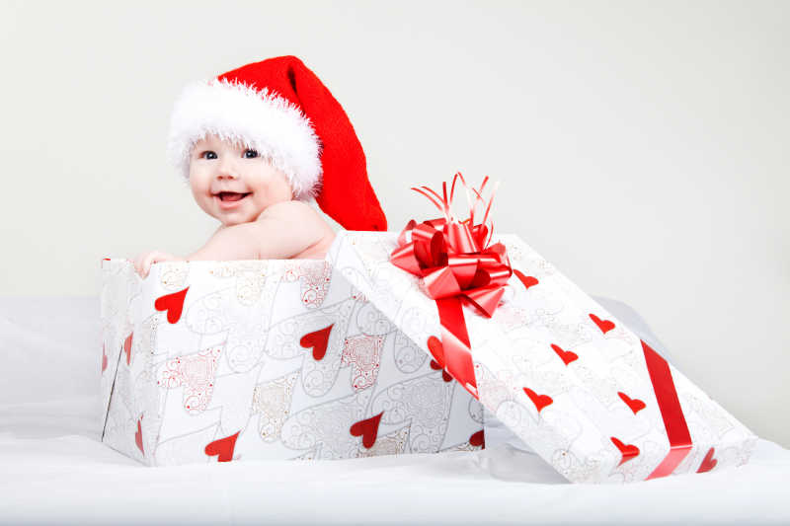
Christmas Surprise Gift
浙江金华市汤溪高级中学 郑素红

Slide 4
Q1：What Christmas gift would I get?
Q2: Why was I feeling good?
I still remember the day when we decorated the house, I was ten and it was two weeks before Christmas. I was looking forward to my presents. Since I'm the youngest in the family, all of the family members would give me a gift one way or another. Sometimes it was a cookie or a hug but it was always there. I was the only center of attention and it was feeling good.

Slide 5
Q3: What did I want this year?
My uncles usually would ask me what I wanted before Christmas and that year I knew what I wanted. It was the spaceship I saw in the ads. I was dreaming of opening a big gift box, and it was there. But that year it came in a way that I wasn't expecting.

Slide 6
Q4: Who was she ?
Was I ready ?
It was two weeks before Christmas. Just two weeks. She couldn't wait. My dear mother told my father that it was time, and then we went to the hospital. After an hour, they told me that I had a sister now. But I didn't want a sister. I wanted a spaceship. The next few days went so fast. No one was caring about me. Everyone was talking about her and I knew that my life is never going to be the same ever again. I wasn't ready to grow up, to be a big brother. But it just happened in an instant.

Slide 7
Q5：How did I feel?
Q6: What did I do after a nightmare?
Q7: What did my newborn sister do?
On the day before Christmas, everyone was in our home, talking only about my newborn sister. My family was becoming hers. Even my uncles didn't ask me anything about the gift. She stole everything I'd ever had, my life and my presents. Thinking about this, I cried to sleep. I had a nightmare( 噩梦) and woke up at the middle of the night. Shadows were all around me, and I was defenseless and so weak. I ran into my parents' bedroom but couldn't wake up my poor parents who were just too worn out. I was standing near their bed, trying not to cry when I saw her. She was awake and looking at me with her big eyes in her small bed.

Slide 8
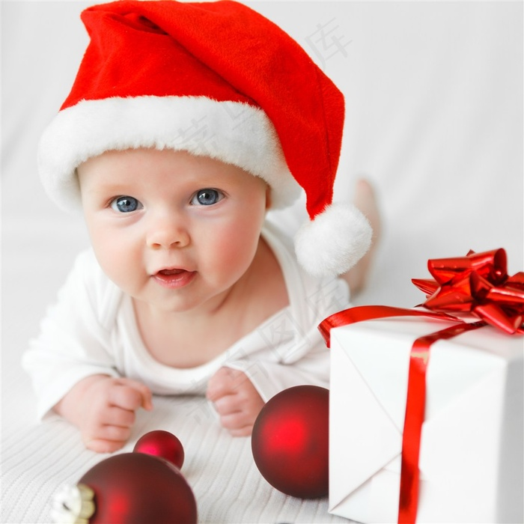
原文伏笔 | 续写回扣
I‘m the youngest in the family； I was the only center of attention and it was feeling good. | my newborn sister was the focus of the family now
I was dreaming of opening a big gift box, and it was there. But that year it came in a way that I wasn't expecting. | What was the gift? Was it a spaceship?
I wasn't ready to grow up, to be a big brother. But it just happened in an instant. | My sister was born two weeks before Christmas. After two weeks, I should be ready to be a big brother.
I had a nightmare and woke up at the middle of the night, crying. My newborn sister was crying, too. | Why was she crying ? How did I feel? How did I react?

Slide 9
……I was standing near their bed, trying not to cry when I saw her. She was awake and looking at me with her big eyes in her small bed.
Para1. Suddenly, she started crying.
定第一段首句（句群）：结合原文最后一段我哭的原因（因为恶梦）和最后一句 She was looking at me with her big eyes in her small bed. 以及she started crying .我可能要探究一下她哭的原因。
“Am I her nightmare?” I thought to myself. Never had I hugged her or kissed her before because I thought she stole everything that used to belong to me.

Slide 10
定第一段尾句（句群）：I switched on the bed lamp, warm light pouring softly down on her pink wet cheeks. Hardly had she seen me when she reached out her tender hands to me. “She is adorable! She is an angel! She trusts me ! ” I exclaimed! My heart just melted as her fingers touched mine! I wrapped her in my arms, wiping her tears away gently and consoling her softly.
定第一段尾句（句群）：结合第二段首句 After having comforted her, 推测尾句我去安慰妹妹，逆推如何安慰？时间是深夜，可以加点灯光，让兄妹第一次彼此温暖相见相拥。
Para2. After having comforted her, something slowly changed inside me.

Slide 11
Para1. Suddenly, she started crying.
（我哭是因为噩梦，妹妹哭是见了我以后才哭的。）
“Am I her nightmare?” I thought to myself.
2. （为什么我是妹妹的噩梦？回扣最后一段我认为妹妹偷走了一切。）
Never had I hugged her or kissed her before because I thought she stole everything that used to belong to me.
3.（用三个排比句，来说明自己的委屈：①不再是家人的焦点②被家人忽视③孤独带来噩梦）
Being not the only focus of my family got me frustrated. Being ignored by my family filled my heart with a sense of loss. Being lonely made me cry at the midnight.

Slide 12
Para1. Suddenly, she started crying.
4. (我的自责与愧疚 回扣原文I was not ready to grow up，我肯定会有成长，我的成长从反省自己开始。）
Was I being so SELFISH? Suddenly, I was overwhelmed by an enormous surge of shame, my face burning with guilt.
（我要安抚妹妹---我开灯消除妹妹的不安，也可以写第一次认真地看妹妹）
I switched on the bed lamp, warm light pouring softly down on her pink wet cheeks.

Slide 13
6.（妹妹见到我时的举动）
Hardly had she seen me when she reached out her tender hands to me. “She was adorable! She trusts me ! ” I exclaimed! My heart just melted as her fingers touched mine!
7. (表现反省后的哥哥的表现）
I wrapped her in my arms, wiping her tears gently and consoling her softly.

Slide 14
Para2. After having comforted her, something slowly changed inside me.
定第二段首句（句群）：(something changed inside me 来推测 要写我的变化。侧重心理感受。)
Looking into her innocent eyes, my initial envy gave way to the responsibility of being a big brother.

Slide 15
Para2. After having comforted her, something slowly changed inside me.
定第二段尾句（句群）（结合原文本第一段每年都收到圣诞礼物。今年的圣诞礼物不是cookie 也不是 hug 而是我亲爱的妹妹。此后，兄妹情深。）
What I never expected this Christmas was that I got such a surprising Christmas gift---my adorable sister. Her laughters and cries added luster and color to my childhood. And I owed/ attributed my overnight growth to her unconditional love for me.

Slide 16
Para2. After having comforted her, something slowly changed inside me.
1.(结合something changed inside me 来推测 要写我的变化。侧重心理感受。)
Looking into her innocent eyes, my initial envy/ jealousy gave way to the responsibility of being a big brother.
2. (哄妹妹睡觉，然后自己回房间，因为成长，所以我心坦然，睡了个好觉。）
I put her to sleep , sneaked / went back to my bedroom and had a sound sleep.

Slide 17
3.(第二天圣诞来临，家里终于过节了, 渲染一下节日的气氛。)
Christmas fell and joyful festive atmosphere filled the whole house， colorful lights sparkling on the Christmas tree decorated with gifts boxes, ribbons and other gorgeous ornaments.
4. (礼物竟然吸引不了我啦 ！）
What surprised me most was that those gift boxes didn’t appeal to me at all.
5. （我要做个快乐的哥哥，给妹妹祝贺圣诞快乐, 欢迎妹妹的到来）
I just couldn’t wait to say “Merry Christmas” to my newborn sister and show my warmest welcome to her arrival.
6. （深深的兄妹情）
Time ticking away, the bond between sister and brother grew stronger, much stronger than I could describe.

Slide 18
Para2. After having comforted her, something slowly changed inside me.
7. 结合原文本第一段每年都收到圣诞礼物。今年的圣诞礼物不是cookie 也不是 hug 而是我亲爱的妹妹。）
What I never expected this Christmas was that I got such a surprising Christmas gift---my beloved /adorable / cute sister.
8. (礼物妹妹的珍贵之处：妹妹伴我成长，苦乐与共。）
Her laughters and cries added luster and color to my childhood. And I owed/ attributed my overnight growth to her unconditional love for me.

Slide 19
下水作文： Para1. Suddenly, she started crying.
“Am I her nightmare?” I thought to myself. Never had I hugged her or kissed her before because I thought she stole everything that used to belong to me. Being not the only focus of my family got me frustrated. Being ignored by my family filled my heart with a sense of loss. Being lonely made me cry at the midnight. Was I being so SELFISH? Suddenly, I was overwhelmed by an enormous surge of shame, my face burning with guilt. I switched on the bed lamp, warm light pouring softly down on her pink wet cheeks. Hardly had she seen me when she reached out her tender hands to me. “She trusts me ! ” I exclaimed! My heart just melted as her fingers touched mine! I wrapped her in my arms, wiping her tears gently and consoling her softly.

Slide 20
Para2. After having comforted her, something slowly changed inside me. Looking into her innocent eyes, my initial envy gave way to the responsibility of being a big brother. I put her to sleep , went back to my bedroom and had a sound sleep. Christmas fell and joyful festive atmosphere filled the whole house, colorful lights sparkling on the Christmas tree . What surprised me most was that those gift boxes didn’t appeal to me at all. I just couldn’t wait to say “Merry Christmas” to my newborn sister and show my warmest welcome to her arrival. Time ticking away, the bond between sister and brother grew stronger, much stronger than I could describe. What I never expected this Christmas was that I got such a surprising Christmas gift---my cute sister. Her laughters and cries added luster and color to my childhood. And I attributed my overnight growth to her unconditional love for me.

Slide 21
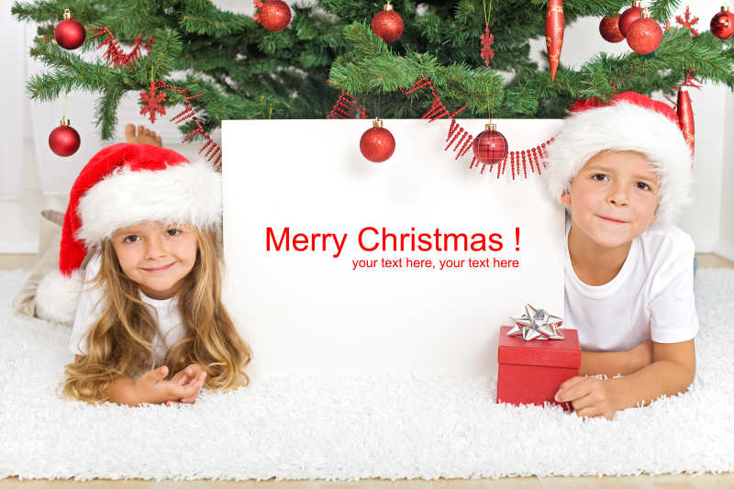
Welcome to our family, my little sister!

