Slide 1


感恩遇见，相互成就，本课件资料仅供您个人参考、教学使用，严禁自行在网络传播，违者依知识产权法追究法律责任。
更多教学资源请关注
公众号：溯恩高中英语
知识产权声明

Slide 2

The World
December 16th-31st, 2023

Slide 3

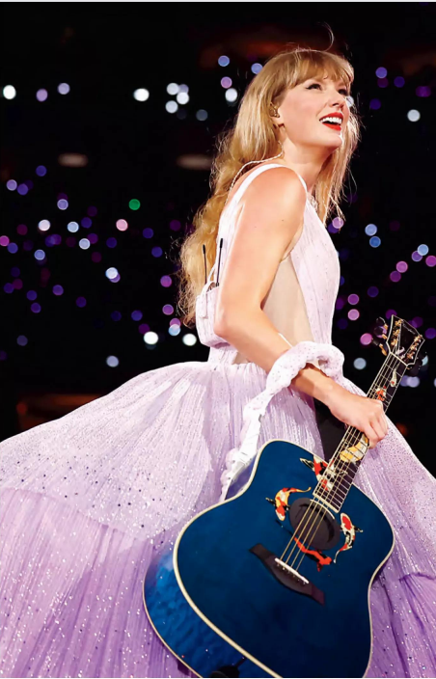
1. The Power Era (Taylor’s Version) 泰勒·斯威夫特

Slide 4
Text Completion
Forbes (December 2023/January 2024 Pages 20-21 )
Thanks to the record-breaking success of the Eras Tour, Taylor Swift became a billionaire in October—making her the rare recording artist _____ (hit) ten-figure status, joining the likes of Jay-Z (net worth: $2.5 billion) and Rihanna ($1.4 billion). A three-and-a-half-hour concert retrospective of her career, the tour has grossed nearly $850 million over 63 US ______ (show). Its first leg has added an _________ (estimate) $190 million, after tax, to Swift’s coffers (财源;金库), ________ (boost) her net worth to $1.1 billion. The show will head to Europe and Asia next year.
The so-called Taylor Swift Effect casts a wide ________ (finance) halo, meanwhile. Two nights of her tour in Denver added an estimated $140 million to Colorado’s GDP thanks to fans spending an average $1300 apiece ___ hotels, restaurants and retailers. The Philadelphia Federal Reserve even cited Swift in its June Beige Book, noting that May—____ month the Pennsylvania native performed at Lincoln Financial Field in Philly for three nights—marked the ________ (strong) month for city hotel revenue since before the pandemic. The US.Travel Association estimates that collectively, the U.S. leg of the tour added more than $5 billion to state economies. “She’s like a big corporation, essentially, that’s in many sectors,” says labor economist and University of Chicago professor Carolyn Sloane. “Her audience has skewed so young and so female for so long ____ people may have underestimated how big this thing could be, ___________ (economy). I don’t think anybody doubts that today.”
to hit
shows
estimated
boosting
financial
on
the
strongest
that
economically

Slide 5

Reading Comprehension
1. What does the underlined word “gross” in paragraph 1 mean?
A. Turn down. B. Bring in.
C. Use up. D. Throw away.
2. Which of the following statements is correct?
A. Swift is one of the many billionaire recording artists.
B. Swift fans’ consumption in Denver contributed to Colorado’s economy.
C. Swift’s tour pumped over $5 billion to the Pennsylvania economy.
D. Sloane didn’t anticipate the economic impact of Swift’s U.S. leg of the tour.

Slide 6
Vocabulary
1. retrospective: thinking about or connected with sth that happened in the past 回顾的；涉及以往的
Afterwards, retrospective fear of the responsibility would make her feel almost faint. 后来，回想起要负的责任她几乎会吓晕过去。
2. gross: to earn a particular amount of money before tax has been taken off it
总收入为；总共赚得
I’m a factory worker who grossed £12,900 last year.
我是个工厂工人，去年的总收入为12900英镑。
Translation
博物馆正在举办这位艺术家早期作品的回顾展。
The museum is having a retrospective exhibit of the artist’s early works.
Translation
到目前为止，这些电影的票房总收入已超过了5.9亿英镑。
So far the films have grossed more than £590 million.

Slide 7
Translation
Its first leg has added an estimated $190 million, after tax, to Swift’s coffers, boosting her net worth to $1.1 billion. The show will head to Europe and Asia next year.
据估计，第一阶段的巡演为斯威夫特的税后收入增加了1.9亿美元，使她的净资产达到11亿美元。此次巡演将于明年前往欧洲和亚洲。
The Philadelphia Federal Reserve even cited Swift in its June Beige Book (褐皮书), noting that May—the month the Pennsylvania native performed at Lincoln Financial Field in Philly for three nights—marked the strongest month for city hotel revenue since before the pandemic.
费城联邦储备银行甚至在其6月份的褐皮书中提到了斯威夫特，指出5月份——这位宾夕法尼亚州人在费城林肯金融球场演出了三个晚上——是自疫情前以来城市酒店收入最强劲的一个月。

Slide 8
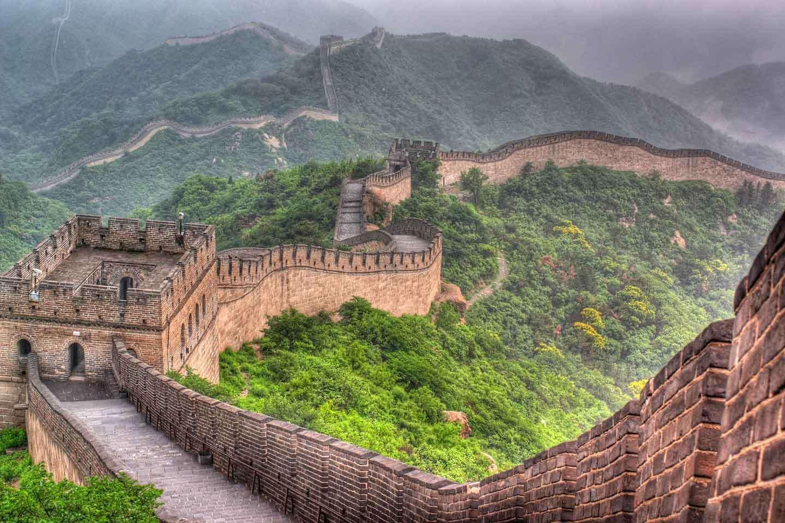
2. Great Wall of China is protected by a coat of lichen and moss
地衣和苔藓护长城

Slide 9
Text Completion
New Scientist (16th December 2023 Page 11)
is being protected
The Great Wall of China _______________ (protect) from erosion by a “biocrust” of moss, lichen and cyanobacteria, much as the wall once shielded the country ____________ northern invasions. The wall, built and rebuilt many times between about 200 BC and the Ming dynasty, which lasted from 1368 until 1644, once ________ (stretch) for more than 8800 kilometres. Today, less than 6 per cent of its total length remains well-preserved, and much has vanished. Many sections of the wall were built with rammed earth, which is when natural materials such as soil and gravel are compacted ________ (create) structures. Bo Xiao at China Agricultural University in Beijing and his __________ (colleague) have sampled a 600-kilometre-long section of the wall and observed that more than two-thirds of it is covered in biocrust. The team found that this layer of lichens, mosses and cyanobacteria contributes to strengthening the wall, keeping ___ dry and protected from wind and water erosion. The biocrust also acts as an insulator, reducing temperature extremes and ________ (lower) the effects of salinity. Biocrust-covered sections were less porous, with reduced water-holding capacity, erodibility and salinity, says the team. These areas also showed increased resistance to _______ (vary) forms of mechanical assault. The findings could change the way managers of heritage sites around the world regard vegetation on ancient structures, says Xiao. The biocrusts may mitigate the extremes of hot and cold the wall faces, says Brett Summerell at the Botanic Gardens of Sydney. “They would provide an environment ___________ helps buffer and protect the ________ (stable) of the structure of the walls.”
from / agianst
stretched
to create
colleagues
it
lowering
various
which / that
stability

Slide 10
Reading Comprehension
1. What can we learn from the Great Wall of China?
A. It stretches for over 8800 kilometres at present.
B. It once defended China from Japanese invasions.
C. Only a small part of it is currently well-preserved.
D. It was only built in the Qin and Ming dynasty.
2. What’s Brett Summerell’s attitude towards the function of the biocrusts?
A. Dismissive. B. Doubtful.
C. Favourable. D. Tolerant.

Slide 11
Vocabulary
1. mitigate: to make sth less harmful, serious, etc. 减轻；缓和
It is unclear how to mitigate the effects of tourism on the island. 还不清楚如何缓解旅游业对这个岛屿的影响。
2. buffer: to protect sb from sth 保护；使不受…的侵害
They tried to buffer themselves against problems and uncertainties. 他们尽力保护自己免受困难和不确定因素的影响。
Translation
植树造林减轻了土壤侵蚀。
Soil erosion was mitigated by the planting of trees.
Translation
这家公司受到了与种植者签订长期合同的保护。
The company is buffered by long-term contracts with growers.

Slide 12
Translation
Today, less than 6 per cent of its total length remains well-preserved, and much has vanished. Many sections of the wall were built with rammed earth, which is when natural materials such as soil and gravel are compacted to create structures.
如今，只有不到6%的长城全长保存完好，大部分已经消失。城墙的许多部分都是用夯土建造的，夯土是将土壤和砾石等天然材料压实以形成结构。
The team found that this layer of lichens, mosses and cyanobacteria contributes to strengthening the wall, keeping it dry and protected from wind and water erosion.The biocrust also acts as an insulator, reducing temperature extremes and lowering the effects of salinity.
研究小组发现，这层地衣、苔藓和蓝藻有助于加强墙壁，保持干燥，免受风和水的侵蚀。生物外壳还起到绝缘体的作用，减少极端温度，降低盐度的影响。

Slide 13
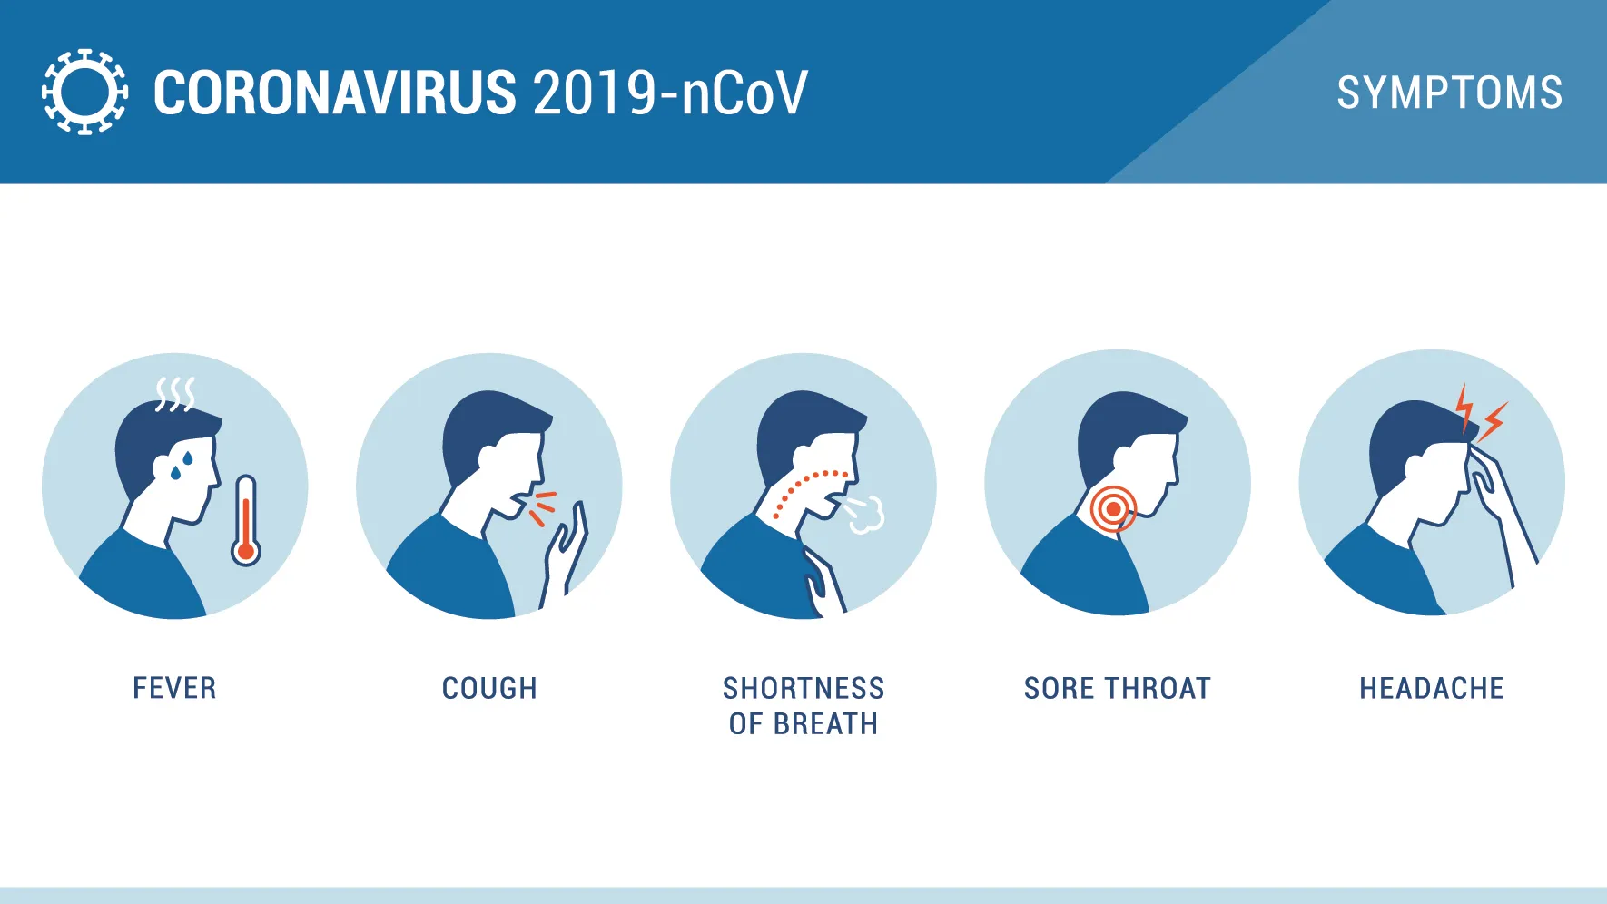
3. New Covid variant on rise, with prevalence greater for under-45s
新冠病毒变体呈上升趋势，45岁以下人群患病率高

Slide 14
Text Completion
The Guardian (22nd December 2023 Page 11)
Covid is in the air this Christmas, data has revealed, with experts warning that a new variant is ___ the rise around the world.
According to data from the Office for National Statistics and the UK Health Security Agency (UKHSA), ___ estimated 4.2%, or one in 24 people, in England and Scotland had Covid on 13 December _________ (compare) with 1.8%, or one in 55, on 29 November. The data is based on self-reported lateral flow device results from about 150,000 __________ (participate) across England and Scotland, who provide, in total, up to 30,000 test results a week. It was also revealed that while prevalence had increased across all age groups, it was ______ (high) in people aged between 18 and 44 years than in those over 65. “The prevalence ____________ (increase) in every English region over the past two weeks and in particular London and the south-east,” the report adds. The figures come days after the World Health Organization said a new sub-variant of Omicron, labelled JN.1, had been classified as a “variant of interest” after _________ (spend) rapidly in the Americas, western Pacific and European regions. The sub-variant has already turned up in the UK, _______ it accounted for 43% of sequenced cases as of 16 December, and in the US and Singapore.
JN.1 is _______ (close) related to another variant called BA.2.86, or Pirola, and both were previously tracked together. According to the US Centers for Disease Control and Prevention (CDC), JN.1 and BA.2.86 differ ___ a single change in the spike protein of the virus.
on
an
compared
participants
higher
has increased
spreading
where
closely
by

Slide 15
Vocabulary
1. variant: a thing that is a slightly different form or type of sth else 变种；变体
The quagga was a strikingly beautiful variant of the zebra. 白氏斑马是一种极其美丽的斑马变种。
2. prevalence: the fact that something is very common or happens often 流行，盛行；普遍，广泛
The prevalence of the disease is higher in some families. 在一些家庭中，该病的发病率较高。
Translation
这种运动是由棒球演变而来的。
This game is a variant of baseball.
Translation
医生们发现肥胖症的发病率在上升。
Doctors are seeing an increase in the prevalence of obesity.

Slide 16
Translation
The data is based on self-reported lateral flow device results from about 150,000 participants across England and Scotland, who provide, in total, up to 30,000 test results a week. It was also revealed that while prevalence had increased across all age groups, it was higher in people aged between 18 and 44 years than in those over 65.
这些数据是基于来自英格兰和苏格兰约15万名参与者的自我报告的横向流动设备结果，他们每周提供总计多达3万个测试结果。研究还显示，虽然所有年龄组的患病率都在上升，但18至44岁的人群患病率高于65岁以上的人群。
The figures come days after the World Health Organization said a new sub-variant of Omicron, labelled JN.1, had been classified as a “variant of interest” after spreading rapidly in the Americas, western Pacific and European regions.
就在几天前，世界卫生组织表示，在美洲、西太平洋和欧洲地区迅速传播后，一种名为JN.1的新的奥密克戎亚变体已被归类为“感兴趣的变体”。

Slide 17
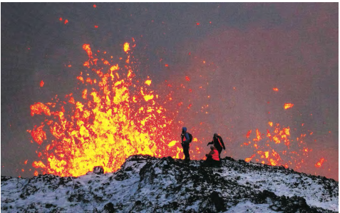
4. Scientists unsure about scope of impact as Iceland volcano spews toxic gas
冰岛火山喷发会带来什么

Slide 18
Text Completion
The Wall Street Journal (21st December 2023 A14 )
After weeks of rumbling and ominous _______ (signal), a volcano erupted Monday on the Reykjanes Peninsula in southwest Iceland. The fissure is a little over two miles long and is near the _______ (coast) town of Grindavik, which had been evacuated after monitoring indicated magma was lurking underneath.
The eruption is visible from ____ nation’s capital, Reykjavik, about 30 miles away. It’s also not far from Keflavik, the site of Iceland’s major airport and a hub for travelers going to and _____ continental Europe.
The Iceland volcano will not affect holiday air travel. This eruption will not produce the kind of fine ash __________ choked the atmosphere and shut down air travel across much of Europe during the 2010 eruption of the icecovered volcano Eyjafjallajokull.
The big question is ______ will it go. Many eruptions in Iceland are in remote places, but this one is only a couple of miles from the fishing town of Grindavik, population 3,300. There is a major power plant nearby as well.
For the moment the town and the power plant _______________ (spare). The lava is coming into contact with cold air, so it quickly forms a skin and ________ (freeze). It has yet to form the kind of heat-sustaining channels that allow lava _______ (flow) great distances, said Jessica Ball, a volcanologist with the U.S. Geological Survey.
“Fissure eruptions like this, they _______ (usual) have this initial phase where there’s a spectacular fountaining, but they’re not putting out a lot of ash, like the 2010 eruption,” Ball said. “So they’re mostly creating a hazard on the ground from lava flows and volcanic gases that are being released.”
signals
coastal
the
from
that / which
where
have been spared
freezes
to flow
usually

Slide 19
Vocabulary
1. evacuate: to move people from a place of danger to a safer place （把人从危险的地方）疏散，转移，撤离
Children were evacuated from London to escape the bombing. 为躲避轰炸，孩子们都撤离了伦敦。
2. hazard: a thing that can be dangerous or cause damage 危险；危害
Growing levels of pollution represent a serious health hazard to the local population.
日益严重的污染对当地人民的健康构成了重大威胁。
Translation
已敦促各雇员立即从办公室撤出。
Employees were urged to evacuate their offices immediately.
Translation
大家都明白吸烟的危害。
Everybody is aware of the hazards of smoking.

Slide 20
Translation
This eruption will not produce the kind of fine ash that choked the atmosphere and shut down air travel across much of Europe during the 2010 eruption of the icecovered volcano Eyjafjallajokull.
这次喷发不会产生像2010年被冰雪覆盖的埃亚菲亚德拉火山喷发时那样的细火山灰，这种细火山灰堵塞了大气，导致欧洲大部分地区的航空旅行中断。
“Fissure eruptions like this, they usually have this initial phase where there’s a spectacular fountaining, but they’re not putting out a lot of ash, like the 2010 eruption,” Ball said.
鲍尔说:“像这样的裂缝喷发，通常在初始阶段会有一个壮观的喷泉，但它们不会像2010年的喷发那样喷出大量的灰烬。”

Slide 21

5. BBC News 12/21/2023

Slide 22

Dictation
An earthquake in northwest China has killed at least eight people. The quake of approximately 5.9 _________ struck Gansu province at midnight local time. A number of buildings are reported to _____________. Chinese state media say rescuers are searching through rubble about 100 kilometers southwest of Lanzhou.
A volcano has erupted in southwestern Iceland following weeks of intense earthquake activity. Nearly 4,000 people were _________ from the town of Grindavik. Footage posted on social media shows a huge red blast ________________ and lava fountain shooting upwards.
The Supreme Court in the US state of Colorado has ______ the former President Donald Trump from running in the presidential primary _______ there in March. The majority ruling said he wasn’t an eligible candidate because he had engaged in insurrection on January 6th, 2021 when his supporters _______ the Capitol in Washington.
There’s been another _______ in efforts at the UN Security Council to agree a draft resolution calling for a __________ of hostilities in Gaza. The vote which was meant to take place on Monday has been further _______ until Wednesday.
magnitude
have collapsed
evacuated
lighting up the sky
barred
election
stormed
setback
suspension
delayed

Slide 23
Vocabulary
1. rubble: broken stones or bricks from a building or wall that has been destroyed or damaged 碎石；碎砖
Entire suburbs have been reduced to rubble.
整个市郊都变成了一片废墟。
2. eligible: someone who is eligible to do sth is qualified or able to do it, for example because they are old enough 有资格的；符合条件的；有能力的
Almost half the population are eligible to vote in today’s election.
大约有一半人有资格参加今天的选举投票。
Translation
炸弹把那片房子炸成了一堆瓦砾。
The bomb reduced the houses to rubble.
Translation
你有资格获得大学奖学金。
You are eligible for a university scholarship.

Slide 24
Translation
A volcano has erupted in southwestern Iceland following weeks of intense earthquake activity. Nearly 4,000 people were evacuated from the town of Grindavik. Footage posted on social media shows a huge red blast lighting up the sky and lava fountain shooting upwards.
经过数周的强烈地震活动，冰岛西南部一座火山爆发。近4000人从格林达维克镇撤离。社交媒体上发布的视频显示，巨大的红色爆炸照亮了天空，熔岩喷泉向上喷射。
There’s been another setback in efforts at the UN Security Council to agree a draft resolution calling for a suspension of hostilities in Gaza. The vote which was meant to take place on Monday has been further delayed until Wednesday.
联合国安理会就呼吁暂停加沙敌对行动的决议草案达成一致的努力再次受挫。原定于周一举行的投票被进一步推迟到周三。

