Slide 1


感恩遇见，相互成就，本课件资料仅供您个人参考、教学使用，严禁自行在网络传播，违者依知识产权法追究法律责任。
更多教学资源请关注
公众号：溯恩高中英语
知识产权声明

Slide 2
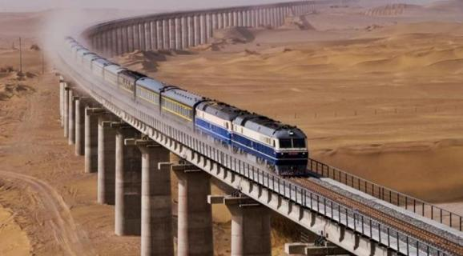

An encounter on a train
Along the Edge of the Taklimakan Desert
2024年1月浙江省首考完形填空剖析
---浙江省金华市汤溪高级中学 郑素红

Slide 3
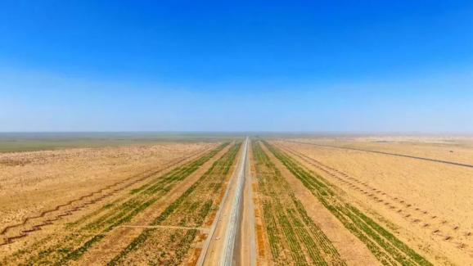
考纲解读
： 完形填空是一种综合测试，涉及的知识面很广，是用来测试考生
的阅读理解能力和综合应用语言的能力。具体表现在以下几个方面：
2024年1月浙江英语首考的具体表现：
(1)词语辨析能力
(2)语法结构分析能力
(3)语篇理解能力
(4)逻辑推理能力
(5)文化背景生活常识运用能力
(6)作者意图剖析能力
考查单词以及词组识记能力；具体语境中语义；多义性；
如 engage with sb ， side with sb （考查名词活用为动词）等。
长难句的理解；2024年首考完形长难句大量增加；结合段间逻辑关系，极大增加理解能力的考查。
语篇结构为总分总，叙事背景+叙事内容+小结（评论感悟收获）
①考查简单的句内逻辑推理能力：如：My 43 friend spoke virtually no English, so I happily took the 44 to practice my Chinese. ② 考查复杂的段间句间逻辑推理能力：如 尾段 第一句 和第二句。
Emerson 美国作家人名， 考查学生的文化背景常识
尾段作者对年轻的中国筑路工人的评价；该段首句和第二句之间的句间语义逻辑关系非常难，是考生出错率相当高的题目，加上assumptions 单词比较难。

Slide 4
篇章结构
篇章层次
高考完形
填空考什么？
段间关系
句间关系
句内关系
语法层次
句子多样化表达
词汇层次
词汇记忆

Slide 5
总分总结构
首段：介绍背景
中段：具体故事
尾段：收获评论
篇章结构
篇章层次
2. 三种逻辑关系
首段尾句：My 43 friend spoke virtually no English, so I happily took the 44 to practice my Chinese. 起到启下作用。引出原文第二段。
尾段首句以及第二句：与原文第二段呼应；尾句与首段首句呼应 （具体看后面解析）
段间关系
While taking a 20-hour train ride along the edge of the Taklimakan Desert in the northwestern China, I had the kind of humbling, educational, and above all else, wonderful 41 with a local that all travelers long for. A young Chinese man 42 me on the train. My 43 friend spoke virtually no English, so I happily took the 44 to practice my Chinese.
41,42,43 直接利用原挖空句子之间的逻辑意义即可解题。 （具体看后面解析 ）
句间关系
My 43 friend spoke virtually no English, so I happily took the 44 to practice my Chinese.
44 直接利用原挖空句子之间的逻辑意义即可解题。 （具体看后面解析 ）
句内关系

Slide 6
词汇层次
词汇记忆
词汇具体语境中的语义
词汇的多义性与搭配，
单词以及词组识记能力
语法层次
句子多样化表达
短短一篇文章，容纳了大量的难度较高的语法现象的各种句子，极大增加了考生阅读理解的难度

Slide 7
解题总原则
总的原则: “先完意，后完形”。
八字方针：上下求索，瞻前顾后。
三步曲：读——填——读

Slide 8
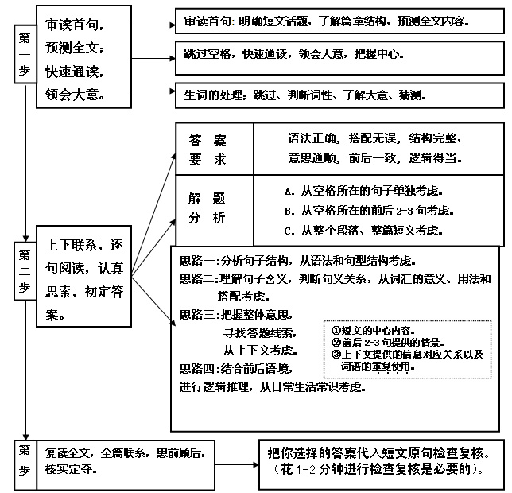
＋快速阅读尾句
具体步骤

Slide 9
Four methods(四种常用的方法)：
1、context
(上下文语境)
2、word distinctions or collocations
(词语辨析和固定搭配)
3、information given in the passage
(利用文章中的信息---原词复现、近义词和反义词等)
4、cultural background and common sense
(文化背景和常识)

Slide 10
While taking a 20-hour train ride along the edge of the Taklimakan Desert in the northwestern China, I had the kind of humbling, educational, and above all else, wonderful 41 with a local that all travelers long for. A young Chinese man 42 me on the train. My 43 friend spoke virtually no English, so I happily took the 44 to practice my Chinese.
Over several hours he would tell me about how he had 45 a two-year professional school to quickly find a job 46 highways in order to help support his family. Perhaps most 47 , however, was the fact that this man spent hours studying every day after hard physical labor. Without batting an eye he would 48 a translated Emerson passage before asking about the literary influence of American 49 as a whole. “And what do you all learn about Russian authors?” I 50 him asking at one point.
It would have been easy to 51 my assumptions about this highway builder who had never been more than a few hundred miles from home. But this highly informed, 52 , and admirable person prevented me doing so. In the course of a couple of hours, he 53 me just how much one can gain from 54 with an open mind, and a willingness to 55 with locals from all walks of life.

Slide 11
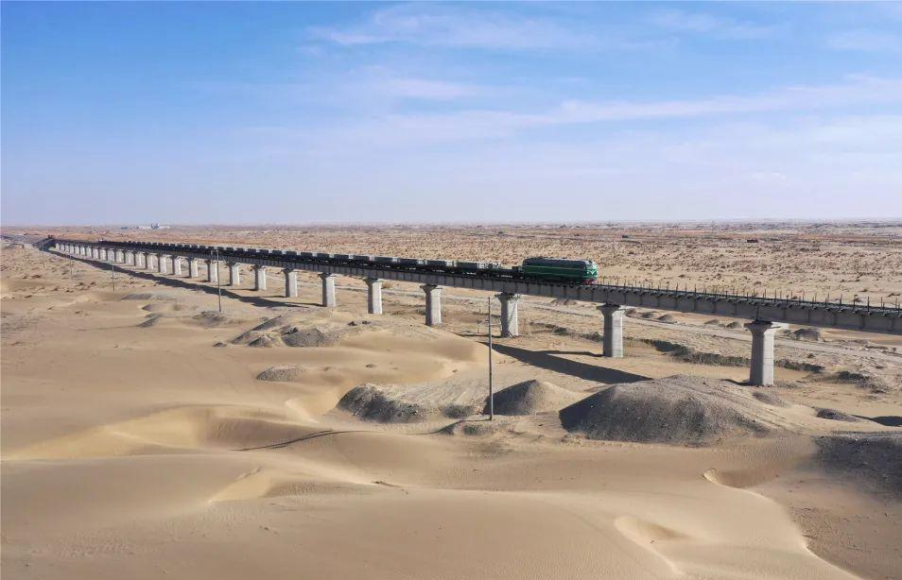
41. A. experiment B. encounter C. competition D. appointment
42. A. treated B. saved C. lectured D. approached
43. A. true B. so-called C. new D. long-lost
44. A. chance B. advice C. trouble D. right
45. A. visited B. financed C. attended D. founded
46. A. building B. sweeping C. checking D. guarding
47. A. typical B. obvious C. natural D. remarkable
48. A. publish B. quote С. copy D. download
49. A. writers B. historians C. workers D. students
50. A. anticipate B. imagine C. recall D. catch
51. A. look into B. rely on C. go over D. deal with
52. A. well-behaved B. multi-skilled C. warm-hearted D. self-educated
53. A. asked B. warned C. showed D. promised
54. A. traveling B. reading C. searching D. teaching
55. A. cooperate B. side C. negotiate D. engage

Slide 12
主题语境：
人与社会
文章类型：
记叙文
外国旅客讲述中国故事
文章大意：
通过一个外国人 （即作者）的视角，回忆并讲述了一次旅行见闻---在一辆穿越塔克拉玛干沙漠的列车上与一位年轻中国筑路工人的偶遇。通过两个人的交流，作者讲述了这个年轻人自学成才，自强不息的中国故事。

Slide 13
考生快速浏览
文章首段或（首句）：
文章尾段或（尾句）：
完形都会有首尾呼应的现象，考生根据这个特点来预测文章的行文逻辑，可以快速架构文章结构和叙事顺序逻辑等。
2024年1月浙江省英语首考具体解析

Slide 14
Para1: the background of the author’s encounter
Q1: Where did it happen?
Q2: Did the young man speak English?
Q3: What did I do with the young Chinese man?
While taking a 20-hour train ride along the edge of the Taklimakan Desert in the northwestern China, I had the kind of humbling, educational, and above all else, wonderful 41 with a local that all travelers long for. A young Chinese man 42 me on the train. My 43 friend spoke virtually no English, so I happily took the 44 to practice my Chinese.

Slide 15
While taking a 20-hour train ride along the edge of the Taklimakan Desert in the northwestern China, I had the kind of humbling, educational, and above all else, wonderful 41 with a local that all travelers long for. A young Chinese man 42 me on the train. My 43 friend spoke virtually no English, so I happily took the 44 to practice my Chinese.
41.考查名词词义辨析+句间逻辑 （与下一句 ）
句意：我在中国西北部的塔克拉玛干沙漠边缘坐了20个小时的火车时，在此期间我与一个当地人有了一种谦卑、有教育意义的，最重要的是，美妙的邂逅，这是所有旅行者都渴望的。
41. A. experiment B. encounter C. competition D. appointment
42. A. treated B. saved C. lectured D. approached
43. A. true B. so-called C. new D. long-lost
44. A. chance B. advice C. trouble D. right

Slide 16
While taking a 20-hour train ride along the edge of the Taklimakan Desert in the northwestern China, I had the kind of humbling, educational, and above all else, wonderful 41 with a local that all travelers long for. A young Chinese man 42 me on the train. My 43 friend spoke virtually no English, so I happily took the 44 to practice my Chinese.
42.考查动词词义辨析+句间逻辑 （与下一句）。句意：一位年轻的中国男子在火车上向我走来。A. treated对待；B. saved拯救；C. lectured 说教；D. approached靠近。根据后文“me on the train”以及后文两人交谈，可知一位年轻的中国男子在火车上向作者走来。
41. A. experiment B. encounter C. competition D. appointment
42. A. treated B. saved C. lectured D. approached
43. A. true B. so-called C. new D. long-lost
44. A. chance B. advice C. trouble D. right

Slide 17
While taking a 20-hour train ride along the edge of the Taklimakan Desert in the northwestern China, I had the kind of humbling, educational, and above all else, wonderful 41 with a local that all travelers long for. A young Chinese man 42 me on the train. My 43 friend spoke virtually no English, so I happily took the 44 to practice my Chinese.
43.考查形容词词义辨析+句间逻辑（与上一句）。句意：我的新朋友几乎不会说英语，所以我很高兴地抓住这个机会练习我的中文。A. true真的；B. so-called所谓的；C. new新的；D. long-lost很久不见的。根据上文“A young Chinese man”可知，两人是在火车上认识的，所以是新朋友。故选C。
41. A. experiment B. encounter C. competition D. appointment
42. A. treated B. saved C. lectured D. approached
43. A. true B. so-called C. new D. long-lost
44. A. chance B. advice C. trouble D. right

Slide 18
While taking a 20-hour train ride along the edge of the Taklimakan Desert in the northwestern China, I had the kind of humbling, educational, and above all else, wonderful 41 with a local that all travelers long for. A young Chinese man 42 me on the train. My 43 friend spoke virtually no English, so I happily took the 44 to practice my Chinese.
44.考查名词词义辨析+句内逻辑。句意：我的新朋友几乎不会说英语，所以我很高兴地抓住这个机会练习我的中文。A. chance机会；B. advice建议；C. trouble麻烦；D. right权利。根据后文“to practice my Chinese”可知，作者抓住这个机会练习中文。故选A。
41. A. experiment B. encounter C. competition D. appointment
42. A. treated B. saved C. lectured D. approached
43. A. true B. so-called C. new D. long-lost
44. A. chance B. advice C. trouble D. right

Slide 19
Para2: the story of the young Chinese man
What :
1. Attend a professional school
2. His job
3. Self-educate after hard work
4. With rich knowledge
Over several hours he would tell me about how he had 45 a two-year professional school to quickly find a job 46 highways in order to help support his family. Perhaps most 47 , however, was the fact that this man spent hours studying every day after hard physical labor. Without batting an eye he would 48 a translated Emerson passage before asking about the literary influence of American 49 as a whole. “And what do you all learn about Russian authors?” I 50 him asking at one point.

Slide 20
Over several hours he would tell me about how he had 45 a two-year professional school to quickly find a job 46 highways in order to help support his family. Perhaps most 47 , however, was the fact that this man spent hours studying every day after hard physical labor. Without batting an eye he would 48 a translated Emerson passage before asking about the literary influence of American 49 as a whole. “And what do you all learn about Russian authors?” I 50 him asking at one point.
45.考查动词词义辨析 +句内逻辑 。句意：在几个小时里，他会告诉我他是如何上了一个为期两年的专业学校，以便迅速找到一份工作，修建高速公路，以帮助支持他的家庭。A. visited拜访；B. financed提供资金；C. attended参加，上(学)；D. founded成立。根据后文“a two-year professional school”可知，指这个年轻人去上了一个为期两年的专业学校。故选C。 Attend a school 上学
45. A. visited B. financed C. attended D. founded
46. A. building B. sweeping C. checking D. guarding
47. A. typical B. obvious C. natural D. remarkable
48. A. publish B. quote С. copy D. download
49. A. writers B. historians C. workers D. students
50. A. anticipate B. imagine C. recall D. catch

Slide 21
Over several hours he would tell me about how he had 45 a two-year professional school to quickly find a job 46 highways in order to help support his family. Perhaps most 47 , however, was the fact that this man spent hours studying every day after hard physical labor. Without batting an eye he would 48 a translated Emerson passage before asking about the literary influence of American 49 as a whole. “And what do you all learn about Russian authors?” I 50 him asking at one point.
46.考查动词词义辨析+下文同源词复现 （builder）；（解题时暂且空着，浏览阅读到下文51空后my assumptions about this highway builder 时才能完全确定） 且与after hard physical labor 呼应，故选A。
45. A. visited B. financed C. attended D. founded
46. A. building B. sweeping C. checking D. guarding
47. A. typical B. obvious C. natural D. remarkable
48. A. publish B. quote С. copy D. download
49. A. writers B. historians C. workers D. students
50. A. anticipate B. imagine C. recall D. catch

Slide 22
Over several hours he would tell me about how he had 45 a two-year professional school to quickly find a job 46 highways in order to help support his family. Perhaps most 47 , however, was the fact that this man spent hours studying every day after hard physical labor. Without batting an eye he would 48 a translated Emerson passage before asking about the literary influence of American 49 as a whole. “And what do you all learn about Russian authors?” I 50 him asking at one point.
47.考查形容词词义辨析+句内逻辑。句意：然而，也许最引人注目的是这个人每天在辛苦的体力劳动之后花几个小时学习。A. typical典型的；B. obvious显然的；C. natural自然的；D. remarkable引人注目的；非凡的；了不起的。根据后文“this man spent hours studying every day after hard physical labor.”可知，这个人每天在辛苦的体力劳动之后花几个小时学习，考生要推断出这是最引人注目的品质。故选D。
45. A. visited B. financed C. attended D. founded
46. A. building B. sweeping C. checking D. guarding
47. A. typical B. obvious C. natural D. remarkable
48. A. publish B. quote С. copy D. download
49. A. writers B. historians C. workers D. students
50. A. anticipate B. imagine C. recall D. catch

Slide 23
Over several hours he would tell me about how he had 45 a two-year professional school to quickly find a job 46 highways in order to help support his family. Perhaps most 47 , however, was the fact that this man spent hours studying every day after hard physical labor. Without batting an eye he would 48 a translated Emerson passage before asking about the literary influence of American 49 as a whole. “And what do you all learn about Russian authors?” I 50 him asking at one point.
48.考查动词词义辨析+句内逻辑+文化背景知识 （ Emerson 是美国著名作家）。句意：他会眼都不眨地引用爱默生的一段译文，然后再询问美国作家对文学的整体影响。A. publish出版；B. quote引用；C. copy复制；D. download下载。根据后文“a translated Emerson passage”指引用爱默生的一段译文，故选B。该题结合年轻人的筑路这个工作，即便B语义不清楚，可以代入A C D三个选项，进行排除 。
45. A. visited B. financed C. attended D. founded
46. A. building B. sweeping C. checking D. guarding
47. A. typical B. obvious C. natural D. remarkable
48. A. publish B. quote С. copy D. download
49. A. writers B. historians C. workers D. students
50. A. anticipate B. imagine C. recall D. catch

Slide 24
Over several hours he would tell me about how he had 45 a two-year professional school to quickly find a job 46 highways in order to help support his family. Perhaps most 47 , however, was the fact that this man spent hours studying every day after hard physical labor. Without batting an eye he would 48 a translated Emerson passage before asking about the literary influence of American 49 as a whole. “And what do you all learn about Russian authors?” I 50 him asking at one point.
49.考查名词词义辨析+句间逻辑+文化背景 （Emerson是美国作家） +下文同义词复现（下一句）。句意：他会眼都不眨地引用翻译过的爱默生的一段话，然后再询问美国作家对文学的整体影响。A. writers作者；B. historians历史学家；C. workers工人；D. students学生。根据上文“a translated Emerson passage before asking about the literary influence of American”以及后文“And what do you all learn about Russian authors?(你们对俄罗斯作家有什么了解？)”可知，年轻人对美国和俄罗斯的作家感兴趣。故选A。考生可以利用下文同义词复现进行解题。
45. A. visited B. financed C. attended D. founded
46. A. building B. sweeping C. checking D. guarding
47. A. typical B. obvious C. natural D. remarkable
48. A. publish B. quote С. copy D. download
49. A. writers B. historians C. workers D. students
50. A. anticipate B. imagine C. recall D. catch

Slide 25
Over several hours he would tell me about how he had 45 a two-year professional school to quickly find a job 46 highways in order to help support his family. Perhaps most 47 , however, was the fact that this man spent hours studying every day after hard physical labor. Without batting an eye he would 48 a translated Emerson passage before asking about the literary influence of American 49 as a whole. “And what do you all learn about Russian authors?” I 50 him asking at one point.
50.考查动词词义辨析+段间逻辑 （文章上一段 ）上一段交代了我坐火车旅游的一次邂逅，具体把年轻人的问题直接引用，自然应该是回忆。句意：“你们对俄罗斯作家有什么了解？”我记得他曾经问过。A. anticipate预期；B. imagine想象；C. recall记起；D. catch抓住。根据后文“him asking at one point”可知，作者在回忆年轻人提过的问题。故选C。本文是旅游见闻，以回忆的手法来叙述与年轻人的一次邂逅。
45. A. visited B. financed C. attended D. founded
46. A. building B. sweeping C. checking D. guarding
47. A. typical B. obvious C. natural D. remarkable
48. A. publish B. quote С. copy D. download
49. A. writers B. historians C. workers D. students
50. A. anticipate B. imagine C. recall D. catch

Slide 26
Para3: the influence of the encounter on the writer
Read this sentence：
But this highly informed, 52 , and admirable person prevented me doing so.
Q1: What does so mean ?
Q2：What did the writer learn from the encounter with the young man?
It would have been easy to 51 my assumptions about this highway builder who had never been more than a few hundred miles from home. But this highly informed, 52 , and admirable person prevented me doing so. In the course of a couple of hours, he 53 me just how much one can gain from 54 with an open mind, and a willingness to 55 with locals from all walks of life.

Slide 27
It would have been easy to 51 my assumptions about this highway builder who had never been more than a few hundred miles from home. But this highly informed, 52 , and admirable person prevented me doing so. In the course of a couple of hours, he 53 me just how much one can gain from 54 with an open mind, and a willingness to 55 with locals from all walks of life.
51.考查动词短语辨析+段间逻辑（文章第二段）+句间逻辑（下一句）。但这位见多识广、自学成才、令人钦佩的人阻止了我这么做。考生要思考：So 指的正是 rely on my assumptions about … 句意：对于这位从未离开过家乡几百英里的公路建设者，我很容易凭空想象。A. look into调查；B. rely on依靠；C. go over复习；D. deal with处理。根据后文“my assumptions about this highway builder who had never been more than a few hundred miles from home” 本句是虚拟语气would have been easy，说明事实上正是通过与年轻人的交谈（第二段），让作者对这个年轻人刮目相看，另眼相待。故选B。
51. A. look into B. rely on C. go over D. deal with
52. A. well-behaved B. multi-skilled C. warm-hearted D. self-educated
53. A. asked B. warned C. showed D. promised
54. A. traveling B. reading C. searching D. teaching
55. A. cooperate B. side C. negotiate D. engage

Slide 28
It would have been easy to 51 my assumptions about this highway builder who had never been more than a few hundred miles from home. But this highly informed, 52 , and admirable person prevented me doing so. In the course of a couple of hours, he 53 me just how much one can gain from 54 with an open mind, and a willingness to 55 with locals from all walks of life.
52.考查考生猜测合成形容词词义辨析能力+上文同义表达复现。 （呼应上文“this man spent hours studying every day after hard physical labor. ）句意：但这位见多识广、自学成才、令人钦佩的人阻止了我这么做。A. well-behaved行为端正的；B. multi-skilled多技能的；C. warm-hearted热心的；D. self-educated自学的。这个人每天在繁重的体力劳动之后花几个小时学习)”，指这个年轻人的自学能力。其他选项的特征在本文没有任何线索暗示；故选D。
51. A. look into B. rely on C. go over D. deal with
52. A. well-behaved B. multi-skilled C. warm-hearted D. self-educated
53. A. asked B. warned C. showed D. promised
54. A. traveling B. reading C. searching D. teaching
55. A. cooperate B. side C. negotiate D. engage

Slide 29
It would have been easy to 51 my assumptions about this highway builder who had never been more than a few hundred miles from home. But this highly informed, 52 , and admirable person prevented me doing so. In the course of a couple of hours, he 53 me just how much one can gain from 54 with an open mind, and a willingness to 55 with locals from all walks of life.
53.考查动词词义辨析+段间逻辑（第二段）通过第二段作者对年轻人的交谈内容的叙述，让作者我从年轻人身上学到了很多。句意：在几个小时的时间里，他向我展示了带着开放的心态旅行，并愿意与来自各行各业的当地人打交道，会有多么大的收获。A. asked询问；B. warned警告；C. showed展示；D. promised承诺。根据后文“me just how much one can gain from”指年轻人通过自己向作者展示了一个人可以从开放的心态和愿意与各行各业的当地人交往中获得多少收获。故选C。
51. A. look into B. rely on C. go over D. deal with
52. A. well-behaved B. multi-skilled C. warm-hearted D. self-educated
53. A. asked B. warned C. showed D. promised
54. A. traveling B. reading C. searching D. teaching
55. A. cooperate B. side C. negotiate D. engage

Slide 30
It would have been easy to 51 my assumptions about this highway builder who had never been more than a few hundred miles from home. But this highly informed, 52 , and admirable person prevented me doing so. In the course of a couple of hours, he 53 me just how much one can gain from 54 with an open mind, and a willingness to 55 with locals from all walks of life.
54.考查动词词义辨析+上文同义词复现+同源词复现 （第一段） 。句意：在几个小时的时间里，他向我展示了带着开放的心态旅行，并愿意与来自各行各业的当地人打交道，会有多么大的收获。A. traveling旅行；B. reading阅读；C. searching搜索；D. teaching教学。根据后文“with an open mind, and a willingness to”结合作者第一段首句While taking a 20-hour train ride along the edge of the Taklimakan Desert in the northwestern China ，/ that all travelers long for 所以是指带着开放的心态旅行，故选A。
51. A. look into B. rely on C. go over D. deal with
52. A. well-behaved B. multi-skilled C. warm-hearted D. self-educated
53. A. asked B. warned C. showed D. promised
54. A. traveling B. reading C. searching D. teaching
55. A. cooperate B. side C. negotiate D. engage

Slide 31
It would have been easy to 51 my assumptions about this highway builder who had never been more than a few hundred miles from home. But this highly informed, 52 , and admirable person prevented me doing so. In the course of a couple of hours, he 53 me just how much one can gain from 54 with an open mind, and a willingness to 55 with locals from all walks of life.
55.考查动词词义辨析+段间逻辑 （第二段）我作为外国游客，抓住机会练习中文，与了这么一位优秀的刻苦的中国筑路工人接触并互动。句意：在几个小时的时间里，他向我展示了带着开放的心态旅行，并愿意与来自各行各业的当地人打交道，会有多么大的收获。A. cooperate合作；B. side站在一边；支持C. negotiate协商；D. engage参与。根据后文“with locals from all walks of life”指和各行各业的当地人打交道，短语engage with表示“与……接触”。故选D。
51. A. look into B. rely on C. go over D. deal with
52. A. well-behaved B. multi-skilled C. warm-hearted D. self-educated
53. A. asked B. warned C. showed D. promised
54. A. traveling B. reading C. searching D. teaching
55. A. cooperate B. side C. negotiate D. engage

Slide 32
1. edge n. 边缘；刀锋
2. humbling a. 令自尊心受挫的
3. educational a. 教育的；有教育意义的
4. local n. 当地人，本地人
5. virtually ad. 事实上，几乎
6. professional a. 职业的，专业的
7. passage n. 过道，走廊；段落，章节
8. literary a. 文学的，文学上的
9. assumption n. 假定，假设
10. informed a. 有学问的；有见识的
11. admirable a. 可钦佩的；值得赞赏的
12. willingness n. 乐意，意愿
13. encounter n. 相遇，邂逅
14. competition n. 竞争；角逐
15. lecture v. 开讲座，讲授 ；训斥 n. 讲座
16. approach vt. 靠近，接近 n. 方法
难点词汇

Slide 33
17. finance vt. 提供资金
18. guard vt. 看守；监视
19. typical a. 典型的；有代表性的
20. remarkable a. 非凡的；奇异的；引人注目的
21. quote vt. 引述；举例说明
22. download vt. 下载
23. historian n. 历史学家，史学工作者
24. anticipate vt. 预料；期望
25. recall vt. 回想起；使想到；召回
26. well-behaved a. 行为端正的
27. multi-skilled a. 多技能的
28. self-educated a. 自学的
29. cooperate vi. 合作，协作；配合
30. negotiate vi. 谈判，磋商，洽谈
31. engage vt. 产生联系；雇用；参加；从事；吸引
32. side vi.站在……一边；给......铺外墙板
难点词汇

Slide 34
1. above all 首要的是；最重要的是
2. long for 渴望
3. take the chance to do sth 抓住机会做某事
4. spend time doing sth 花费时间做某事
5. Without batting an eye 不露声色，不动声色
6. as a whole 总体上
7. prevent sb (from) doing 阻止某人做某事
8. in the course of 在……过程中
9. all walks of life 各行各业
10. engage with sb 与某人接触
11. side with sb 支持；站在……的一边
12. negotiate with sb 与……谈判
词组突破

Slide 35
长难句突破
While taking a 20-hour train ride along the edge of the Taklimakan Desert in the northwestern China, I had the kind of humbling, educational, and above all else, wonderful 41 with a local that all travelers long for.
分析：
While doing sth ; 时间状语从句的简化形式，
I had the kind of encounter with a local 为主句；加了漫长的三个并列形容词以及定语从句修饰 encounter; 并列形容词中还穿插了插入语 above all else ,增加理解难度。
句意： 在中国西北部的塔克拉玛干沙漠边缘坐了20个小时的火车时，我与一个当地人有了一种令人谦卑、有教育意义的，最重要的是，美妙的相遇，这种邂逅是所有旅行者都渴望的。

Slide 36
长难句突破
Over several hours he would tell me about how he had 45 a two-year professional school to quickly find a job 46 highways in order to help support his family.
分析：
…he would tell me about 后是个连词How引导的漫长的宾语从句；
to quickly find a job 以及 in order to help support his family都是目的状语；
3. building highways 是 a job 的同位语，表示工作的内容。
句意：在几个小时的时间里，他告诉我，他是如何上完两年的专业学校，然后迅速找到一份工作，以帮助养家糊口的。

Slide 37
长难句突破
Perhaps most 47 , however, was the fact that this man spent hours studying every day after hard physical labor.
分析：
Perhaps most remarkable, however, was the fact. 是完全倒装句；
the fact 后是that 引导的同位语从句；
句意：然而，也许最引人注目的是这个人每天在繁重的体力劳动之后花几个小时学习。

Slide 38
长难句突破
Without batting an eye he would 48 a translated Emerson passage before asking about the literary influence of American 49 as a whole.
分析：
1. Without batting an eye, 介词短语充当伴随状语；
2. before doing sth , 介词短语充当时间状语，
句意：，他毫不犹豫地引用了爱默生的一段译文，然后询问美国作家整体上对美国文学的影响。

Slide 39
长难句突破
It would have been easy to 51 my assumptions about this highway builder who had never been more than a few hundred miles from home.
分析：
It would have been easy to do sth; 虚拟语气， to do 形式主语；
who 引导了定语从句，修饰this highway builder.
句意：我原本很容易相信我对这位从未离开过家几百英里的公路建设者的各种的假设。 （作者真实的意思是：通过和这个年轻人的交谈，作者对这个公路建设工人产生了油然而生的敬意和赞美。）该句后面的But this highly informed, 52 , and admirable person prevented me doing so.
说明我并没有轻易相信我对这个年轻人的各种假设。

Slide 40
长难句突破
In the course of a couple of hours, he 53 me just how much one can gain from 54 with an open mind, and a willingness to 55 with locals from all walks of life.
分析：
…me 后面是how much 引导的宾语从句；
该宾语从句带两个状语：from traveling 以及with 结构，with 含有两个并列的宾语；
动词不定式 to engage with locals from all walks of life 充当willingness 的后置定语，locals 后from all walks of life 为介词短语作后置定语：乐意与来自各行各业的当地人产生联系；
句意：在几个小时的时间里，他向我展示了一个人可以从旅游中获得多么多的收获，如果带着开放的心态和与各行各业的当地人交往的意愿。

Slide 41
本文各题解题所用技巧分类
1、context (上下文语境)
1）句间逻辑题：41，42，43；
2）句内逻辑题：44， 45，47，48
3）段间逻辑题：50，51，53，54，55
文章是一个外国游客记录了在中国西北坐火车旅行期间与一个年轻中国人的偶遇。---回忆当时的见闻。第一段首句说明我坐火车旅行+尾句表明第二段是我和这个年轻人之间的交谈内容；与最后一段是互相照应的：我通过与这个年轻人的联系互动，从他身上学到了他难能可贵的精神。

Slide 42
Four methods(四种常用的方法)：
2、word distinctions or collocations
(词语辨析和固定搭配)
51 考查词组意义的辨析 + 段间逻辑
（该句与第二段逻辑关系十分紧密）
+ 句间逻辑 But this highly informed, 52 , and admirable person prevented me doing so.
说明： 我并没有轻易相信我对这个年轻人的各种假设。

Slide 43
Four methods(四种常用的方法)：
3、information given in the passage
(利用文章中的信息---原词复现、近义词和反义词等)
46（与第三段51空后同源词复现）
49（与下文“And what do you all learn about Russian authors?”同义词复现）
52 （与原文第二段第二句 he spent … after hard physical work.)

Slide 44
Four methods(四种常用的方法)：
4、cultural background and common sense
(文化背景和常识)
48，利用年轻人是公路建设工人的身份，排除 A C D,锁定B 选项；
49, Emerson 是美国著名作家，属于文化背景常识，有此常识的同学可以直接选出答案；也可以借助于 Russuan author 同义词复现来解题。

Slide 45
解题时，有些题目会是四种方法中两种或三种糅合在一起，2024年1月首考的这篇完形 这种解题的套路比较多一些。

Slide 46
2024年1月首考与2023年1月首考完形对比
文本长难句大幅度增加，增加了理解的难度；
选项词汇难度增加，文章以及选项考查词汇的多义性有多处；加大了对考生词汇语用能力和多义性记忆的考查；
句内逻辑题目减少，加大句间、段间逻辑意义的考查；要求学生在完意的过程中，理解要准确；
句式丰富，各种语言表达穿插切换；
利用文章中词汇上下文复现来解题的题目增多；

Slide 47
备考点津
关注高考重难点语法，突破长难句的理解；
关注首尾，快速确定文本大致内容；
关注句内逻辑；句间逻辑；段间逻辑；
关注上下文各种线索--词汇或某个句子；
关注背景文化常识素养的积累；
关注构词法，能利用构词法知识猜测词义
重中之重：
词汇储备

