Slide 1


感恩遇见，相互成就，本课件资料仅供您个人参考、教学使用，严禁自行在网络传播，违者依知识产权法追究法律责任。
更多教学资源请关注
公众号：溯恩高中英语
知识产权声明

Slide 2

B3U3单词拓展
浙江省江山中学：周宁

Slide 3


diverse / daɪˈvɜːs adj.不同的；多种多样的
这次展览以展示中国传统文化的各个方面为特色，展示了各种各样的展品和活动。
The exhibition featured a diverse range of displays and activities that showcased various aspects of Chinese traditional culture.
2. 人类语音对文化多样性有很大贡献。_{2022全国I卷}
The set of human speech sounds contributes much to
cultural diversity.
3. 这些动物消耗了大量的植被，减少了公园里的植物多样性。_{2017全国III}
These animals consumed large amounts of vegetation, which reduced plant diversity in the park.

Slide 4

fortune /ˈfɔːtʃuːn n. 机会；运气
橘子树不仅仅是装饰;它们是好运和财富的象征。_{2020全国Ⅱ卷}
Orange trees are more than decoration; they are a symbol of good fortune and wealth.
2. 孩子们会得到红包，希望在新的一年里带来好运。
Children are given money in a red envelope to
bring good fortune in the New Year.
3. 他决定到一个新的国家去发迹，希望能找到更好的成功机会。
He decided to seek his fortune in a new country, hoping to find better opportunities for success.

Slide 5

admit / ədˈmɪt/ vi&vt. 承认 vt.准许进入（或加入）
1. 这个淘气的男孩低下头,用颤抖的声音承认窗玻璃是他打破的。
Lowering his head, the naughty boy admitted(to) breaking the window in a trembling voice.
2. 眼里流着泪，他承认自己在期末考试中作弊了。
With his eyes full of tears, he admitted having cheated
in the final examination.
3. 凡穿校服者都将免费入场。
Admission will be free for whoever wears the school uniform.
4. 据说历史是由胜利者书写的，这些胜利者制定了进入天才俱乐部的标准。_{2021全国甲}
It’s said that history is written by the victors, and those victors set the standards for admission to the genius club.

Slide 6

occur / əˈkɜː(r)/ vi. 发生；出现
多么伟大的一座城市啊——一座在1906年发生地震后能够重建自己的城市。
And what a city—a city that was able to rebuild itself after the earthquake that occurred in 1906.
2. 我们是进化的产物，而不仅仅是几十亿年前的进化。_{2020课标全国Ⅲ}
We are the products of evolution, and not just evolution that occurred billions of years ago.
3. 他想到了一个好主意，松了口气。
A good idea occurred to him and he sighed with relief.
4. 伯纳突然想到可以靠卖爆米花赚钱。_{2020新高考Ⅰ}
It occurred to Bernard could make some
money by selling popcorn.

Slide 7

head to / hed tuː/ （朝……）前进；（向……）去
你跑进杂货店买了一瓶水。你得到了你需要的，走向前面，选择看起来最快的队伍。_{2021浙江}
You run into the grocery store to pick up one bottle of water. You get what you need, head towards/to the front, and choose the line that looks fastest.
2. 当我看到拖拉机开向高速公路时，我的心都僵在胸口了。_{2020浙江}
My heart froze in my chest as I saw the tractor
heading towards the motorway.
3. 准备好母亲节早餐后，这对双胞胎昂着头
向妈妈的卧室走去。
After preparing the Mother’s Day breakfast, the twins
held their heads high and headed for their mother’s bedroom.

Slide 8
seek /siːk / sought, sought /sɔːt / 寻找；寻求；争取；（向人）请求
我看来,遇到困难时,我们应该向我们最信任的人寻求帮助。_{2021全国甲}
In my opinion, when in trouble, we should seek help from those we trust most.
2. 解决这个问题的最好的办法就是我们设法与动物和谐共处。
The best solution to the problem was that we sought to live in harmony with animals.
3. Susanne Shultz博士说，这项研究值得称赞，因为它丰富了我们对人类语言进化的认识。_{2021浙江}
Dr Susanne Shultz said the study was praiseworthy in seeking to enrich our knowledge of the evolution of human language.
4. 去年，仰光的写字楼租金上涨了约150%，随着越来越多的外国公司来到这个亚洲最后的经济前沿之一寻求财富，租金还将进一步上涨。
Rangoon office rents rose by about 150% in the past year, and are set to rise further as more foreign companies come to seek their fortune in one of Asia's last economic frontiers.
5. 亨利·大卫·梭罗乐于退出社会生活，在静谧的生活中寻求与自然的和谐关系。_{2021天津}
Henry David Thoreau was happy to withdraw from social life, seeking a harmonious relationship with nature in the quietness of his life.

Slide 9

select / sɪˈlekt vt. 选择；挑选；选拔
我们不会回应每一位候选人。如果你被选中,将有经理与你联系。2021北京
We do not respond to every candidate. If selected, you will be contacted by a manager.
2. 在实验中,戈芬氏凤头鹦鹉能够为这项工作选择正确的工具…… _{(2022全国甲)}
In the experiment, Goffin's cockatoos were able to select the right tool for the job...
3. 我们学校图书馆为我们学生提供各种不同学科的新书可供选择。
Our school library provides us students
with a wide selection of new books on different subjects.

Slide 10


claim / kleɪm / vt.&n.夺取（生命）；宣称；断言
在1906年旧金山地震和随后发生的一系列火灾中,有三千多人丧生。
Over 3,000 lives were claimed in the 1906 San Francisco earthquake and the series of fires that occurred after it.
2. 据称,每晚有规律地睡八个小时确实对我们的健康有影响。
It is claimed that getting a regular eight-hour sleep every
night makes a real difference to our health.
3. 到目前为止还没有人认领在图书馆里发现的钱。
So far nobody has claimed the money discovered in the library.

Slide 11
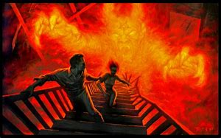
escape / ɪˈskeɪp vi.&vt.逃走；逃脱；避开； n.逃跑；逃脱；解脱
参观了云南南部之后,我不得不承认这是中国躲避寒冬的最佳地区。
After visiting the southern part of Yunnan, I have to admit that it is the best region of China to escape the cold winter.
2. 午餐时间的逃离让她可以避免老板拍她的肩膀。_{2019课标全国Ⅱ}
A lunchtime escape allows her to keep a boss
from tapping her on the shoulder.
3. 知道他们的儿子死里逃生,这对夫妇拥抱彼此,突然大哭起来。
Knowing that their son had a narrow escape, the couple hugged each other and burst into tears.

Slide 12

settle / ˈset(ə)l/ vt.&vi.定居；结束（争论）；解决（纠纷）
除了我以外，家里的每个人都很快地在这个城市安顿下来了。_{2021全国甲}
Everyone in the family settled quickly in the city except me.
2. 户籍制度将进行改革,以鼓励更多年轻人才在新城市定居。_{(China Daily)}
The household registration system will be reformed so as to
encourage more young talents to settle down in the new cities.
3. 自己平静下来,这样你可能会在十点前入睡。
Settle yourselves down before 9:30 pm so you may fall asleep before 10.
4. 不幸的是，探险者和随之而来的定居者只花了几十年的时间就摧毁了这些资源的大部分。_{2021新高考Ⅰ}
Unfortunately, it took the explorers and the settlers who followed only a few decades to decimate a large part of these resources.

Slide 13
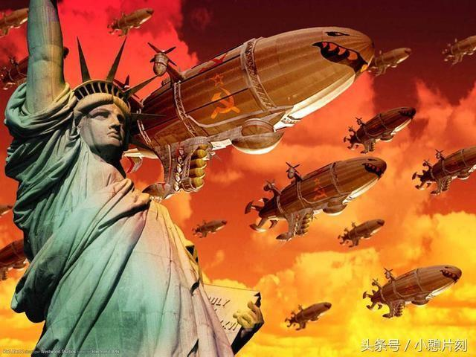
construction / kənˈstrʌkʃn n.建筑；建造；建造物；（句子、短语等的）结构
我们的新教学楼尚在修建中。
Our new teaching buildings are still under construction.
2. 我希望这些关于如何戒烟的建设性的建议能对你的父亲有所帮助。
I hope these constructive suggestions on how to give up smoking can be helpful to your father.
under repair/consideration/ argument/discussion/treatment
正在修理/考虑/争论/讨论/治疗中
construction n.
construct v.
constructive adj.

Slide 14

to name a few 仅举几例
多传统的中国民间艺术在世界上很受欢迎:剪纸、京剧、相声等等。_{2021全国甲}
Many traditional Chinese folk arts have been popular in the world: paper-cutting, Beijing Opera, crosstalk, to name but a few.
2. 所设活动项目包括壁球、射箭、游泳等等，不一而足。
Activities available include squash, archery and swimming, to name but a few.

Slide 15
suit / suːt vt.适合；满足……需要；相配；合身 n.西服；套装
这个小女孩穿着一套新衣服,蹦蹦跳跳地出了家门。
Dressed in a suit of new clothes, the little girl danced out of the house.
2. 请告诉我你什么时间最合适。下周末我应该随时都有空。
Please let me know what time suits you best. I should be available at anytime next weekend.
3. 但如果一个瘦的人吃得很多，我也会跟着吃。_{2020新高考Ⅰ}
But if a thin person eats a lot, I’ll follow suit.
4. 有适合每个人口味的中国菜，有来自中国各地的传统菜肴。
There is Chinese food to suit everyone’s taste, with traditional dishes from all over China.

Slide 16

contain / kənˈteɪn vt.包含；含有；容纳
吃含有维生素A、C和E的食物,它们对你的健康有很多好处。
Try to eat food containing vitamins A, C and E—they will do lots of good to your health.
2. 人类语言包含2000多种不同的声音，从常见的“m”和“a”到一些南部非洲语言中罕见的咔嚓声。_{2022新高考I}
Human speech contains more than 2,000 different sounds, from the common “m” and “a” to the rare clicks of some southern African languages.
3. 当她看到她失散多年的儿子时,她无法克制自己,泪流满面。
Seeing her long-lost son, she couldn’t contain herself and her
face was covered with tears.
4. 绝望和无助，简无法控制她的眼泪的遗憾。
Desperate and helpless, Jane couldn't contain her tears of regret.

Slide 17
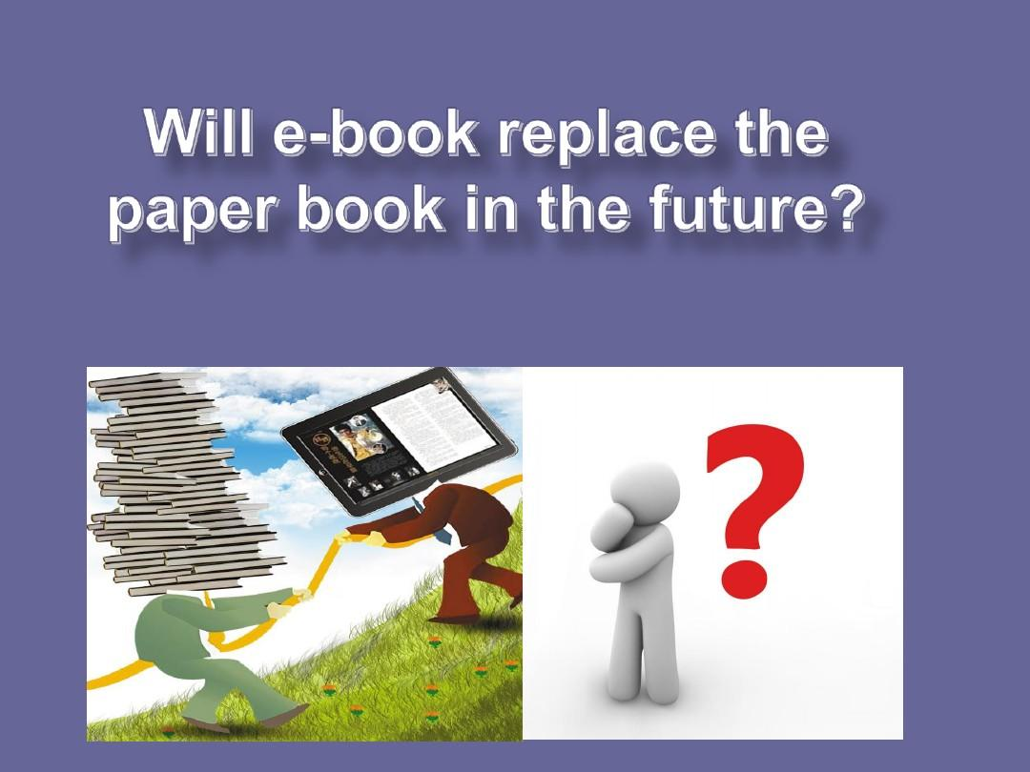
replace/ rɪˈpleɪs vt. 接替；取代；更换
如果我们用自行车代替汽车,我们的城市将变得更好。 _{(2022全国乙)}
Our cities will be better places if we replace cars with bicycles.
2. 当我看到北极熊试图用它巨大的爪子拆毁栅栏的时候,这种兴奋迅速被恐惧和不安代替。
When I saw the polar bear trying to pull down the fence with his giant paws, the excitement was quickly replaced by fear and anxiety.

Slide 18

operation / ˌɒpəˈreɪʃ(ə)n/ n. 手术；企业；经营
1. 后来11月底,蒂莉做了腿部手术。_{2022全国甲}
And then in late November, Tilly had an operation on her leg.
2. 据估计,到2025年,全国将有超过两千万辆共享单车投入使用。
It is estimated that more than 20 million shared bikes
will have been put into operation nation-wide by 2025.
3. 新校规很快就会生效。
The new school rules will soon come into operation.

Slide 19

bring about / brɪŋ əˈbaʊt 导致；引起
大多数人没有意识到许多动物物种不能适应现代文明带来的变化。
Most people do not realise that many animal
species cannot adapt to the changes brought about
by modern civilization.
2. 你认为是什么带来了文化多样性?
What do you think brought about the cultural diversity?
3. 全球化对所有人都产生了巨大的影响在世界范围内，既带来巨大的利益，也带来巨大的挑战。
Globalisation has had a huge impact on people all around the world, bringing about both significant benefits and great challenges.

Slide 20

earn / ɜːn vt&vi. 挣得；赚得；赢得；博得
爷爷说去年夏天靠卖鱼挣了不少钱。 _{2018全国}
My grandpa said last summer they earned quite a lot by selling the fish.
2. 凭借强劲而凌厉的球风，她赢得了“铁榔头”的称号。
Her strong and powerful playing style
earned her the name “Iron Hammer”.
3. 为了实现获得护理学位的目标，Jennifer Maue
r比普通大学生需要更多的意志力。_{2020山东}
Jennifer Mauer has needed more willpower than the typical college student to pursue her goal of earning a nursing degree.

Slide 21

series /ˈsɪəriːz n. 一系列；连续；接连
这一事件引发了一系列谁也没有预见到的事件。
The incident sparked off a series of events that nobody had foreseen.
2. 首先，他建造了一系列相互连接的透明玻璃纤维罐。_{2023新高考Ⅰ}
First, he constructed a series of clear fiberglass tanks connected to each other.
3. 电视台计划明年推出一系列新的犯罪剧。
The television network is planning to release a new series of crime dramas next year.

Slide 22

financial /faɪˈnænʃ(ə)l/ adj. 财政的；财务的；金融的
目前，在英国东北部的20家养老院中，有700名老人在照顾母鸡，该慈善机构得到了财政支持，将其推广到全国。_{2022新高考I卷}
There are now 700 elderly people looking after hens in 20 care homes in the North East, and the charity has been given financial support to roll it out countrywide.
2. 为当地居民提供经济援助和其他福利。_{2021全国乙}
Provide financial aid and other benefits for local people.

Slide 23
apart from / əˈpɑːt frɒm 除了……外（还）；此外
除了有趣和有教育意义之外，这个活动为不同文化背景的人提供了一个交流的平台。
Apart from being fun and educational, this activity serves as a platform for people of different cultural backgrounds to communicate with each other.
2. 云南除了是花卉王国，还是许多少数民族的故乡。
Apart from being the kingdom of flowers, Yunnan province is home to many ethic minority groups.

Slide 24
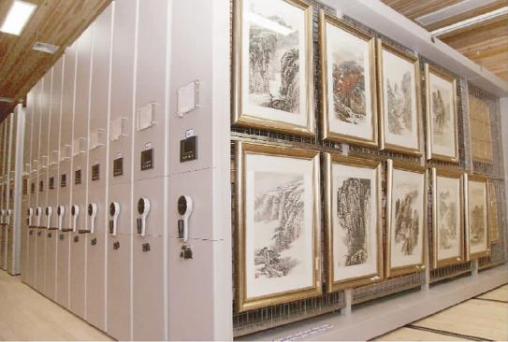
collection /kəˈlekʃ(ə)n / n. 作品集；收集物；收藏品
每一章都总结了一些实践，这些实践旨在帮助您按照本章的主要思想行事。_{2023新高考Ⅰ}
Each chapter concludes with a collection of practices, which are designed to help you act on the big ideas of the chapter.
3. 李白是中国最伟大的诗人之一，
他的所有诗歌都被收录在《中国诗歌集》中。
Libai is one of the greatest poets in China,
and all his poems have been collected in the collection of Chinese poetry.
3. 博物馆的艺术收藏以梵高和莫奈等著名画家的作品为特色。（应）
The art collection at the museum features works by famous painters such as Van Gogh and Monet.

Slide 25


definitely /ˈdefɪnətli adv. 肯定；确实
如果你的孩子喜欢呆在厨房里，那么烹饪夏令营绝对是合适的选择。_{2020海南}
If your child enjoys being in the kitchen, then the culinary camp is definitely the right fit.
2. 谢谢你对我提高英语口语的建议，我一定会考虑的。
I appreciate your suggestions for improving my oral English, and I will definitely take them into consideration.

Slide 26
mild / maɪld/ adj.温和的；和善的；轻微的
医生说这只是轻微的流感，所以我很快就会好起来的。
The doctor said it was just a mild case of the flu, so I should be feeling better soon.
2. 她温和地笑了笑，表示对赞美的感激。（续）
She gave a mild smile to show her appreciation for the compliment.
3.。天气预报说今天下午只有小雨。
The weather forecast predicted only mild showers for the afternoon.
4. 一般来说，温和地区的语言相对较少，通常有很多人说，而炎热潮湿地区的语言很多，通常只有少数人说。_{2018全国I卷}
The general rule is that mild zones have relatively few languages, often spoken by many people, while hot, wet zones have lots, often spoken by small numbers.

Slide 27

precious /ˈpreʃəs adj. 珍惜的；宝贵的
广泛的收藏包括雕刻大师作品，彩色玻璃，以及大约9世纪到15世纪的欧洲珍贵物品。_{2018江苏}
The extensive collection consists of masterworks in sculpture, colored glass, and precious objects from Europe dating from about the 9th to the 15th century.
2. 印第安人明智地照顾这些宝贵的自然资源。_{2021新高考I}
Native Americans had taken care of these
precious natural resources wisely.
3. 与所爱的人共度的时光是宝贵的，应该珍惜。（续）
Time spent with loved ones is precious and should be cherished.

