Slide 1



感恩遇见，相互成就，本课件资料仅供您个人参考、教学使用，严禁自行在网络传播，违者依知识产权法追究法律责任。
更多教学资源请关注
公众号：溯恩高中英语
知识产权声明

Slide 2
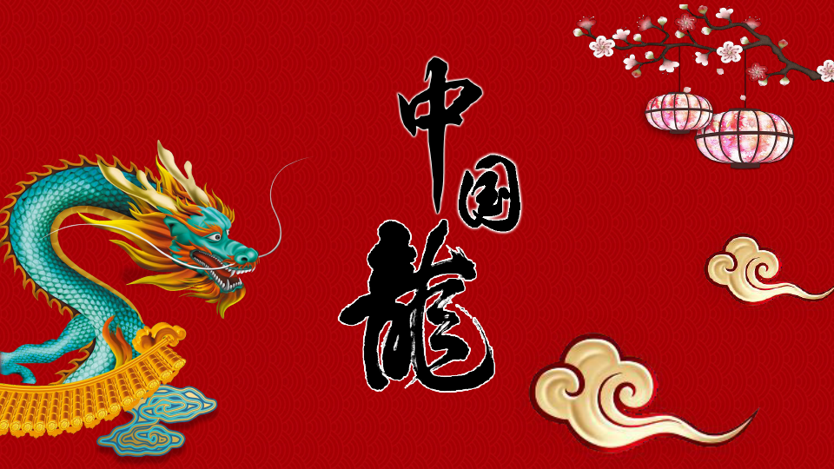


Slide 3
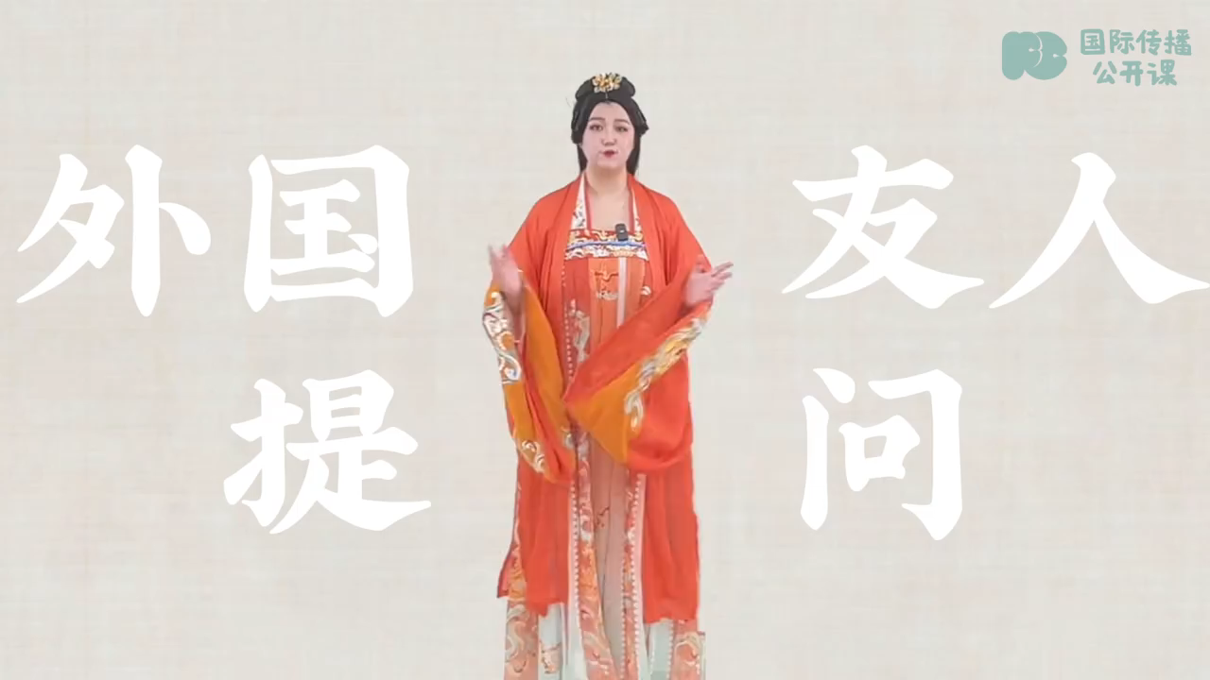

Slide 4
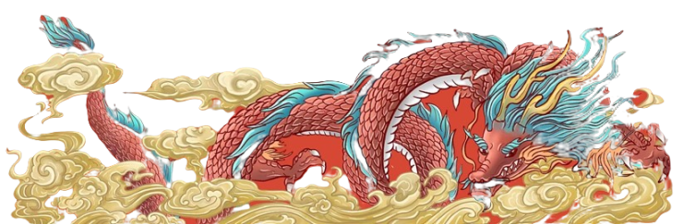
Do Chinese dragons also represent evil like the west?
Loong is an 1.___________(imagine) creature, a Chinese legend. The 2. ___________(shape) of the image of loong by Chinese people can 3. ___________(trace) back over 8000 years ago. Through the 4. ___________(continue) development of descendants the image of a loong gradually solidified: It has the body of a snake, the eyes of the tiger, the horns of a deer, the head of a horse, the ears of a cow, the beard of a sheep, the 5.___________(scale) of a fish, the tail of a phoenix and the claws of an eagle.
In ancient times, people highly revered loong, believing 6.___________it could summon wind and rain, and could do anything. 7.___________ the Shang and Zhou dynasties, the pattern of loong officially became a symbol of emperor and power and lasted for thousands of years. In modern times, loong 8.___________(consider)a symbol of Chinese nation, representing 9.___________(brave), justice and 10.___________(wise).
imaginative
shaping
be traced
continuous
scales
that
During
is considered
bravery
wisdom
Blank-filling

Slide 5

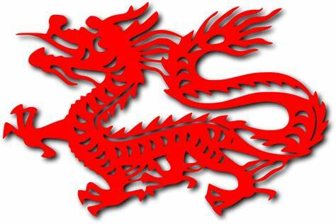
Words and expressions
descendant | / dɪˈsendənt / | n.后裔，子孙
solidify | / səˈlɪdɪfaɪ / | v.（使）凝固，变硬；（使）变可靠
phoenix | / ˈfiːnɪks / | n.凤凰，不死鸟
revere | / rɪˈvɪə(r) / | v.尊敬，崇敬
scale | / skeɪl / | n.规模，范围；等级
summon | / ˈsʌmən / | v.召唤；召集

Slide 6
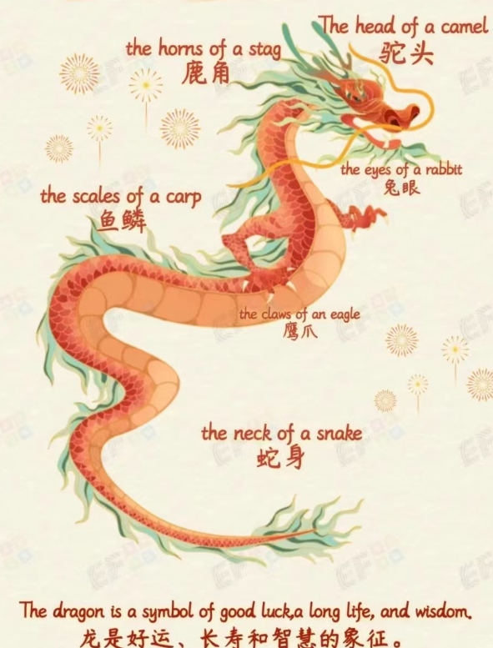
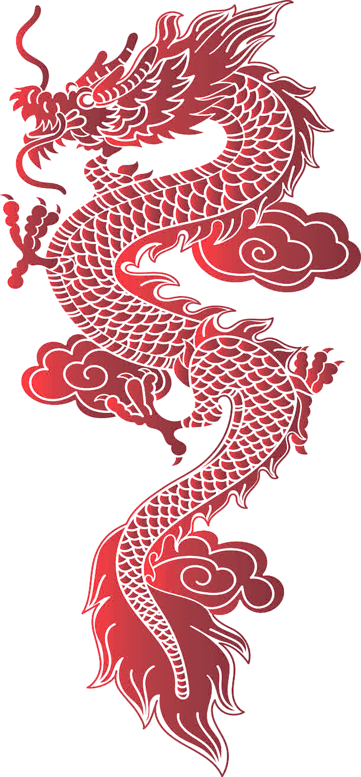
Do Chinese dragons also represent evil like the west?
Loong is an imaginative creature, a Chinese word. The shaping of the image of loong Chinese people can be traced by over 8000 years ago. Through the continuous development of descendants the image of a loong gradually solidified: It has the body of a snake, the eyes of the tiger, the horns of a deer, the head of a horse, the ears of a cow, the beard of a sheep, the scales of a fish, the tail of a phoenix and the claws of an eagle.
In ancient times, people highly revered loong, believing that it could summon wind and rain, and could do anything. During the Shang and Zhou dynasties, the pattern of loong officially became a symbol of emperor and power and lasted for thousands of years. In modern times, loong is considered a symbol of Chinese nation, representing bravery, justice and wisdom.
Passage reading

Slide 7
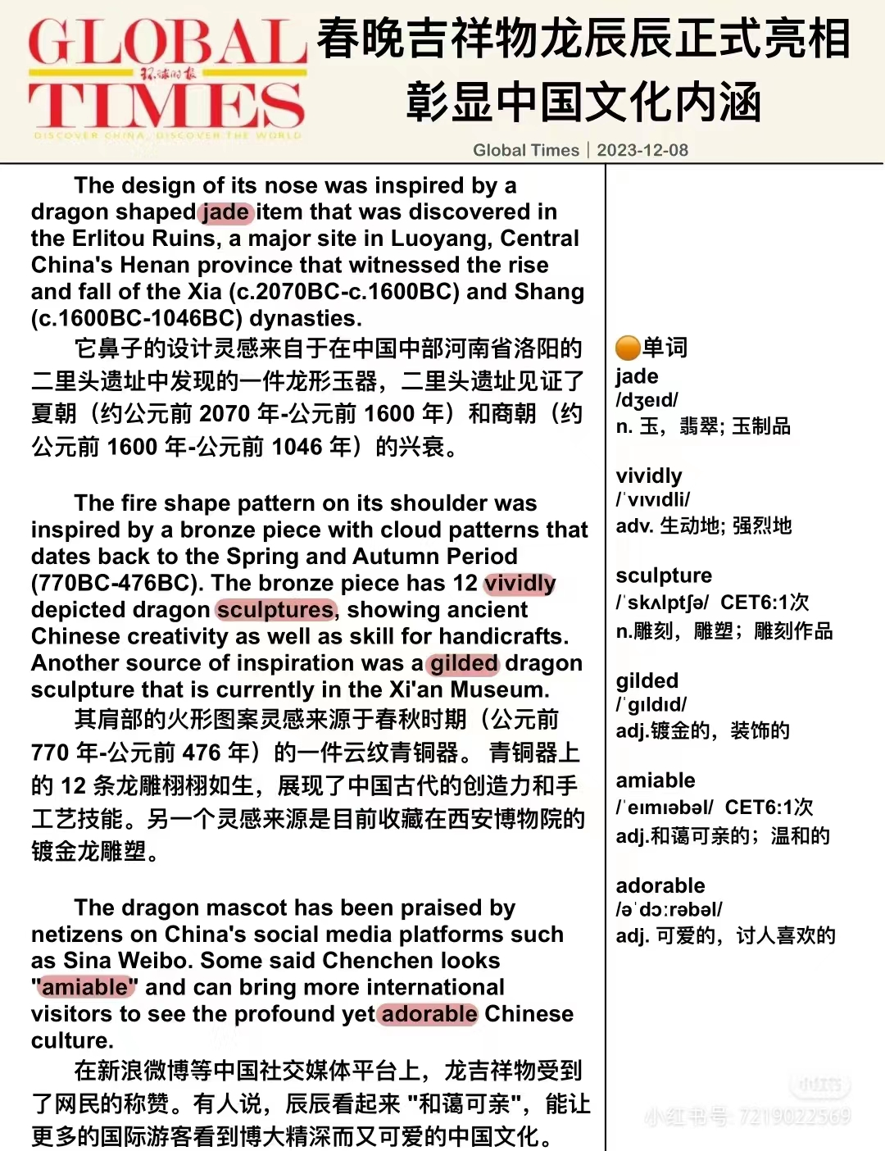
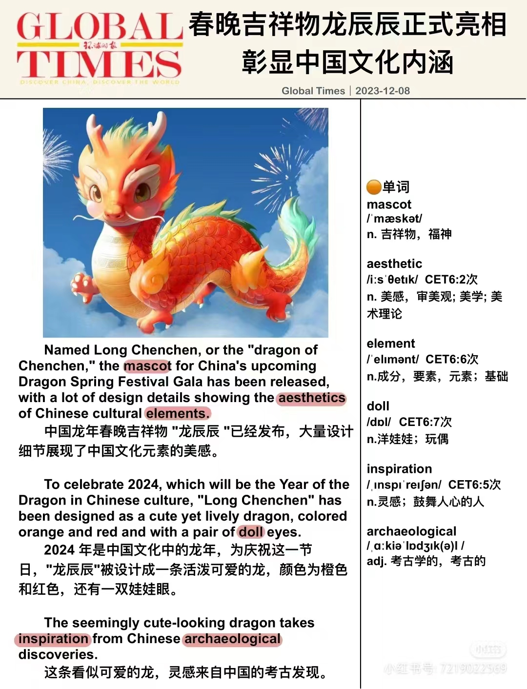
further
reading

Slide 8
