Slide 1



感恩遇见，相互成就，本课件资料仅供您个人参考、教学使用，严禁自行在网络传播，违者依知识产权法追究法律责任。
更多教学资源请关注
公众号：溯恩高中英语
知识产权声明

Slide 2







以讲述人物故事为引 梳理复习类似话题应用文
同文异构 融会贯通
Fay

Slide 3

I'll Make A Man Out Of You

Slide 4
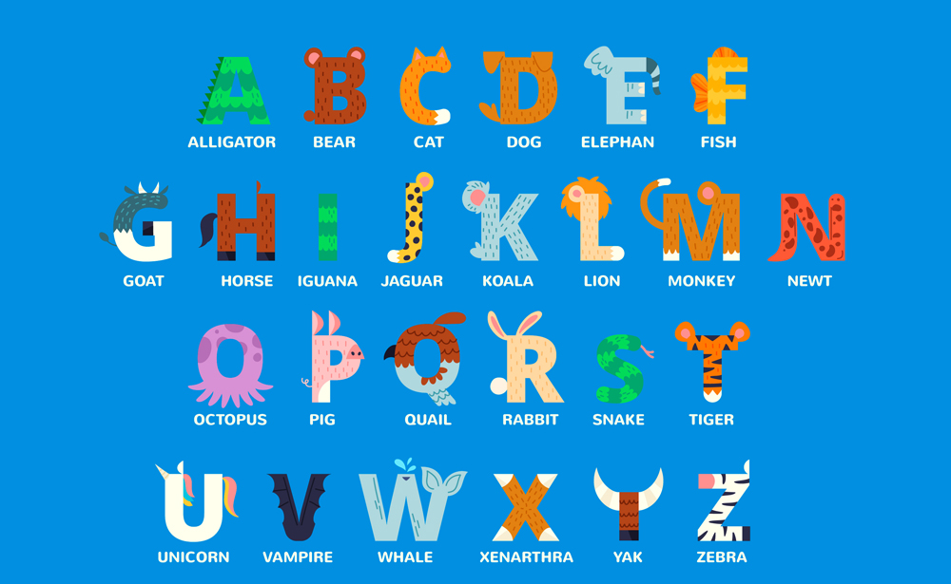
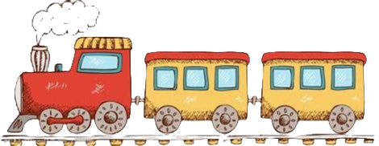
Warming-up
Vocabulary train

Slide 5

Ambitious
Bold/brave
Cautious
Determined/devoted
Earnest/enthusiastic
Faithful
Generous
Hospital
Innovative
Judicious
Knowledgeable
Loyal
Modest
Naive
Optimistic
Punctual/passionate
Qualified
Reliable
Sensible
Thoughtful
Vocabulary
train

Slide 6
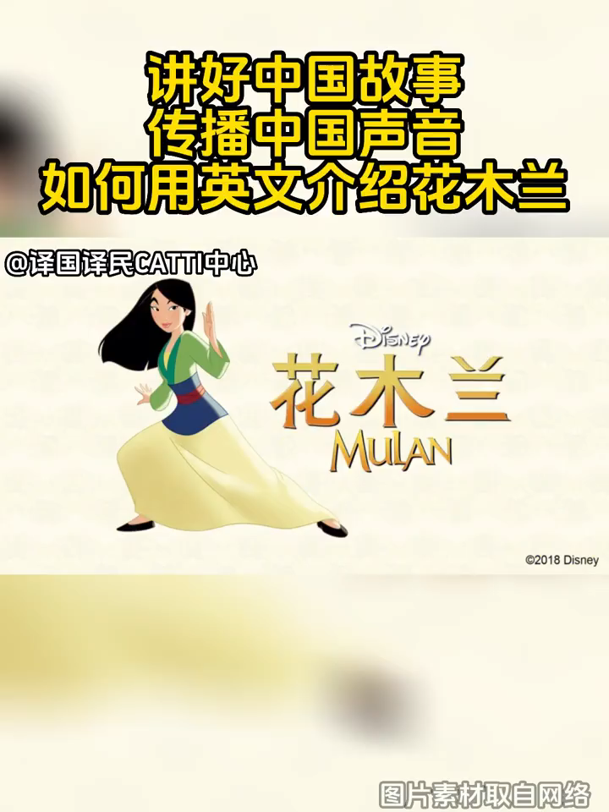
Video time
Mulan
a legendary heroine who is known for her bravery and strength

Slide 7

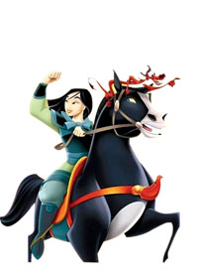
Mulan is a 1___________(legend) Chinese who is known for her bravery, 2___________(selfless) and filial piety. Her story 3_______________(tell) for centuries.
In the story, Mulan is a young woman who lives in China 4___________ the Northern Wei Dynasty. The government of the Northern Wei Dynasty required every household to send one man to fight in the war. Mulan's father was old and sick, and her younger brother was too young to fight. So Mulan decided to disguise herself 5________ a man and take her father's place in the army.
Fighting on the border was a difficult task for many men, and it was even 6_____________（ difficult ）for Mulan, who had to hide her identity and fight alongside her comrades. After many years of fighting, Mulan finally returned home 7___________（ victory）. The emperor was so impressed by her bravery that he pardoned her for impersonating a man and offered her a position in the government. 8___________, Mulan declined, 9___________（say） that she needed to return home to care for her 10___________（age） parents.
The story of Mulan is a reminder of the strength and courage of women. It is also a reminder of the importance of family and duty.
legendary
selflessness
has been told
Blank-filling
during
as
more difficult
victorious
However
saying
aging

Slide 8
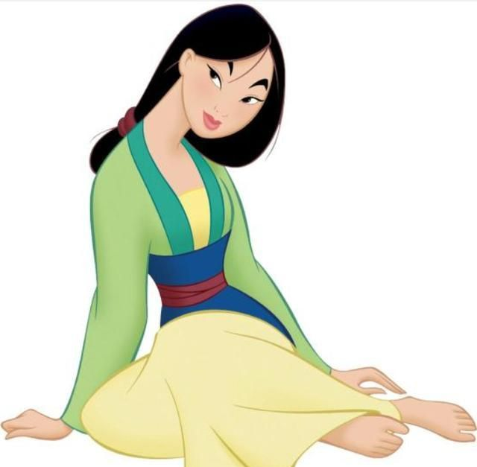
Words and expressions
legendary | / ˈledʒəndri / | adj.非常有名的，大名鼎鼎的
filial piety | / ˈfɪliəl ˈpaɪəti / | 孝道
disguise | / dɪsˈɡaɪz / | v.假扮，伪装；掩饰
comrade | / ˈkɒmreɪd / | n.伙伴，战友；同志
victorious | / vɪkˈtɔːriəs / | adj.胜利的，获胜的
impersonate | / ɪmˈpɜːrsəneɪt / | vt.扮演；模仿；拟人，人格化
decline | / dɪˈklaɪn / | v.下降，衰退；拒绝，谢绝
aging | / ˈeɪdʒɪŋ / | adj.变老的，变旧的
Take one’s place 替代某人的位置 Be impressed by被……所感动；印象深刻 hide one’s identity 隐藏身份 identify 认出，识别；查明 care for照顾，照料；喜欢，享受

Slide 9
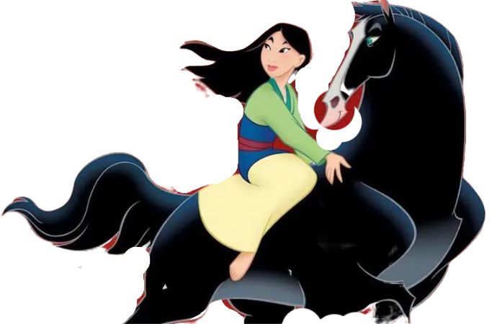
Mulan is a legendary Chinese who is known for her bravery, selflessness and filial piety. Her story has been told for centuries.
In the story, Mulan is a young woman who lives in China during the Northern Wei Dynasty. The government of the Northern Wei Dynasty required every household to send one man to fight in the war. Mulan's father was old and sick, and her younger brother was too young to fight. So Mulan decided to disguise herself as a man and take her father's place in the army.
Fighting on the border was a difficult task for many men, and it was even more difficult for Mulan, who had to hide her identity and fight alongside her comrades. After many years of fighting, Mulan finally returned home victorious. The emperor was so impressed by her bravery that he pardoned her for impersonating a man and offered her a position in the government. However, Mulan declined, saying that she needed to return home to care for her aging parents.
The story of Mulan is a reminder of the strength and courage of women. It is also a reminder of the importance of family and duty.
Writing
Keep or choose the most representative events and shortly clarify the ending of the story.
2023年全国甲
你校举办以英语讲述中国故事为主题的征文活动，请以一位历史人物为题，写一篇短文投稿，内容包括:
1.人物事迹;
2.意义;
3.启示。
In the story, Mulan is a young woman who lives in China during the Northern Wei Dynasty. The government of the Northern Wei Dynasty required every household to send one man to fight in the war. Mulan's father was old and sick, and her younger brother was too young to fight. So Mulan decided to disguise herself as a man and take her father's place in the army.
When Mulan's father was called up to fight in the army
Fighting on the border was a difficult task for many men, and it was even more difficult for Mulan, who had to hide her identity and fight alongside her comrades. After many years of fighting, Mulan finally returned home victorious. The emperor was so impressed by her bravery that he pardoned her for impersonating a man and offered her a position in the government. However, Mulan declined, saying that she needed to return home to care for her aging parents.
Mu lan declined the high position in the government and return home to care for her aging parents.

Slide 10
Mulan is a legendary Chinese who is known for her bravery, selflessness and filial piety. Her story has been told for centuries.
In the story, When Mulan's father was called up to fight in the army, Mulan decided to disguise herself as a man and take her father's place in the army. Fighting on the border was a difficult task for many men, and it was even more difficult for Mulan, who had to hide her identity and fight alongside her comrades. After many years of fighting, Mulan finally returned home victorious. Moreover, Mu Lan declined the high position in the government and returned home to care for her aging parents.
The story of Mulan teaches us courage, loyalty, and perseverance. It shows that women can be just as brave and strong as men. Mulan is a reminder of the strength and courage of women. It is also a reminder of the importance of family and duty.
(154words)
2023年全国甲
你校举办以英语讲述中国故事为主题的征文活动，请以一位历史人物为题，写一篇短文投稿，内容包括:
1.人物事迹;
2.意义;
3.启示。

Slide 11
Final version
Mulan is a legendary Chinese who is known for her bravery, selflessness and filial piety. Her story has been told for centuries.
In the story, When Mulan's father was called up to fight in the army, Mulan decided to disguise herself as a man and take her father's place in the army. After many years of fighting, Mulan finally returned home victorious, never revealing her true identity. Moreover, Mu Lan declined the high position in the government and returned home to care for her aging parents.
The story of Mulan teaches us courage, loyalty, and perseverance. It shows that women can be just as brave and strong as men. Mulan is a reminder of the strength and courage of women. It is also a reminder of the importance of family and duty.
(130words)
2023年全国甲
你校举办以英语讲述中国故事为主题的征文活动，请以一位历史人物为题，写一篇短文投稿，内容包括:
1.人物事迹;
2.意义;
3.启示。
Introduce the person briefly
Her story has a profound impact on Chinese people
Describe the main deeds &achievements
Conclude with the inspirations or the impacts
Make appropriate adjustment
depending on different genre.
Introduce/recommend

Slide 12
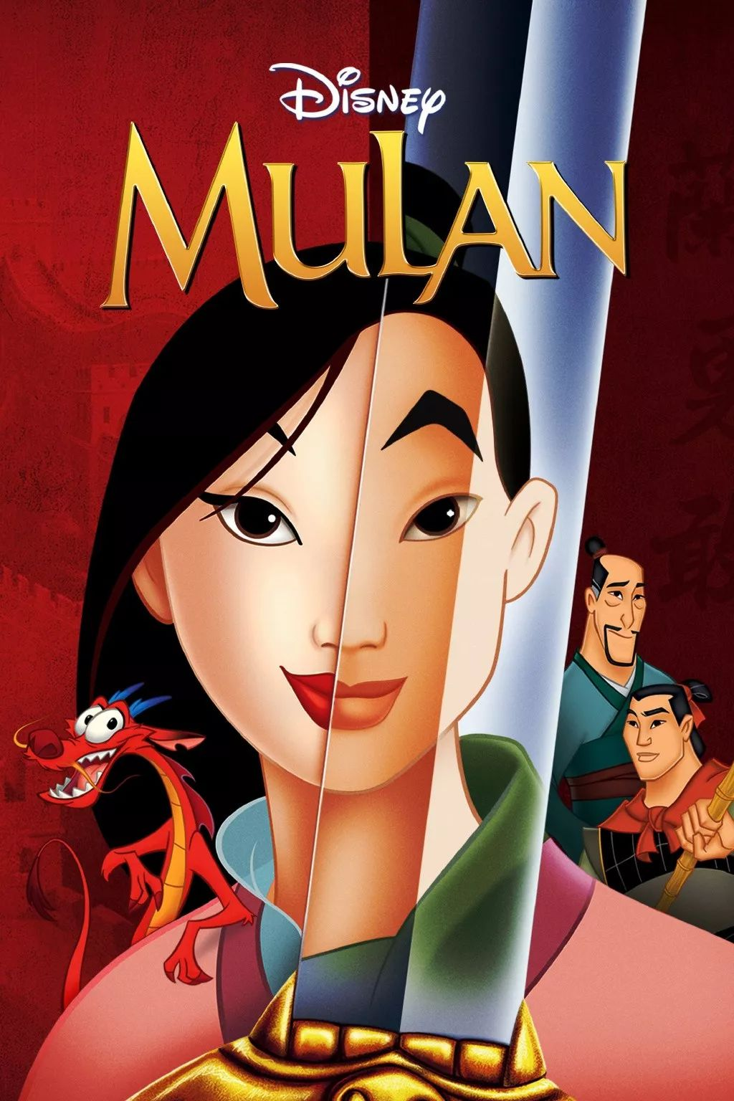
Practice
假如你是李华，受学生会委托为校宣传栏“英语天地”写一则通知，请大家观看一部英语电影 Mu Lan,内容包括:
1.电影内容
2.___________
3. ___________
2018 全国卷Ⅱ改编
放映时间、地点
注意事项
Notice
We are happy to announce that the English movie Mulan will be shown in our school auditorium on Friday, September 20th. The show will start at 7 pm and end at 9 pm.
In the story, Mulan decided to disguise herself as a man and take her father's place in the army. After many years of fighting, Mulan finally returned home victorious, never revealing her true identity. Don't miss this opportunity to experience the legend of Mulan firsthand.
Admission is free, and all students are welcome to attend. Please arrive early to get a good seat, as space is limited. We look forward to seeing you there!
放映时间、地点
电影内容
注意事项

Slide 13
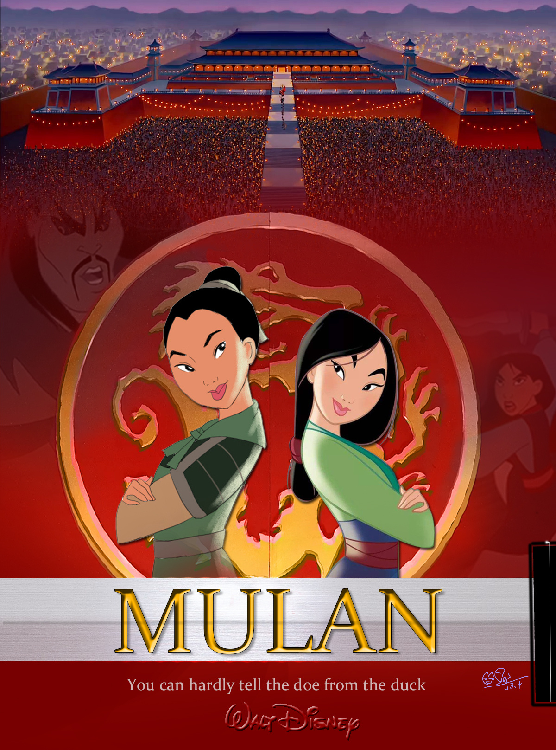
假定你是李华，打算参加你校即将举办的主题为"用英语讲中国故事"的演讲比赛。请你写一篇演讲稿。内容包括：
1．介绍你要讲的中国故事；
2．_________________________。
speech
你喜欢它的原因
2021 江苏模拟卷
Today, I’m honored to share with you the classic tale of Mu Lan.
Mulan is a legendary Chinese who is known for her bravery and selflessness. In the story, When Mulan's father was called up to fight in the army, Mulan decided to disguise herself as a man and take her father's place in the army. After many years of fighting, Mulan finally returned home victorious, never revealing her true identity. Moreover, Mu Lan declined the high position in the government and returned home to care for her aging parents.
I’m drawn to this story because Mu Lan represents the spirit of courage, loyalty and perseverance. Her story serves as a reminder of the strength and courage of women. Thank you for you attention.
介绍你要讲的中国故事
你喜欢它的原因

Slide 14

①假如你是李华，上周你校举办了“用英语讲好中国故事”的主题演讲活动，请你给英语报写一则报道，要点如下：
1. 活动时间、地点；
2. __________；
3. __________
②假如你是李华，你的英国朋友George对中国经典故事很痴迷。你校将举办用英语讲好中国故事演讲比赛，请你给George写封邮件邀请他参加。内容包括：
1. 比赛时间；
2. __________；
3. __________
 | ① | ② | ③ | ④
体裁人称
时态语气
篇章结构
内容要点
活动过程
演讲话题
活动意义
报名方式
Compare and choose one for homework
③假定你是李华，你和同学根据英文电影改编了一个短剧，给外教Miss Evan 写封邮件，请她帮忙指导，内容包括：
1. 剧情简介；
2. __________；
3. __________
④近期你校将举办一场 “用英文讲好中国故事” 的英文演讲比赛，请你代表学生会在学校公众号上用英语写一则通知，内容包括：
1. 比赛目的；
2. __________；
3. __________
指导内容
比赛信息
商定时间地点
欢迎报名

Slide 15
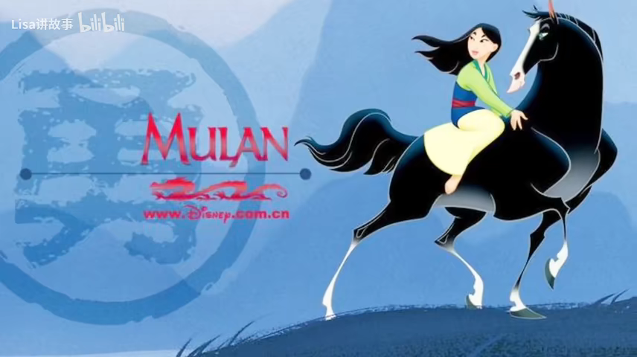

Slide 16

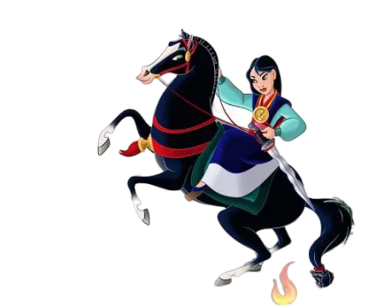
The flower that blooms in adversity is the most rare and beautiful of all.
逆境中绽放的花朵，才是最珍贵、最美丽的。

Slide 17
①假如你是李华，上周你校举办了“用英语讲好中国故事”的主题演讲活动，请你给英语报写一则报道，要点如下：
1.活动时间、地点
2.活动过程
3.活动意义
A speech contest was held with the theme of Telling Chinese Stories in English at our school last week.
The event attracted many students and teachers, who gathered in the school auditorium to listen to the speeches given by the participants. During the contest, the contestants shared interesting stories about China's past and present. They also discussed various topics such as Chinese traditional culture, modern technology, and environmental protection. Some of them even used multimedia presentations to make their speeches more vivid and engaging.
All the participants showed great enthusiasm and creativity in presenting their ideas. Their fluent English, accurate pronunciation, and good body language impressed everyone in the audience. Better yet, this contest encouraged students to explore Chinese culture from a new perspective and enhanced their English communication skills. All in all, it was an inspiring and meaningful event that helped promote cultural exchange in our school.

Slide 18
②假如你是李华，你的英国朋友George对中国经典故事很痴迷。你校将举办用英语讲好中国故事演讲比赛，请你给George写封邮件邀请他参加。内容包括：
1.比赛时间；
2.比赛信息；
3.欢迎报名
Dear George,
How's everything going? Knowing you have always been fascinated by classic Chinese stories, so I'm writing to invite you to a speech contest we are organizing at our school.
This contest themed Telling Chinese Stories in English is a perfect opportunity for you to share your passion with others. It will be held on Saturday, September 25th, from 9 a.m. to 12 p.m. in the school auditorium. Participants will have five minutes each to deliver their speeches, and they can choose any Chinese story as the topic. Plus, there will be a panel of judges who will evaluate the speeches based on content, organization, delivery, and language use. The top three contestants will receive special prizes.
We would love to have you participate in the contest. Your knowledge and enthusiasm for Chinese culture would make a great contribution to the event. If you're interested, please let me know so that I can send you the registration form. Feel free to ask if you have any questions.
I look forward to hearing from you soon.
Best regards,
Li Hua

Slide 19
③假定你是李华，你和同学根据英文电影改编了一个短剧，给外教Miss Evan 写封邮件，请她帮忙指导，内容包括：
剧情简介；
指导内容；
商定时间、地点.
Dear Miss Evans,
How's it going? I'm writing to ask if you could give guidance on our new play. The drama is an adaptation of the movie Mu lan. It tells the story of a legendary Chinese, Mu lan who disguised herself as a man and took her father's place in the army.
Despite a considerable amount of time devoted to preparing the play, we still encounter obstacles owing to a lack of experience. Knowing that you are an accomplished actress well as a knowledgeable tutor, we sincerely invite you to give us instructions on facial expressions, help to correct the mistakes and polish the lines in the play.
I know you have a busy schedule, but I will appreciate it if you can spare some time to give guidance to us at 5:30 p.m. next Monday in the music hall. Is it ok for you?
Looking forward to your reply.
Yours,
Li Hua

Slide 20
④近期你校将举办一场 “用英文讲好中国故事” 的英文演讲比赛，请你代表学生会在学校公众号上用英语写一则通知，内容包括：
比赛目的；
比赛信息；
欢迎报名。
Notice
We are pleased to announce that our school will be hosting an English speech competition with the theme of Telling Chinese Stories in English. The purpose of this competition is to provide a platform for students to showcase their English speaking skills and deepen their understanding of Chinese culture.
Each participant will have five minutes to deliver their speech in English. The topic can be any Chinese story, such as myths, legends, or historical events, and should be presented in an engaging and creative manner. Visual aids, such as PowerPoint presentations, are encouraged.
Prizes will be awarded to the top three contestants, and all participants will receive certificates of participation.
If you would like to participate, please register by Tuesday, October 25th, 2024, by emailing your name, grade, and speech topic to englishspeechcomp@school.edu.cn.
We look forward to your active participation and a successful event!
The Student Union

