Slide 1



感恩遇见，相互成就，本课件资料仅供您个人参考、教学使用，严禁自行在网络传播，违者依知识产权法追究法律责任。
更多教学资源请关注
公众号：溯恩高中英语
知识产权声明

Slide 2
选择性必修一unit3 教材词汇

Slide 3
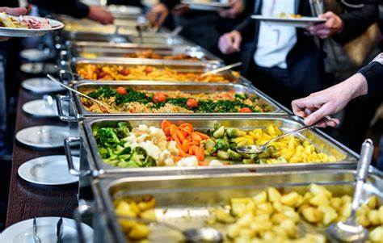
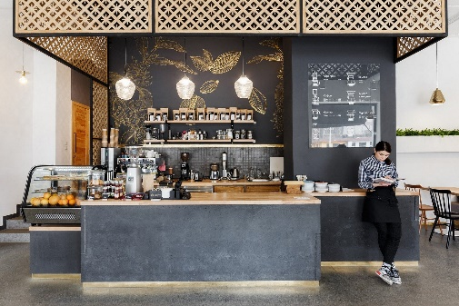
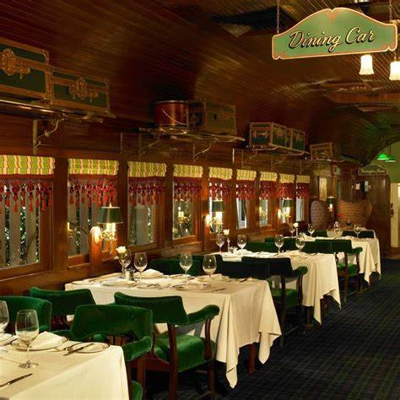

buffet
n.
A cold buffet had been laid out in the dining-room.
自助餐
We sat in the station buffet sipping tea.
小餐吧
=dining car 餐车
v.
The strong wind is buffeting the tiny tree.
Their plane had been severely buffeted by storms.
The nation had been buffeted by a wave of strikes (罢工).
(1) be repeatedly struck or blown around by winds 连续猛击
(2) experience difficult or unpleasant situations 遭遇不幸或困难

Slide 4

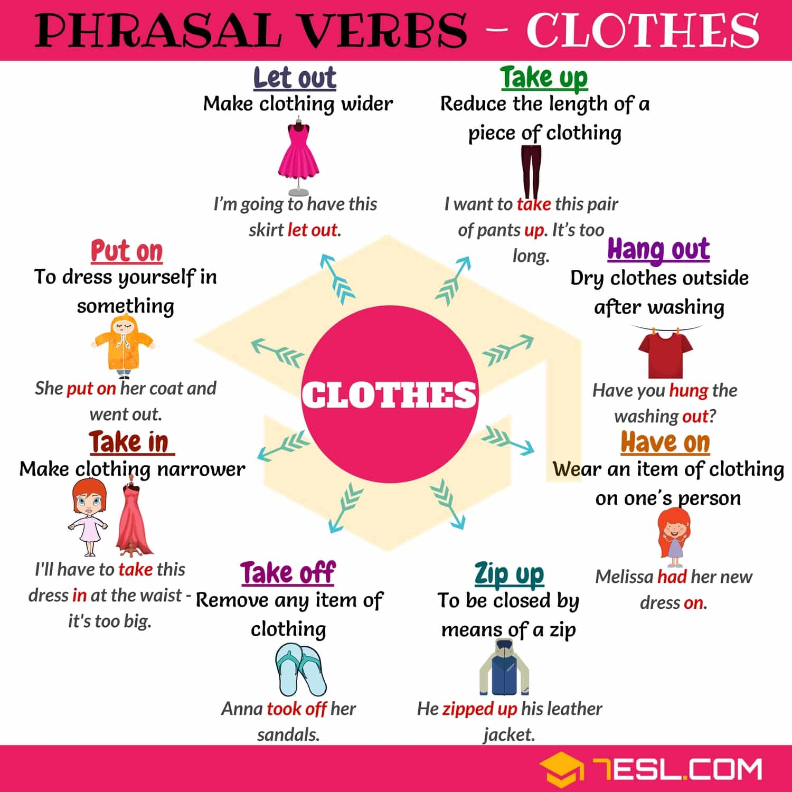
cloth
a cloth bag 布袋
a piece of cloth 一块布料
区别 clothing clothes cloth (s)
Put your dirty ______ in the hamper (脏衣篓), and then wipe your face with a damp _____.
It is urgent that food and _______ be sent to the famine victims.
clothes
cloth
衣物（总称）
clothing

Slide 5
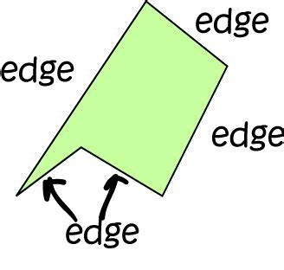
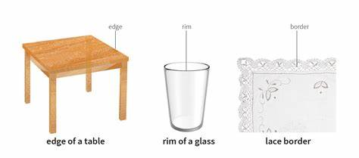
edge
n.边缘；边际；刀刃
We were on a hill, right on the edge of town.我们在一座小山上，正好位于城镇边缘。
The heavy rain drove him to the edge of desperation.这场暴雨把他推向了绝望的边缘。
My nerves were constantly on edge. 我的神经处于不断紧张中。
They have the edge on/ over us. 他们略胜我们一筹。
v. 慢慢移动
He edged closer to the telephone, ready to grab it.他慢慢地移近电话，准备抓起它。

Slide 6
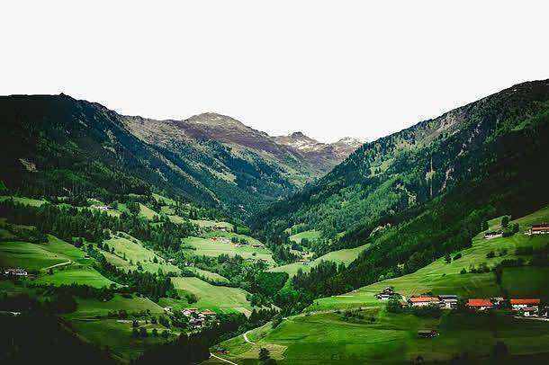
valley
n. 山谷
• ...a wooded valley set against the backdrop of Monte Rosa.
…罗莎峰前一个林木繁茂的山谷。

Slide 7
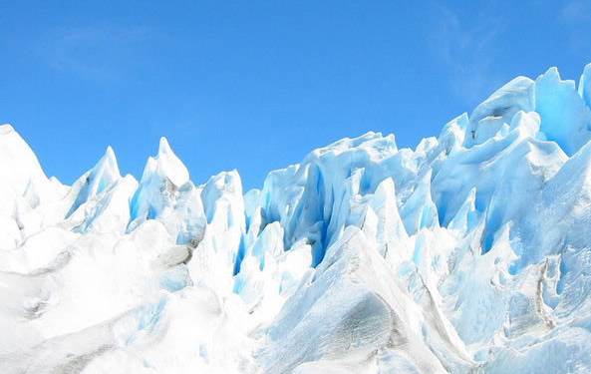
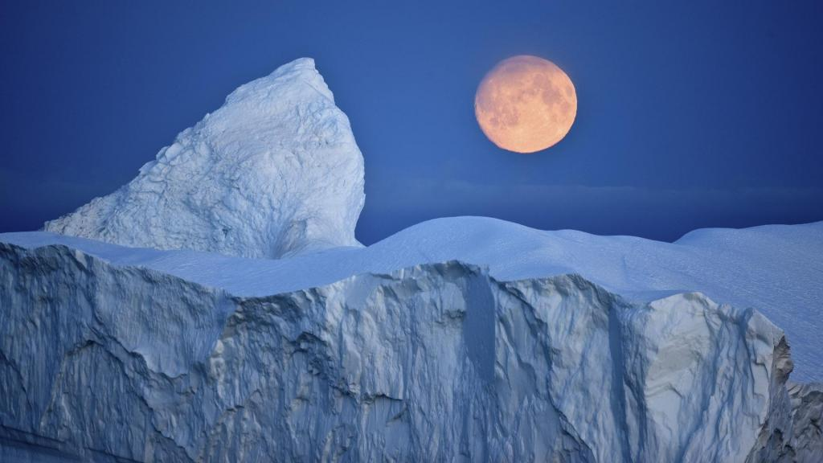
glacier
n. 冰川

Slide 8

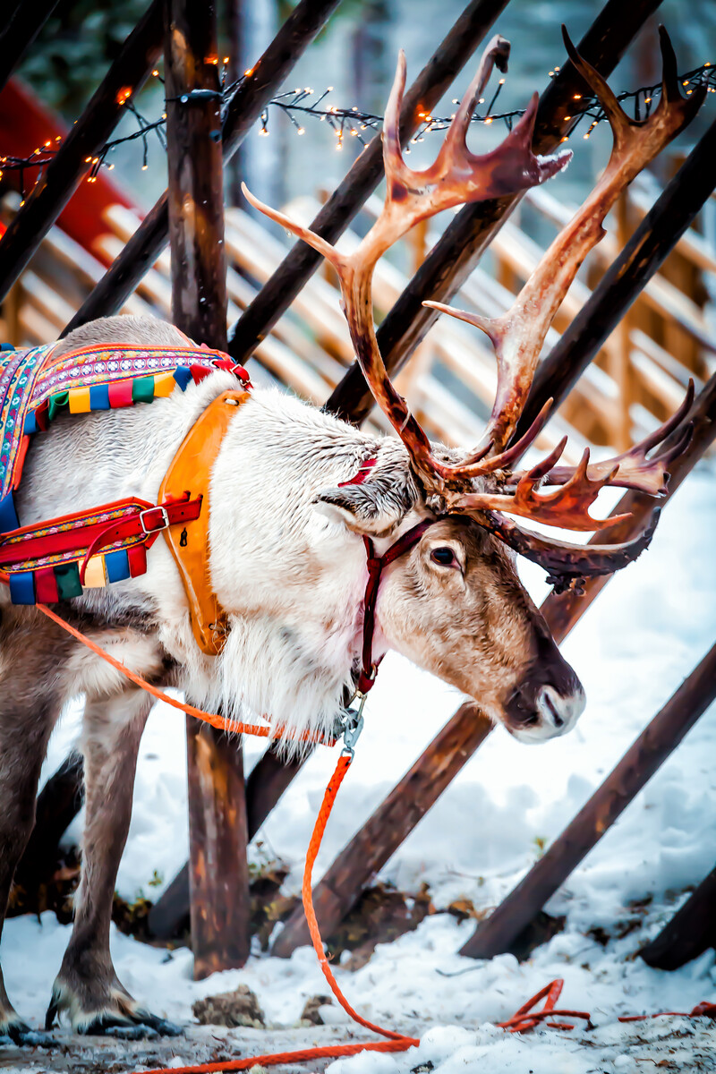
reindeer
n. 驯鹿
Reindeer is a symbol of Christmas.

Slide 9
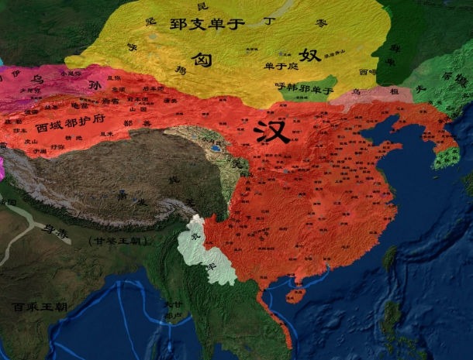

territory
n. 领土；版图；领地
They have refused to allow UN troops to be stationed in
their territory.
他们拒不允许联合国部队驻扎在他们的国土上。
defend their territory against intruders不允许外来者侵入
This type of work is uncharted territory for us. 我们从未涉足过这类工作。
Legal problems are Andy's territory (= he deals with them) . 法律问题由安迪负责处理。
come/ go with the territory 成为必然的部分（或结果）
She has to work late most days, but in her kind of job that goes with the territory.
她在大部分日子里都得工作到很晚，但根据她的工作性质，这是不可避免的。

Slide 10

ban
v. 明令禁止；取缔= prohibit
He was banned from driving for six months.
他被禁止驾驶六个月。
n. 禁令 to impose/lift a ban 颁布╱解除禁令
There is to be a total ban on smoking in the office. 办公室将彻底禁止吸烟。

Slide 11
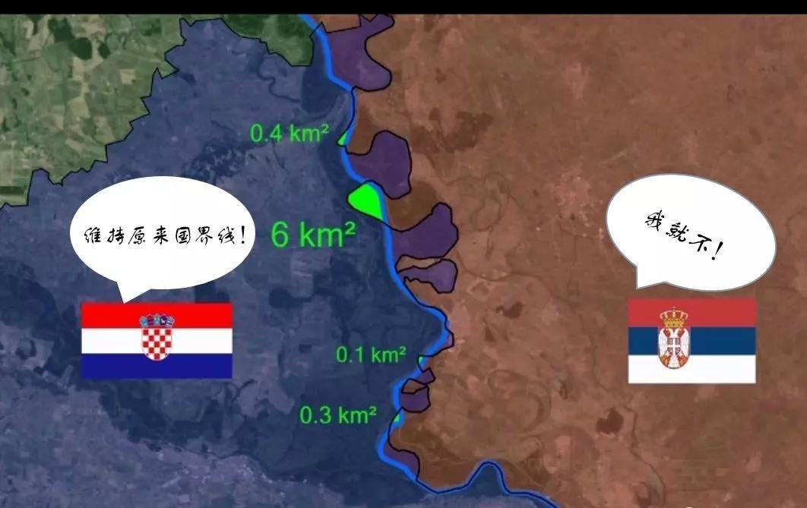

boundary
1.边界
national boundaries 国界
boundary changes/disputes 边界变化╱争端
2.界限
The boundaries between history and storytelling are always being blurred and muddled.
历史与故事的界限一直模糊不清。
Scientists continue to push back the boundaries of human knowledge. 科学家不断扩大人类知识的范围。

Slide 12
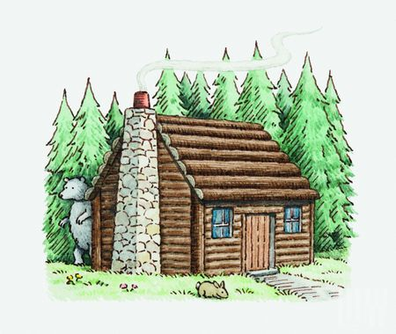

cottage
n. 小屋；（尤指）村舍，小别墅
The cottage sounds idyllic.
小屋看来恬静宜人。
The cottage had a delightful sea view.
这小屋可以看到宜人的海景。
We're not on the telephone at the cottage.
我们的乡间别墅没有安装电话。

Slide 13
visible
反：invisible
adj. 1. 看得见的；可见的
The house is clearly visible from the beach. 从海滩可以清楚地看到那所房子。
Most stars are not visible to the naked eye . 大多数星星肉眼看不见。
2. 明显的；能注意到的=obvious
visible benefits 显而易见的实惠
He showed no visible sign of emotion. 他丝毫不露声色。
She made a visible effort to control her anger. 看得出她竭力控制自己不发火
It was visible/ obvious/ apparent/ clear that...很明显……
adv. The Russians were visibly wavering.俄国人显然犹豫不决。

Slide 14
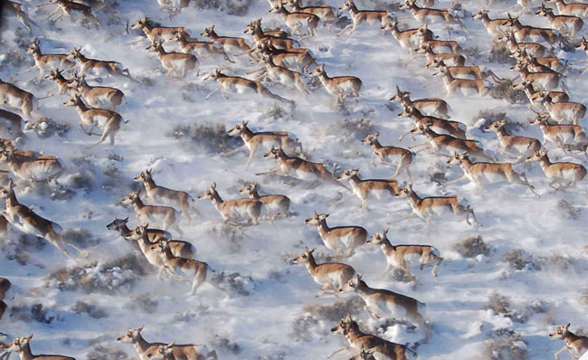
on the move
The car was already on the move. 汽车已经开动了。
The wide plain, with thousands of animals on the move, was an awesome spectacle.
成千上万的动物在辽阔的平原上活动构成了令人赞叹的奇观。
The firm is on the move to larger offices. 公司正在迁往更大的办公区。
Jack never wanted to stay in one place for very long, so they were always on the move.
杰克从不想在一个地方久留，所以他们总在辗转奔波。

Slide 15

accompany
v. 1.陪同；陪伴 = keep sb. company
His wife accompanied him on the trip. 那次旅行他由妻子陪同。
2.伴随；与…同时发生
strong winds accompanied by heavy rain 狂风夹着暴雨
Each pack contains a book and accompanying CD. 每包内装书一本，并附光盘一张。
3.~ sb (at/on sth)（尤指用钢琴）为…伴奏
The singer was accompanied on the piano by her sister.
女歌手由她姐姐钢琴伴奏。

Slide 16

adopt
n. adoption
v. 1. 收养；领养 to adopt a child 领养孩子
She was forced to have her baby adopted. 她被迫把婴儿给人收养。
2.采用（某方法）；采取（某态度）
All three teams adopted different approaches to the problem. 三个队处理这个问题的方法各不相同。
3.正式通过，表决采纳（建议、政策等）
The council is expected to adopt the new policy at its next meeting. 委员会有望在下次会议上正式通过这项新政策。
4.（名字等）；移居（某国）；承袭（风俗）
to adopt a name/ title/ language/ many of the practices 取名；袭用头衔；采用某语言；承袭（风俗）5.采用（某种举止、说话方式等）
He adopted an air of indifference. 他摆出一副满不在乎的样子。
6.选定，选举（某人为候选人或代表）= elect
She was adopted as parliamentary candidate for Wood Green.
她被推举为伍德格林选区的议员候选人。

Slide 17
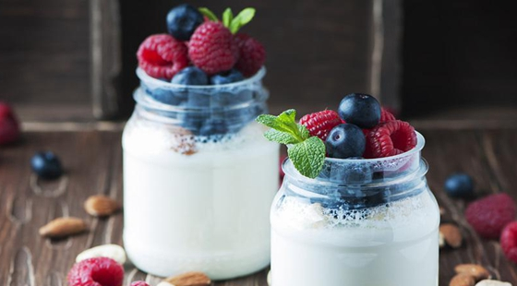
sour
adj.
1. 酸的；有酸味的 a sour flavour 酸味
2. 阴郁的；闷闷不乐的；没好气的
a sour face 阴郁的脸色
The meeting ended on a sour note with several people walking out.
几个人退席，会议不欢而散。
go sour变坏；恶化；出毛病
Their relationship soon went sour. 他们的关系很快有了嫌隙。
sour grapes 酸葡萄（表示某人表面贬低某事物，实则是嫉妒）
He said he didn't want the job anyway, but that's just sour grapes. 他说反正他并不想干这份工作，这不过是吃不着葡萄就说葡萄酸而已。
v. （使）变坏，恶化
The atmosphere at the house soured.屋子里的气氛不对了。

Slide 18

set out
1．开始旅行或出发：开始进行一次旅行或行程。
We set out early in the morning to avoid traffic.
为了避免交通拥堵，我们一大早就出发了。
2．开始做某事：开始进行某项活动或任务。
He set out to learn a new language.
他开始学习一门新语言。
3．安排或展示某物：以特定方式安排或展示某物。
She set out the dishes on the table for dinner.
她在餐桌上摆放好了餐具。

Slide 19
bless
v.
1. 求上帝降福于；祝福 God bless you! 愿上帝保佑你
2. be blessed with sth/sb 赋有（能力等）；享有（幸福等）
She's blessed with excellent health. 她身体很好，是一种福气。
I’m blessed to have all of you accompanying me. 很幸运有你们的一路相伴。
blessing n. 幸事；祈福祷告；许可
It's a blessing that nobody was in the house at the time. 幸好当时屋子里没人。
He went with his parents' blessing . 他是得到父母的同意去的。
a blessing in disguise 因祸得福
Losing my job turned out to be a blessing in disguise because it gave me the opportunity to start my own business.失去工作最终成为了因祸得福，因为这给了我创业的机会。

Slide 20
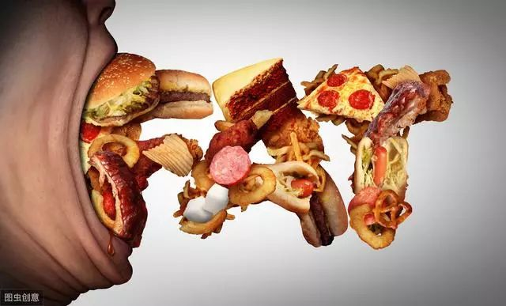
live off
依靠某物或某人作为生存的主要来源，如金钱或食物
He seems to live off junk food.
他好像靠吃垃圾食品为生。

Slide 21

prohibit v.
prohibition n.
1. （尤指以法令）禁止= forbid
a law prohibiting the sale of alcohol 禁止售酒的法令
the prohibition of smoking in public areas 禁止在公共场所吸烟的规定
2. 阻止；使不可能= prevent
The high cost of equipment prohibits many people from taking up this sport. 昂贵的装备令许多人对这项运动望而却步。

Slide 22

journalist
新闻记者；新闻工作者
A journalist is a person whose job is to collect news and write about it for newspapers, magazines, television, or radio.

Slide 23

sneeze
v./ n.打喷嚏
I've been sneezing all morning. 我一上午直打喷嚏。
Put a handkerchief over your mouth when you sneeze. 打喷嚏时用手帕捂住嘴。
She gave a violent sneeze. 她打了个大喷嚏。
not to be sneezed at 值得认真对待；不可轻视
In those days, $20 was not a sum to be sneezed at.
那时候，20元可不能不当回事。

Slide 24

teapot
n. 茶壶
For some, it may seem silly, a tempest in a teapot.
对有些人来说，这似乎很荒唐，是小题大做。
(tempest大风暴；暴风雨；暴风雪)

Slide 25

label
n./v.
1. 标签；签条；标记
price/address labels 价格标签；地址签条
He peered at the label on the bottle.他注视着瓶子上的标签。
The produce was labelled "Made in China."该产品上贴有“中国制造”的标签。
2. 不恰当的）称谓，绰号，叫法
I hated the label ‘housewife’. 我不喜欢“家庭主妇”这个称谓
I can't bear people who make judgements and label me.
我受不了那些对我评头论足、乱贴标签的人。

Slide 26
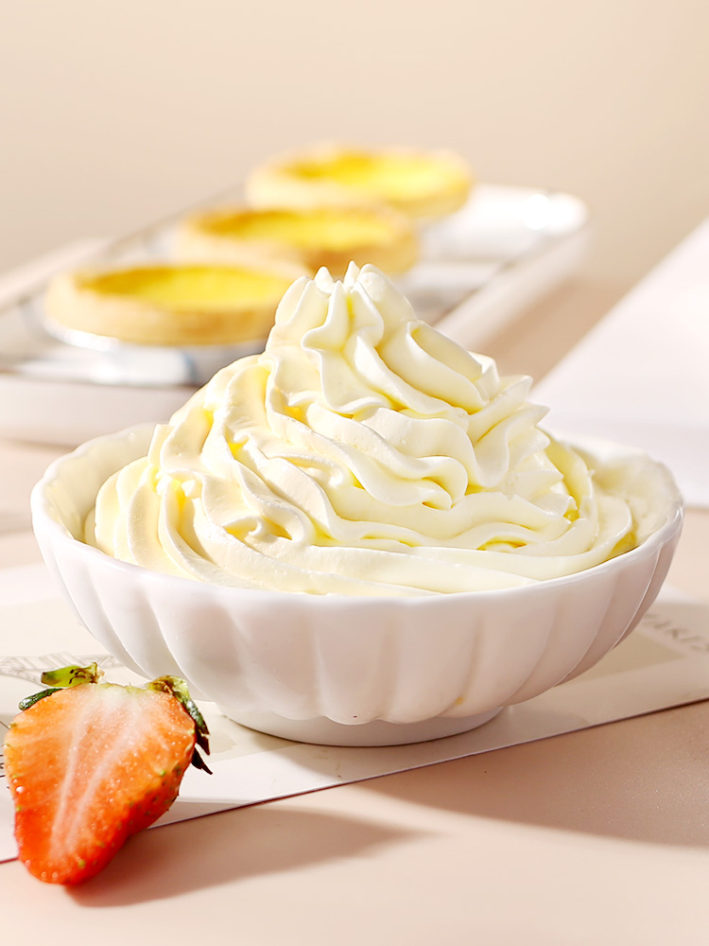
cream
n.
奶油; 护肤霜，药膏; 奶油色; 精英，精华
the cream of the crop of this season's movies 本季节电影的最佳影片
the cream of New York society 纽约社会的精英
v.
把…搅成糊状
Cream the butter and sugar together.
The best students were creamed off by the grammar schools.
最好的学生都已被文法学校录取。
We got creamed in the first round.
我们在第一轮就被彻底打败了
adj.
奶油色的; 淡黄色的; 米色的

Slide 27

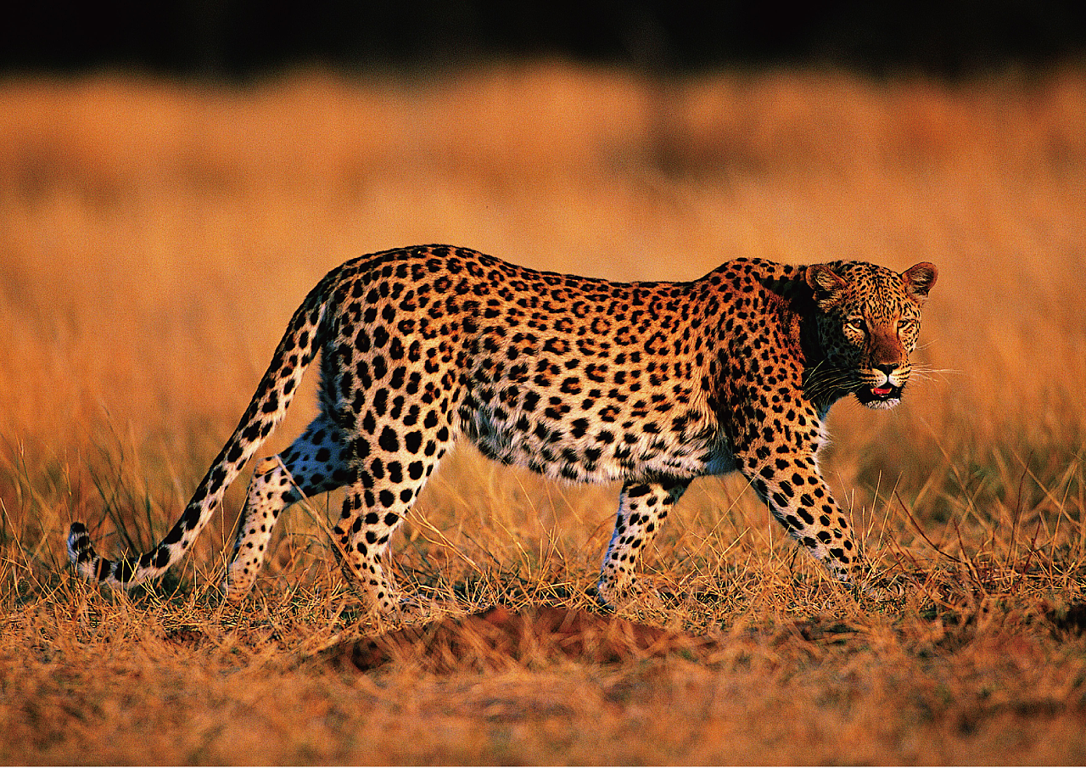
leopard
n. 豹
A leopard cannot change his spots. 江山易改本性难移。

Slide 28

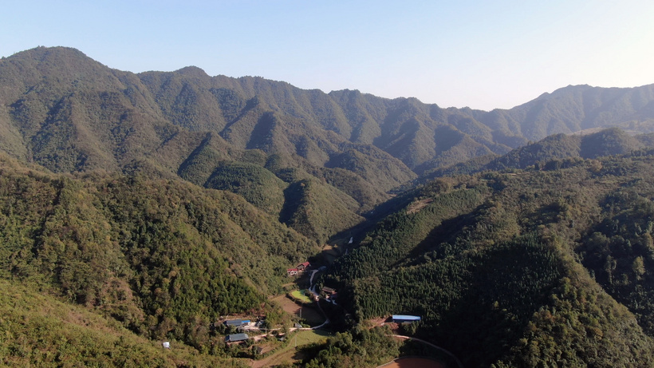
stretch
v. 1. 伸展；舒展
He stretched and yawned lazily. 他伸了伸懒腰，打了个哈欠。
The exercises are designed to stretch and tone your muscles. 这些活动目的在于伸展和增强你的肌肉。
2. 伸出，伸长（胳膊、腿）
She stretched across the table for the butter.
她伸手到桌子那头去拿黄油。
I stretched out a hand and picked up the book.
我伸出一只手，把书捡起来。
3. 延伸；绵延
Fields and hills stretched out as far as we could see. 放眼望去，田野山丘绵延不绝。
4. 延续
The town's history stretches back to before 1500. 该城的历史可以上溯到公元1500年以前。
The talks look set to stretch into a second week. 看来谈判十有八九要延续到下个星期了。
5. 足够买（或支付）
I need a new car, but my savings won't stretch to it. 我需要一辆新车，但我的积蓄不够。

Slide 29
6. 大量地）使用，消耗
The influx of refugees has stretched the country's resources to the limit . 难民的大量涌入把这个国家的资源消耗殆尽。
We can't take on any more work—we're fully stretched as it is. 我们不能再接受其他工作了—现在已经竭尽所能了。
7. 使竭尽所能；使全力以赴；使发挥出全部本领
I need a job that will stretch me. 我需要一份让我能充分发挥才智的工作。
I'm trying to move on and stretch myself with something different.
我正试图换个工作，使自己在不同的事情上得到充分发挥。
8.滥用；随意歪曲
He admitted that he had maybe stretched the truth a little. 他承认可能有点言过其实了。
The play's plot stretches credulity to the limit . 这出戏的剧情简直就是胡编滥造。
9. 俭省
They're used to stretching their budgets.
他们习惯于精打细算。

Slide 30
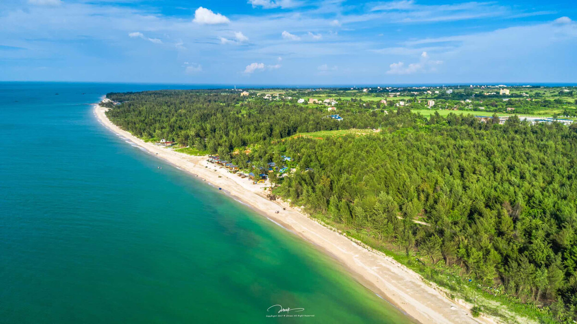
n.
一片; 一段时间; 舒展; 弹性; 直道
stretch of road 一段路
That's a pretty stretch of coast. 那是一段美丽的海岸线。
The landscape seemed to stretch into infinity. 风景似乎延伸到了无穷远处。
She used to read for hours at a stretch (= without stopping) . 她以前看书常常连看几小时。
The campaign has entered its final stretch. 竞选已进入最后冲刺阶段。
Stay in this position and feel the stretch in your legs. 保持这个姿势，体会腿部绷紧的感觉。
We got out of the car and had a good stretch. 我们下车好好舒展了一下身体。

Slide 31

rewarding
adj. 令人满意的; 令人有所收获的
a rewarding experience/job 有益的经历/工作
stimulating and rewarding 激发人的、令人有所收获的

Slide 32
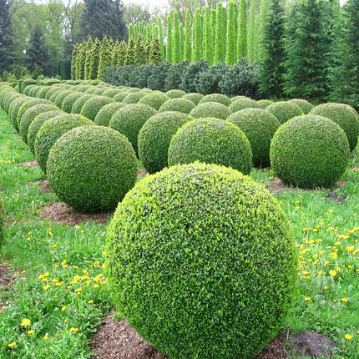
bush
He snapped a twig off a bush. 他啪地从灌木上折下一小枝。
They used a machete to cut through the bush.
他们用大砍刀在灌木林中劈出了一条路。
beat around the bush 拐弯抹角

Slide 33

lung
at the top of one’s lungs 尽可能大声地喊叫

Slide 34
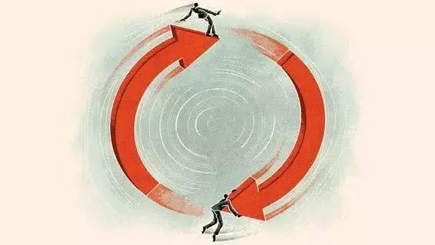
cycle
v. 骑自行车；骑自行车旅行
A new metro runs under the square, carrying hundreds of thousands who used to cycle to work. 一条新地铁在广场下面运行，载着数以千计过去骑自行车上班的人们。
There are a multitude of small, quiet roads to cycle along.
有多条可以骑自行车的僻静小路。
n.
1. 自行车；摩托车
We went for a cycle ride on Sunday.
我们星期天骑自行车去兜风了。
2. 循环
We need to break the vicious cycle of violence and counterviolence.
我们需要结束暴力和反暴力的恶性循环。

Slide 35
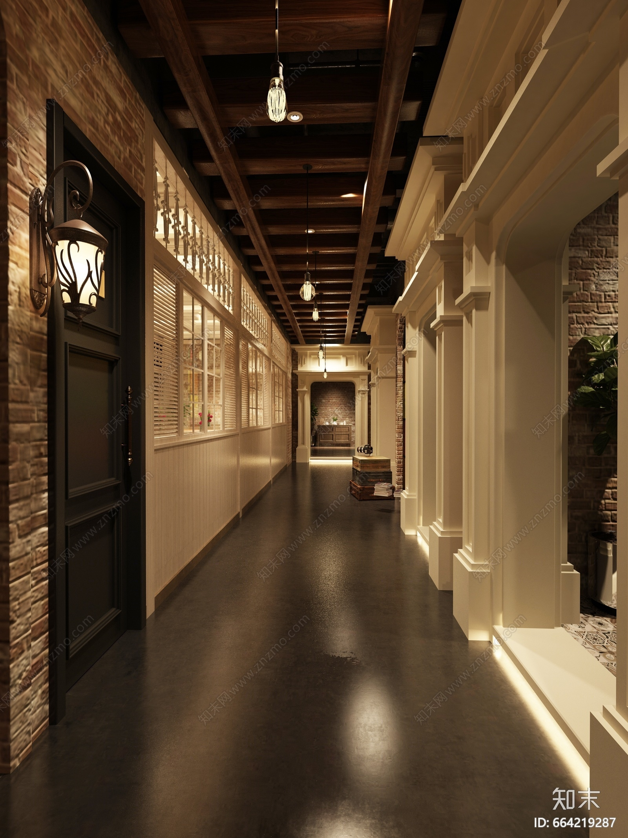
corridor
n.
Their laughter filled the corridor. 他们的笑声充满了走廊。
She pounded along the corridor after him.
她跟着他在走廊里咚咚地走过。
I could hear the pit-a-pat of feet in the corridor.
我能听见走廊上啪哒啪哒的脚步声。
The corridor opened into a low smoky room.
这条走廊通向一个既低矮又烟雾弥漫的房间。

Slide 36

pedal
n. （自行车等的）脚蹬子，踏板
She pressed her foot down sharply on the brake pedal. 她猛踩刹车踏板。
v. 骑自行车
I saw her pedalling along the towpath. 我看见她在纤道上骑自行车。
He jumped on his bike and pedalled off. 他跳上自行车就骑走了

Slide 37
fountain
n.
1. 喷泉
The main square has a fountain that spouts water 40 feet into the air.
主广场有个喷泉，喷水高达40英尺。
2. 丰富来源；源泉= source
You are a fountain of ideas. 你就是思想的源泉。
v. 喷射；喷流
She watched the blood fountaining from her wrists.
她看着血从手腕喷涌而出。

Slide 38
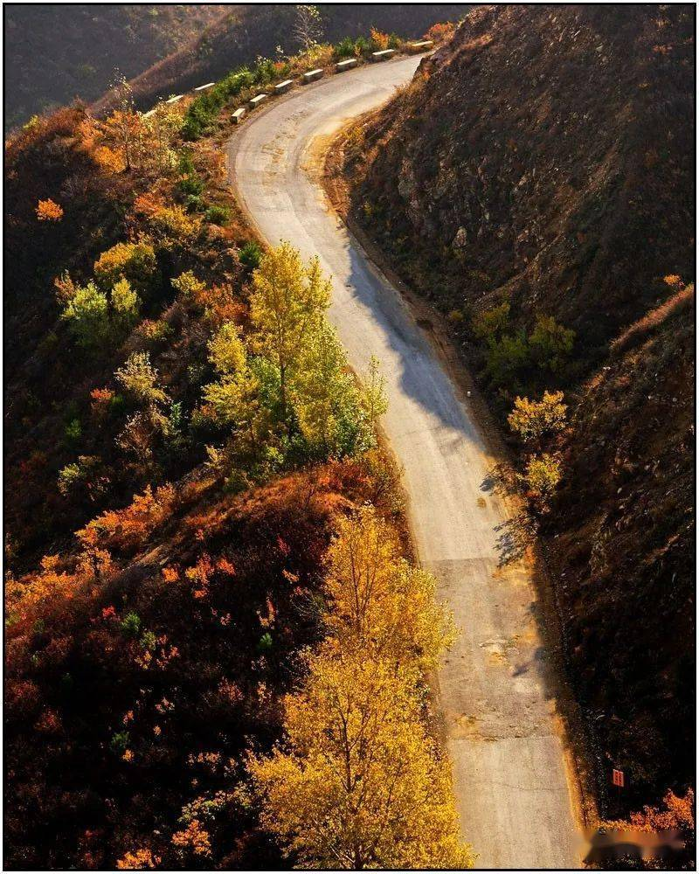
route
n.
1. 路线；路途
Which is the best route to take? 哪一条是最佳路线？
They took the scenic route back to the hotel. 他们选了一条景色优美的路线回旅馆。
He began cracking open big blue tins of butter cookies and feeding the dogs on his route.
他开始打开装着奶油曲奇的蓝色大罐子，巡访途中喂起那些狗来。
2. (公共汽车的) 行车路线; (飞机、轮船的) 航线
...the main shipping routes to Japan.
…去往日本的主要轮船航线。
3. 途径；渠道
the route to success 成功之路

Slide 39
ahead
adv.
1. （时间、空间）向前面，在前面
Brett looked straight ahead. 布瑞特向前直视。
We've got a lot of hard work ahead. 我们往后还有很多艰苦工作要做。
2. 提前；预先；提早= in advance
The party was planned weeks ahead. 聚会提前几个星期就已筹划好了。
3. 占优势；领先
Our team was ahead by six points. 我们队领先六分。
You need to work hard to keep ahead. 你要努力才能保持领先优势。

Slide 40
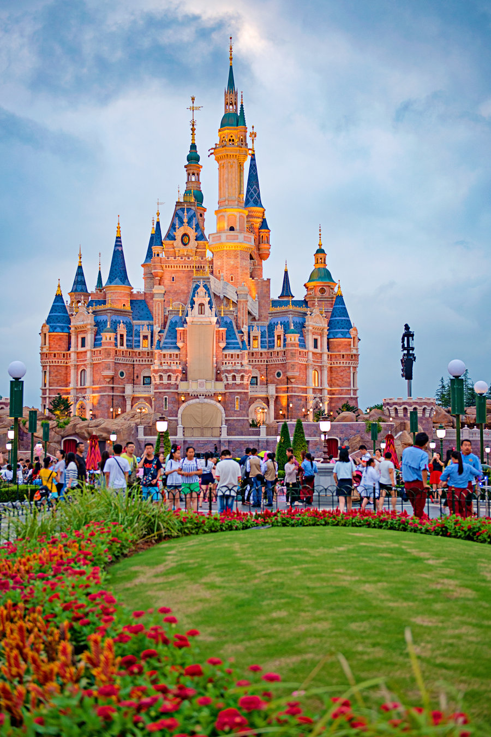
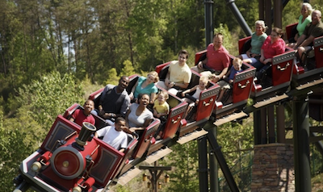
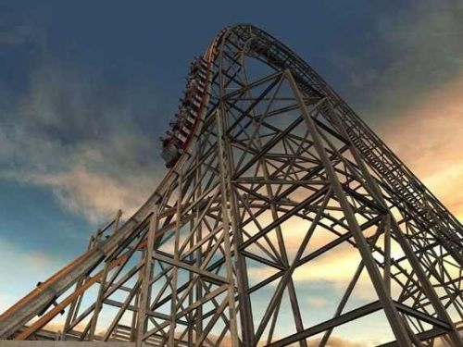
theme
theme park
Dollywood
n. 主题；主旋律
We seem to be straying from the main theme of the debate.
我们似乎是偏离了辩论的主题。
on the theme of ...……的主题
主题乐园（娱乐项目大多围绕一个主题的大型公园）

Slide 41
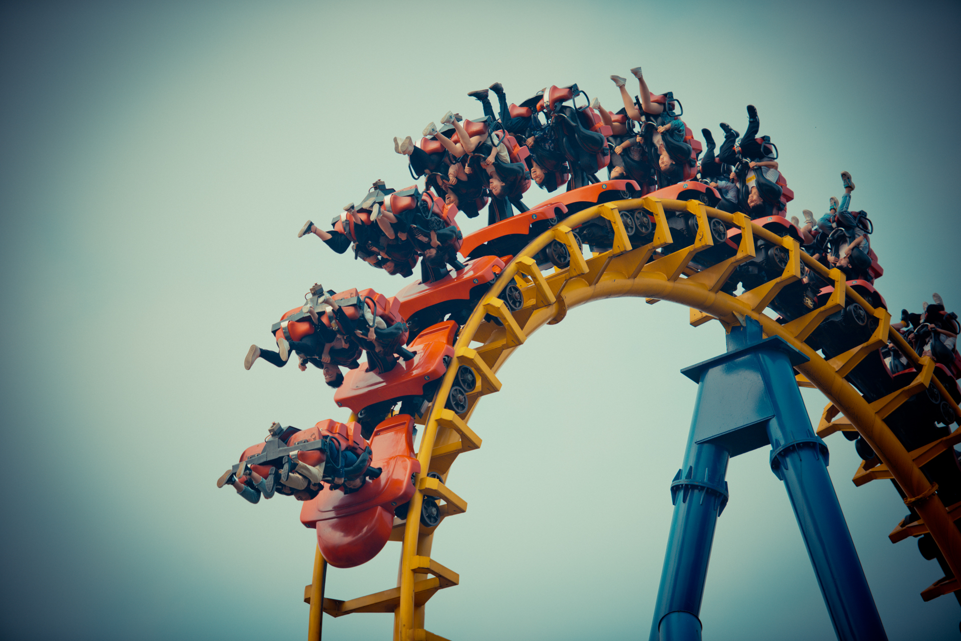
roller coaster
n.
1.（游乐场的）过山车，环滑车
a roller-coaster ride 乘坐过山车
2. 不断变化的局势
The last few weeks have been a real roller coaster.
过去的几个星期，形势真是变幻莫测。
I've been on an emotional roller coaster since I've been here.
自从我到这里以来，情绪像坐上了过山车。

Slide 42

incredible
adj. 不能相信的；难以置信的
The wildflowers will be incredible after this rain.
这场雨过后，野花将开得非常好。
I work an incredible amount of hours.
我工作的时间极长。
incredibly adv.
It was incredibly hard work.
那是个非常艰辛的工作。

Slide 43
appeal
n.
1. 吸引力；感染力；魅力
The Beatles have never really lost their appeal. 披头士乐队的感染力经久不衰。
The prospect of living in a city holds little appeal for me. 将要住在城市里对我没有什么吸引力。
2.启发；打动
I relied on an appeal to his finer feelings. 我寄望能打动他的爱心。
3. 呼吁，吁请，恳求
They made an emotional appeal for help. 他们情绪激动地恳求救助。
v. 上诉；申诉
He plans to appeal against his conviction. 他不服判决，准备上诉。

Slide 44

appeal to
1. 有吸引力
The design has to appeal to all ages and social groups. 设计得要雅俗共赏，老幼皆宜。
We need to appeal to a wider customer base. 我们需要吸引更广泛的客户。
2.启发；劝说；打动
They needed to appeal to his sense of justice. 他们需要激发他的正义感。

Slide 45

pirate
n. 海盗；盗版
a pirate ship 海盗船
v.盗印；窃用

Slide 46

adorable
adj. 可爱的；讨人喜爱的
There are so many adorable animals out there, but they all need a home.
外面有那么多可爱的动物，但它们都需要一个家。

Slide 47
wander
v.
1. 漫游；游荡；闲逛；徘徊；流浪；漂泊
She wandered aimlessly around the streets. 她在大街上漫无目的地到处游荡。 We wandered back towards the car. 我们溜达着回到汽车那里。
2. 偏离（正道）；走失；离散
The child wandered off and got lost. 那孩子走散后迷路了。
They had wandered from the path into the woods. 他们离开小路消失在树林里。
3.走神；神志恍惚；（思想）开小差
It’s easy to be distracted and let your attention wander . 很容易走神分散了注意力。Try not to let your mind wander . 尽量别让你的思想开小差。
Her thoughts wandered back to her youth. 她浮想联翩，思绪回到了青春岁月。

Slide 48

4. 目光慢慢地移开
His eyes wandered towards the photographs on the wall. 他的目光慢慢地移向墙上的照片。
She let her gaze wander . 她东瞅瞅西望望。
5.蜿蜒；迂回曲折
The road wanders along through the hills. 这条路蜿蜒曲折地穿过山丘。
n.游荡；溜达；闲逛；徘徊
I went to the park and had a wander around.
我去公园转了一圈。

Slide 49

amusement
amuse
n.
1. 可笑；愉悦；娱乐
She could not hide her amusement at the way he was dancing. 她见他跳舞的姿势，忍俊不禁。
To my amusement he couldn’t get the door open. 使我感到好笑的是，他竟然打不开门。
Her eyes twinkled with amusement . 她的眼睛闪耀着愉悦的光芒。
I stumbled sideways before landing flat on my back, much to the amusement of the rest of the guys. 我向侧面绊了一下，然后仰面摔倒了，这让其余人乐不可支。
2.消遣方式
People had very few amusements to choose from. There was no radio, or television. 那时人们可选择的消遣方式很少。没有收音机，也没有电视。
v. 使发笑
The thought seemed to amuse him. 这个想法好像让他觉得好笑。
It amused him to think that they were probably talking about him at that very moment. 想到就在这会儿他们大概正在谈论他，他不禁笑了起来。

Slide 50
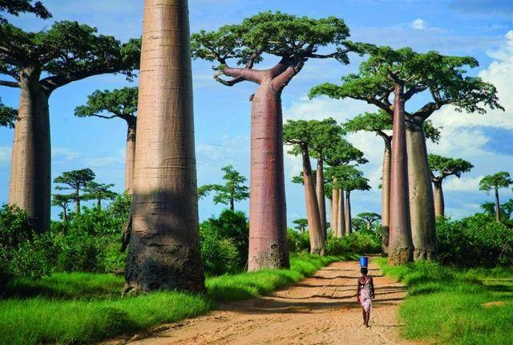
enormous
adj. 巨大的；庞大的；极大的
His death left an enormous gap in my life.
他去世给我的生活留下巨大的空白。
The problems facing the President are enormous.
总统面临的问题是巨大的。
She gets enormous pleasure out of working freelance.
她从事自由职业感受到极大的乐趣。
She recoiled in horror at the sight of an enormous spider.
看到一只巨大的蜘蛛，她吓得直退。

Slide 51

swing
v. swung, swung
1. （使）摆动，摇摆，摇荡
His arms swung as he walked. 他边走边摆着双臂。
As he pushed her, she swung higher and higher. 随着他推她，她在秋千上越荡越高。
2. 纵身跃向；荡向；悬吊到
He swung himself out of the car. 他纵身跳下车。
The gunshot sent monkeys swinging away through the trees.
枪声一响，猴子纷纷在树丛中飞跃荡走。
3.（使）弧线运动，转弯，转动
He swung his legs over the side of the bed.
他把两腿移过来放下床
The door swung open. 门开了。

Slide 52

4. （使）突然转向，突然转身
The bus swung sharply to the left. 公共汽车猛地拐向左边。
5. （挥动某物）朝…打去
She swung at me with the iron bar. 她挥着铁棍朝我打来。
He swung another punch in my direction. 他朝着我这边又挥了一拳。
6. （使）改变（意见、情绪等）
His emotions swung between fear and curiosity. 他时而害怕，时而好奇。
I managed to swing them round to my point of view.
我设法使他们转而接受了我的观点。
swing into action 立即行动起来；马上大干起来
I’ll swing by your house on the way home from work. (=drop by) 下班回家路过时我要到你家来一下。

Slide 53
n.
1. 摆动；挥动；转动；强劲节奏
He took a wild swing at the ball. 他对准球猛地挥拍一击。
2. 改变；改变的程度
He is liable to abrupt mood swings. 他的情绪易于大起大落。
3. 秋千
The kids were playing on the swings. 孩子们在荡秋千。
in full swing在热烈进行中；处于兴盛阶段
When we arrived the party was already in full swing. 我们赶到时，聚会已进入高潮。

Slide 54

iron
n. 铁
She had a will of iron (= it was very strong) . 她有钢铁般的意志。
v.（用熨斗）熨，烫平
I'll need to iron that dress before I can wear it. 我得先把那件连衣裙烫平再穿。
Damp clothes iron easily. 湿衣服容易熨平。

Slide 55
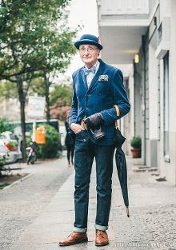
fashion
n. （衣服、发式等的）流行款式，时兴式样；时装业
Long skirts have come into fashion again. 长裙又时兴起来了。
Jeans are still in fashion. 牛仔裤仍然流行。
Some styles never go out of fashion. 有些款式永远不会过时。
His death rocked the fashion business. 他的死震惊了时装界。
I've never had much of an eye for fashion. 我对时装从来没多少鉴赏力。
v. （尤指用手工）制作，使成形，塑造
She fashioned a pot from the clay. 她用黏土制成一个罐。
adj. fashionable 时髦的

Slide 56
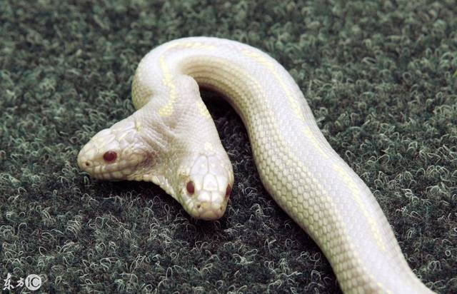
rare
adj. 稀少的；稀罕的 rarer, rarest
On the rare occasions when they met he hardly even dared speak to her.
彼此难得相见，他还几乎不敢跟她说话。
It was a rare honour to be made a fellow of the college.
成为这所学院的研究员是极大的荣誉。
Such a move is rare, but not unprecedented.
这样的举动少见，但并非从来没有过。

Slide 57
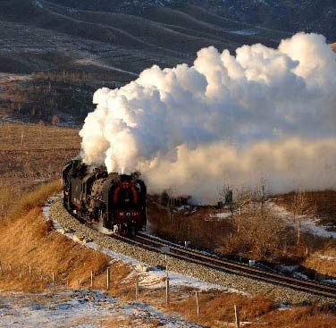
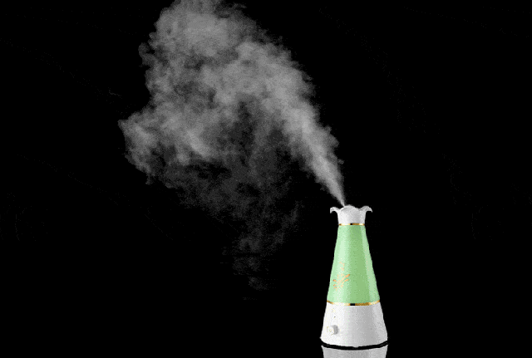
steam
n. 水蒸气；蒸汽
Steam rose from the boiling kettle.
壶里的水开了，冒着蒸汽。
She wiped the steam from her glasses.
她擦去眼镜上的水汽。
v. 快速行走；疾行
He spotted her steaming down the corridor towards him. 他看见她沿着走廊向他疾步走来。
full speed/steam ahead全速前进；全力
get up/pick up steam
1.声势逐渐强大；渐成气候；慢慢活跃起来
His election campaign is beginning to get up steam. 他的竞选活动逐渐形成声势。
2.逐渐提速

Slide 58

superb
adj. 极佳的；卓越的；质量极高的
His performance was absolutely superb. 他的表演精彩绝伦。
The car's in superb condition. 这辆车车况极好。

Slide 59
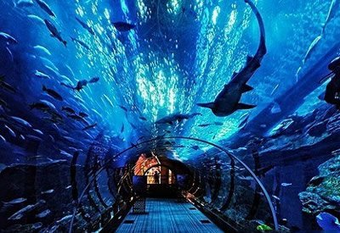
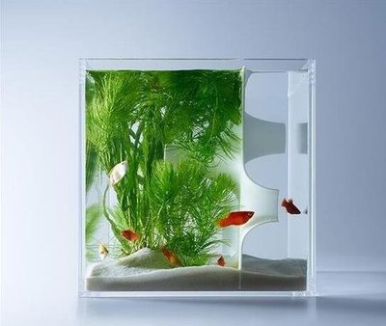
aquarium
n. 养鱼缸；水族馆

Slide 60
up to
1. 直到；达到；最多
He worked up to the last minute to finish the project.
他工作到最后一刻才完成了这个项目。
2. 取决于
It’s up to you.

Slide 61
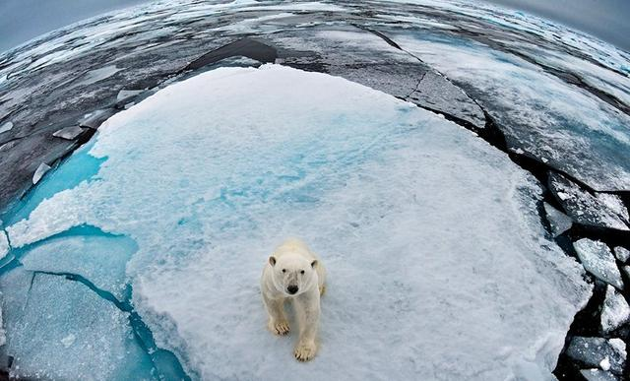
polar
adj.
1. 极地的
...the rigours of life in the polar regions.
…极地的艰苦生活。
There was a period of excessive warmth which melted some of the polar ice. 有段时期温度过高，融化了极地的部分冰层。
2. 正好相反的
The nomads’ lifestyle was the polar opposite of collectivization.
游牧民的生活方式同集体化的生活方式刚好相反。

Slide 62
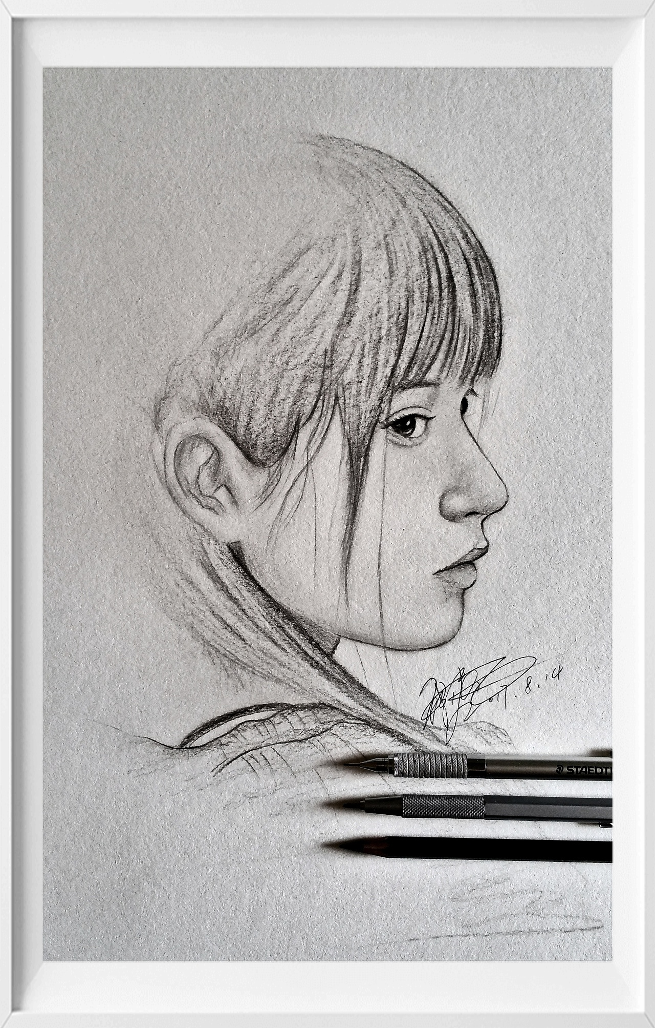
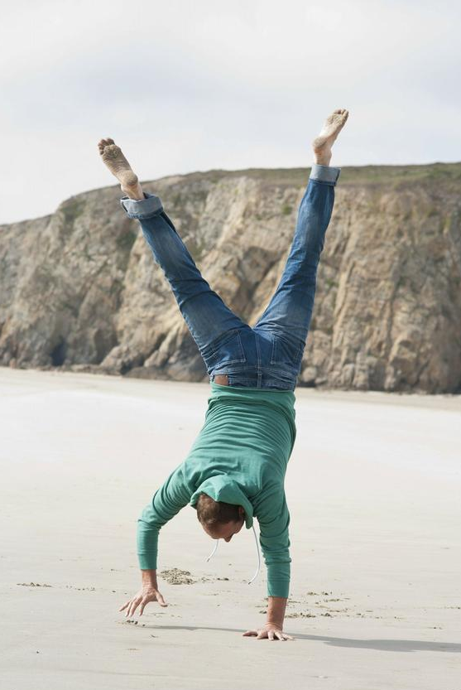
upside down
adv. 倒置地
The painting was hung upside down. 这幅画挂颠倒了。

Slide 63

splendid
adj. 极好的
The book includes a wealth of splendid photographs. 这本书有大量非常好的照片。

Slide 64
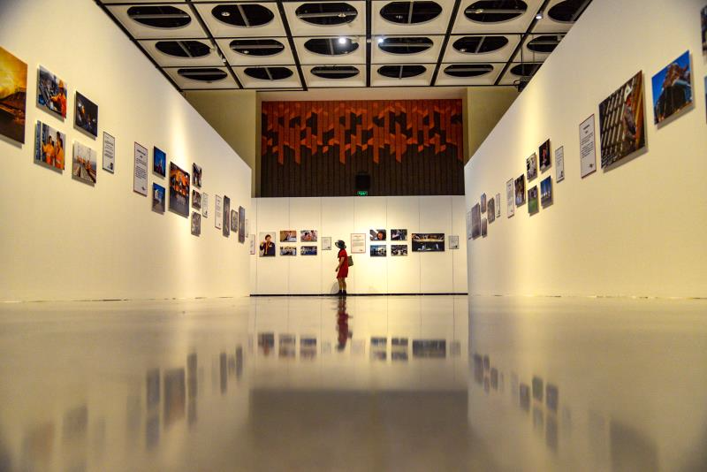
display
v.
1. 陈列；展出；展示= exhibit
The exhibition gives local artists an
opportunity to display their work.
这次展览为当地艺术家提供了展示自己作品的机会。
She displayed her bruises for all to see.
她将自己身上青一块紫一块的伤痕露出来给大家看。
2. 显示，显露，表现（特性或情感等）
I have rarely seen her display any sign of emotion. 我难得见到她将喜怒形于色。
n. 1. 陈列；展览 a display cabinet 陈列柜
2. 展示；表演a firework display 烟火表演
on display 陈列；展出= on show
Designs for the new sports hall are on display in the library. 新体育馆的设计图展示在图书馆里。

Slide 65
appetite
n.
1. 食欲；胃口
He suffered from headaches and loss of appetite . 他患有头痛和食欲不振。
The walk gave me a good appetite. 散步使我胃口大开。
Don't spoil your appetite by eating between meals. 不要在两餐之间吃东西，以免影响胃口。
The sandwich took the edge off my appetite. 这份三明治使我食欲大减。
Lili had clearly regained her appetite but Doran was disinterested in food. 莉莉已经明显恢复了食欲，但多兰对食物还是不感兴趣。
2. 强烈欲望
The public have an insatiable appetite for scandal. 公众对丑事总是喜闻乐道。
He spent a lot of money in satisfying the appetite for excitement and amusement.
他花了很多钱来满足他对刺激和娱乐的欲望。

Slide 66
entertainment
n. 娱乐片；文娱节目；表演会；娱乐活动
The newscast covers topical events and entertainment. 该新闻广播涉及时事和娱乐。
His death has left a void in the entertainment world that can never be filled.
他的去世在娱乐界留下了一个永远无法填补的空白。

Slide 67
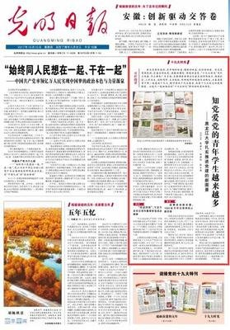
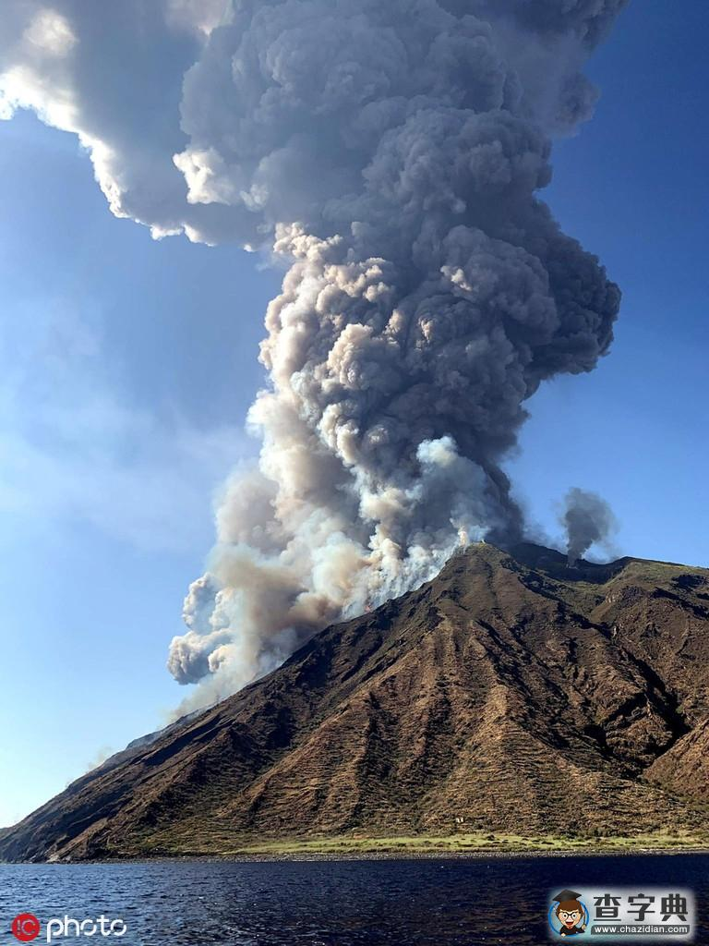
column
n.
1. (报刊的) 专栏
His name features frequently in the social columns of the tabloid
newspapers. 他的名字常常显著出现在通俗小报的社会专栏中。
2.纪念柱; 圆形支柱
Seven massive columns rise up from a marble floor. 七根巨大的圆柱从大理石地面拔地而起。
A dense column of smoke rose several miles into the air.
一柱浓烟升上几英里高的天空。

Slide 68
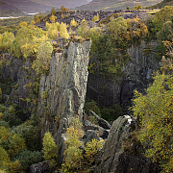
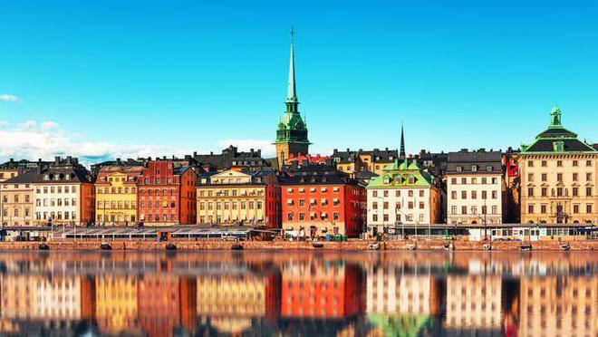

Sarek National Park
Sweden
the Arctic Circle
Siberian
萨勒克国家公园
瑞典
北极圈
n.西伯利亚人；西伯利亚语
adj.西伯利亚的；西伯利亚人的；西伯利亚人语的

