Slide 1



感恩遇见，相互成就，本课件资料仅供您个人参考、教学使用，严禁自行在网络传播，违者依知识产权法追究法律责任。
更多教学资源请关注
公众号：溯恩高中英语
知识产权声明

Slide 2
M4U4 教材词汇

Slide 3

interaction
n. 互动，交流；相互影响，相互作用
The two sides agreed to discuss ways of expanding cultural interaction, including exploring a China-US cultural year event and other activities. 双方同意讨论扩大文化交流的途径，包括探讨举办中美文化年及其他活动。

Slide 4

vary
v.（大小、形状等）相异，不同，有别
Tastes and preferences vary from individual to individual.
人的爱好和选择各不相同。
Topics you choose can vary from literature to health.
你可以选择文学或健康等不同的话题。
various adj. 各种不同的；各种各样的= diverse
There are various options open to you. 你有多种选择。
The bath oil comes in various fragrances. 这种沐浴油有不同的香味。
variety n. 多样化；种类 a great variety/ diversity of 各种各样的
There is a wide variety of patterns to choose from.
有种类繁多的图案可供选择。

Slide 5

appropriate
adj. 适当的
The book was written in a style appropriate to/ for the age of the children. 这本书的文体适合儿童阅读。
adv. appropriately

Slide 6

by contrast
相比之下
The new restaurant is bright and modern, by contrast, the old one looks outdated.
新餐厅明亮现代，相比之下，旧餐厅看起来过时了。
by comparison
相比之下
By comparison, expenditure on education increased last year.
相比之下，去年教育经费增加了。

Slide 7

approve
v.
1. vi. 赞成；同意 approve of sth. 反：disapprove of
She doesn’t approve of me leaving school this year.
她不同意我今年离校。
2. vt. 批准，通过（计划、要求等）
The committee unanimously approved the plan. 委员会一致通过了计划。
n. approval 反：disapproval
A roar of approval resounded through the legislature.
一片赞成声在议会中回响。
with/ without one’s approval 有/没有某人的同意
meet with one’s approval 得到某人的赞同

Slide 8
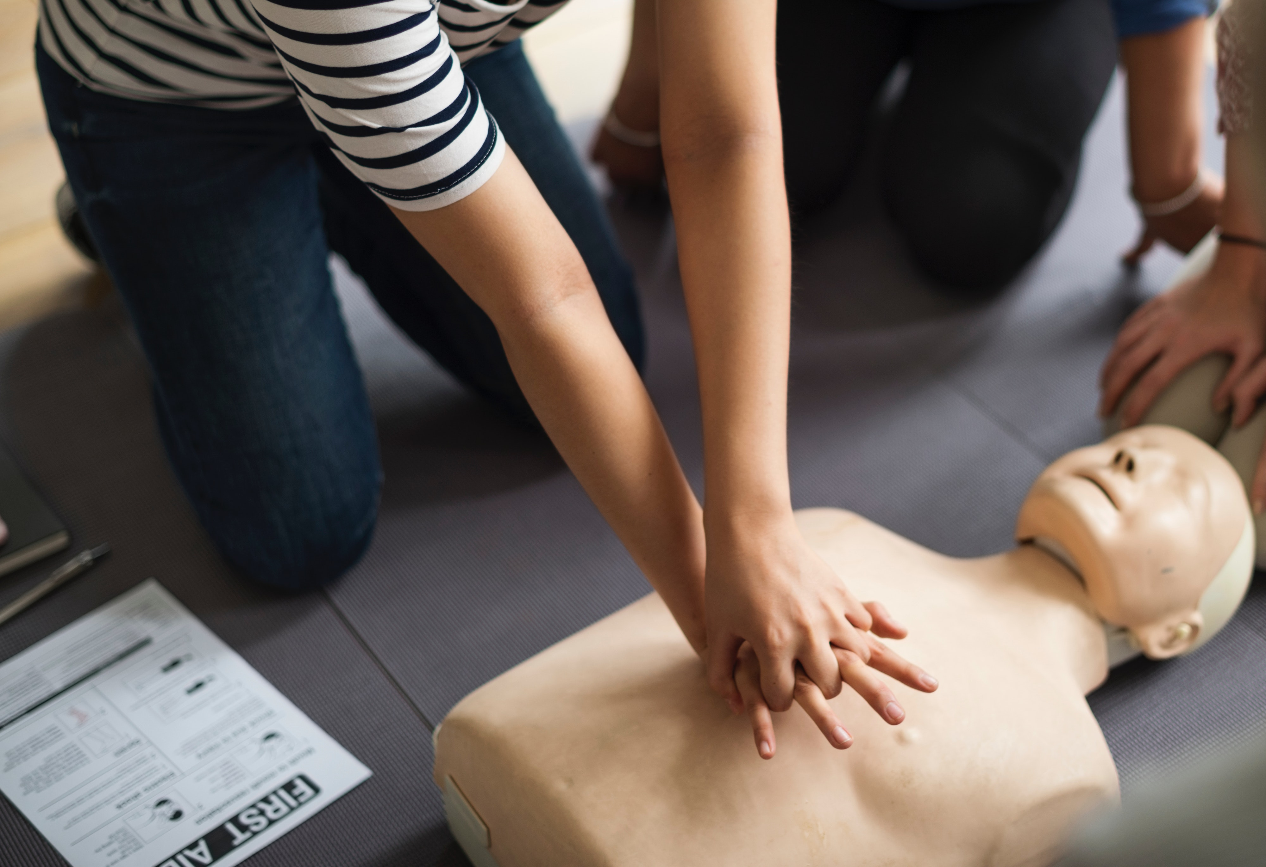
demonstrate
v.
1. 证明；证实；论证；说明
Let me demonstrate to you some of the difficulties we are facing.
我来向你说明一下我们面临的一些困难。
It has been demonstrated that this drug is effective.
这药已证实是有效的。
2. 示范；演示
Her job involves demonstrating new educational software.
她的工作包括演示新的教学软件。
3.展现 (才能、品质、感情)
Have they, for example, demonstrated a commitment to democracy?
例如，他们展现了对民主的奉献吗？

Slide 9
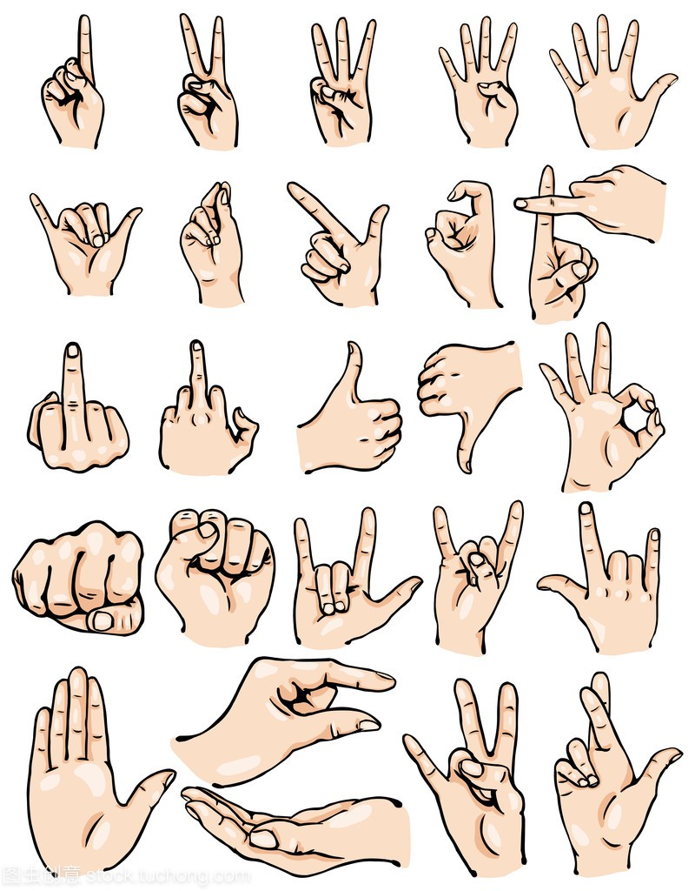
gesture
n.
1. 手势；姿势；示意动作
He made a rude gesture at the driver of the other car.
他向另外那辆汽车的司机做了个粗野的手势。
2.（表明感情或意图的）姿态，表示
They sent some flowers as a gesture of sympathy to the parents of the child.
他们送了一些花表示对孩子父母的同情。
We do not accept responsibility but we will refund the money as a gesture of goodwill .
我们不承担责任，不过我们愿意退款以表示我们的善意。
v.做手势；用手势表示；用动作示意
She gestured for them to come in. 她示意让他们进来。
They gestured that I should follow. 他们示意让我跟在后面。

Slide 10
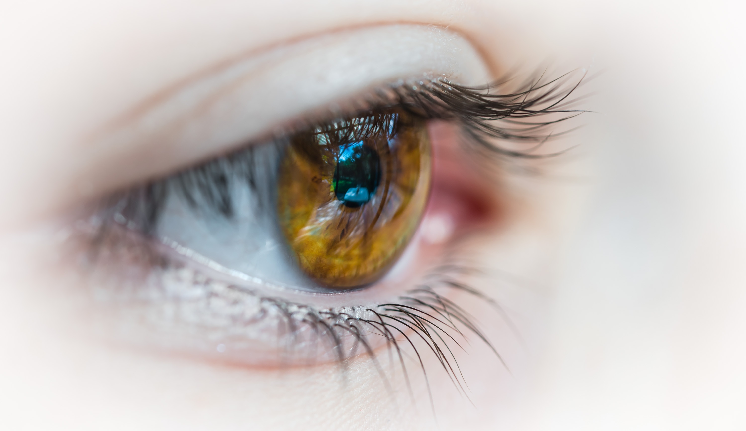
witness
n. 目击者；见证人；证人
He has been witness to a terrible murder. 他目击了一起残忍的凶杀事件。
His good health is a witness to the success of the treatment.
他身体健康证明这种疗法是成功的。
v.
India has witnessed many political changes in recent years.
印度近些年见证了许多政治变革。
The following hours witnessed her painting a bunch of flowers on the canvas.
接下来几个小时，她一直在画布上画一束花。

Slide 11
employ
v.
1. 雇佣
We'll have to check him out before we employ him.
我们得先调查一下再雇用他。
be employed in doing 从事于，忙于（做某事）
She was employed in making a list of all the jobs to be done.
她忙着把要做的所有工作列一个清单。
2. 应用；运用；使用
The police had to employ force to enter the building.
警察不得不强行进入大楼。
n. employment unemployment employer-employee

Slide 12

identical
adj.
1. 完全同样的；相同的
Her dress is almost identical to mine. 她的连衣裙和我的几乎一模一样。
My opinion is identical with his. 我的意见与他的观点相同。
2. 同一的
This is the identical room we stayed in last year.
这就是我们去年住的那个房间。

Slide 13
interpret
v.
1.诠释；说明
The students were asked to interpret the poem. 学生们被要求诠释那首诗的意义。
2. 把…理解为；领会
I didn't know whether to interpret her silence as acceptance or refusal. 我不知该把她的沉默看作是接受还是拒绝。
3. 口译
She couldn't speak much English so her children had to interpret for her. 她讲不了几句英语，所以她的孩子们得给她翻译。
4. 演绎（按自己的感觉演奏音乐或表现角色）
He interpreted the role with a lot of humour. 他把这个角色演得十分幽默。
n. interpretation interpreter

Slide 14
differ
v.
1. 相异；有区别；不同于
French differs from English in this respect.
=French and English differ in this respect. 在这方面法语和英语不同。
2. 意见相左；持不同看法；不同意
I have to differ with you on/ over/ about that.
在这一点上我不能同意你的看法。
That is where we differ.
那就是我们的分歧所在。
adj. different n. difference

Slide 15
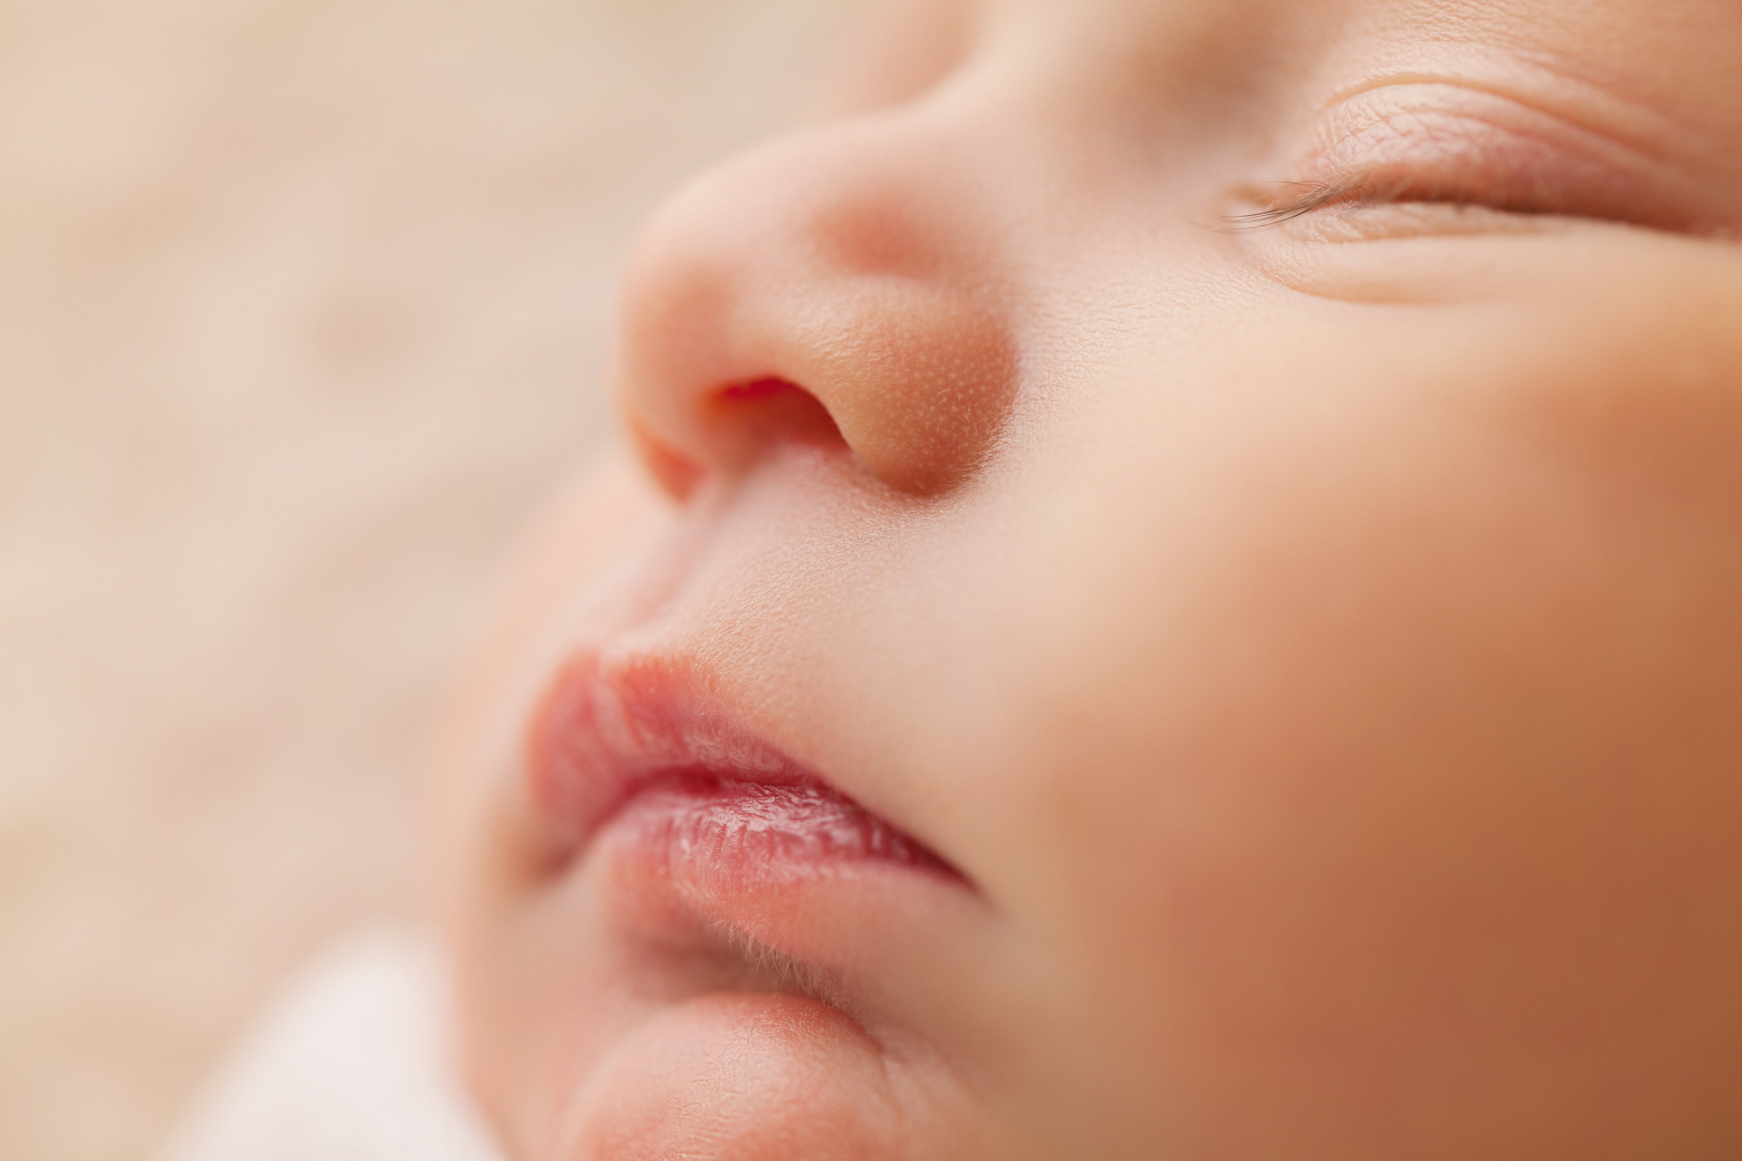
cheek
n.
1. 面颊；脸颊
chubby/rosy/pink cheeks 丰满的╱红润的╱粉红的脸颊
He kissed her on both cheeks. 他亲吻了她的双颊。
A tear traced/ trickled a path down her cheek.
一滴眼泪沿着她的面颊流了下来。
He pinched the baby's cheek playfully. 他捏着宝宝的脸颊逗着玩。
2. 厚脸皮
I’m amazed they had the cheek to ask in the first place.
我很吃惊，他们最初竟有脸问。

Slide 16

favour
n.
1. 帮助；好事；恩惠
Could you do me a favour and pick up Sam from school today?
今天你能帮我个忙去学校接萨姆吗？
2. 喜爱; 支持
It remains to be seen if the show will find favour with an audience.
这场演出是否将获得观众喜爱还要拭目以待。
Vt. 较喜欢；选择

Slide 17
do sb no favours 无助于某人；给某人留下坏印象
You’re not doing yourself any favours, working for nothing.
你干活不取报酬，对自己没有任何好处。
in favour (of sb./sth.)
1. 赞同；支持 He argued in favour of a strike. 他据理力争主张罢工。
2. 为获得（更好或更需要的事物）
He abandoned teaching in favour of a career as a musician. 他弃教从事音乐。
in sb’s favour
有利于某人；有助于某人
She was willing to bend the rules in Mary's favour. 她愿意放宽规定以有利于玛丽。

Slide 18

bow
v.
1. 鞠躬；点头
He bowed low to the assembled crowd. 他向集结的人群深深地鞠了一躬。
2. 低（头）；垂（首）
She bowed her head in shame. 她羞愧地低下了头。
They stood in silence with their heads bowed. 他们默默地垂头而立。
3. （使）弯曲
The pines bowed in the wind. 松树被风吹弯了。
Their backs were bowed under the weight of their packs. 沉重的背包压弯了他们的脊背。
4. bow to sth 屈从于
They finally bowed to pressure from the public. 他们终于在公众的压力下让步了。

Slide 19
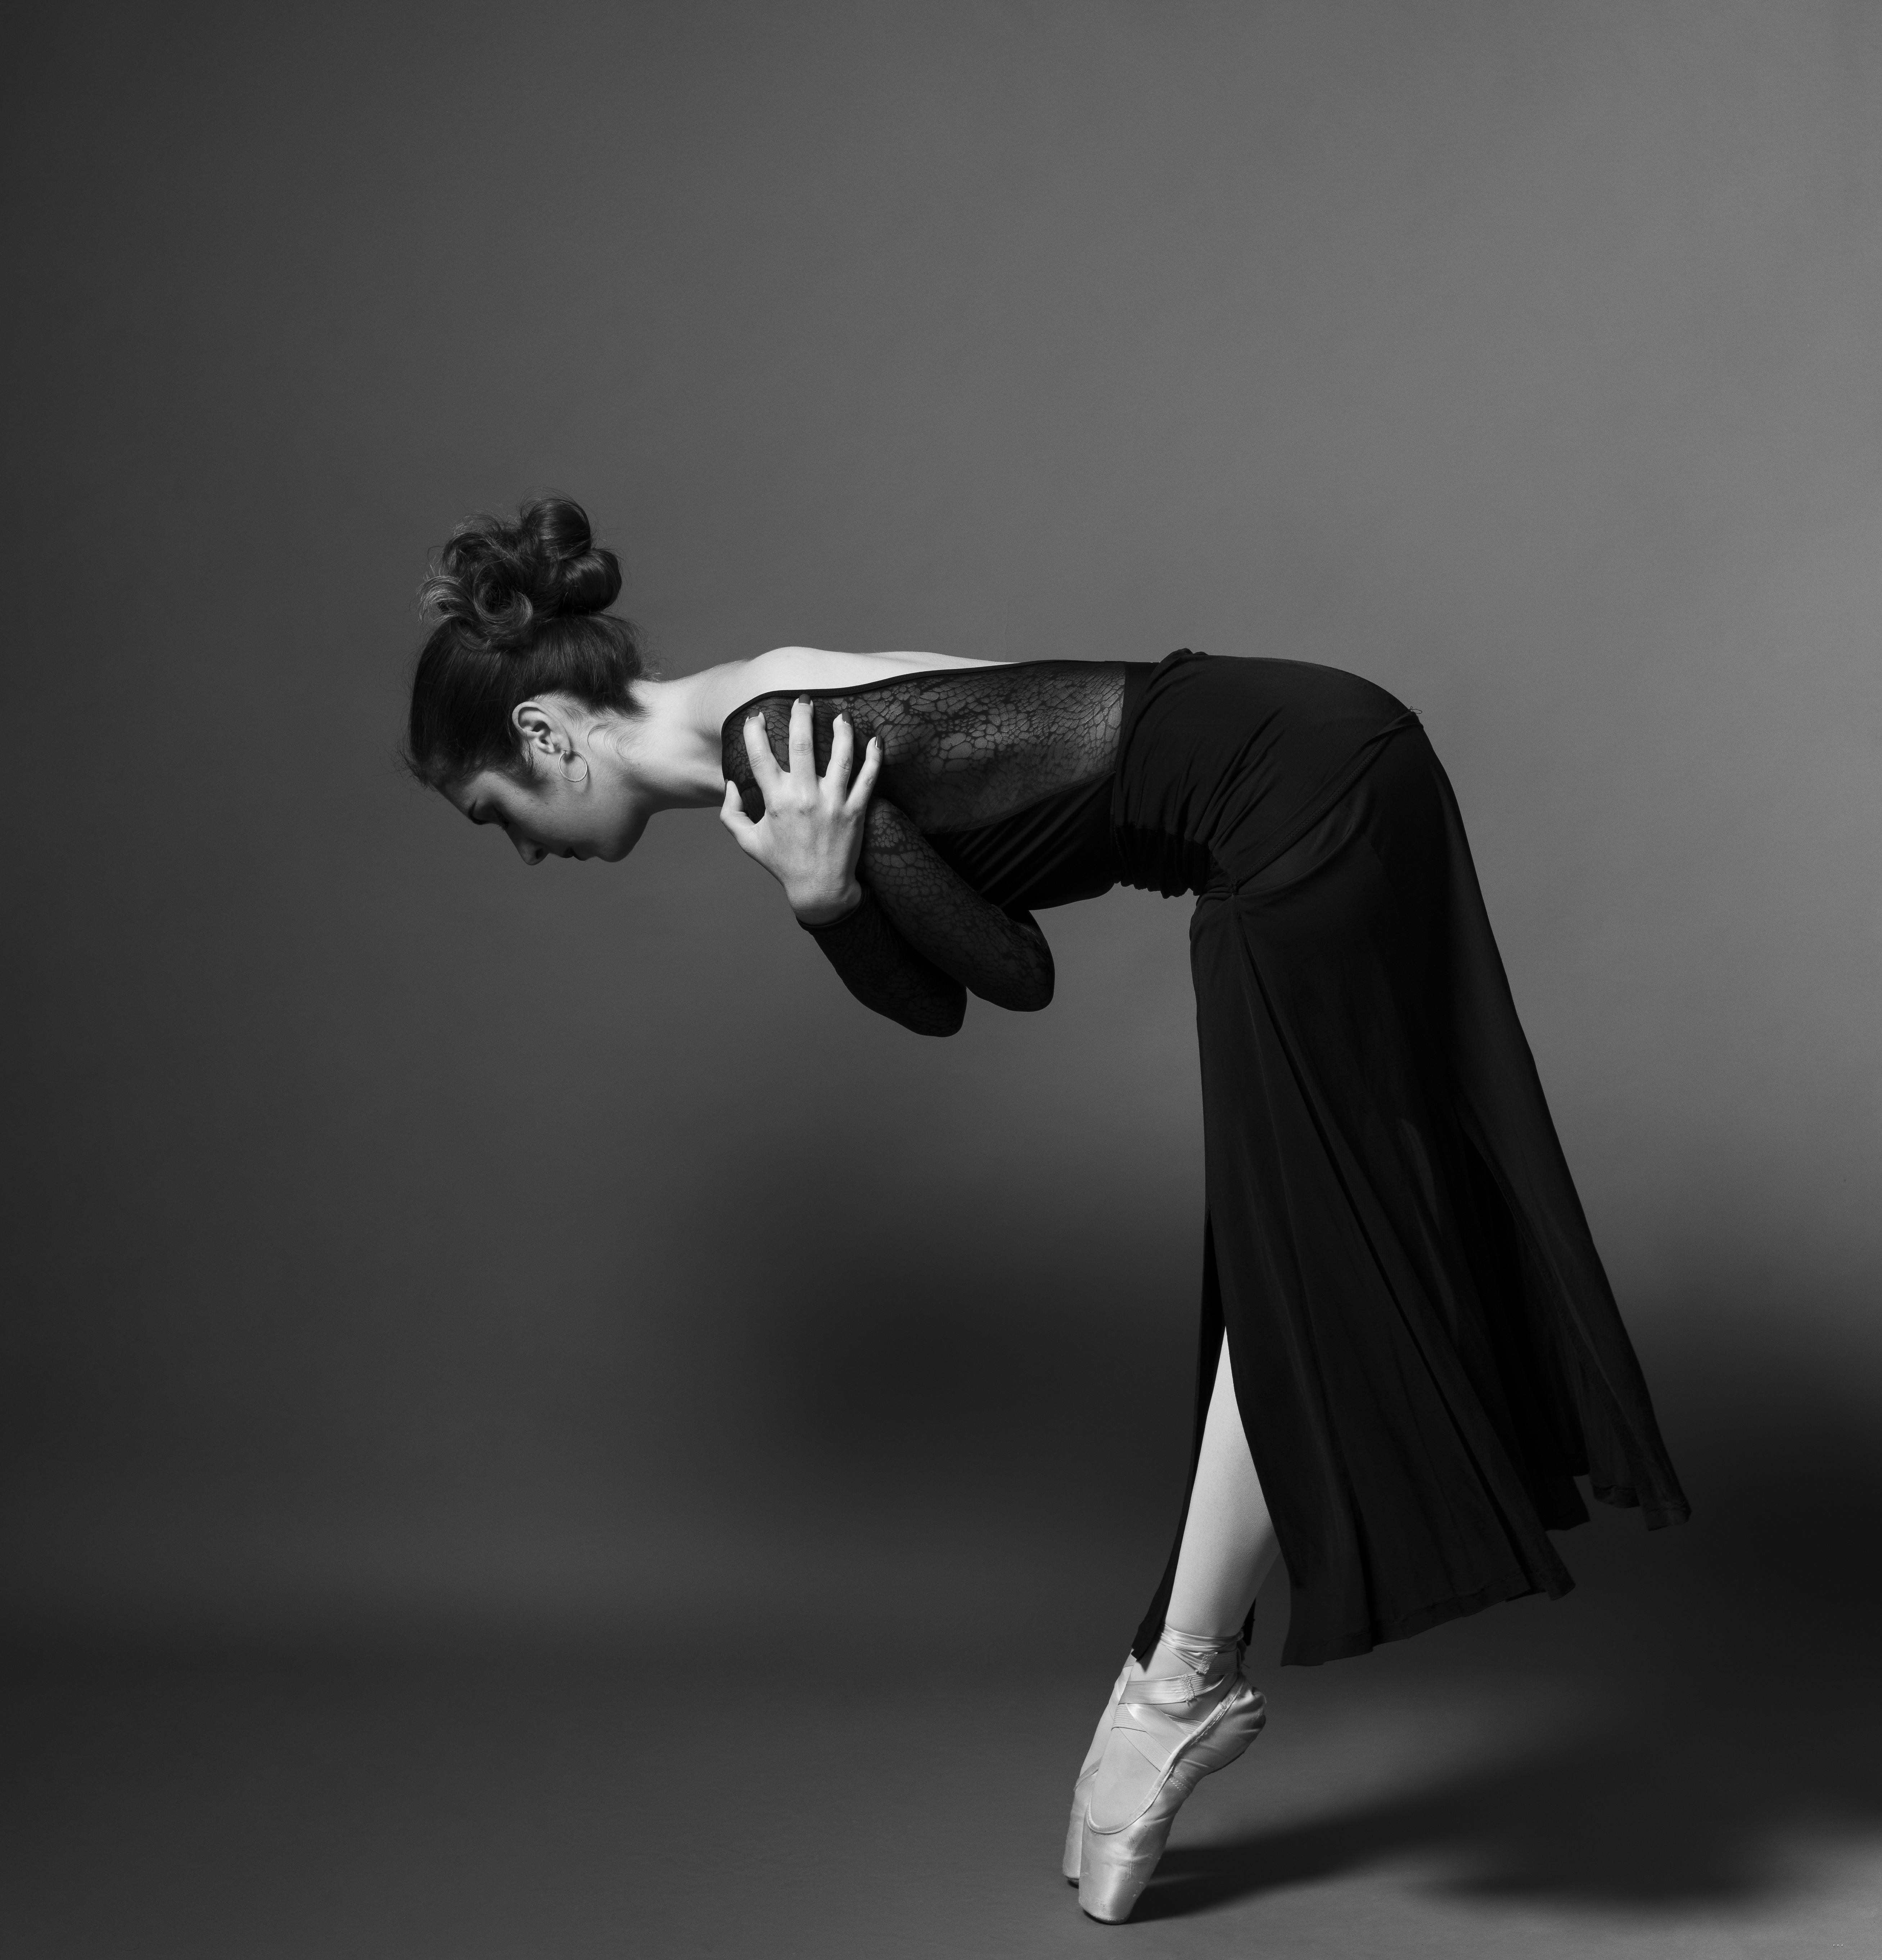
bow
n.
1. 鞠躬
I gave a theatrical bow and waved.
我夸张地鞠了一躬，然后挥了挥手。
2. 船头
The waves were about five feet high now, and the bow of the boat was leaping up and down.
浪头现在约有五英尺高，船头上下颠簸。
3. 蝴蝶结
Add a length of ribbon tied in a bow.加一段打成蝴蝶结的缎带。
4. 弓
Some of the raiders were armed with bows and arrows.有些偷袭者配备了弓箭。

Slide 20
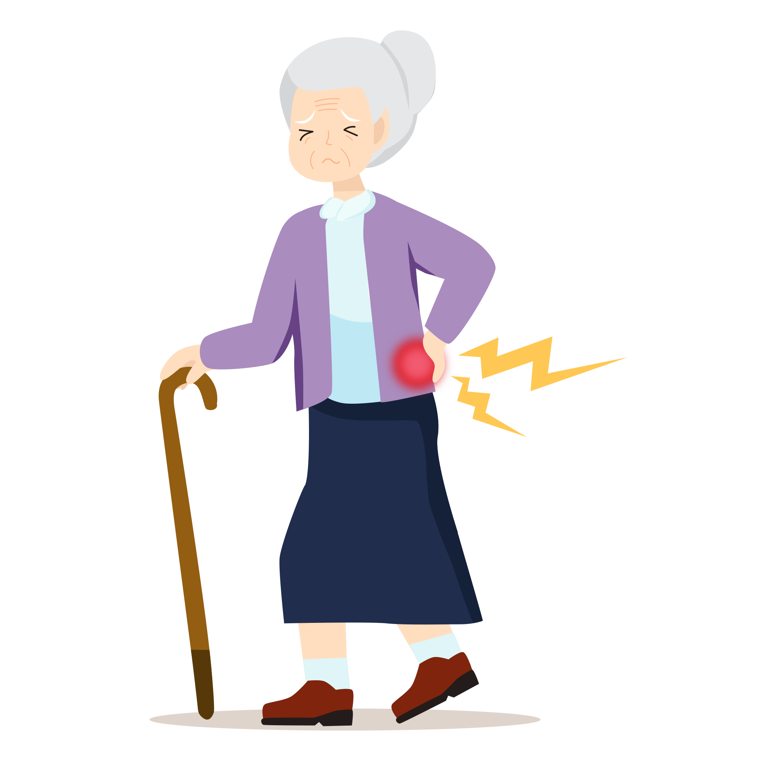
waist
n.
1. 腰；腰部
He put his arm around her waist. 他搂住了她的腰。
He tied the rope around his waist. 他把那条缆绳系在他的腰上。
2. (衣服的) 腰部
She tucked her thumbs into the waist of her trousers.
她把拇指插进裤腰里。

Slide 21

make inferences
推断：根据已知的信息和推理能力得出结论或判断。
Good readers make inferences based on the text they are reading.

Slide 22
break down
1. (机器、车辆等) 出故障
Their car broke down. 他们的车抛锚了。
2. (讨论、关系) 失败; (系统) 瘫痪
Talks with business leaders broke down last night. 与商界领导人的谈判于昨晚失败了。
3.(对观点、陈述等) 分门别类
The report breaks down the results region by region. 该报告将结果按地区一一分类。
4. 分解
Over time, the protein in the eggshell breaks down into its constituent amino acids.
随着时间的推移,蛋壳中的蛋白质分解成其构成成分氨基酸。
5.失控痛哭
Because he was being so kind and concerned, I broke down and cried.
因为他那时对我那般友善关心,我失控哭了起来。
6.砸倒 (门、障碍物)
An unruly mob broke down police barricades and stormed the courtroom.
一群无法无天的暴徒捣毁了警障冲进了法庭。
7.破除 (障碍、偏见等)
Women's sports are breaking down the barriers in previously male-dominated domains.
女子体育运动正在打破障碍进入一些先前由男子占主导地位的领域。

Slide 23


barrier
n.
1. 屏障；障碍物
The crowd had to stand behind barriers. 人群只好站在障碍物后面。
2. 障碍；阻力；关卡
Lack of confidence is a psychological barrier to success. 缺乏信心是阻碍成功的心理因素。
3.分界线；屏障；隔阂
The Yangtze river is a natural barrier to the north-east. 长江是东北方向的一道天然屏障。
There was no real barrier between reality and fantasy in his mind.
在他的头脑中，现实与幻想之间没有真正的界线。
the language barrier 语言隔阂（因语言不通而无法交流）

Slide 24

fake
adj.假的
He tried to fake sincerity as he smiled at them.
当他朝他们笑的时候，他设法假装真诚。
n. 假货；赝品
All the paintings proved to be fakes. 所有这些画结果证实都是赝品。
v. 假装，佯装，装出（某种感情、有病等）
She’s not really sick—she’s just faking it . 她并不是真的病了，不过是假装的。
He faked a yawn. 他装着打了一个呵欠

Slide 25
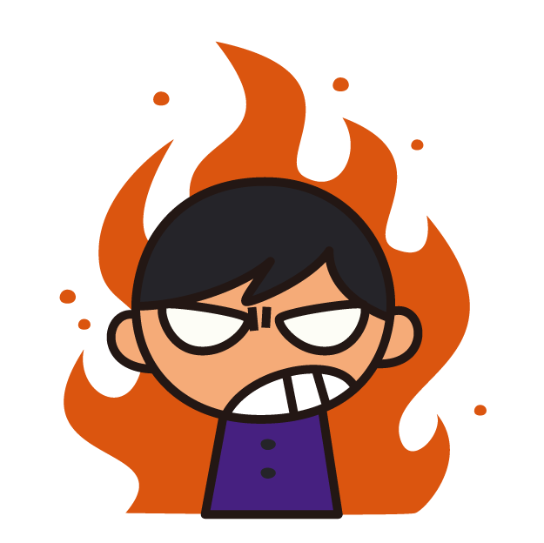
anger
n. 怒；怒火；怒气
He was filled with anger at the way he had been treated. 他因遭受如此待遇而怒火满腔。
Jan slammed her fist on the desk in anger. 简气愤地捶打桌子。
v. 使发怒；激怒
The question clearly angered him. 这个问题显然激怒了他
angry adj. 生气的

Slide 26
reliable
adj.
1.可信赖的；可依靠的
My car’s not as reliable as it used to be. 我的车不像过去那样靠得住了。
2. 真实可信的；可靠的
Our information comes from a reliable source. 我们的消息来源可靠。
reliability n.
The incident cast doubt on her motives and reliability.
这件事使人怀疑她有何动机，以及她是否可靠。

Slide 27
incident
n.
1. 发生的事情（尤指不寻常的或讨厌的）
One particular incident sticks in my mind. 有一件事我总忘不了。
2. 严重事件，暴力事件（如犯罪、事故、袭击等）
There was a shooting incident near here last night. 昨夜这附近发生了枪击事件。
The demonstration passed off without incident . 这次示威平静地结束了。

Slide 28

trial
n.
1.（法院的）审讯，审理，审判
a murder trial 谋杀案的审理
He's on trial for murder. 他因涉嫌谋杀罪而受审。
The men were arrested but not brought to trial . 这些人已被逮捕但并未送交法院审判。
2. 对能力、质量、性能等的）试验，试用
The new drug is undergoing clinical trials. 这种新药正在进行临床试验。
The system was introduced on a trial basis for one month. 这个制度已引进试行一个月。
a trial of strength (= a contest to see who is stronger) 实力的较量
3. 令人伤脑筋的事；惹麻烦的人；考验
the trials and tribulations of married life 婚姻生活的考验与磨炼
She was a sore trial to her family at times. 她有时让家人伤透了脑筋。
trial and error 反复试验；不断摸索
Children learn to use computer programs by trial and error .
儿童通过反复摸索才学会运用计算机程序。

Slide 29
slight
slightly
adj.
1. 轻微的；略微的
I woke up with a slight headache. 我醒来时有点头痛。
She takes offence at the slightest thing (= is very easily offended) . 她动辄生气。
There was not the slightest hint of trouble. 当时看不出丝毫会出现麻烦的迹象。
2.细小的；纤细的；瘦小的
a slight woman 瘦小的女子
3. 无须重视的；不足道的
This is a very slight novel. 这是一部颇不足道的小说。
not in the slightest=not at all 一点也不；毫不；根本没有
He didn’t seem to mind in the slightest. 他好像一点都不在乎。

Slide 30

twin
n. 孪生儿之一；双胞胎之一
She’s expecting twins. 她怀着双胞胎。
v. 使（两人或两事物）紧密结合；使耦合；使相连
The opera twins the themes of love and death.
这出歌剧把爱与死的主题紧密结合在一起。

Slide 31
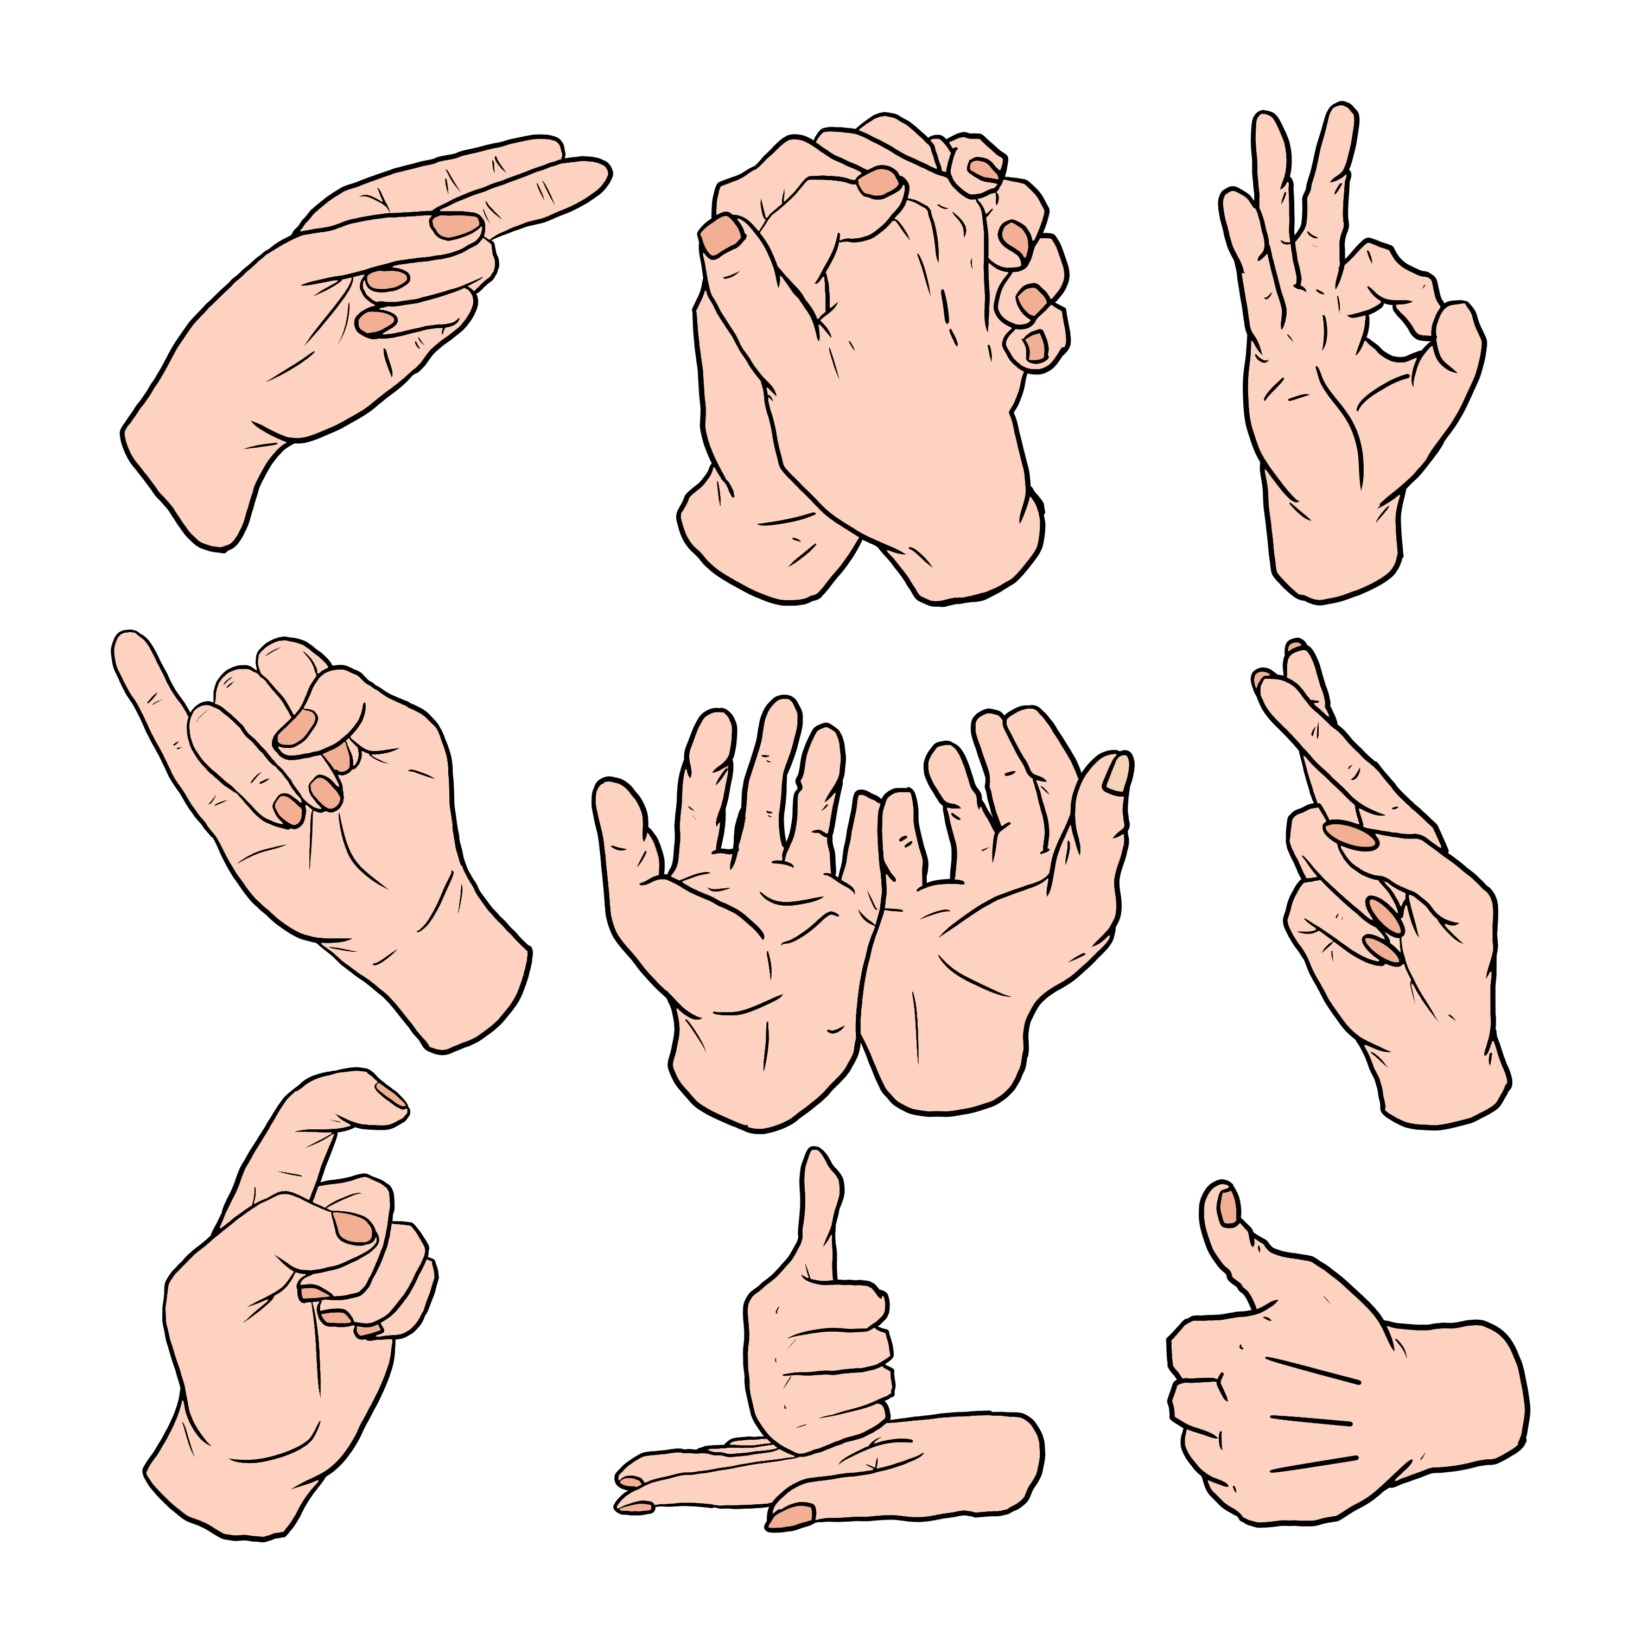
nonverbal
adj.
不使用语言的，非言语的；不能说话的

Slide 32

assessment
n. 评估
There is little assessment of the damage to the natural environment.
几乎没有有关自然环境破坏的评估。

Slide 33
internal
adj.
1. 国内的; 组织内部的
The country stepped up internal security.
该国加强了国内安全防卫。
He does not want to interfere in the internal affairs of another country.
他不想干涉他国的内部事务。
2. 体内的; 内部的
The doctor said the internal bleeding had been massive.
医生说内出血的量很大。

Slide 34
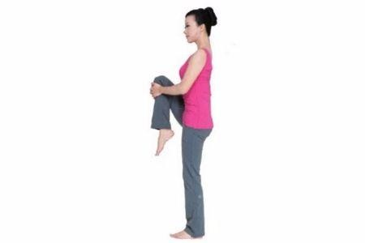
straighten up
1. This is my job, to straighten up, to file things.
这就是我的工作，整理东西，把东西归档。
2.I was able to straighten up with the huge pumpkin resting on my shoulders.
我站直身子，巨大的南瓜在我的肩膀上。

Slide 35

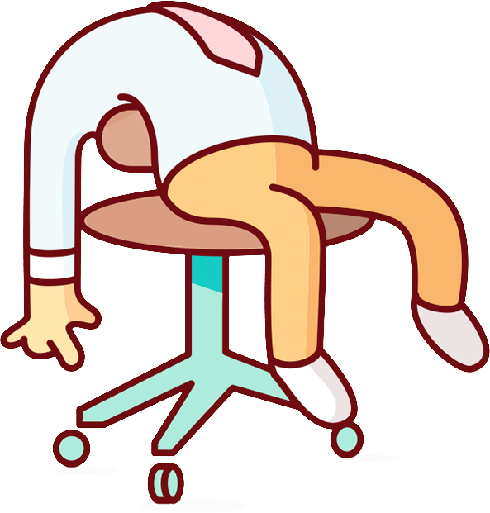
slump
v.
1. （价格、价值、数量等）骤降，猛跌，锐减= drop
Sales have slumped this year. 今年销售量锐减。
Profits slumped by over 50%. 利润突降50%以上。
2. 重重地坐下（或倒下）
The old man slumped down in his chair. 老先生一屁股跌坐到椅子上。
She slumped to her knees. 她扑通一声跪倒在地。
n.
1. 销售量、价格、价值等的）骤降，猛跌，锐减= decline
a slump in profits 利润锐减
2.萧条期；衰退
The toy industry is in a slump.

Slide 36
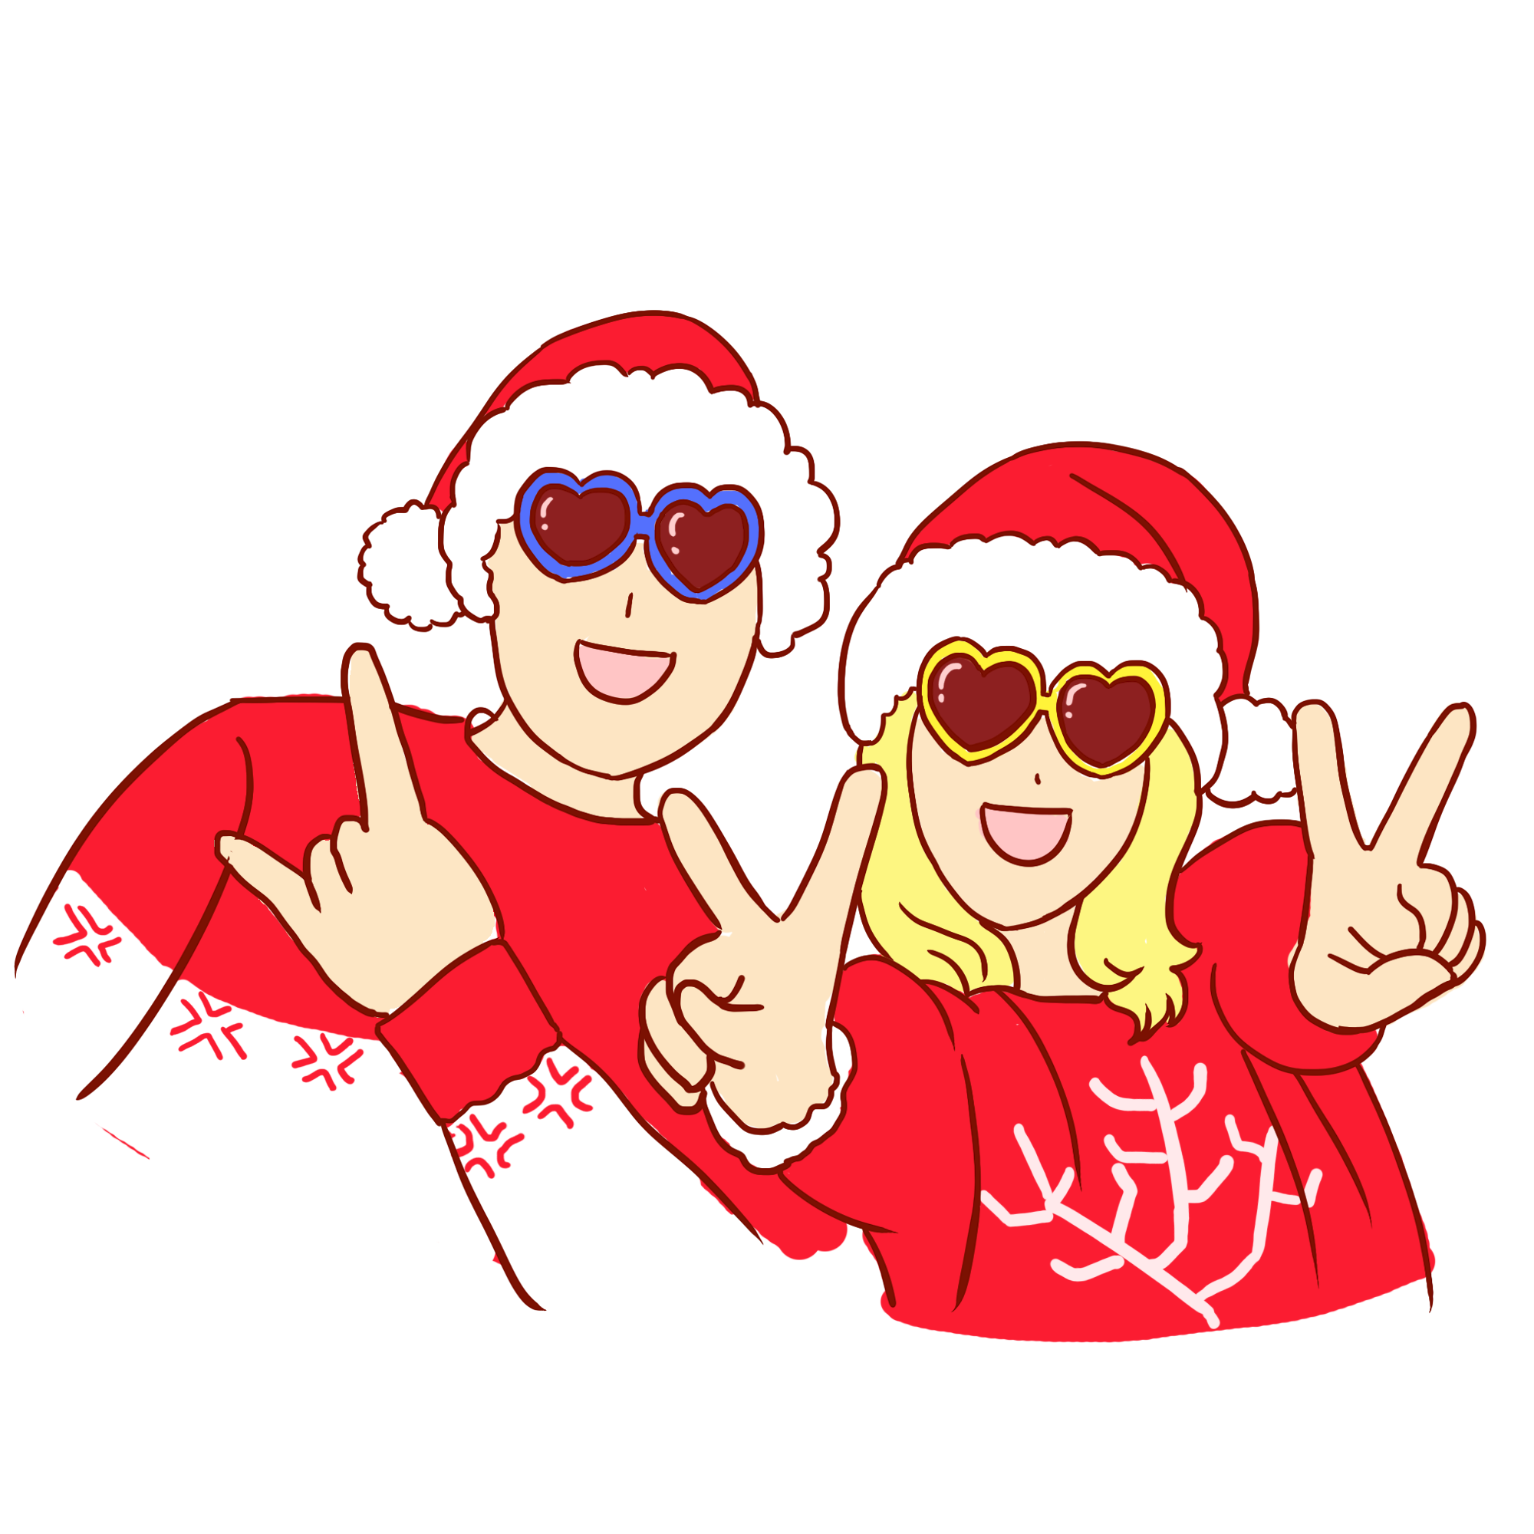
pose
v.
1.造成（威胁、问题等）；引起；产生
to pose a threat/challenge/danger/risk 构成威胁/挑战/危险/风险
The task poses no special problems. 这项任务不会造成特别的问题。
2. （为画像、摄影）摆好姿势
The delegates posed for a group photograph. 代表们摆好姿势准备拍集体照。
3. 佯装；冒充；假扮
The gang entered the building posing as workmen. 这伙匪徒冒充工人混进了大楼。
n.（为画像、拍照等摆的）姿势
He adopted a relaxed pose for the camera. 他摆了个悠闲的姿势拍照。

Slide 37
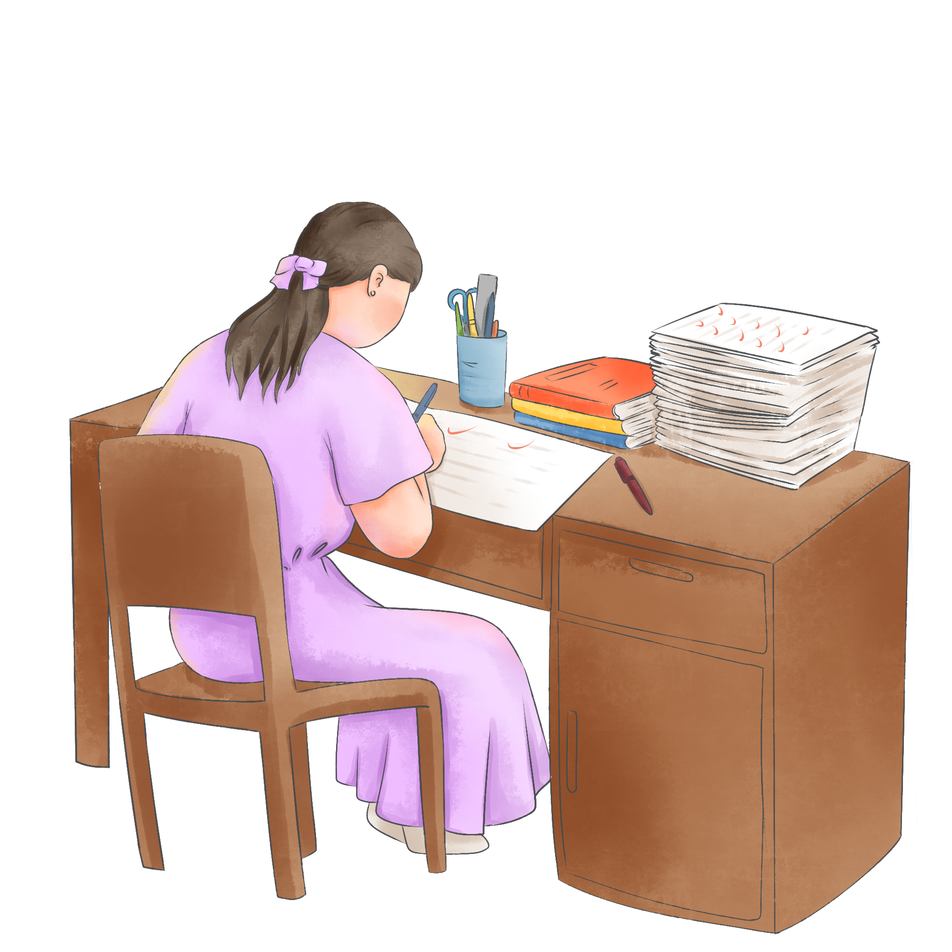
bend
v.1.（使）倾斜，偏向
He bent and kissed her. 他低下头吻了她。
She bent forward to pick up the newspaper. 她弯腰去捡报纸。
She was bent over her desk writing a letter. 她正伏案写信。
2.（使四肢等）弯曲
Bend your knees, keeping your back straight. 膝盖弯曲，背部挺直。
3. 把…弄弯（或折起）
He bent the wire into the shape of a square. 他把铁丝折成正方形。
4.（使）拐弯，弯曲
The road bent sharply to the right. 路向右急转弯。

Slide 38
1. bend sb’s ear (about sth)向某人唠叨诉说（尤指自己的难处）
2. bend your mind/efforts to sth 致力于某事；专心致志于
3. bend the truth 扭曲事理；歪曲事实
4. on bended knee(s)下跪（请求…）；央求；苦苦哀求
5. bend sb to sth迫使；说服
He manipulates people and tries to bend them to his will (= make them do what he wants) . 他能左右民众，让大家跟随他的意志。
6. round the bend/ twist疯狂
She’s gone completely round the bend. 她完全疯了。
The children have been driving me round the bend today (= annoying me very much) . 孩子们今天快把我气疯了。

Slide 39

reveal
v. 1. 揭示；显示；透露=disclose
to reveal a secret 泄露一条秘密
The report reveals (that) the company made a loss of ￡20 million last year.
报告显示，公司去年亏损2 000万英镑。
It was revealed that important evidence had been suppressed.
据透露，重要的证据被隐瞒了。
Officers could not reveal how he died. 警察们不能透露他的死因。
2. 显出；露出；展示= display
He laughed, revealing a line of white teeth. 他笑了起来，露出一排洁白的牙齿。
The door opened to reveal a cosy little room.
房门打开，一间温暖舒适的小屋展现在眼前。
She crouched in the dark, too frightened to reveal herself.
她蜷缩在黑暗中，吓得不敢露面。

Slide 40
clarify
v.
1. 使更清晰易懂；阐明；澄清
to clarify a situation/problem/issue 澄清情况/问题
I hope this clarifies my position. 我希望这能阐明我的立场。
She asked him to clarify what he meant. 她要他说清楚他是什么意思。
2.（尤指通过加热使黄油）纯净，净化
clarified butter 已净化的黄油
clarification n. 澄清，阐明；净化
I am seeking clarification of the regulations. 我正在努力弄清楚这些规则。

Slide 41
in other words
He didn’t want to go to the party, in other words, he wasn’t interested.
他不想去参加派对，换句话说，他对此不感兴趣。

Slide 42
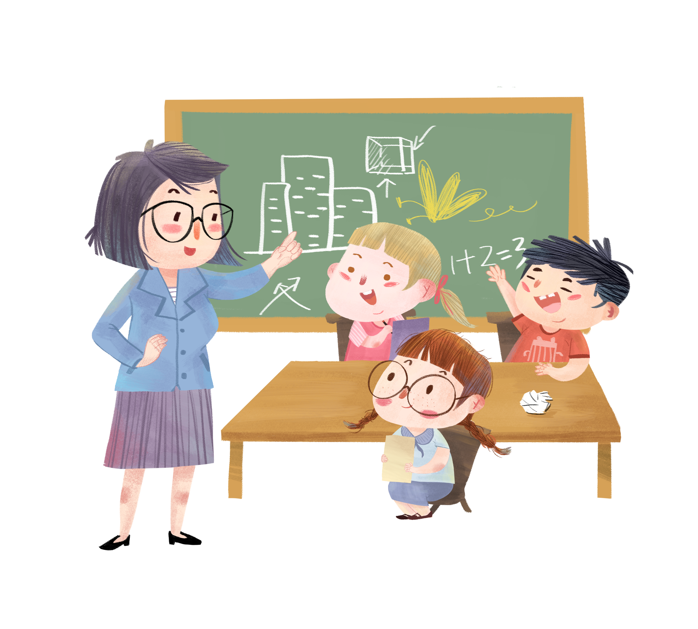
educator
n. 教育工作者；教师

Slide 43
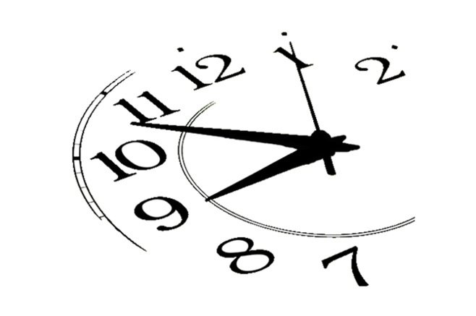
tick
v. 1. 发出滴答声；滴答地走时
In the silence we could hear the clock ticking.
寂静中，我们能听到钟表滴答作响。
While we waited the taxi's meter kept ticking away.
我们等候时，出租汽车的计程器一直在滴答滴答地走着。
2. 标记号；打上钩；打对号
Please tick the appropriate box. 请在适合的方框内打钩。
tick all the/ sb’s boxes 投其所好；迎合众人╱某人的喜好
This is a movie that ticks all the boxes. 这是一部适合众人口味的影片。
what makes sb tick使某人这样做的原因
I’ve never really understood what makes her tick. 我从未真正弄懂她为什么这么做。
tick away/ by/ past (时间)
I had to get to the airport by two, and the minutes were ticking away. 我必须在两点前赶到机场，但是时间一分一秒地过去了。
tick sth away (钟表等) 标示时间流逝
The clock ticked away the minutes. 钟表显示时间一分一秒地过去。

Slide 44

tendency
n.
1. 倾向；偏好；性情
I have a tendency to talk too much when I’m nervous. 我紧张时总爱唠叨。
There is a tendency for this disease to run in families. 这种疾病易在家族里遗传。
She has a strong natural tendency towards caution. 她天生非常小心谨慎。
2.趋势；趋向= trend
There is a growing tendency among employers to hire casual staff. 雇主雇用临时职员有增加的趋势。

Slide 45
lower
adj. 反义词 upper
1.（尤指位于同类物品或成对物品中另一个的）下面的，下方的
His lower lip trembled. 他的下唇在颤抖。
2.在底部的；近底部的 the mountain's lower slopes 山麓斜坡
v
1.把…放低；使…降下=raise
He had to lower his head to get through the door. 他得低头才能过这道门。
She lowered her newspaper and looked around. 她放低报纸往四下看了看。
They lowered him down the cliff on a rope. 他们用绳索把他放下悬崖。
2.减少；缩小；降低
He lowered his voice to a whisper. 他压低了声音悄悄地说。
Her voice lowered as she spoke. 她一边说一边压低了嗓音。
This drug is used to lower blood pressure. 这种药用于降血压。
1. lower yourself (by doing sth)
( 通常用于否定句 ) 降低自己的身份；自贬人格
I wouldn’t lower myself by working for him. 我不会贬低自己的身份去为他工作。

Slide 46
imply
v.
1. 含有…的意思；暗示；暗指
Are you implying (that) I am wrong? 你的意思是不是说我错了？
I disliked the implied criticism in his voice. 我讨厌他暗中批评的口吻。
2.说明；表明=suggest
The survey implies (that) more people are moving house than was thought.
调查显示，准备搬家的人口比想象的要多。
The fact that she was here implies a degree of interest.
她到场就说明了她有一定程度的兴趣。
3.( 思想、行为等 ) 必然包含；使有必要=mean
The project implies an enormous investment in training.
这个项目需要在培训方面做巨大的投资。
n. implication

Slide 47
barely
adv.
1. 仅仅；刚刚；勉强可能
The music was barely audible. 音乐声勉强能听见。
She was barely able to stand. 她勉强能站立。
We barely had time to catch the train. 我们差点没赶上火车。
2.几乎不；几乎没有
She barely acknowledged his presence. 她只略微向他打了个招呼。
There was barely any smell. 几乎没有什么气味。
3. 刚好；不超过（某个数量、年龄、时间等）
They arrived barely a minute later. 过了不到一分钟他们就到了。
4. 刚才；刚刚
I had barely started speaking when he interrupted me.
我刚刚开始讲话，他便打断了我。

Slide 48

chin
颏；下巴 n.
1. (keep your) chin up 振作起来；不气馁；不灰心
Chin up! Only two exams left. 别泄气！只剩下两门考试了。
2. take sth. on the chin （无怨无悔地）承受某事

Slide 49
occupy
v.
1.使用，占用（空间、面积、时间等）=take up
The bed seemed to occupy most of the room. 床似乎占去了大半个屋子。
Administrative work occupies half of my time. 行政事务占用了我一半的时间。
2.使用（房屋、建筑）；居住
He occupies an office on the 12th floor. 他在12楼有一间办公室。
3.侵占；占领；占据
The capital has been occupied by the rebel army. 叛军已占领了首都。
4.使忙于（做某事）；忙着（做某事）
She occupied herself with routine office tasks. 她忙于办公室的日常工作。
Problems at work continued to occupy his mind for some time.
工作上的问题继续在他的脑海中萦绕了一段时间。
5.任职；执政=hold
The president occupies the position for four years. 总统任期四年。
n. occupation

Slide 50
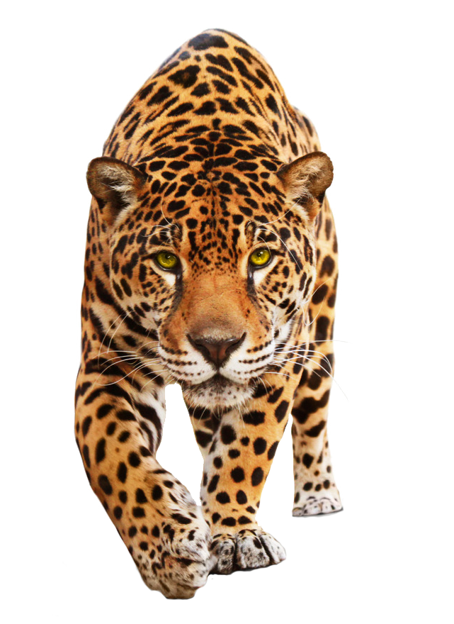
stare
v. 盯着看；凝视；注视
I stared blankly at the paper in front of me. 我茫然地看着面前这张纸。
He sat staring into space (= looking at nothing) . 他坐在那儿凝视着前方。
She looked at them with dark staring eyes. 她那双深色的眼睛专注地看着他们。
n. （尤指不友好或吃惊的）盯，凝视，注视
She gave him a blank stare. 她面无表情地直视着他。

Slide 51
ceiling
n.
1.天花板
The rooms were spacious, with tall windows and high ceilings.
房间很宽敞，且窗户和屋顶都很高。
He hit his head on the low ceiling. 他的头碰了低矮的天花板。
A lamp was suspended from the ceiling. 一盏吊灯悬在天花板上。
2.(价格、工资等的) 上限
...an informal agreement to put a ceiling on salaries.
…一项规定工资上限的非正式协议。

Slide 52
distract
v. 分散 (注意力); 使分心
Tom admits that playing video games sometimes distracts him from his homework.
汤姆承认玩电子游戏有时让他做家庭作业时分心。
There was nothing at all in this miserable place to distract him.
在这个令人忧伤的地方，根本没什么东西可以转移他的注意力。

Slide 53
perceive
v.
1. 感知到
Students must perceive for themselves the relationship between success and effort.
学生们必须自己去认识到成功与努力之间的关系。
Voters perceive him as a decisive and resolute international leader.
选民认识到他是一位果断、坚定的国际领袖。
2.认为
Stress is widely perceived as contributing to coronary heart disease.
压力普遍被认为能造成冠心病。

Slide 54
distinguish
v.
1. 辨别; 区分
Could he distinguish right from wrong?
他能辨别是非吗？
2.有别于
There is something about music that distinguishes it from all other art forms.
音乐中一些因素使之有别于其他艺术形式。
3. 辨别出
There were cries, calls. He could distinguish voices.
有各种各样的哭声和叫喊声。他能从中分辨出声音。
4.使著名
Over the next few years he distinguished himself as a leading constitutional scholar.
在随后的几年中，他作为宪法学的权威学者而享有盛誉。

Slide 55
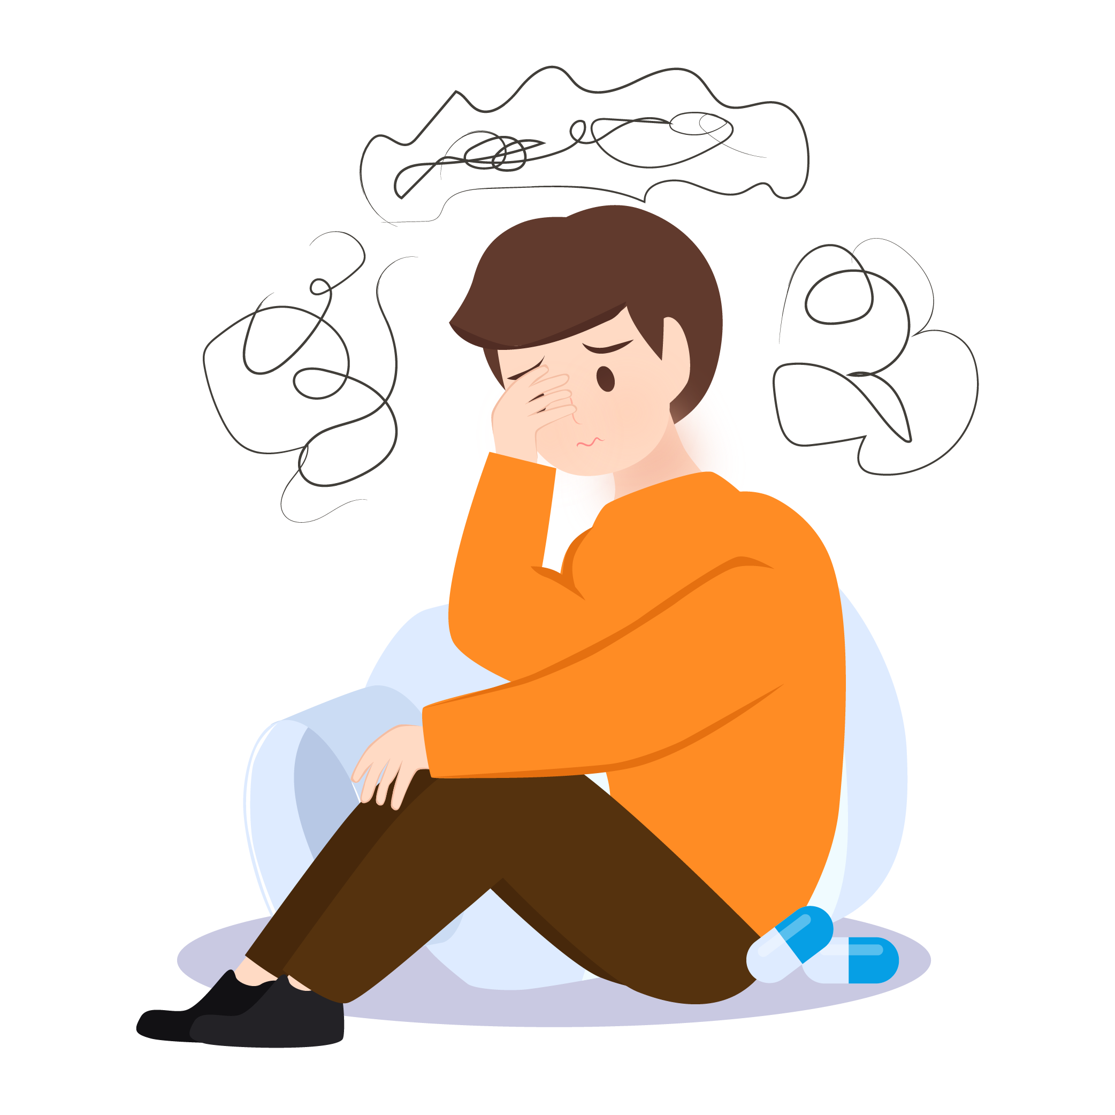
anxiety
n. 焦虑
Her voice was full of anxiety. 她的声音饱含焦虑。
At that moment she felt the first twitch of anxiety.
那一刻她第一次感到一阵焦虑。

Slide 56
chest
n.
1.胸部
He crossed his arms over his chest.他在胸前交叉双臂。
He was shot in the chest. 他胸部中弹。
The pain stabbed at his chest. 他胸部疼得像刀扎似的。
The water came up to my chest. 水漫到了我的胸部。
2.储物箱
At the very bottom of the chest were his carving tools.
在储物箱的最底部有他的雕刻工具。

Slide 57
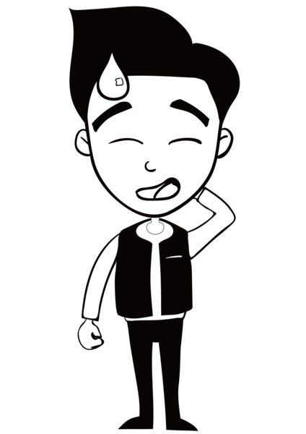
embarrassed
adj. 尴尬的
He looked a bit embarrassed. 他看上去有点尴尬。
She felt embarrassed under his steady gaze. 她在他凝视的目光下感到很尴尬。

Slide 58
ashamed
adj. 尴尬的; 惭愧的
I felt incredibly ashamed of myself for getting so angry.
我为自己发了这么大的脾气而感到极为惭愧。
He felt so embarrassed and ashamed that he turned quickly, plunged into the sea, and disappeared.
他感到又尴尬又羞愧，赶紧转身跳进海里，消失了。

Slide 59
merely
adv.
1. 只不过 (用来强调某事物不是很重要或很有价值)
Michael is now merely a good friend. 迈克尔现在只不过是一个好朋友而已。
Francis Watson was far from being merely a furniture expert.
弗兰西斯·沃森不仅仅是位家具专家。
2. 仅仅 (用来强调数量之少)
The brain accounts for merely three percent of body weight. 大脑仅占体重的3％。
not merely 不仅仅
The team needs players who want to play for Canada, not merely any country that will have them.
这个队需要愿意为加拿大比赛的运动员，而不仅仅是愿意为任何一个雇用他们的国家去比赛的运动员。

Slide 60
call on
1. 呼吁; 公开请求
One of Kenya’s leading churchmen has called on the government to resign.
肯尼亚宗教界的一位重要人物已呼吁政府下台。
2.短暂访问
Sofia was intending to call on Miss Kitts.
索菲娅打算去拜访基茨小姐。

Slide 61
bother
v. 1.( 常用于否定句和疑问句 ) 花费时间精力（做某事）
‘Shall I wait?’ ‘No, don't bother’. “要我等一下吗？”“不，别费事了。”
It's not worth bothering with (= using) an umbrella—the car's just outside.
不必打伞—汽车就停在外面。
I don't know why I bother! Nobody ever listens! 我不知道我干吗要浪费时间！根本没人听！
He didn't even bother to let me know he was coming. 他甚至连通知都没通知我他要来。
Why bother asking if you're not really interested? 如果你不是真的感兴趣，干吗费口舌打听呢？
2.使（某人）烦恼（或担忧、不安）；给（某人）造成麻烦（或痛苦）
The thing that bothers me is... 让我感到不安的是…
That sprained ankle is still bothering her (= hurting) . 她那扭伤的脚踝还在隐隐作痛。
3.打扰；搭话烦扰
Sorry to bother you, but there's a call for you on line two. 很抱歉打扰你一下，二号线有你的电话。
n. 令人烦恼的情况（或事物、人）=nuisance
I hope I haven't been a bother. 希望我没烦扰你。

Slide 62
weep
v.
1.（通常因悲伤）哭泣，流泪
She started to weep uncontrollably. 她不由自主地哭了起来。
He wept for joy. 他高兴得流泪了。
I do not weep over his death. 他死了我也不哭。
I could have wept thinking about what I'd missed. 想到所失去的东西，我真想痛哭一场。
She wept bitter tears of disappointment. 她失望得痛哭流涕。
I wept to see him looking so sick. 看到他病成那个样子我怆然泪下。
2. ( 伤口 )流出，渗出（液体）
His legs were covered with weeping sores (= sores which had not healed) . 他的双腿有多处红肿流脓的伤口。

Slide 63
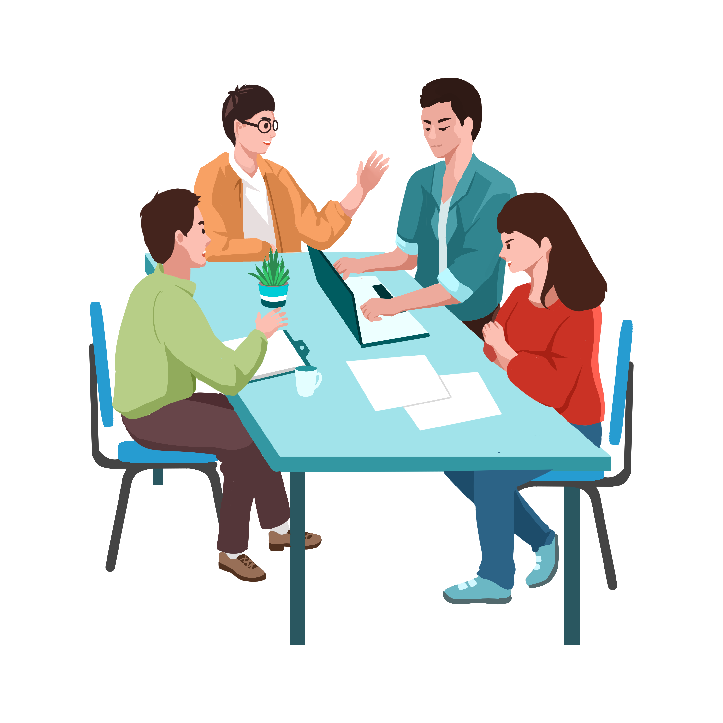
at work
She is always focused and productive at work.
她在工作中总是专注且高效。

Slide 64

conflict
n.
1.冲突；争执；争论
The violence was the result of political and ethnic conflicts. 那次暴力是政治与种族冲突的结果。
She found herself in conflict with her parents over her future career.
她发现自己在将来择业的问题上与父母存在着分歧。
John often comes into conflict with his boss. 约翰经常和他的老板发生争执。
The government has done nothing to resolve the conflict over nurses' pay.
政府未采取任何措施来解决护士工资问题引发的冲突。
2.（军事）冲突；战斗
armed/military conflict 武装╱军事冲突
3.抵触；矛盾；不一致
Her diary was a record of her inner conflict. 她的日记记录了她内心的矛盾。
Many of these ideas appear to be in conflict with each other. 这些观念中有许多看上去似乎相互矛盾。
v. 冲突，抵触
conflicting emotions/interests/loyalties 相互矛盾的感情╱利益╱忠诚
These results conflict with earlier findings. 这些结果与早期的发现相矛盾。

Slide 65
inquire/ enquire
v. 1. 查询; 打听
"What are you doing there?" she inquired.
“你在那里做什么？”她问道。
He called them several times to inquire about job possibilities.
他给他们打了几次电话打听就业的可能性。
2. 调查; 查究
Inspectors were appointed to inquire into the affairs of the company.
检查员被派去调查该公司的事务。

Slide 66
ultimately
adv.
1. 最终
Whatever the scientists ultimately conclude, all of their data will immediately be disputed.
无论科学家们最终得出什么结论，他们的所有数据将随即受到质疑。
2. 最重要地
Ultimately, Judge Lewin has the final say.
最重要地，卢因法官有最终发言权。

Slide 67
adjust
v.
1. 调整以适应
We have been preparing our fighters to adjust themselves to civil society.
我们一直在让我们的战士们准备好自我调整以适应普通社会。
2. 调整
To attract investors, Panama has adjusted its tax and labour laws.
为了吸引投资者，巴拿马已经调整了其税务及劳动法规。
3.调节
Liz adjusted her mirror and then edged the car out of its parking space.
莉兹调节了她的后视镜，然后把车慢慢地开出了停车位。
4.适应
He stopped to try to adjust his vision to the faint starlight.
他停下来，试着使眼睛适应昏暗的星光。

Slide 68
intervene
v.
1. 干预
The situation calmed down when police intervened.
警察干预后，局势平静了下来。
2. 插话
Hernandez intervened and told me to stop it.
贺尔南德兹插话，不让我再说下去。
3. 干扰
The mailboat arrived on Friday mornings unless bad weather intervened.
除非受到恶劣天气的干扰，邮船于星期五上午到达。

Slide 69
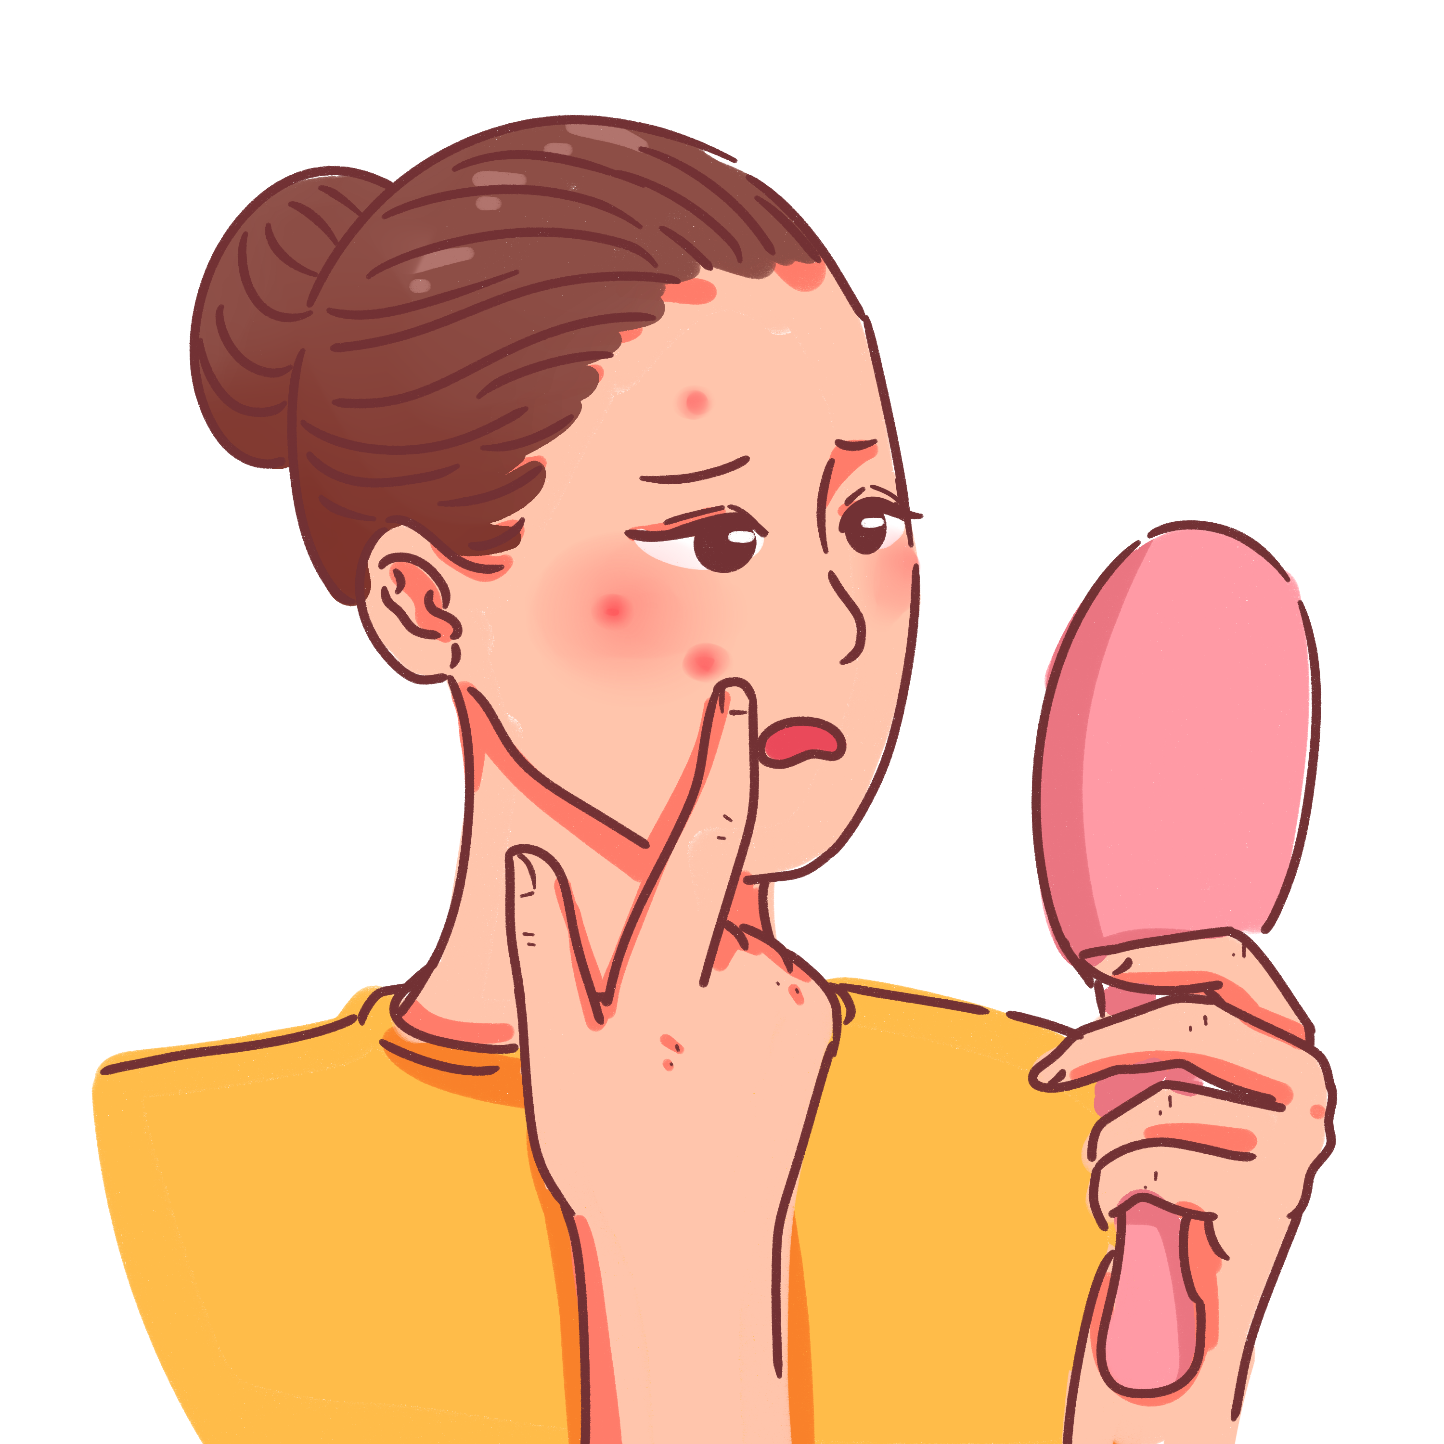
react
v.
1. 作出反应
They reacted violently to the news.
他们对这条新闻反应强烈。
2.反抗
My father never saved money and perhaps I reacted against that.
我父亲从不攒钱，也许我反对这种做法。
3.(对药物或其他所碰触的东西等) 起不良反应
Someone allergic to milk is likely to react to cheese.
对牛奶过敏的人可能会对奶酪也有不良反应。
4.起化学反应
Calcium reacts with water but less violently than sodium and potassium do.
钙能与水产生化学反应但不如钠以及钾那么剧烈。

Slide 70
component
n.
1. 组成部分
Enriched uranium is a key component of a nuclear weapon.
浓缩铀是核武器的一个关键组成部分。
adj.
2.组成的
Gorbachev failed to keep the component parts of the Soviet Union together.
戈尔巴乔夫没能使苏联各组成部分保持在一起。

Slide 71
tone
n. 1.语气；口气；腔调；口吻
speaking in hushed/low/clipped/measured tones 以压低、低沉、短促、缓慢谨慎的语调讲话
I still didn't like his tone of voice; he sounded angry and accusing.
我仍然不喜欢他说话的语气；他的声音听起来好像是怒气冲冲地在指责人。
2.风格；特色；气氛；情调
The overall tone of the book is gently nostalgic. 这本书整体格调是温情的怀旧。
She set the tone for the meeting with a firm statement of company policy.
她坚定地说明了公司的方针，为会议定下了调子。
3.色调
Each brick also varies slightly in tone, texture and size.每块砖在色调、质地和尺寸上也略有不同。
v.1.使强健
This movement lengthens your spine and tones the spinal nerves.
该运动能伸展你的脊柱，强健脊髓神经。
2.与…协调；与…相配
The beige of his jacket toned (in) with the cream shirt. 他那夹克的米黄色与乳白色的衬衫非常协调。
tone down 使（讲话、意见等）缓和；使温和
The language of the article will have to be toned down for the mass-market.
这篇文章的措辞必须缓和一下以适合大众市场。

Slide 72
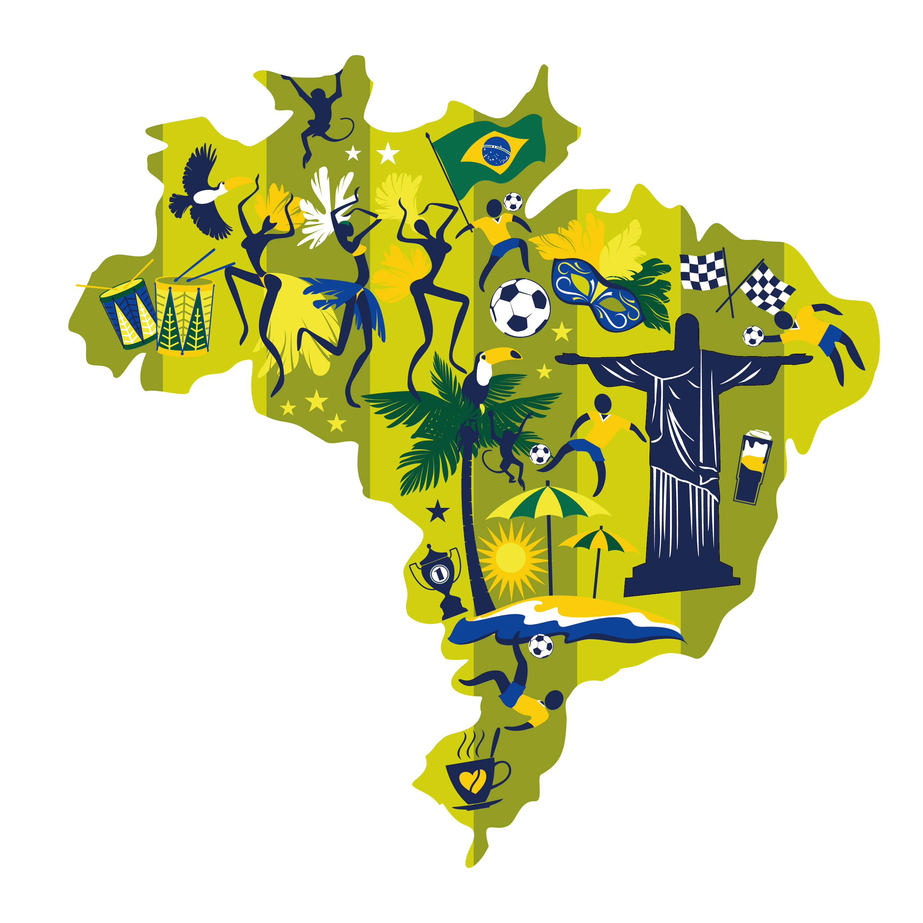
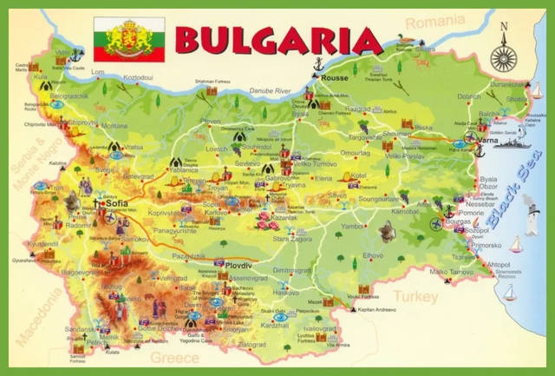

Brazil 巴西
Bulgaria 保加利亚
Albania 阿尔巴尼亚

