Slide 1



感恩遇见，相互成就，本课件资料仅供您个人参考、教学使用，严禁自行在网络传播，违者依知识产权法追究法律责任。
更多教学资源请关注
公众号：溯恩高中英语
知识产权声明

Slide 2
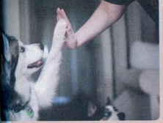
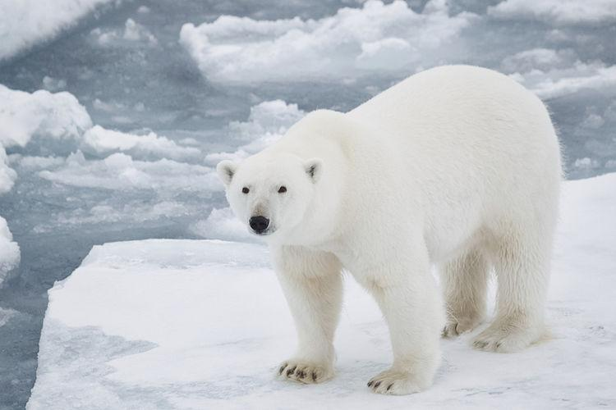
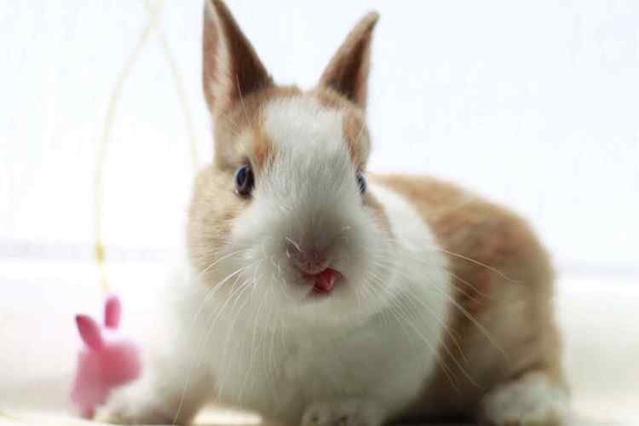
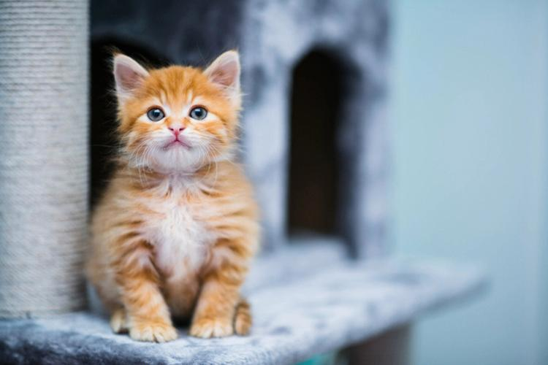
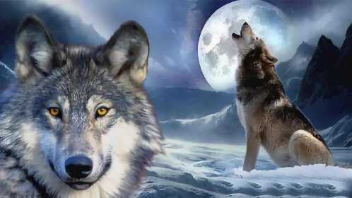
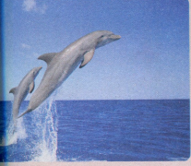
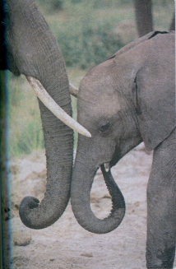
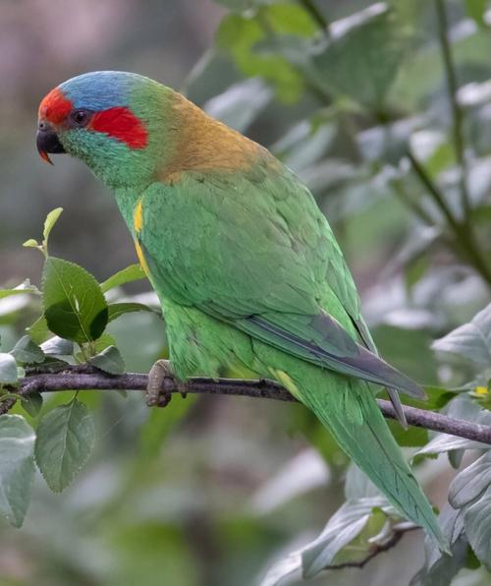
ANIMAL BODY LANGUAGE
人教版选择性必修一
Workbook Reading and Writing

Slide 3

Aim 1
Aim3
Get to know how dogs, elephants and dolphins use body language from the text.
Accumulate descriptions of common animal movements.
Do micro-writing about describing animals.
Aim2

Slide 4
PART 1
Reading and Comprehending

Slide 5

Comprehending
Activity 1
Look through the text, skim for gist and identify its style and language features.
What does the passage mainly talk about?(Theme& Content)
How does the author develop it? (Text type & Language features)
Why does the author write this passage?(Purpose )
Animal body language.
An expository writing
To inform us of the body language of dogs, elephants and dolphins.

Slide 6
Activity 2 Fill in the table according to the text.
Dogs use sound, body movements, and their tails to communicate
Body language | Meaning
ears standing up and eyes wide open | happy
barking, moving its tail , running around in circles, jumping up and down | want to play
lying on its back and closing its eyes | afraid
showing its teeth and growling ; try making itself look as big as possible; tail standing straight out from the body | angry

Slide 7
Elephants also use noises and body language(ears and gestures) to express themselves.
Body language | Meaning
nose or trunk making noises | to welcome other elephants
spreading its ears | watch out
touching each other with its trunks | showing friendship
standing close to each other
putting their heads together

Slide 8
Dolphins live in groups and love to show each other their feelings
Body language | Meaning
hitting its tail on the surface of the water | angry
jumping high out of the water and landing on its side, making a loud noise | sending a message over a long distance
 | showing its strength
leaping into the air | playing with friends
swimming in small groups close to the surface | tired and resting

Slide 9
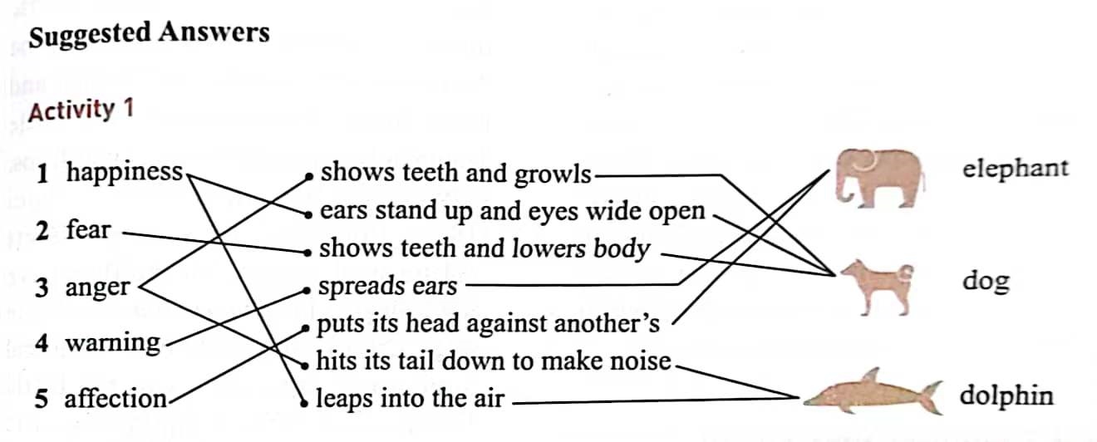
Activity 3.
Match the emotions with the body language and animals on page 86.

Slide 10
PART 2
Micro-writing

Slide 11
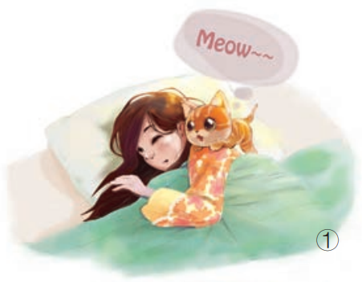
Activity 4 Micro-writing
Describe the following scenes by employing the given expressions of cat’s sounds, body movements and their tails.
purr meow stretch swish its tail
nuzzle its head against her face
摇摆着尾巴
用鼻子或嘴巴蹭她的脸
The cat goes over to the girl and nuzzles its head against her face giving a meow.

Slide 12

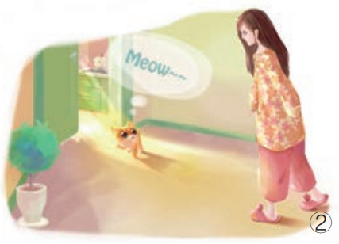
Cats
sounds, body movements and their tails
purr meow stretch swish its tail
nuzzle its head against her face
She woke up with a yawn. The cat leads the sleepy girl into the kitchen, looking behind her and meowing all the way.

Slide 13
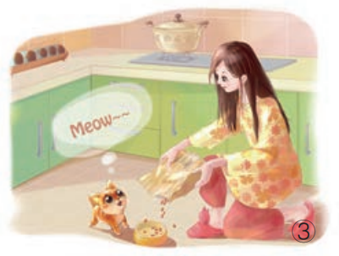
Cats
sounds, body movements and their tails
purr meow stretch swish its tail
nuzzle its head against her face
The cat looks up happily at the girl as she pours cat food into the bowl.

Slide 14
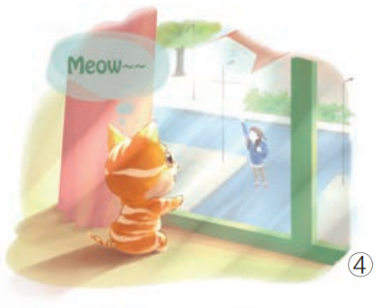
Cats
sounds, body movements and their tails
purr meow stretch swish its tail
nuzzle its head against her face
The cat runs to the window and sees the girl off, giving a meow of farewell as if he was saying “please come back early”.

Slide 15
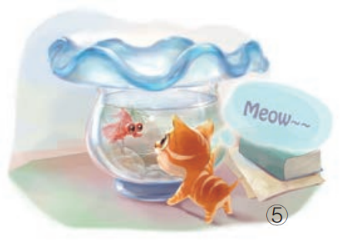
Cats
sounds, body movements and their tails
purr meow stretch swish its tail
nuzzle its head against her face
The cat decides to play with the goldfish. It stands outside the goldfish bowl, swishing its tail.

Slide 16
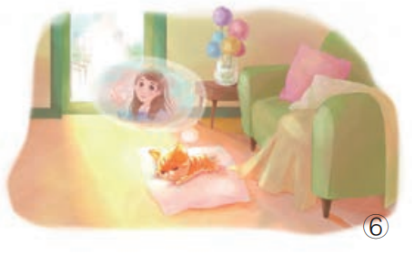
Cats
sounds, body movements and their tails
purr meow stretch swish its tail
nuzzle its head against her face
The cat becomes bored, so it stretches out on a pillow in the living room and going to sleep, purring and dreaming of the girl.

Slide 17
PART 3
Accumulation

Slide 18
cat/kitten/kitty(小猫；猫咪)
Ears were folded down forward and then pinged back(弹回).
meow v. 喵n.猫叫
Ex: The sleek cat meowed softly, seeking attention.
The kitten made a soft meow, curling itself into a furry little ball.小猫轻轻地叫了一声，把自己卷成一个毛茸茸的小球。
purr v.(猫发出的)呼噜声 n.
a gentle purr
微场景
The kitten suddenly got up off his
owner’s lap. Her eyes focused on
the door. Then her legs were moving
fast. Zooming round the corner, she
flew up the stairs into Iris‘s bedroom
and jumped onto the bed. She curled up next to Iris and started grooming herself, licking her paws and rubbing them over her ears.
小猫突然从主人的腿上跳下来。她盯着门。然后快速跑起来。她快速转弯，上楼，进入Iris的卧室然后跳到床上。她蜷缩在Iris旁边，开始梳理自己的毛，舔爪子，并把爪子在耳朵上摩擦。

Slide 19
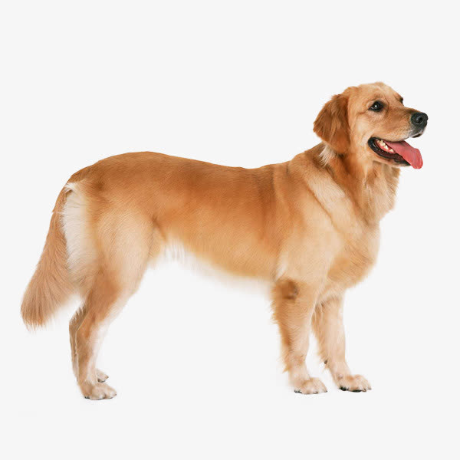
dog/puppy(小狗；幼犬)
prick up its ears
竖起耳朵
lower its body to be
close to the ground
back arched
crouch 蹲；蹲伏；蜷伏
snuggle up to依偎，蜷伏
curl 蜷缩
lay on its back
eyes wide open
sniff (嗅、闻)
the tail stand straight
out from the body
wag the tails
put the tails between its legs
growl低吼；咆哮/ bark
lick/woof(汪汪)
The energeitc dog barked loudly,
signaling playing time.
show / expose its teeth(AN)/bite
scamper欢快奔走；蹦跳
run around in circles
jump up and down
Filled with so much energy, they race around the yard, barking and chasing each other and then sprint back to us for pats and hugs. They waited patiently in the drive way and perched on her shoes.
fluffy/furry paws (毛茸茸的爪子)
scratch抓；刮
rub with its paws/claws用爪子摩擦

Slide 20
wolf/ coyote
howl v.长嚎，嗥叫
Ex. The wolf howled at the moon.
sharp teeth
a strong bite
live in packs to hunt down large prey
hold ears and tail high(pack leader)
crouch low , flatten ears and tuck the tail between legs(junior wolf)夹着尾巴
tear v.撕裂，撕开
Ex. The wolf’s teeth would be tearing
into his flesh
incredibly cunning狡猾的
fierce/ ferocious 凶猛的

Slide 21
polar bear/ polar bear cubs(幼崽)
furry ears/fatty skin/killer claws
thick white fur to keep them warm
dazzling fur
roar v. & n. 吼叫
with an angry roar
crunch across snow嘎吱嘎吱地穿过
paddle in icy water for days划水
hunt for seals (海豹) to eat
use nose to sniff out underground seal dens
stand on its back legs
push at the wooden fence posts
tear down the fence with his massive/powerful paws paws(爪子)
Paws dig dens兽穴 in the snow, break the ice to find food and pull food out of water.
furious beast暴怒的野兽
the largest land-based meat-eater
hunt mainly on drifting pack ice of shallow coastal seas
roam over the pack ice漫步在浮冰上

Slide 22
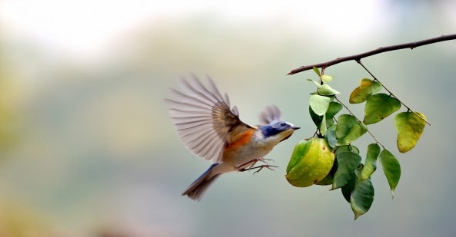
bird（robin知更鸟/wood warbler林莺/ hummingbird 蜂鸟）
hover v. （鸟等）翱翔，盘旋
let out a squeaking call发出尖锐的叫声
chirp v.吱吱喳喳地叫
tweet n. (小鸟的)唧啾，吱喳
flap/spread it wings 振翅
fluttered gracefully towards
perch on a branch/twig停在树枝上
look into one’s eyes, turning its head from side to side
bright/crystal/sparkling eyes
adorable humming bird

Slide 23
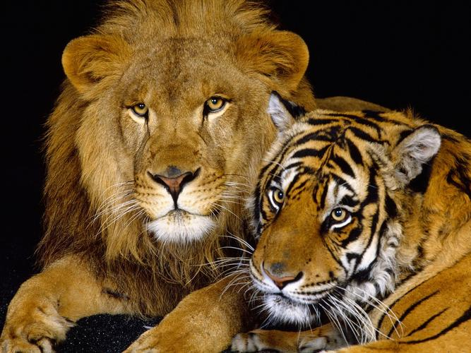
lion/tiger
Ex: The powerful lion roared ferociously, asserting dominance.
The majestic tiger roared ferociously , hunting its prey.
parrot
mimic one’s words
hop v. (动物或鸟的)齐足(或双足)短距离跳跃

Slide 24
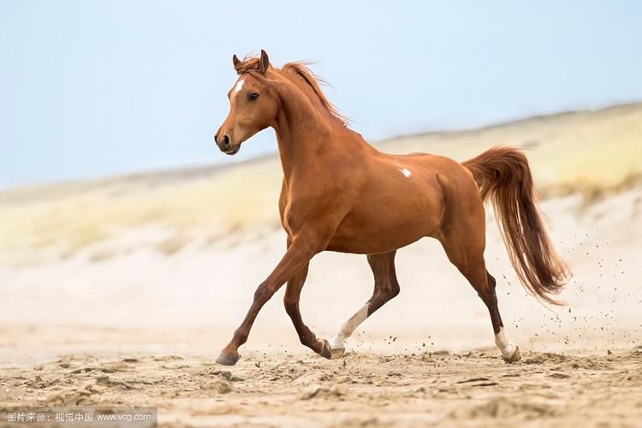
rabbit/bunny
thump v.强有力地跳动
The rabbit thumped, quickly hopping away from potential danger.
Sometimes the bunny hopped around the house, while sometimes she just snuggled up in our laps, bringing us endless joy.有时小兔子在屋子里跳来跳去，有时候她只是依偎在我们腿上，给我们带来了无穷的欢乐。
horse/pony (小马)
The little horse neighed gently, expressing happiness. (嘶鸣)
gallop v.奔驰，疾驰

Slide 25
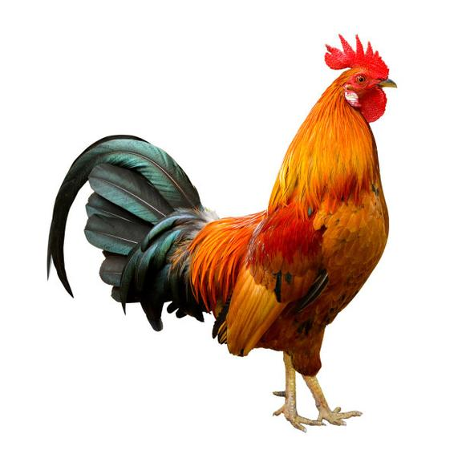
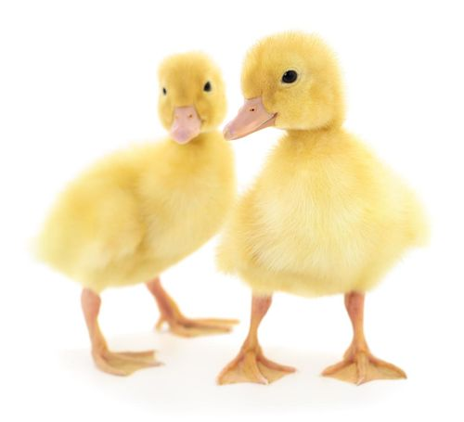
rooster公鸡cock
cackle v.咯咯叫 crow v.啼叫，打鸣
The proud rooster crowed at dawn, announcing the start of a new day.
cluck v.（鸡）咯咯地叫，发出咯咯声
duck/duckling
waddle v. 摇摆地行走quack v. （鸭子）嘎嘎叫
The tiny fluffy ducklings followed her around, with their waddling steps, wherever she went.
无论她去哪里，毛茸茸的小鸭子们都摇摇摆摆地跟着她。
The cheerful duck quacked loudly, splashing in the pond. (在水中)溅着水花行走

Slide 26
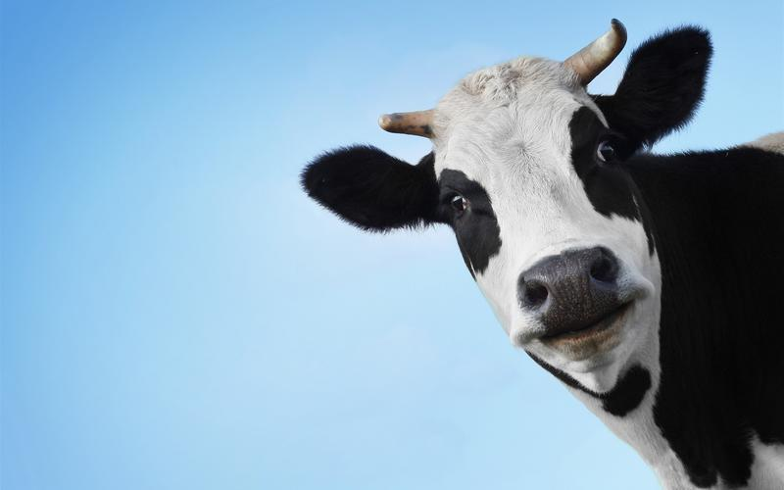
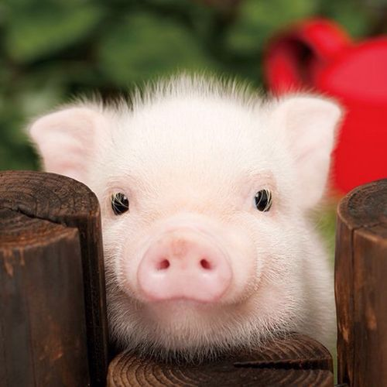
cow奶牛/cattle牛/ox公牛
moo v. （牛叫声 ）哞
The contented cow mooed in the field, surrounded by greenery.
pig/hog(喂肥供食用)猪
oink v. （猪叫声 ）哼
The happy pig oinked playfully, rolling in the mud.

Slide 27
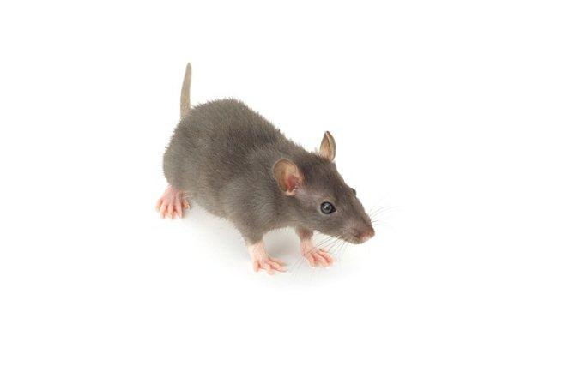
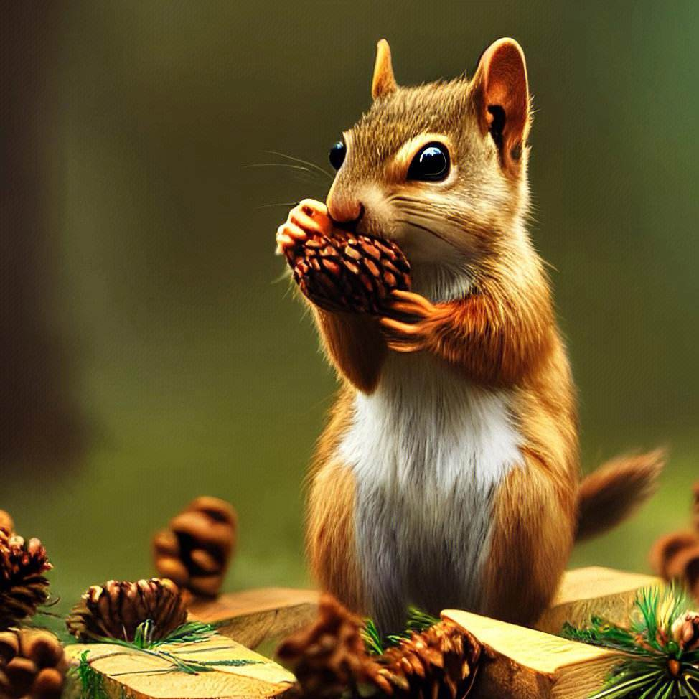
mouse
squeaked v. 吱吱叫
The mouth squeaked, alerting others to potential danger.
squirrel松鼠
chirp v. 吱喳叫
The cute squirrel chirped energetically, collecting nuts for winter.

Slide 28
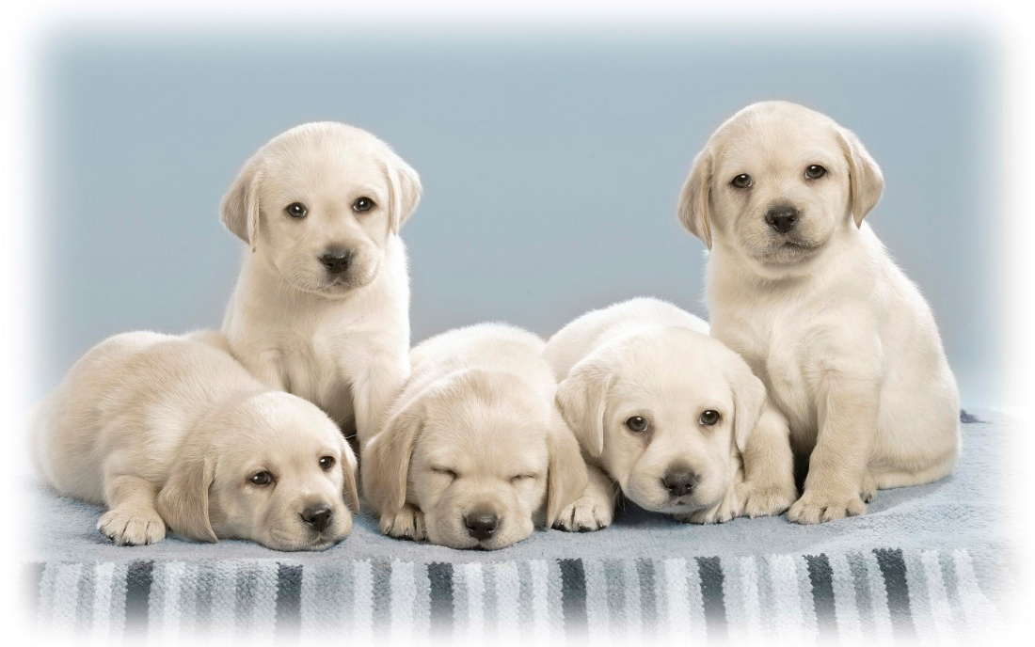

Thank you!

