Slide 1



感恩遇见，相互成就，本课件资料仅供您个人参考、教学使用，严禁自行在网络传播，违者依知识产权法追究法律责任。
更多教学资源请关注
公众号：溯恩高中英语
知识产权声明

Slide 2

让人物心理在你的笔端鲜活
心理描写

Slide 3

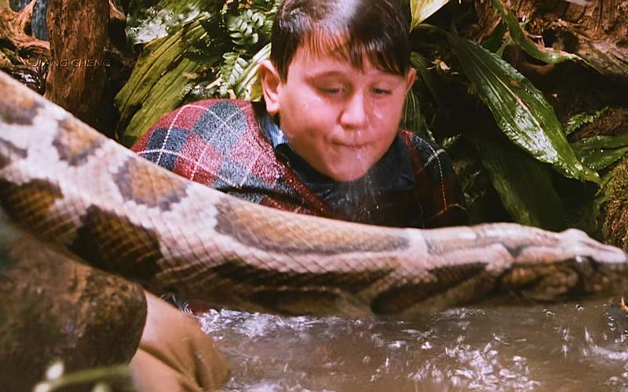
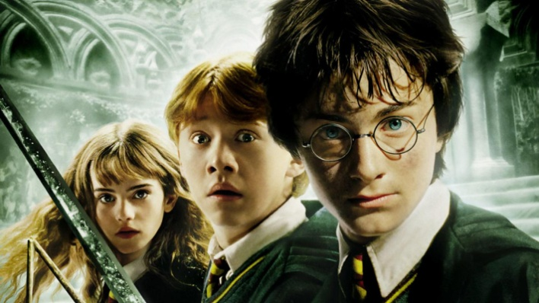
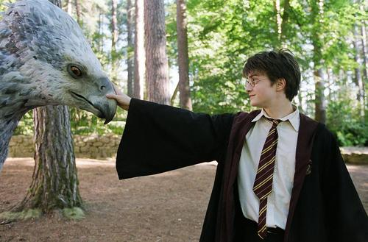
心理描写
心理描写是指作者对人物在一定的环境中的心理状态、精神面貌和内心活动进行的描写，展示人物的内心世界，体现人物性格品质。

Slide 4
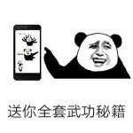
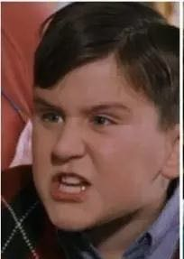
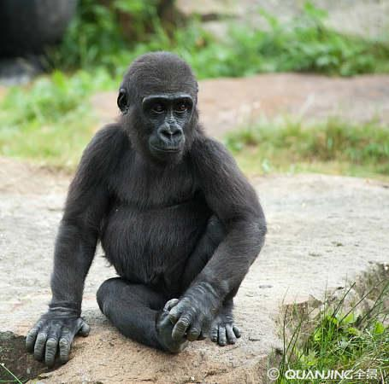

取胜第一招：直接心理描写
素材摘录1：It wasn’t bad, either, Harry thought, licking it as they watched a gorilla scratching its head who looked remarkably like Dudley, except that it wasn’t blond.
这也不错，哈利想，一边舔着冰棒，一边看一只大猩猩挠头。它看起来非常像达德利，只是它不是金色的。
scratch /skrætʃ/ v. 挠(痒处);抓伤(皮肤)
and the
Sorcerer’s Stone

Slide 5
素材背景：It was a very sunny Saturday and the zoo was crowded with families. The Dursleys bought Dudley and Piers large chocolate ice creams at the entrance and then, because the smiling lady in the van had asked Harry what he wanted before they could hurry him away, they bought him a cheap lemon ice pop.
Tips: Direct psychological description is the most common and widely used method of describing character’s psychology, with some sentences containing key words such as “think” as obvious markers. The word “think” may appear before or after psychological activity. Sometimes, it is followed by a comma or colon.
and the
Sorcerer’s Stone

Slide 6
素材摘录2： And there's Aunt Petunia knocking on the door, Harry thought, his heart sinking. But he still didn't open his eyes. It had been such a good dream.
“那是佩妮姨妈在敲门，”哈利想，心里一沉。但他还是没有睁开眼睛。那实在是个太美妙的梦了。
素材背景：Hagrid finally found Harry on stormy night and told him about everything. The next morning, a sudden loud tapping noise on the door woke him up, Harry thought it was Aunt Petunia knocking on the door and what happened the night before was only a good dream.
and the
Sorcerer’s Stone
Notes:
llo

Slide 7
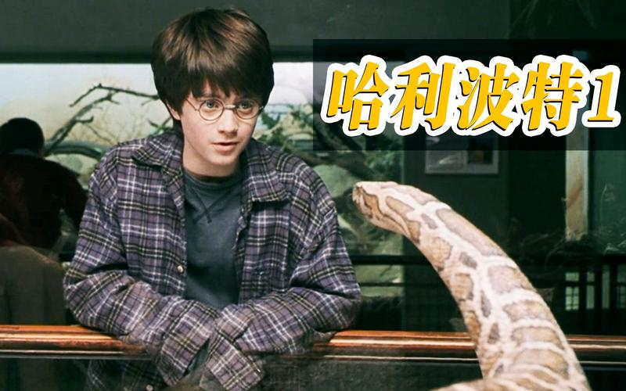
取胜第二招：心理分析
素材摘录1：Harry moved in front of the tank and looked intently(专心地)at the snake. He wouldn’t have been surprised if it had died of boredom itself – no company except stupid people drumming their fingers on the glass trying to disturb it all day long. It was worse than having a cupboard as a bedroom, where the only visitor was Aunt Petunia hammering on the door to wake you up; at least he got to visit the rest of the house.
哈利走到水箱前面，聚精会神地看着蛇。如果它无聊死了，他也不会感到惊讶——除了一些愚蠢的家伙整天用手指敲玻璃试图打扰它之外，没有其他伙伴陪伴它。这比只能睡楼梯间壁橱更糟糕。虽然唯一的访客是佩妮姨妈，她敲着门叫醒你；但至少他可以在房子的其他地方走动。
and the
Sorcerer’s Stone

Slide 8
素材背景：Harry met a snake with high intelligence in the zoo.
素材解读： Here the snake is the reflection of Harry himself.
蛇----自己
Both of them have no company.
no company
Both of them are surrounded by stupid and rude people.
stupid/rude
He is a little bit better than the snake, for he has freedom.
freedom

Slide 9
素材摘录2： When he had been younger, Harry had dreamed and dreamed of some unknown relation coming to take him away, but it had never happened; the Dursleys were his only family. Yet sometimes he thought (or maybe hoped) that strangers in the street seemed to know him.
在哈利小一点的时候，他多么希望某个未曾见过的亲戚来把他带走，但这从未发生过；德思礼一家成了他唯一可待的家。然而，有时他会想（或者可能希望）街上的陌生人会认识他。
素材背景：Harry wasn’t happy, staying at the Dursleys. He was hoping some unknown relatives may come to take him away.
and the
Sorcerer’s Stone
Notes:
llo

Slide 10
Tips: By analyzing the psychology of characters can show their inner world better. Readers can gain a clearer understanding of their thoughts and feelings.
Psychological analysis, is a direct description of a character's inner activities by the author, usually in the third person. As the author analyzes and evaluates the inner world of the characters as an observer, it not only facilitates a more delicate portrayal of the characters' thoughts and activities at that time and place, but also allows for a progressive overview of their emotional changes and inner struggles over a period of time, making the writing more flexible and convenient.
and the
Sorcerer’s Stone

Slide 11
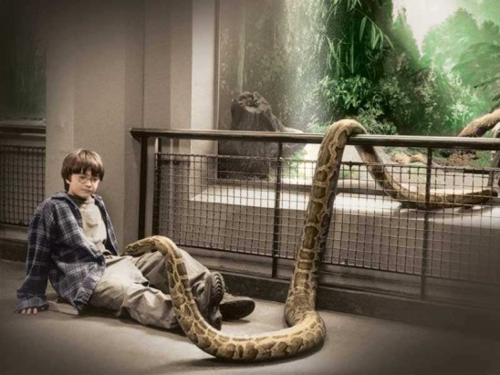
取胜第三招：用动作体现心理活动
它（蛇）朝他眨了眨眼.哈利瞪大了眼睛。然后他迅速环顾四周，看是否有人注意他们。他们没有。他回头看了看蛇，也眨了眨眼。
素材摘录1：
It(the snake ) winked(眨眼).
Harry stared. Then he looked quickly around to see if anyone was watching. They weren’t. He looked back at the snake and winked, too.
look around (cautious)
look back (determined)
wink (expecting the next reaction)
shocked/ intrigued
素材解读：The writer uses verbs “stared”, “look around”, “look back” and “wink” to show a series of mental activities of Harry after he sees the snake wink at him.

Slide 12
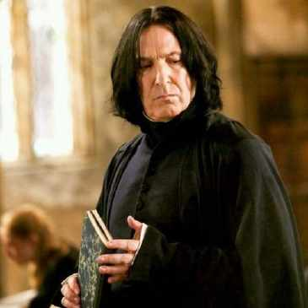
素材摘录2：Harry forced himself to keep looking straight into those cold eyes.
forced himself to…逼迫自己去
keep looking straight into…保持直视着…
哈利竭力使自己直视那双冰冷的眼睛。
素材背景：It was Harry’s first potions lessons and Professor Snape was very unkind to him. He tried his best to be brave.
素材解读：The writer uses verbs “force himself” and “keep looking straight” to show Harry’s inner activity.
Tips： The distinctive actions of the characters vividly reveal their psychological activities.
and the
Sorcerer’s Stone

Slide 13
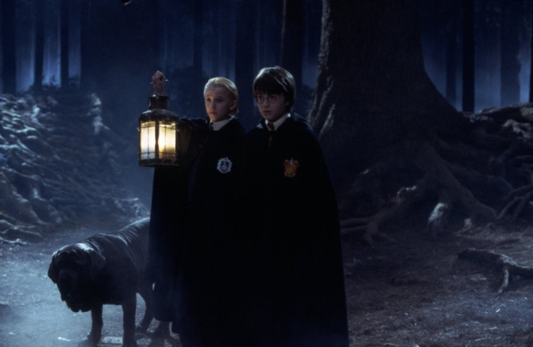
素材摘录3：They walked on through the dense, dark trees. Harry kept looking nervously over his shoulder.
他们继续在茂密、漆黑的树林间穿行。哈利总是紧张地扭头张望。
素材背景：Harry, Hermione, Malfoy and Hagrid were walking through the forbidden forest at midnight to look for the unicorn. Harry had the nasty feeling they were being watched.
素材解读：The writer uses verbs “keep looking” and an adverb “nervously” to show Harry’s thoughts that he was afraid that they were being followed. Plus, the description of the environment increases that frightening concern.
and the
Sorcerer’s Stone

Slide 14
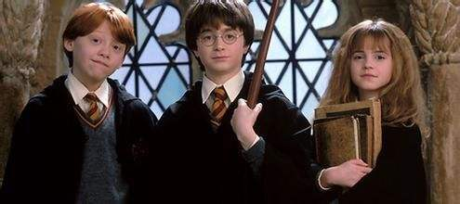
取胜第四招：用神态展示心理活动
素材摘录1： "Oh, I will," said Harry, and they were surprised at the grin that was spreading over his face.
“哦，我会的。”哈利说。他脸上绽开了一个灿烂的笑容，使罗恩和赫敏都感到诧异。
素材背景：It was the end of the school term. Uncle Vernon came to pick up Harry. Ron and Hermione wished Harry good holiday.
素材解读：The writer uses facial expression “grin” to tell the readers Harry’s inner activity that he is going to use magic at home to have fun with Dudley this summer.

Slide 15
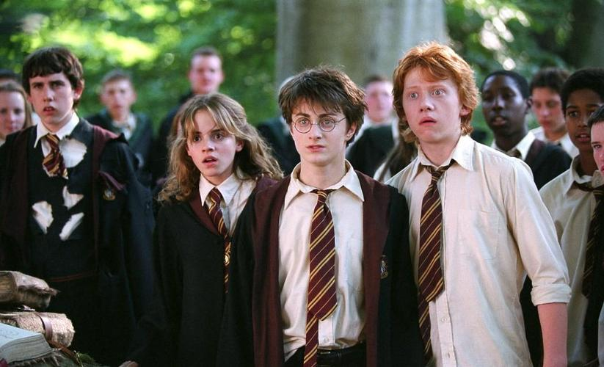
素材摘录2： Madam Hooch was bending over Neville, her face as white as his.
胡施夫人弯下腰去为尼维尔作检查，她的脸就跟尼维尔的一样白。
素材背景：During their first flying lesson, Neville was so nervous and jumpy and frightened of being left on the ground, pushed off hard before the whistle had touched Madam Hooch's lips. Worse still, he slipped sideways off the broom and fell facedown on the grass in a heap.
素材解读：The writer uses Madam Hooch’s facial expression “white” to tell the readers she is nervous and maybe wondering “Will Neville be all right?”
Tips: The facial expressions of characters can vividly show their inner emotions and psychological activities.

Slide 16
取胜第五招：用梦境描绘心理活动
素材摘录1： Perhaps Harry had eaten a bit too much, because he had a very strange dream. He was wearing Professor Quirrell's turban, which kept talking to him, telling him he must transfer to Slytherin at once, because it was his destiny. Harry told the turban he didn't want to be in Slytherin; it got heavier and heavier; he tried to pull it off but it tightened painfully -- and there was Malfoy, laughing at him as he struggled with it -then Malfoy turned into the hook-nosed teacher, Snape, whose laugh became high and cold -- there was a burst of green light and Harry woke, sweating and shaking.
也许是因为哈利吃得太多的缘故吧，他夜里做了一个很奇怪的梦。他正戴着屈拉教授的无边帽。那顶帽子一直不停地跟他讲话，要他必须马上转到史林德林去，还说这是他的命运决定的。哈利告诉帽子他不愿意去史林德林，帽子就变得越来越沉重，他拼命想挣脱它，可它偏偏越勒越紧，令哈利痛苦不已。正当他挣扎的时候，马尔夫出现了，不停地嘲笑着哈利，接着马尔夫摇身一变，成了鹰钩鼻子的史纲皮教授，笑声也越来越尖，越来越冷。一道绿光闪过，哈利被吓醒了，浑身是汗，全身发抖。

Slide 17
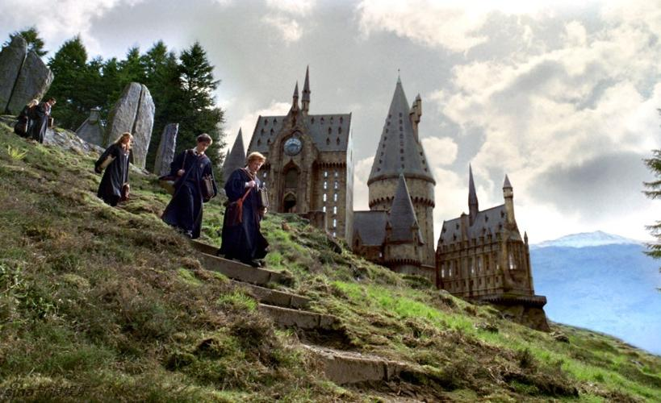
素材背景：It was Harry’s first night at Hogwarts. He seemed to have a strange dream. Harry woke from the dream and then he rolled over and fell asleep again, and when he woke next day, he didn't remember the dream at all.
素材解读：After Harry arrives at Hogwarts, he was sorted into GRYFFINDOR by the sorting hat. Yet Harry is afraid that he will be sorted into Slytherin, where Malfoy is. Through the dream, the readers see Harry’s inner thoughts clearly.
Tips: Describing a dream is a psychological descriptive method that some students tend to overlook. Dreams are concentrated expressions of human thoughts, which can also reveal the personality traits of characters and deepen the theme of the article.

Slide 18


取胜第六招：用内心独白心理活动
素材摘录1：Harry’s heart gave a horrible jolt. A test? In front of the whole school? But he didn’t know any magic yet. He looked around anxiously and saw that everyone else looked terrified, too.
jolt /dʒəʊlt/ v.& n. 颠簸;震动;摇晃
哈利的心猛地一颤。测试？在全校师生面前？可他连一点魔法也不会。他焦急地环顾四周，所有人都惶恐不安。
素材背景：While Harry and other first years waited to be sorted, Ron told Harry they would be sorted into different houses by tests.

Slide 19
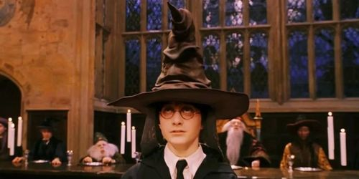
素材解读：Here the writer uses vivid verbs, adjectives and adverb to show Harry’s inner activities. Apart from that, “A test? In front of the whole school?” is the short version of inner monologue, which directly shows what Harry is thinking at that particular moment.
Tips: Inner monologue is an important means to pour out one’s heart and reveal one’s “heartstrings”.
Generally, first person is used in Inner monologue. It is like the voiceover of characters thinking in movies.

Slide 20

独白，指人的自思、自语等内心活动。通过人物内心表白来揭示人物隐秘的内心世界，能充分地展示人物的思想、性格，使读者更深刻地理解人物的思想感情和精神面貌。
独白
指戏剧角色背着台上其他剧中人对观众说的话；也指影视片中的解说词。说话者不出现在画面上，但直接以语言来介绍影片内容、交待剧情或发表议论。
旁白

Slide 21
Have a practice 1
Fill in the blanks, using the proper words to describe the inner activities of the character(s). Please point out which psychological description is used in the passage.
After Harry went through the trapdoor, Harry found out it was Quirrell that had been looking for the Stone. Meanwhile, Harry’s mind was racing.
_______________________________________________________ (此时此刻我心里最大的愿望), ______________ (他想), is _________________________________ (我要赶在Quirrell之前找到魔法石).
内心独白
What I want more than anything else in the world at the moment
he thought
to find the Stone before Quirrell does

Slide 22
Have a practice 2
Fill in the blanks, using the proper words to describe the inner activities of the character(s). Please point out which psychological description is used in the passage.
Harry wore the sorting hat and waited. At the same time, the sorting hat was thinking which house he should put Harry. Harry felt it was a long time and he was worried.
Harry __________________________ (紧紧抓住凳子的边缘) and _________ (心里想), _______________ (不去Slytherin), _______________ (不去Slytherin).
gripped the edges of the stool
thought
Not Slytherin
not Slytherin
直接心理描写

Slide 23
Have a practice 3
Fill in the blanks, using the proper words to describe the inner activities of the character(s). Please point out which psychological description is used in the passage.
After the incident in the zoo, Uncle Vernon drove Harry into the cupboard without giving him any food.
Harry lay in his dark cupboard much later, _______________________ (希望他有块手表). He didn’t know _________________ (几点了) and he _______________ (不确定) the Dursleys were asleep yet. Until they were, he couldn’t risk ______________ (溜进) the kitchen for some food.
wishing he had a watch
what time it was
couldn't be sure
sneaking to
心理分析

Slide 24


Many thanks!
Goodbye!

