Slide 1



感恩遇见，相互成就，本课件资料仅供您个人参考、教学使用，严禁自行在网络传播，违者依知识产权法追究法律责任。
更多教学资源请关注
公众号：溯恩高中英语
知识产权声明

Slide 2
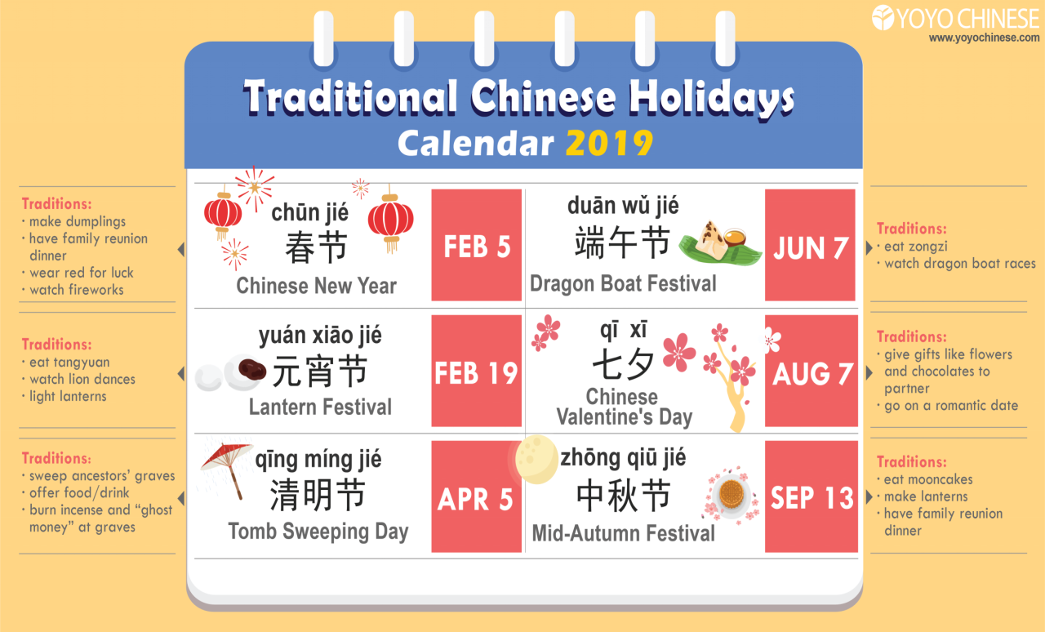
2024
FEB 10
JUN 10
FEB 24
AUG 10
ARI 4
SEP 17

Slide 3
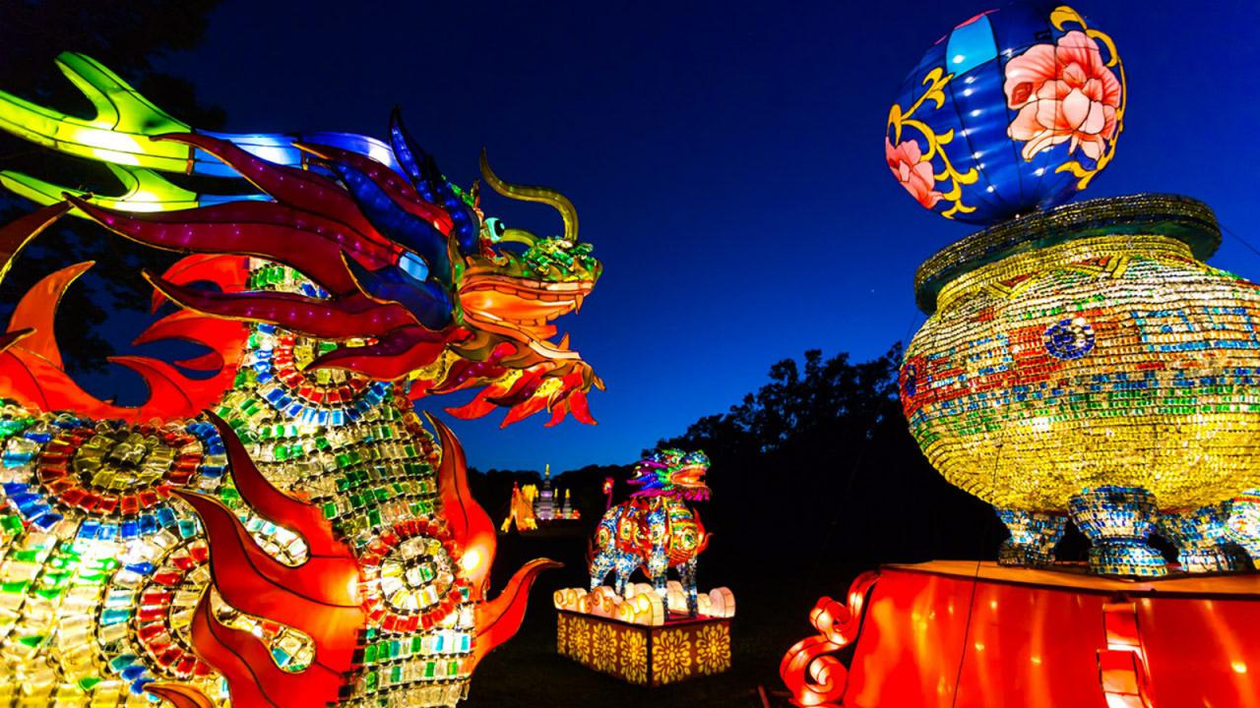
Chinese New Year

Slide 4
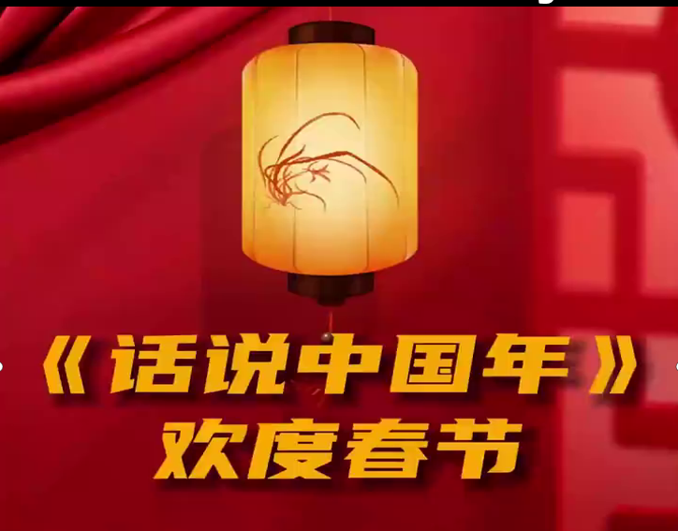
What is Chinese New year?
视频资料一

Slide 5

Chinese New Year
The first day of the first lunar month is Spring Festival, the beginning of a New Year of China. Spring Festival is China’s 1.___________(big) extravaganza and a day for family reunion. Being around family members at 2. ___________ turn of the year is a vital ritual for the Chinese people. Many of people 3. ___________(live) away from the hometowns return home during Spring Festival, which 4. ___________(give) rise to 5. ___________ is called the largest annual human 6. ___________（migrate) in the world, also known as the Spring Festival travel rush. The Spring Festival Celebration is a 7. ___________(continue) process starting from the 23rd or 24th of the 12th lunar month. People often worship the Kitchen God, clean their house, do 8. ___________(they) shopping and put up Spring Festival couplets 9. _______ New Year’s Eve 10. _____ the lunar calendar.
Word bank
extravaganza
/ ɪkˌstrævəˈɡænzə /
n.铺张华丽的表演
ritual / ˈrɪtʃuəl /
n.仪式，典礼
worship/ ˈwɜːʃɪp /
v.敬奉（神）；爱慕，崇拜
couplet/ ˈkʌplət /
n.对句，对联
Give rise to
引起，导致，产生
the lunar calendar
农历
biggest
the
living
gives
what
migration
continuous
their
until
on

Slide 6

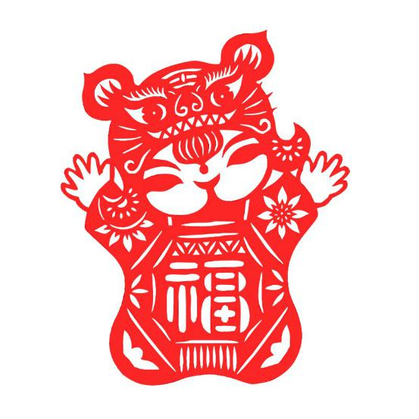
Chinese New Year, also known as the Spring Festival, is one of the 1___________________________in Chinese culture. The festivities typically kick off on Lunar New Year's Eve, marked by thorough 2_________________and a sumptuous reunion dinner. As night falls, the sky is illuminated by the dazzling 3____________________ and 4_____________, symbolizing the 5__________to the old year and 6__________________of the new one.
Throughout the holiday season, people 7______________________, 8________________________________________. Red decorations and auspicious couplets adorn every household, while traditional dragon lion dances 9___________________________to the celebrations, 10______________________to the start of the New Year.
grandest traditional celebrations
Word bank
kick off 开始，发起
sumptuous / ˈsʌmptʃuəs /
adj.豪华的，奢华的
illuminate/ ɪˈluːmɪneɪt /
v.照射,照亮；阐明,解释
dazzling/ ˈdæz(ə)lɪŋ /
adj.令人赞叹的；耀眼的
auspicious/ ɔːˈspɪʃəs /
adj.有助于成功的；吉利的
adorn / əˈdɔːn /
v.装饰；使生色
festive/ ˈfestɪv /
adj.节日的；喜庆的；
household cleaning
display of fireworks
firecrackers
farewell
the hopeful welcome
visit friends and family
exchanging New Year's greetings and blessings
add a lively and festive touch
bringing joy and harmony

Slide 7

Words and expressions
extravaganza / ɪkˌstrævəˈɡænzə / n.铺张华丽的表演
ritual / ˈrɪtʃuəl / n.仪式，典礼
worship / ˈwɜːʃɪp / v.敬奉（神）；爱慕，崇拜
couplet / ˈkʌplət / n.对句，对联
sumptuous / ˈsʌmptʃuəs / adj.豪华的，奢华的
illuminate / ɪˈluːmɪneɪt / v.照射,照亮；阐明,解释
dazzling / ˈdæz(ə)lɪŋ / adj.令人赞叹的；耀眼的
auspicious / ɔːˈspɪʃəs / adj.有助于成功的；吉利的
adorn / əˈdɔːn / v.装饰；使生色
festive / ˈfestɪv / adj.节日的；喜庆的；
give rise to 引起，导致，产生
the lunar calendar 农历
kick off 开始，发起

Slide 8
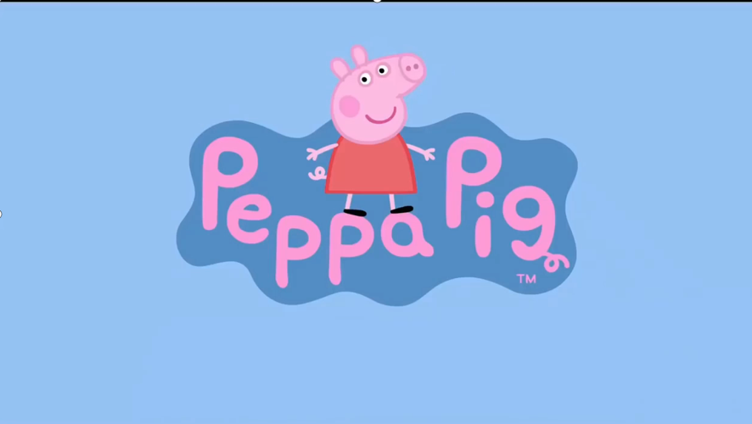
视频资料二

