Slide 1


感恩遇见，相互成就，本课件资料仅供您个人参考、教学使用，严禁自行在网络传播，违者依知识产权法追究法律责任。
更多教学资源请关注
公众号：溯恩英语
知识产权声明

Slide 2
如何最大效度
利用好一篇语法填空
高考二轮复习语法填空专题
以2024年教育部权威命制真题选摘为例
广东外语外贸大学 郭烨辉

Slide 3
目录
01
反思：易错点与疑难点提取
02
换位：培养学生自主命题意识
03
语料：训练后的语言知识习得
04
链接：拓展素材的利用范畴

Slide 4

01
一、反思：易错点与疑难点提取

Slide 5
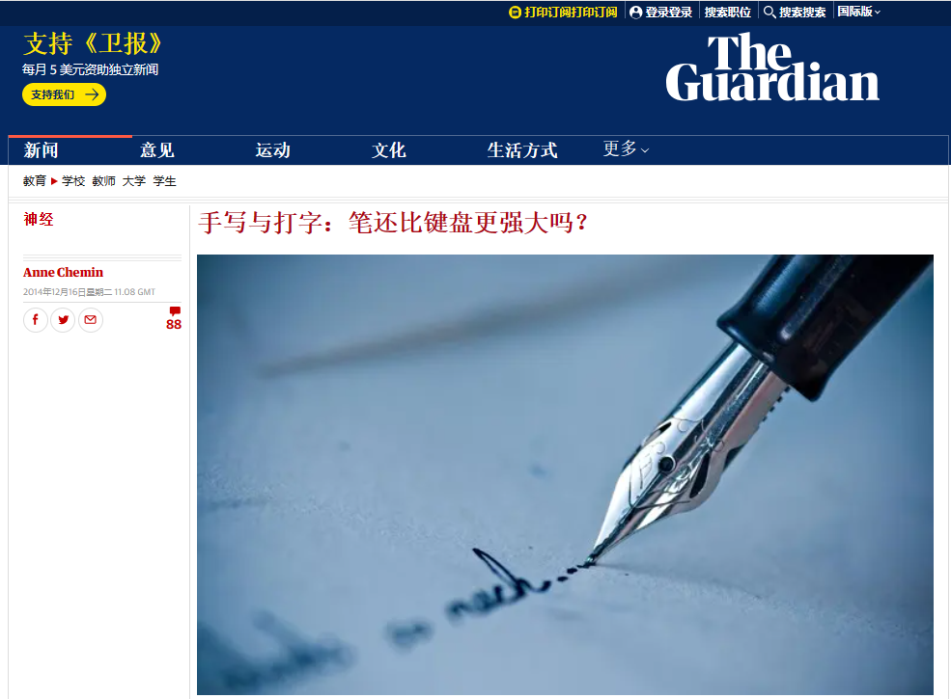
原题呈现
Whenever you have to write a paper, a letter, or any other document for work or school, you probably head toward the computer. Now, most people reach for ______（keyboard）faster than they pick up pens. In a Scottish primary school, however, Mr. Norman Lewis is taking a different approach He feels that neat handwriting ______（be） still an important skill, so he has his students write not only by hand but also______ old fashioned fountain pens.
Fountain pens______（use） in schools long ago and have been regaining popularity lately because they are refillable Today, a writer______（simple） throws an empty pen away and gets ______ new one.
So far, Mr. Lewis is pleased with the results of his experiment. He reports that his students are taking more care with their work, and their self-confidence has improved as well. He is happy with the_____ （improve） he sees in his students’ writing ______ in his own writing He knows that computers are here ______ （stay） and that they will not disappear However, he believes that the practice with fountain pens helps students to focus, to write faster, and they can feel proud of （they）.
keyboards
is
with
were used
simply
a
本文摘自《卫报》
improvement
and
to stay
themselves

Slide 6
一、反思：本文易错点？考查知识？命题考究？
完成训练后，能否提出几个有价值的易错反思问题？既可以是答题方面，也可以是命题底层逻辑。
Whenever you have to write a paper, a letter, or any other document for work or school, you probably head toward the computer. Now, most people reach for ___56___（keyboard）faster than they pick up pens. In a Scottish primary school, however, Mr. Norman Lewis is taking a different approach He feels that neat handwriting ___57___（be） still an important skill, so he has his students write not only by hand but also___58___ old fashioned fountain pens.
Fountain pens___59___（use） in schools long ago and have been regaining popularity lately because they are refillable Today, a writer___60___（simple） throws an empty pen away and gets ___61___ new one.
So far, Mr. Lewis is pleased with the results of his experiment. He reports that his students are taking more care with their work, and their self-confidence has improved as well. He is happy with the__62___ （improve） he sees in his students’ writing ___63___ in his own writing He knows that computers are here ___64___ （stay） and that they will not disappear However, he believes that the practice with fountain pens helps students to focus, to write faster, and they can feel proud of 65 （they）.
Q1：58题做错，那什么时候才能考虑平行结构？
Q2：62题为什么不能用improvements？
学生提出的非常有深度的问题
Q3：64题该如何理解清楚to stay? 如何溯源出处？
Q4：现代科技腾飞的背景下，命题人为什么命制关于回归传统写作的话题？

Slide 7
Q1：58题做错，那什么时候才能考虑平行结构？
平行结构: 指的是相同的语法结构，它要求有同等重要的思想、概念，并列的句子成分要用同类的语法形式来表达，平行结构是一种修辞手法。它可以使句子前后保持平衡和协调，从而增加语言的连贯性。
它要求词与词、短语与短语、句子与句子一一对应)
本题错误情形：
... so he has his students write not only by hand but also with old-fashioned fountain pens. (学生容易基于not only...but also这个平行结构，前面有by hand，后面就想当然选择了by foutain pens，就算最后一段“with fountain pens”结构复现时都没有考虑纠错)
比较下面两题：
After more than 20 drafts, the final design of the medal features the natural landscape of Hangzhou in the style of a traditional painting --- ________(mist) hills, a rippling lake, and rolling mountains on the front, and the back face features the logo of the Olympic Council of Asia.
misty
being sold
Censorship prevents a movie from being shown or a book ___________(sell).

Slide 8
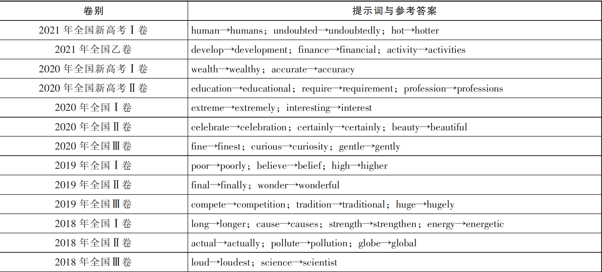
Q2：62题为什么不能用improvements？
引用自李华军老师论文
命题潜规则：提示词一般都是经过一次变形得到正确答案。
【2021年新高考】 The hot spring at the foot of the mountain is something you must try after the climb. It will _________________ (undoubted) help you get refreshed!
undoubtedly

Slide 9
Q3：64题该如何理解清楚to stay? 如何溯源出处？
He knows that computers are here ___64___ （stay） and that they will not disappear However, he believes that the practice with fountain pens helps students to focus, to write faster, and they can feel proud of 65 （they）.
【牛津】be here to stay/have come to stay:
to be accepted or used by most people and therefore a permanent part of our lives
【朗文】here to stay:
if something is here to stay, it has become a part of life and will continue to be so
【剑桥】here to stay:
If something is here to stay, it has stopped being unusual and has become generally used or accepted:
It's not uncommon for individuals who are new to online investment platforms to fall ______ some schemes promising unrealistically high returns, only to discover later that they have been deceived.
for
注意积累一些地道的表达
fall for上当，受骗：指因为被欺骗或受到诱惑而上当受骗。

Slide 10
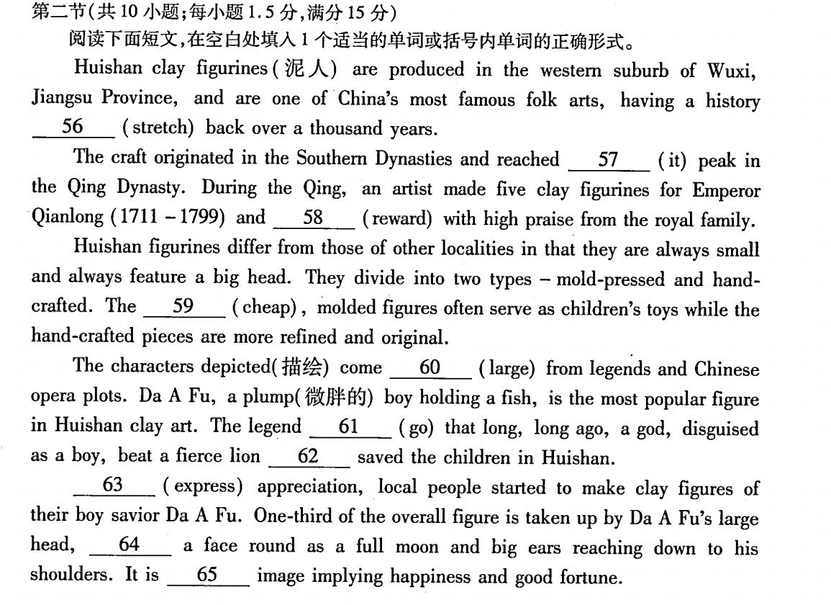


2024届11月杭州一模
56.stretching
57.its
58.was rewarded 59.cheaper
60.largely
61.goes
62.and
63.To express
64.with
65.an
可以设置哪些反思位置示例：
1.originate
2.feature 和characteristic
3.serve as
4.The legend goes that
5.注意动作前填and 还是which
6.什么时候考虑with

Slide 11
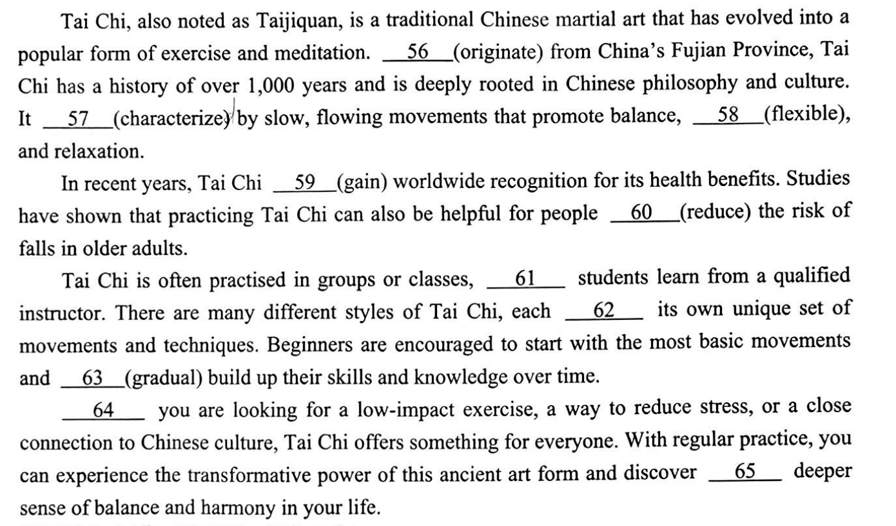
2024年11月宁波一模
56.Originating
57.is characterized 58.flexibility
59.has gained
60.to reduce
61.where 62.with 63.gradually 64.Whether
65.a
可以设计的反思位置示例：
1.be rooted in
2.characterize
3.ble结尾变形
4.with 的考虑情况
5.句首词慎重，
从逻辑入手
6.transformative
7.harmony 的形容词

Slide 12
02
二、换位：培养学生自主命题意识

Slide 13
学生自主命题是新高考改革的有效尝试
许兴亮教授指出，学生自主命题变“教为主”为“学为主”，体现了以学习者为中心的教学原则，有利于激发学生自主评价、自我发展的内生力，变“要我考”为“我要考”。
这一尝试引导学生从解答题目走向解决问题，使学生在考场上思考探究的过程真正成为有意义的过程。
用生活的情境来审视生活的应用，用现实的挑战培育生活的能力，在获取知识、解决问题中建立学生与世界的联系，从而让学生获得更多的成长经验。
私人化定制方式使得命题呈现更为明显的情境化设计倾向。 命题重视选取个人体验、社会生活、学科认知等情境为载体设计典型任务，促使学生在任务解决过程中提升学习理解、实践应用、创新迁移等关键能力，以应对未来社会复杂的问题。
在自己尝试命题后可以找partner进行自命题分享，分别进行作答。当然完全可以在该题填空完毕后作为阅读文本，进行阅读理解方面的命题探索。

Slide 14
二、换位：如果让我出，我会考什么？
学生优质尝试
2024年1月浙江首考
The shelves in most supermarkets are full of family-size this and multi-buy that. However, if you’re shopping for one, buying extra to benefit from price ___56___ (reduction) doesn’t make sense. Either your shopping is then too heavy ___57___(carry) home or you can’t use what you’ve bought while it’s still fresh.
Of course, shops are not charities — they price goods in the way which will make them the ___58___ (much) money. If most of their customers are happy to buy ___59___ (large) quantities, that’s what they’ll promote. But that leaves the solo (单独) customers out of pocket and ___60___(disappiont).
Many supermarkets are no longer doing “buy one get one free” promotions because of the criticism ___61___ they lead to waste. Consumers prefer money off individual items. However, though it’s nice to get a few cents off a pack of sausages, ___62___ would help even more if they could sometimes be offered in smaller packs. Even the biggest sausage fan doesn’t want to eat them every day
If your supermarket sells loose produce, then ___63___ (buy) smaller quantities is easier. Over the last two years, some supermarkets have started selling chicken or salad in packs designed with two halves containing separate portions (份). Then, when you use one section, the other ___64___ (stay)fresh.
Who knows, perhaps some of the more forward-looking ones may yet come out with ___65___ whole range of “just for you” pack sizes with special offers as well.
56. reductions 57. to carry 58. most 59. larger 60. disappointed
61. that 62. it 63. buying 64. stays 65. a

Slide 15
二、换位：如果让我出，我会考什么？
对比以下真题形式，比较你的命题尝试与真题的区别，注意考点的数量控制。
The shelves in most supermarkets are full of family-size this and multi-buy that. However, if you’re shopping for one, buying extra ___56___ (benefit) from price reductions doesn’t make sense. Either your shopping is then too heavy to carry home ___57___ you can’t use what you’ve bought while it’s still fresh. Of course, shops are not charities — they price goods in the way ___58___ will make them the most money. If most of their customers are happy to buy larger quantities, that’s ___59___ they’ll promote. But that leaves the solo (单独) customers out of pocket and disappointed. Many supermarkets are no longer doing “buy one get one free” promotions because of the ____60___ (criticize) that they lead to waste. Consumers prefer money off individual items. However, though it’s nice to get a few cents off a pack of sausages, it would help even more if they could sometimes ___61___ (offer) in smaller packs. Even the biggest sausage fan doesn’t want to eat them every day. If your supermarket sells loose produce, then buying smaller quantities is easier. Over the last two years, some supermarkets ___62___ (start) selling chicken or salad in packs ___63___ (design) with two halves containing separate portions (份). Then, when you use one section, ___64___ other stays fresh. Who knows, perhaps some of the more forward-looking ___65___ (one) may yet come out with a whole range of “just for you” pack sizes with special offers as well.

Slide 16
03
三、语料：训练后的语言知识习得

Slide 17
三、语料：做一篇语法，我还能学到什么？
九省联考相关词汇整理
English Vocabulary | 中文翻译 | 词性
document | 文件 | n.
probable-probably | 可能的/可能 | adj/adv.
keyboard | 键盘 | n.
approach | 接近/方法 | v./n.
neat | 整洁的 | adj.
popularity | 流行度 | n.
refillable | 可再次填充的 | adj.
self-confidence | 自信心 | n.

Slide 18
三、语料：做一篇语法，我还能学到什么？
head toward/towards __________________
reach for __________________
pick up pens __________________
neat handwriting__________________
old fashioned__________________
fill-refill-refillable__________________
the practice with__________________
采取一个不同的方法__________________
重新流行__________________
对……感到满意__________________
稳定存在下去__________________
对……感到自豪__________________
朝……走去
以九省联考语料为例
伸手去够
拿起钢笔
整洁的书写
旧式的
填充；再次填充；可再装满的
……的实践
take a different approach
regain popularity
be pleased with
be here to stay
be proud of

Slide 19
04
四、链接：拓展素材的利用范畴

Slide 20
四、链接：有没有写作适合的素材？适用什么语境
【24浙江首考】If your supermarket sells loose produce, then buying smaller quantities is easier. Over the last two years, some supermarkets have started selling chicken or salad in packs designed with two halves containing separate portions . Then, when you use one section, the other stays fresh.
请你给社区的一家超市提出商品营销上的意见并说明理由。
应用文简略语境假设：__________________________________________________________
【23.6新高考一卷】Xiao long bao (soup dumplings), those amazing constructions of delicate dumpling wrappers, encasing hot, tasty soup and sweet, fresh meat, are far and away my favorite Chinese street food.
请向外国朋友推介一种你最喜爱的民间小吃。
应用文简略语境假设：___________________________________________________________
【24浙江首考】However, he believes that the practice with fountain pens helps students to focus, to write faster, and they can feel proud of themselves.
关于“手写”是否继续存在的讨论；倡议大家采用手写 等
应用文简略语境假设：_____________________________________________________________

Slide 21
能力检验与
题目开发设计讲解
补充
提升
高质量题目 随堂训练与讲解
开发题目再训练与积累
总结课堂所得和语法填空精髓

Slide 22
原创改编命题训练
Debates 56 the subject of carbon capture have been going on recently. Scientists, especially engineers and geologists, have strongly criticized green groups who claimed that carbon capture and storage (CCS) schemes are costly mistakes. The scientists insisted that such schemes 57 （become）vital weapons in the battle against global heating. They also warn that failure to set up ways to trap and store carbon would make it 58 （possible）to meet the emissions target by 2050. “CCS is going to be the only effective way in the short term 59 （prevent） our steel industry,manufacture（基础设施）and many other processes from continuing to pour emissions into the atmosphere,” said Professor Stuart Haszeldine, of Edinburgh University. “ 60 we are to have any hope of keeping global temperature increases down below 2 degrees Celsius, we desperately need to develop ways to capture and store carbon dioxide.” Green groups claimed CCS would not make “a meaningful contribution to 2050 climate targets”. They say CCS was not reliable to decarbonize（脱碳）the energy system and that CCS has 61 history of over-promising and under-delivering. Instead, they urged the construction of more renewable energy plants 62 （give）priority. But the claims 63 （dismiss）by engineers and geologists. “These claims are quite unfair,” said Michael Stephenson, director at the British Geological Survey. A government spokesman for the Department of Energy and Climate Change said, “We are committed to meeting our climate change targets in a way which is affordable 64 can provide secure energy to families and businesses. We are considering the role that CCS could play in decarbonization of the UK. But we also need to take government spending into 65 (consider). CCS had better come down in cost.”
表示” 坚决要求“，和demand，order等词汇一样，宾语从句谓语用虚拟语气形式should do，should可以省略。
表示”坚持认为“，宾语从句谓语用陈述语气，注意和主句时态一致。
56. around/on 57. (should) become 58.impossible 59.to prevent 60. If
61. a 62. to be given 63.were dismissed 64.and 65. consideration

Slide 23
二次开发主要示例
Task 1：完成下列语料积累
关于……的话题
on the subject of __________________
carbon capture __________________
costly mistakes __________________
meet the emissions target__________________
pour emissions into the atmosphere__________________
urge sth. to be given priority__________________
be committed/devoted/dedicated to doing__________________
在对抗……的战役中__________________
作出一次有意义的贡献__________________
有着……的一段历史__________________
把……考虑进去__________________
碳捕捉
代价巨大的错误
达到排放目标
把排放物倒排在大气
敦促……被优先考虑
致力于
in the battle against
make a meaningful contribution to
have a history of
take sth. into consideration/account
Task 2：课后对本篇文章进行命题方面的再开发探索。

Slide 24




未来语法填空备考重要方向
加强长难句分析，加强对句子结构和成分的识别和理解。
重视疑难语法考点（非谓语、三大从句）等的突破，扫清知识漏洞
坚持语言运用为导向的语法复习观，即遵循“形式一意义一运用”，要突出学以致用，强调词汇和语法在具体语境中的应用。
阅读外刊材料，增强阅读理解能力与功底，提升语感与直觉敏锐度，增强地道表达的输入积累，形成自我的语料体系。

Slide 25
THANK YOU

