Slide 1


感恩遇见，相互成就，本课件资料仅供您个人参考、教学使用，严禁自行在网络传播，违者依知识产权法追究法律责任。
更多教学资源请关注
公众号：溯恩英语
知识产权声明

Slide 2


把握三大协同，还原续写故事拼图
-----以2023年新高考全国I卷读后续写为例

Slide 3

一、试题文本

Slide 4
2023年新高考全国卷I读后续写
第二节（满分25分）
阅读下面材料，根据其内容和所给段落开头语续写两段，使之构成一篇完整的短文。
When I was in middle school, my social studies teacher asked me to enter a writing contest, I said no without thinking. I did not love writing. My family came from Brazil, so English was only my second language. Writing was so difficult and painful for me that my teacher had allowed me to present my paper on the sinking of the Titanic by acting out a play, where I played all the parts. No one laughed harder than he did.
So, why did he suddenly force me to do something at which I was sure to fail? His reply: “Because I love your stories. If you’re willing to apply yourself, I think you have a good shot at this.” Encouraged by his words, I agreed to give it a try.
I chose Paul Revere’s horse as my subject. Paul Revere was a silversmith (银匠) in Boston who rode a horse at night on April 18, 1775 to Lexington to warn people that British soldiers were coming. My story would come straight from the horse’s mouth. Not a brilliant idea, but funny, and unlikely to be anyone else’s choice.
What did the horse think, as he sped through the night? Did he get tired? Have doubts? Did he want to quit? I sympathized immediately. I got tired. I had doubts. I wanted to quit. But, like Revere’s horse, I kept going. I worked hard. I checked my spelling. I asked my older sister to correct my grammar. I checked out a half-dozen books on Paul Revere from the library. I even read a few of them.
When I handed in the essay to my teacher, he read it, laughed out loud and said, “Great. Now, write it again.” I wrote it again, and again and again. When I finally finished it, the thought of winning had given way to the enjoyment of writing. If I didn’t win, I wouldn’t care.
注意：1. 续写词数应为150左右；2. 请按如下格式在答题卡的相应位置作答。
A few weeks later, when I almost forgot the contest, there came the news._________________________________
I went to my teacher’s office after the award presentation. ____________________________________________

Slide 5

二、命题立意分析

Slide 6
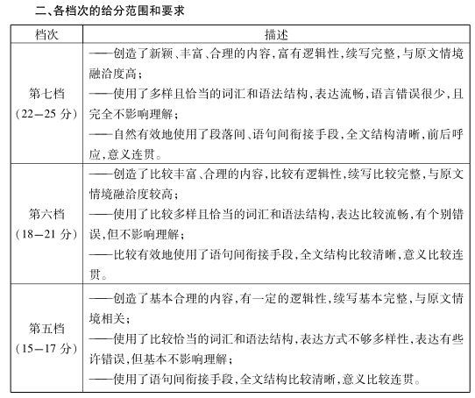
命题表述：提供一段350词以内的语言材料，要求考生在理解一篇不完整语篇的基础上，依据该材料内容、所给段落开头语进行续写（150词左右）， 将其发展成一篇与给定材料有逻辑衔接，情节和结构完整的短文。
1. 主要考察知识点：
主题：主流价值观
情节：结构合理性、段落衔接度、内容融洽度
语言：叙述得体性

Slide 7
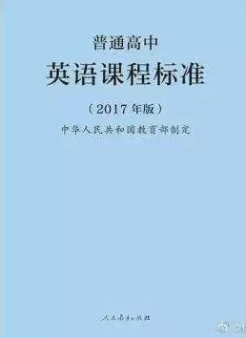
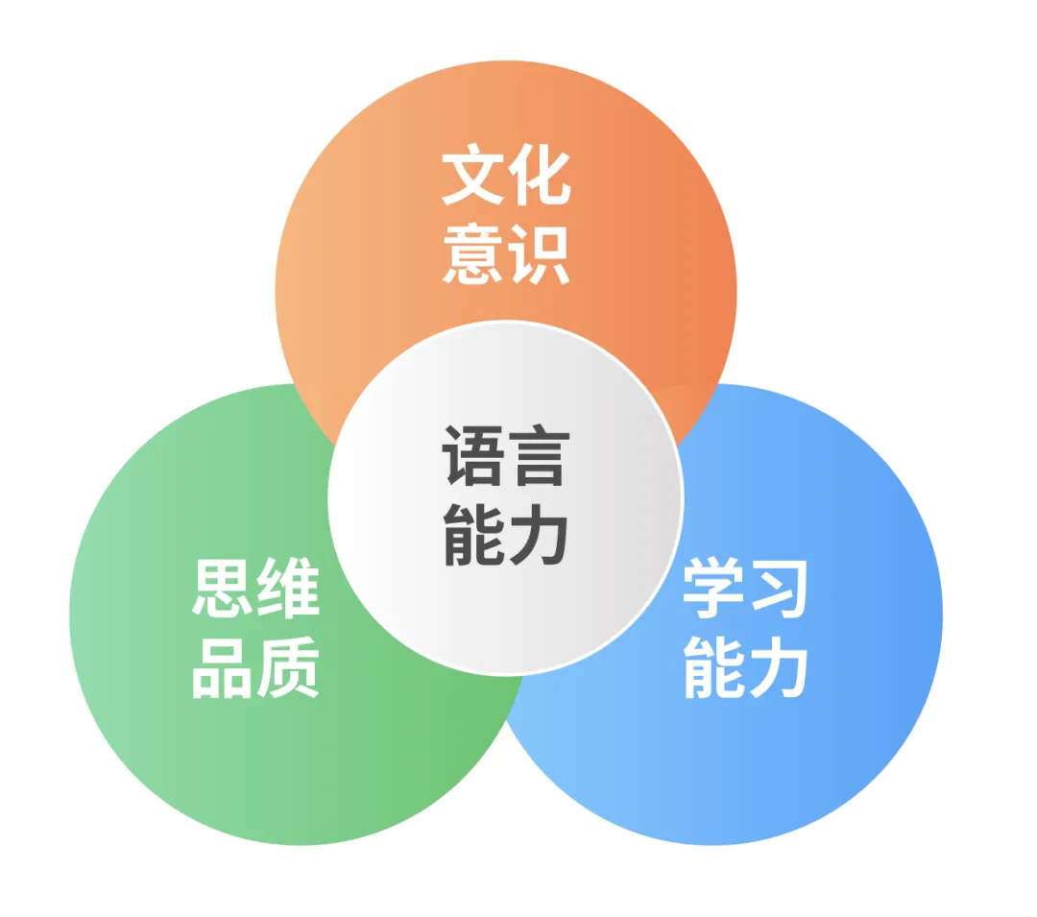
2. 课程标准要求
发展英语学科核心素养，落实立德树人根本任务
英语学科核心素养结构图

Slide 8
3. 考察的学科能力
语言能力：阅读理解能力与书面表达能力的双向考察
文化意识：对核心价值的考察，形成正确价值观、价值观、世界观
思维能力：
逻辑思维---用逻辑方法来提炼故事核心信息，寻找续写呼应点
批判性思维---不断评价新情节是否融洽，时刻调整与修正
创新性思维---重新架构原文情节，产生新想法，创造性解决问题
学习能力：调整学习策略，拓宽学习渠道，提升学习效率

Slide 9

三、试题特点分析

Slide 10


1. 题目的设计思路
体裁：
记叙文
中学时，英语蹩脚的“我”在老师的鼓励下参加写作比赛而获奖的事
语篇话题：
主题语境：
人和自我---自我成长
立德树人：
语言学习的规律和方法
学习过程的坚持

Slide 11

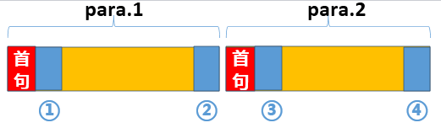
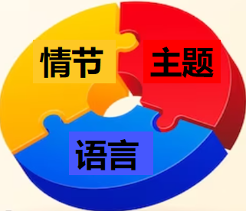

三大主题
人和自我+人和社会+人和自然
2. 相关
核心概念
主题协同
冲突意识
动态分析中心人物
从提示句新事物入手
情节协同
321原则
过渡2
过渡1
承上
启下
承上
点题
ARE原则
模仿
语言协同
创新

Slide 12

3. 分析解决题目思维方法
8.赏例文
7.细评价
6.巧润色
5.列提纲
4.推情节
3.思主题
2.找冲突
1.读情节

Slide 13

四、解题方法展示

Slide 14


1.审题分析
命题表述：阅读下面材料，根据其内容和所给段落开头语续写两段，使之构成一篇完整的短文。注意：续写词数应为150左右；请按如下格式作答。
读写结合，读写联动，语言理解与语言产出同时进行。
续写内容开放，但不等于任意发挥。原文内容与续写段落首句已为续写设定了隐含方向。

Slide 15
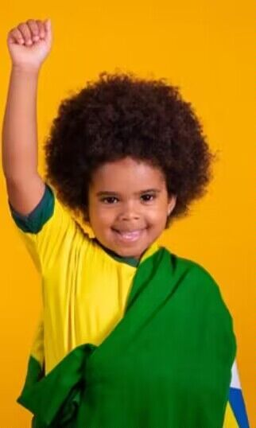

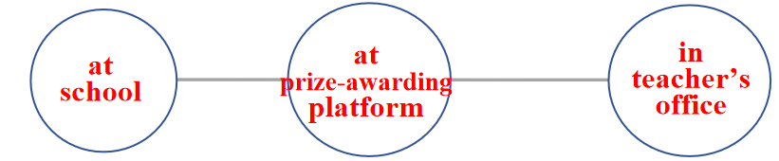
2. 解题方法展示
(1)Read for the plot读情节,梳理基本要素
叙事要素:
1.角色：I, my teacher
2.视角：第一人称
3.时空线：when I was in middle school;
---before the contest, during the contest, after the contest
4.地点线：

Slide 16


5.情节线
Climax
I finished the essay and enjoyed writing
续写第一段：A few weeks later, when I almost forgot the contest,
there came the news.
I polished my essay again and again
Encouraged by the teacher, I chose the subject and began to write
续写第二段： I went to my teacher’s office after the
award presentation.
My teacher asked me to enter a writing contest
Beginning
Ending

Slide 17
(2) Read for the conflict找冲突，动态分析中心人物
conflict1
negative
When I was in middle school, my social studies teacher asked me to enter a writing contest, I said no without thinking. I did not love writing. My family came from Brazil, so English was only my second language. Writing was so difficult and painful for me that my teacher had allowed me to present my paper on the sinking of the Titanic by acting out a play, where I played all the parts. No one laughed harder than he did.
So, why did he suddenly force me to do something at which I was sure to fail? His reply: “Because I love your stories. If you’re willing to apply yourself, I think you have a good shot at this.” Encouraged by his words, I agreed to give it a try.
I chose Paul Revere’s horse as my subject. Paul Revere was a silversmith (银匠) in Boston who rode a horse at night on April 18, 1775 to Lexington to warn people that British soldiers were coming. My story would come straight from the horse’s mouth. Not a brilliant idea, but funny, and unlikely to be anyone else’s choice.
What did the horse think, as he sped through the night? Did he get tired? Have doubts? Did he want to quit? I sympathized immediately. I got tired. I had doubts. I wanted to quit. But, like Revere’s horse, I kept going. I worked hard. I checked my spelling. I asked my older sister to correct my grammar. I checked out a half-dozen books on Paul Revere from the library. I even read a few of them.
When I handed in the essay to my teacher, he read it, laughed out loud and said, “Great. Now, write it again.” I wrote it again, and again and again. When I finally finished it, the
thought of winning had given way to the enjoyment of writing. If I didn’t win, I wouldn’t care.
自我否定
冲突1
自我尝试
solution1
自我怀疑
冲突2
自我坚持
conflict2+solution2
冲突3
自我突破
conflict3+solution3
positive

Slide 18
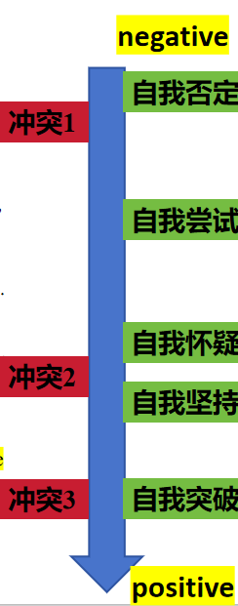

(3) Spot the theme 思主题, 定基调
主题:人和自我---自我成长
作者面对困境没有退缩，坚持不懈
作者突破自我局限敢于尝试

Slide 19
(4) Predict the development推情节，从提示句新事物入手
Para1:A few weeks later, when I almost forgot the contest, there came the news.
321原则具体说明：what is the news?
①result of the contest and invitation to the award presentation
ARE原则: How did I respond?
②my feelings and actions toward the news
③attend the award ceremony and
want to share with my teacher
Para2:I went to my teacher’s office after the award presentation.
321原则具体说明：why did I go to the teacher’s office?
④show gratitude to the teacher
ARE原则: How did the teacher respond?
⑤the teacher’s congraduations and comments
⑥主题：Nothing is difficult for a willing and a persistent soul.

Slide 20
(5) Outline the plot拟提纲,321+ARE原则
Para1:A few weeks later, when I almost forgot the contest, there came the news.
情节一：（承上）生：得知获奖（物主互动）（情感线：吃惊）
情节二：（过渡）生：经历授奖（主配互动）（情感线：兴奋+不可思议）
情节三：（启下）生：急于分享（己己互动）（情感线：兴奋+喜悦）
Para2:I went to my teacher’s office after the award presentation.
情节一：（承上）生：表达感激（师生互动）（情感线：喜悦+感激）
情节二：（过渡）师：表达祝贺（师生互动）（情感线：喜悦+引以为傲）
情节三：（点题）生：恍然大悟（师生互动）（主题升华）

Slide 21
(6) Polish the language巧润色，模仿与创新
When I was in middle school, my social studies teacher asked me to enter a writing contest, I said no without thinking. I did not love writing. My family came from Brazil, so English was only my second language. Writing was so difficult and painful for me that my teacher had allowed me to present my paper on the sinking of the Titanic by acting out a play, where I played all the parts. No one laughed harder than he did.
So, why did he suddenly force me to do something at which I was sure to fail? His reply: “Because I love your stories. If you’re willing to apply yourself, I think you have a good shot at this.” Encouraged by his words, I agreed to give it a try.
I chose Paul Revere’s horse as my subject. Paul Revere was a silversmith (银匠) in Boston who rode a horse at night on April 18, 1775 to Lexington to warn people that British soldiers were coming. My story would come straight from the horse’s mouth. Not a brilliant idea, but funny, and unlikely to be anyone else’s choice.
What did the horse think, as he sped through the night? Did he get tired? Have doubts? Did he want to quit? I sympathized immediately. I got tired. I had doubts. I wanted to quit. But, like Revere’s horse, I kept going. I worked hard. I checked my spelling. I asked my older sister to correct my grammar. I checked out a half-dozen books on Paul Revere from the library. I even read a few of them.
When I handed in the essay to my teacher, he read it, laughed out loud and said, “Great. Now, write it again.” I wrote it again, and again and again. When I finally finished it, the thought of winning had given way to the enjoyment of writing. If I didn’t win, I wouldn’t care.
1.语言清新流畅，幽默写实，有第一人称叙述的亲临亲历感。
2.把自己比作银匠的马PR，用比喻和拟人带入感受，传情达意。
3.3个排比句，短促有力。
4.重复与对比，呼应前文观点。

Slide 22
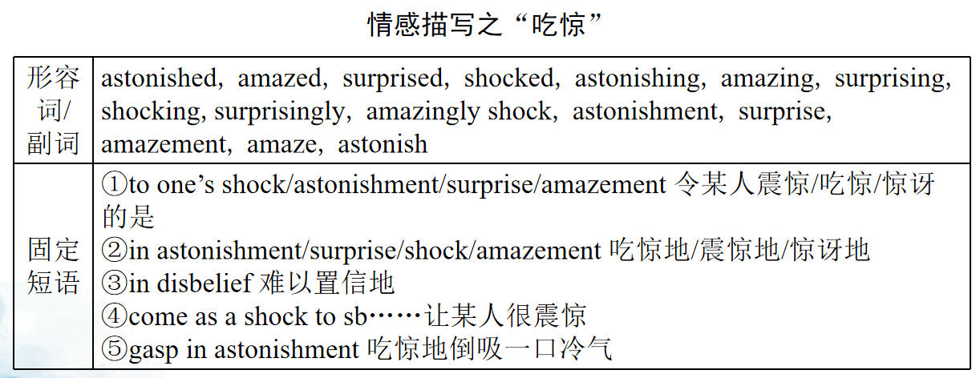
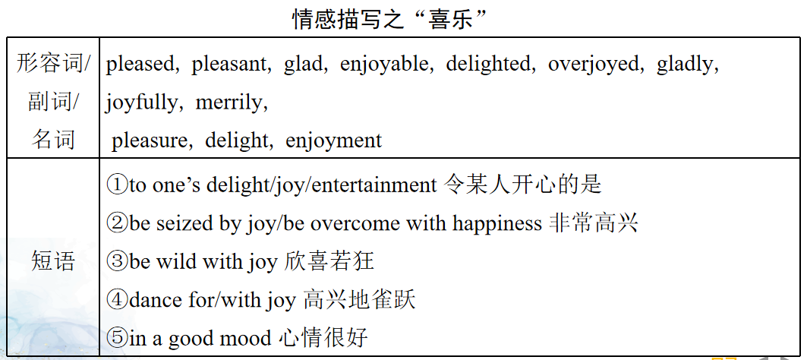
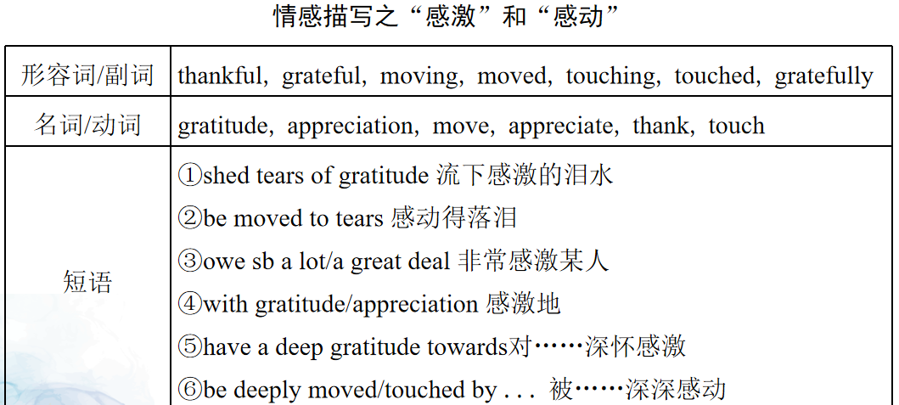

微场景描写，创新表达
1.写作是语料的重组变换。“动作”、“心理”、“对话”描写素材的积累与提取。
2.所有的描写都是服务于主题与情节，把握好描写的度，不能面面俱到，拖慢情节发展。
3.不可堆砌好词、好句、套句，冲淡原文叙事风格。

Slide 23
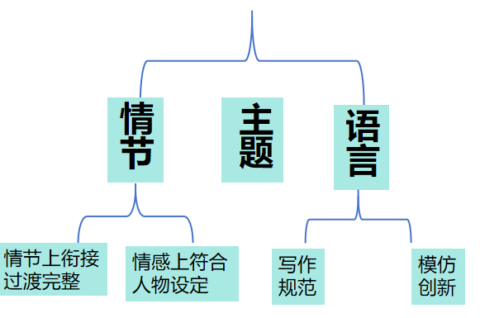
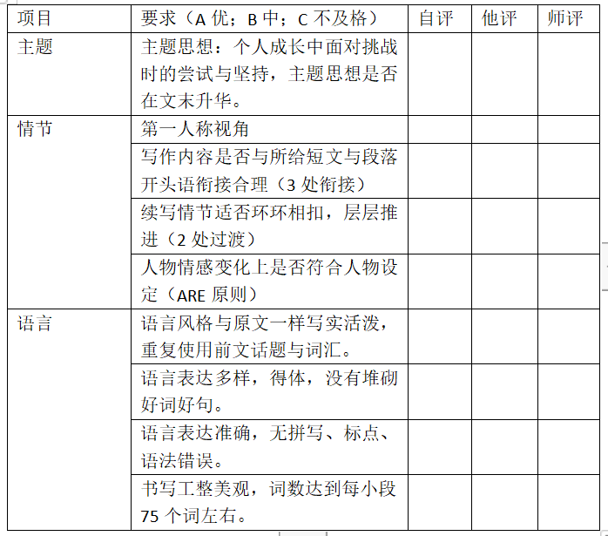
(7) Assessment细评价，量化续写要素

Slide 24
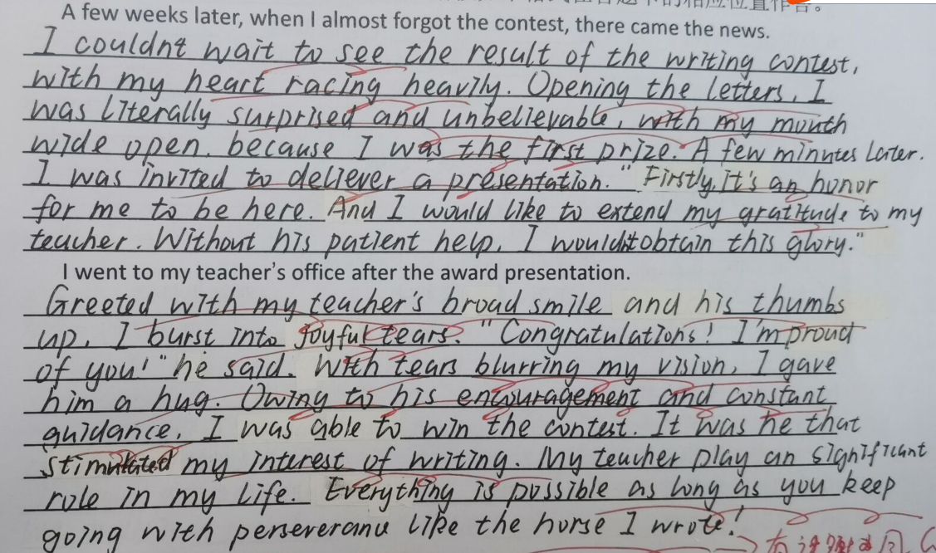
(8)Sample writing and Appreciation例文赏析
学生作品赏析
1、三处衔接与一处点题连接自然流畅，故事完整连贯。
2、从“动作”、“心理”、“对话”三个角度描写人物。人物形象鲜活立体。
3、长短句并存，词句表达丰富多样，考生有较强的语言水平。
4、文末点题时重复使用前文中马的话题元素，保持了一定的语言协同性。

Slide 25
例文赏析
A few weeks later, when I almost forgot the contest, there came the news. The moment I saw my name on the top of the first prize list, surprise and joy occupied my mind（无灵主语）. Despite the obstacle and confusion on the road, the horse eventually reached his destination with determination（把自己比作马---原文话题重现，语言协同1）. I was invited to deliver a speech on the award presentation. I explained why I chose this special subject and even acted out one-role play as Revere’s horse on the stage, which made the audience laugh out. In the end, I showed my gratitude to the horse rider---my social studies teacher.（把老师比作骑马的人---原文话题重现，语言协同2）
I went to my teacher’s office after the award presentation. Bathed in the enjoyment, he waved at me and expressed his congratulations. With tears almost blurring my vision, I gave him a big hug. Without his encouragement, I couldn’t have won the prize（虚拟语气）. It was him that carved my writing path.Golden sunlight scattered through the office window, spreading he brightness and warmth（环境映衬心情）. He patted my back and laughed out again. Then he pointed that my passion, devotion and persistence contributed to my success. “Just like the horse you wrote, he got tired and had doubts, but he kept going.”（把自己比作马---原文话题重现，语言协同3，主题升华）
优秀的读后续写：
与积极的主题协同
与严谨的逻辑协同
与优质的语言协同

Slide 26

五、教学启示提炼

Slide 27





1. 解题规律
回归教材，取法于教材，落实教考衔接。
师生共读共写，搭建多维支架。
强化阅读，开发时文外刊阅读资源。
开发多模态资源，注重读后续写微技能训练。

Slide 28








搭建结构支架，助力读懂原文
搭建思维支架，助力预测走向
师生共读共写
搭建多维支架
搭建图表支架，助力图文互动
搭建语言支架，助力语言协同
搭建评价支架，助力自我诊断
搭建范例支架，助力反思提升

Slide 29
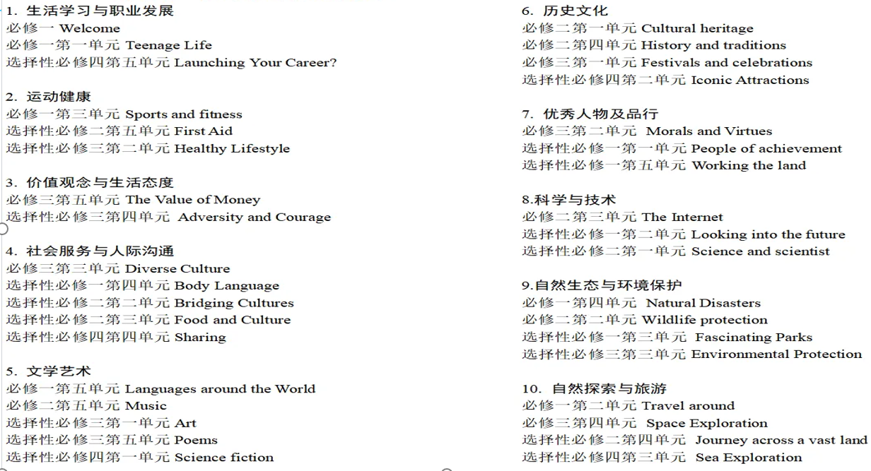
回归教材，取法于教材，落实教考衔接
文章无限，但价值导向有限。以新教材大单元主题语境为框架培养学生的英语学科核心素养。

Slide 30

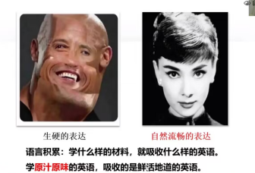
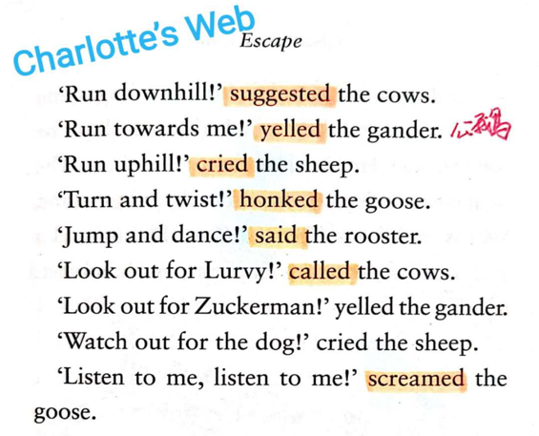
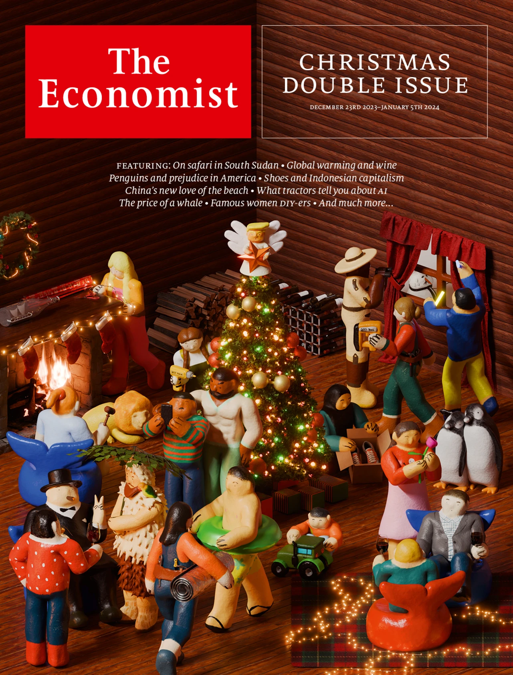

强化阅读，开发时文外刊阅读资源

Slide 31
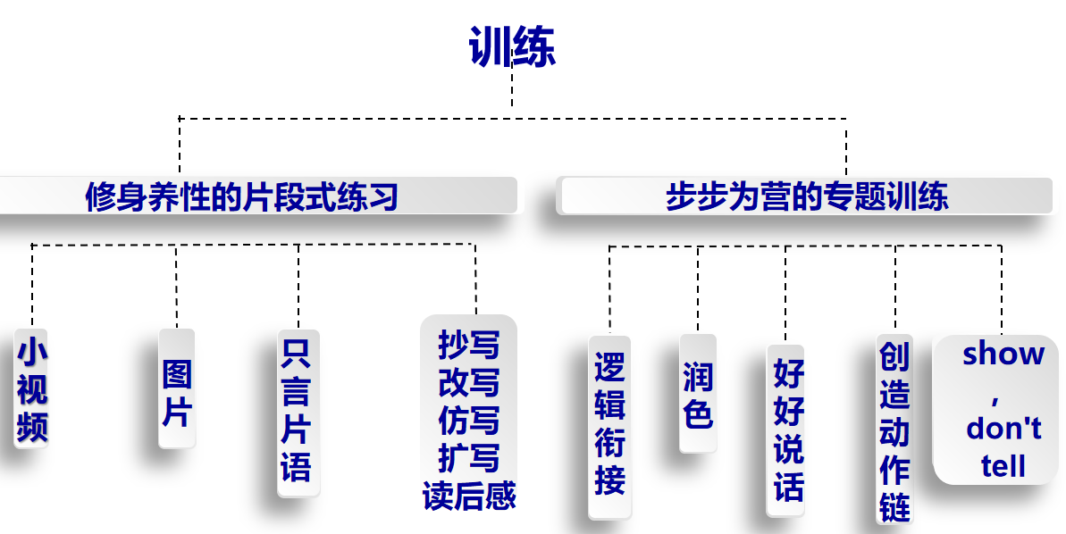
开发多模态资源，注重读后续写微技能训练

Slide 32

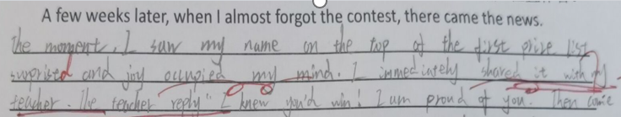
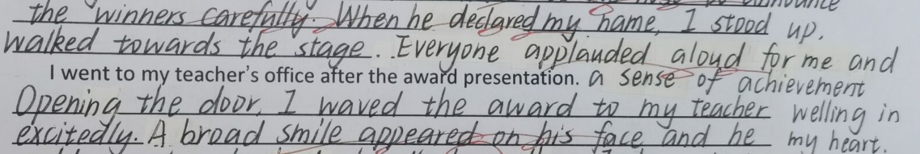
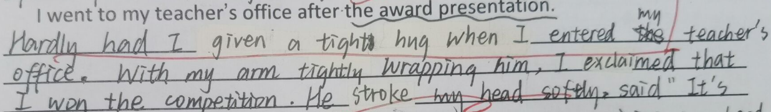
2. 学生的疑难点
（1）情节缺乏逻辑
如：第一段写师生对话，时空转换不合理。
（2）段落缺乏衔接
如：续写首段的尾句直接从上台领奖的掌声中过渡到第二段首句的办公室，没有写急于与老师分享的心理，与开头语衔接弱。
（3）语言缺乏协同
如：堆砌套句和高级表达，对话流水式叙述过多。

Slide 33
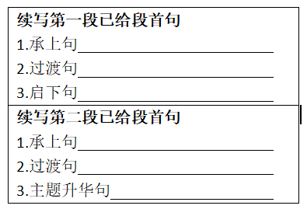



3.学法指导
巧列提纲，
细化段落小情节
要点编号，
批注阅读文本
圈画重点词句，从时间、地点、人物、事件4个角度提取信息，呈现要点内在关系，标记散落在文中的线索，理清思路。
广积累
勤练笔
1.在经典名著阅读中寻找优美语言，
诵读与欣赏。
2.在读后续写精彩范例中汲取描写灵感，
背诵与仿写。
3.在平时的阅读文本中挖掘好词佳句，
积累与模仿。
经常动笔，写句子，写小短文，写周记随笔。每天写上3-5句。不限定内容，不规定词数，只要动笔就行。

Slide 34
4. 拓展解题
1.主题是控制情节走向的幕后统帅
2.传播主流价值观，歌颂人性真善美
3.利用主题语境 快速归纳主题
主题语境 | 主题群 | 写作主题
人与自我 | 生活与学习； 做人与做事 | 自我成长
人与社会 | 社会服务与人际沟通； 文学、艺术与体育； 历史、社会与文化； 科学与技术 | 人和人之间的互相帮助
人与自然 | 自然生态； 环境保护； 灾难防范； 宇宙探索 | 人和野生动植物及环境和谐互动； 人和宠物的和谐互动； 灾难自救和救援

Slide 35
试题 | 主要内容 | 主题
2023年1月浙江卷 | 挽救困在蜘蛛网中的蜂鸟
2022年1月浙江卷 | 傲娇学霸与迷糊学渣
2022年6月浙江卷 | 为无家可归的人施粥
2022年6月全国1卷 | 残疾学生参加赛跑
2021年1月浙江卷 | 头插南瓜，视频走红
2021年6月浙江卷 | 打工挣钱，补贴家用
2021年6月全国1卷 | 双子做早餐，庆祝母亲节
2020年1月浙江卷 | 离家求学，狗狗伤感
2020年7月浙江卷 | 拍摄北极熊遇险
2020年7月全国1卷 | 制作爆米花，救助穷人
人与自然（人与动物）
人与自我（个人成长：学校生活）
人与社会（帮助别人）
人与自我（个人成长：学校生活）
人与自我（个人成长：家庭趣事）
人与自我（个人成长：家庭生活）
人与自我（个人成长：家庭生活）
人与自然（人与动物）
人与自然（人与动物）
人与社会（帮助别人）

Slide 36
5. 变式训练设计
(2022高考题全国卷1读后续写）
It was the day of the big cross-country run. Students from seven different primary schools in and around the small town were warming up and walking the route（路线）through thick evergreen forest. I looked around and finally spotted David, who was standing by himself off to the side by a fence. He was small for ten years old. His usual big toothy smile was absent today. I walked over and asked him why he wasn't with the other children. He hesitated and then said he had decided not to run. What was wrong? He had worked so hard for this event! I quickly searched the crowd for the school’s coach and asked him what had happened. “I was afraid that kids from other schools would laugh at him,” he explained uncomfortably. “I gave him the choice to run or not, and let him decide.” I bit back my frustration（懊恼）. I knew the coach meant well-he thought he was doing the right thing. After making sure that David could run if he wanted, I turned to find him coming towards me, his small body rocking from side to side as he swung his feet forward. David had a brain disease which prevented him from walking or running like other children, but at school his classmates thought of him as a regular kid. He always participated to the best of his ability in whatever they were doing. That was why none of the children thought it unusual that David had decided to join the cross-country team. It just took him longer--that's all. David had not missed a single practice, and although he always finished his run long after the other children, he did always finish. As a special education teacher at the school, I was familiar with the challenges David faced and was proud of his strong determination.
We sat down together on some steps, but David wouldn’t look at me. I watched as David moved up to the starting line.

Slide 37
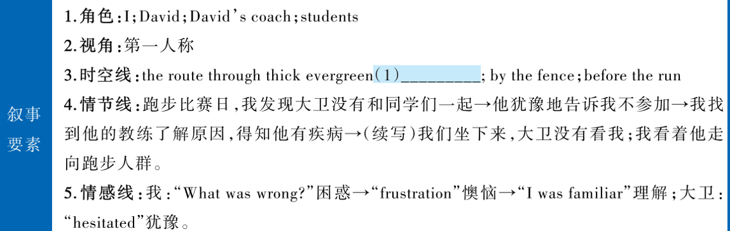
forest
David with a brain disease prepared for the race while on that very day, he wanted to give up for fearing the laugh from the kids in the other schools.
本文讲述了一位从事特殊教育的教师鼓励患病男孩勇敢站上起跑线，与其他同学一起参加跑步的故事。文章的主题属于人与自我，自我的成长：从打算放弃，到受到鼓舞，到追寻内心，战胜内心的恐惧，弘扬自强不息的精神。

Slide 38
情节思路——从提示句新事物入手+321原则+ARE原则
We sat down together on some steps, but David wouldn’t look at me.
①（承上）我的action: 鼓励他，说：……
②（过渡）他 的response之emotion
③（启下）他的response之话语和动作
I watched as David moved up to the starting line.
④（承上）比赛开始
⑤（过渡）他的action:照应人物特点线索
⑥（点题）我或群众的response: applause→he lost but won!

Slide 39
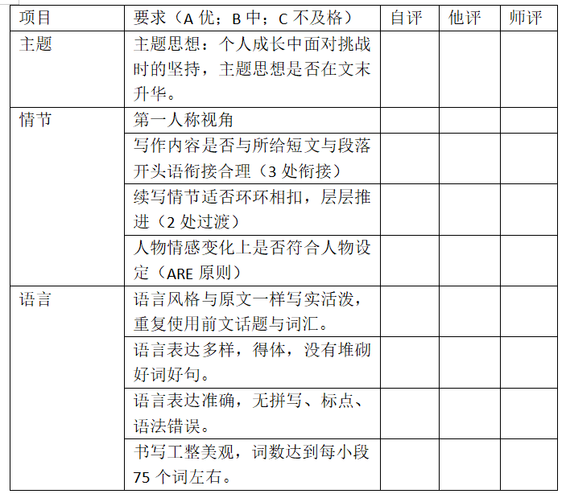
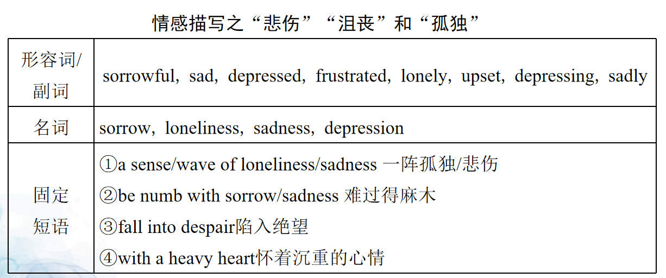
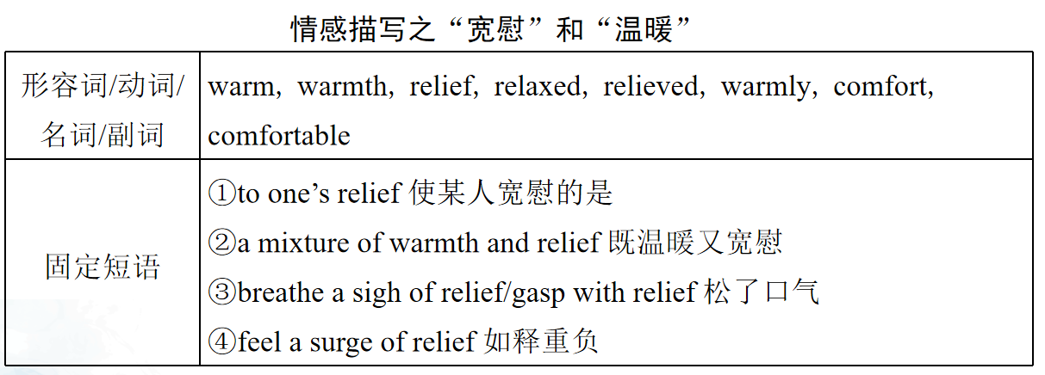
动作描写 Unfortunately, he stumbled and fell to the ground only a few meters into the race, causing my heart to sink.
主配角互动和心理描写His classmates surrounded him, congratulating him on his effort and determination. I could see the pride written all over his face, and my heart swelled with joy.
对话描写He nodded and gazed at the field with determination. "I'm going to run," he said softly, yet fiercely.

Slide 40
We sat next to each other, but David wouldn’t look at me. He buried his head into his arms and couldn’t help sobbing. I turned him around and looked him in the eyes sincerely.“ Come on, you can do it.” I whispered to her in a soft voice and patted his shoulder gently. I showed the photo in my cellphone with her. In the photo, he was running as fast as he could with all the other boys on the playground. The bright smiles, the loud cheers ,the sweaty face as well as the determination to win victory suddenly crowded into his mind. Without hesitation, he wiped away the tears and struggled to his feet to embrace the challenge.
I watched as David moved up to the starting line with the other runners. The starter’s gun sounded. But he had only gone a few metres before he tripped and fell flat on the ground. My heart sank. As I started to shout encouragement, other voices around me took up the call. “Come on David!” David picked himself up and started again until he crossed the finish line to wild cheers and applauses, though the last one. He also got a special award for his courage. He also got respect of all students. To him, that was worth a whole lot more than the award.
优秀的读后续写：
与积极的主题协同
与严谨的逻辑协同
与优质的语言协同

Slide 41


把握三大协同，还原续写故事拼图

