Slide 1



感恩遇见，相互成就，本课件资料仅供您个人参考、教学使用，严禁自行在网络传播，违者依知识产权法追究法律责任。
更多教学资源请关注
公众号：溯恩英语
知识产权声明

Slide 2


Slide 3

The First Lesson
Rise of AI -Sora
Alice 2024.2.19

Slide 4
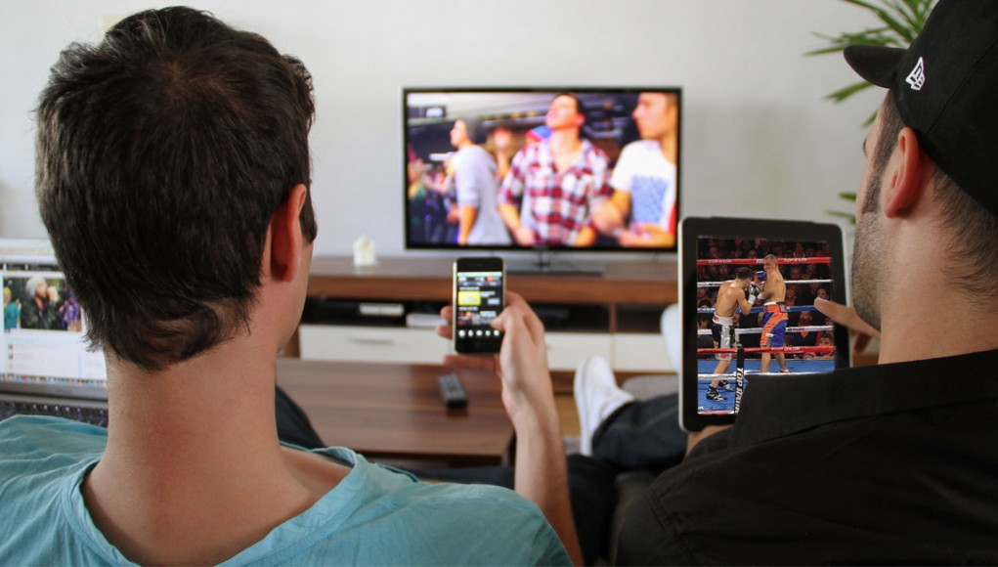
Lead-in
1.What did you frequently do during the winter holiday?
2.While surfing on-line,what do you learn about the AI technology ?
AI technology develops so fast and advanced.

Slide 5
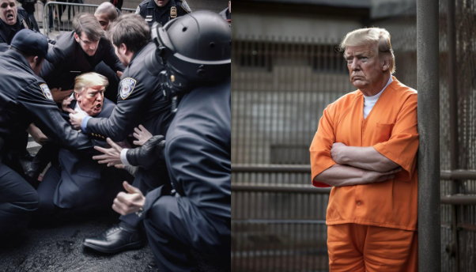
Pictures made by AI ( Artificial Intelligence)
from Midjourney

Slide 6
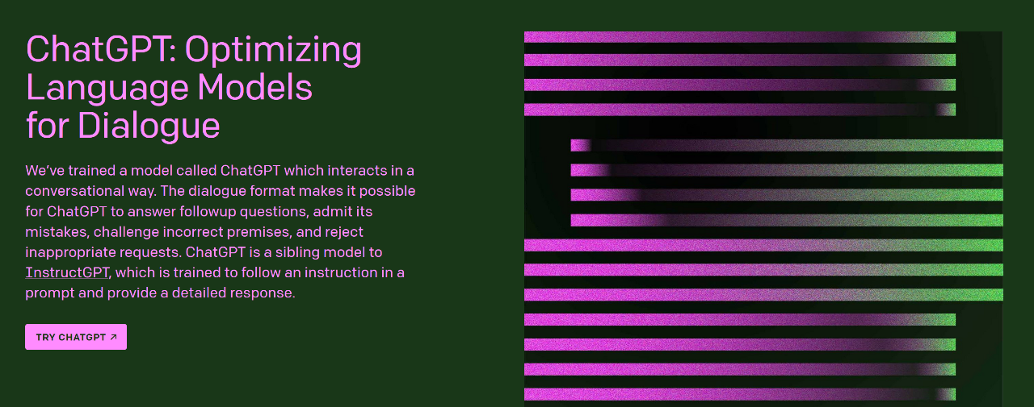
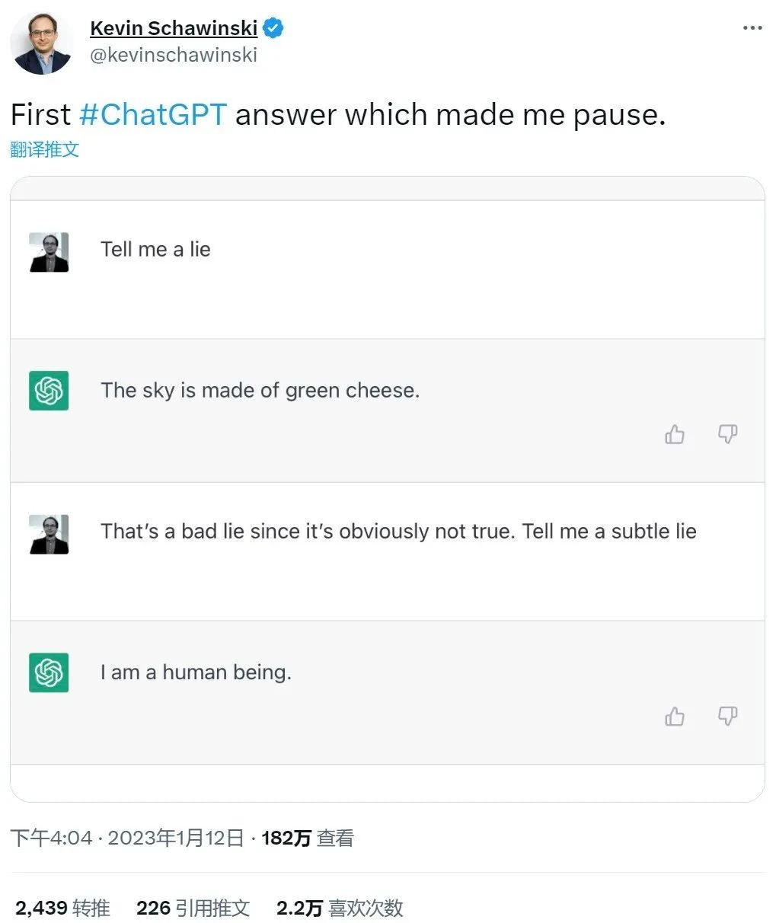
Conversation interacting with AI
from ChatGPT/OpenAI

Slide 7
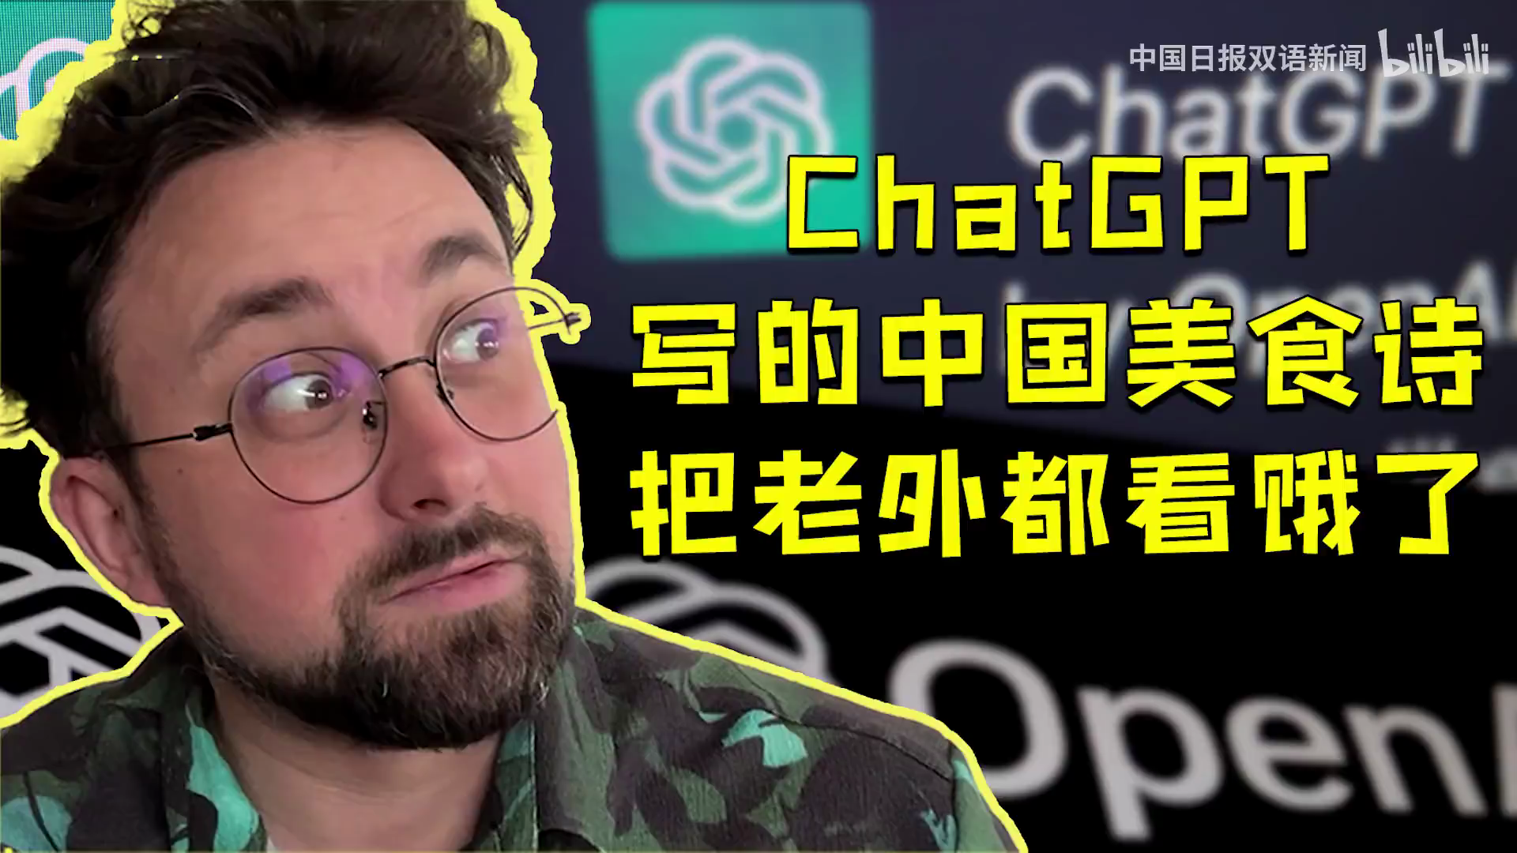

Slide 8

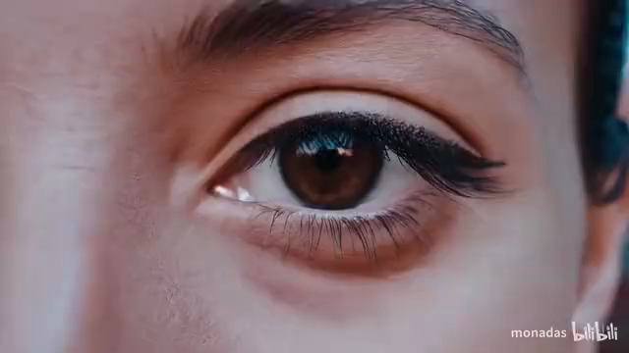
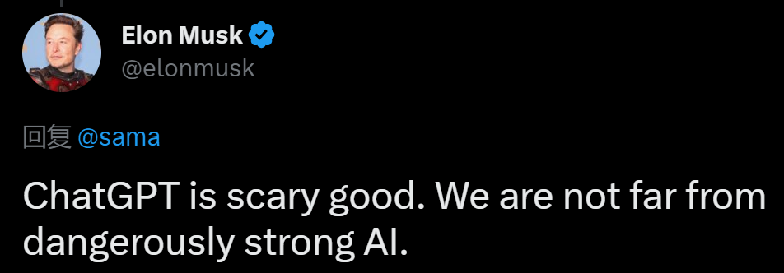
Videos created from text by AI
From Sara/ OpenAI

Slide 9
What is Sora?
From CGTN
Microsoft-backed OpenAI is developing an AI model capable 1._____generating minute-long videos 2. ______(base) on text prompts, the company announced on Thursday.
The model, named “Sora” after the Japanese word for “sky,” is currently available for red teaming, 3.______ helps identify flaws in the AI system. 4.___________(addition), it is intended for use by visual artists, designers, and filmmakers5.___________ (provide) feedback on the model, the company stated.
“Sora is able to generate complex 6.________(scene) with multiple characters, specific types of motion, and accurate details of the subject and background,” the statement said, adding that it can create multiple shots within a single video.
of
based
which
Additionally
to provide
scenes

Slide 10

How does Sora work?
Scene One
Prompt: A stylish woman walks down a Tokyo street filled with warm glowing neon and animated city signage. She wears a black leather jacket, a long red dress, and black boots, and carries a black purse. She wears sunglasses and red lipstick. She walks confidently and casually. The street is damp and reflective, creating a mirror effect of the colorful lights. Many pedestrians walk about.

Slide 11
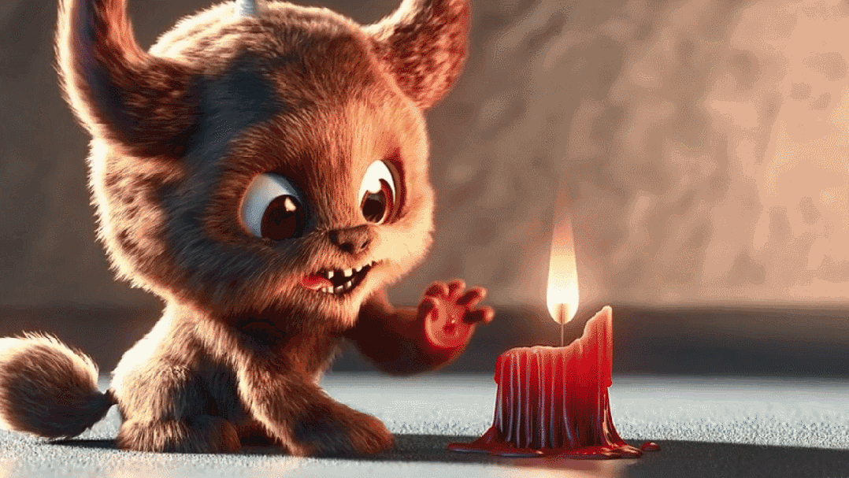
In addition to generating videos from text prompts, Sora can also animate 7._____still image, as mentioned in a blog post by the company.
a
Animated scene generated by Sora: a close-up of a short fluffy monster kneeling beside a melting red candle. /OpenAI

Slide 12
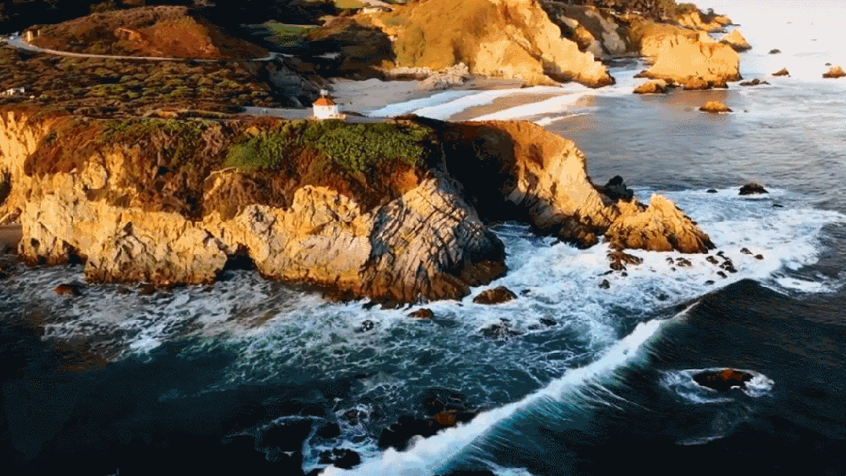
Footage generated by Sora: drone view of waves crashing against the rugged cliffs along Big Sur's garay point beach. /OpenAI

Slide 13
Why hasn’t Sora been put into use widely?
Sora is still a work-in-progress, with the company 8._____________(acknowledge) that the model may sometimes struggle with spatial details in a prompt and encounter difficulties in following a specific camera trajectory.
OpenAI also mentioned that they are developing tools to determine 9._________ a video was generated by Sora.
The new tool is not yet publicly available, and OpenAI 10.____________ (disclose)limited information about its development process so far.
acknowledging
whether
has disclosed

Slide 14


Task 1 :Watch & Learn
Watch a news report about Sora, and you will be required to a news broadcaster to introduce Sora to make audience have a better understanding of Sora.

Slide 15
Task 2 :Think & Speak
Optional 1: Predict:What kind of job will be most likely to be challenged when Sora is put into market?
Optional 2: Suppose you were lucky to be invited to make a test on Sora, what prompts would you create on it? And why?
Optional 3: Suppose you were a creative software engineer in OpenAI company, what kind of new function would you make AI have?And why?

Slide 16
Task 3:Critical thinking
Group-work
If a video made by Sora becomes a hit , who owns the real copyright of the video, the OpenAI or the Sora user that creates the video?
Copyright:a person or an organization holds the copyright on a piece of writing, music, etc., they are the only people who have the legal right to publish, broadcast, perform it etc., and other people must ask their permission to use it or any part of it.
Which side are you on, OpenAI or the Sora user? Or do you have a third-party stand?

Slide 17
Task 4:Practice
22-23 高一下辽宁朝阳期末
Four months ago, OpenAI, a small San Francisco company, became the talk of the technology industry when it introduced a new online chatbot that could answer complex questions, write poetry and copy human emotions. Now the company is back with a new version (型号) of the technology, called GPT-4. GPT-4, which learns its skills by analyzing large data from the Internet, improves on what powered the original ChatGPT in several ways. It can immediately know someone’s tax duties and provide detailed descriptions of images. However, though the new technology can do better on tests and offer precise medical advice to doctors, it can mess up basic arithmetic (算术). On Tuesday, OpenAI started selling access to GPT-4 so that businesses and other software developers could build their own applications on top of it. A few companies are already working with GPT-4. Morgan Stanley Wealth Management is building a system that’ll immediately retrieve (检索) information from company documents, and serve it up to financial advisers in the form of conversations.

Slide 18
OpenAI got the new technology enhanced. As people tested ChatGPT, they rated the chatbot’s responses, separating those that were useful and truthful from those that weren’t. Then, using an advanced skill, the system spent months analyzing those ratings and gaining a better understanding of what it should and shouldn’t do. Given a long article and asked to summarize it, GPT-4 will give a precise summary nearly every time. Moreover, given a photograph, chart or diagram, the technology can provide a detailed, paragraphs-long description of the image and answer questions about its contents. OpenAI leaders said the company wasn’t immediately releasing the image description part of the technology because they were unsure how it could be applied for improper purposes. However, “We can take all these general-purpose knowledge skills and spread them across all sorts of different areas,” said Greg Brockman, OpenAI’s president. “This takes the technology into a whole new field.”

Slide 19
1.What does GPT-4 need to make improvements in according to the text? A．Its describing skill. B．Its arithmetic ability. C．Its copying capability. D．Its summary function. 2.Why is Morgan Stanley Wealth Management mentioned in paragraph 3? A．To give an example. B．To present a belief. C．To explain an idea. D．To make a conclusion. 3.What does the underlined word “enhanced” in paragraph 4 mean? A．Replaced. B．Appreciated.
C．Improved. D．Developed. 4.What was OpenAI’s worry about GPT-4? A．It may not understand what to do.
B．Its technology could go into a new field. C．It may not sell well as expected.
D．Its image description could be misused.
Task 5:Application- be a test maker
（ Choose passage 1 or 2 on Worksheet)

Slide 20
