Slide 1


感恩遇见，相互成就，本课件资料仅供您个人参考、教学使用，严禁自行在网络传播，违者依知识产权法追究法律责任。
更多教学资源请关注
公众号：溯恩英语
知识产权声明

Slide 2
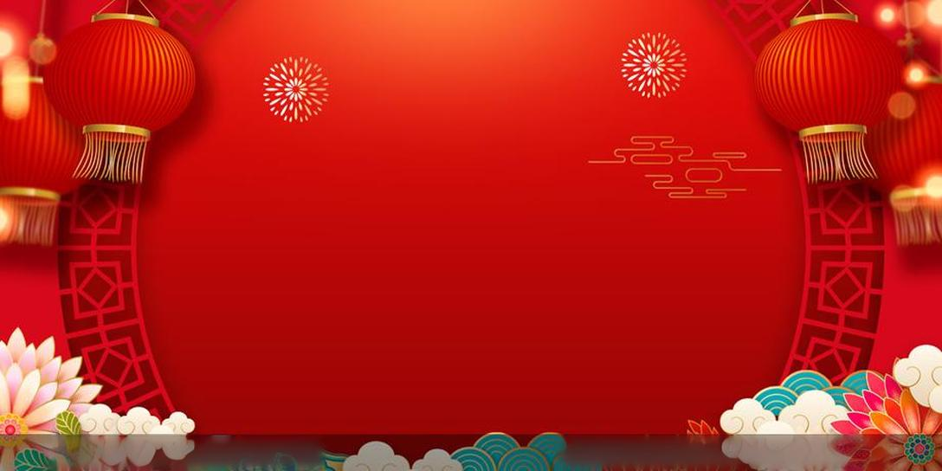

The First Session of the Chinese Dragon Year
of the

Slide 3

Section One
Brief introduction
of the Spring Festival
of the

Slide 4
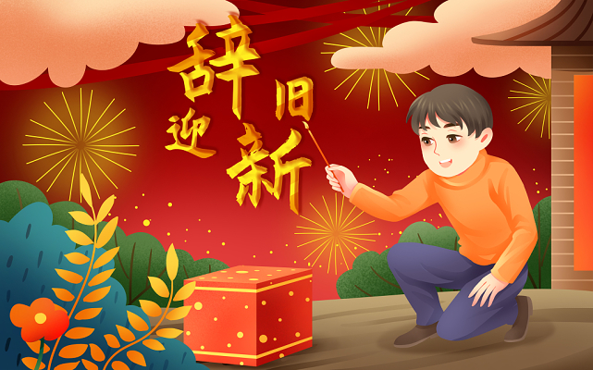

The Chinese New Year, also known as the Spring Festival, is the most important and celebrated festival in Chinese culture. Marking the end of winter and the beginning of spring, it symbolizes new beginnings, family reunion and best wishes for a prosperous year ahead.

Slide 5
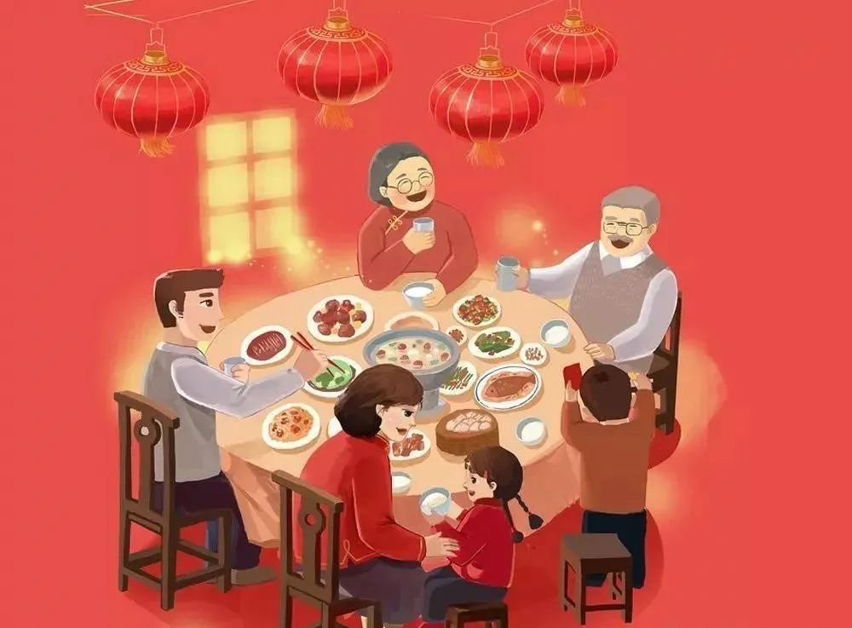
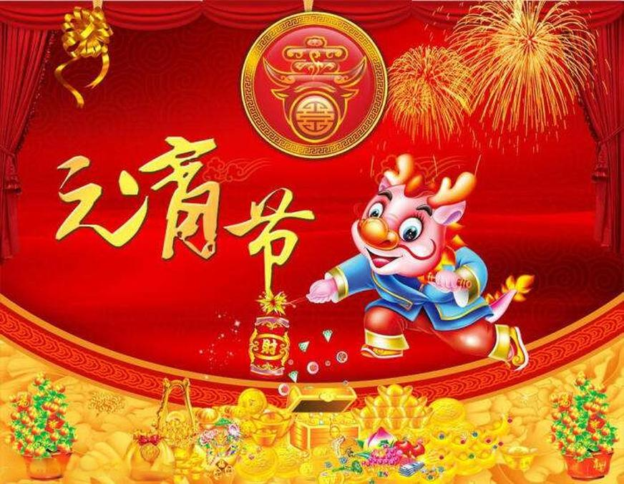
Based on the Chinese lunar calendar, the festival typically falls between late January and early February. The celebration traditionally lasts 15 days, starting from the New Year’s Eve to the Lantern Festival, the 15th day of the first lunar month.

Slide 6
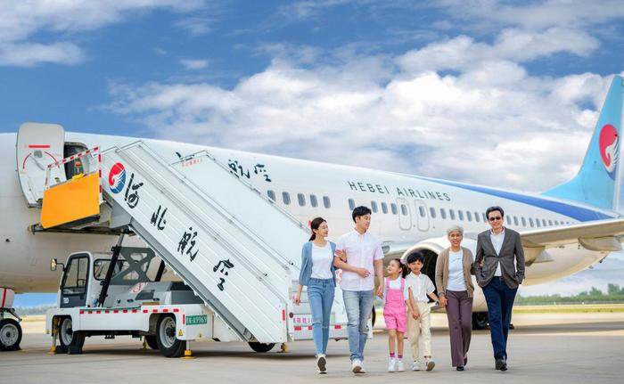
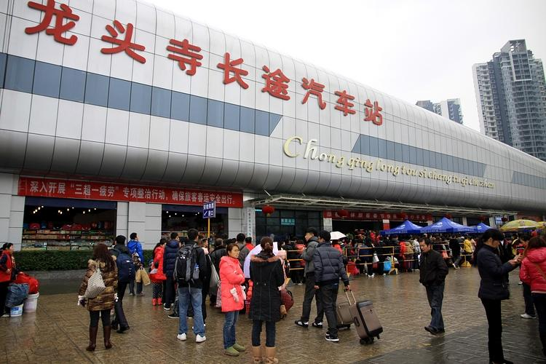
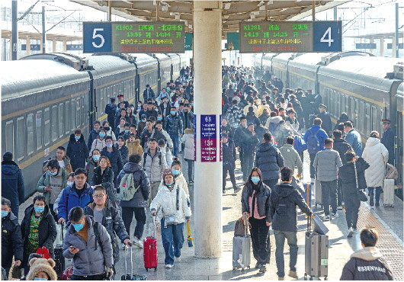
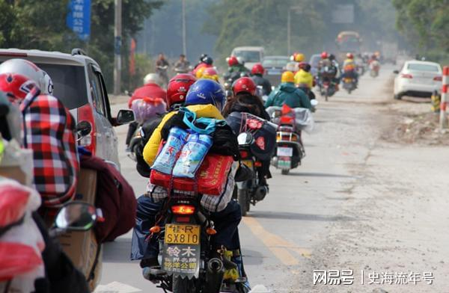
The Chinese New Year also witnesses the largest annual human migration in the world, known as Chunyun, or the Spring Festival travel rush. Millions of people travel across the country to reunite with their families, making it an incredibly busy travel season.

Slide 7
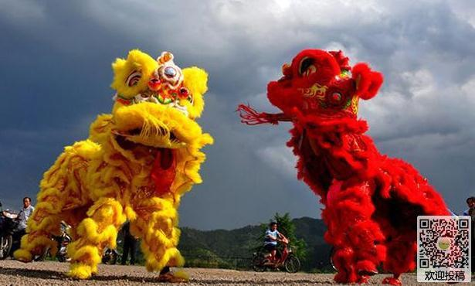
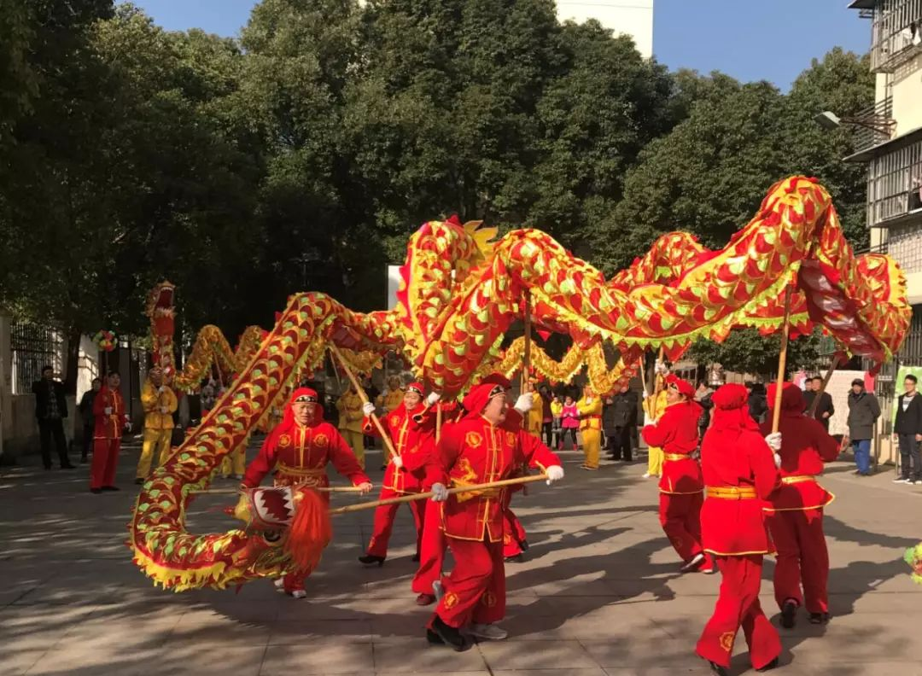
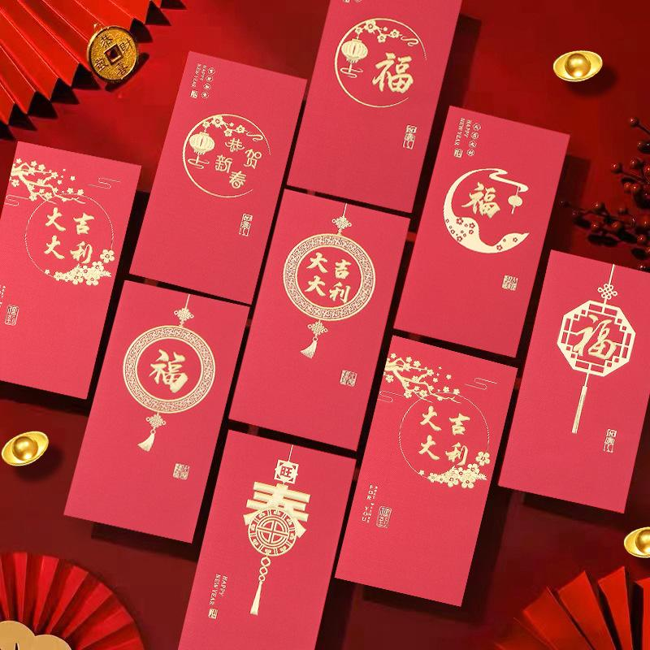
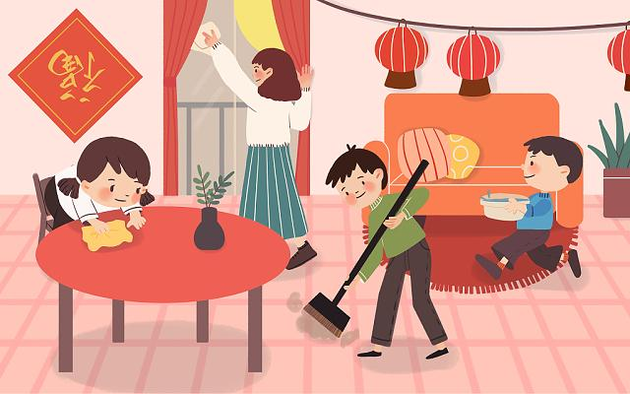
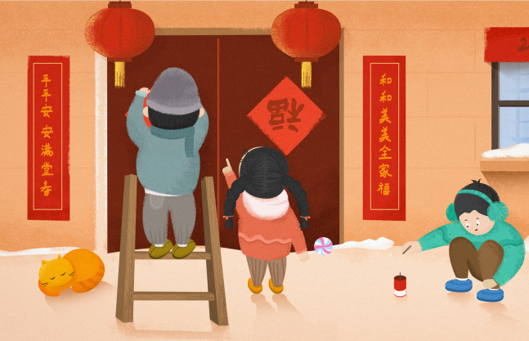
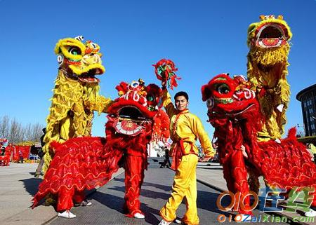
The festival is characterized by various customs and traditions, including cleaning and decorating homes to sweep away ill-fortune and make way for incoming good luck, setting off fireworks and firecrackers to scare away evil spirits (afraid of loud noises, red color and flames) , giving red envelopes (hongbao) filled with money for luck and prosperity and lion and dragon dances to bring good fortune.

Slide 8
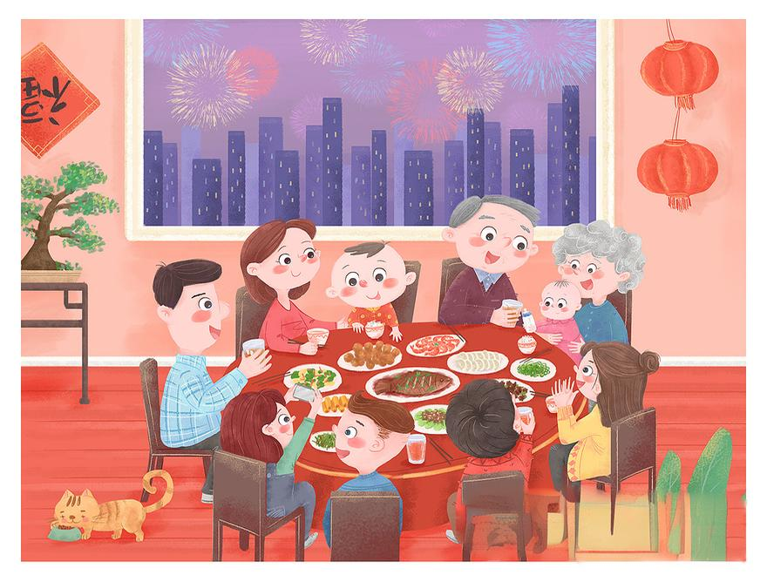
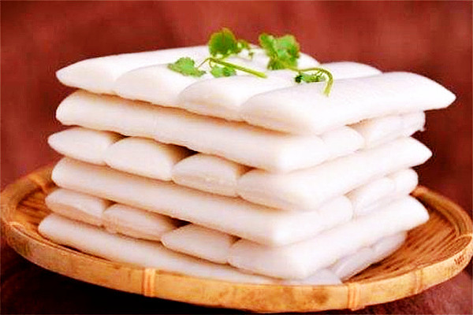
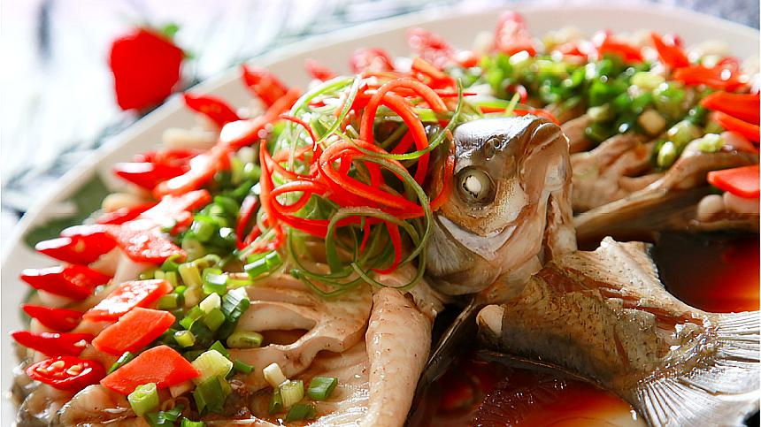
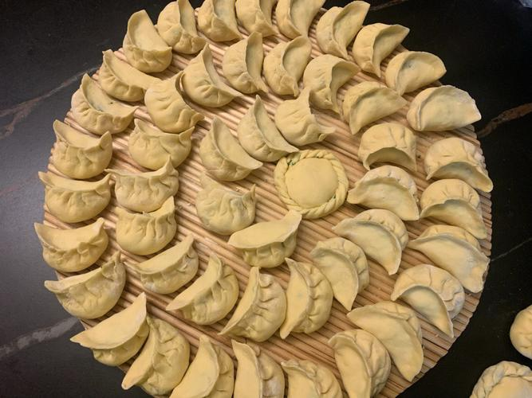
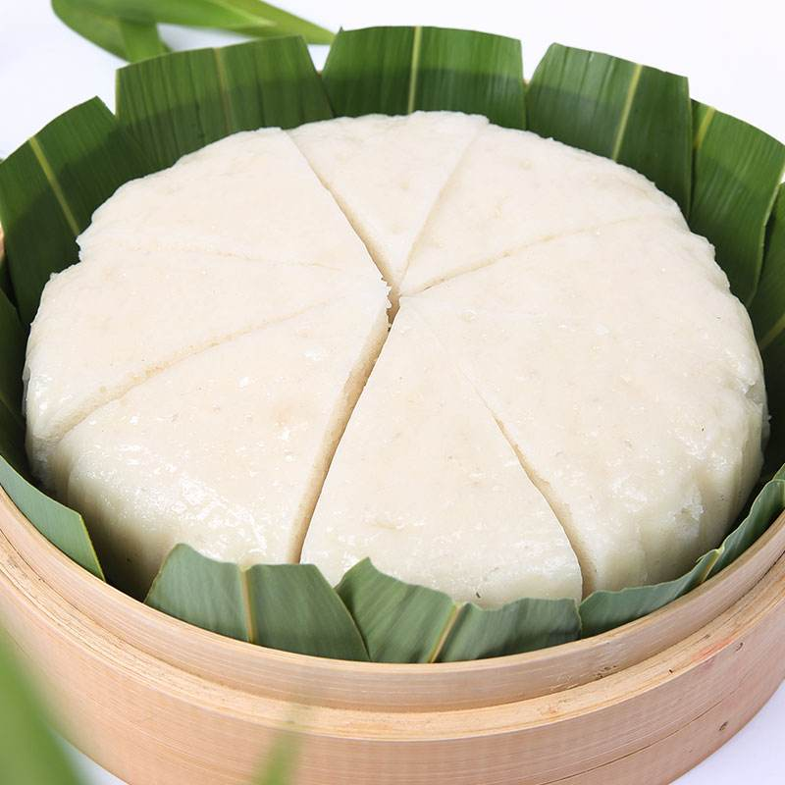
One of the key features of the Chinese New Year is the family reunion dinner, known as “Nian Ye Fan”, on New Year’s Eve. This meal is a grand feast, including dishes like dumplings, fish and niangao (a sticky rice pudding or rice cake), each symbolizing good fortune, prosperity and longevity.

Slide 9

One of the highlights of the festival is the Spring Festival Gala, a televised event broadcast on New Year’s Eve. It features a wide variety of performances, including music, dance, crosstalk, magic show, comedy and drama and enjoys great popularity among billions of people across the globe.

Slide 10
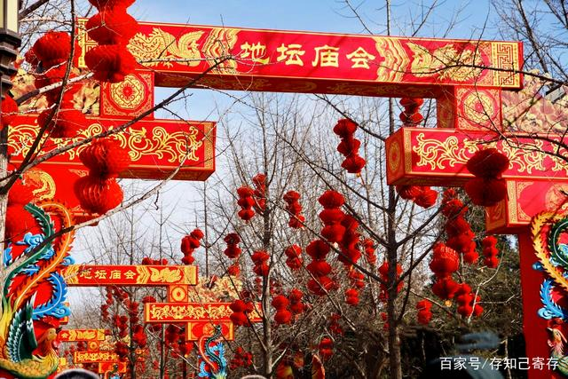
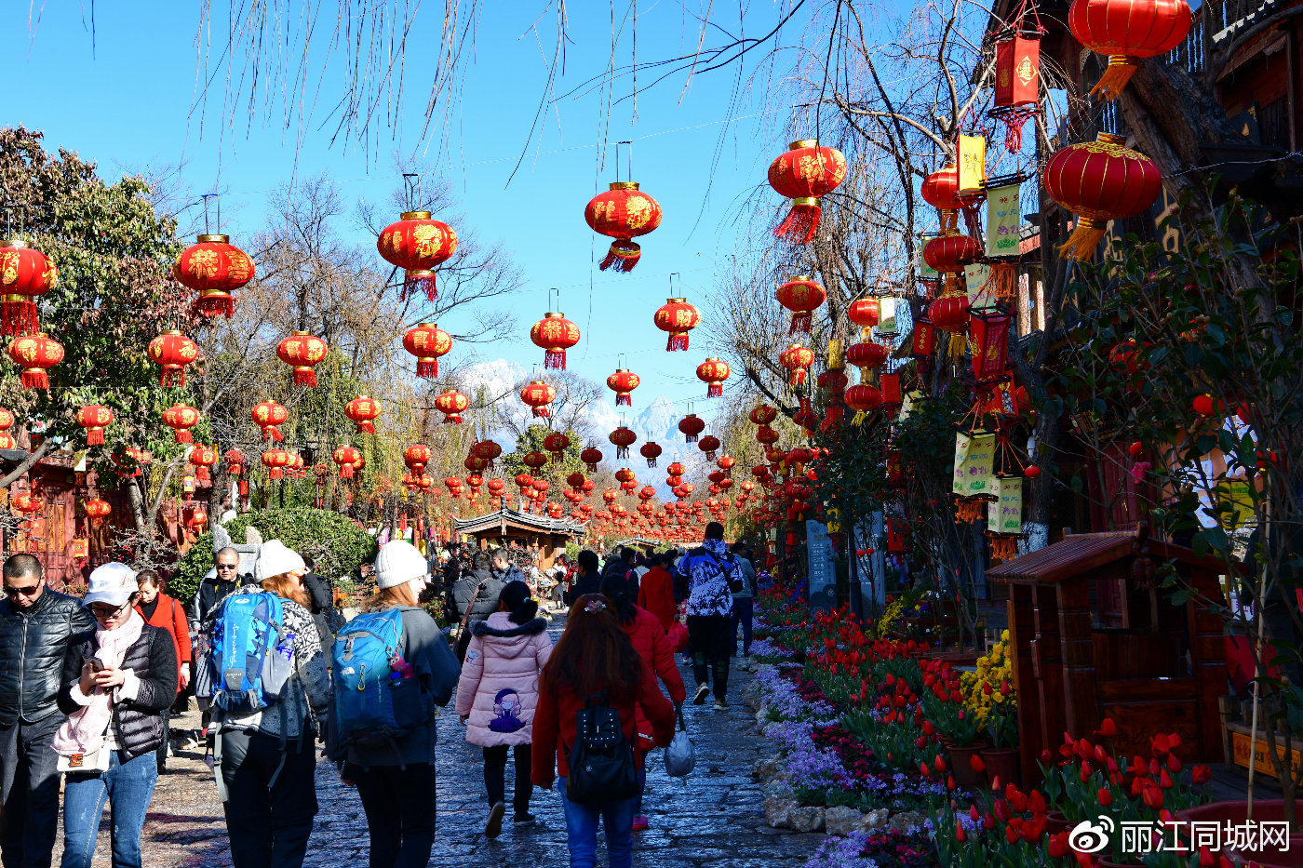
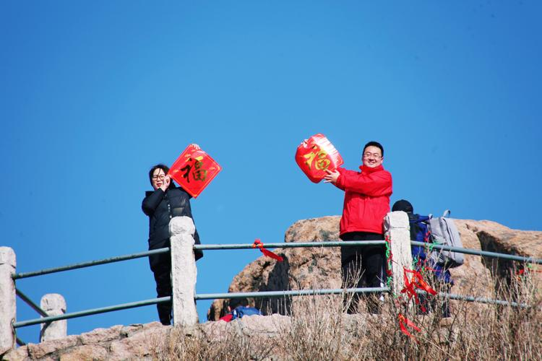
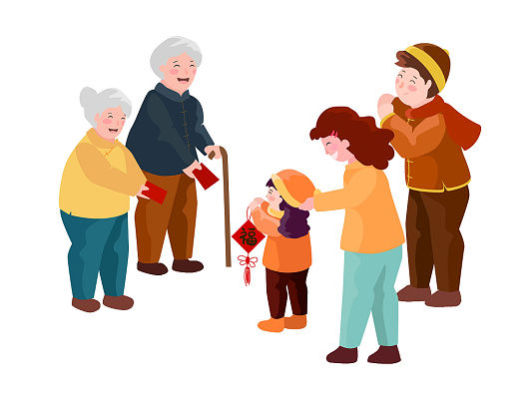
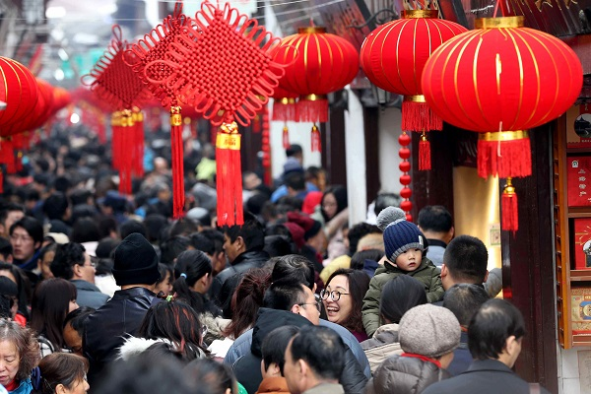
It is a common practice for the Chinese to visit relatives and friends from the first day of the Chinese new year to the Lantern Festival. People visit temple fairs, climb mountains or go travelling with their family or friends to have great fun and enjoy rare leisure time.

Slide 11
Section
Two
Its global
influence
of the

Slide 12
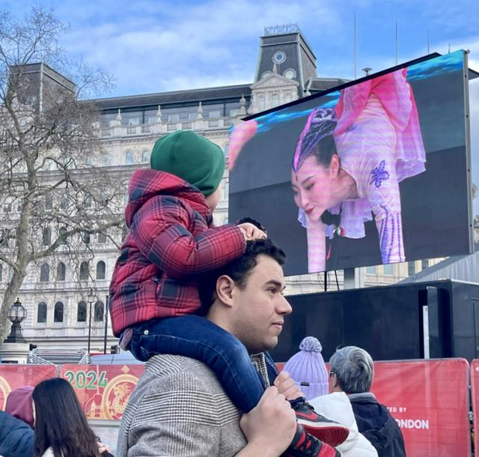
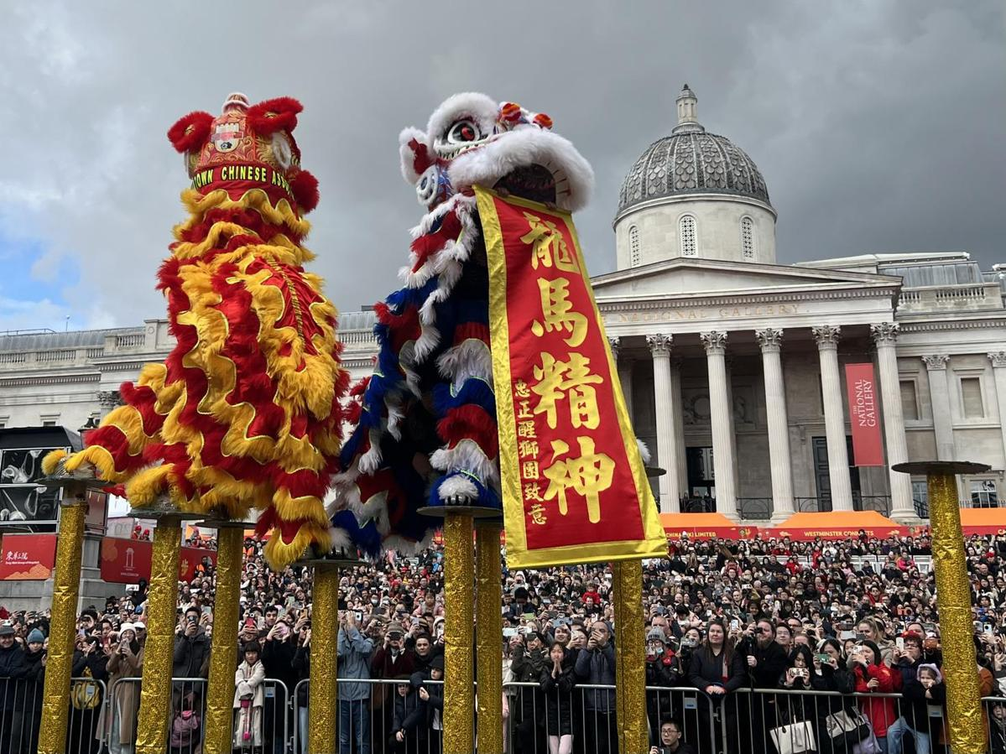
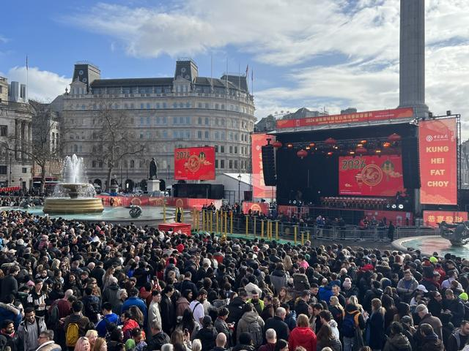
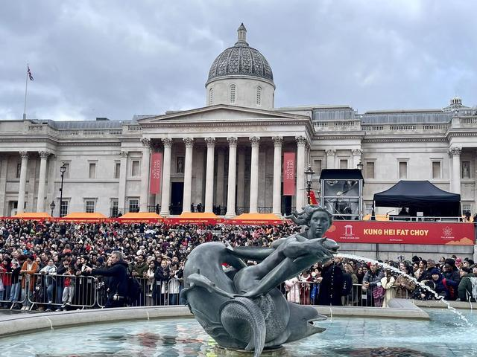
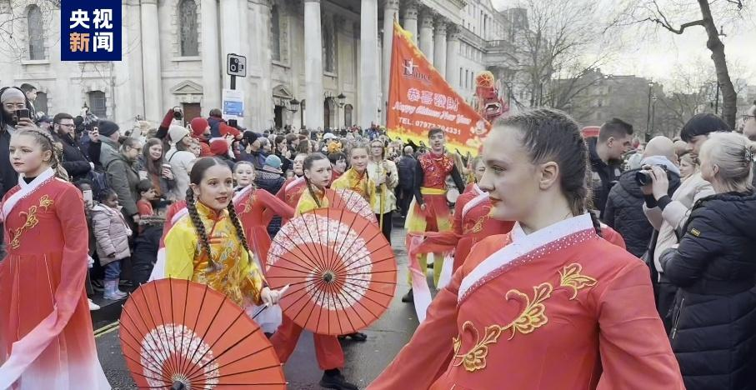
More than 700,000 people in London joined in a carnival on Sunday ( Feb.11) organized by the London Chinatown Chinese Association, or LCCA, to welcome the Year of the Dragon.
The celebration, claimed by the organizers to be the largest Chinese New Year event outside Asia, commenced at 10 am with a diverse parade featuring handcrafted floats, dragon dance troupes, and displays of traditional Chinese costumes. The procession started from the east of Trafalgar Square and concluded on Shaftesbury Avenue in Chinatown.

Slide 13
A grand Chinese New Year celebration is held at London's Trafalgar Square on Feb 11. The flying lion dance, as one of the event highlights, draws cheers and applause from the crowds.

Slide 14
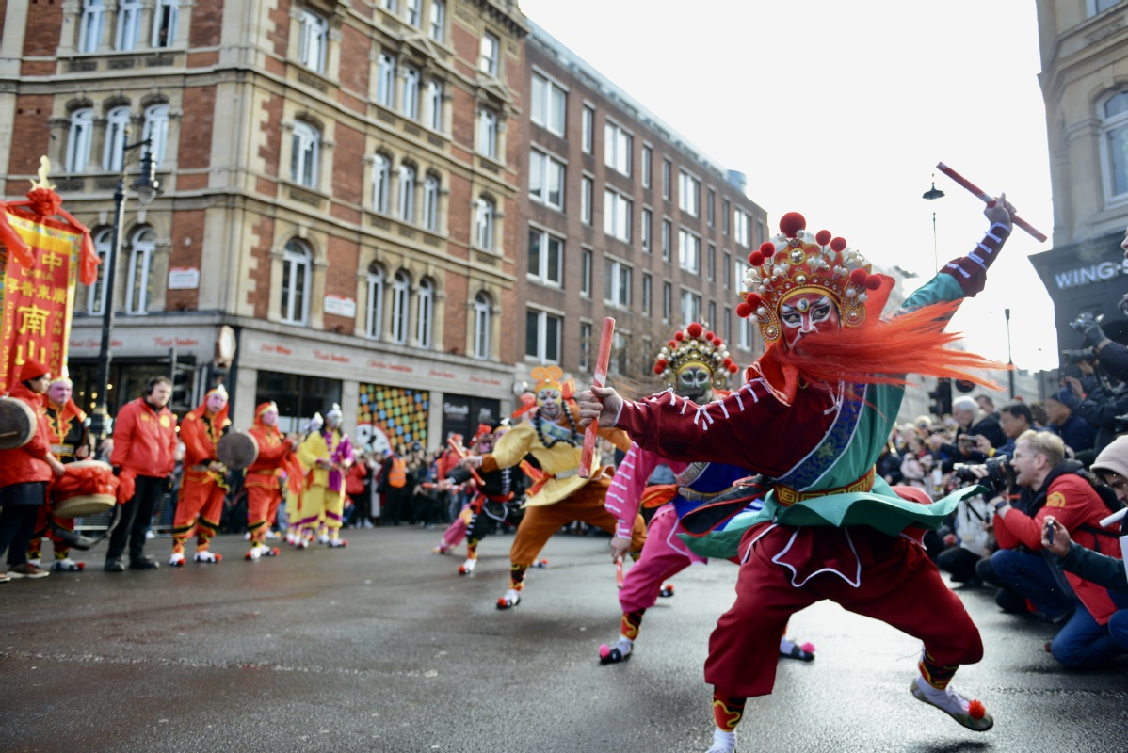
The Puning Yingge dance features not only electrifying performances but also colorful and exciting costumes.
The group of 16 dancers, originating from the Chaoshan region in South China's Guangdong province, where the art form originated, offered a sensory cultural feast to the people of the United Kingdom.

Slide 15

Message from United Nations Secretary-General António Guterres on Lunar New Year 2024
联合国秘书长安东尼奥·古特雷斯2024年龙年新春致辞

Slide 16
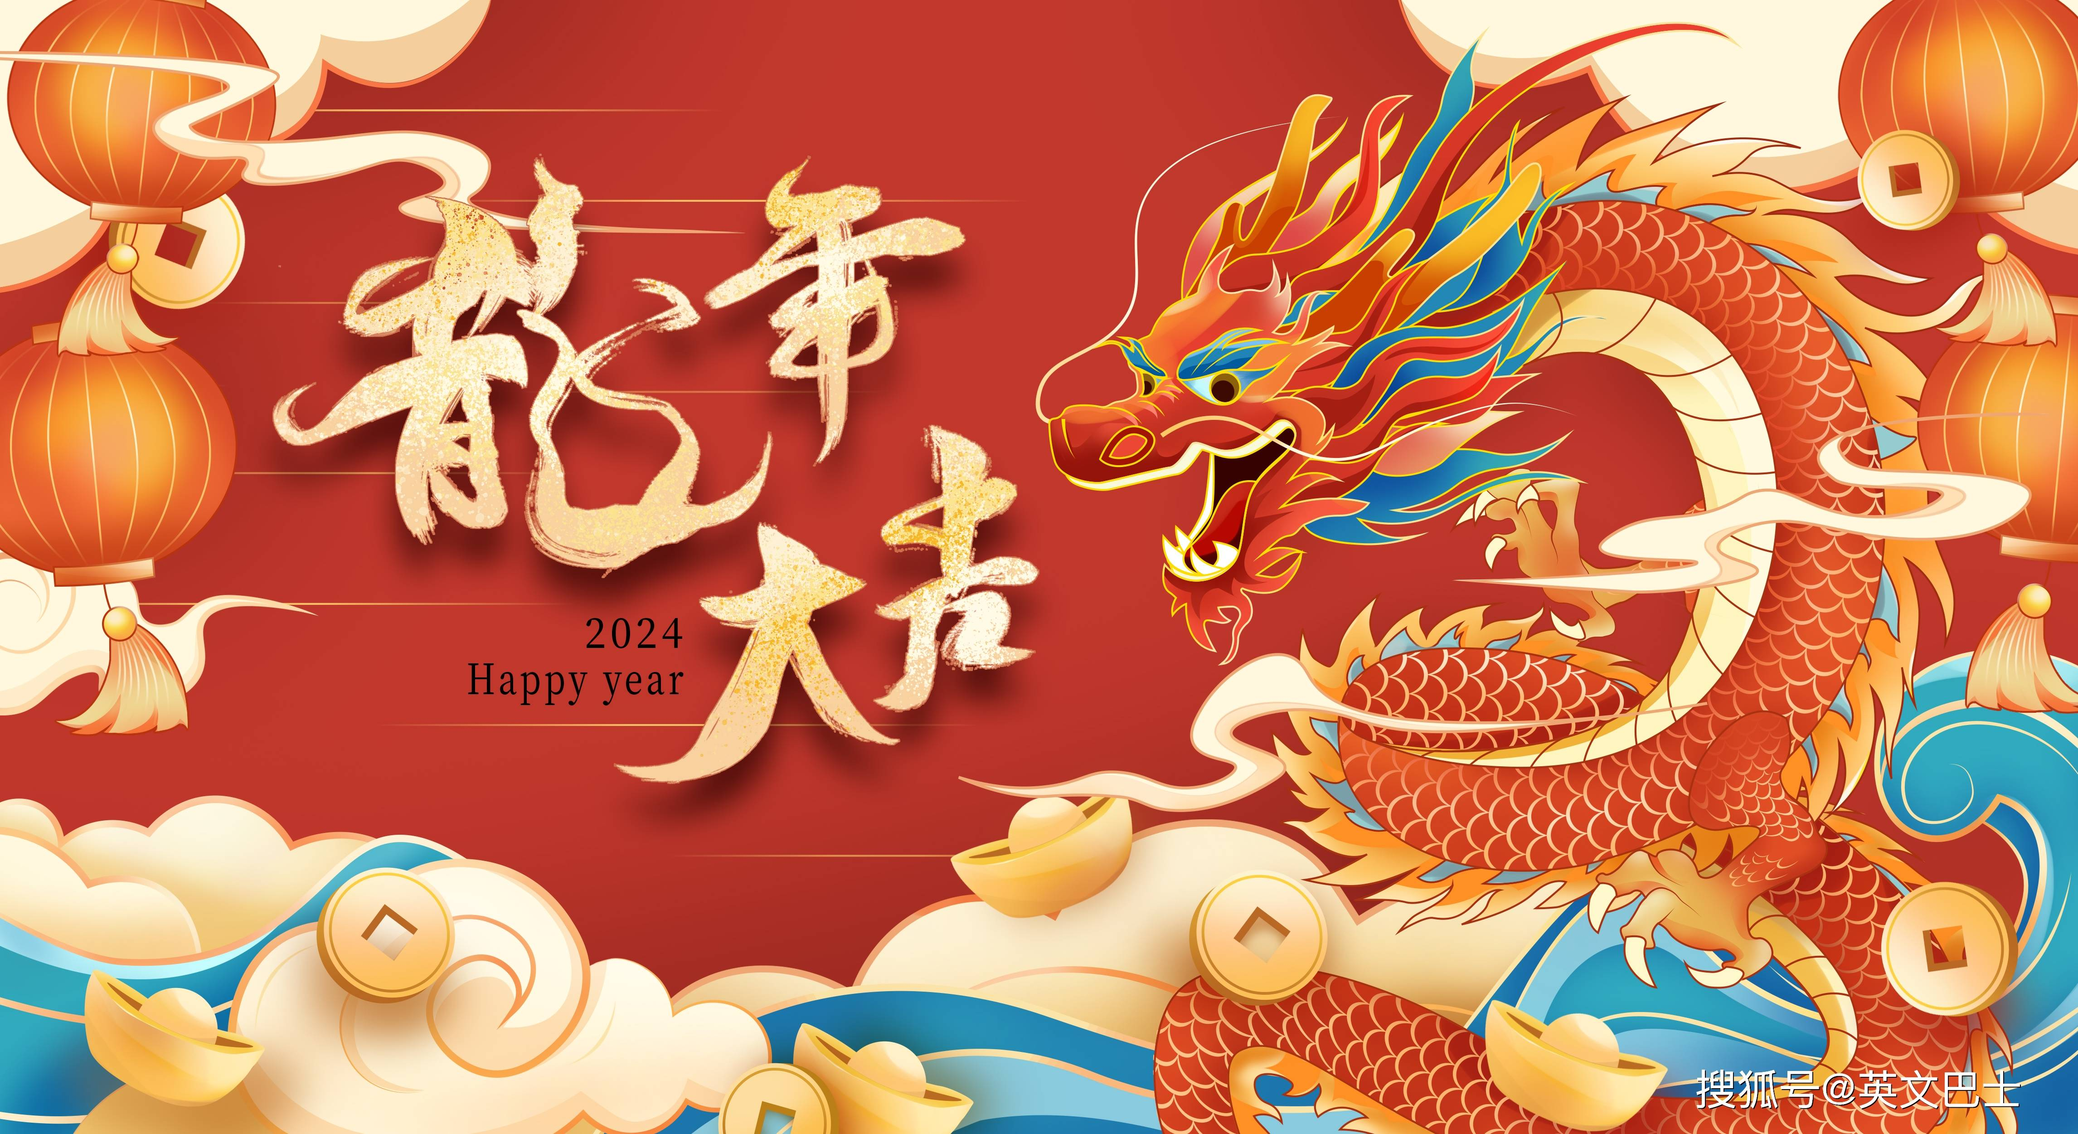
Chun Jie Kuai Le!
Happy Lunar New Year! I am pleased to send my warmest greetings as we usher in the Year of the Dragon. The dragon symbolizes energy, wisdom, protection and good luck. We need these qualities to rise to today’s global challenges. This year, the celebration at the United Nations is special: for the first time, the Lunar New Year is part of the UN holiday calendar. I thank China and the Chinese people for your unwavering support to the United Nations, to multilateralism and global progress. Together, we can realize a sustainable, just and peaceful future .I wish you good health, happiness and prosperity in this new year.
Xie Xie!
在龙年到来之际，我谨向大家致以最亲切的问候。龙象征着活力、智慧、守护、吉运。正是我们应对当今全球挑战所需要的特质。今年联合国的庆祝其不同：农历新年首次登上联合国节庆日历。我感谢中国和中国人民对联合国、多边主义和全球进步的坚定支持。只要我们携手共进，就能实现一个可持续、公正与和平的未来。祝大家在新的一年里身体健康、幸福美满、兴旺发达。

Slide 17
Section
Three
Festive
Movies
of the

Slide 18
According to data from Maoyan Professional Edition, as of 21:00 on February 17th, the total box office of new films during the 2024 Spring Festival season (February 10th to February 17th) has exceeded 8.023 billion yuan, surpassing the highest box office of the 2021 Spring Festival season of 7.842 billion yuan, setting a new record for the box office of the Spring Festival season in the history of Chinese cinema! The total number of audience during the festival period reached 163 million, and the total number of screenings was 3.937 million, both setting new records for the highest number of audience and screenings in the history of the Spring Festival season in Chinese cinema.
猫眼专业版数据显示，截至2月17日21时，2024年春节档（2.10-2.17）新片总票房突破80.23亿元，超过了历史最高的2021年春节档票房78.42亿元，刷新了中国影史春节档票房的新纪录！档期内总观影人次1.63亿，总场次393.7万场， 双双刷新了历史最好成绩，创下中国影史春节档总观影人次新高和总场次新高。

Slide 19
This year's top four films in the Spring Festival box office are "YOLO", "Pegasus 2," "Boonie Bears: Time Twist," and "Article 20." The box office of each of the four films mentioned above exceeded 1.3 billion yuan during the festival period, contributing a combined total of 97.6% of the overall box office for the festival.
今年春节档票房前四名分别为《热辣滚烫》《飞驰人生2》《熊出没·逆转时空》和《第二十条》。以上4部影片单片档期票房均超过13亿元， 合计贡献了97.6%的档期大盘票房。

Slide 20

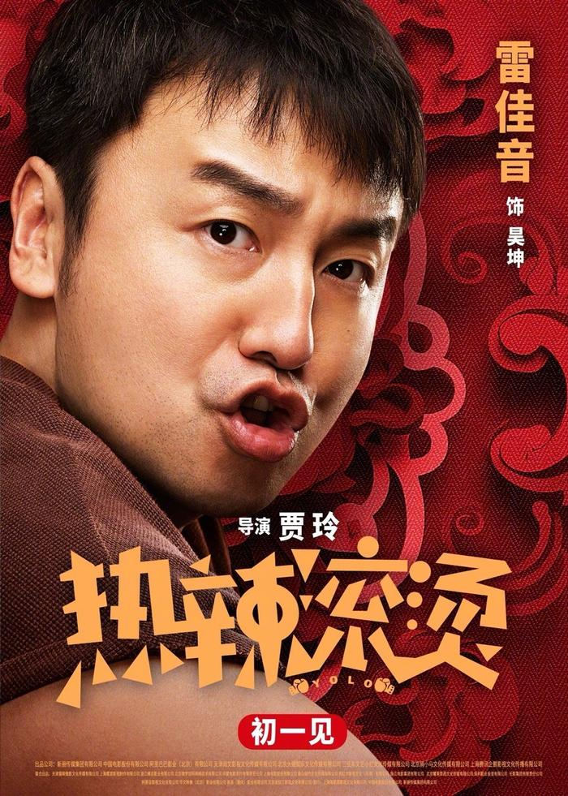
"YOLO" continued to demonstrate Jia Ling's remarkable ability to attract audiences and, through its overwhelmingly positive reception by viewers, achieved an impressive turnaround, topping the box office on February 11th (the second day of the Lunar New Year). Since then, it has consistently dominated the daily box office, grossing over 300 million yuan for six consecutive days.
《热辣滚烫》延续了贾玲此前的票房号召力，并凭借迅速发酵的观众口碑，于2月11日（大年初二）实现票房“逆袭”登顶， 此后连续6天以超过3亿元的单日票房成绩夺得票房日冠军。

Slide 21
Classic Lines in YOLO
Line 1: 因为 Yolo! 你只活一次！
Because you only live once!
Line2： 如果没有特别幸运，那就请特别努力！
If you are not particularly lucky, then please make greater efforts.
Line3： 虽然辛苦，我还是会选择那种滚烫的人生。
Despite sufferings and hardship, I’m still willing to choose a life full of challenges.
Line4： 变好的过程都不太舒服，试试再努力点。
The process of getting better is not comfortable, so try harder and harder.
Line5: 我只是想赢一次。
I just want to win once.

Slide 22
Section
Four
Best Wishes
of the

Slide 23
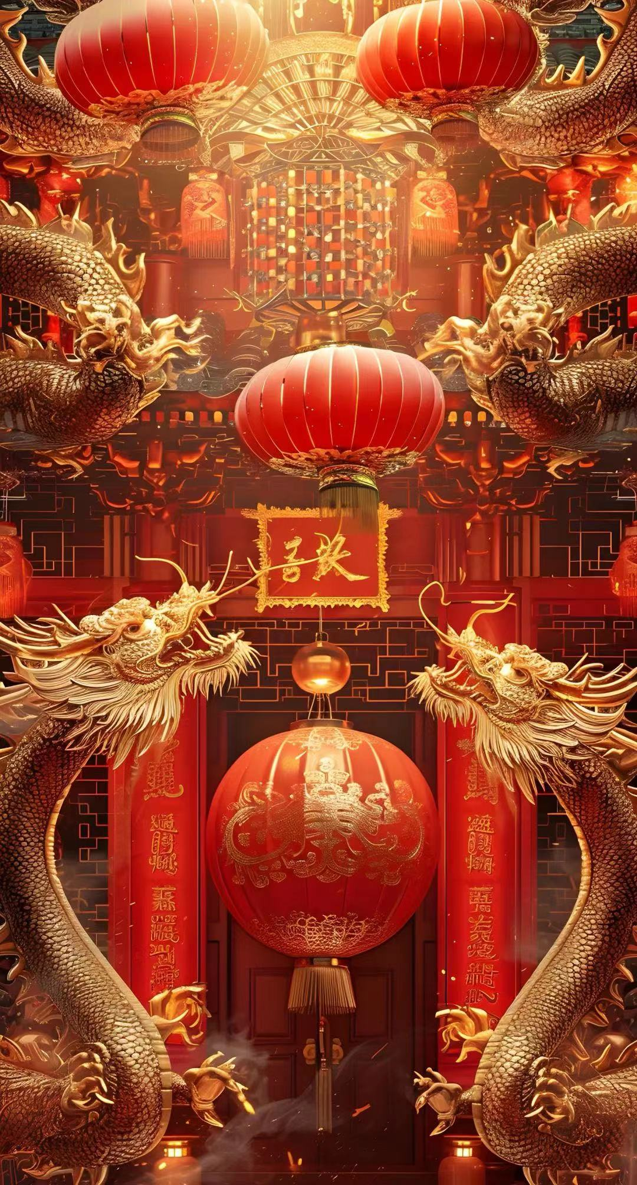
What are the hottest greetings for the Chinese
Dragon
Year?

Slide 24
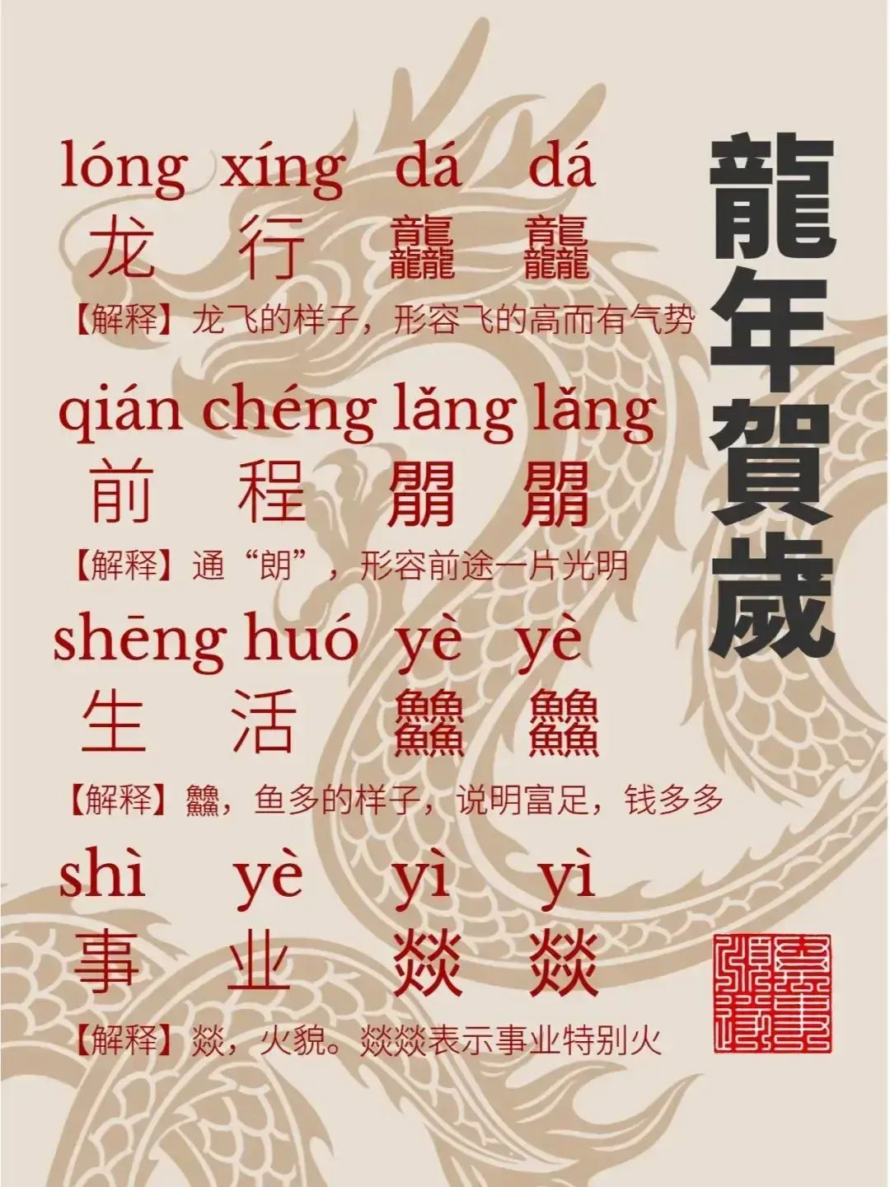

Slide 25
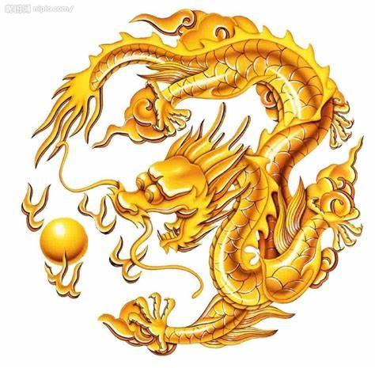
The Chinese dragons are soaring.
You’ll have a bright future.
You’ll enjoy a prosperous life.
Your business will take off.

Slide 26

Wish you all a prosperous dragon year by making greater efforts than before!

