Slide 1


感恩遇见，相互成就，本课件资料仅供您个人参考、教学使用，严禁自行在网络传播，违者依知识产权法追究法律责任。
更多教学资源请关注
公众号：溯恩高中英语
知识产权声明

Slide 2
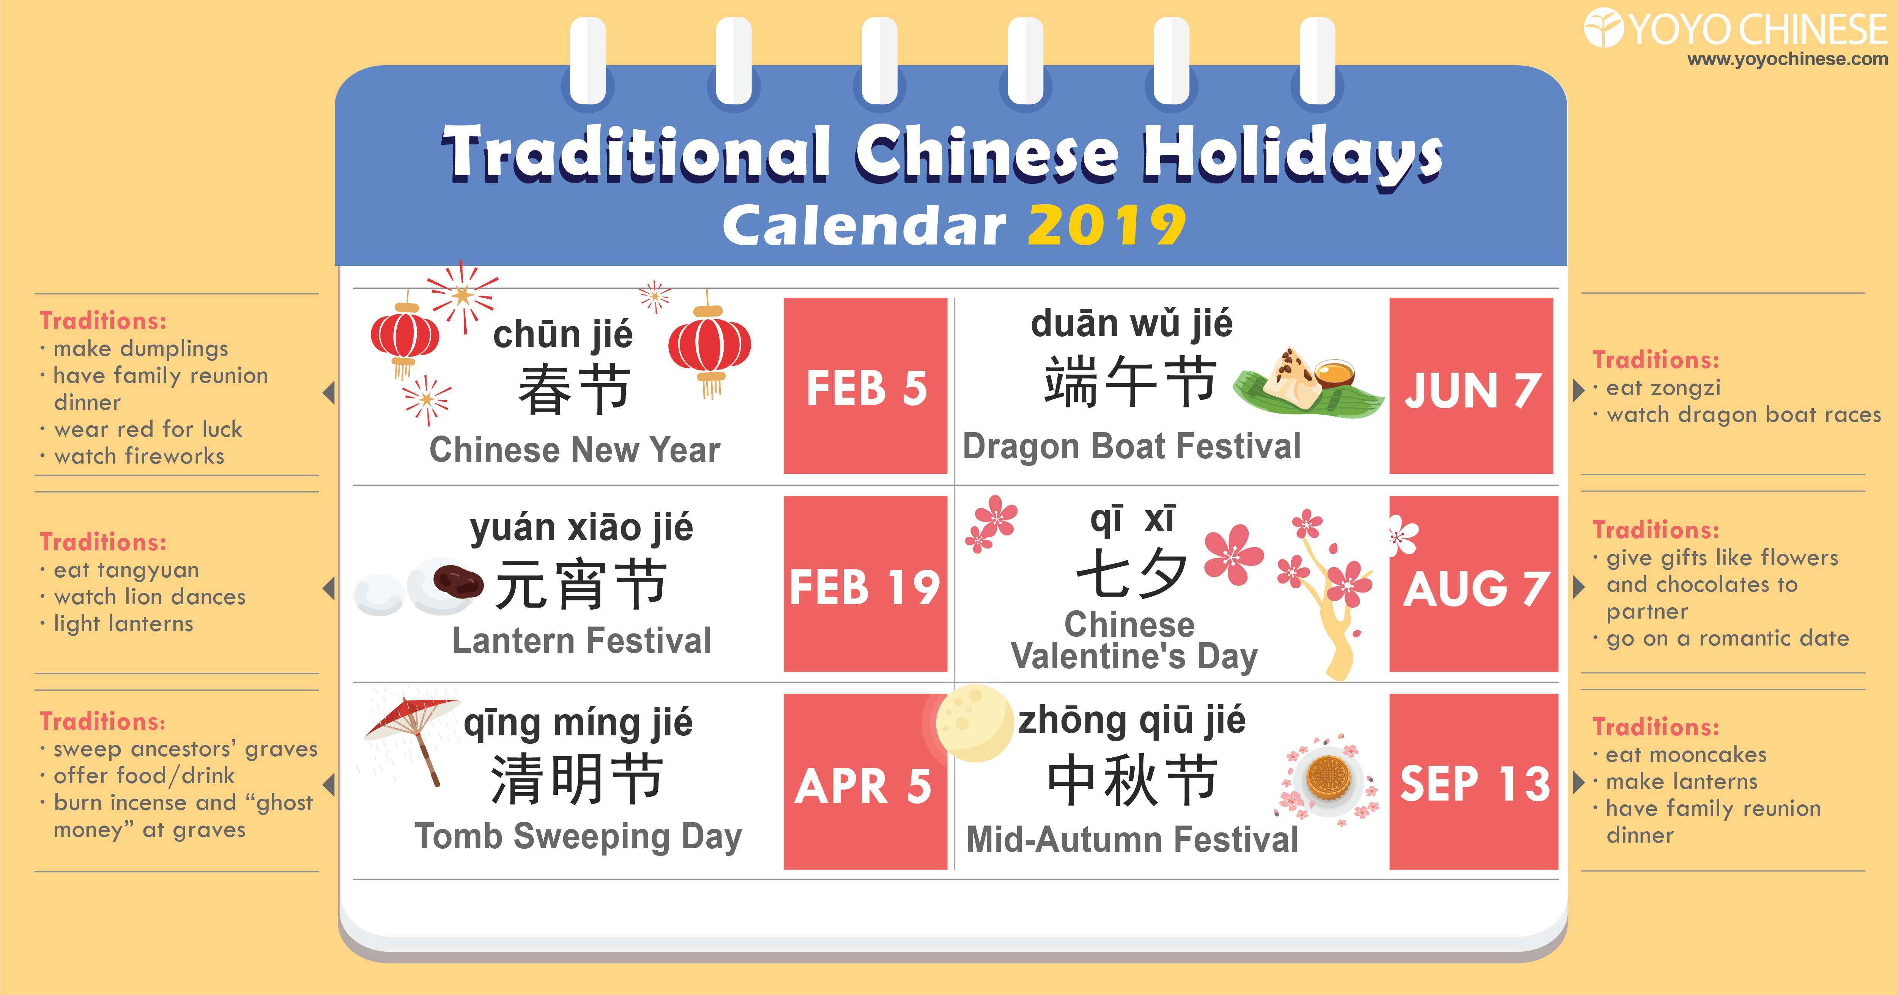
2024
FEB 10
JUN 10
FEB 24
AUG 10
ARI 4
SEP 17

Slide 3
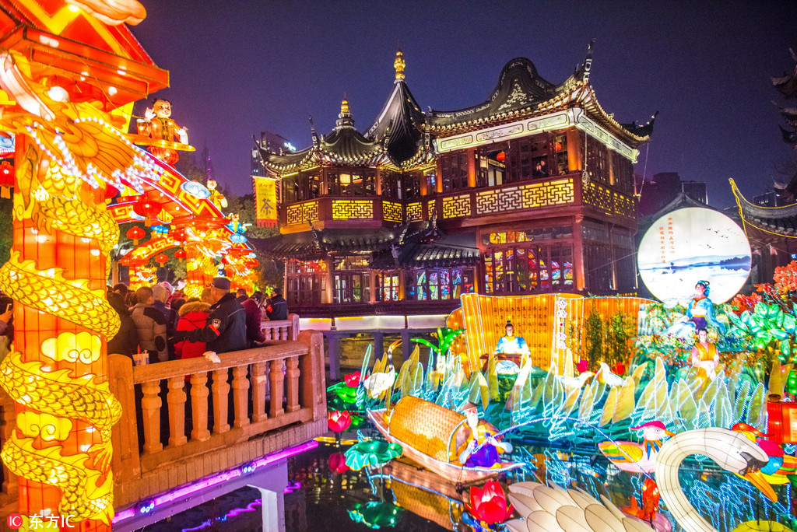
Lantern Festival

Slide 4
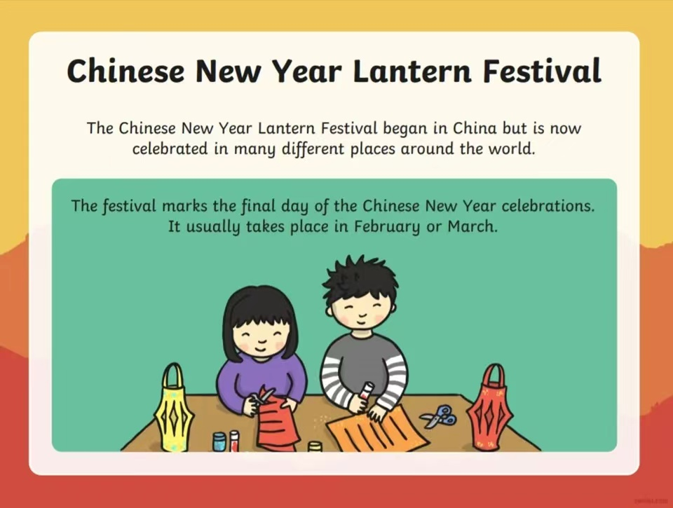

Slide 5
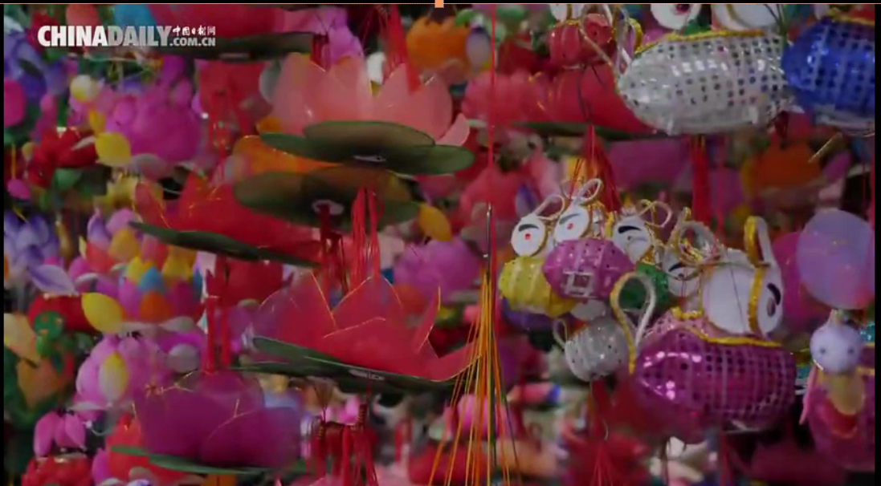
视频资料1

Slide 6
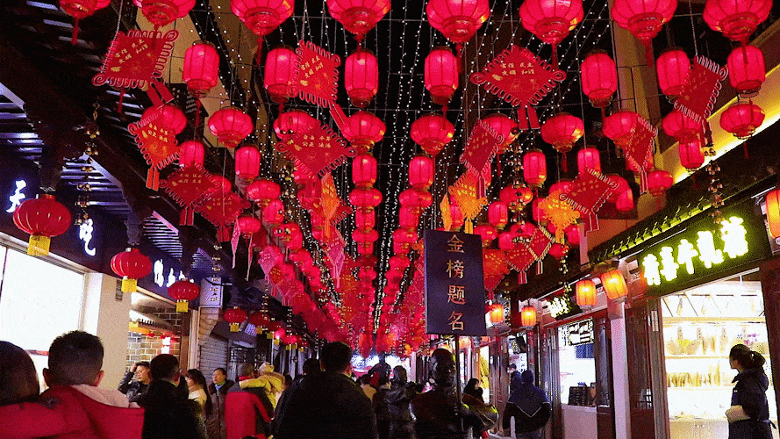
Lantern Festival, the earliest 1.____________(exist) carnival in China, falls on the fifteenth day of the first lunar month. Its arrival also marks the end of Spring Festival celebrations.
It is 2.____________(custom) to appreciate the beauty of Lanterns at night during Lantern Festival. Large scale lantern exhibitions are held throughout the country. The Zigong Lantern Show in Southwest China’s Sichuan province and Yuyuan Lantern Show in East China’s Shanghai are 3.____________(represent) lantern shows with traditional local characteristics.4._________ increasing number of Chinese living abroad, the world is gaining interest and accepting Chinese culture. Lantern shows are held every year in many parts of the world 5.___________(celebrate) Lantern Festival.
There also regional differences in China’s lantern art culture. Lantern with lit candles are signatures of the South. In Northeast China, Lantern Festival in Harbin, HeilongJiang province, boasts 6._________ one-of-a-kind scenery. Glittering and translucent ice sculpture in different shapes create a fairytale of 7.____________(crystal) reflections of color and light.
existing
customary
representative
With
to celebrate
a
crystallized

Slide 7
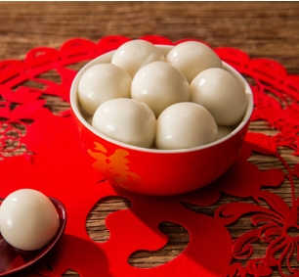
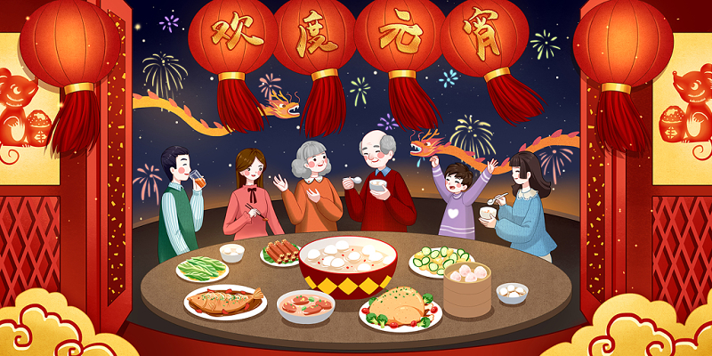
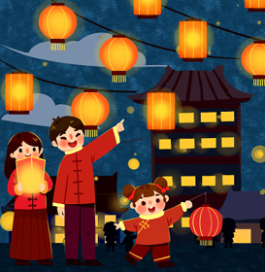
In addition to 8.____________(view) lanterns, there is another custom of Lantern Festival that cannot 9.____________(miss), eating tangyuan or glutinous rice balls. The feelings can be sweet such sesame or jujube paste or savory, with minced meat. These sweet and round delicacies are molded from glutinous rice flour, symbolizing wholesomeness of family. Sometimes people will pick out a tangyuan and put in a special “stuffing” such as a coin. The one lucky person 10._________ bites onto that coin is said to be blessed with good luck in the new year.
Lantern Festival is the last day of Chinese New Year celebrations. For those working or studying away from home, it is time to bid farewell to their families and set out on a journey in a brand new year.
viewing
be missed
who

Slide 8
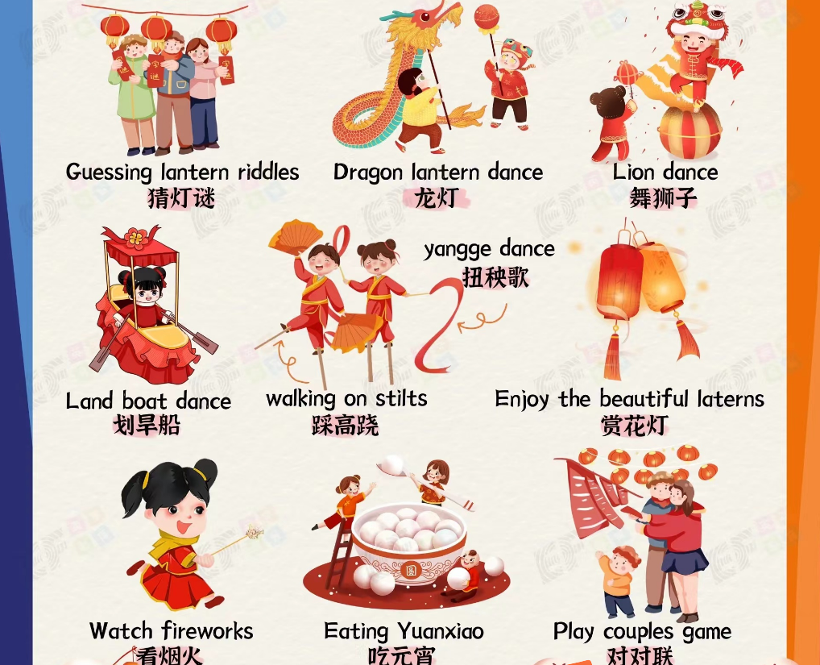

Slide 9
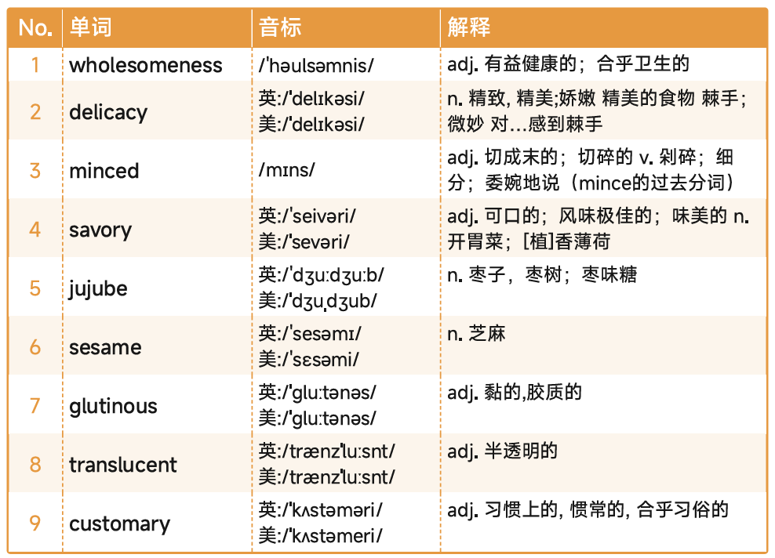




Slide 10

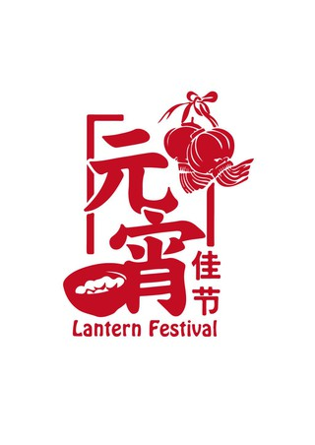
Lantern Festival, the earliest existing carnival in China, falls on the fifteenth day of the first lunar month. Its arrival also marks the end of Spring Festival celebrations.
It is customary to appreciate the beauty of Lanterns at night during Lantern Festival. Large scale lantern exhibitions are held throughout the country. The Zigong Lantern Show in Southwest China’s Sichuan province and Yuyuan Lantern Show in East China’s Shanghai are representative lantern shows with traditional local characteristics. With increasing number of Chinese living abroad, the world is gaining interest and accepting Chinese culture. Lantern shows are held every year in many parts of the world to celebrate Lantern Festival.
There also regional differences in China’s lantern art culture. Lantern with lit candles are signatures of the South. In Northeast China, Lantern Festival in Harbin, HeilongJiang province, boasts a one-of-a-kind scenery. Glittering and translucent ice sculpture in different shapes create a fairytale of crystallized reflections of color and light.
In addition to viewing lanterns, there is another custom of Lantern Festival that cannot be missed, eating tangyuan or glutinous rice balls. The feelings can be sweet such sesame or jujube paste or savory, with minced meat. These sweet and round delicacies are molded from glutinous rice flour, symbolizing wholesomeness of family. Sometimes people will pick out a tangyuan and put in a special “stuffing” such as a coin. The one lucky person who bites onto that coin is said to be blessed with good luck in the new year.
Lantern Festival is the last day of Chinese New Year celebrations. For those working or studying away from home, it is time to bid farewell to their families and set out on a journey in a brand new year.

Slide 11
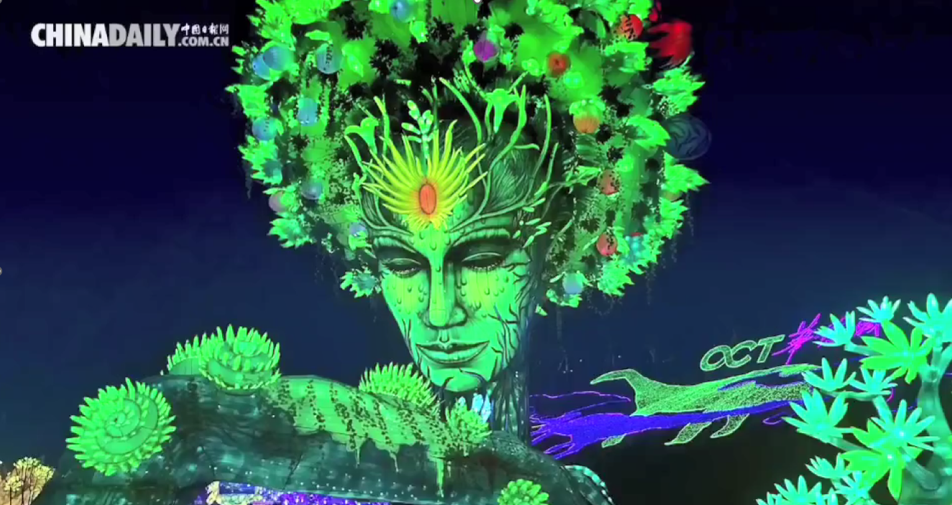
视频资料2

Slide 12
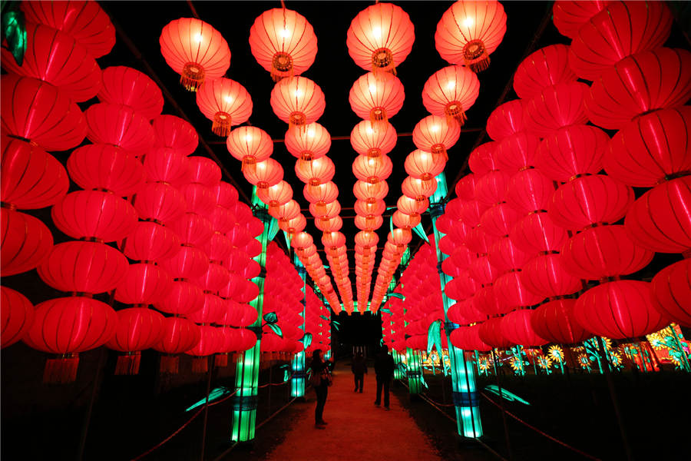
For the Chinese, lanterns have not only lit up the night, but also illuminated hearts that long for home.

