Slide 1


感恩遇见，相互成就，本课件资料仅供您个人参考、教学使用，严禁自行在网络传播，违者依知识产权法追究法律责任。
更多教学资源请关注
公众号：溯恩英语
知识产权声明

Slide 2

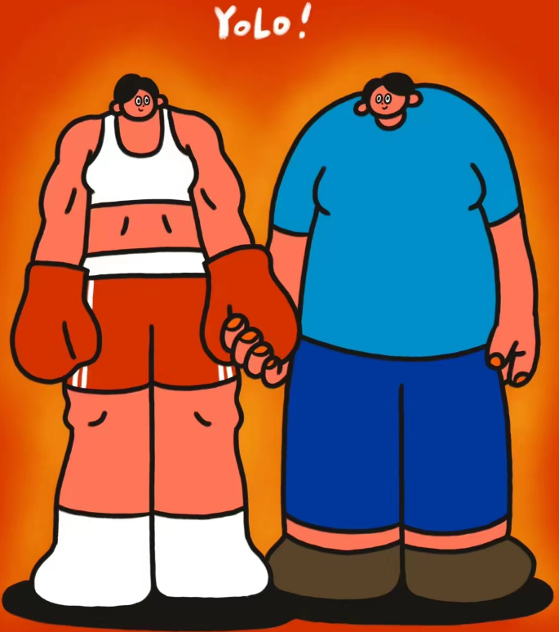
YO LO
It is difficult to say which is impossible, for the dream of yesterday is the hope of today and reality of tomorrow.
很难说哪件事是不可能的
昨天的梦想是今天的希望，也会变成明天的现实。

Slide 3



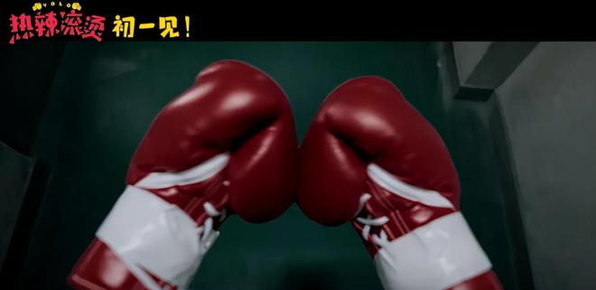

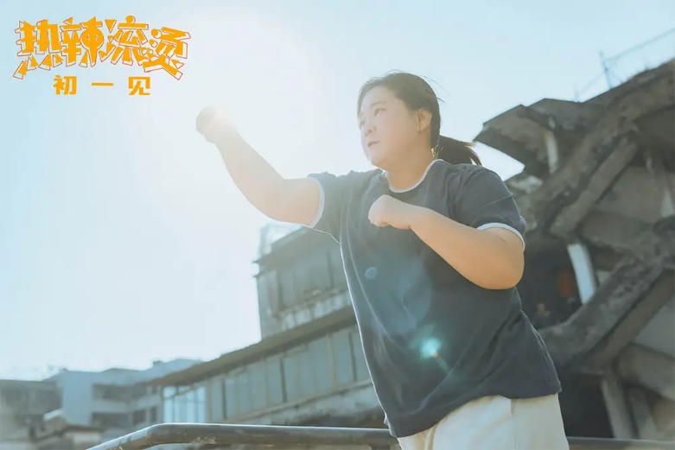
VARIETY
Feb 9, 2024 5:00pm PT
Sony Pictures Acquires ‘YOLO,’ Chinese Comedy Film From ‘Hi, Mom’ Director Jia Ling, for Global Release (EXCLUSIVE)
Sony Pictures has acquired international distribution rights to “YOLO,” a mainland Chinese comedy film that releases in China on Saturday, the first day of the Lunar New Year holiday. The film is written, directed by and stars Jia Ling, China’s top-grossing female filmmaker. She portrays Le Ying, an unemployed woman in her thirties.

Slide 4

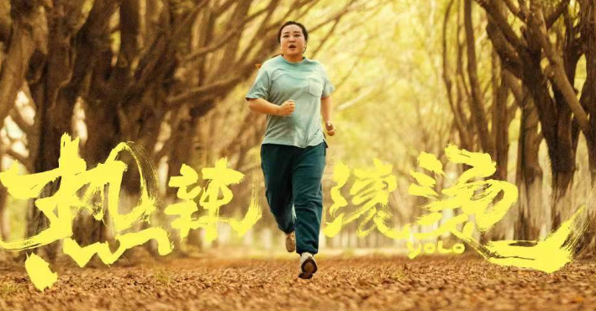
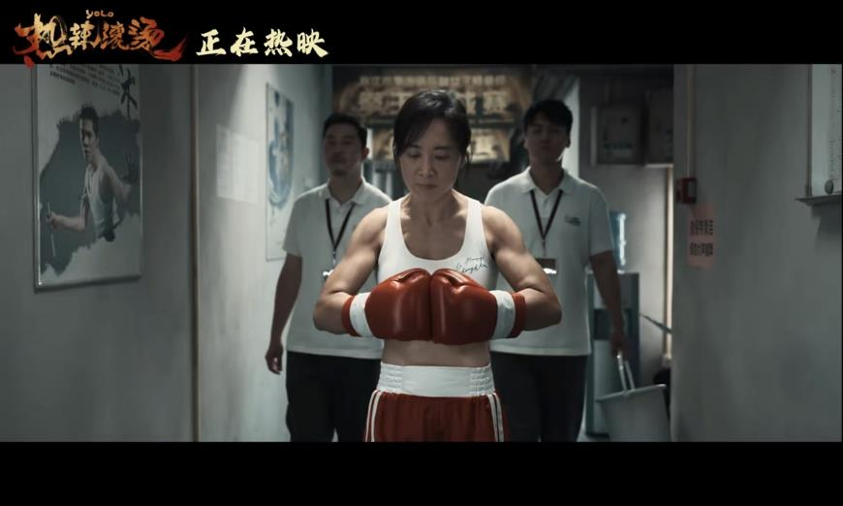

GLOBAL TIMES
VOLUME 1 NO. 920 FRIDAY FEBRURY 02 2024
Actress Jia Ling's 50kg weight-loss journey generates fresh buzz amid ‘Yolo’ movie success
Actress Jia Ling topped the social media topics on the second consecutive day of the Chinese Lunar New Year as her stunning weight loss of 50 kilograms during the shooting of her movie Yolo triggered heated discussions over healthy lifestyle and allowed some viewers to draw aspirations from her arduous weight-loss journey.

Slide 5
Hot Focus
Don't aim for success if you want it; just do what you love and believe in, and it will come naturally.

Slide 6
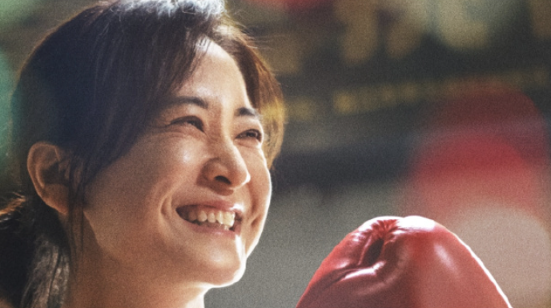
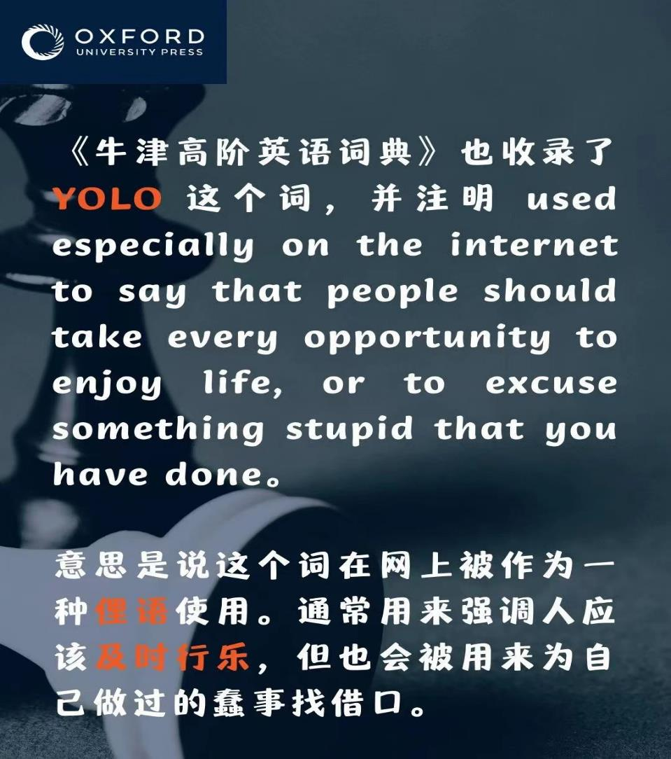
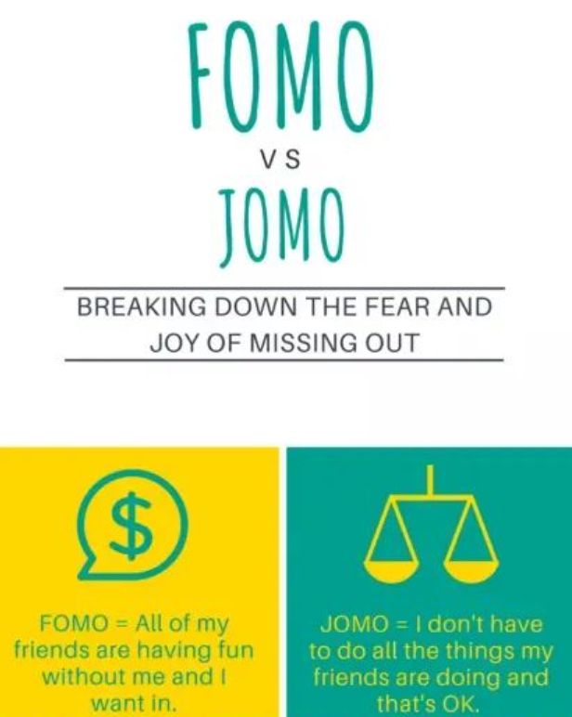
Passage A
comedic prowess /kəˈmiːdɪk ˈpraʊəs /
喜剧能力；喜剧才华
同comedic abilities
prowess 来自法语
意为extraordinary abilities
infectious / ɪnˈfekʃəs /
adj.传染性的；有感染力的
fixture / ˈfɪkstʃə(r) /
n.固定装置 eg: a light fixture
YOLO=You only live once
类似表达：
seize the day
carpe diem
directorial debut /daɪrekˈtɔːriəl ˈdeɪbjuː/
首次导演
Jialing, known for a comedic prowess and infectious personality, has long been a fixture in the Chinese entertainment industry. And now she returns with YOLO. It's her second major screen production, following a massive success in her directorial debut film, Hi Mom in 2021.
FEAR OF MISSING OUT

Slide 7
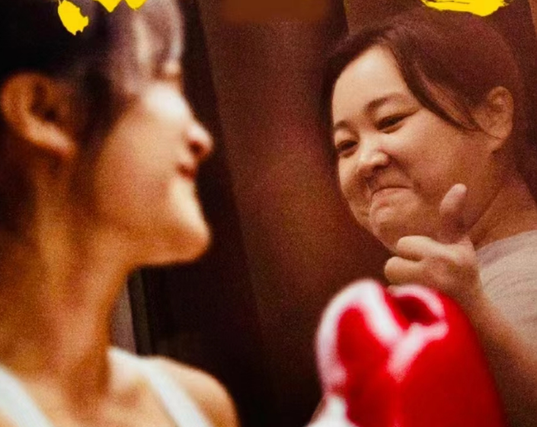
But it's not just the movie itself that's causing a stir. It's the 41-year-old actresses stunning physical transformation in the early teasers for Yolo, which follows a complete homebody who takes up boxing, audiences caught glimpses of Jialing's dedication to her role as a boxer. She had shed an impressive 50 kg in a span of six months
stir / stɜː(r) /
v. 搅动；搅拌
cause a stir 引起争议或骚动
physical transformation 身体变化
mental/spiritual/social transformation
data/energy/frequency transformation
teaser / ˈtiːzə(r) /
n.爱戏弄别人的人;预告片;悬念式广告
tease v.取笑，嘲笑；逗弄
homebody n.宅男；宅女
dedication / ˌdedɪˈkeɪʃ(ə)n /
n.奉献，献辞
delicate v.致力于，献身于
delicate to/delicate oneself to
catch glimpses of 瞥见；一窥其貌
shed/ ʃed / v.去除，摆脱
a span of 一段期限
a span of life/decades/three months

Slide 8
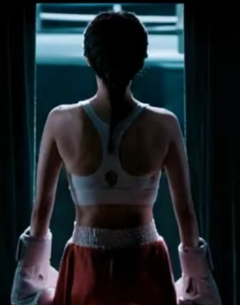

Jialing, known for a comedic prowess and infectious personality, has long been a fixture in the Chinese entertainment industry. And now she returns with YOLO. It's her second major screen production, following a massive success in her directorial debut film, Hi Mom in 2021. But it's not just the movie itself that's causing a stir. It's the 41-year-old actresses stunning physical transformation in the early teasers for Yolo, which follows a complete homebody who takes up boxing, audiences caught glimpses of Jialing's dedication to her role as a boxer. She had shed an impressive 50 kg in a span of six months.
The figure
The event
The effect

Slide 9
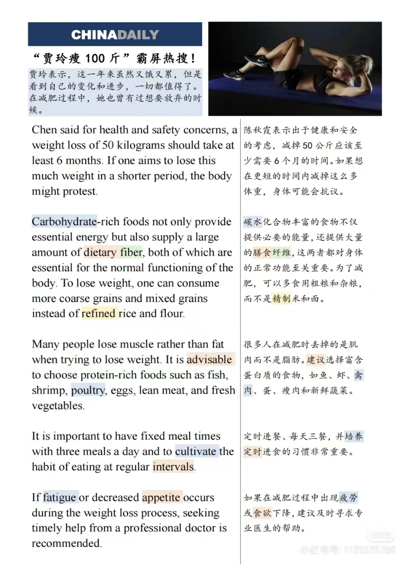
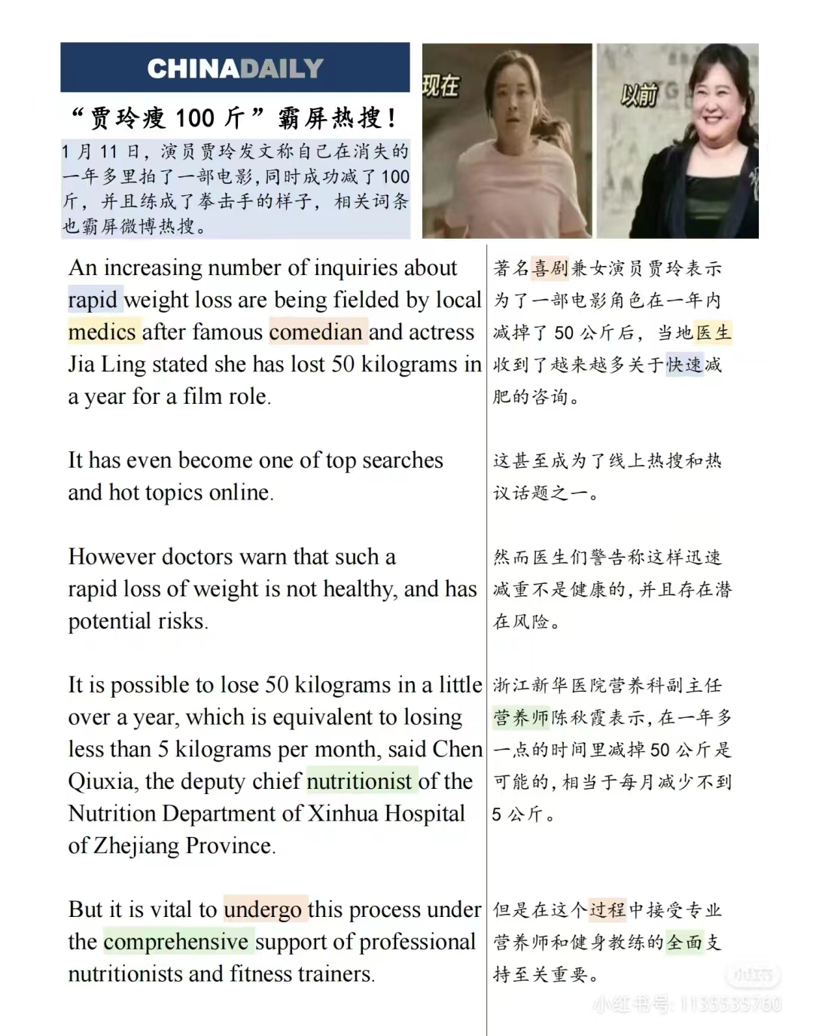
Passage B
But it's not just the movie itself that's causing a stir. It's the 40 year old actresses stunning physical transformation in the early teases for Yolo, which follows a complete home body who takes up boxing, audiences caught glimpses of Jaleen's dedication to her role as a boxer. She had shared an impressive 50 kg in a span of six months.

Slide 10
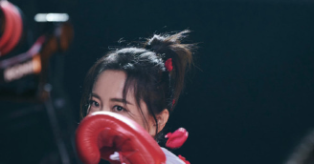

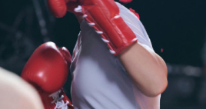
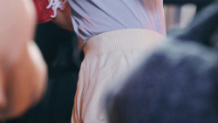
Comprehending
1.What are the potential risks of rapid weight loss, according to doctors?
A. Increased energy levels
B. Muscle gain
C. Decreased appetite
D. Health issues
2Why does Chen Qiuxia recommend a weight loss of 50 kilograms should take at least 6 months?
A. To undergo the process without professional support
B. To avoid the body protesting
C. To decrease the amount of dietary fiber
D. T o increase muscle mass
3. How can one ensure a healthy weight loss process according to the text?
To ensure a healthy weight loss process, one should seek comprehensive support from professional nutritionists and fitness trainers, consume more coarse grains and mixed grains, choose protein-rich foods, and maintain fixed meal times with three meals a day.
4.What do you think of Jia Ling’s success?

Slide 11

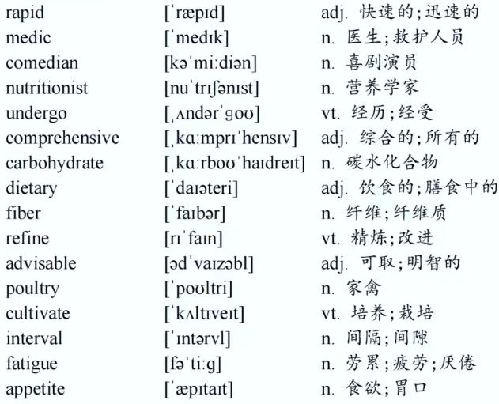
comedic prowess /kəˈmiːdɪk ˈpraʊəs /
喜剧能力；喜剧才华
infectious / ɪnˈfekʃəs /
adj.传染性的；有感染力的
fixture / ˈfɪkstʃə(r) /
n.固定装置
YOLO=You only live once
directorial debut /daɪrekˈtɔːriəl ˈdeɪbjuː/
首次导演
stir / stɜː(r) /v. 搅动；搅拌
cause a stir 引起争议或骚动
physical transformation 身体变化
teaser / ˈtiːzə(r) /
n.爱戏弄别人的人;预告片;悬念式广告
homebody n.宅男；宅女
dedication / ˌdedɪˈkeɪʃ(ə)n /n.奉献，献辞
delicate v.致力于，献身于
catch glimpses of 瞥见；一窥其貌
shed/ ʃed / v.去除，摆脱
a span of 一段期限
Y
O
L
O

Slide 12
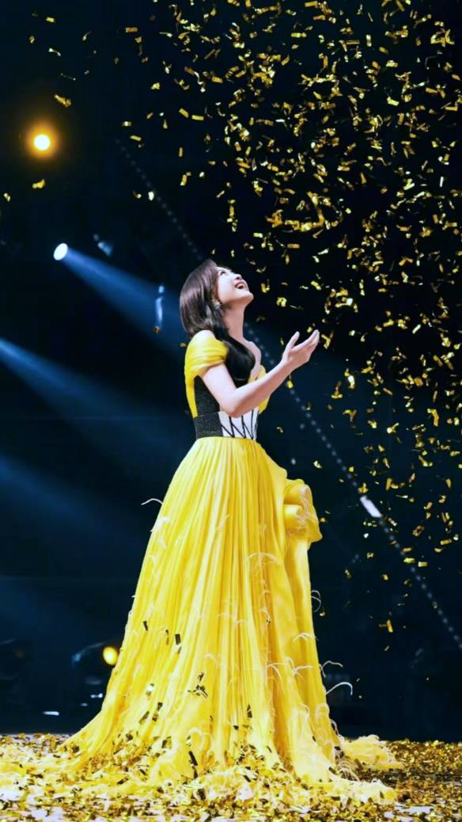
May all women be birds.
祝所有女性都做飞鸟，
There are directions, not chains.
有指引航线，而非锁链。
Be a big tree, not a dodder flower.
做大树，而非菟丝花。
Be the torch, be the brilliant starlight.
做炬火，做灿烂星光。
I wish you high-spirited, I wish you a clank,
祝你昂扬、祝你铮铮。
May you break free from shackles to break the ceiling, may you take root in the earth and straighten your spine.
祝你挣脱枷锁击碎天花板，祝你扎根大地挺直脊梁。
I wish her well, I wish her high-spirited, rather than wishing her an early son.
要祝她铮铮，祝她昂扬，胜过祝她早生贵子。

Slide 13
Topic Review
Human and Self ---healthy lifestyle and active attitude

Slide 14

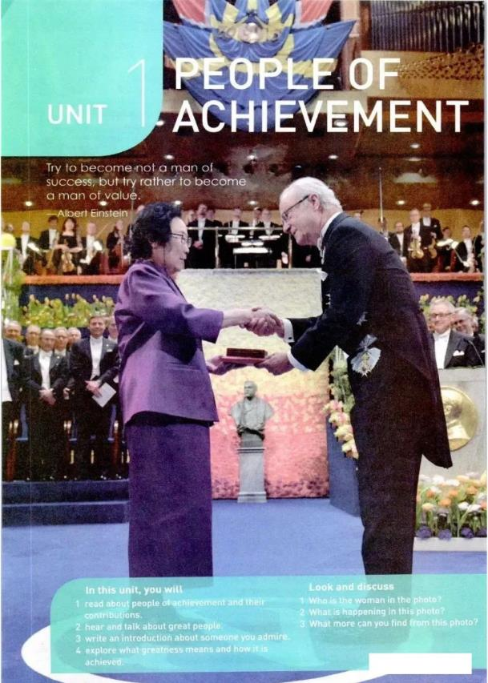

Text review

Slide 15
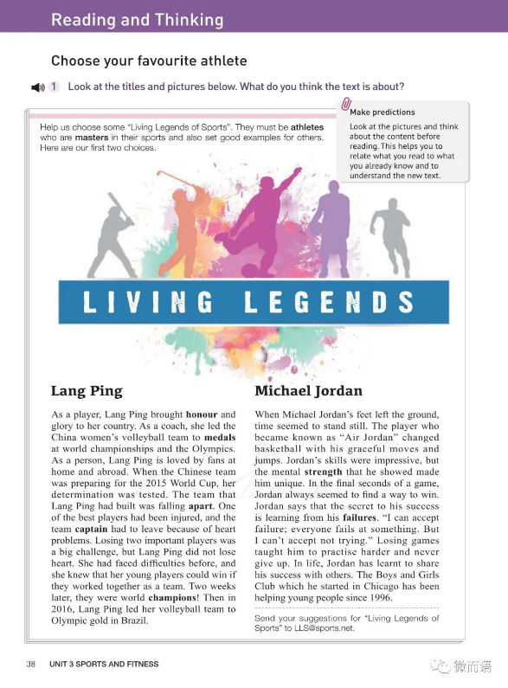
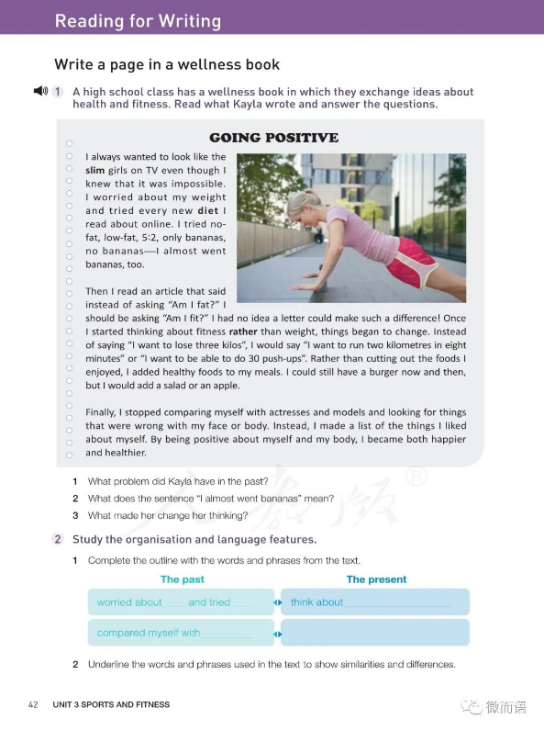
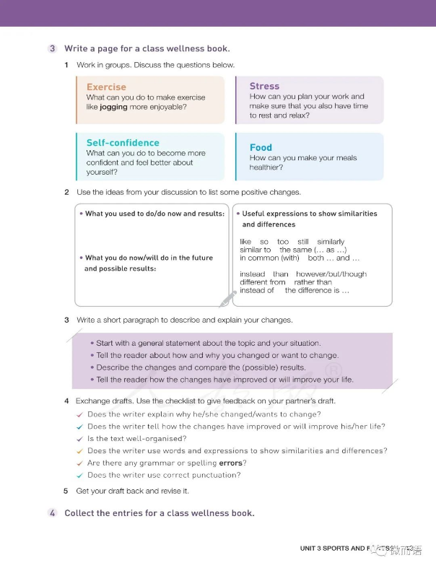
Text review
Sports and fitness
Key words
Expressions
Sentences
come along compare…to
track and field add…to
work out make a list of
make it rather than
set an example ……
fall apart
lose heart
give up
at home and abroad
because of
make sense
pretend to do sth
even if/though
make a difference
1. Losing two important players was a big challenge, but Lang Ping did not lose heart.
2.I can accept failure, everyone fails at something. But I can not accept not trying.
3. Finally, I stopped comparing myself with actresses and models and looking for things that were wrong with my face or body. Instead, I made a list of the things I liked about myself. By being positive about myself and my body, I became both happier and healthier.
4…….
stadium stress
boxing diet
badminton jog
marathon slim
event championship
track injure
gym failure
sweat ……
athlete
master
honor
determination
strength
positive

Slide 16
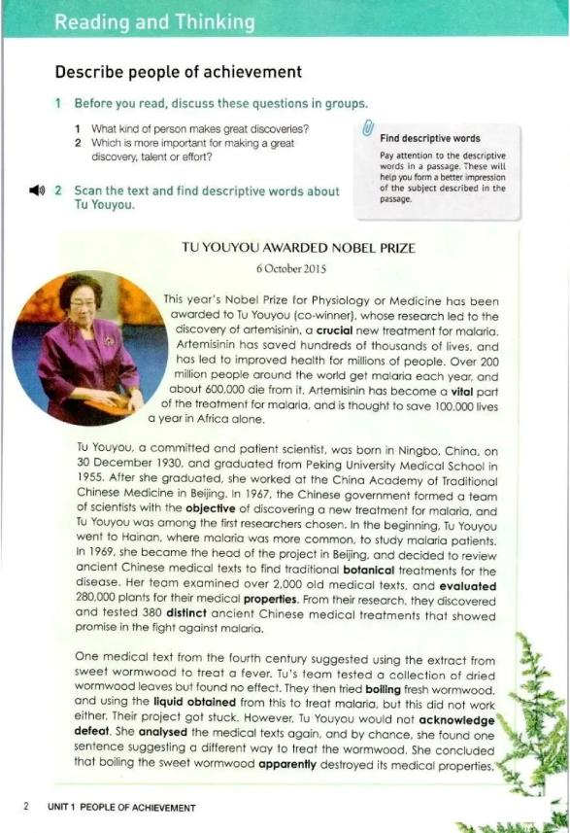
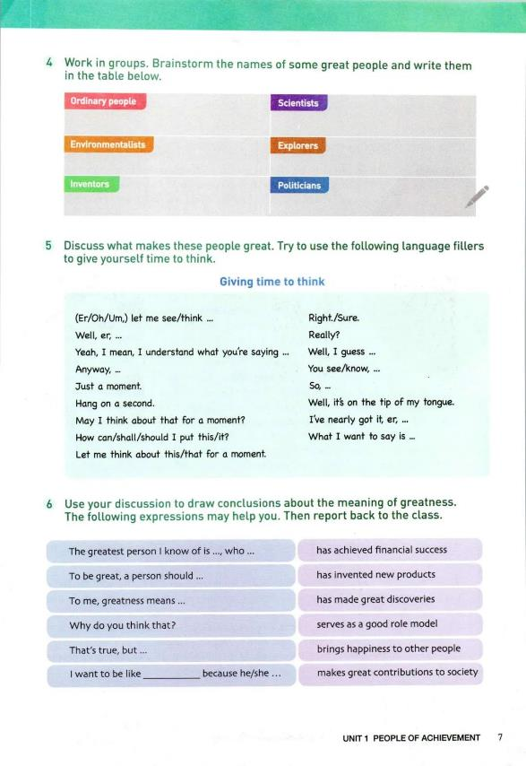
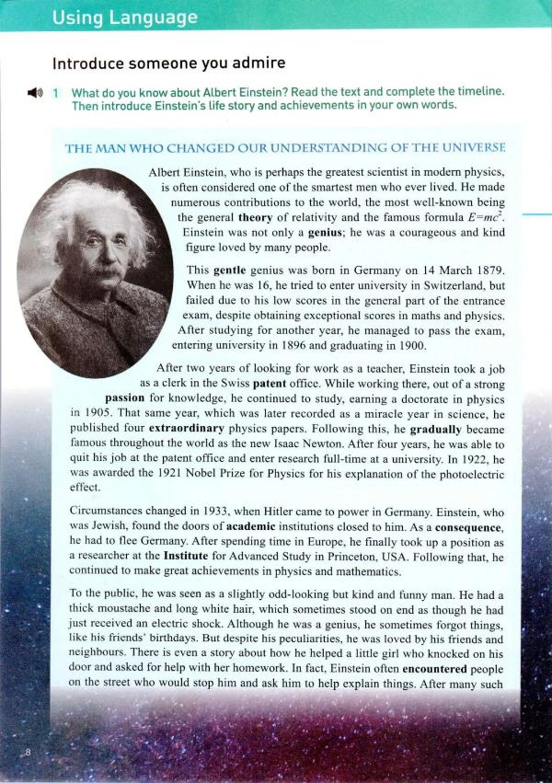
Text review
People of achievement
Key words
Expressions
Sentences
by chance apart from
insist on sum up
be awarded NBP do great and
due to mighty things
come to power ……
a strong passion (for)
as a consequence of
show promise in
with the objective of
an electric shock
pass away
be mistaken for
take up
have positive contributions to society
1. Upon hearing that she had been awarded the Nobel Prize, she said, “The honour is not just mine. There is a team behind me, and all the people of my country. This success proves the great value of traditional Chinese medicine. It is indeed an honour for China’s scientific research and Chinese medicine to be spread around the world.”
2. Einstein was not only a genius; he was a courageous and kind figure loved by many people.
3.This all proves that even the smallest or gentlest people can still do great and mighty things.
4…….
crucial genius
vital passion
committed gradually
academic extraordinary
objective championship
evaluate consequence
distinct remarkable
obtain ……
acknowledge
defeat
apparently
insist
encounter
numerous

Slide 17
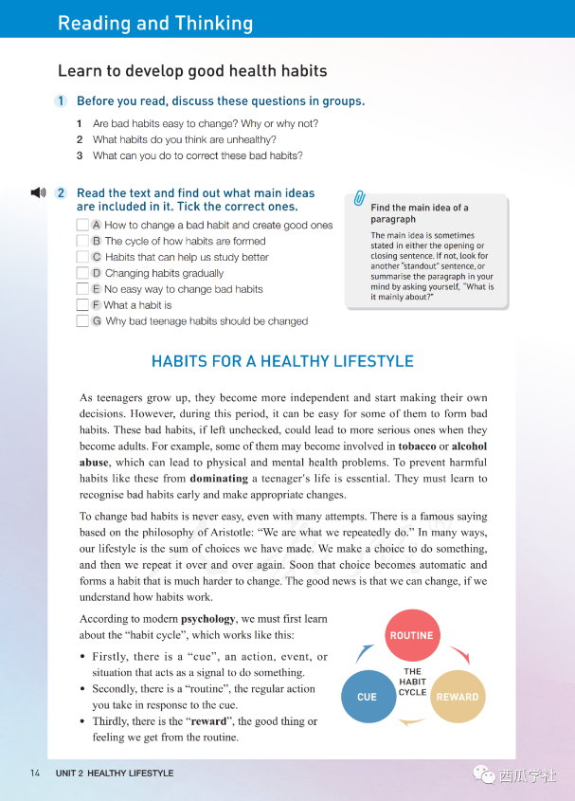
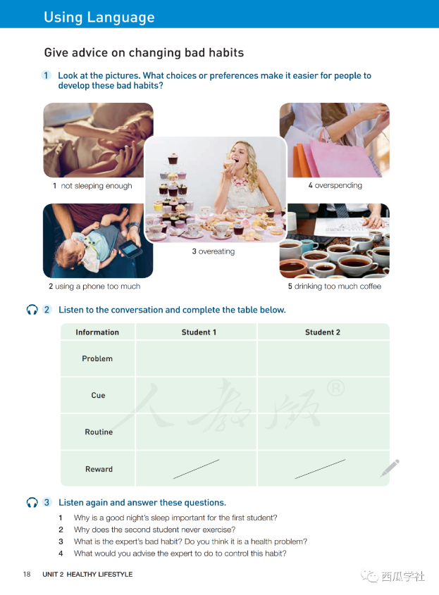
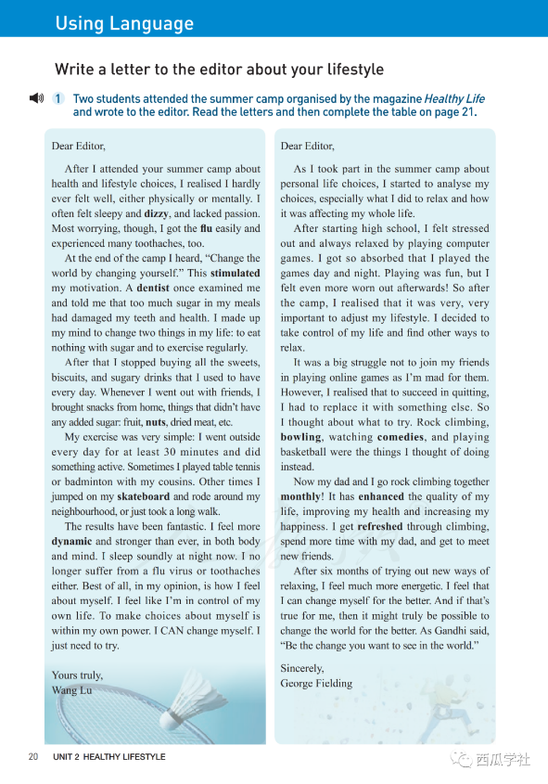
Text review
Healthy lifestyle
Key words
Expressions
Sentences
alcohol stress
physical diet
dominate jog
cue slim
reward championship
rely injure
facilitate failure
negative ……
Pessimistic
Discipline
honor
determination
strength
positive
in response to break a habit
rely on feel more dynamic
straight away suffer from
Decide on in control of
lifestyle choices ……
Normal routine
Make up one’s mind
be composed of
skip breakfast
show some discipline
take small steps
build a happy and healthy life
1. For example, some of them may become involved in tobacco or alcohol abuse, which can lead to physical and mental health problems.
2. There is a famous saying based on the philosophy of Aristotle: “We are what we repeatedly do.” In many ways, our lifestyle is the sum of choices we have made.
3. In fact, the most successful way to change is not suddenly, but over a period of time.
4.Change the world by changing yourself.
5…….

Slide 18
Practical Application
To be whoever you want to be.
There’s no time limit. Start whenever you want.

Slide 19
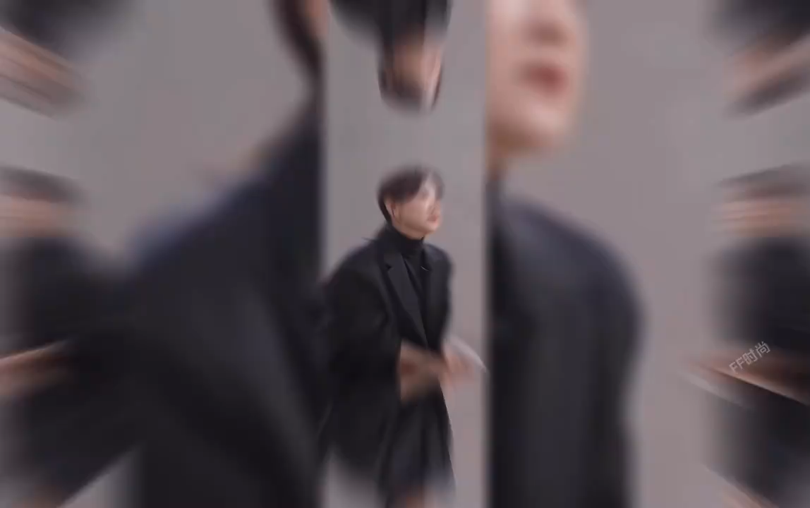
Actress Jia Ling topped the social media topics on the second consecutive day of the Chinese Lunar New Year as her great weight 1_________(lose)of 50 kilograms during the shooting of her movie Yolo triggered heated discussions over healthy lifestyle and allowed some viewers 2___________(draw) aspirations from her arduous weight-loss journey.
The 3_________(high) anticipated comedy Yolo hit theaters across China on Saturday, the first day of the Lunar New Year. It is now leading the domestic movie box office. According to Douban, “YOLO” 4____________(adapt) from the 2014 Japanese movie “100 Yen Love”. This movie is comedian-actress-director Jia Ling's sophomore feature, three years after her 2021 directorial debut box-office blockbuster “Hi, Mom” for which she holds the record as the world's highest grossing female movie director.
Topics related 5_______ Jia's stunning weight loss were dominating Weibo such as "full record of Jia's losing weight journey" and "Jia Ling totally shocked me," as netizens discuss 6__________it is time to develop a more balanced habit starting from the Spring Festival.
"Her achievement is quite7 ____________( inspire) and 8_______deserves a movie ticket," moviegoer Li Qiaoya, 9________ regularly visits the gym to lose weight, told the Global Times on Sunday. "I feel 10___________(guilt) for eating too much during the Spring Festival already."
Y
O
L
O
loss
to draw
Practice1
highly
is adapted
to
whether
inspiring
it
who
guilty

Slide 20

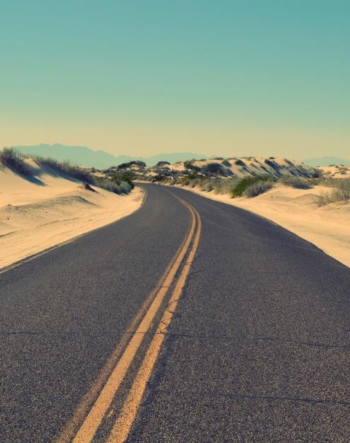
Dear Mary，
I am sorry to hear that you are having difficulties maintaining your fitness. Here is my advice.
One of the best ways to stay healthy is through wise food choices. We all know that snacks and junk food can be irresistible, but they are often high in sugar. Instead, it is highly recommended to maintain a balanced diet that includes sufficient protein, vegetables, and carbohydrates.
In addition to a balanced diet, regular exercise is essential. Jogging, cycling, swimming, or ball games are all excellent forms of exercise. Choose the one that you enjoy the most.
I hope these recommendations help address your concerns. I wish you a swift return to good health.
Yours,
Li Hua
Practice 2
假如你是李华，你收到好友玛丽的信件得知她在保持健康方面遇到了困惑，请给她回复一邮件，提出一些保持健康方面的建议。要点：
（1）健康的重要性
（2）保持良好的饮食习惯
（3）注重身体锻炼

Slide 21
Practice 3
Dear Editor ，
As I attended the summer camp about health and lifestyle choices , I started to analyze them seriously , especially playing games , the unhealthy way I relaxed myself , and its effects on my life .Half a year ago , I felt stressed out and always relaxed with computer games day and night .
Playing was fun , but I felt even more worn out afterwards ! After the camp , I realized that it was time to adjust my lifestyle by finding other ways to relax . Rock climbing and playing basketball were the things I thought of doing instead . Though it was a big struggle , I made it with great determination .
After six months of trying out , I feel more energetic and refreshed now. I believe that I can change myself for the better .
Yours sincerely ,
Li Hua
假如你是李华，半年前你参加了《健康报》关于"健康与生活方式选择"的夏令营，开始反思自己的不良生活方式，现在请你给该报编辑写一封信投稿，内容包括：
1．你过去的一种不良生活方式及其对你的影响；
2．你如何改变这种不良方式；
3．改变这种方式后你的感受。

Slide 22
This quote highlights the importance of determination and devotion. To me , a strong willpower is what it takes to accompany anything difficult.
This is apparently true to Jia Ling. Faced with the challenges to lose 50kg in a span of six months, she encountered social prejudices and physical misery. However, she made up her mind to overcome the obstacles instead of acknowledging defeat. After one year, her stunning physical transformation enables the audience to catch glimpses of her dedication to her role as a boxer.
Overall, I’m inspired by Jia Ling. Her determination demonstrates that in time of difficulties, we are supposed to spare no effort to win. Hopefully, we can turn “impossible“ into “ I’m possible”.
Practice 4
2023 浙江嵊州一模
假如你是李华，某英语网站正在讨论对“The man who has made up his mind to win will never say impossible”的理解。你打算跟帖参与讨论，内容包括：
1.你对此的理解；
2.结合具体实例；
3.你的启发与感悟。

Slide 23
Dear fellow students ,
With the approach of the Asian Games , The National Fitness Program is proceeding with full vigor ( 如火如荼地进行）. Here , on behalf of the Student Union , I strongly advocate that every student should take an active part in it .
Initially , working out for one hour every day tops the list of my recommendation , during which time you can jog , walk or swim . Besides , it is also advisable to develop a sport skill , such as playing table tennis and basketball . You are also supposed to join a sport club in our school , where not only can you make more friends but also sharpen your excellent skills .
Let ' s work out and keep moving . You can build up your body , strengthen your willpower and fully appreciate the unique charm of sports. After all , the greatest wealth is health .
The Student Union
Practice 5
2023 浙江稽阳联考
假如你是某国际学校学生会主席李华。你所在城市开展了 “全民健身运动(National Fitness Program)”。请你代表学生会，给全校学生写一份倡议书，呼吁大家参与此活动。内容包括：
1.发起倡议；
2.具体做法；
3.活动意义。

Slide 24

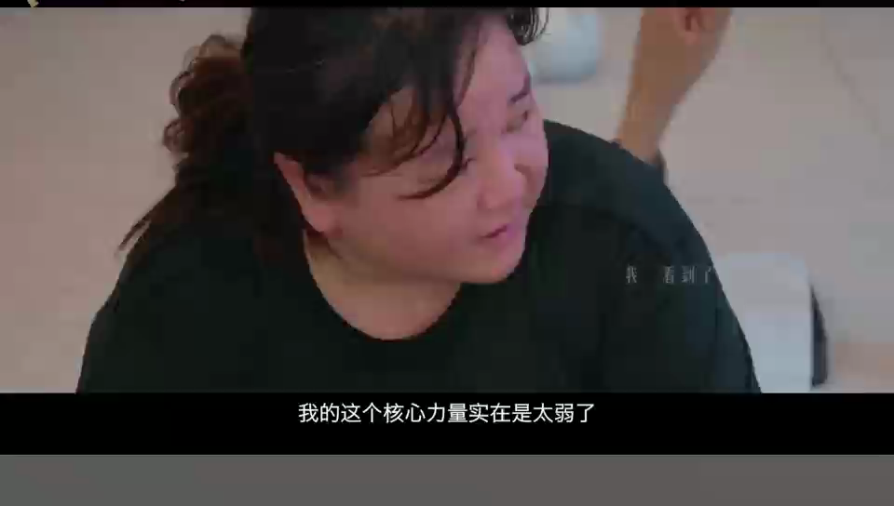

To be a better self
Let us, be up and doing,
With a heart for any fate,
Still achieving,
Still pursuing,
Learn to challenge and to change
To act, that each to-morrow
Find us farther than to-day.
learn with
Fay

